Slide 1


C programming project
Weather Forecasting System
Name : AL Aziz Sec : A Roll no: 84

Slide 2
Variables:
1.API_ENDPOINT: This variable stores the URL of the LIBRARY MANAGEMENT API
endpoint that we use to retrieve weather data.
1.API_KEY: This variable stores the API key that we use to authenticate our API requests.
1.struct weather: This variable is a structure that stores the weather data that we retrieve
from the API.

Slide 3
Functions:
1. handle_response(): This function is a callback function that is called by the `curl_easy_perform()` function when the API response is received. It extracts the weather data from the JSON response and stores it in the `struct management` variable.
2. main(): This is the main function of the program. It takes the city name as an argument, builds the API request URL using `API_ENDPOINT` and `API_KEY`, and makes the API request using libcurl. It then extracts the weather data from the API response using the `handle_response()` function and displays it in a user-friendly format.

Slide 4
Files:
1. Library.c: This is the main source code file of the program. It contains the `main()` and `handle_response()` functions.
Datasets:
1. Open library management API: This is the external dataset that we use to retrieve weather data.

Slide 5
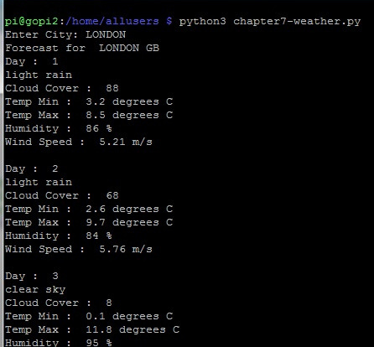
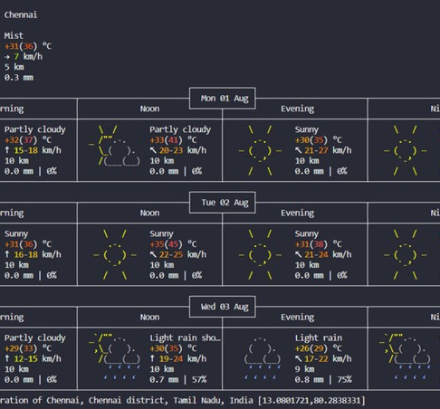
Screenshots:

Slide 6

Name : AL Aziz Sec : A Roll no : 84

