Slide 1
Task Explanation
Objective: Predict whether a customer will accept a personal loan offer from Universal Bank using machine learning.
Dataset: Contains customer information such as age, income, family size, education level, and banking behavior (e.g., credit card usage, online banking).
Target Variable: Personal Loan (1 = Accepted, 0 = Not Accepted).
Approach:
Perform data preprocessing (e.g., handle missing values, encode categorical features).
Train classification models (e.g., XGBoost, LightGBM, HistGradientBoosting, NNs).
Evaluate model performance using metrics: accuracy, precision and recall.
Outcome: A machine learning model that predicts loan offer acceptance, helping the bank target potential customers effectively.
Model deployment using Flask API and Docker
link to Data description: https://rstudio-pubs-static.s3.amazonaws.com/474745_1faa956045b74cbd8f73d9ede798b91b.html
link to dataset: https://www.kaggle.com/datasets/sriharipramod/bank-loan-classification/code

Slide 2
Process Overview: Data Cleaning and Model Building
In this project, I performed the following steps for dataset cleaning and model building:
1. Data Collection
Created web_scrapping1.py and web_scrapping2.py to:
Automatically download a PDF file containing California Zip Codes and County names. (Please be connected to the Internet to download open-sourced Zip Codes for California)
Extract and merge data from the PDF to create a unique list of Zip Codes and their corresponding County names.
Saved the results as a JSON and CSV file in the dataset folder.
2. Data Cleaning and Preparation
Replaced Zip Codes with County names.
Removed rows with negative values for "Year of Experience."
Calculated correlation coefficients and p-values to drop unnecessary columns.
Used Variance Inflation Factor (VIF) to detect and address multicollinearity.
Converted categorical variables (Education and County names) into dummy variables.
Addressed severe class imbalance (1:10 ratio) in the target variable (Y) by:
Applying SMOTE to generate synthetic data for the minority class. Combining SMOTE with undersampling to retain some original majority class data.
Detected and removed incorrectly generated synthetic data (e.g., rows with NaN values).
Applied Standard Scaling and PCA to check for model improvements.
3. Machine Learning Model Building
Used GridSearchCV to find the best model and hyperparameters.
Built a Neural Network (NN) model and used GridSearchCV to optimize its parameters.
Additional Notes
The main analysis was conducted ona Jupyter notebook, loan_classification_task.ipynb
Links to scientific sources (medium.com) were included in the notebook to support decisions made during the analysis.

Slide 3
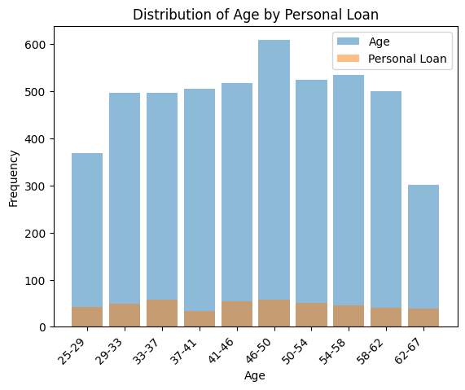
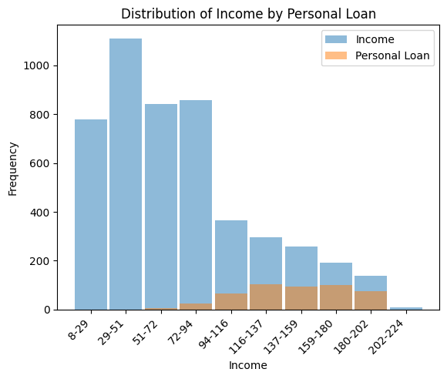
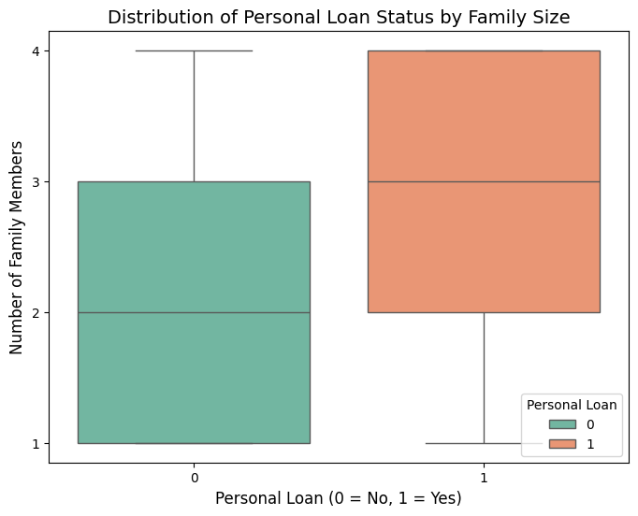
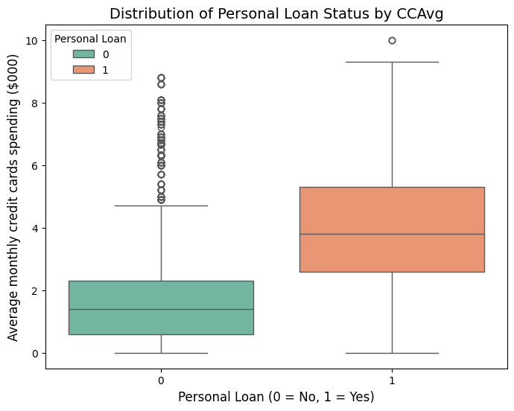
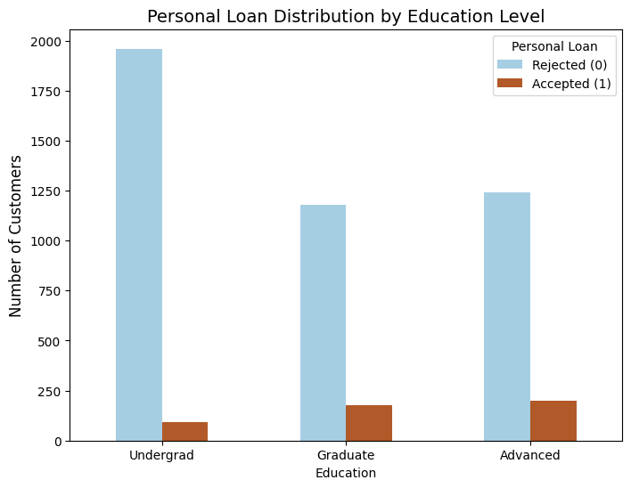
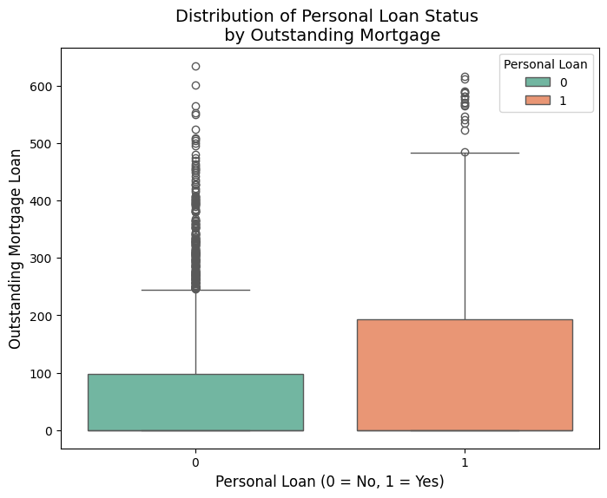
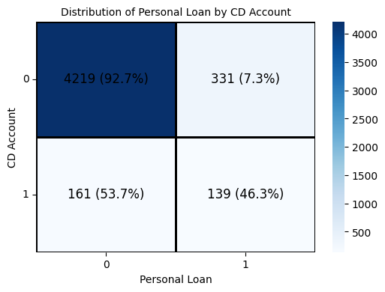
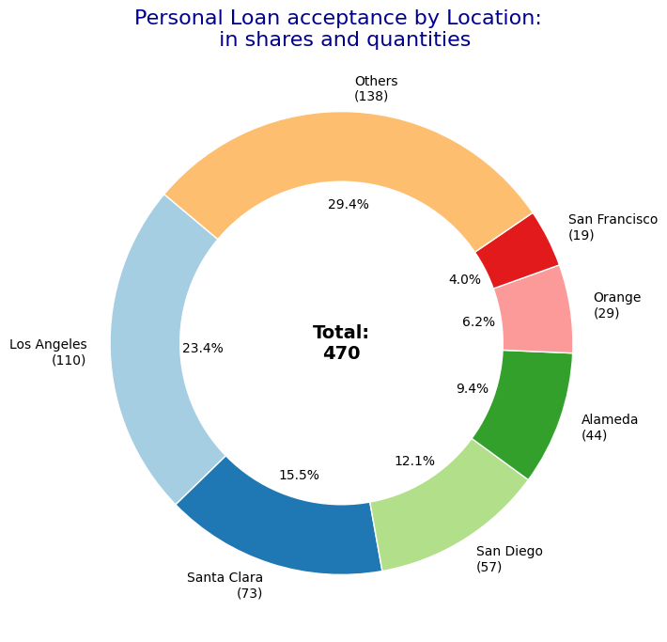
Data visualization – on the original data after cleaning

Slide 4
Model performance evaluation
GridSearch results with the best score for each corresponding metric
The table is sorted by TP
After the GridSearch, first I chose the best Model for each metric types, the yellow-highlighted models
Then I run Test dataset for each of them and got the Confusion Matrix results
I selected xgboost, lightgboost and histogram-based gradient boosting models. Because the business core idea is to find a person who accepts a personal loan offer (class 1). So, I want to maximize TP and minimize FN and FP.
The hist_grad_boost models yield the same best hyper parameter across all metric types. Also does lightgbm model.

Slide 5
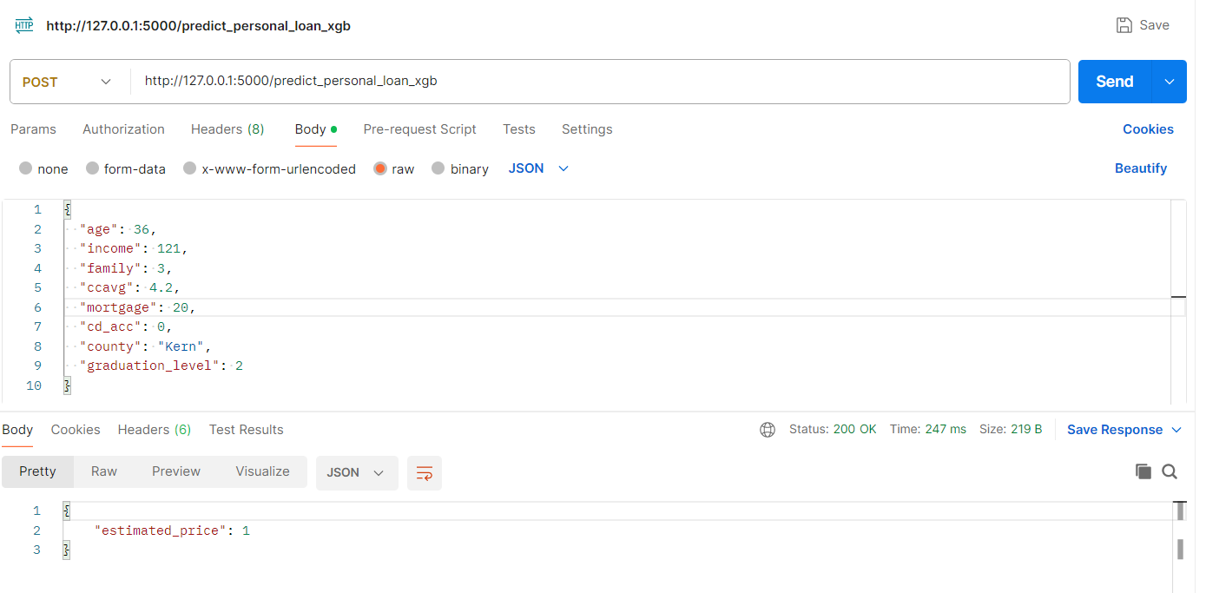
Model deployment
Flask API Integration:
Developed a Flask API to facilitate communication between the data and the models for predictions. Deployed three models, each with its own dedicated API endpoint:
predict_personal_loan_hgb (Histogram-Based Gradient Boosting)
predict_personal_loan_lgb (LightGBM)
predict_personal_loan_xgb (XGBoost)
Containerization with Docker:
Created a Dockerfile to containerize the application, ensuring seamless portability across different environments and simplifying deployment.
Testing the API
To test the API, build and run the Docker container using the following commands (they were given in the Docker file as well) and use Postman:
docker build -t loan_classification:latest -f Dockerfile .
docker run -p 5000:5000 loan_classification:latest
Example API Request
Below is an example of the required JSON input for the API:
{
"age": 27,
"income": 180,
"family": 1,
"ccavg": 6.2,
"mortgage": 0,
"cd_acc": 1,
"county": "Los Angeles",
"graduation_level": 3
}
API example screenshot from Postman

