Slide 1







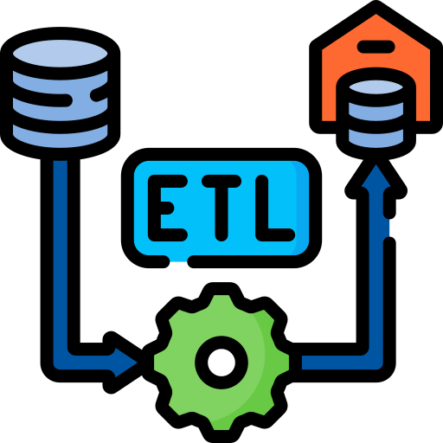







Data Engineering
Data
Analysis
Data Science + Deployment
Machine
Learning
reverse proxy

