Slide 1
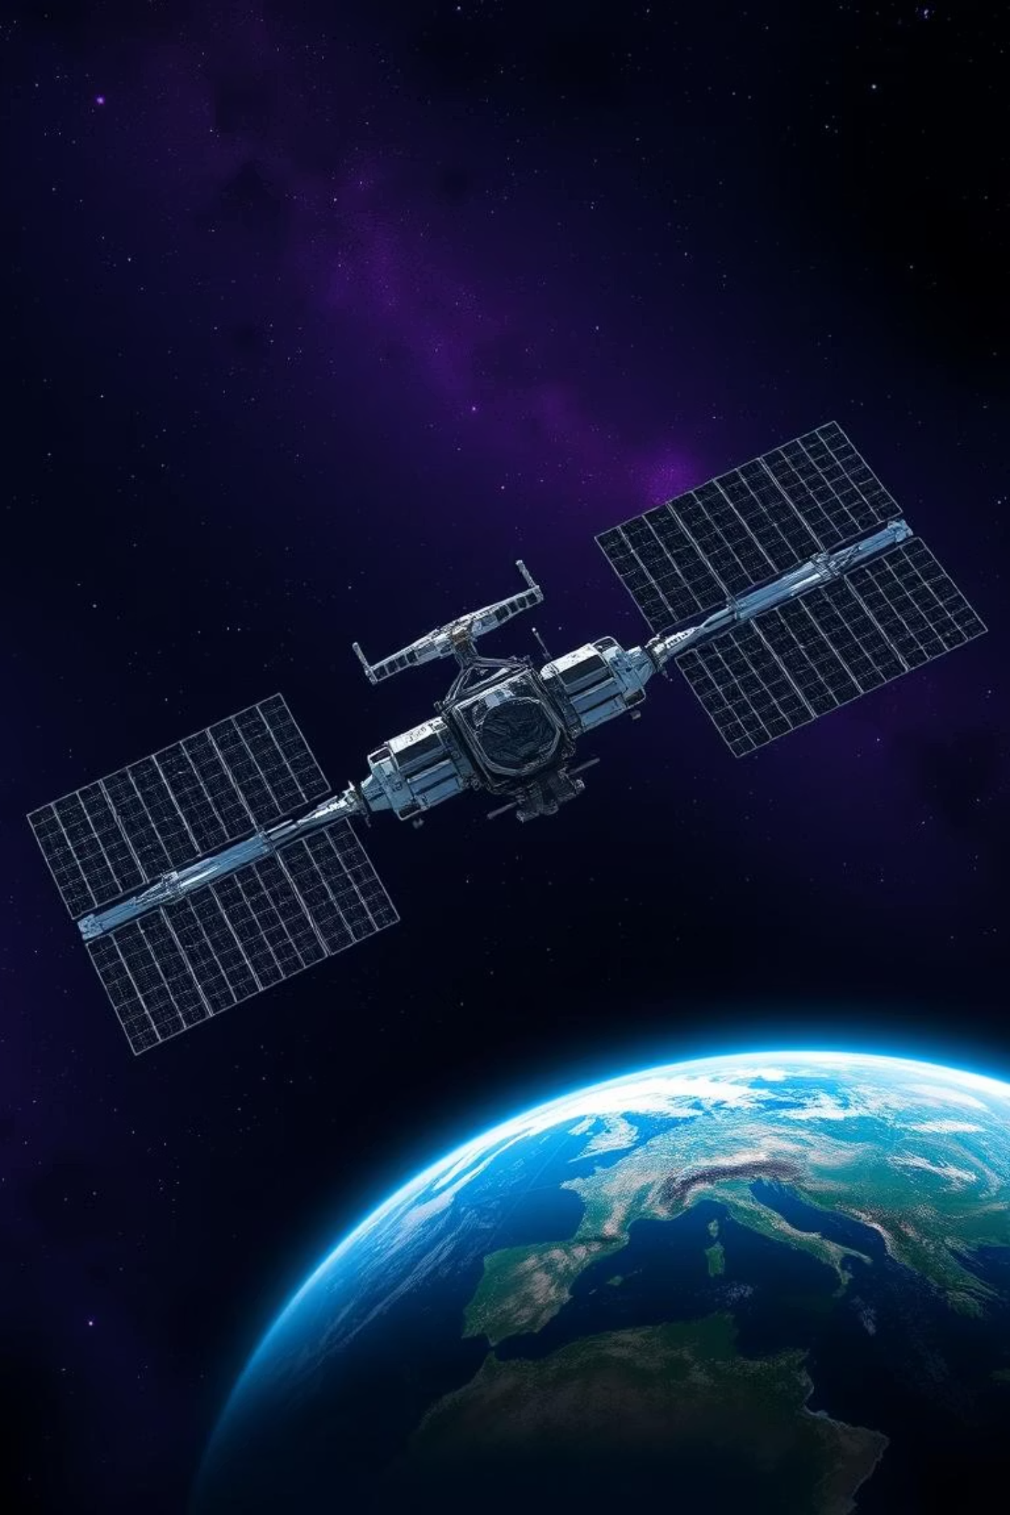
Space Biology Knowledge Engine
Introduction to the Project
The Space Biology Knowledge Engine is a cutting-edge platform and AI powered Dynamic Dashboard designed to centralize and enhance access to space biology research, supporting NASA's mission to understand life in microgravity and beyond.
Key Goals:
Streamline discovery of biological data from space missions
Facilitate interdisciplinary collaboration among scientists
Accelerate advancements in human space exploration
Team: DEIBYTE Date: 05-10-2015

Slide 2
Project Motivation: Current Challenges
Space biology data is scattered across publications, databases, and missions, making it hard for researchers to synthesize findings efficiently.
Major Hurdles:
Inaccessible archives leading to duplicated efforts
Lack of integrated tools for cross-referencing biological entities
Time-intensive manual searches in vast scientific literature
01
02
Fragmented Access
Need for Synthesis
Researchers struggle with siloed data from NASA missions and journals.
A centralized engine will unify knowledge for faster innovation.

Slide 3
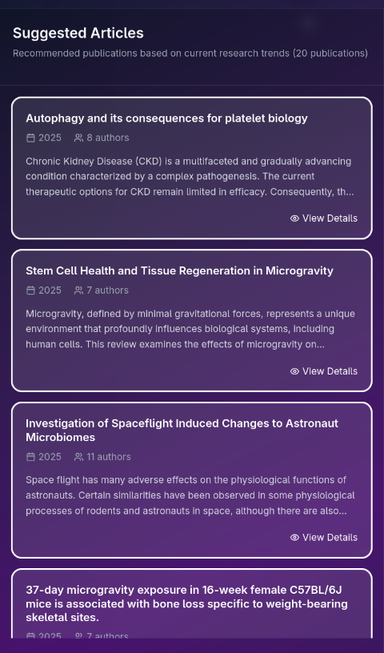
Core Features of the Platform
The engine offers intuitive tools to navigate space biology knowledge seamlessly.
Searchable Database
Comprehensive repository of publications, experiments, and datasets from space biology studies.
Knowledge Graph Visualization
Interactive graphs linking genes, proteins, and mission data for deeper insights.
AI-Powered Semantic Search
Natural language queries with Q&A capabilities for precise, context-aware results.
Entity Extraction & Summaries
Automated summaries and extractions of key biological entities from papers.

Slide 4
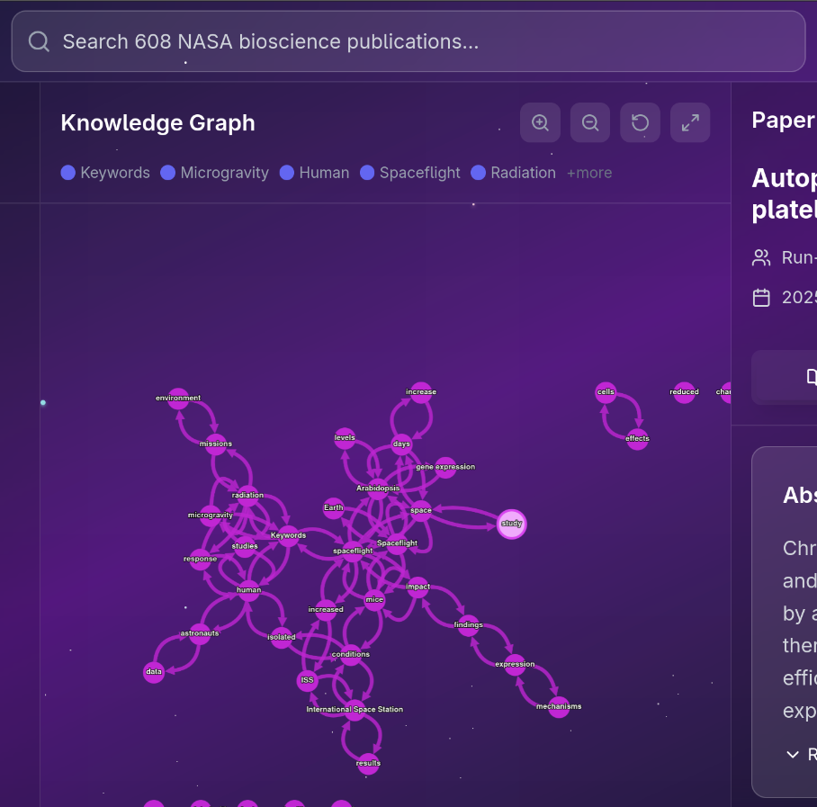
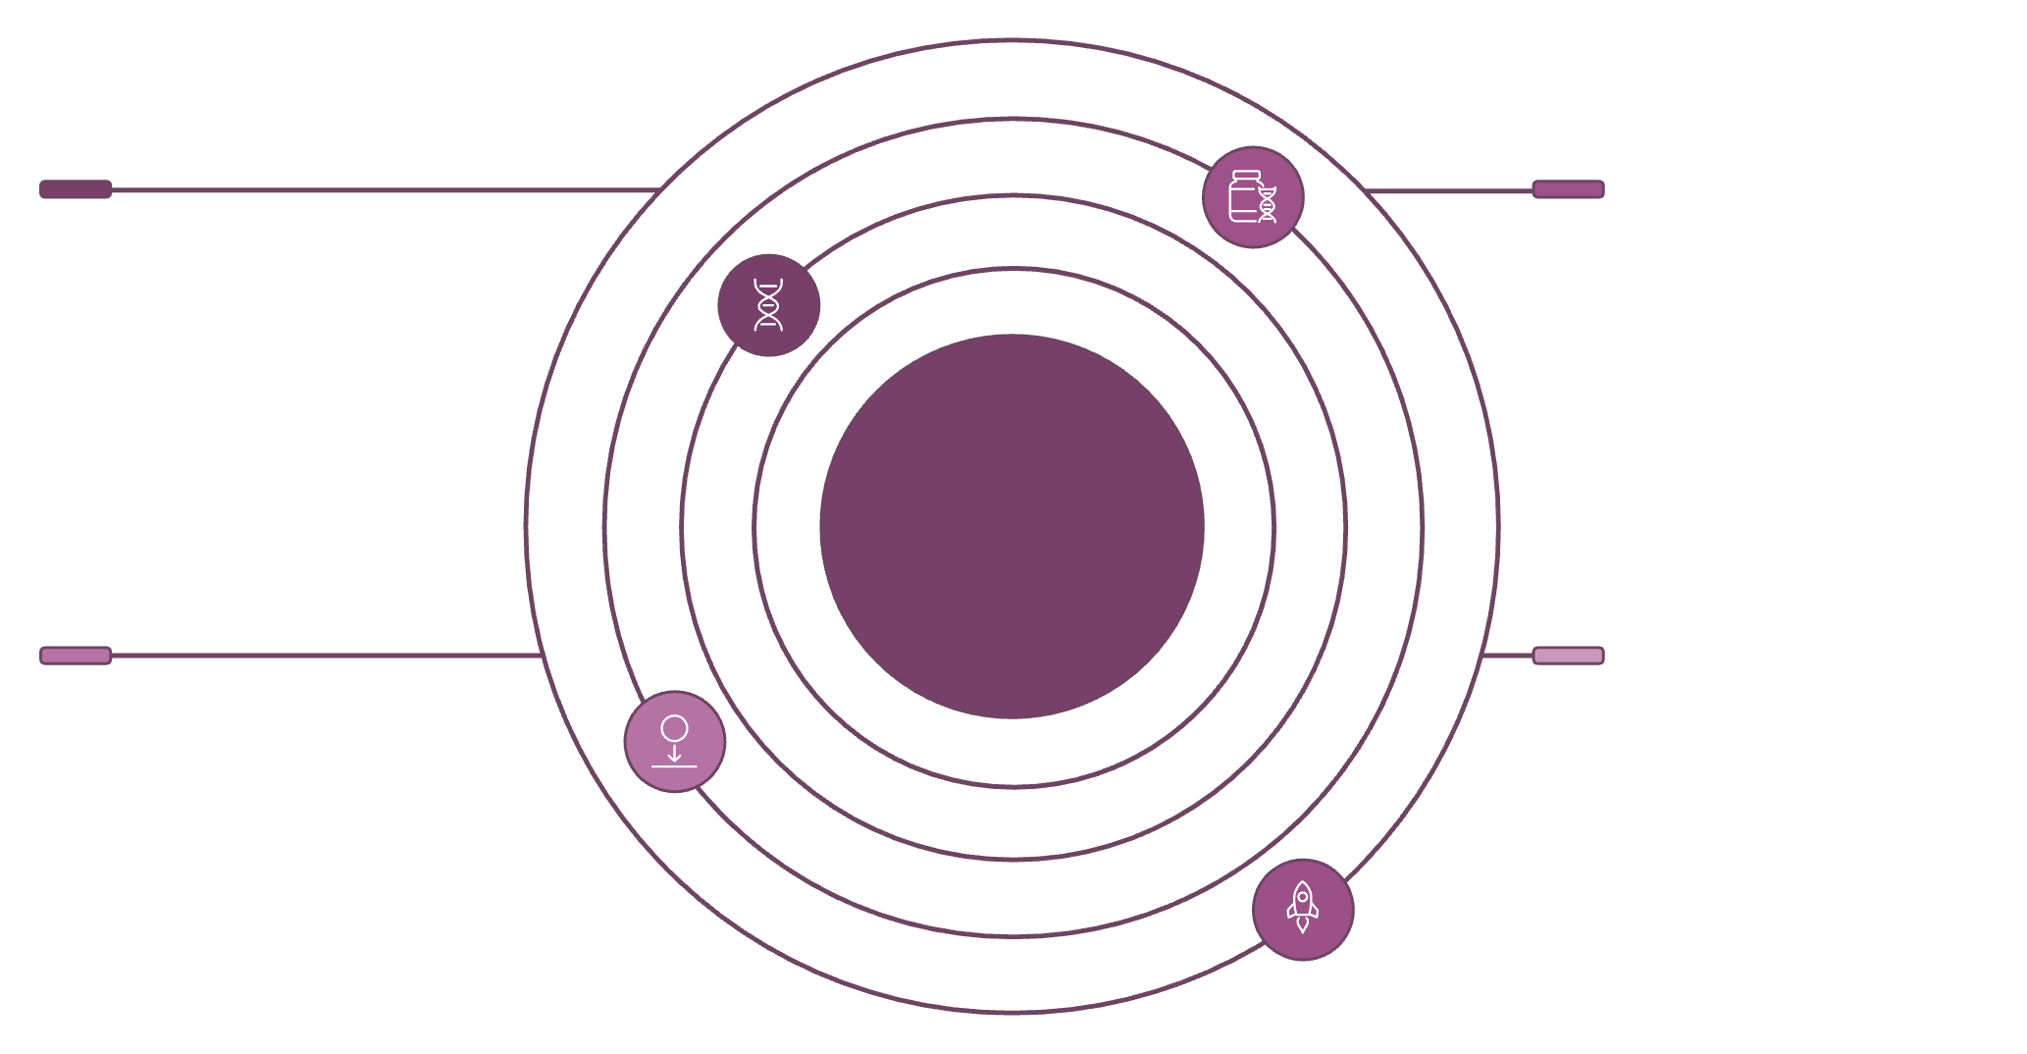




Data Collection and Knowledge Graph
Data is sourced from NASA archives, peer-reviewed journals, and mission logs, then processed into a dynamic knowledge graph.
Process Benefits:
Automated ingestion and cleaning for accuracy
Graph visualization reveals connections between biological effects and space variables
Enables predictive modeling of experiment outcomes
Genes
Proteins
Gene nodes linking to proteins and mission findings
Protein interactions and functional annotations
Space Biology Knowledge Graph
Microgravity Effects
NASA Missions
Phenotypes and pathway changes observed in space
Mission datasets and experiment metadata links

Slide 5
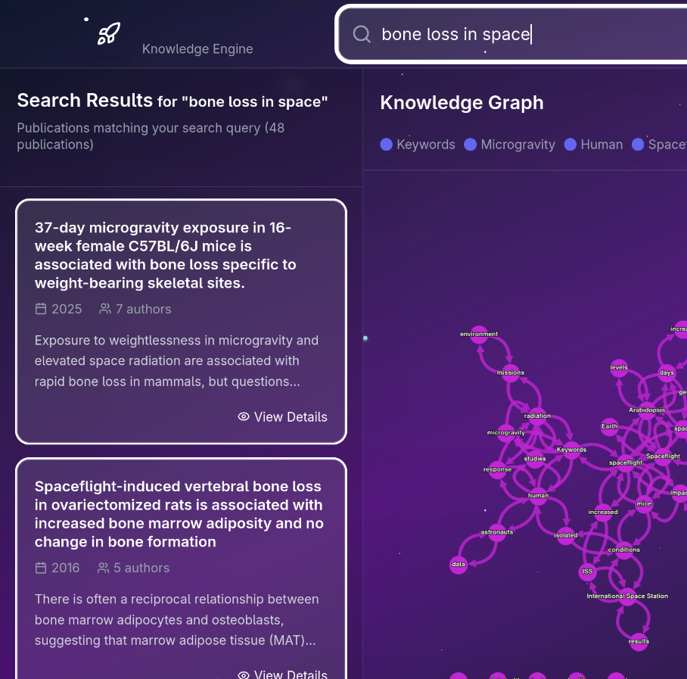



AI and NLP Integration
Advanced AI models drive intelligent features, from entity recognition to semantic understanding, tailored for space biology experts.
Key Applications:
Semantic Search
Understands queries like 'effects of radiation on plant growth in space' for relevant results.
Entity Recognition
Extracts and links biological terms using SciSpacy and Mistral models.
Automated Summaries
Generates concise overviews of papers with Sentence Transformers for embeddings.
Benefits: Saves researchers hours, uncovers hidden patterns in data.

Slide 6
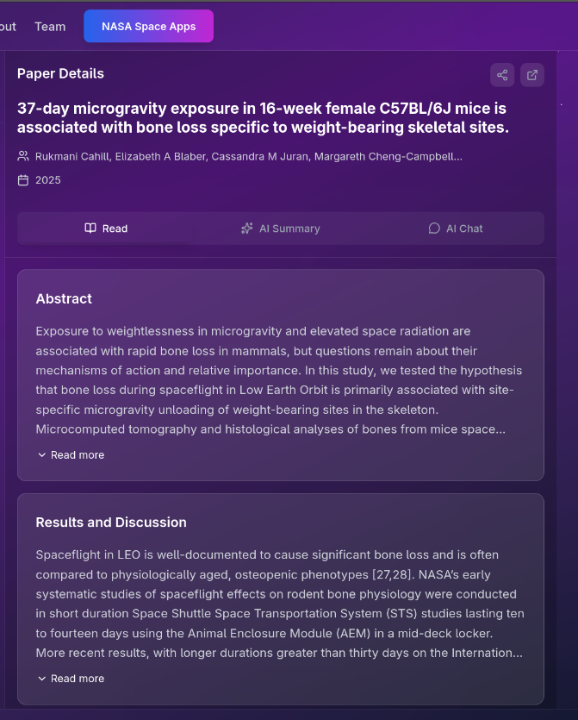
User Experience and Interface
The intuitive UI guides users through search, exploration, and detailed analysis with minimal friction.
Main Flows:
Quick search bar with auto-suggestions for publications
Interactive graph explorer for drilling into relationships
Detailed views with summaries, citations, and export options
Search & Discover
Explore Details
Enter queries and visualize results in real-time graphs.
Click nodes for entity info, related papers, and mission data.

Slide 7
Impact, Future Work, and Conclusion
This platform transforms space biology research, accelerating NASA's goals for sustainable exploration.
Expected Impact:
Enhanced collaboration across NASA teams and global scientists
Faster identification of biological risks and opportunities in space
Broadened access to mission-derived knowledge
Future Enhancements: Real-time data integration from ongoing missions, expanded AI for predictive simulations, and mobile access.
Next Steps: Pilot testing with NASA researchers—let's advance space biology together.

