Slide 1

v0.1.0
SMART HOSPITALITY MANAGEMENT SYSTEM
AI-assisted Windows desktop PMS for hotels, boutique hotels, guest houses, aparthotels and resorts
Sell Right. Measure Right. Protect the Data.
Windows desktop (.exe)
100% local AI option
Encrypted identity data
Turkish / English
Version 0.1.0 · August 2026 · MIT license · Legal compliance remains the operator's responsibility

Slide 2
🔢 The Program in Numbers
60
1075
77.6%
72
Database tables · 56 ORM models · versioned with Alembic
Collected tests — all run without network access; that rule is itself tested
Branch coverage — taken from `pytest --cov=app --cov-branch`
Permissions · 7 default roles · checked in two separate layers
13
5
14
0
Critical scenarios — overlap, no-show, quota, malformed JSON
AI providers: LM Studio · OpenAI · NVIDIA · Anthropic · Mock
Application screens in this deck — all captured on fictional demo data
High-severity bandit findings · medium: 0 · low: 9
None of these numbers was typed in: `sunum/olcum.py` measures them from the source as the deck is built (19 August 2026). What cannot be measured prints as "not measured", never as a remembered figure.

Slide 3
🏨 Who It Is For — and What It Is Not
The program runs on a single property's own computer: it is not a cloud subscription, not a channel manager, not an accounting suite.
🏩
Target Property
🧾
What It Covers
Hotels, boutique hotels, guest houses, aparthotels and resorts with 5–150 rooms. Runs on one machine or a small local network; an internet connection is not required.
The complete front-office cycle from booking to departure: sales, stay, folio, payment, housekeeping, maintenance and management reports.
🚫
What It Is Not
⚖️
Where Responsibility Sits
Not a channel manager, not a POS, not accounting software. Turkish e-invoice and police-notification integrations are NOT DONE: the data model exists, the connection does not.
The software makes data processing easier; compliance with data protection, e-invoicing and guest-notification obligations remains entirely with the operating business.
Unfinished modules are disabled by default and shown in the UI as a placeholder screen that states their status — docs/ROADMAP.md

Slide 4
🔄 A Day in Four Screens
The day starts on the dashboard, runs through the front desk and the housekeeping and maintenance teams, and ends with night audit.
📊
Dashboard
📅
Reservations
Occupancy, ADR, RevPAR and ALOS tiles; critical alerts (overdue departures, open faults, low stock) and a 14-day occupancy curve, all on one screen.
Calendar, group bookings, waiting list, channel-tagged records. Night-by-night pricing and overlap prevention run at save time.
🛎
Front Desk
🧹
Housekeeping & Maintenance
Check-in, room card, companions, folio, extra charges, payment and check-out. Early check-in and late check-out are charged in slots.
Daily cleaning tasks are generated and assigned; a fault record can take a room out of sale — a blocked room cannot be booked.
Shortcuts: Ctrl+1 Dashboard · Ctrl+2 Reservations · Ctrl+3 Front Desk · Ctrl+4 Rooms · Ctrl+5 Guests · Ctrl+R Reports

Slide 5
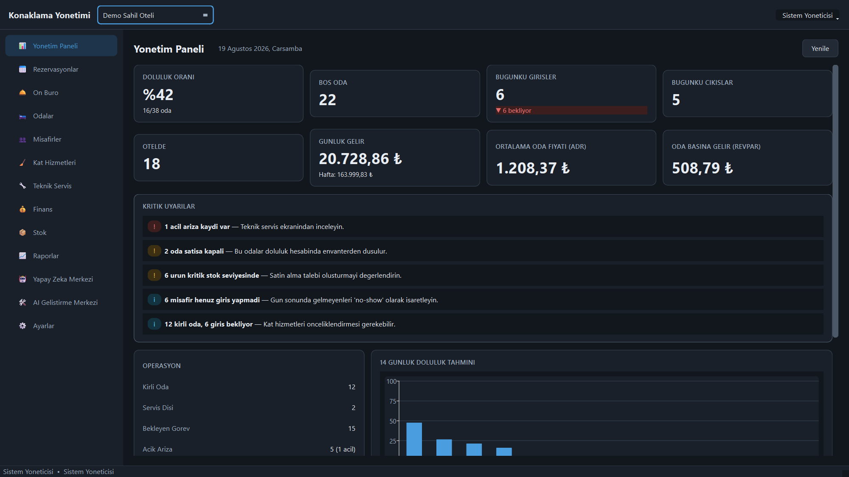
🖥️ On Screen: The Dashboard
Occupancy, vacant rooms, daily revenue, ADR and RevPAR tiles; critical alerts and a 14-day occupancy forecast — the day starts on a single screen.
This and the following screenshots are taken from the program itself; all of the data is synthetic demo content with no real personal data.

Slide 6
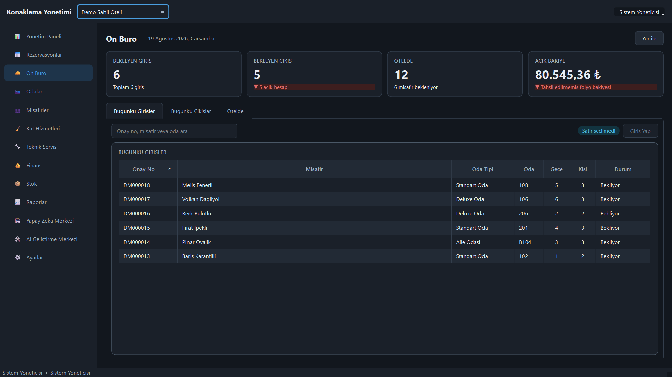
🛎️ On Screen: The Front Desk
Pending arrivals and departures, in-house guests and the uncollected folio balance on one screen; check-in starts from the list with a single button.

Slide 7
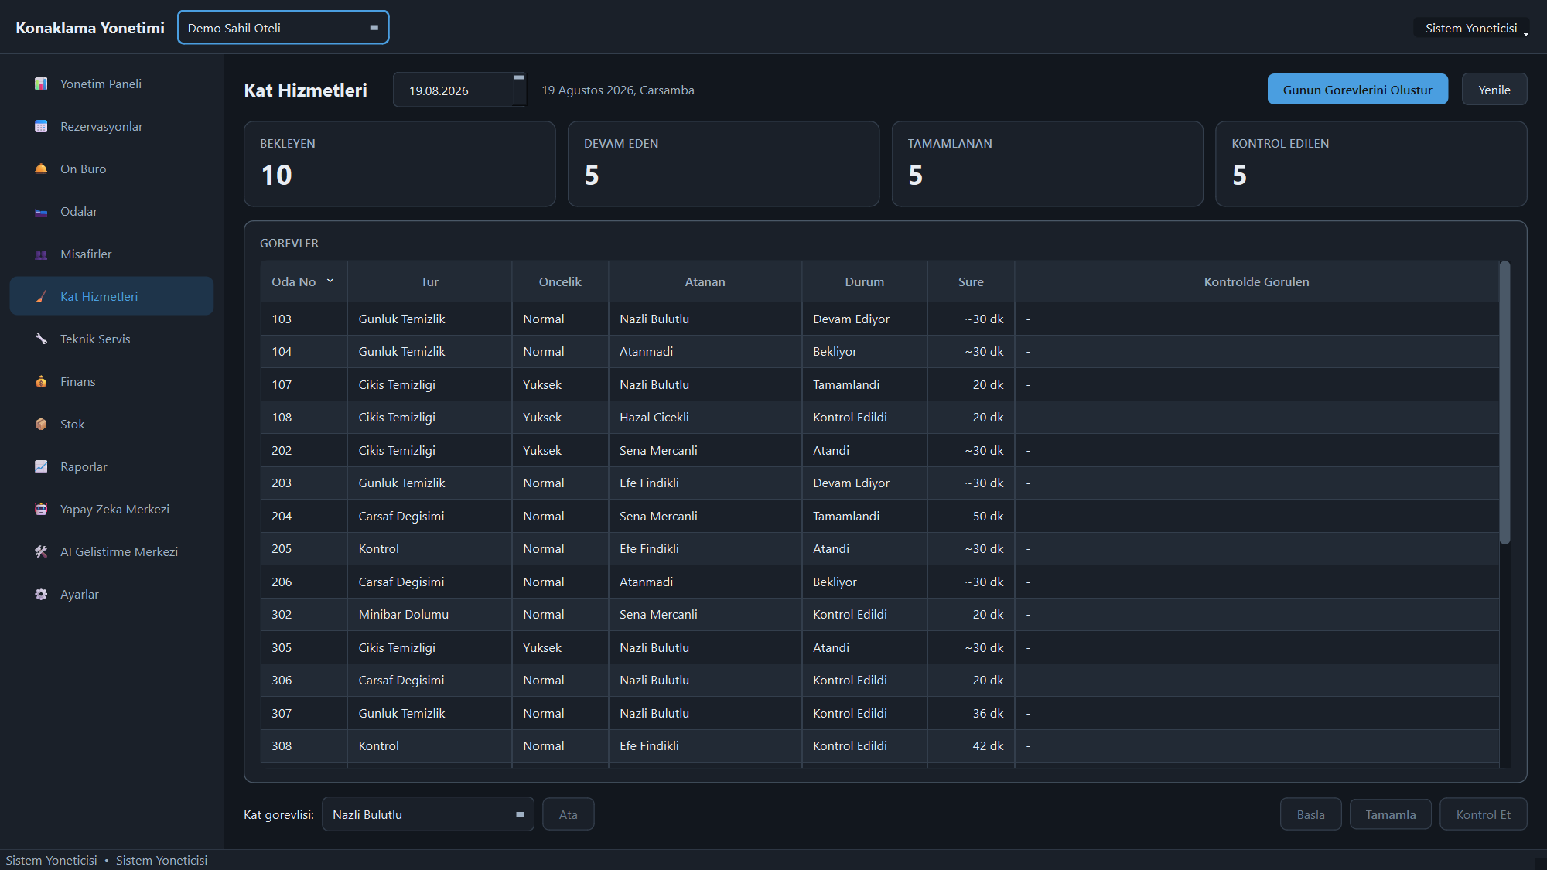
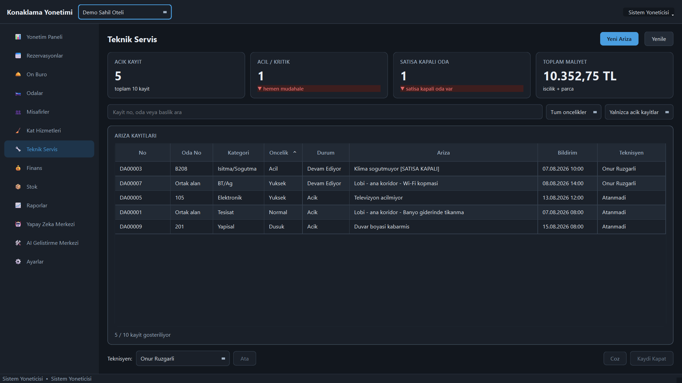
🧹 On Screen: Housekeeping and Maintenance
Daily cleaning tasks are generated with one click, assigned and closed with an inspection step; fault records are tracked with priority and room links.
Housekeeping
Maintenance

Slide 8
🧮 The Same Room Cannot Be Sold Twice
Overlap prevention is not a warning but a two-layer constraint: the application check and the database constraint enforce the same rule independently.
🚧
Two-Stage Check
📐
Half-Open Interval
First the application layer queries availability and produces a readable error; at write time the database constraint applies the same rule again. In a race, the second transaction is rejected.
Dates are modelled as [arrival, departure): the departure day is not a night, so the room can be sold again the same day. Most overlap bugs are born exactly at this boundary.
💵
Night-by-Night Pricing
🔀
State Machine
Season rate, weekend uplift, extra person, discount and tax are computed for each night separately; no single average rate is multiplied by the stay length.
Draft → confirmed → checked-in → checked-out; cancellation and no-show are separate paths. Invalid transitions are rejected and fee rules depend on the state.
99 domain tests cover this layer alone: availability 24, pricing 23, state machine 18, money and date value objects 34.

Slide 9
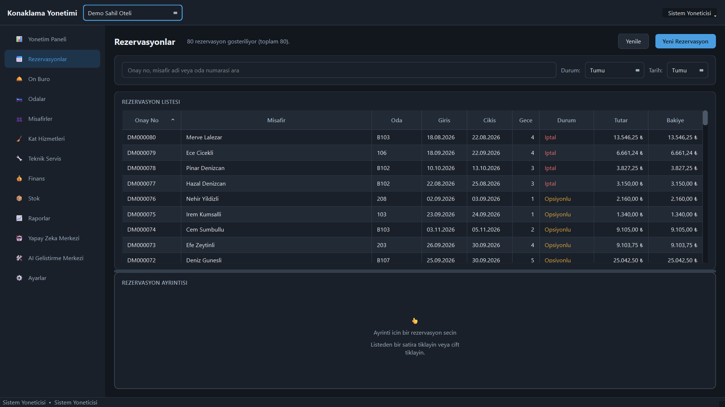
📅 On Screen: Reservations
Search with status and date filters; confirmation number, nights, amount and balance in one list. Cancelled and optional bookings are colour-coded.

Slide 10
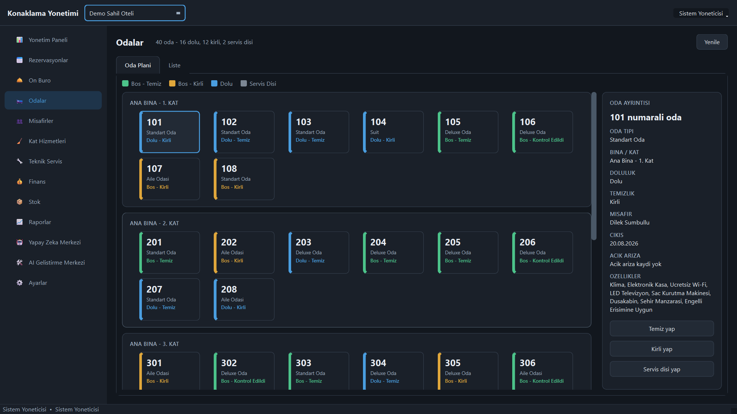
🛏️ On Screen: The Room Map
A building- and floor-based room map: occupancy and cleanliness are colour-coded; the selected room's details and actions sit in the right-hand panel.

Slide 11
🧾 Folio — Never Deleted, Only Voided with a Reason
In financial records, correcting is not deleting. The program never removes a charge line; it voids it with a reason and the audit trail survives.
✍️
The Trail Survives
💳
Payments and Refunds
A mistaken charge line is voided and its reason recorded. The night audit total and the history therefore stay explainable at any later date.
Cash, card and transfer payments; refunds, deposits and damage records. The balance is derived from the folio; an inconsistent amount is rejected.
⏱
Early In / Late Out
📆
Night Audit
Charged in slots: a 4-hour late check-out is two slots and equals 50% of the nightly rate. The rule is pinned down by a test.
Arrivals, departures, in-house guests and cash movements are collected in the night audit report and exported as PDF, Excel or CSV.
There is no separate Finance screen yet: payments and folio work happen on the Front Desk, financial summaries under Reports.

Slide 12
🔐 Identity Data Stays Encrypted — and Searchable
You cannot search an encrypted column. The program resolves that dilemma with a blind index: the data stays encrypted, the search runs over a keyed digest.
🗄
Field-Level Encryption
🔎
Blind Index
National ID and passport numbers are written to the database encrypted. Verified with a raw SQL query: the column shows no readable number.
Search runs on an HMAC-SHA256 digest of the number: exact match works, the value is never exposed. Partial search is deliberately unsupported.
👁
Unmasking Is a Separate Right
📇
Guest CRM
Seeing the unmasked number is a separate permission; not every user who can view the record holds it, and each unmasking is written to the audit log.
Profile, stay history, preferences, VIP and blacklist, consent records. The summary currently counts only the primary guest; companion nights are excluded.
API keys, e-mail addresses, phone, ID and card numbers are masked automatically in logs; the masking is protected by its own test.

Slide 13
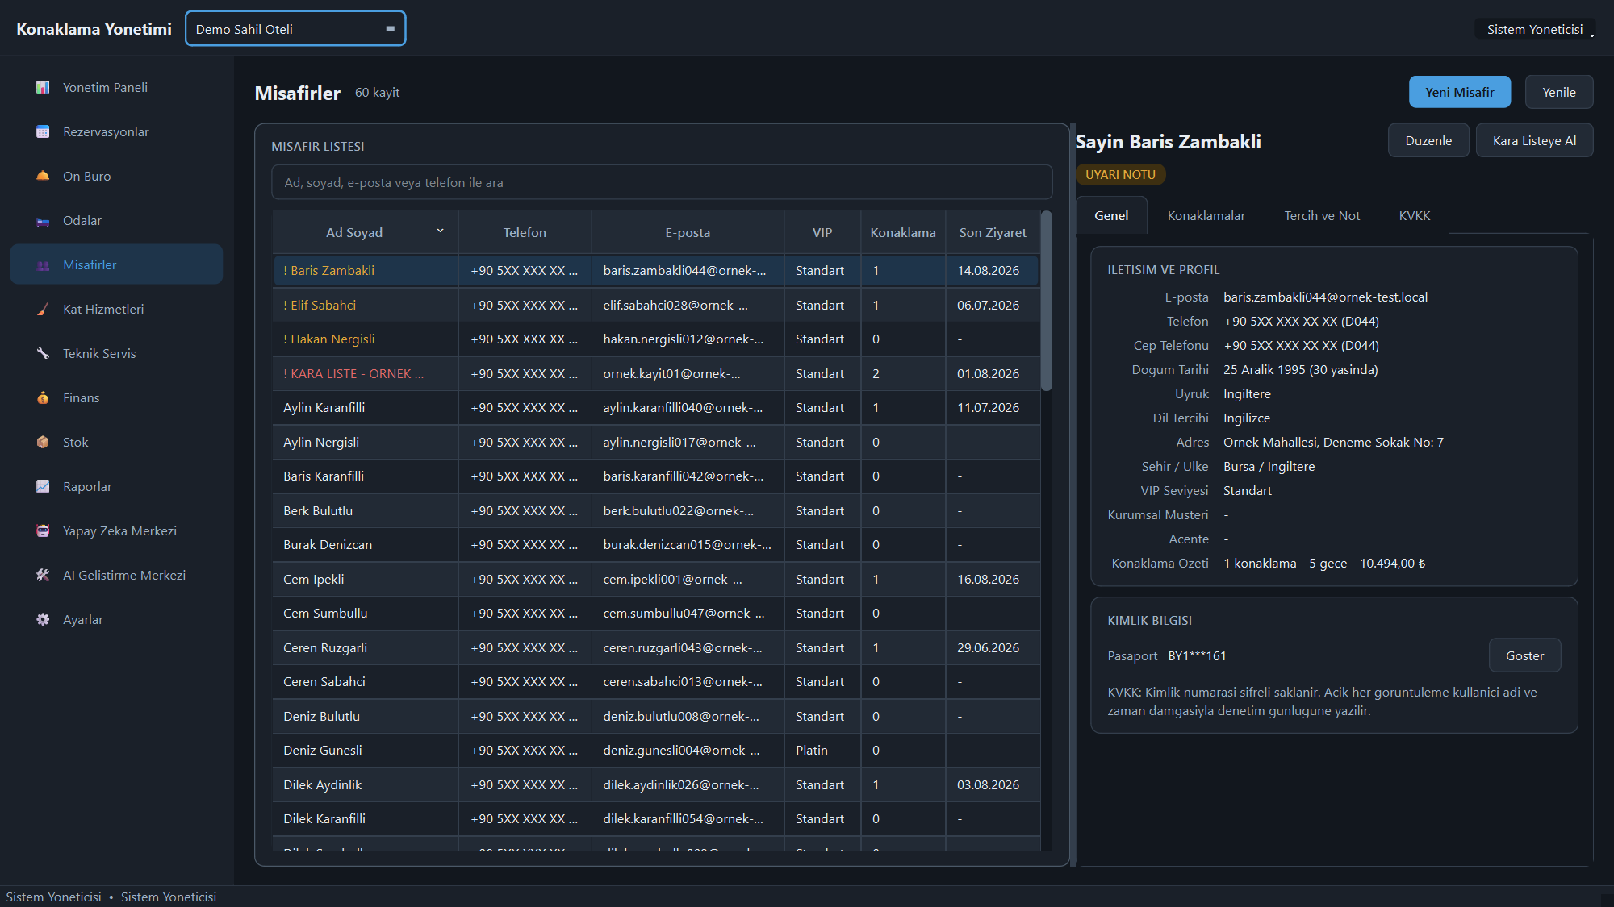
👥 On Screen: Guest Profile and Privacy
The ID number is stored encrypted and displayed masked; the 'Show' button writes every reveal to the audit log with the user name and a timestamp.

Slide 14
📈 Measurement — Hotel Metrics
Occupancy, ADR, RevPAR and ALOS come from one query layer: the number on screen and the number in the report are produced by the same code.
📊
KPIs and Alerts
🔮
14-Day Occupancy
Occupancy, ADR, RevPAR, ALOS, cancellation and no-show rates. Critical alerts sit at the top: overdue departures, open faults, low stock.
The next two weeks are drawn from confirmed reservations. This is not a demand-forecasting model but a projection of bookings already on the books.
🧷
Channel and Room Type
📤
PDF · Excel · CSV
Revenue is split by channel (direct, agency, online) and by room type; what each channel actually brings in is visible in a single table.
Every report exports in three formats. CSV is written with a UTF-8 BOM so that Excel opens accented characters correctly.
106 reporting tests also cover export formats and the empty-data case: with no data the report does not crash, it renders empty.

Slide 15
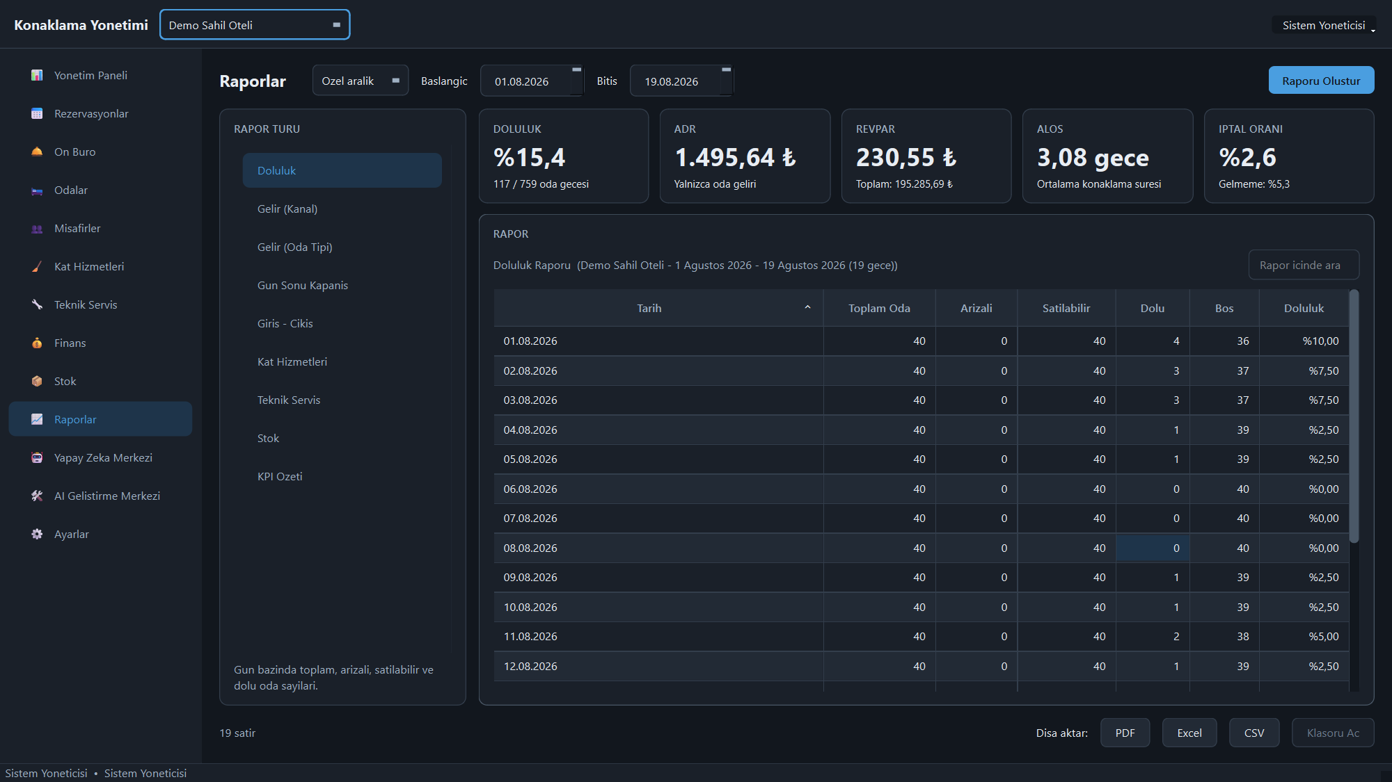
📈 On Screen: Reports
Occupancy, channel and room-type revenue, night audit, housekeeping and a KPI summary; every report can be exported to PDF, Excel and CSV.

Slide 16
🤖 The AI Advises — It Never Writes
The AI layer is the security boundary between the database and the model: no personal data leaves, and the model never changes a record on its own.
🛑
Prompt Screening
🏠
Local Option
E-mail addresses, phone numbers and long digit strings are masked before the call; if any personal data remains after masking, the request is never sent.
With LM Studio the model runs on your own machine: no cloud, no API bill, no data leaving the building. Cloud providers are optional.
💡
Advice Only
🏷
Badge and Cost
Rate suggestions, guest-review sentiment analysis and message drafts are produced. None is applied automatically; the decision stays with the user.
Every output is marked with an "AI generated" badge; token count, duration and estimated cost are shown — free on a local model.
If the primary provider fails, fallback happens only on TRANSIENT errors. An invalid API key is permanent: it is reported, not hidden.

Slide 17
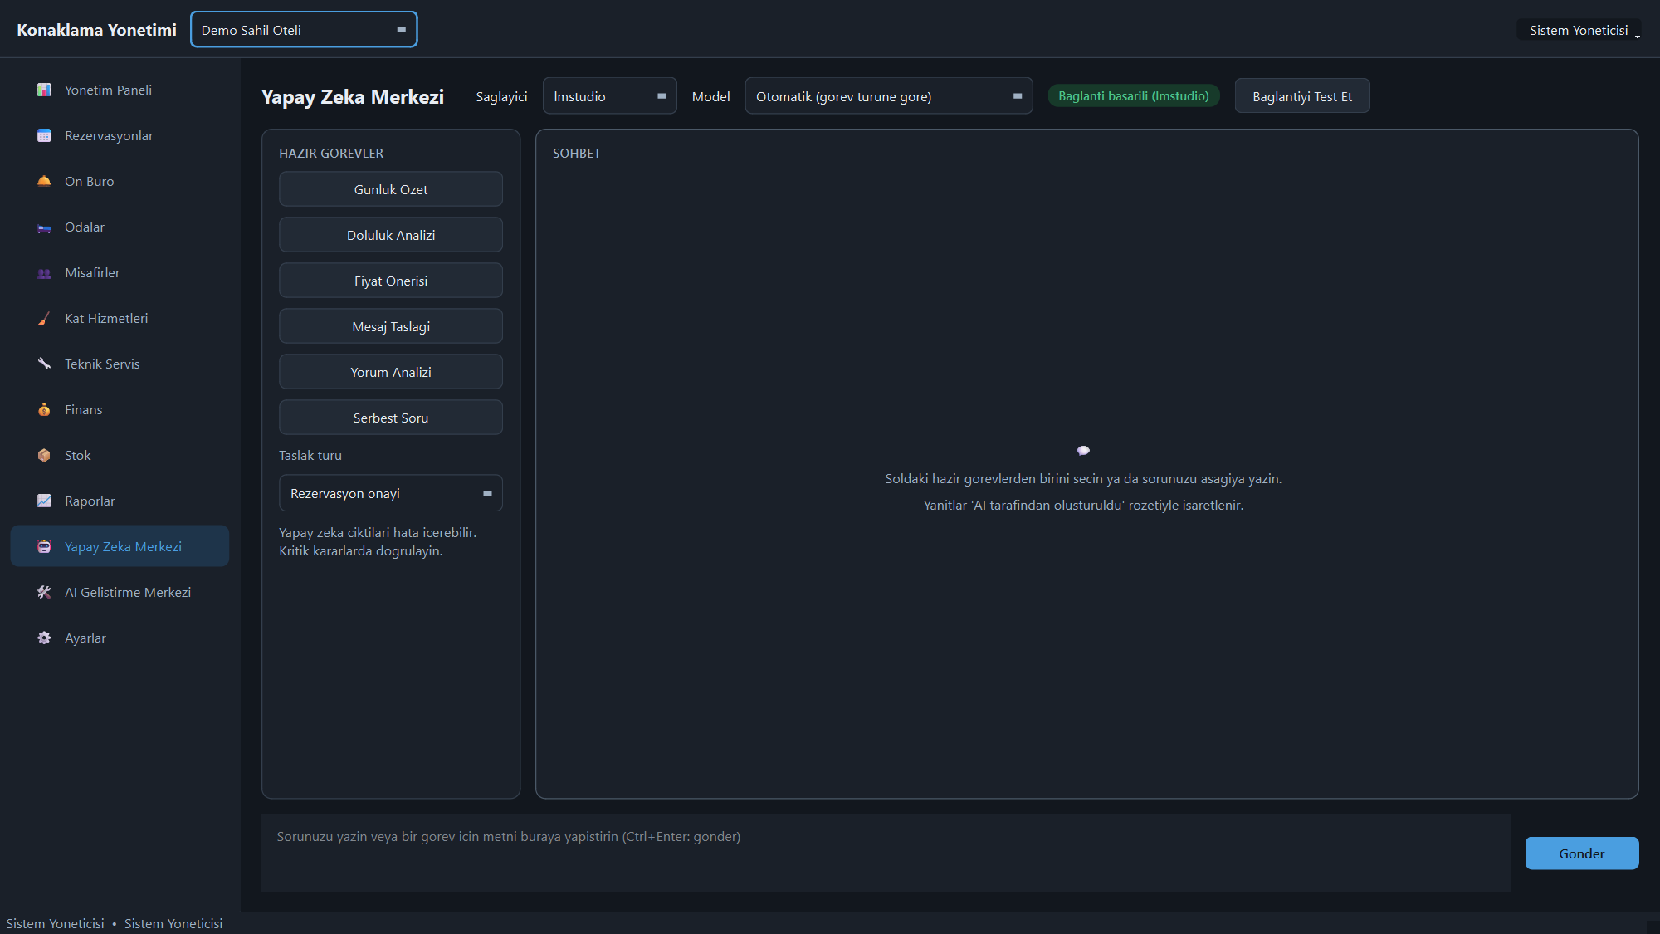
🤖 On Screen: The AI Center
Ready-made tasks and free-form questions; provider and model are chosen on the same screen. Every answer carries an 'AI-generated' badge.

Slide 18
🛠 AI Development Centre — A Restricted Sandbox
The AI can be given coding tasks; what it may do is bounded by a command policy, a sandbox and a quality chain.
📜
Command Policy
📦
Sandbox and Diff
Two layers: (1) an allow-list decides which command may run, (2) a target check decides which file it may touch. `.env`, key files and the guest database are closed to every reader, whichever one is used.
Writes happen only under the sandbox root; every change is shown as a diff first, nothing is written without approval, and lost-update protection is in place.
🌿
Git Guard
✅
Quality Chain
The task runs on its own branch, a checkpoint is taken before it starts, and failure rolls back automatically. Merging to main needs separate approval.
Format → lint → types → tests → security. No change is committed until the tests pass, and the user cannot relax that rule.
187 tests cover this module. The layer that actually executes the command has low coverage; that gap is stated openly in the test report, with its measurement.

Slide 19
🛡 Security — Measured, Not Assumed
The security review is not a list of claims: each item rests on a test or on the output of a tool that was actually run.
🔑
Authentication
🧩
Authorization Twice
Passwords are hashed with Argon2id; brute-force lockout, session timeout and a uniform error message that prevents user enumeration are in place.
Permissions are checked both in the UI (menu, buttons) and in the service layer. Hiding a screen is not enough; the unauthorized service call is rejected too.
🗝
Secret Handling
📚
Audit Log
API keys live in Windows Credential Manager; they are never written to the database, the source or error messages. The repository was scanned for secrets.
Critical operations are written to an append-only audit log: who did what, when, and to which record.
bandit: 0 high, 0 medium and 9 low-severity findings — each low finding carries a written rationale. The numbers are measured as the deck is built.

Slide 20
🔍 The Reviews Found Real Holes
The value of a security review is in what it finds. Everything below was fixed, each has a regression test, and the fixes are described in docs/SECURITY_REVIEW.md section 8.
🚪
Missing Permission Check
💬
No Ownership Check
Taking a room out of sale skipped the permission check: a user without maintenance rights could block a room. Closed; guarded by `tests/application/test_operations_services.py`.
AI chat history did not verify ownership; one user could read another's conversation. Closed; guarded by `tests/application/test_ai_service.py`.
🧨
Policy Bypasses
💰
Financial Inconsistency
Bypasses were found in the command policy and closed. The last one came out of an independent pre-release review: an allow-listed reader (`head`, `findstr`) could read `.env` with no approval. The decision now looks at the file touched, not at the command's name.
Arithmetic errors in folio and payment handling were corrected, and a key error being swallowed during provider fallback was fixed. Money never travels as `float`, only as `Decimal` — and that is tested.
No commit hashes are cited on purpose: the evidence for a fix is the test that guards it. The same document lists what was not fixed — the number generators are not concurrency-safe.

Slide 21
🧪 The Numbers Were Run, Not Remembered
1075 tests pass and none of them touches the network — and that fact is itself protected by a test. The figure was measured while this deck was generated.
📦
Layer by Layer
🎯
13 Critical Scenarios
Domain 99 · security 75 · infrastructure 145 · application 158 · AI 123 · UI 182 · reporting 106 · development centre 187.
Overlapping booking, cancellation, no-show, early arrival, blocked room, wrong payment, unauthorized access, dead model, quota, invalid key, malformed JSON, empty report — all covered.
📉
Gaps Written Down
⚙️
CI on Every Push
The startup path (login screen, main window) and the CLI stay uncovered; backup has low coverage. None of this is hidden — it is listed with its measurements and explained in docs/TEST_REPORT.md.
GitHub Actions (.github/workflows/ci.yml): format, lint, types, tests, security scanning, migration consistency and a "did a sensitive file enter the repo" gate. `ruff check app tests` currently reports 0 findings.
The report is a snapshot: 19 August 2026, version 0.1.0, Windows 11, Python 3.11. The numbers are measured at generation time and change when the code does.

Slide 22
🏗 Architecture — Dependencies Flow One Way
ui → application → domain ← infrastructure. The business rules know neither the database nor the UI, which is why the 99 domain tests run in seconds.
🧱
Framework-Free Domain
🕐
Timezone-Aware
The domain layer imports neither the ORM nor the UI toolkit. The rule is not only documented but enforced by an import test.
A custom column type stores every timestamp in UTC. Offset and daylight-saving bugs are solved in one place instead of scattered through the data layer.
🔁
Migratable Schema
🧩
Page Registry
60 tables are versioned with Alembic and CI verifies schema/migration consistency on every change. Enumerations are stored as text, not as integers.
Adding a screen does not touch the main window: one line is added to the registry. Unfinished screens are declared in the same place.
SQLite by default, PostgreSQL supported. Case-insensitive Turkish search is limited on SQLite; dotted/dotless "I" needs PostgreSQL.

Slide 23
⚙️ Setup, Backup and Packaging
One command to install, one to back up, one to package. The database and logs live next to the application, so the installation stays portable.
🚀
One-Command Setup
💾
Consistent Backup
The setup script validates the Python version, creates the virtual environment, writes .env with a random session key, applies migrations and creates the admin account.
The SQLite backup uses VACUUM INTO; copying the file in WAL mode produces an inconsistent backup. The current database is kept aside before any restore.
📦
Windows Package
🧰
Maintenance Commands
The build script produces an .exe with PyInstaller; on first launch a wizard prepares the database and shows the admin password once.
bootstrap · seed-demo · backup · restore · check-ai · doctor. check-ai tests the provider connection, doctor the health of the installation.
A demo installation ships five role accounts (manager, front desk, housekeeping, maintenance, accounting). In a real deployment demo data and accounts must be removed.

Slide 24
📋 What Is Not Done — Stated Just as Clearly
If a feature is on the roadmap, it means it should not be used in production today. The program does not hide its gaps from the user.
🧾
e-Invoice and Notification
🖥
Finance · Stock · Staff
NOT DONE. The invoice table has the fields and the settings file the keys; the authority integration, XML generation and notification flow do not exist.
Business logic and reports exist, dedicated screens do not. Opening one shows what is planned and how to do the same job today.
🔢
Number Generator
☁️
Cloud Providers
Reservation and folio numbers are produced with max()+1; under concurrent use the second write is rejected and must be retried. The fix lands in v0.2.
The NVIDIA and Anthropic adapters are written but never exercised against the real API — that needs a key. LM Studio was verified with a real request.
Document question-answering (RAG) and visual document analysis are also unfinished: the data model exists, the workflow is not wired.

Slide 25
🗺 Roadmap
The order is deliberate: first the screens that complete daily operations, then depth in AI, and regulatory integrations last.
🧭
v0.2 — Operations
🧠
v0.3 — Artificial Intelligence
Finance, stock and room-type/rate-plan screens; staff and shift management; the concurrency fix for number generation; a group booking interface.
Completing the document indexing flow, visual document analysis (with a data-protection assessment), demand forecasting and dynamic rate suggestions.
🔌
v0.4 — Integrations
🏁
v1.0 — Production
The e-invoice integrator connection, guest notification, a channel manager draft and the e-mail/SMS notification layer.
PostgreSQL production setup, multi-property testing, an independent security audit, performance testing with 10,000+ reservations and user acceptance tests.
Most open to contribution: regulatory integrations, workflow feedback from real hotels, and the English interface translation.

Slide 26
RUN THE HOUSE KNOWING WHAT YOU SOLD
60 tables · 1075 tests · 77.6% coverage · encrypted identity data · a local AI option
A program that writes down its gaps too.
User guide
Test report
Security review
Roadmap
github.com/Azizsekerdil/akilli-konaklama-yonetim-sistemi · MIT license · Version 0.1.0 · August 2026

