Slide 1
Smart Restaurant
Restaurant Management System
From the order to the kitchen, from stock to reports — the whole restaurant in one application.
Single-file setup
Works offline
Turkish / English
Smart Restaurant Management System
1 / 26

Slide 2
The problem it solves
Most restaurants run on three separate things: a till program, paper in the kitchen, and a spreadsheet for stock.
▪ A gap between the check and the kitchen — wrong and late orders
▪ Finding out an ingredient has run out only when the order is placed
▪ Real profit stays invisible because recipe cost is unknown
▪ Reports collected at month end, too late to act on
▪ No trace of who voided or discounted what
Smart Restaurant Management System
2 / 26

Slide 3
The system at a glance
One application, one single-file install.
14
modules
from POS to backups
12
user roles
62 separate permissions
486
automated tests
run on every release
2
languages
Turkish and English
Smart Restaurant Management System
3 / 26

Slide 4
Modules
Each module stands on its own; together they produce the real value.
POS and orders
Touch sales, split checks, multiple payments, coupons and discounts
Kitchen display
Live ticket flow, split by station, time alerts
Stock and recipes
Batch tracking, FIFO/FEFO, automatic deduction, waste records
Floor and reservations
Table plan, merging, waiting list
Customers and loyalty
Segments, points, campaigns, consent records
Staff
Shifts, timesheets, leave, performance
Reporting
Sales, profitability, daily closing, Excel/PDF output
Statistics centre
Period comparison, intensity matrix
Artificial intelligence
Local or cloud model, smart analyses
Backups
Consistent snapshot, safe restore
Training
In-app guide, lessons by role
Security
Role-based permissions, audit log, PIN approval
Smart Restaurant Management System
4 / 26

Slide 5
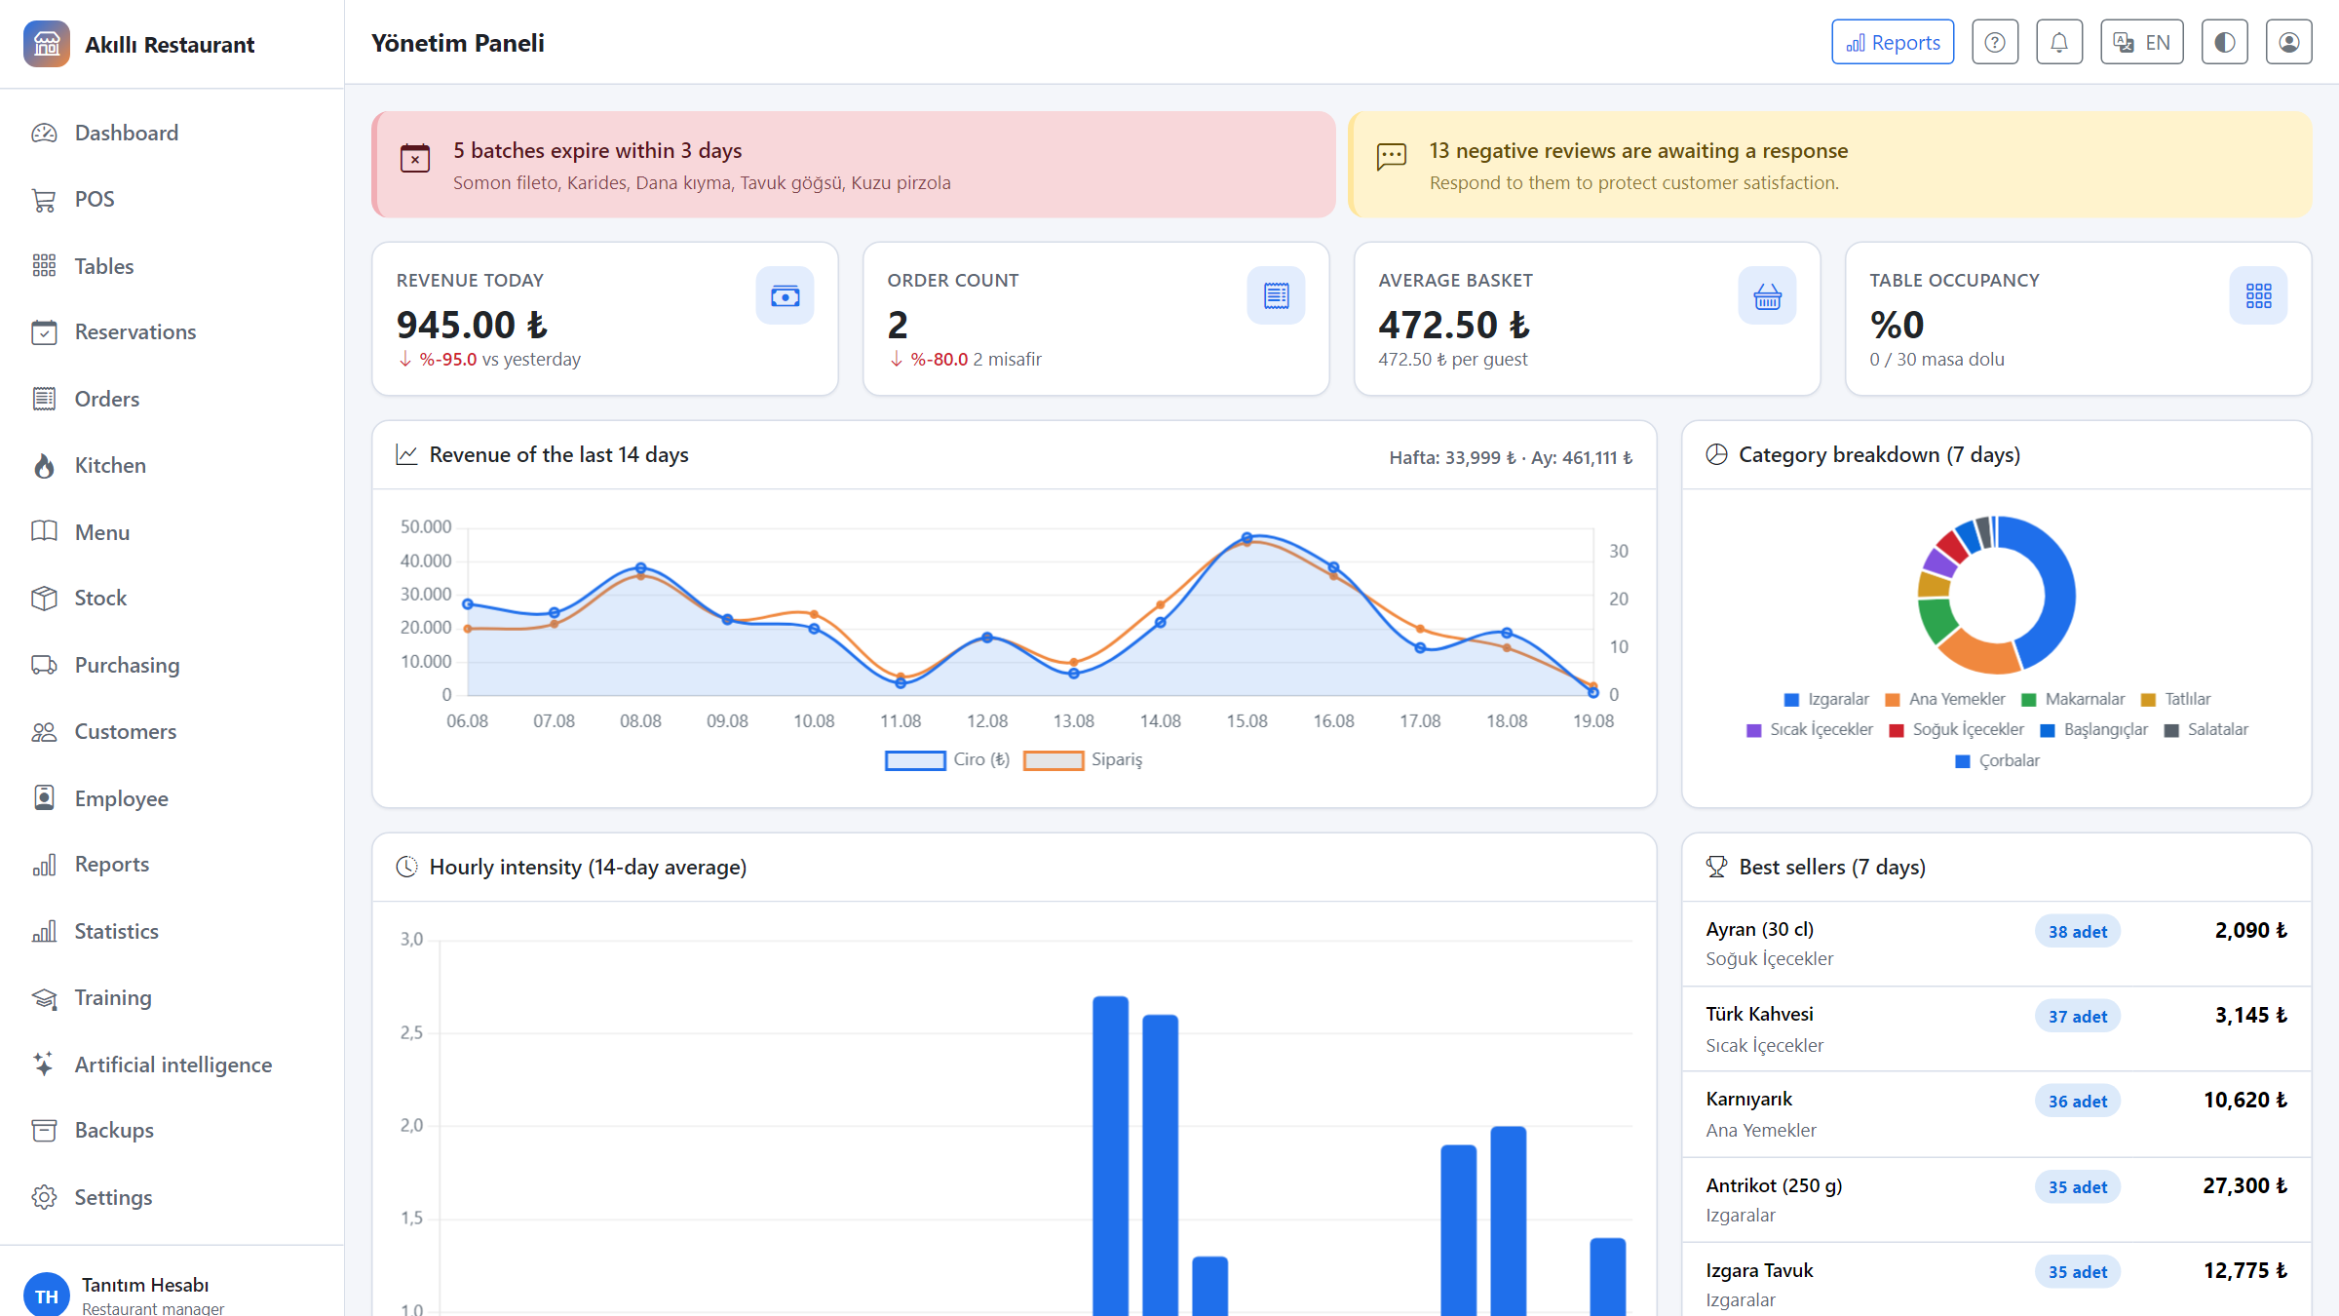
Dashboard
Today's revenue, order count, occupancy, 14-day trend, category breakdown and critical alerts on one screen.
Smart Restaurant Management System
5 / 26

Slide 6
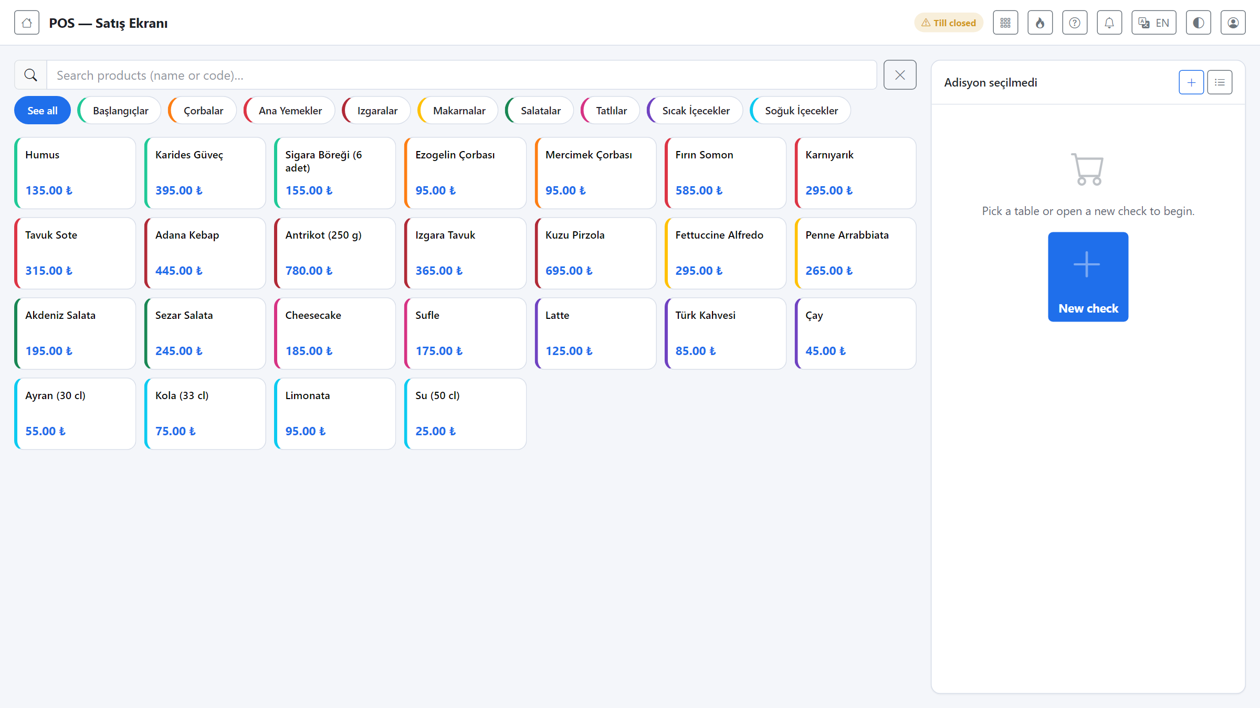
POS — sales screen
Touch-friendly selling: category filters, quick product search, check and table management.
Smart Restaurant Management System
6 / 26

Slide 7
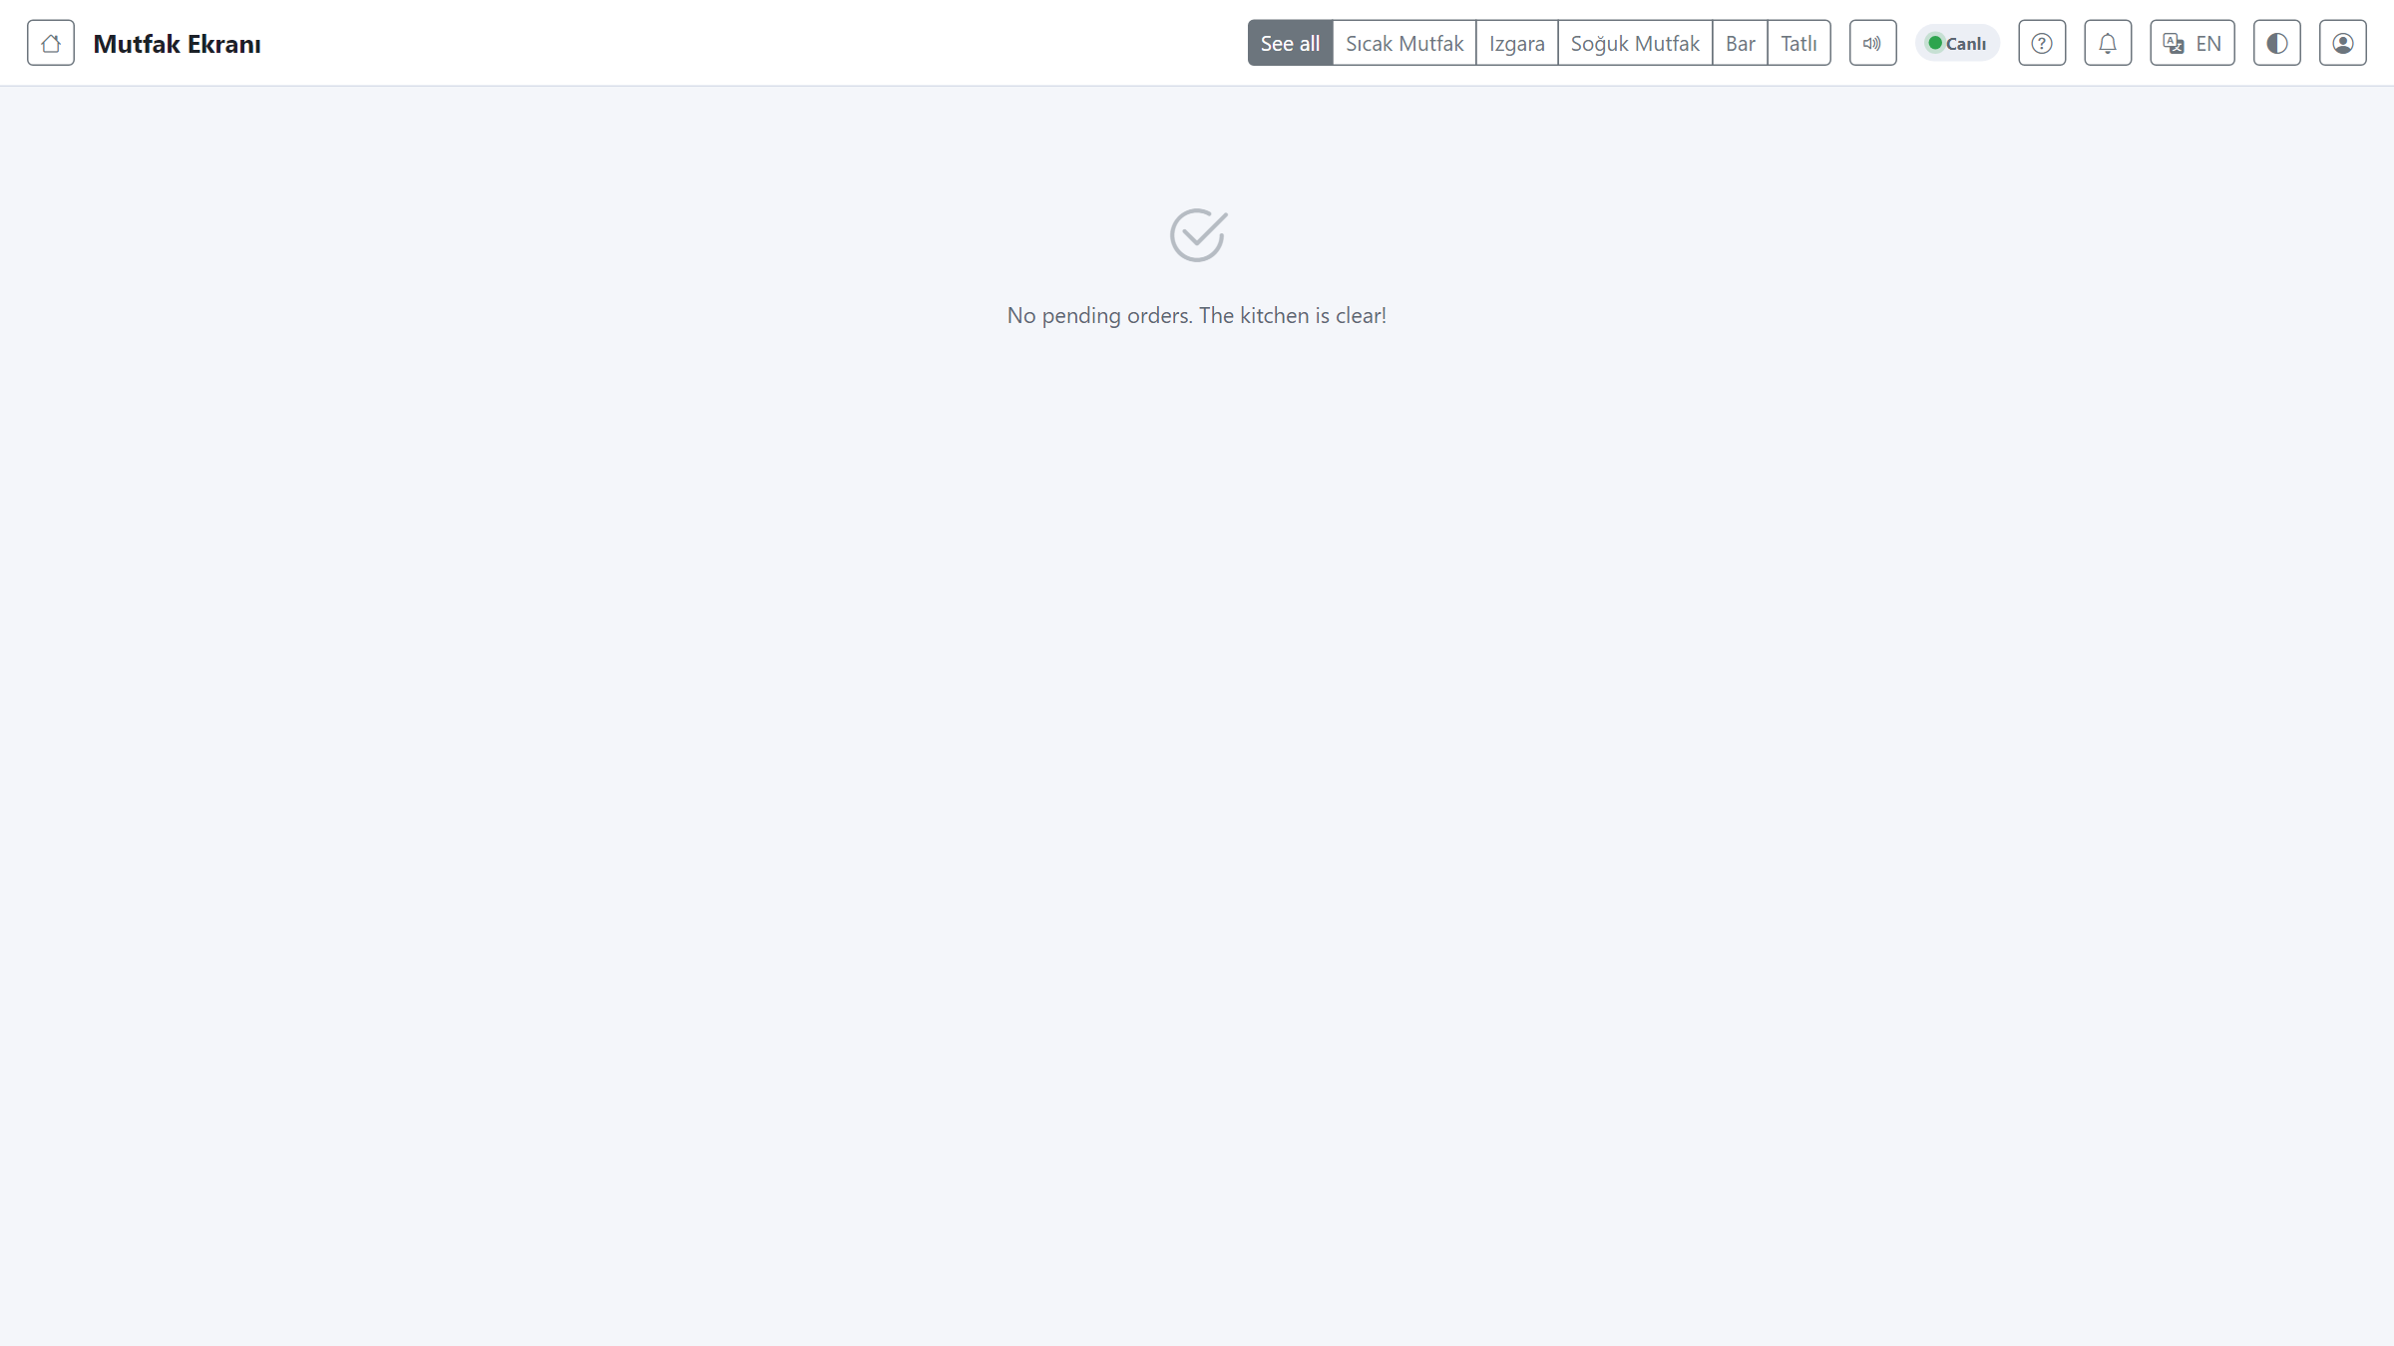
Kitchen display (KDS)
Orders split by station and stream live; overdue tickets change colour and sound an alert.
Smart Restaurant Management System
7 / 26

Slide 8
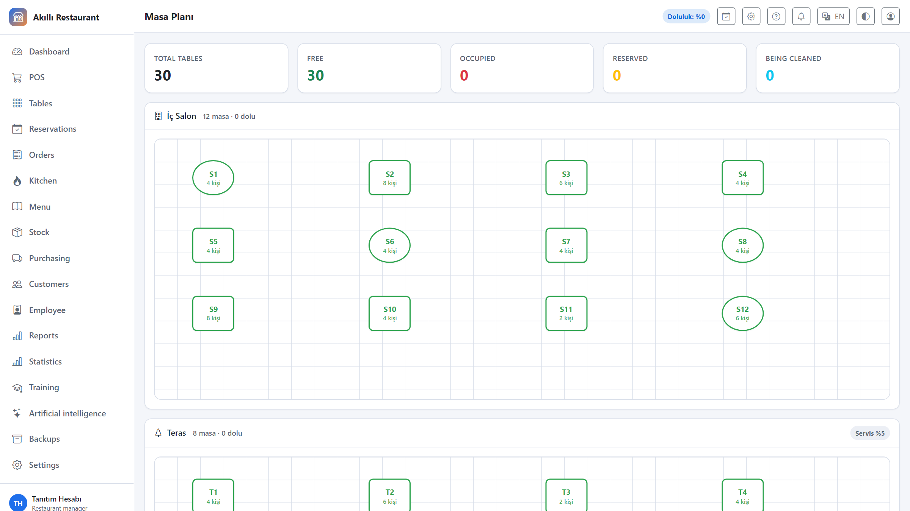
Table plan
Floor sections, table states and QR-coded table management at a glance.
Smart Restaurant Management System
8 / 26

Slide 9
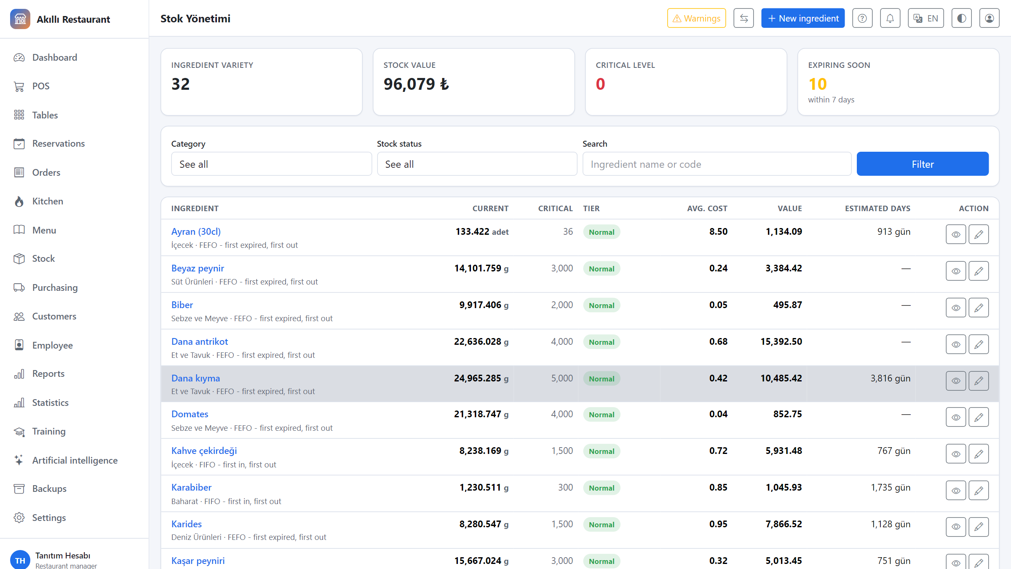
Stock and ingredients
Lot-based FIFO/FEFO tracking, critical-level alerts and run-out forecasts.
Smart Restaurant Management System
9 / 26

Slide 10
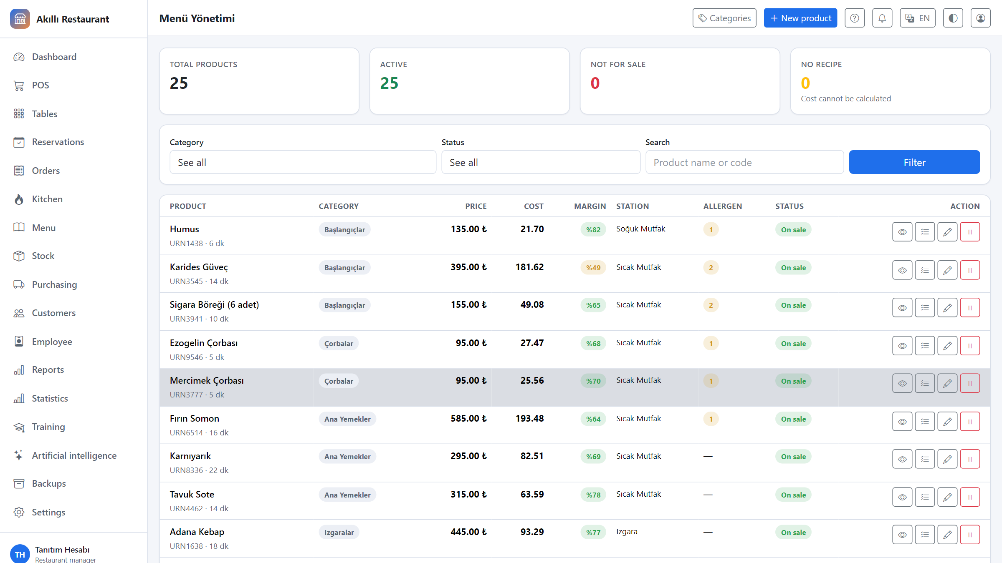
Menu and recipes
Product cards, portions and modifiers; real cost and margin derived from the recipe.
Smart Restaurant Management System
10 / 26

Slide 11
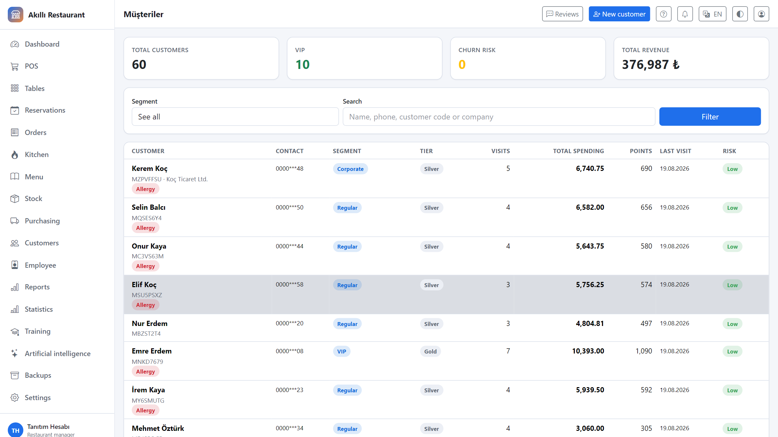
Customers and loyalty
Segments, loyalty points, consent records and permission-based masking.
Smart Restaurant Management System
11 / 26

Slide 12
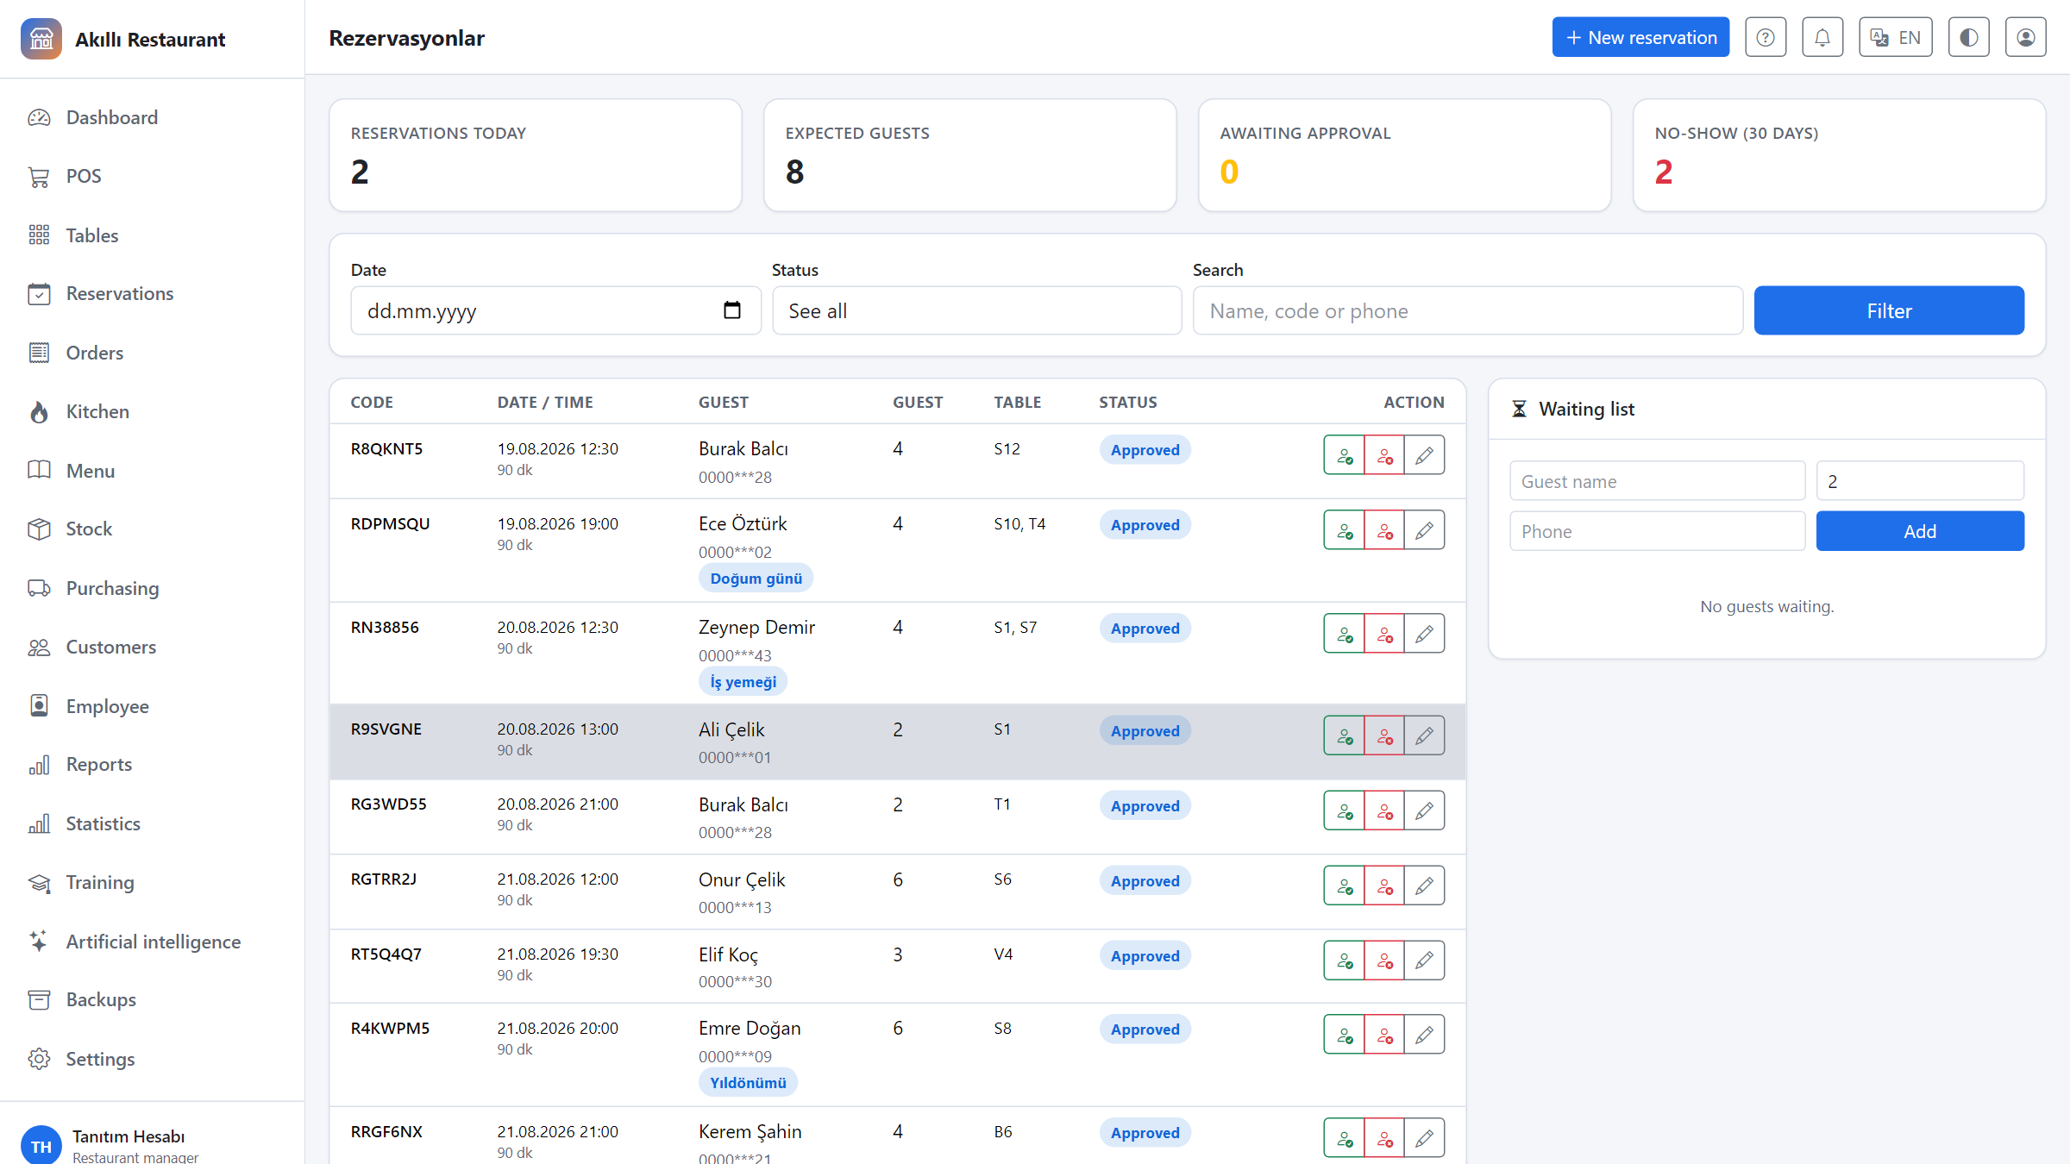
Reservations
Reservation list, waiting list and conflict checks.
Smart Restaurant Management System
12 / 26

Slide 13
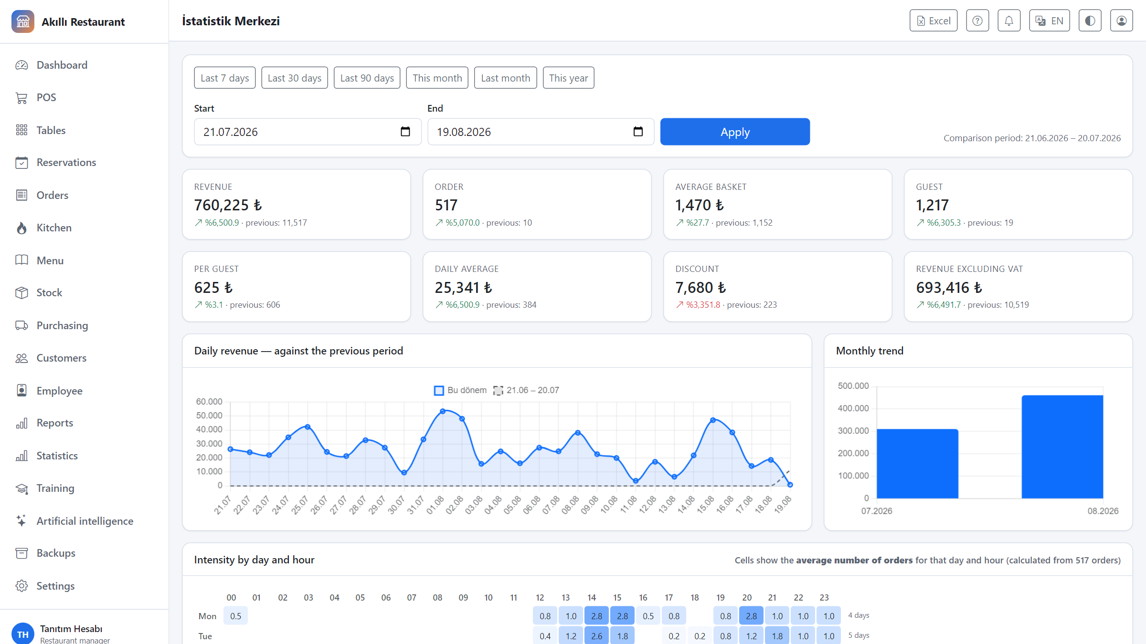
Statistics centre
Period comparison, intensity matrix and trend charts.
Smart Restaurant Management System
13 / 26

Slide 14
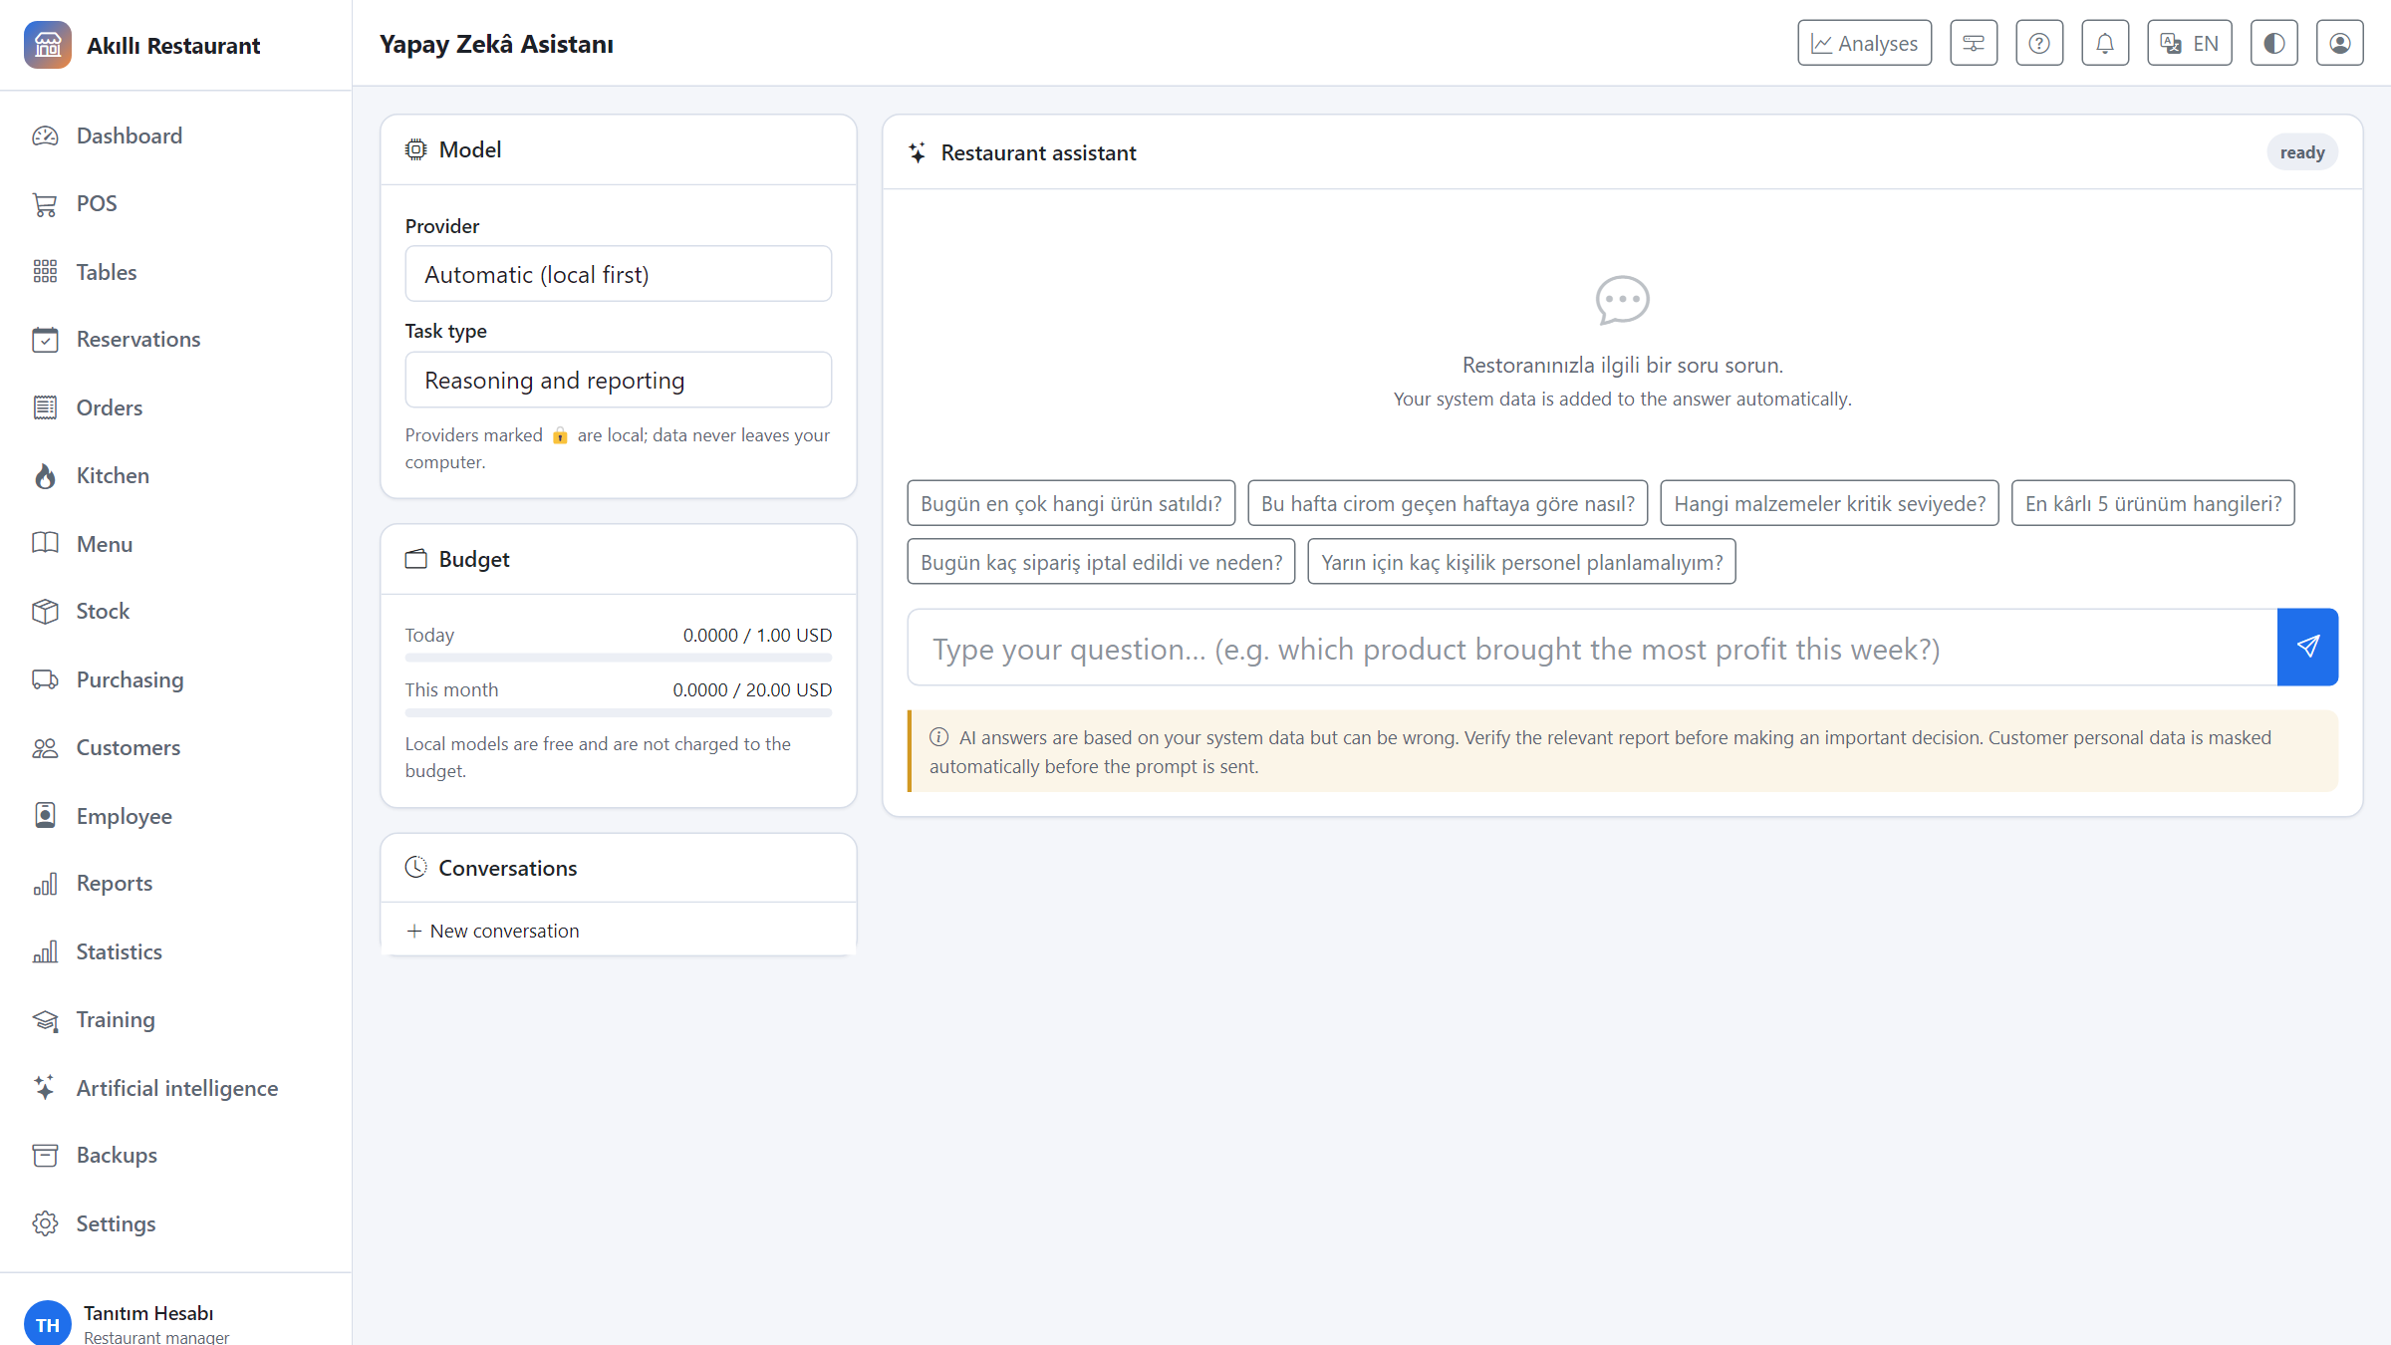
AI assistant
Q&A over your own data; with a local model, nothing leaves the machine.
Smart Restaurant Management System
14 / 26

Slide 15
The order is entered once
▪ The server picks the product on the POS and adds a note
▪ "Send to kitchen" splits the order across stations: hot kitchen, grill, bar, pastry
▪ At the same moment the recipe's ingredients leave stock
▪ The kitchen screen shows the ticket instantly — no page refresh
▪ When the time is exceeded the ticket turns yellow, then red, with an audible alert
WHY IT MATTERS
Paper tickets, shouting across the pass and the "did it get through?" uncertainty disappear. Stock stops being a separate job; the sale itself updates it.
Smart Restaurant Management System
15 / 26

Slide 16
Seeing the real profit
▪ Every product has a recipe and a portion yield
▪ Ingredient cost is calculated per batch, at the real purchase price
▪ The profitability report gives profit, margin and food cost ratio per product
▪ Products without a recipe are listed separately as a warning
▪ The effect of a price change on margin can be simulated beforehand
AN HONEST NUMBER
A product without a recipe counts as zero cost, so its profit looks higher than it is. The system does not hide this; it says at the top of the report how many products lack a recipe.
Smart Restaurant Management System
16 / 26

Slide 17
Statistics centre
▪ The chosen period is compared side by side with the previous equal period
▪ A day × hour intensity matrix — for staff planning
▪ Customer behaviour: new vs returning, most valuable customers
▪ Waste rate, stock value, service speed and table turnover
▪ Every section exports to a single Excel file
NO DECISIONS ON THIN DATA
Cells resting on fewer than three observations are faded. A single busy Saturday is not presented as a regular pattern — the system tells you how much data each number rests on.
Smart Restaurant Management System
17 / 26

Slide 18
AI — without your data leaving the building
▪ Choose a local model (LM Studio, Ollama) or a cloud provider
▪ Sensitive data can be restricted to the local model only
▪ Customer personal data is masked before the prompt is sent
▪ Demand forecasting, menu engineering, waste and anomaly analysis
▪ A daily management summary: what went well, what needs attention
A FORECAST IS NOT A CERTAINTY
Every AI output is shown with its confidence level, the amount of data behind it and its limitations. A budget cap can be set; local models are free and are not charged against it.
Smart Restaurant Management System
18 / 26

Slide 19
Data safety and backups
▪ One-click backup from inside the app: database, files and a portable dump
▪ A consistent snapshot even while the system is running
▪ Integrity verification with SHA-256
▪ An automatic safety backup before any restore; a confirmation phrase is required
▪ Optional scheduled automatic backups
API KEYS STAY OUT OF THE BACKUP
Backup archives usually travel by email or cloud storage. Keys are excluded by default so they cannot leak that way; they can be included explicitly, and the archive is then marked.
Smart Restaurant Management System
19 / 26

Slide 20
Who sees what
Permissions are role-based; the menu shows only the sections you can actually use.
Role | What they see | Requires approval
Server | POS, tables, their own orders | Voids, discounts
Cashier | POS, payment, till, basic reports | Refunds, price overrides
Chef | Kitchen, menu, recipes, stock | —
Storekeeper | Stock, counts, purchasing, suppliers | —
Manager | Everything + financial reports + backups | —
Owner | Everything + restore + users | —
Smart Restaurant Management System
20 / 26

Slide 21
Security
Restaurant data means customer personal data. The system treats it that way.
▪ Role-based permissions, with per-user grants and revocations
▪ Manager PIN approval for voids, refunds and discounts
▪ An immutable audit log: who, when, what
▪ Account lockout after five failed sign-ins
▪ Customer phone and email are masked for users without the permission
▪ Data erasure and anonymisation for data-protection requests
Smart Restaurant Management System
21 / 26

Slide 22
Setup and use
▪ A single-file application (~57 MB) — no Python installation needed
▪ Windows 10/11 (x64) & macOS (Apple Silicon) — Download: GitHub Releases (v1.0.0)
▪ The macOS package targets Apple Silicon (arm64) and is not notarized (first launch: right-click -> Open)
▪ Double-click it; on first run it offers to try the system with demo data
▪ Database, files and logs live in the folder next to the program
▪ No internet required; cloud AI is optional
▪ PostgreSQL and Docker support for those who want a server setup
LEARNING CURVE
The application contains a built-in guide of eight lessons. Lessons are filtered by role; a server is not shown the backup lesson. About 38 minutes in total.
Smart Restaurant Management System
22 / 26

Slide 23
Technical foundation
Built to last, to be auditable, and to grow.
▪ Python 3.11+ and Django 5.2 — mature, documented, widely supported
▪ WebSockets for the kitchen display (Django Channels, Daphne)
▪ SQLite on a single machine; PostgreSQL for multi-terminal setups
▪ 486 automated tests; linter, formatter and security scan on every release
▪ Dependency vulnerability and secret scanning required before publishing
▪ All settings come from the environment; no secret lives in the source code
Smart Restaurant Management System
23 / 26

Slide 24
Fiscal compliance notice
The receipts, checks and daily reports this system produces are for internal information and do not replace legal fiscal documents.
▪ A legal Z report must be produced by a certified fiscal device.
▪ Electronic invoices must be issued through an authorised integrator.
▪ The system provides interfaces for these integrations; it does not claim to produce fiscal documents.
Smart Restaurant Management System
24 / 26

Slide 25
Quality measures
Verified automatically before every release.
486
tests
unit, integration, permissions, security
pip-audit + osv
dependency scan
run before every release
1,764
translated strings
Turkish / English
gitleaks
secret scan
run before every commit
Smart Restaurant Management System
25 / 26

Slide 26
Ready to try
The program runs as a single file and opens with a restaurant already full of sample data.
1. Put the application in an empty folder and double-click it
2. Choose "Try with sample data"
3. The sample-data step prints the usernames and a one-time random password for that install
4. Reach the user guide from the ? button in the top bar
Clear the sample data and create your own users before going live.
Smart Restaurant Management System
26 / 26

