Slide 1
SURF SCHOOL MANAGEMENT SOFTWARE
28
Smart Surf School
Management System
modules, one database
2,128
tests passing, 0 failing
Everything a surf school runs on, in one application:
lessons, bookings, equipment, surf conditions, safety, finance and AI.
39/39
screens working
Version 1.0.0 · Django 5.2 LTS · Turkish / English

Slide 2
THE PROBLEM
How many places does a surf school run in?
A typical day: bookings arrive on WhatsApp, student details live in a notebook, nobody is sure who has which board, takings are on paper receipts, and the forecast is in another app entirely.
Two lessons, one slot
Nobody sees the clash until two coaches wait for the same student.
Missing equipment
Who has the board? When is it due? What about the deposit?
Safety details too late
The instructor learns about the asthma after the lesson, not before.
Invisible money
What the month actually earned is a guess.
Knowledge that walks out
When someone leaves, what they knew leaves too.
This system puts all five in one database.
Smart Surf School Management System — Introduction
2 / 28

Slide 3
MEASURED
The system in numbers
Every figure below was read from the project — none is an estimate.
28
86
75
15
modules
data models
REST resources
roles
203
2,128
39/39
20
capabilities
tests passing
screens working
acceptance steps
Tests via `pytest`: 2,130 collected, 2,128 passing, 2 skipped because they need a live AI provider. Code coverage was NOT measured for this release, so no percentage is quoted. Screens verified with real HTTP requests against a running server.
Smart Surf School Management System — Introduction
3 / 28

Slide 4
SCOPE
Six areas, one application
People
Operations
Equipment
Customers, students, instructors, CRM. Surf level, medical notes, certification expiry, commission.
10 lesson types, booking calendar, waitlist, surf camps, the day's schedule.
QR-labelled inventory, hourly/daily/weekly rentals, damage and service history.
Surf & safety
Money
Decision support
Live wave, wind and tide, a Surf Score per level, incident reports, lifeguard roster.
Payments, refunds, invoices, expenses, commission, lesson packages and point of sale.
Statistics engine, dashboards, PDF/Excel/CSV reports, backups and an audit trail.
Smart Surf School Management System — Introduction
4 / 28

Slide 5
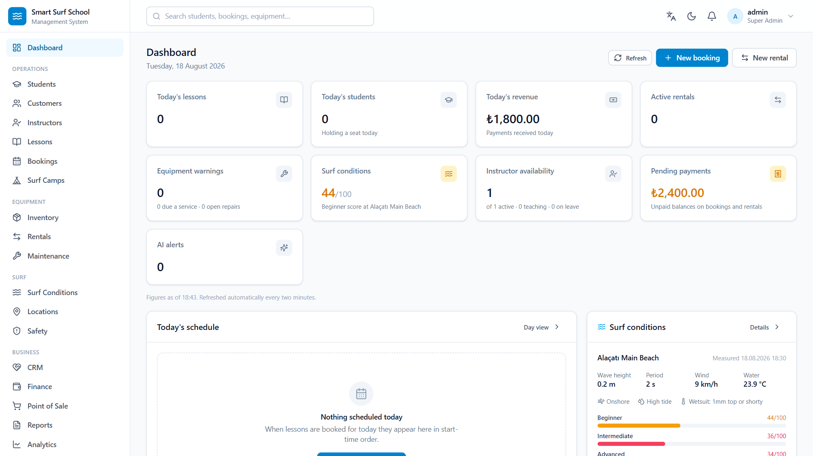
THE INTERFACE
What it looks like: the dashboard
Today's lessons, revenue, pending balances, equipment warnings and sea conditions — at a glance.
Every screenshot in this deck was taken from the running application on 2026-08-18, showing synthetic demo data — none of them is a mock-up or a design rendering.
Smart Surf School Management System — Introduction
5 / 28

Slide 6
ACCESS
Who can see what?
15 roles and 203 capabilities come from one table. The menu, the screens, the REST API and the AI assistant all read it — which is why a screen can never offer an action the API would refuse.
Super Admin
Everything, including backup restore
Manager
Operations + finance + staff
Head Instructor
Lessons, instructors, safety sign-off
Surf Instructor
Their own lessons and students
Lifeguard
Safety module, incident reporting
Reception
Customers, bookings, taking payment
Rental Staff
Check-out and check-in, deposits
Finance
Payments, refunds, reports, commission
Customer / Student
Only their own records — enforced per row
Taking money (finance.view) and reading the takings (finance.revenue) are separate privileges; rental staff hold the first and not the second, so the aggregate query is never run. Asserted in apps/accounts/tests/test_object_scoping.py.
Smart Surf School Management System — Introduction
6 / 28

Slide 7
BOOKINGS
The system catches the clash, not the person
Rules run live while a booking is typed. Each one is tested separately.
Free seats
Is the lesson full, how many places are left.
The student's own clash
Are they already booked at that time.
Level fit
Does the lesson type accept this level.
Instructor availability
Weekly hours, time off, another lesson.
Instructor-to-student ratio
A stricter limit applies when a minor is in the group.
Safety restrictions
Any medical or skill restriction on the student.
When something clashes, the system says exactly what is wrong — and the rule cannot be worked around, because that is when people get hurt.
Smart Surf School Management System — Introduction
7 / 28

Slide 8
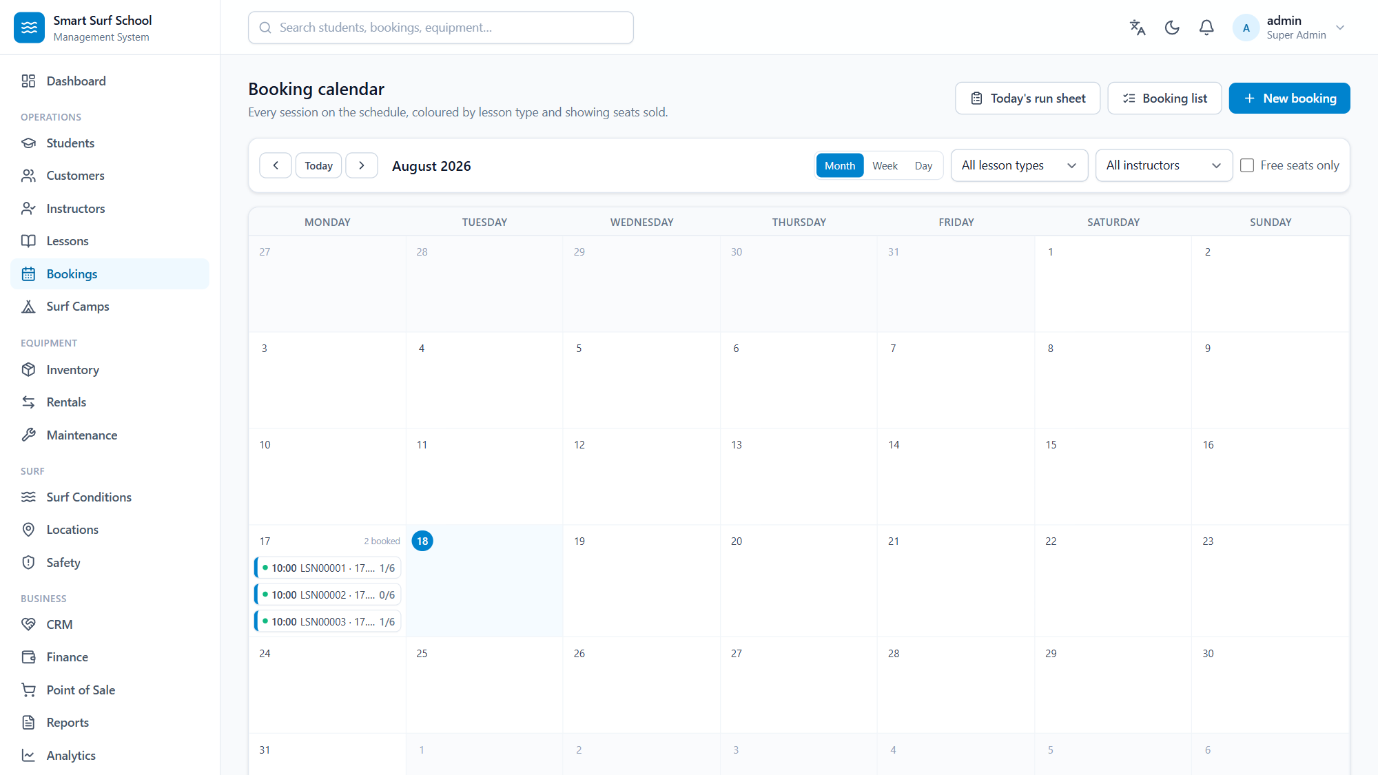
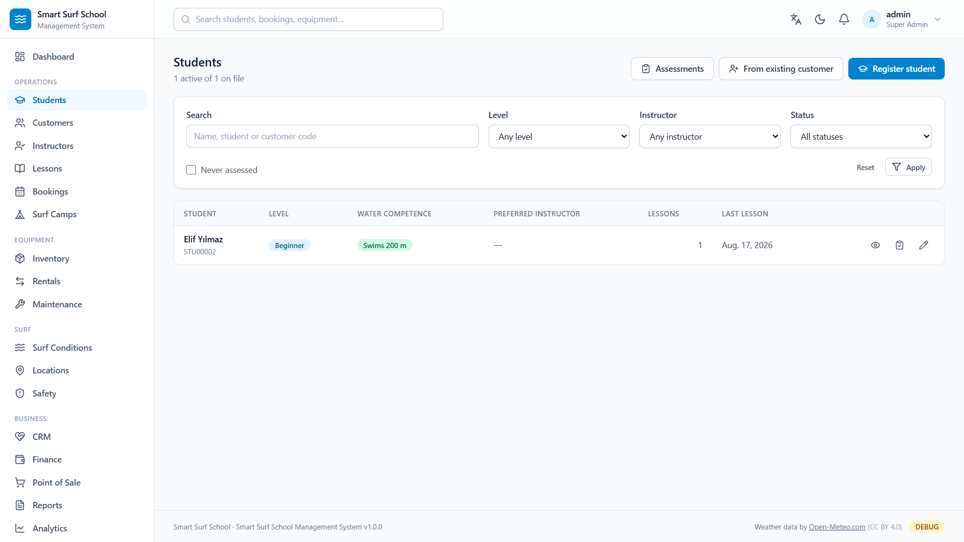
INTERFACE — BOOKINGS
The calendar and the student file
Booking calendar: coloured by lesson type, seats sold on every entry.
Student list: level, water competence and last lesson side by side.
Smart Surf School Management System — Introduction
8 / 28

Slide 9
EQUIPMENT
Who has the board, and when it is due
QR labels
The right board
Honest pricing
Every item has a unique code and a QR label. Scan it at the counter and the line is added.
Volume in litres from weight and level; wetsuit thickness from the water temperature.
Hourly, daily or weekly — and a hire of a week or more automatically takes the weekly rate when it is cheaper.
Late and damaged
Service history
Predicted maintenance
Late fees are capped at three times the hire; reported damage opens a maintenance record automatically.
Ding, crack, fin, leash, wetsuit tear — every repair recorded with its cost.
A risk ranking computed from your own service history. Statistics — not an AI guess.
Smart Surf School Management System — Introduction
9 / 28

Slide 10
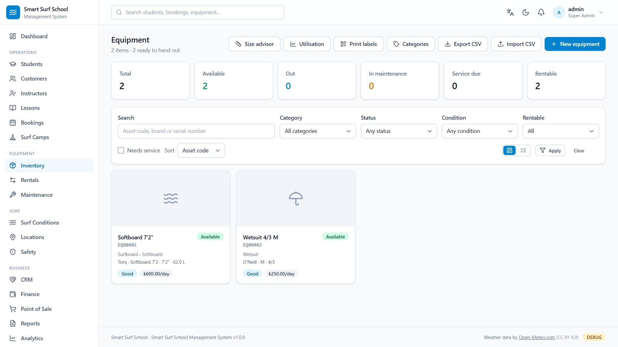
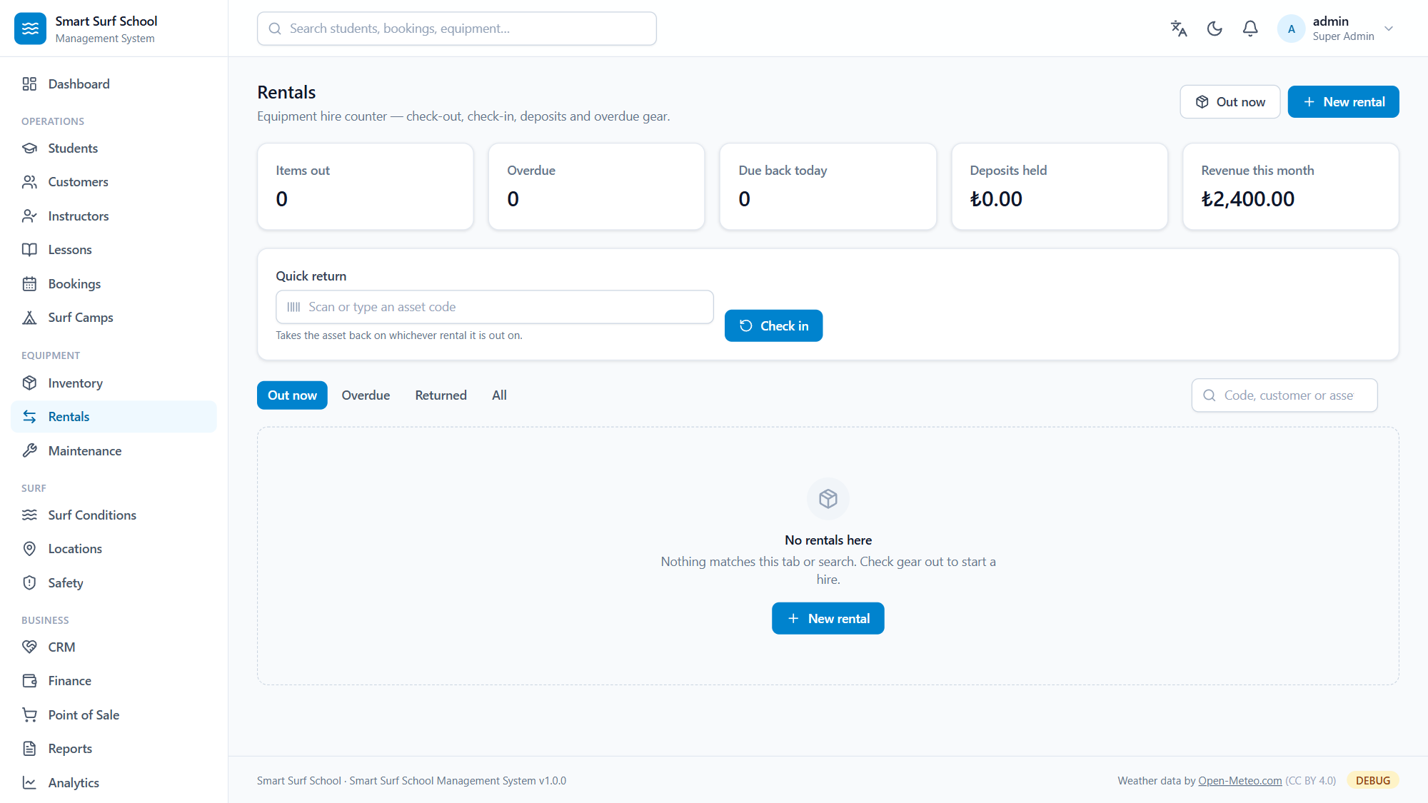
INTERFACE — EQUIPMENT
Inventory and the hire counter
QR-tagged inventory: status, condition and daily rate on the card.
The hire counter: one scan to check gear back in, deposits and overdue tracking.
Smart Surf School Management System — Introduction
10 / 28

Slide 11
SURF CONDITIONS
Surf Score: 0–100, and why it is that number
Wave, wind, period, tide, water temperature and weather, scored separately for each surf level. The score is COMPUTED — never asked of a language model — and every component is shown.
Wave height fit
35%
Wind quality (offshore/onshore)
25%
Swell period
15%
Tide match
10%
Weather and precipitation
10%
Water temperature comfort
5%
Hard safety gate: above the level's wave or wind limit the score is capped at 25 and marked unsafe. With no wave data no score is produced at all — an unknown ocean is not a safe ocean.
Smart Surf School Management System — Introduction
11 / 28

Slide 12
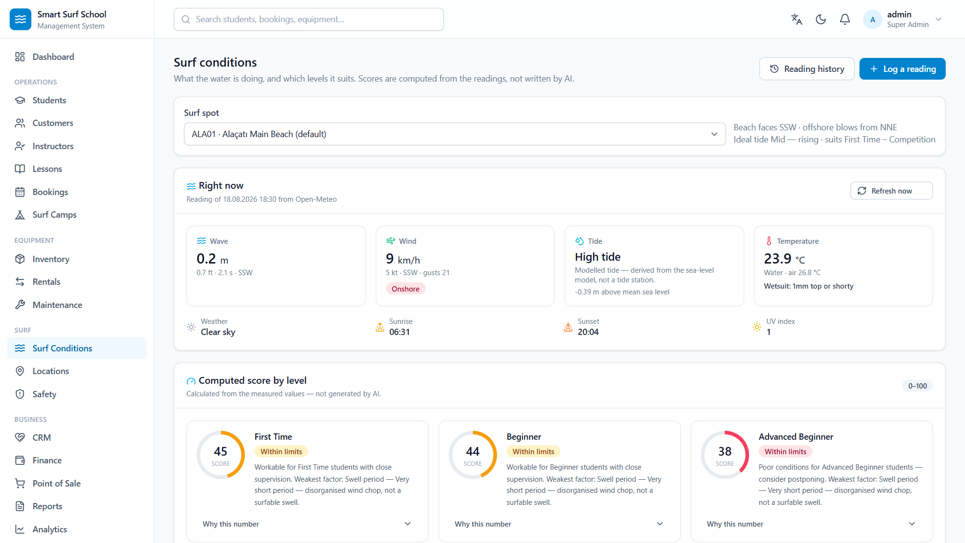
INTERFACE — THE SEA
Live sea state, computed score
A live Open-Meteo reading: wave, wind, tide and water temperature — and the Surf Score computed per level, with its reasoning shown.
Smart Surf School Management System — Introduction
12 / 28

Slide 13
SAFETY PRINCIPLE
The AI is never the final authority on a safety decision.
The system summarises conditions, thresholds and history. Whether a lesson runs, whether a student enters the water, and whether a piece of equipment is fit for use is decided by a qualified member of staff.
The data model works the same way: a weather warning suggested by the AI is not an active warning until a named person acknowledges it.
Smart Surf School Management System — Introduction
13 / 28

Slide 14
MONEY
Exact to the cent, with the history intact
Decimal arithmetic
Refunds keep the record
Atomic operations
Money is never a floating-point number anywhere. 12 digits, 2 decimals — sums and comparisons are exact.
A refund creates a matching negative entry; the original payment is never altered.
A booking and its lesson attendance are created together or not at all.
Lesson packages
Point of sale
Audit trail
Sell a discounted multi-lesson package; it draws down as it is used and the balance shows on the customer's page.
Barcode entry, a stock ledger, printed receipts. Voiding a sale returns the stock rather than deleting the record.
Every payment, refund and permission change is stored immutably with who, what and when.
Smart Surf School Management System — Introduction
14 / 28

Slide 15
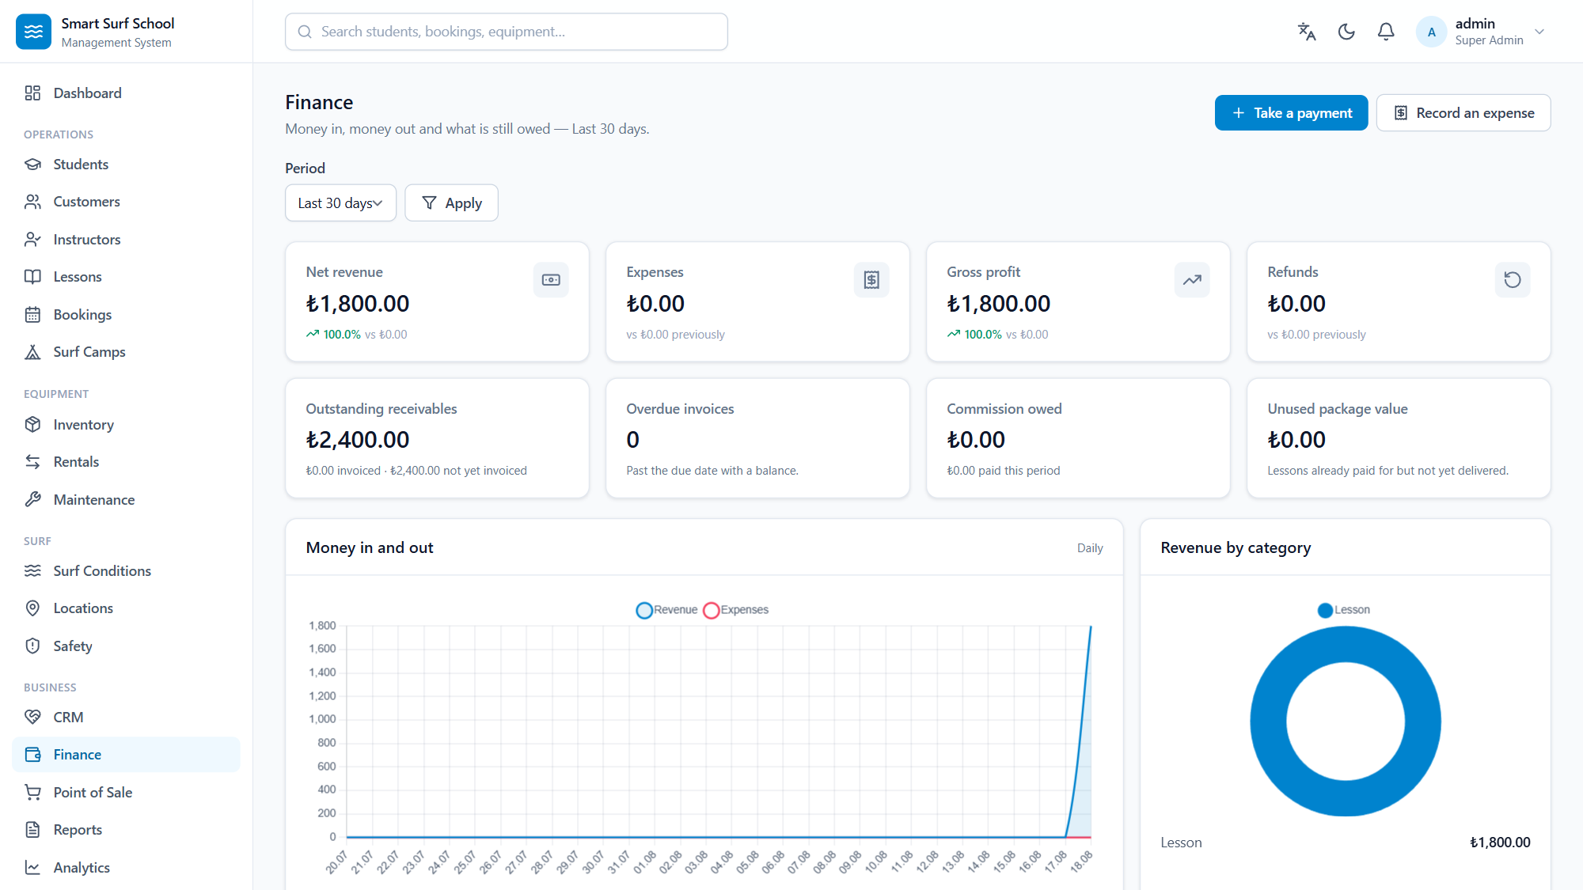
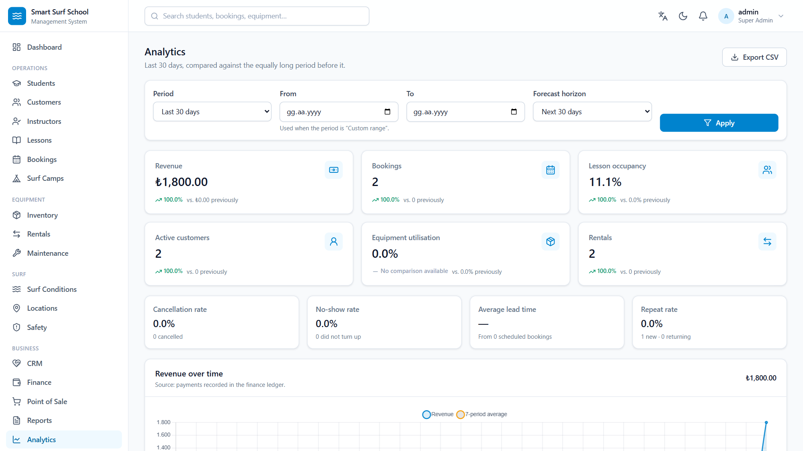
INTERFACE — MONEY
The finance board and analytics
Net revenue, expenses, receivables and overdue invoices — last 30 days.
Occupancy, cancellation rate, repeat customers and the revenue trend.
Smart Surf School Management System — Introduction
15 / 28

Slide 16
ARTIFICIAL INTELLIGENCE
Measured AI, not claimed AI
Model choices came from real calls made on this machine, not from vendor documentation.
857 ms
535 ms
389 ms
311 ms
Nemotron 3 Super
(assistant)
Nemotron 3.5 Lightning
(fast routing)
Riva Translate
(TR ↔ EN)
Embedding 1B
(2048 dimensions)
A finding that changed the design: without `thinking: false` the Nemotron models exceeded 90 seconds and leaked chain-of-thought into the answer. With the flag: 535 ms and a clean reply. See docs/research/VERIFIED_API_PROBES.md
Smart Surf School Management System — Introduction
16 / 28

Slide 17
AI ARCHITECTURE
Local first, cloud optional
Providers sit behind one interface. Call sites ask for a ROLE, never a model name. A failed provider is a value rather than an exception — so the application stays fully usable with no internet at all.
LM Studio (local)
Free, offline, data never leaves the machine
NVIDIA NIM
Strong reasoning, vision, translation, embeddings
Anthropic Claude
Optional
OpenAI-compatible
Ollama, vLLM and others
Local only
For when customer data must not leave the building
Automatic
Cheap questions stay local, hard ones go to the cloud
A local embedding model means knowledge-base search works offline too.
Smart Surf School Management System — Introduction
17 / 28

Slide 18
AI TRUSTWORTHINESS
The assistant cannot invent data
«Do not make things up» is a mechanism here, not a hope. The model can only obtain a figure from a tool that runs a real query.
13 database tools
Lessons, bookings, revenue, equipment, maintenance, rentals, instructors, customers, surf conditions, safety.
Permissions checked in the tool
A tool runs with the capabilities of the person ASKING. The assistant is not a privilege-escalation path.
«No data» is a real answer
When a query returns nothing the model says so rather than filling the gap with a plausible number.
Citations
Answers drawn from the knowledge base show the document they came from.
Visible working
Under every answer: which provider, which model, how many milliseconds, and which lookups ran.
Smart Surf School Management System — Introduction
18 / 28

Slide 19
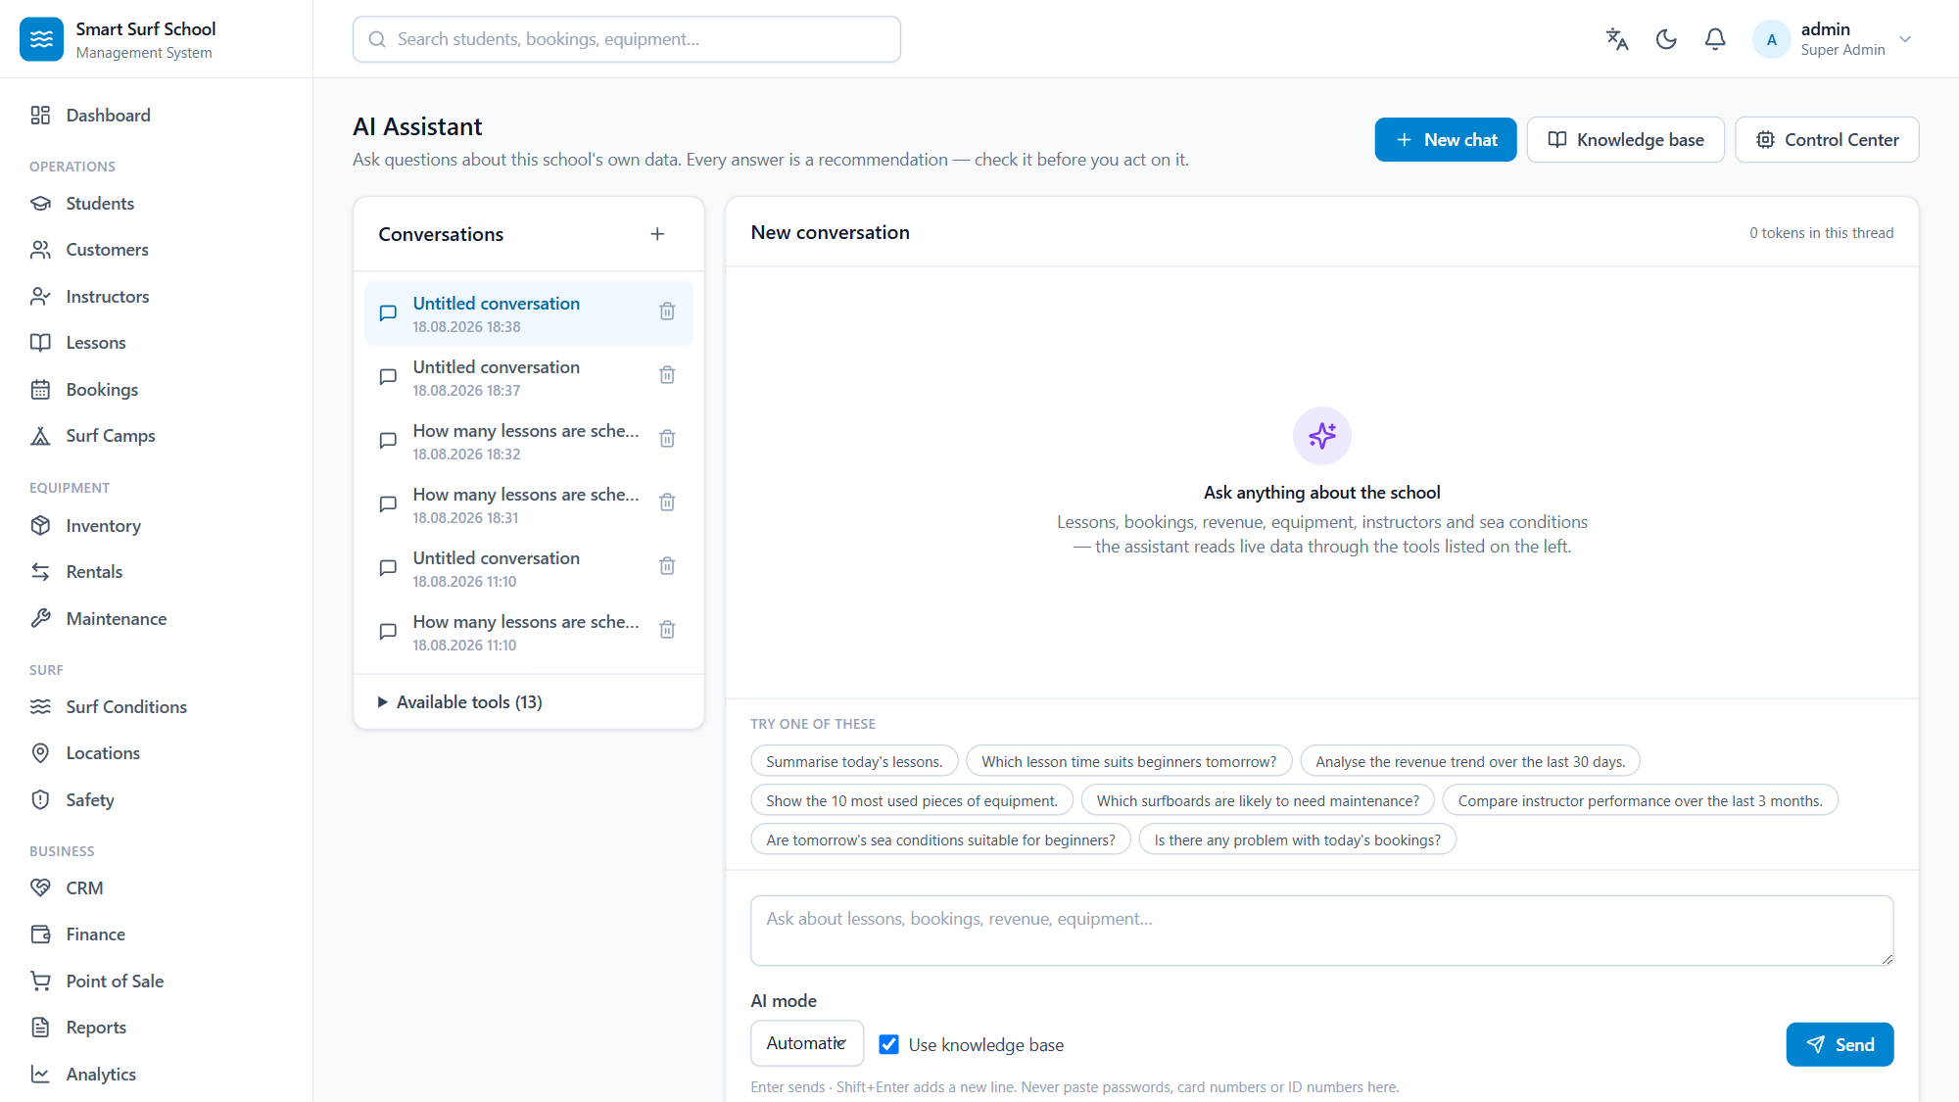
INTERFACE — AI
The assistant at work
The AI assistant talks to the school's own data: 13 database tools, ready-made questions, and a provider/model/latency line under every answer.
Smart Surf School Management System — Introduction
19 / 28

Slide 20
DEVELOPMENT TERMINAL
The AI proposes, policy decides, a human approves
No shell
Allowlist
Workspace jail
Commands run as a validated argument vector. Chaining and redirection are not filtered — they are impossible.
git status yes, git push no. manage.py test yes, manage.py flush never.
UNC paths, drive-relative paths, 8.3 short names, CON/NUL device names and NTFS streams are all closed off.
Approval gate
Clean environment
Full record
An edited command is re-validated from scratch — approval is not permission to bypass the policy.
No credential reaches the child process; on timeout the whole process tree is killed.
Every decision is audited, including the refusals.
Smart Surf School Management System — Introduction
20 / 28

Slide 21
CONTINUITY
Backups: a plan, not a hope
Taking a backup is the easy part; the real risk is restoring the wrong one over good data. Restore is deliberately made difficult.
1. Verify
SHA-256 checksum and an integrity check
2. Type the code
The operator types the backup code to continue
3. Permission
backups.restore is required separately
4. Safety backup
The current state is backed up FIRST
5. Restore
With every step written to the audit log
6. On failure
Everything is put back automatically
SQLite is captured through the sqlite3 backup API rather than by copying the file — copying a live database produces a corrupt backup.
Smart Surf School Management System — Introduction
21 / 28

Slide 22
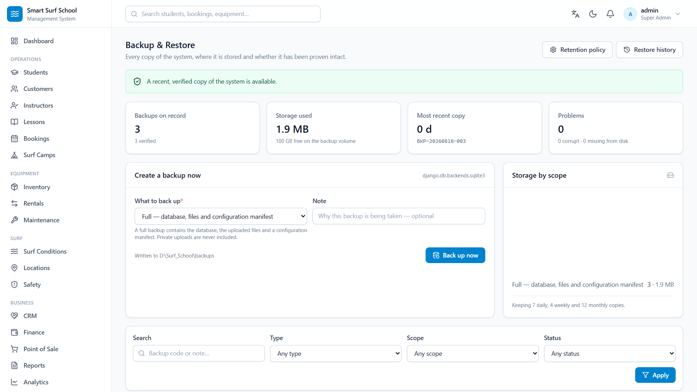
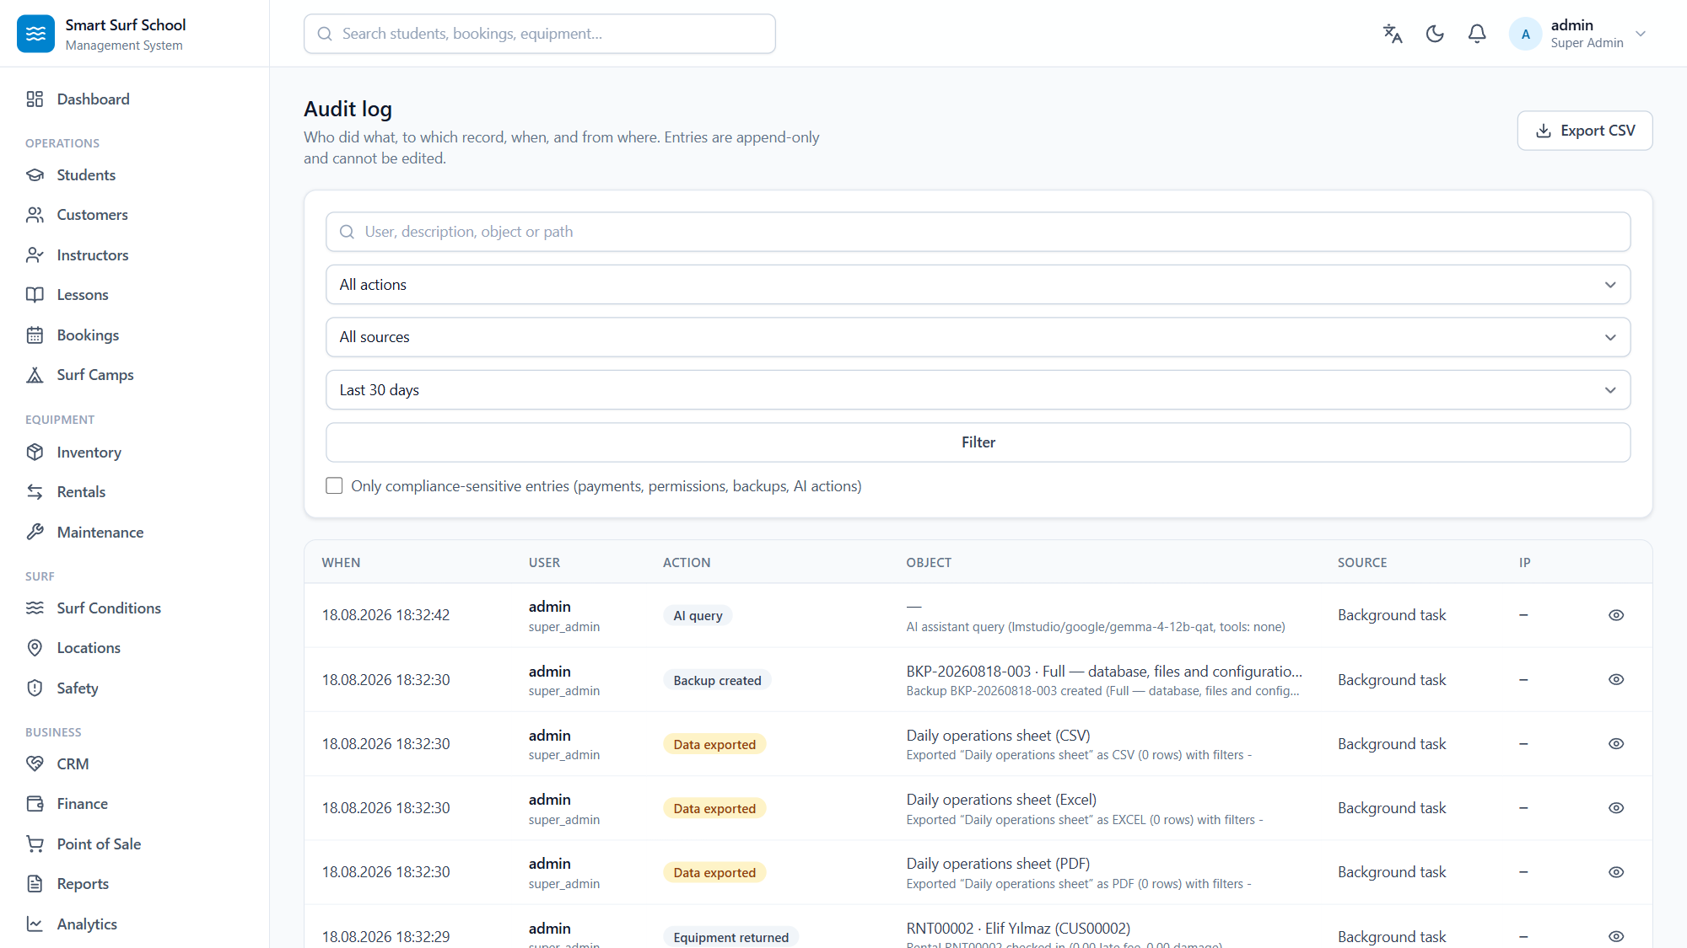
INTERFACE — OPERATIONS
Backups and the audit log
Verified backups, the retention policy and a one-click new copy.
The audit log: who, what, when — rows are appended, never edited.
Smart Surf School Management System — Introduction
22 / 28

Slide 23
IN USE
Easy to learn, in two languages
Turkish and English
Help Center
Training Center
Menus, notifications, validation messages and Help Center and Training Center content is genuinely bilingual. The interface chrome is English today: 337 templates use {% trans %} but no compiled Turkish catalogue ships yet. Turkish locale formatting -- dates, numbers, currency -- does apply.
16 categories, 22 articles — a reference for every screen, in both languages.
10 interactive courses, 71 steps. Real tasks, from your first student to your first backup.
Setup wizard
Role aware
Dark and light
First run asks for the school name, currency, language and surf spot — and then creates the real records.
An instructor's dashboard leads with their own lessons; a customer sees only their own bookings.
Bright at the counter, dark in the office.
Smart Surf School Management System — Introduction
23 / 28

Slide 24
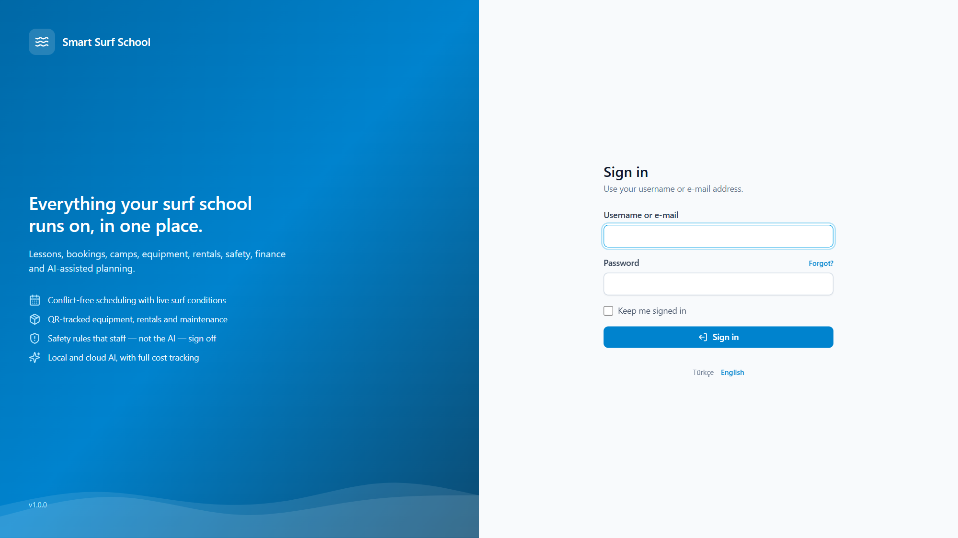
INTERFACE — SIGN-IN
Bilingual sign-in, role-aware screens
The sign-in screen: TR/EN language switch; after sign-in the menu and dashboards shape themselves to the user's role.
Smart Surf School Management System — Introduction
24 / 28

Slide 25
TECHNOLOGY
Plain, durable, portable
The technology was chosen for this business's real conditions — one computer, weak internet, no IT staff — rather than for fashion.
Python 3.11 + Django 5.2 LTS
Supported until 2028
Django REST Framework
75 resources, OpenAPI documentation
HTMX + Alpine + Tailwind
No separate build, no CDN
SQLite → PostgreSQL
One environment variable
Redis / Celery
Used when present; the app is identical without
Works offline
Every asset is vendored locally
The dependency audit reports no known vulnerabilities, and static security analysis reports no high-severity findings.
Smart Surf School Management System — Introduction
25 / 28

Slide 26
QUALITY
Whatever is claimed was measured
All of the following were run on this machine and the results recorded.
2,128
90
39/39
20
tests passing
0 failing
access-control
assertions
screens
rendering
end-to-end
acceptance steps
The acceptance scenario runs through the real service layer: create an instructor and a student, a lesson, a booking, take payment, complete the lesson, hire equipment and take it back, generate reports, make a backup, ask local and cloud AI, and check the audit log.
Smart Surf School Management System — Introduction
26 / 28

Slide 27
HONESTY
Known limits
If an introduction only lists strengths, the buyer discovers the weaknesses in production. Here are the known ones:
Development runs on SQLite
PostgreSQL is the production target and the switch is one environment variable, but PostgreSQL was not installed on this machine.
No browser automation suite
Screens are verified over real HTTP; click-through flows were tested by hand.
Open-Meteo's free tier is non-commercial
The data licence is fine, the free hosted service is not; a met.no fallback is built in.
No load testing
The target is one school on one machine.
AI providers are tested by hand
Automated tests never touch the network — that is a deliberate decision.
Smart Surf School Management System — Introduction
27 / 28

Slide 28
IN SHORT
A surf school's day,
in one application
The system catches the clash and the safety rule
Money is exact and the history cannot be rewritten
The surf score is computed, never asked of an AI
The assistant only ever talks about real data
It works with no internet at all
Version 1.0.0 · github.com/Azizsekerdil/smart-surf-school-management-system
Windows 10/11 (x64) & macOS (Apple Silicon) · Download: GitHub Releases (v1.0.0)
The macOS build targets Apple Silicon (arm64) and is not notarized — first launch: right-click → Open.

