Slide 1
SMART VAN SALES MANAGEMENT SYSTEM
Smart Van Sales
Management System
End-to-end direct-store-delivery platform for food & beverage
Hot Sale
FEFO Stock
Route Optimisation
Local-first AI
From the factory to the shop shelf — one system
v1.0.0

Slide 2
SMART VAN SALES MANAGEMENT SYSTEM
v1.0.0 02 / 33
THE PROBLEM
At day end, everyone quotes
a different number.
When van stock, invoices raised, cash collected and the physical count are each kept separately, nobody can trace where the evening's discrepancy came from.

Slide 3
SMART VAN SALES MANAGEMENT SYSTEM
v1.0.0 03 / 33
Four places it breaks
Where van sales operations most reliably lose money
Guessed van stock
Expiry leakage
What was loaded is in a notebook, what was sold is on receipts. When they disagree at night, the variance belongs to nobody.
Short-dated stock sits on the shelf while a newer batch is sold. The write-off is discovered only at disposal.
Route blindness
Credit risk
Routes are built from habit. Nobody measures the relationship between kilometres driven and revenue earned.
The credit limit lives on paper; the office learns about the over-limit sale after the rep has already made it.

Slide 4
SMART VAN SALES MANAGEMENT SYSTEM
v1.0.0 04 / 33
The chain this system covers
Every link feeds from the previous one — no manual re-entry anywhere
Factory
›
Central Depot
›
Regional Depot
›
Van Loading
›
Sales Van
›
Salesperson
›
Daily Route
Customer
›
Hot Sale
›
Invoice / Waybill
›
Collection
›
Return
›
Van Count
›
Day-End Reconciliation

Slide 5
SMART VAN SALES MANAGEMENT SYSTEM
v1.0.0 05 / 33
The measure of the system
Figures measured from the running system, not targets
118
293
49
207
database tables
API endpoints
interface screens
permissions
37
21
942
2
business services
built-in reports
database indexes
languages (TR / EN)

Slide 6
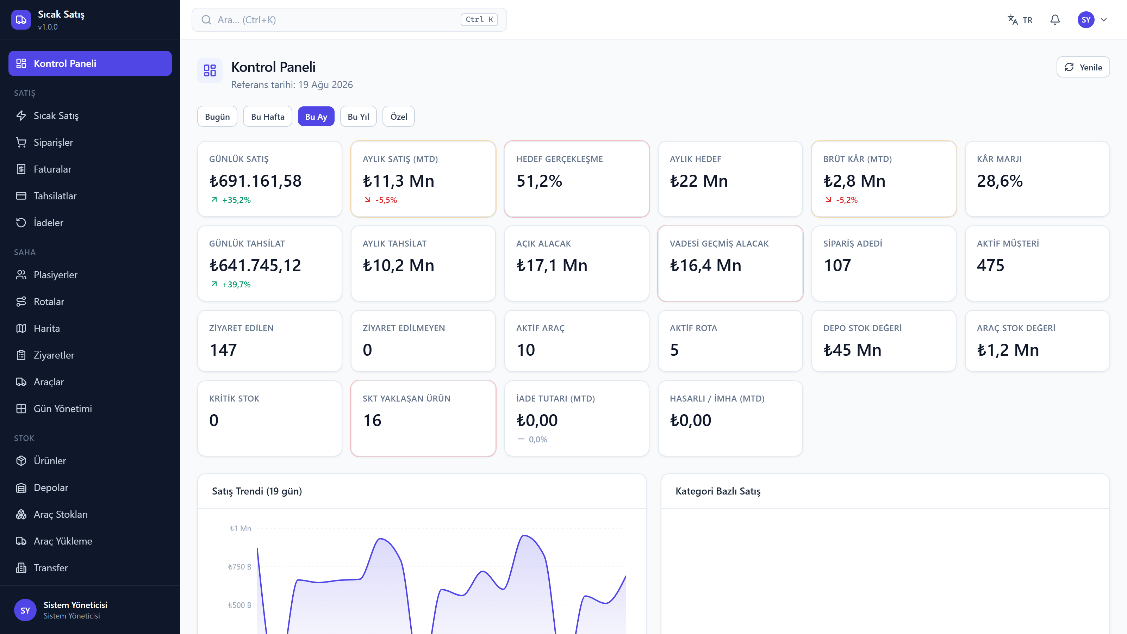
SMART VAN SALES MANAGEMENT SYSTEM
v1.0.0 06 / 33
The dashboard
20 KPIs and 7 live charts — panel and reports share one aggregation

Slide 7
01
Hot Sale
The screen a rep opens hundreds of times a day
v1.0.0 07 / 33

Slide 8
SMART VAN SALES MANAGEMENT SYSTEM
v1.0.0 08 / 33
Six taps at the customer's door
Built to be used one-handed, standing in a shop
1 · Pick the customer
2 · See the van stock
3 · Read the AI suggestion
Balance, credit limit, risk and recent purchases all on the same screen.
Only what is physically on the van; short-dated items carry a coloured warning badge.
From average consumption and days since the last purchase, the system estimates what has run out.
4 · Build the basket
5 · Take payment
6 · Complete the sale
Enter quantity and unit; campaigns apply themselves and free goods appear as their own line.
Cash, card, transfer, cheque or open account. A cheque does not reduce the balance until it clears.
Order, delivery, invoice, ledger entry and stock issue are created in one go.

Slide 9
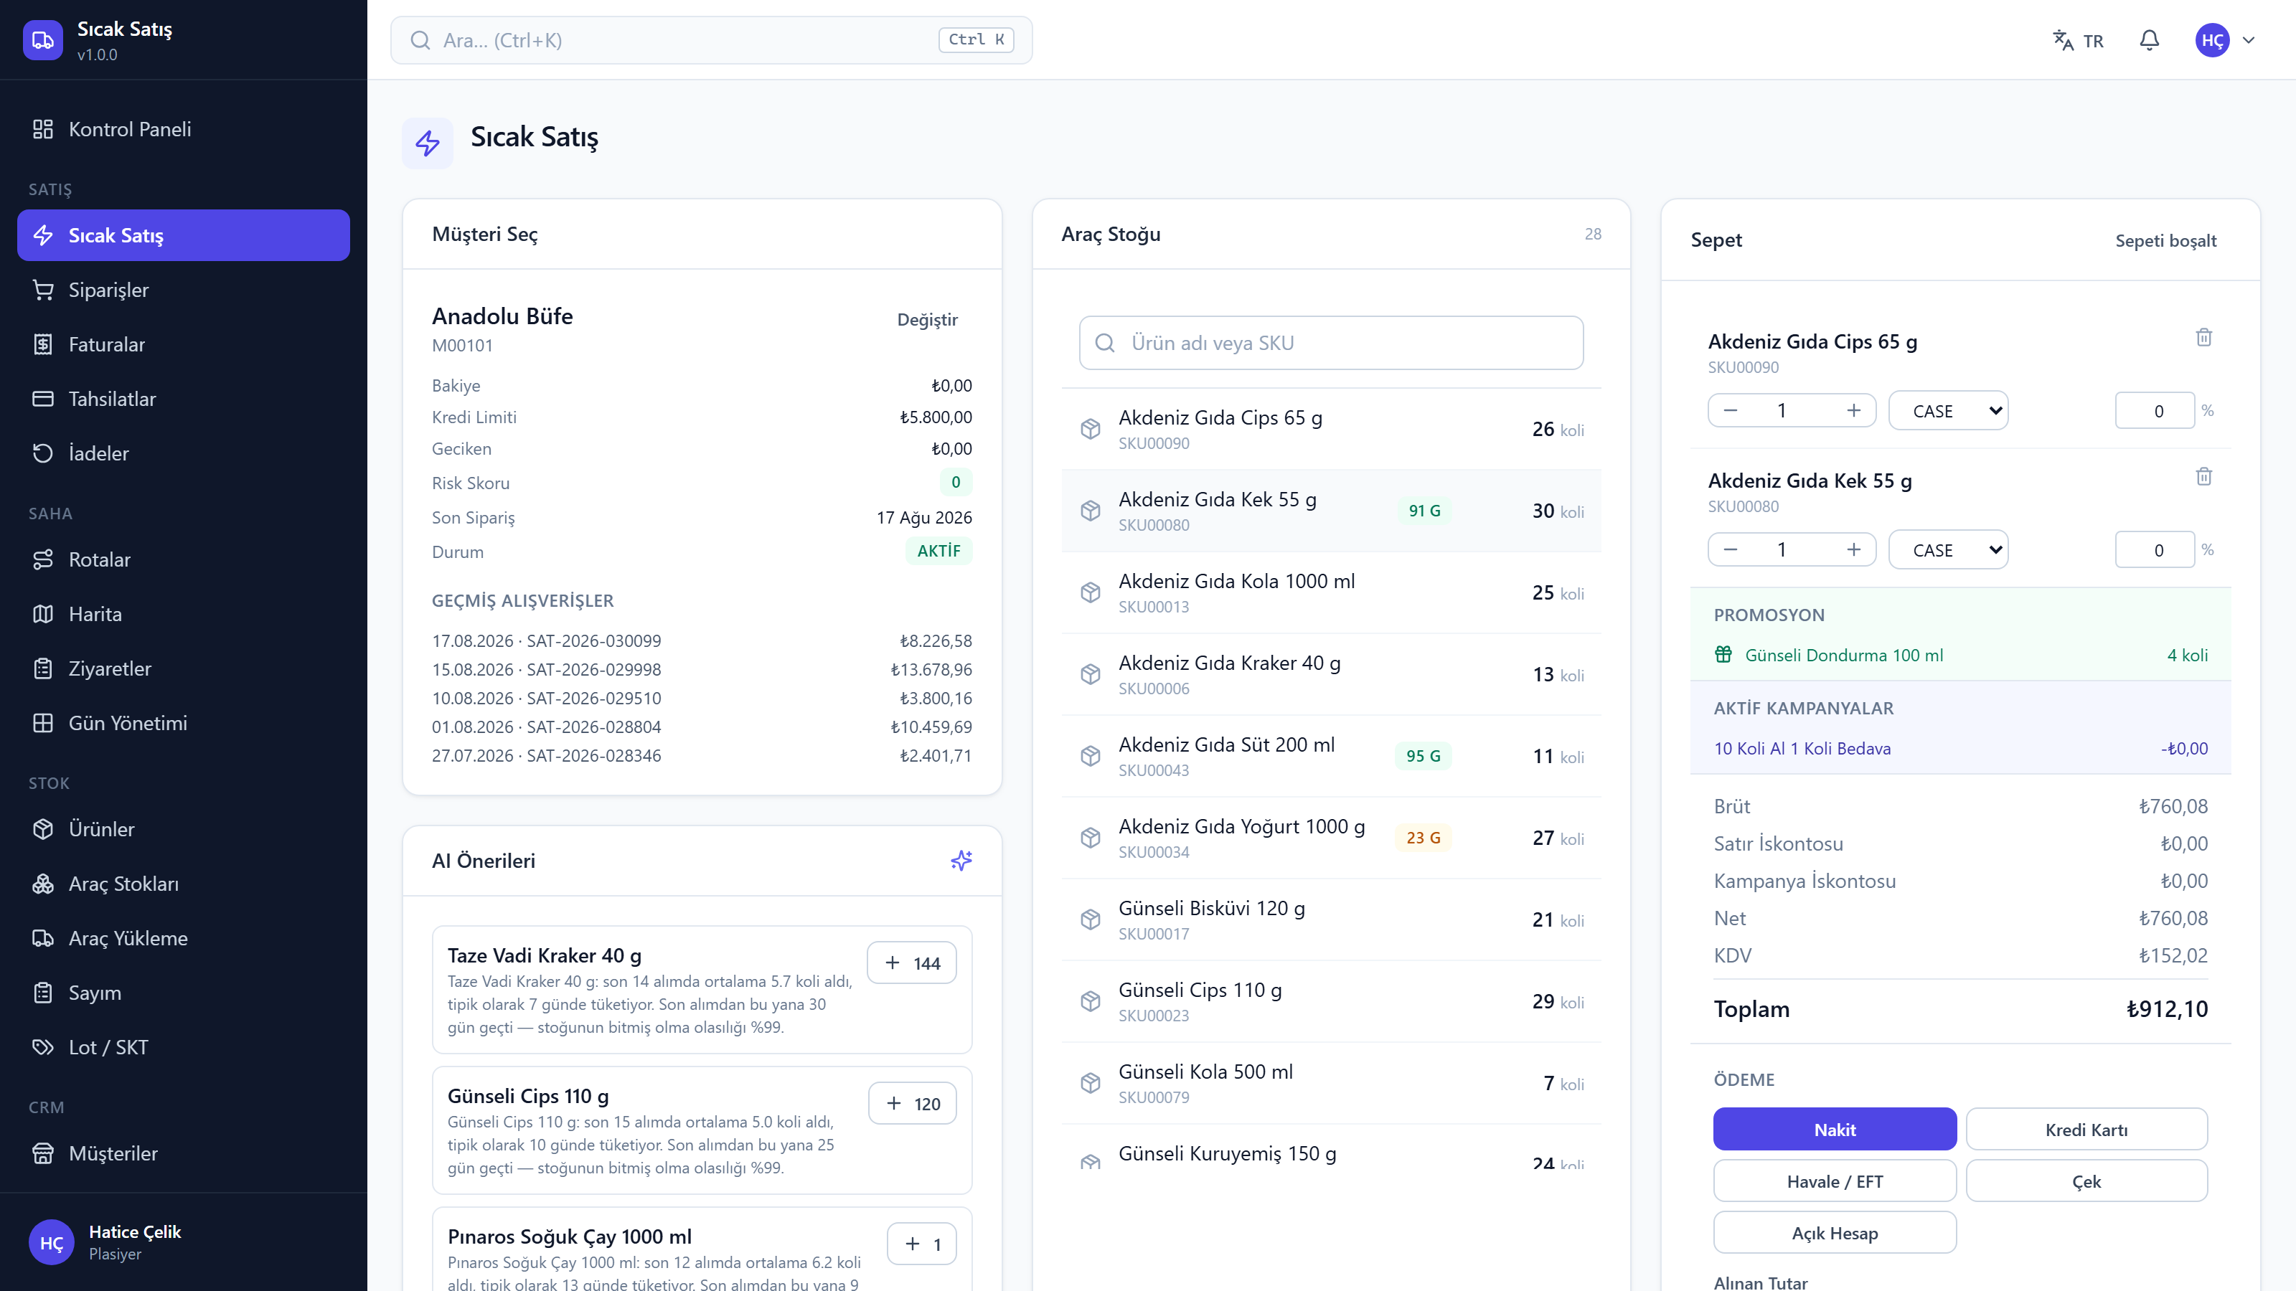
SMART VAN SALES MANAGEMENT SYSTEM
v1.0.0 09 / 33
HOT SALE
The salesperson's screen
· Picking a customer shows balance, credit limit, risk score and past orders
· The middle column is the van's real stock; short-dated items carry a badge
· Campaigns apply themselves — free goods appear as their own line
· Totals compute live: gross, line discount, campaign, VAT
· Payment method is chosen and the sale posts in one transaction

Slide 10
SMART VAN SALES MANAGEMENT SYSTEM
v1.0.0 10 / 33
DESIGN DECISION
All of it is written, or none of it.
order + delivery + invoice + ledger + payment = 1 transaction
Order → delivery → FEFO stock issue → invoice → ledger → payment is a single database transaction. If any step fails, none of it is written. There is no such thing as a half-finished sale.

Slide 11
SMART VAN SALES MANAGEMENT SYSTEM
v1.0.0 11 / 33
Working offline
Coverage is not guaranteed in the field — the system assumes that
Held on the device
Safe to resend
With no connection the basket waits on the device and the rep keeps selling.
Every basket carries a unique id. Submitting the same sale twice never creates a second record.
Reference data cached
Installable app
Product, customer and campaign lists open without a connection.
Installs to a phone or tablet as a PWA — no app store process required.

Slide 12
02
Stock
In food distribution, stock means dates
v1.0.0 12 / 33

Slide 13
SMART VAN SALES MANAGEMENT SYSTEM
v1.0.0 13 / 33
An immutable stock ledger
The structure that settles the day-end argument
Movements are never deleted
Balance derives from the ledger
Stock movements are only appended; a correction is itself a new movement. History cannot be rewritten.
A balance is kept for fast reads but can be rebuilt from the ledger at any moment.
FEFO by default
Batch traceability
The nearest-expiry batch leaves first. In food that is not a preference, it is a requirement.
Which batch went to which customer is recorded — a recall produces a list immediately.

Slide 14
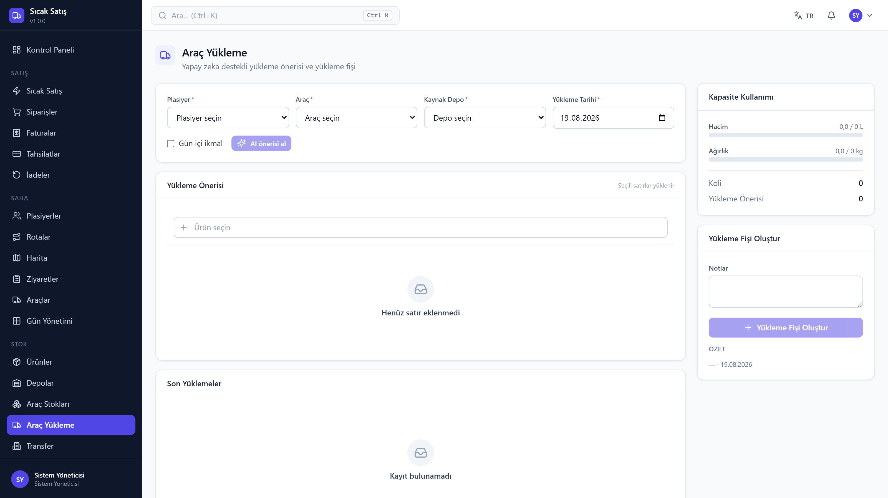
SMART VAN SALES MANAGEMENT SYSTEM
v1.0.0 14 / 33
VAN LOADING
AI-assisted loading
· Past consumption of the route's customers, weekday and season effects
· Stock already on the van is subtracted
· Volume and weight capacity cannot be exceeded
· Every line carries its own reason and confidence level
· The suggestion is editable — the rep has the last word

Slide 15
SMART VAN SALES MANAGEMENT SYSTEM
v1.0.0 15 / 33
DAY-END RECONCILIATION
The variance is computed, not debated.
theoretical = opening + loaded + reloaded − sold + returned − wastage
variance = theoretical − physical count
Every term comes from the movement ledger; there is no hand-maintained counter anywhere. A non-zero variance flags the session, writes an adjustment movement and notifies the manager.

Slide 16
SMART VAN SALES MANAGEMENT SYSTEM
v1.0.0 16 / 33
A van is a warehouse
We did not write a separate 'van stock' subsystem
Same rules
Created automatically
A van is a warehouse of type VEHICLE. FEFO, counting, transfers and valuation all work on it unchanged.
Saving a vehicle creates its warehouse; there is nothing extra to set up.
Capacity enforced
Why this way
Volume and weight are checked during loading and an overload is refused.
A second stock subsystem would be a copy of the same rules that drifts apart over time.

Slide 17
03
The Field
Routes, visits and position
v1.0.0 17 / 33

Slide 18
SMART VAN SALES MANAGEMENT SYSTEM
v1.0.0 18 / 33
Route optimisation
Capacity, time windows and service time solved together
Two-layer solver
The feature never disappears
Google OR-Tools when installed; otherwise the system's own Clarke-Wright + 2-opt solver takes over.
A missing 100 MB dependency does not disable routing — the fallback solver always works.
Real constraints
Plan vs actual
Vehicle volume and weight, customer opening hours, service time, working-day limit and priority customers.
Completed, skipped and delayed stops, plus the planned-versus-actual kilometre difference.

Slide 19
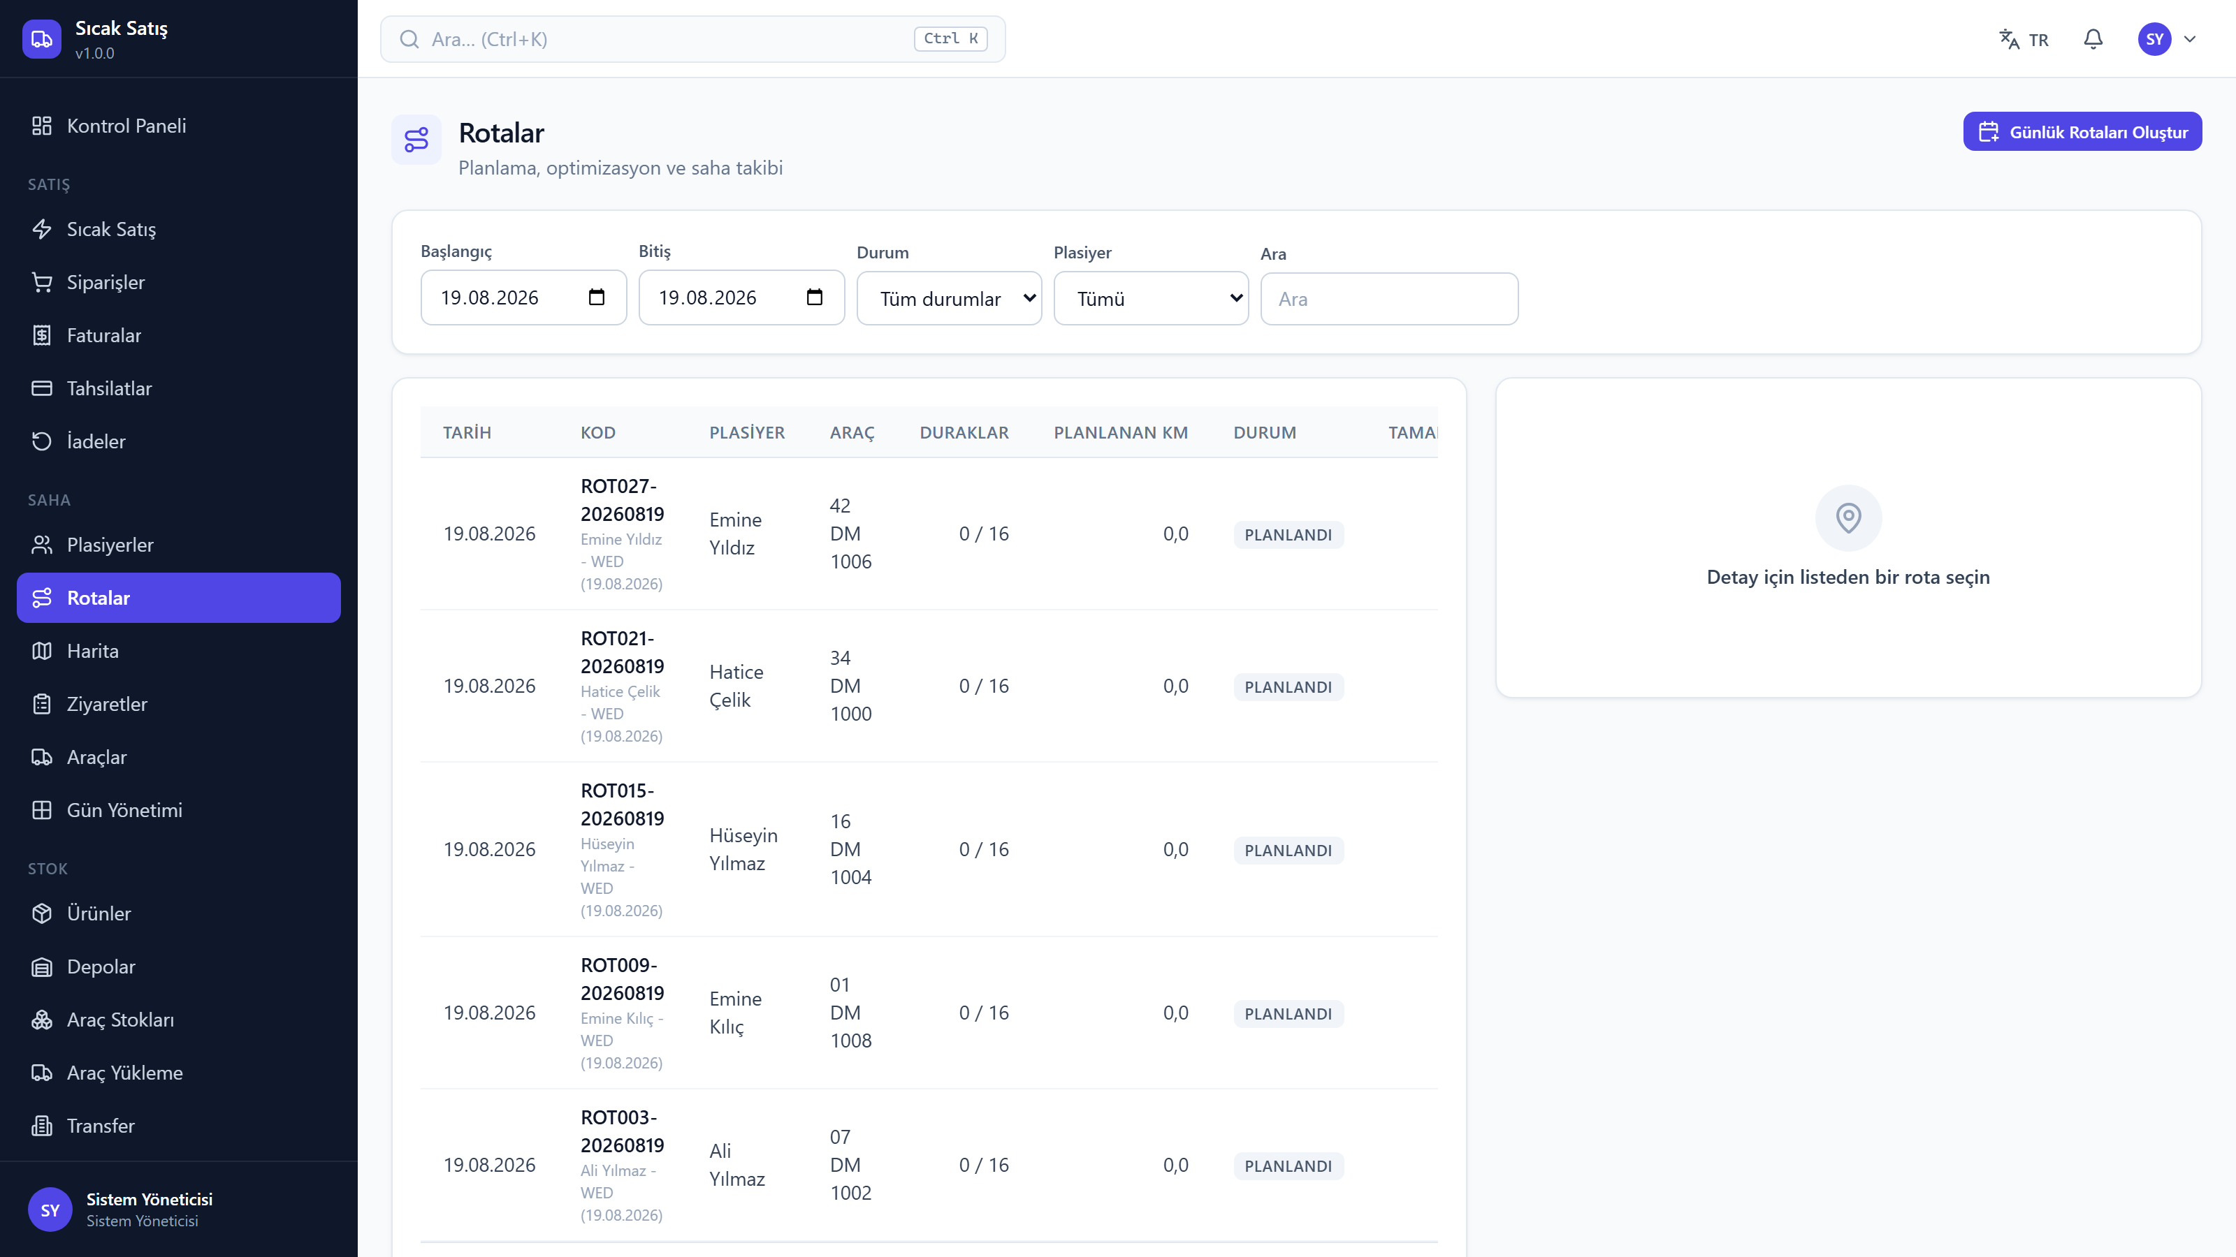
SMART VAN SALES MANAGEMENT SYSTEM
v1.0.0 19 / 33
THE FIELD
Routes and map
· Daily routes are generated from customers' visit days
· Optimisation solves capacity, time windows and service time together
· Which solver ran is stated on screen
· Planned versus actual kilometres are reported

Slide 20
04
Analytics
A forecast you cannot measure is a forecast you cannot trust
v1.0.0 20 / 33

Slide 21
SMART VAN SALES MANAGEMENT SYSTEM
v1.0.0 21 / 33
Demand forecasting
FMCG demand is intermittent — classical methods do badly on it
Classify first
Then choose
Is the series smooth, intermittent or lumpy? The method follows from the class; no single method is imposed.
Croston, SBA, TSB, Holt-Winters or a day-of-week seasonal naive — whichever suits this particular series.
Back-test the choice
Zeros count
Validated with MAE / MAPE / RMSE. The method used and its error are shown on screen.
The calendar is zero-filled; those zeros are what define intermittent demand in the first place.

Slide 22
SMART VAN SALES MANAGEMENT SYSTEM
v1.0.0 22 / 33
Dashboard and reports
Panel and report share one aggregation — they cannot disagree
20 KPIs
7 live charts
Daily and monthly sales, target achievement, gross margin, collections, open and overdue receivables, stock value, expiring soon.
Sales trend, category split, top products and salespeople, regional distribution, collections versus sales.
21 built-in reports
PDF · Excel · CSV
Sales, salesperson, customer, SKU, brand, region, route, collections, risk, stock, expiry, wastage, returns, campaigns, profitability, targets.
Written as UTF-8 with BOM so Turkish characters open correctly in Excel with no import step.

Slide 23
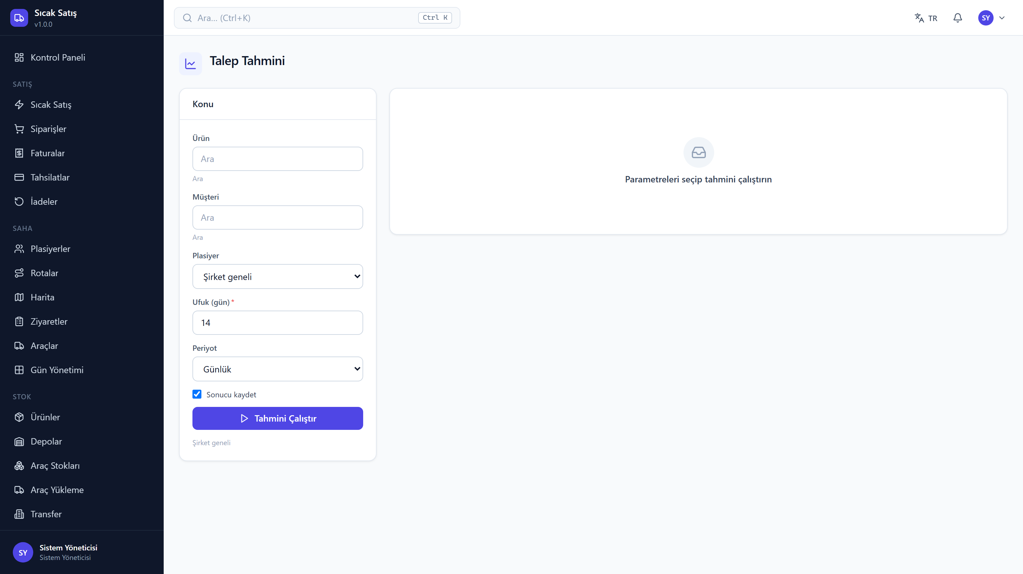
SMART VAN SALES MANAGEMENT SYSTEM
v1.0.0 23 / 33
ANALYTICS
Demand forecasting
· The series is classified first: smooth, intermittent or lumpy
· The method follows from the class — none is imposed
· The choice is validated by back-testing (MAE / MAPE / RMSE)
· Method used, error and confidence interval are shown on screen

Slide 24
05
Artificial Intelligence
Local-first, explainable, budgeted
v1.0.0 24 / 33

Slide 25
SMART VAN SALES MANAGEMENT SYSTEM
v1.0.0 25 / 33
Three providers, one interface
The router picks a model per task and fails over when one is down
LM Studio — local
NVIDIA NIM — cloud
Runs on your own machine, costs nothing and no data leaves the building. The default first choice.
Steps in when the local model is not enough; over 100 models selected by task type.
Claude — cloud
Budget protection
Configurable for long-context and harder reasoning work.
When the monthly limit is reached the paid providers stop while the local model keeps working.

Slide 26
SMART VAN SALES MANAGEMENT SYSTEM
v1.0.0 26 / 33
The AI Sales Manager
Plain-language question → read-only query → justified answer
Example questions
It shows its source
«Show the 10 best-selling reps today» · «Show customers with high collection risk» · «Which customers did we lose in the last 90 days?»
The data behind the answer is visible in an expandable panel — "where did that number come from" is answerable.
Read-only
Closed tables
A single SELECT may be executed. No data-modifying command is accepted.
User, session and audit tables are entirely off limits to AI queries.

Slide 27
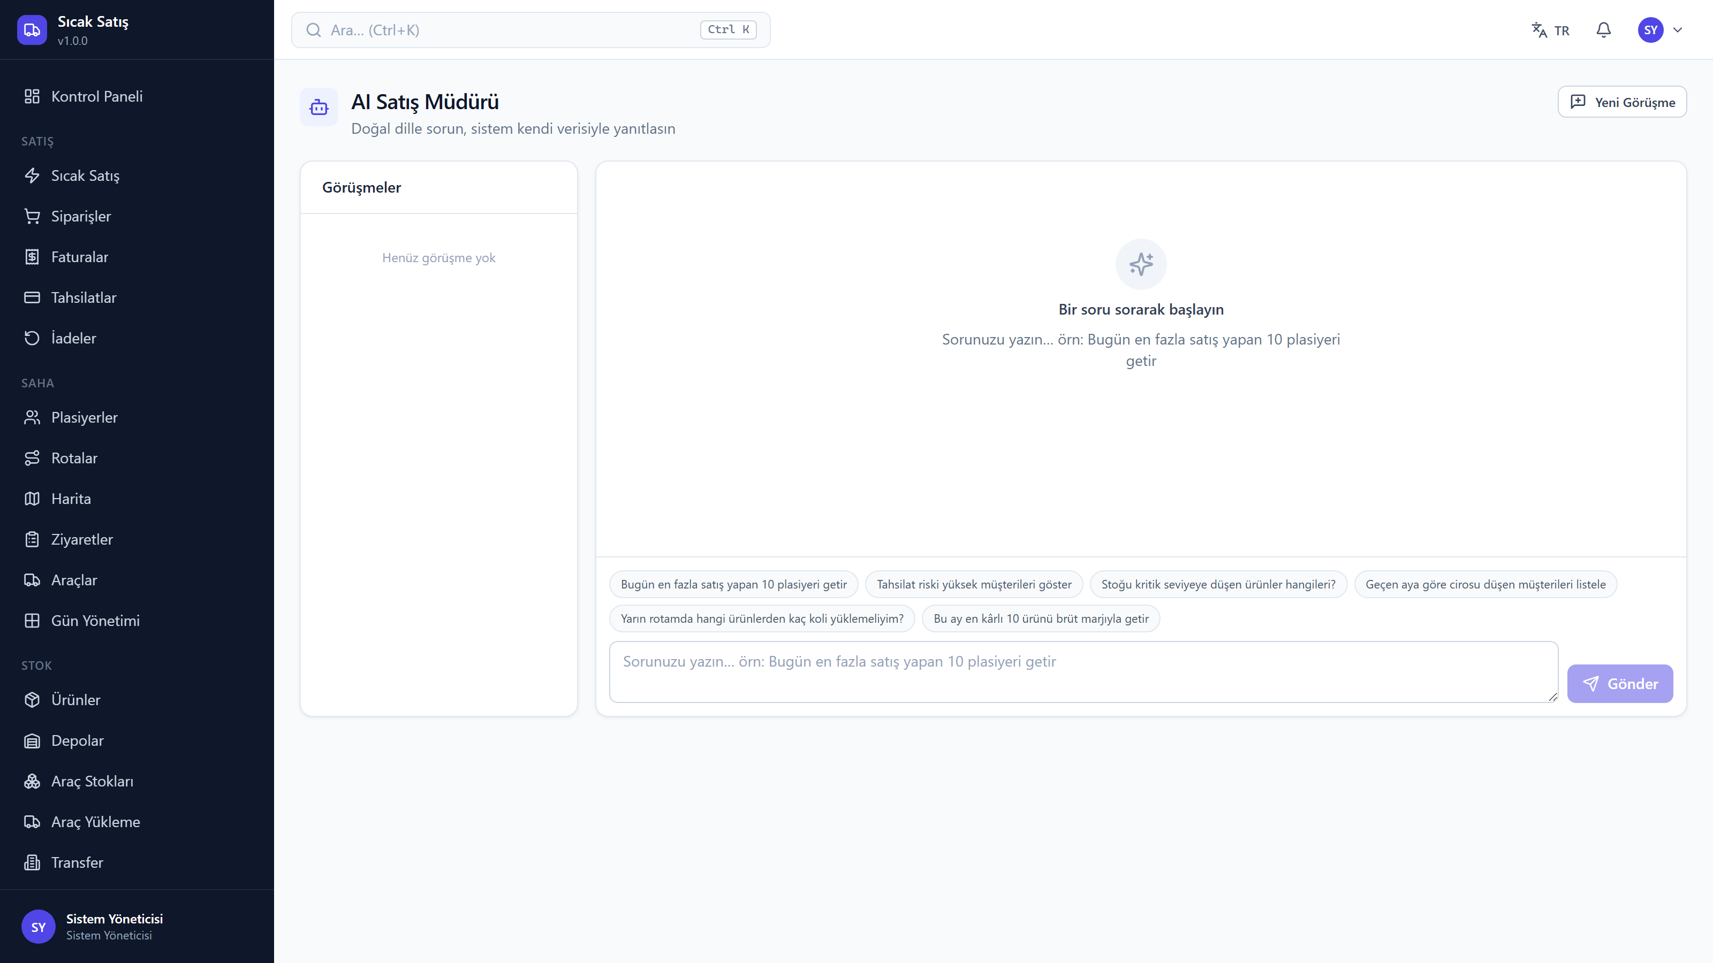
SMART VAN SALES MANAGEMENT SYSTEM
v1.0.0 27 / 33
ARTIFICIAL INTELLIGENCE
The AI Sales Manager
· A question is asked in plain language
· The system produces and runs a read-only query only
· The data behind the answer is visible in an expandable panel
· User, session and audit tables are off limits

Slide 28
SMART VAN SALES MANAGEMENT SYSTEM
v1.0.0 28 / 33
Security
Authorisation is checked separately at three layers
19 roles · 207 permissions
No privilege escalation
Screen, action and data scope are enforced separately. A rep sees only their own records.
Nobody can assign a role above their own or grant a permission they do not hold.
Chained audit log
Secrets stay secret
Each entry carries the previous one's digest. Alter a historical row and the chain breaks, reporting where.
API keys are never stored in the database, are stripped before logging and are masked on screen.

Slide 29
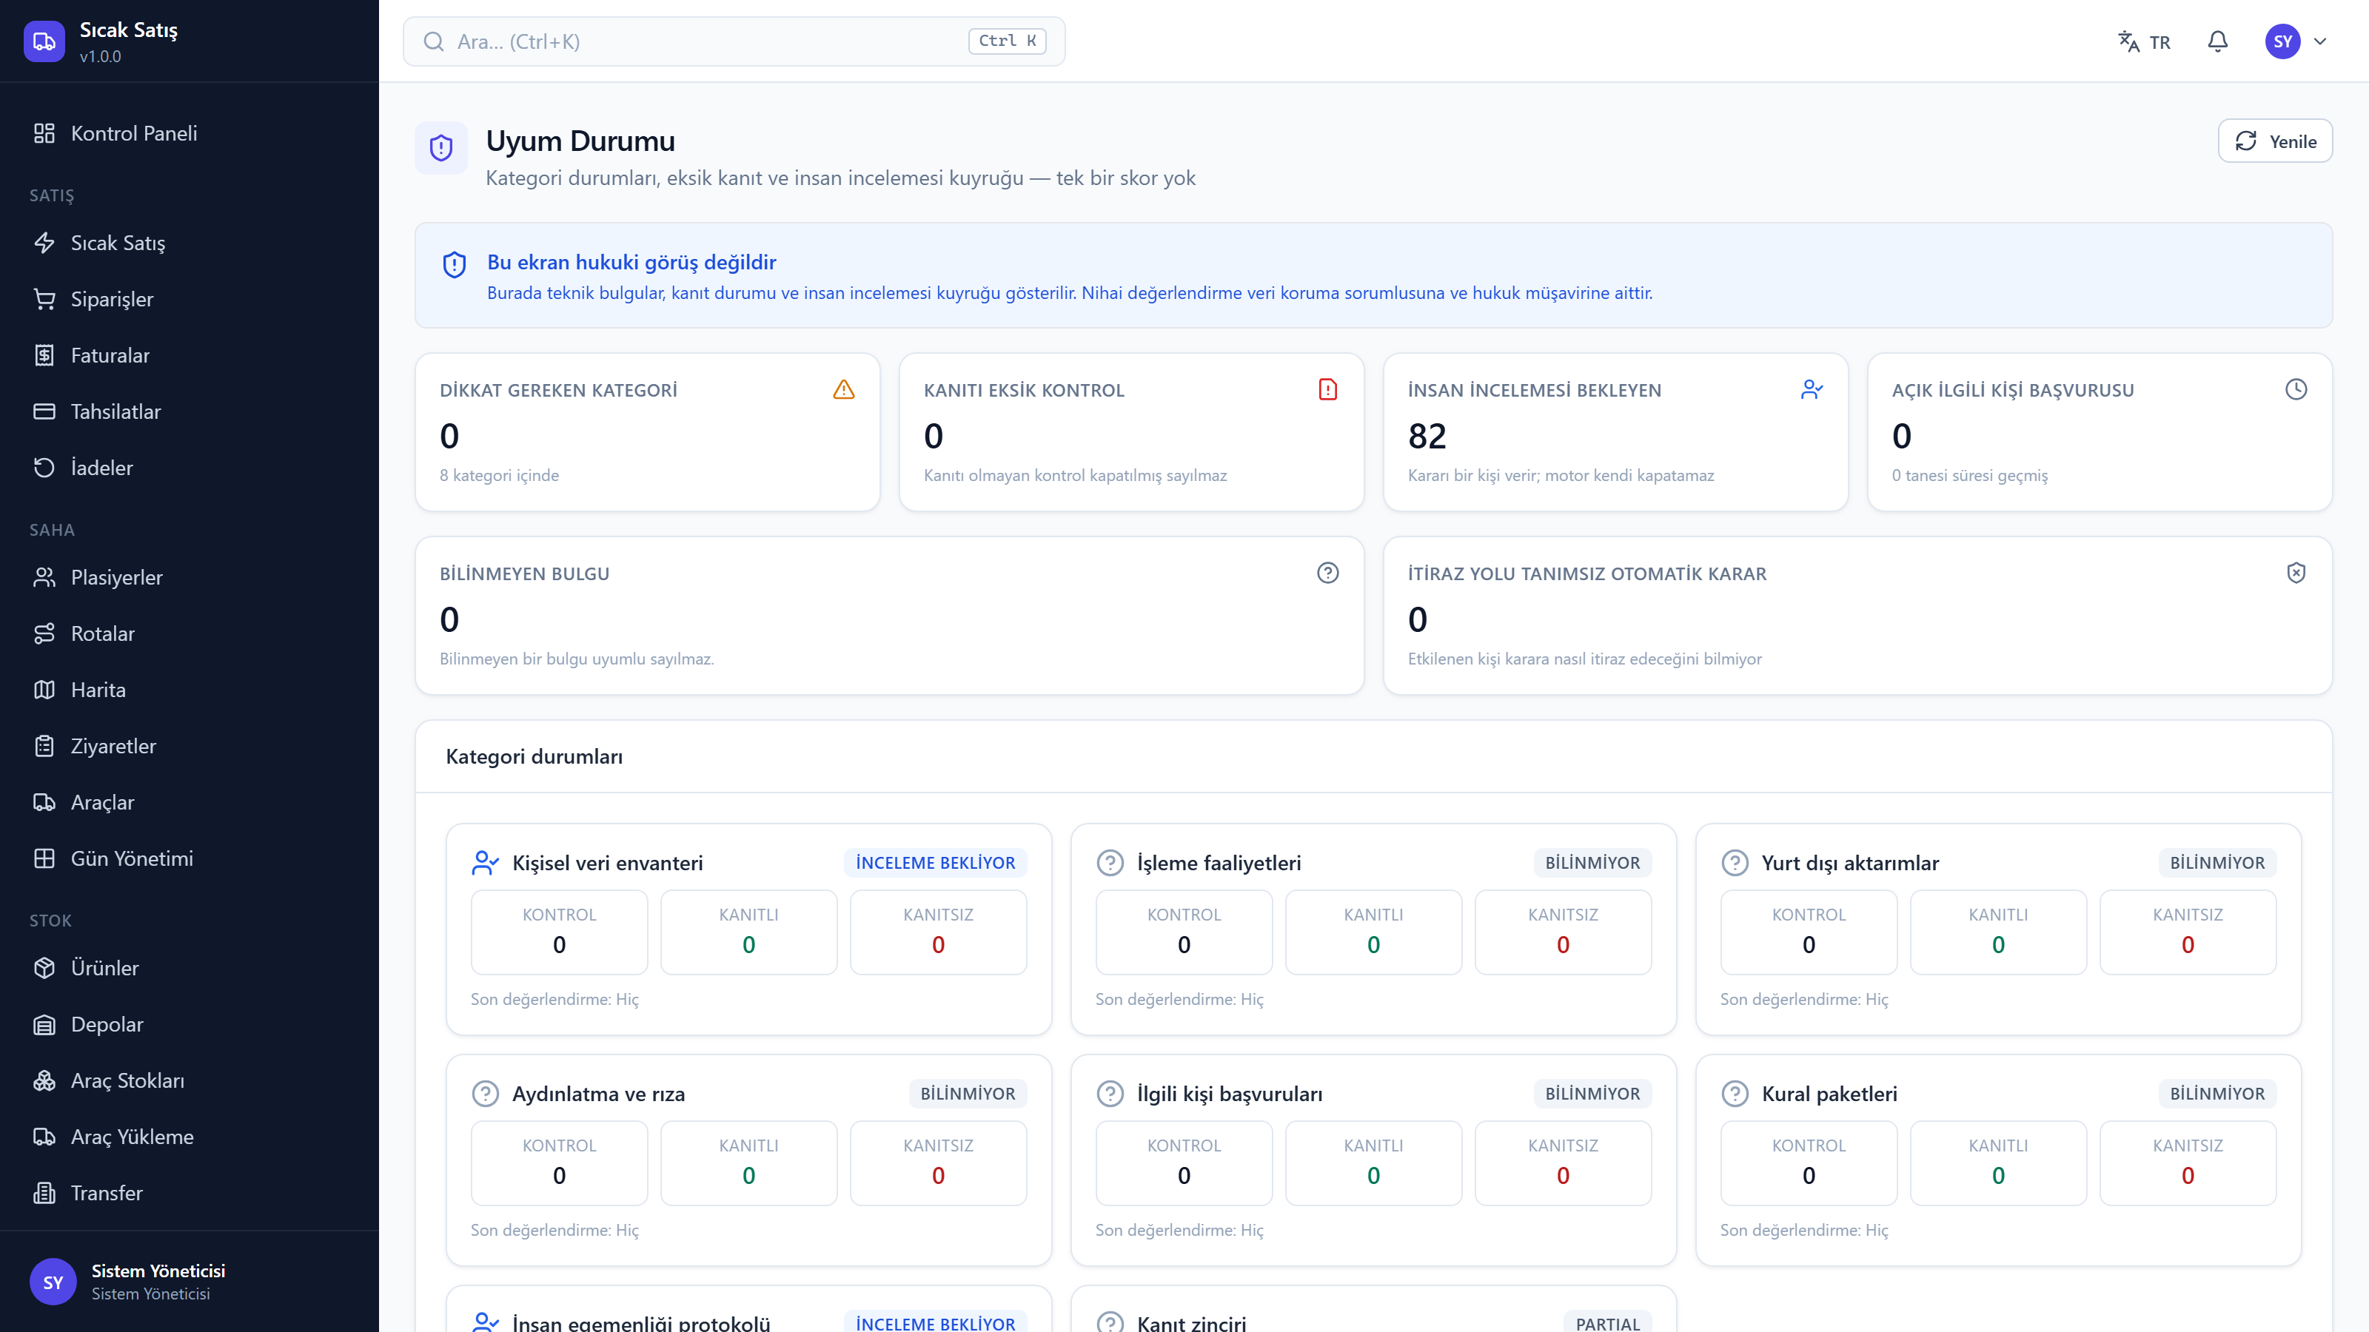
SMART VAN SALES MANAGEMENT SYSTEM
v1.0.0 29 / 33
COMPLIANCE
Compliance and human rights layer
· The personal-data inventory is measured from the code, not assumed
· Consent and notice are kept as separate records
· Missing evidence yields 'insufficient evidence', never 'compliant'
· Every decision put to the authority engine — refusals included — leaves a chained receipt and an appeal path

Slide 30
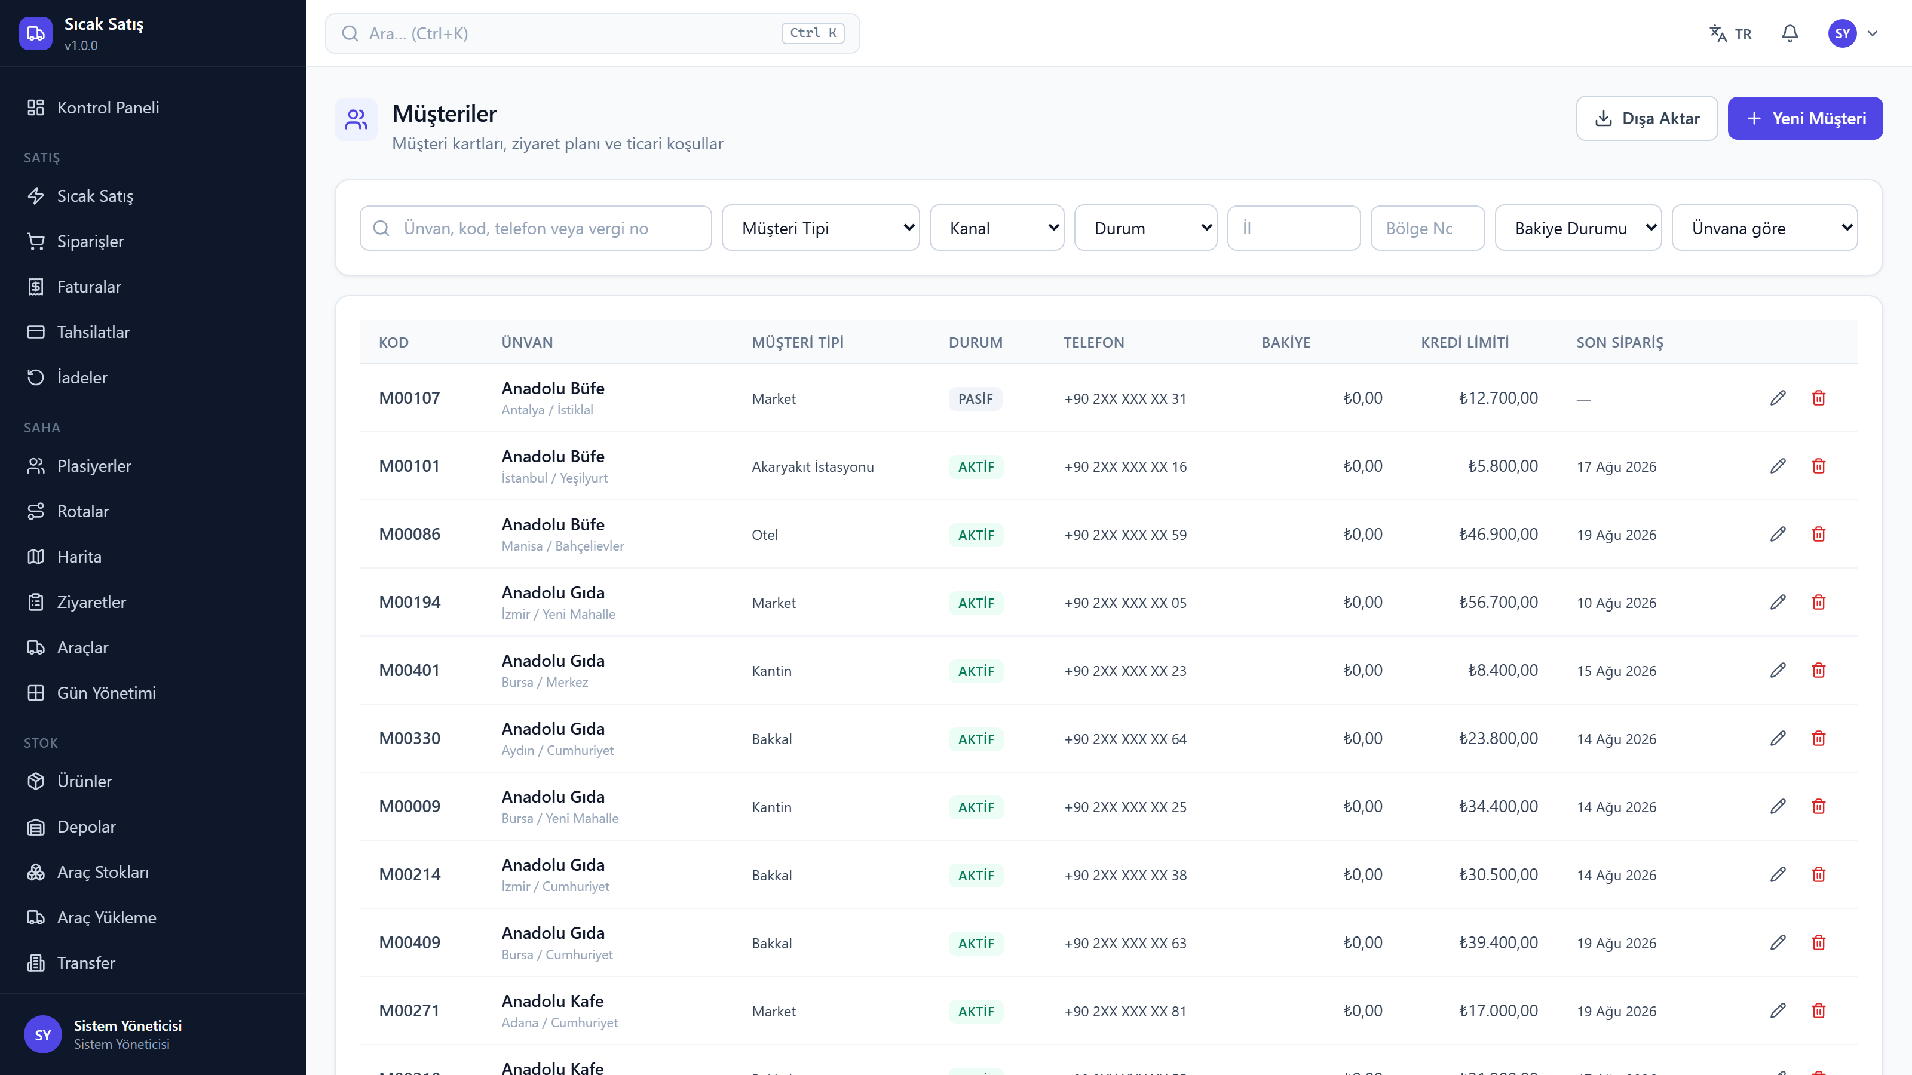
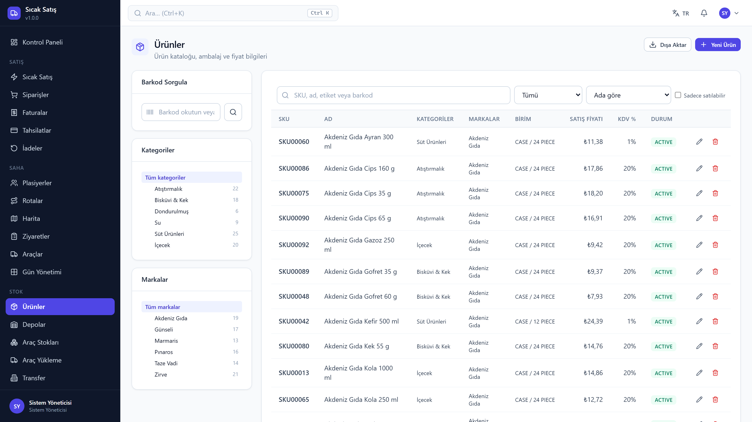
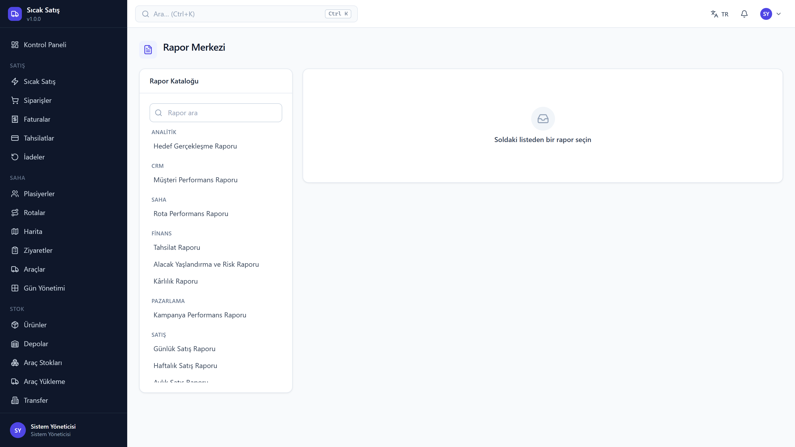
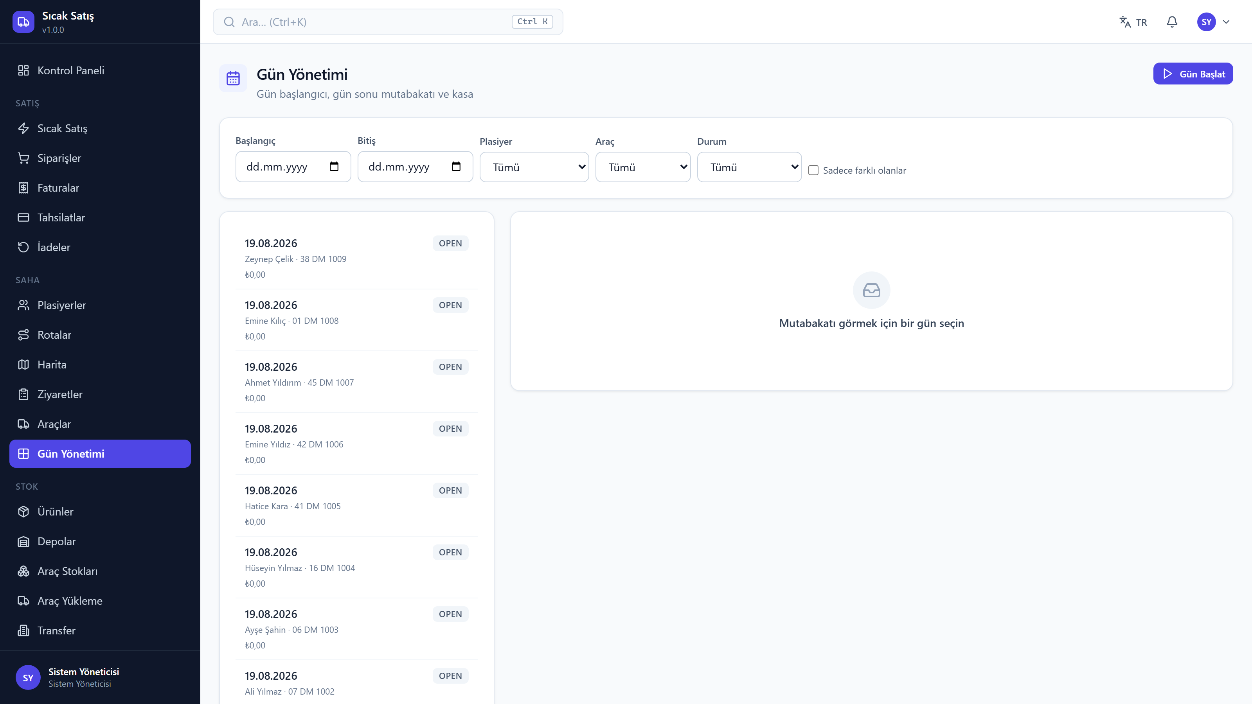
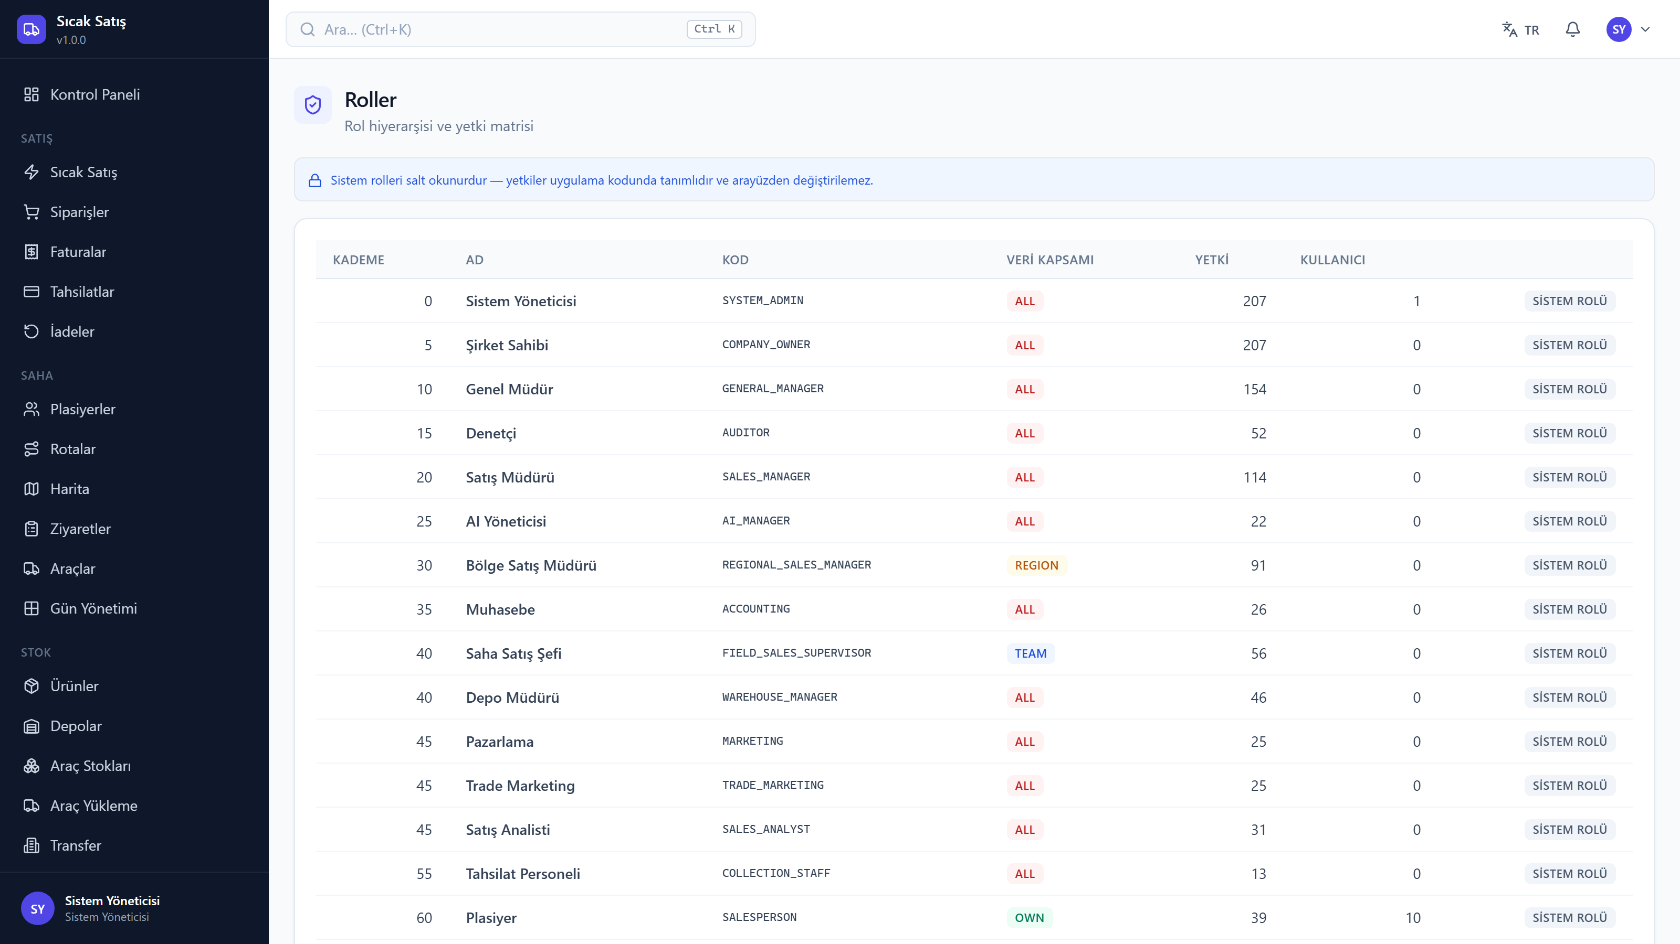
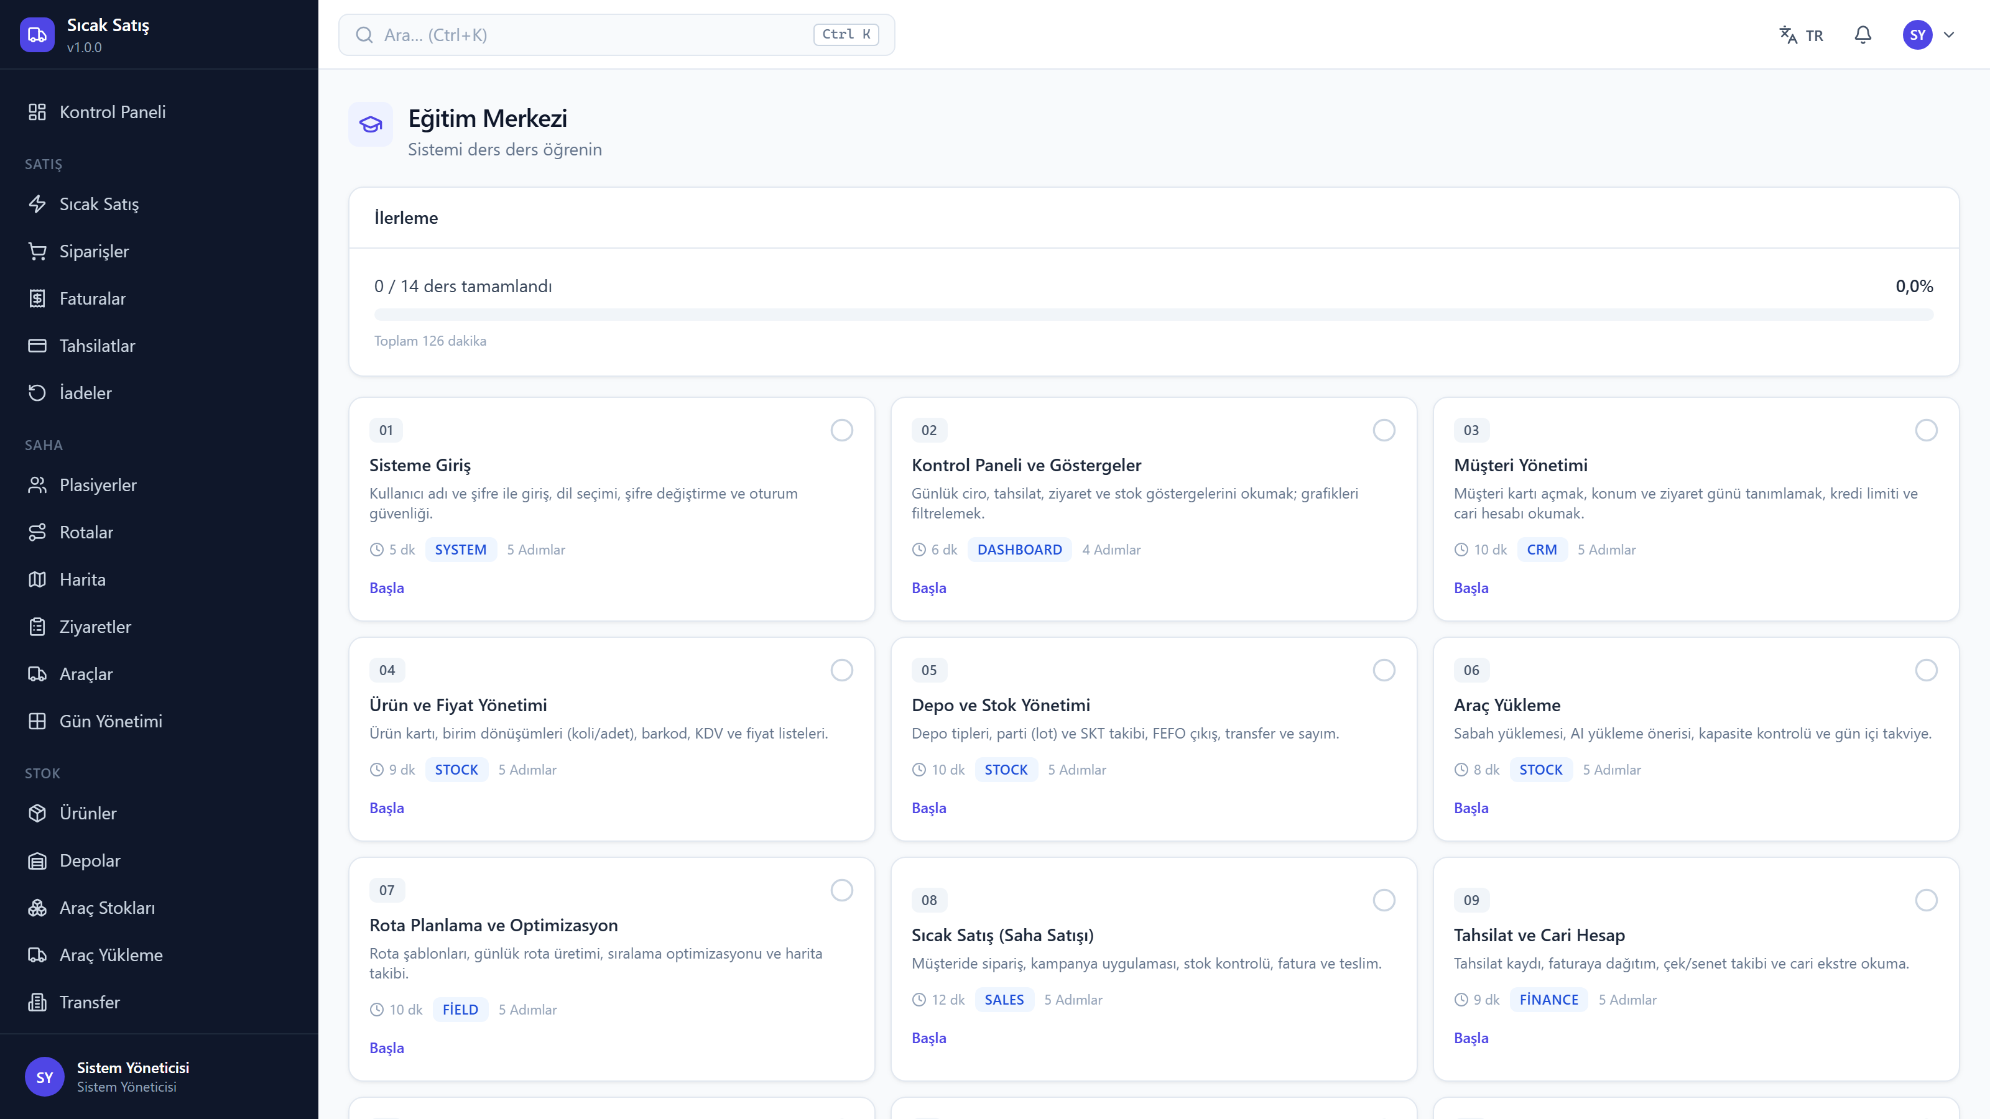
SMART VAN SALES MANAGEMENT SYSTEM
v1.0.0 30 / 33
Other screens
The system has 49 screens; six of them here
Customers
Products
Reports
Day sessions
Roles & permissions
Training centre

Slide 31
SMART VAN SALES MANAGEMENT SYSTEM
v1.0.0 31 / 33
Technology and setup
Nothing that was not already installed has been made mandatory
Technology
Setup
· Python 3.11 · FastAPI · SQLAlchemy 2.0
· React 18 · TypeScript · Vite · Tailwind
· SQLite by default — PostgreSQL optional
· PWA: offline capable, installable
· Redis and Docker are not required
· setup.ps1 — one-command install
· start.bat — one-click start
· Demo data: 500 customers, 12 months history
· 14-lesson in-app training centre
· TR / EN — instant language switch

Slide 32
SMART VAN SALES MANAGEMENT SYSTEM
v1.0.0 32 / 33
PLATFORMS & DOWNLOAD
Windows 10/11 (x64) & macOS (Apple Silicon)
Download: GitHub Releases (v1.0.0)
github.com/Azizsekerdil/smart-van-sales-management-system/releases
Two assets are published on GitHub Releases: a Windows zip and a macOS zip. The macOS package targets Apple Silicon (arm64) and is not notarized — on first launch, right-click → Open.

Slide 33
Smart Van Sales Management System
Every movement in the field recorded, every figure accounted for at day end
Install: setup.ps1
Start: start.bat
Guide: docs/USER_GUIDE_EN.md
This deck is generated from the product's own version
v1.0.0

