Slide 1
Wine House
Smart Wine Restaurant Management System
Runs locally · offline-resilient · role-based
Version 0.1.0 · Introduction · 2026
Wine House · Aziz Şekerdil · 2026
1

Slide 2
At a glance
Measured, tested, working software
16
Django apps
129
database tables
19
user roles
13
built-in reports
380
automated tests · all passing
73%
line coverage (all code)
0
known runtime vulnerabilities
29
runtime dependencies
Wine House · Aziz Şekerdil · 2026
2

Slide 3
Why is a wine restaurant different?
What generic POS software cannot solve
Wine sells in two units — bottle and glass — but stock is held in one.
An opened bottle starts to deteriorate; when it was opened and how it is preserved matters.
The gap between expected and actual glasses per bottle is direct lost profit.
Wine has a drink window; a bottle not sold in time loses value.
A few degrees of cellar temperature drift can damage thousands in inventory.
A sommelier's recommendation must be limited to what is actually in stock.
Wine House · Aziz Şekerdil · 2026
3

Slide 4
What does Wine House do?
One application, one database
Floor operations — table map, reservations, orders, kitchen display, payment, day close
Digital wine cellar — identity, layout, lot tracking, by-the-glass service, yield analysis
Menu and costing — recipes, portion cost, allergens, dynamic pricing
Inventory and purchasing — FIFO/FEFO, expiry, waste, suppliers, quotation comparison
Customers and staff — GDPR-compliant CRM, loyalty, shifts, performance
Reporting — 13 reports, PDF / Excel / CSV
Artificial intelligence — sommelier assistant, provider-agnostic, privacy-preserving
Wine House · Aziz Şekerdil · 2026
4

Slide 5
Design principles
Every decision has a rationale
Principle
What it means
Local-first
The restaurant keeps working when the internet drops
AI is optional
All core functions work fully with AI disabled
Financial records are frozen
Changing a menu price never alters a past bill
Trace instead of delete
Corrections use reversing entries; the audit trail survives
Safe by default
Dangerous features ship switched off
Least privilege
Each user sees only their own job
Wine House · Aziz Şekerdil · 2026
5

Slide 6
6 / 57
Floor Operations
From table to till
Wine House · Aziz Şekerdil · 2026
6

Slide 7
Table map
The whole floor at a glance
Section-based layout: main room, terrace, bar, cellar room
Eight table states coded by colour and text — readable in low light
Open order number and current total shown on the table
Click a table to jump straight to its order
44-pixel touch targets for POS terminals
Wine House · Aziz Şekerdil · 2026
7

Slide 8
Reservation conflict detection
The same table cannot be double-booked
1
Create reservation
2
Assign table
3
Do the time windows overlap?
4
Is capacity sufficient?
On conflict the system refuses the assignment and names the clashing reservation.
5
Accept or reject
Wine House · Aziz Şekerdil · 2026
8

Slide 9
Orders: why freeze the price?
The foundation of financial accuracy
If it were not frozen
In Wine House
· The menu price changes today
· Price, tax, cost and item name are copied at line creation
· Yesterday's bill total changes too
· Later menu changes never touch a past bill
· Accounts no longer reconcile with the till
· A report run a year later returns the same result
· A historical report returns different numbers each run
· Day-close totals are frozen a second time
Wine House · Aziz Şekerdil · 2026
9

Slide 10
Kitchen order tickets and displays
KOT generation and KDS flow
Sending an order produces one ticket per station
Food to the kitchen, drinks to the bar, wine to the sommelier — automatically
Ticket colour follows elapsed time: grey → amber → red (overdue)
Allergen warnings appear as a red line on the ticket
Ticket flow: Queued → Preparing → Ready → Served
A sent line is never sent twice
Wine House · Aziz Şekerdil · 2026
10

Slide 11
Bill splitting and payment
Seat-based splitting, multi-method payment
Automatic split by seat number — each seat becomes its own order
Order merging: when two tables join, so do their bills
Cash, card, meal card, transfer, voucher, loyalty points
Partial payments supported; the outstanding balance is always visible
Card commission is calculated automatically and reported net
Sandbox mode: no real money moves in this release
Wine House · Aziz Şekerdil · 2026
11

Slide 12
Day close and cash reconciliation
Closed once, then frozen
The day cannot close while orders are open — no missing bill slips through
Expected cash is compared with counted cash and the variance shown
Payment-method breakdown, voids and refunds are computed
All totals are frozen into a daily snapshot
Reports read from that snapshot — history never shifts
Wine House · Aziz Şekerdil · 2026
12

Slide 13
13 / 57
Digital Wine Cellar
The distinguishing core
Wine House · Aziz Şekerdil · 2026
13

Slide 14
Wine identity
Everything a sommelier wants to know
Producer, vineyard, country → region → appellation hierarchy
Grape composition with percentages — 60% Öküzgözü, 40% Boğazkere
Vintage, alcohol, bottle size, sulphite and vegan information
Tasting profile: body · acidity · tannin · sweetness (0–5 scale)
Aroma notes, serving temperature, decanting time, glass type
Drink window: from · peak · until
Barcode, internal QR code, label photograph
Wine House · Aziz Şekerdil · 2026
14

Slide 15
Cellar layout and storage conditions
The physical reality of inventory
Hierarchical layout: cellar → cabinet → rack → bin → display
Target temperature, humidity and tolerance per location
Readings are recorded; out-of-range drift raises an alert
Occupancy rate and bottles stored are shown live
Private-cellar clients' bottles are kept separate and excluded from house valuation
Wine House · Aziz Şekerdil · 2026
15

Slide 16
Lot tracking and FEFO
Which bottle should leave first?
Every purchase lot is tracked separately: receipt date, unit cost, supplier, location
FEFO — the lot that must be consumed first is opened first
Lot-level cost is the basis of accurate profitability
Invoice reference and supplier linkage are preserved
Remaining bottles can never exceed received bottles (database constraint)
Wine House · Aziz Şekerdil · 2026
16

Slide 17
How a glass leaves stock
The system's finest business rule
1
Pour a glass (150 ml)
2
Is there an open bottle with enough volume?
3
If not: pick lot by FEFO → deduct 1 bottle from stock
4
Reduce the open bottle by 150 ml
When less than half a glass remains, the bottle is marked finished automatically. Two waiters cannot open the last bottle simultaneously — row locking prevents it.
5
Write the pour record (sale / tasting / comp / spillage)
Wine House · Aziz Şekerdil · 2026
17

Slide 18
Yield analysis
750 ml bottle · 150 ml pour · 5 glasses in theory
5
expected glasses
4
actual glasses
600 ml
served
80%
realised yield
150 ml
lost
1 glass
missed revenue · per bottle
The gap between theoretical and actual points to spillage or over-pouring. The glass-vs-bottle report shows this bottle by bottle.
Wine House · Aziz Şekerdil · 2026
18

Slide 19
Open bottles and fault tracking
Where is the loss occurring?
Freshness window by method: standard 48 h · preservation 1 week · needle system 30 days
Bottles past their window are flagged on screen
Fault records: cork taint (TCA), oxidation, reduction, heat damage, spillage, breakage
Each fault deducts stock and computes the estimated loss
Resolution is tracked: supplier claim · written off · replaced for the guest
Wine House · Aziz Şekerdil · 2026
19

Slide 20
Drink window and cellar valuation
Inventory is an asset that changes over time
Each wine gets a status: too young · ready · at peak · drink soon · past peak
Bottles approaching the end of their window move to a priority list
Cellar valuation: cost value, retail value, potential margin
Remaining volume in open bottles counts towards valuation
Wines below their minimum bottle count raise a critical-stock alert
Wine House · Aziz Şekerdil · 2026
20

Slide 21
Duplicate and anomaly detection
Data quality does not maintain itself
The same barcode used on two different records
Same producer + very similar name + same vintage (fuzzy match)
Implausible vintage — a future year or more than 120 years old
Price anomaly — selling price below purchase price
The system never deletes or merges anything on its own — it only raises a review flag
Wine House · Aziz Şekerdil · 2026
21

Slide 22
22 / 57
Menu, Inventory and Costing
The arithmetic of profit
Wine House · Aziz Şekerdil · 2026
22

Slide 23
Recipes and portion costing
The real cost of every plate
Recipe lines link to stock items
Portion cost is derived from the weighted average unit cost of stock
A waste allowance percentage is added to the cost
Gross margin, margin percentage and food-cost ratio are automatic
Allergen and dietary tags (vegetarian, vegan, gluten-free) attach to items
Dynamic pricing: happy hour, campaigns, windows that cross midnight
Wine House · Aziz Şekerdil · 2026
23

Slide 24
Menu engineering
What stays, what changes?
Quadrant
Popularity
Margin
Action
Star
High
High
Protect and promote
Plowhorse
High
Low
Reduce cost or revisit price
Puzzle
Low
High
Promote; add to sommelier picks
Dog
Low
Low
Consider removing from the menu
Kasavana-Smith method · computed automatically from sales data
Wine House · Aziz Şekerdil · 2026
24

Slide 25
Inventory, purchasing and waste
Full traceability from receipt to issue
FIFO or FEFO — chosen per item
Alerts for lots approaching their expiry date
Goods receipt: partial rejection, cold-chain check, automatic lot creation
Stock counts: system versus counted, variance posted as a movement
Waste records with 11 reasons: spoilage, expiry, breakage, spillage, staff meals…
Reorder suggestions from minimum levels — the system suggests, never orders
Quotation comparison: cheapest and fastest flagged separately
Wine House · Aziz Şekerdil · 2026
25

Slide 26
Stock movements are immutable
The balance is always verifiable
Every receipt and issue creates its own movement record
Once written it cannot be updated or deleted — enforced in code
Corrections are made with a reversing movement
Stock balance can always be reconciled against the sum of movements
The same immutability applies to loyalty points and the audit log
Wine House · Aziz Şekerdil · 2026
26

Slide 27
27 / 57
Customers, Staff and Reports
Wine House · Aziz Şekerdil · 2026
27

Slide 28
GDPR-compliant customer management
Data protection is not an afterthought
Phone, email and identity data are stored encrypted
Search over encrypted fields uses an irreversible HMAC digest
Separate consent per purpose: service, email, SMS, profiling, AI processing
Withdrawing consent does not delete the record — a withdrawal timestamp is written for proof
Data portability: a customer's entire record exports in one click
Right to erasure: personal data is anonymised, financial records retained by law
Birth year is not stored — only day and month (data minimisation)
Wine House · Aziz Şekerdil · 2026
28

Slide 29
13 reports · 3 formats
With guaranteed Turkish character rendering
Sales: daily summary · products and categories · payment mix · forecast
Wine: profitability · glass vs bottle · cellar valuation
Inventory: waste analysis · stock valuation
Operations: table turnover · staff performance · menu engineering
AI: cost and token usage
PDF · Excel · CSV — ç ğ ı İ ö ş ü render correctly in all three
Wine House · Aziz Şekerdil · 2026
29

Slide 30
How Turkish characters are guaranteed
Where most systems break silently
Format
The problem
Wine House solution
CSV
Excel opens the file with the wrong encoding
Written with a UTF-8 BOM; survives a double-click
Excel
Numbers written as text
Numbers stay numeric; locale-aware number and date formats
PDF
Built-in fonts do not cover Turkish
A system TrueType font is located and embedded
PDF (no font)
Silently corrupt output
An explicit error is raised — no broken PDF is produced
Wine House · Aziz Şekerdil · 2026
30

Slide 31
31 / 57
Artificial Intelligence
An assistant, not an authority
Wine House · Aziz Şekerdil · 2026
31

Slide 32
Provider-agnostic architecture
Never locked to a single vendor
LM Studio (local) · Anthropic Claude · NVIDIA · Mock (offline testing)
Model names are never hard-coded — always read live from the provider
Task-aware model selection: chat, coding, vision, analytical, embedding
Timeouts, retries, exponential backoff, request cancellation
Fallback chain: if one provider fails, the next is tried
Mock always sits last — the AI flow never brings the app down
Wine House · Aziz Şekerdil · 2026
32

Slide 33
Privacy: what reaches the cloud?
The user always sees it
Default behaviour
If a cloud call is needed
· The default provider is local LM Studio
· Email, phone, national ID, IBAN, card number are masked
· Customer data never leaves the premises
· API keys are never transmitted under any circumstance
· `Local only` mode disables the cloud entirely
· The user sees exactly what was sent on screen
· Exceeding the monthly cost cap blocks cloud calls
· A summary reports how many items of each type were masked
Wine House · Aziz Şekerdil · 2026
33

Slide 34
AI cannot write to the database
A hard boundary
Every suggestion is persisted as a record and awaits human approval
No price, stock, menu item or pairing changes without that approval
Sommelier suggestions are drawn only from wines currently in stock
The system prompt explicitly forbids health claims and medical advice
The 18+ limit and responsible consumption appear on every suggestion screen
Every call is logged: provider, model, tokens, cost, latency, outcome
Wine House · Aziz Şekerdil · 2026
34

Slide 35
35 / 57
Security and Quality
Wine House · Aziz Şekerdil · 2026
35

Slide 36
19 roles · least privilege
Everyone sees only their own job
Role
Permissions
Cannot do
Waiter
18
Cellar management · user creation · day close
Sommelier
41
Day close · taking payment · staff management
Cashier
12
Menu changes · stock adjustments
Auditor
101
No write operations at all
System administrator
519
—
Wine House · Aziz Şekerdil · 2026
36

Slide 37
Second approval and audit log
Separation of duties
Critical operations need approval: voids, refunds, over-limit discounts, comps, stock adjustments, restores
A user cannot approve their own request
Without approval the operation is not applied — a request is raised and the process stops
The audit log is immutable and undeletable — enforced in code
Permission denials are logged too; unauthorised attempts are traceable
Records past their retention period are archived before removal
Wine House · Aziz Şekerdil · 2026
37

Slide 38
Backup and restore
A backup is not a backup until a restore is proven
Encrypted ZIP archive + SHA-256 integrity digest
Every backup is verified automatically after creation
Restores require second approval
An automatic safety backup is taken before writing to the live database
The default target is the test database — drills are possible
The retention policy always keeps at least three backups
Daily automated backup via Windows Task Scheduler
Wine House · Aziz Şekerdil · 2026
38

Slide 39
Quality indicators
Measured and reported
380
tests · all passing
73%
line coverage (all code)
0
known runtime dependency vulnerabilities
0
high/medium static-analysis findings
0
secret-scan findings
23
database migrations
All figures are measured from the repository at release time: pytest, coverage, pip-audit/osv-scanner (runtime dependencies), bandit and semgrep (medium+), gitleaks. Details: PUBLIC_RELEASE_MANIFEST.json
Wine House · Aziz Şekerdil · 2026
39

Slide 40
Technical profile
Layer
Choice
Language / framework
Python 3.11+ · Django 5.2 · Django REST Framework
Database
SQLite (WAL) · optional PostgreSQL
Interface
Bootstrap 5.3 + HTMX — bundled locally, no CDN
Encryption
Fernet (AES-128-CBC + HMAC-SHA256)
Reporting
ReportLab (PDF) · openpyxl (Excel)
Artificial intelligence
Custom httpx-based adapter layer
Installation
A single PowerShell script · double-clickable .bat files
Wine House · Aziz Şekerdil · 2026
40

Slide 41
An honest status report
No unfinished feature is presented as finished
Ready and working
Experimental or planned
· Floor operations · KDS · payment · day close
· Live payment and e-invoicing (adapter only)
· Wine cellar · by-the-glass service · yield analysis
· Thermal printer driver
· Inventory · purchasing · waste · stock counts
· Bulk email/SMS dispatch
· CRM · GDPR · staff · 13 reports
· Cellar sensor integration
· AI layer · backups · 19 roles
· Label image analysis · multi-terminal sync
Every feature carries a badge in the application: Ready · Experimental · Planned
Wine House · Aziz Şekerdil · 2026
41

Slide 42
42 / 57
Screens from the Application
Real interface · synthetic demo data · v0.1.0 · UI shown in Turkish (EN toggle built in)
Wine House · Aziz Şekerdil · 2026
42

Slide 43
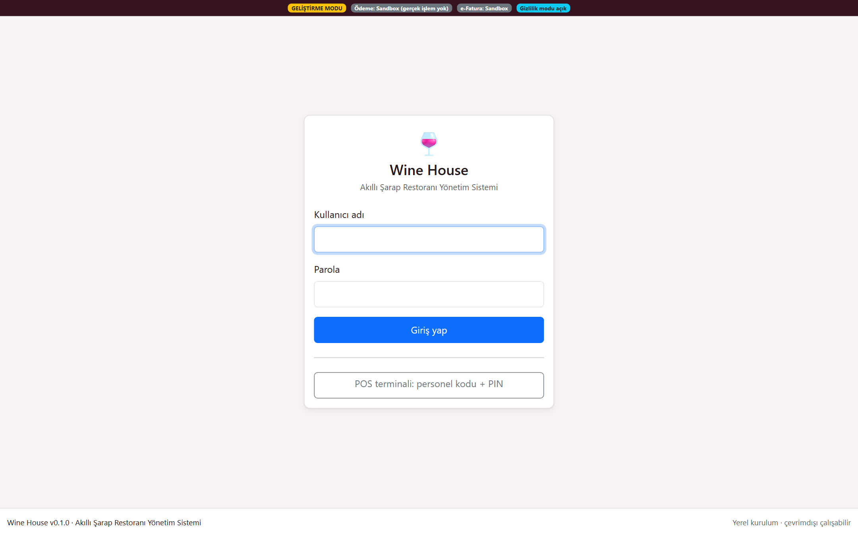
Sign-in screen
Password or quick PIN sign-in · role-based access starts with 19 roles
Wine House · Aziz Şekerdil · 2026
43

Slide 44
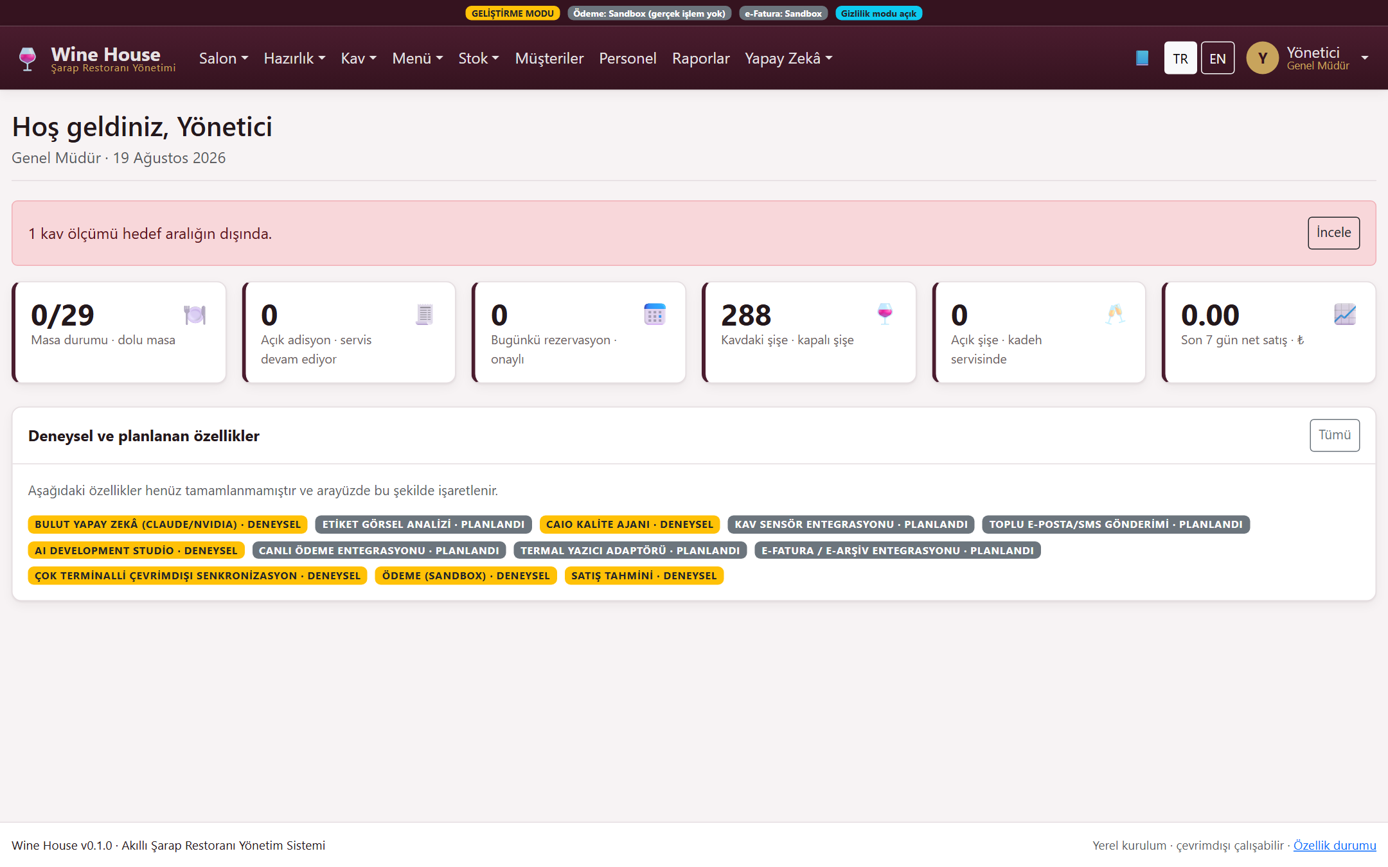
Main dashboard
Tables, open orders, reservations, cellar and sales at a glance; experimental features are clearly badged
Wine House · Aziz Şekerdil · 2026
44

Slide 45
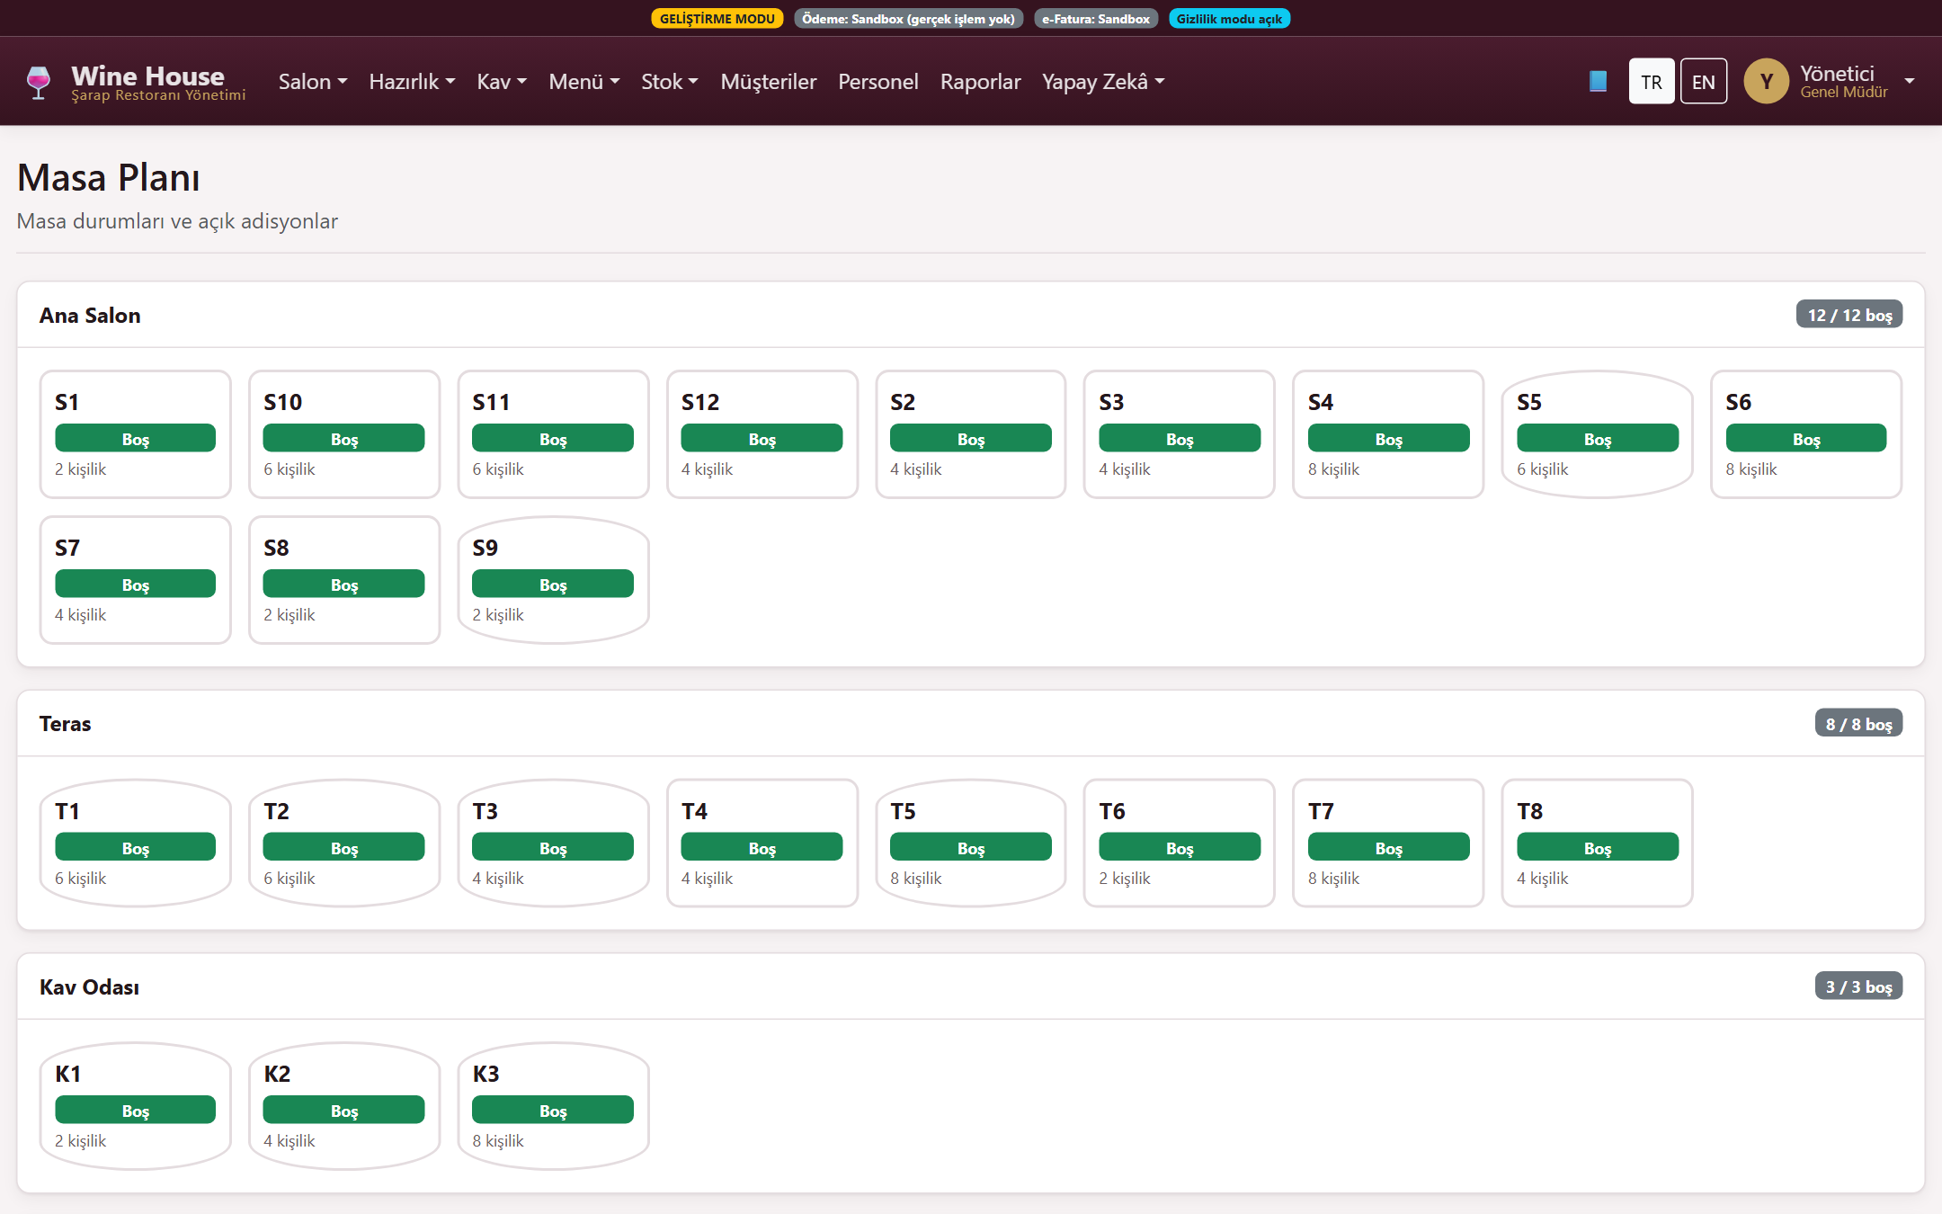
Table map
Live table status by section with links to open orders
Wine House · Aziz Şekerdil · 2026
45

Slide 46
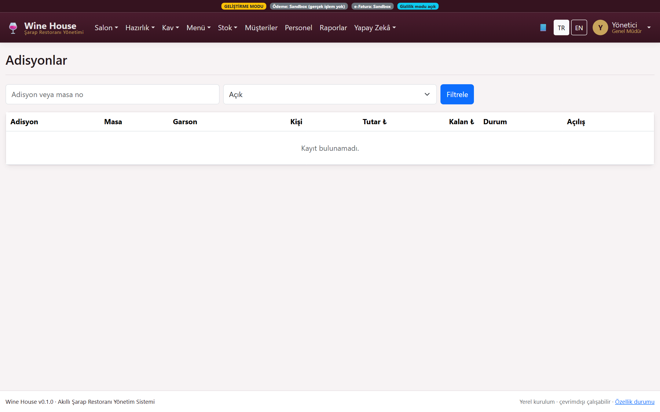
Orders
Order management with price freezing, line voids, discounts and approvals
Wine House · Aziz Şekerdil · 2026
46

Slide 47
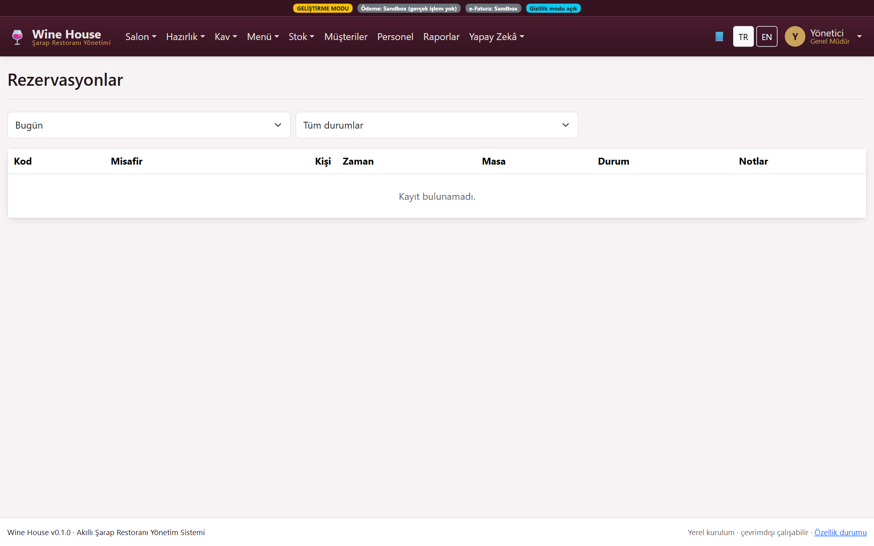
Reservations
Conflict checking, capacity control and waitlist
Wine House · Aziz Şekerdil · 2026
47

Slide 48
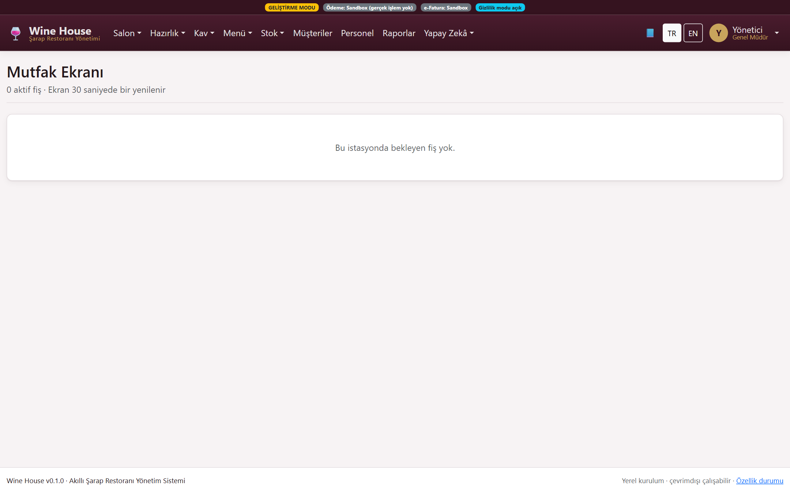
Kitchen display (KDS)
Station separation, ticket progression, delay warnings and allergen flags
Wine House · Aziz Şekerdil · 2026
48

Slide 49
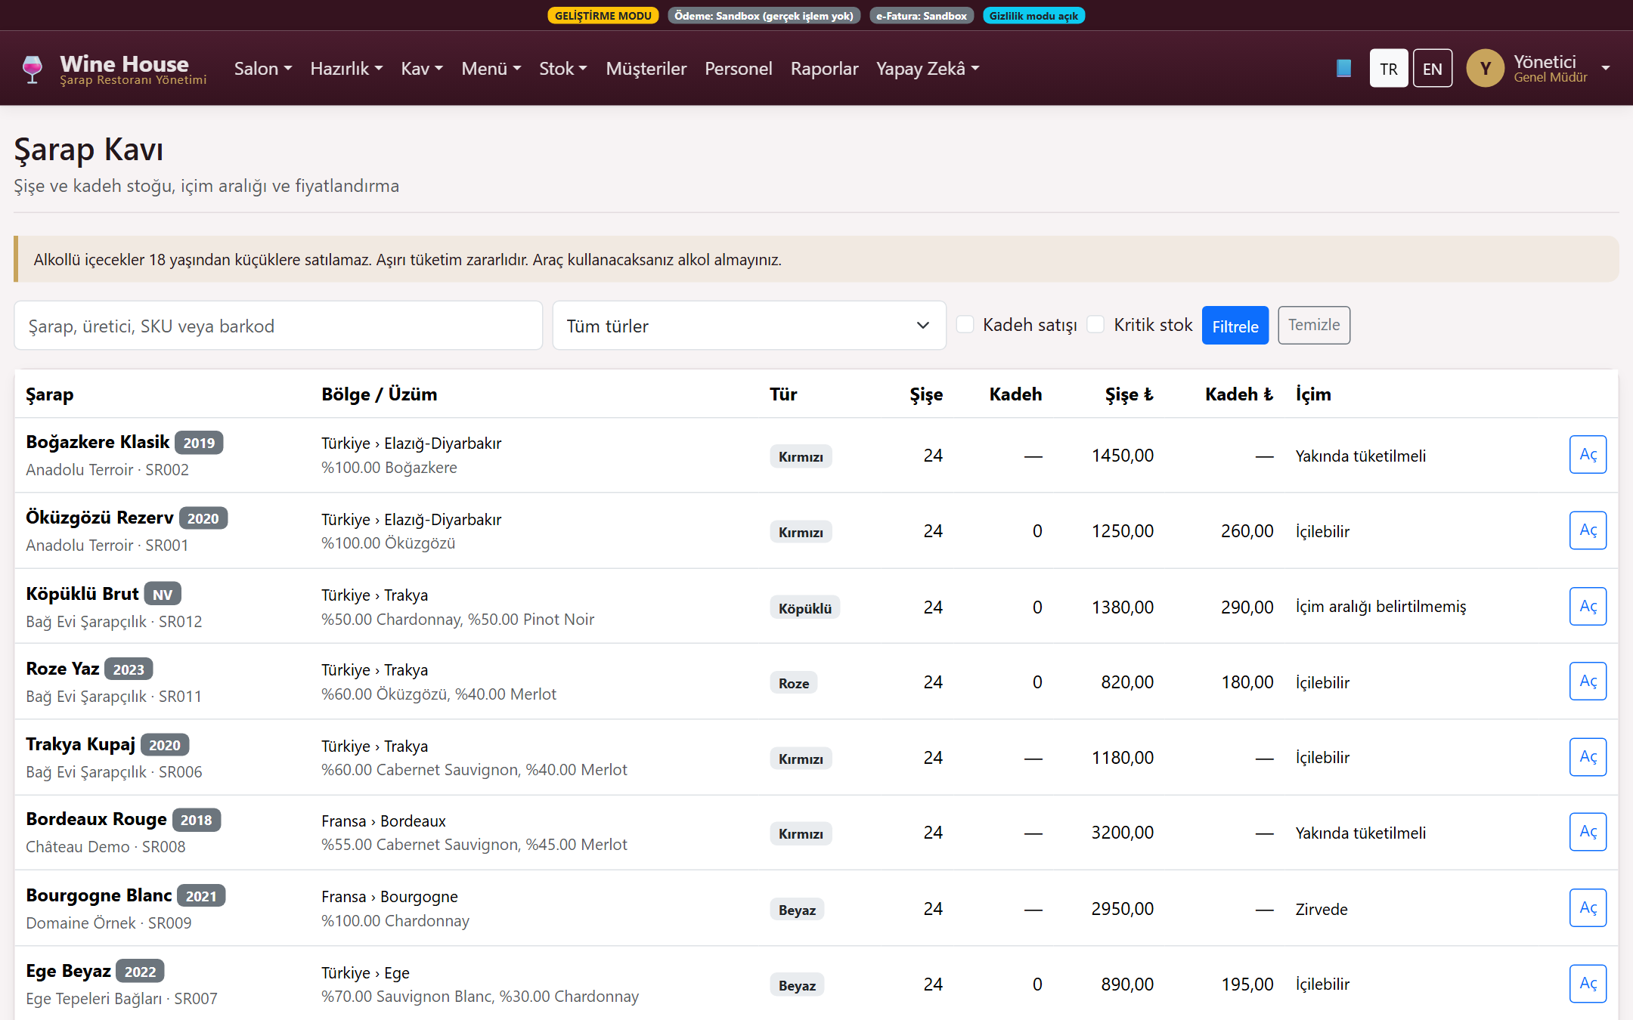
Wine cellar
Bottle and by-the-glass stock, drinking windows and pricing
Wine House · Aziz Şekerdil · 2026
49

Slide 50
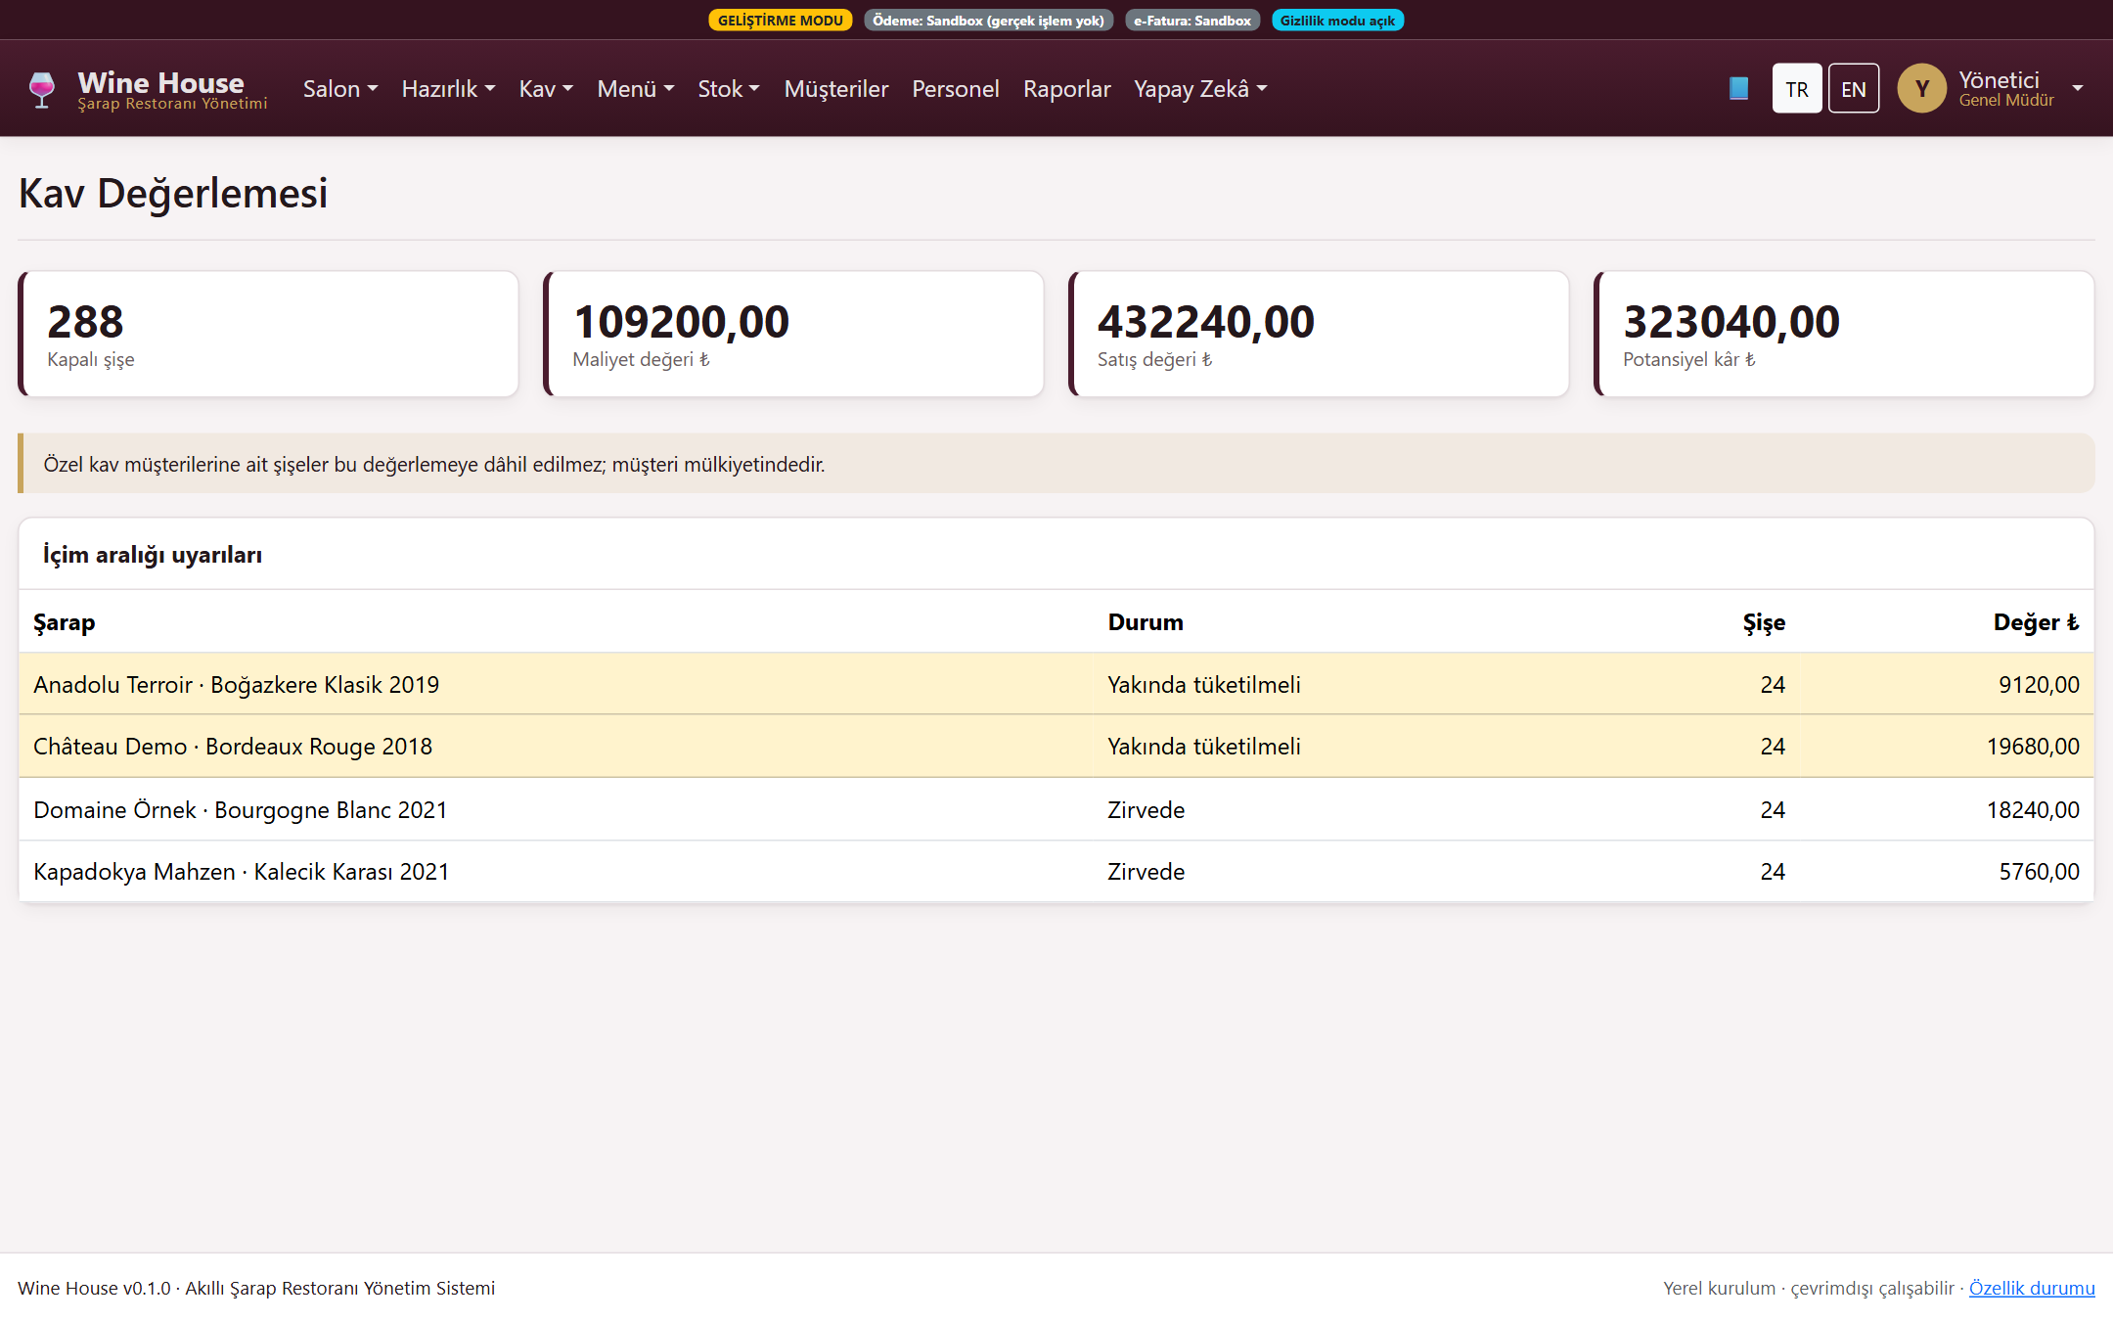
Cellar valuation
Financial snapshot of the cellar at cost and list value
Wine House · Aziz Şekerdil · 2026
50

Slide 51
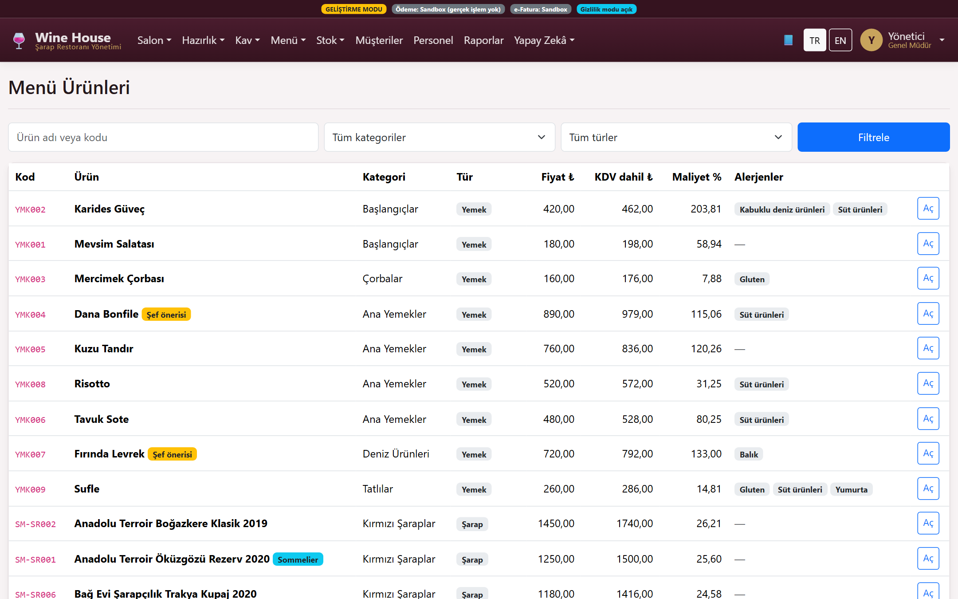
Menu and recipes
Menu management with portion cost, allergens and nutrition labels
Wine House · Aziz Şekerdil · 2026
51

Slide 52
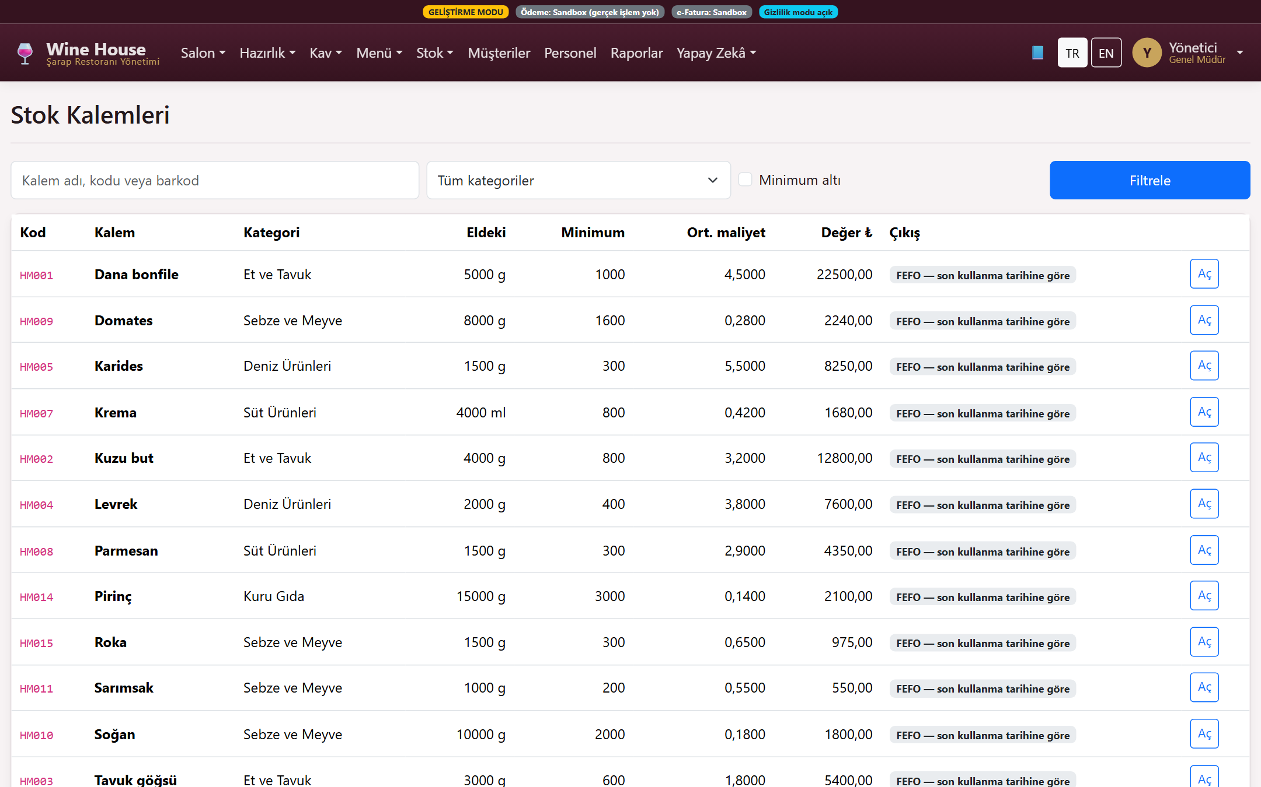
Inventory and purchasing
FIFO/FEFO lot tracking, receiving, stock counts and waste flows
Wine House · Aziz Şekerdil · 2026
52

Slide 53
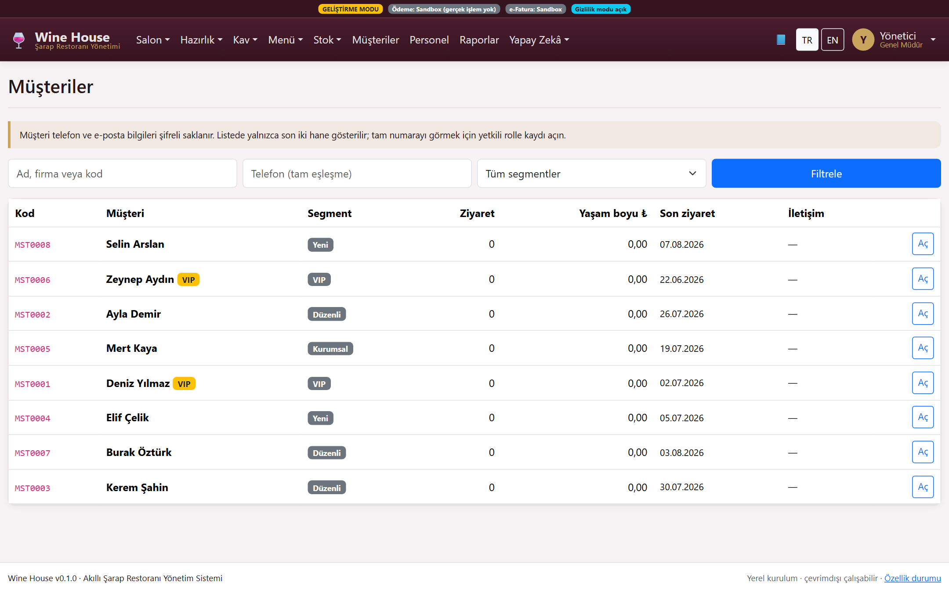
Customer relations
Consent management, export, anonymisation and loyalty — GDPR flows built in
Wine House · Aziz Şekerdil · 2026
53

Slide 54
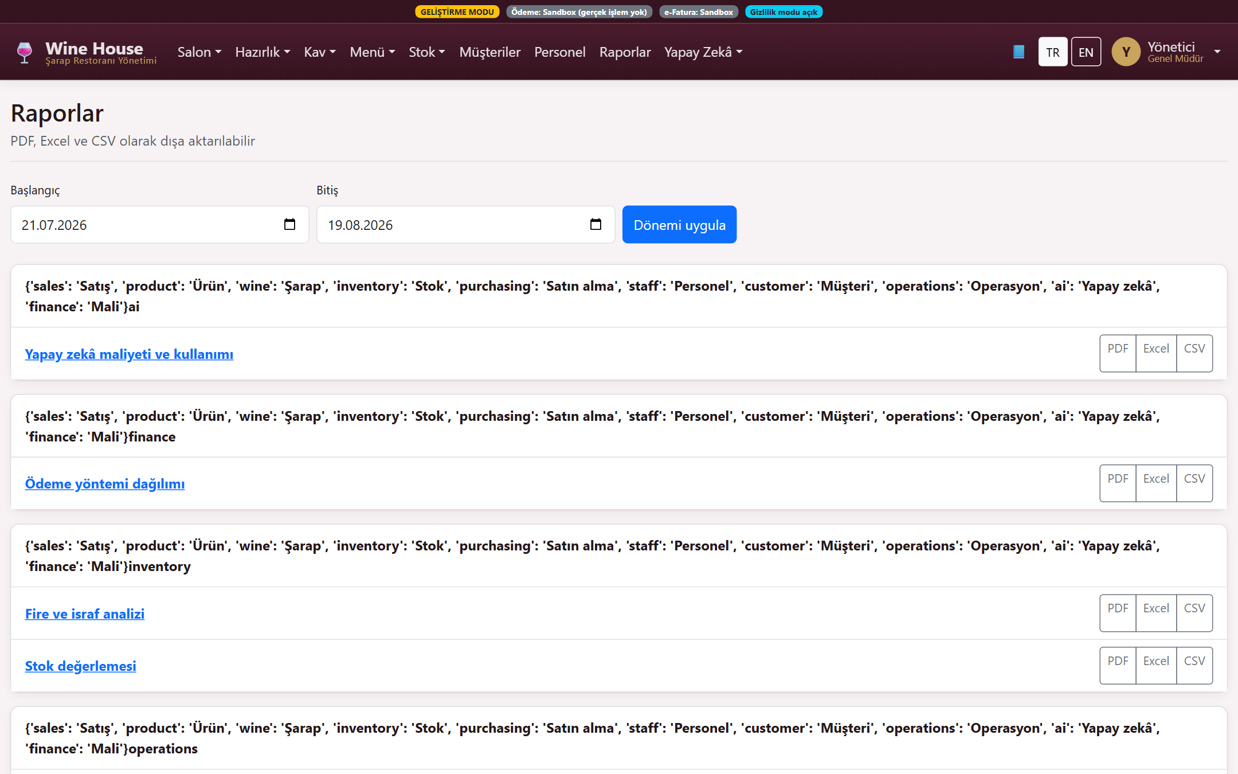
Reports
13 ready-made reports · PDF, Excel and CSV export
Wine House · Aziz Şekerdil · 2026
54

Slide 55
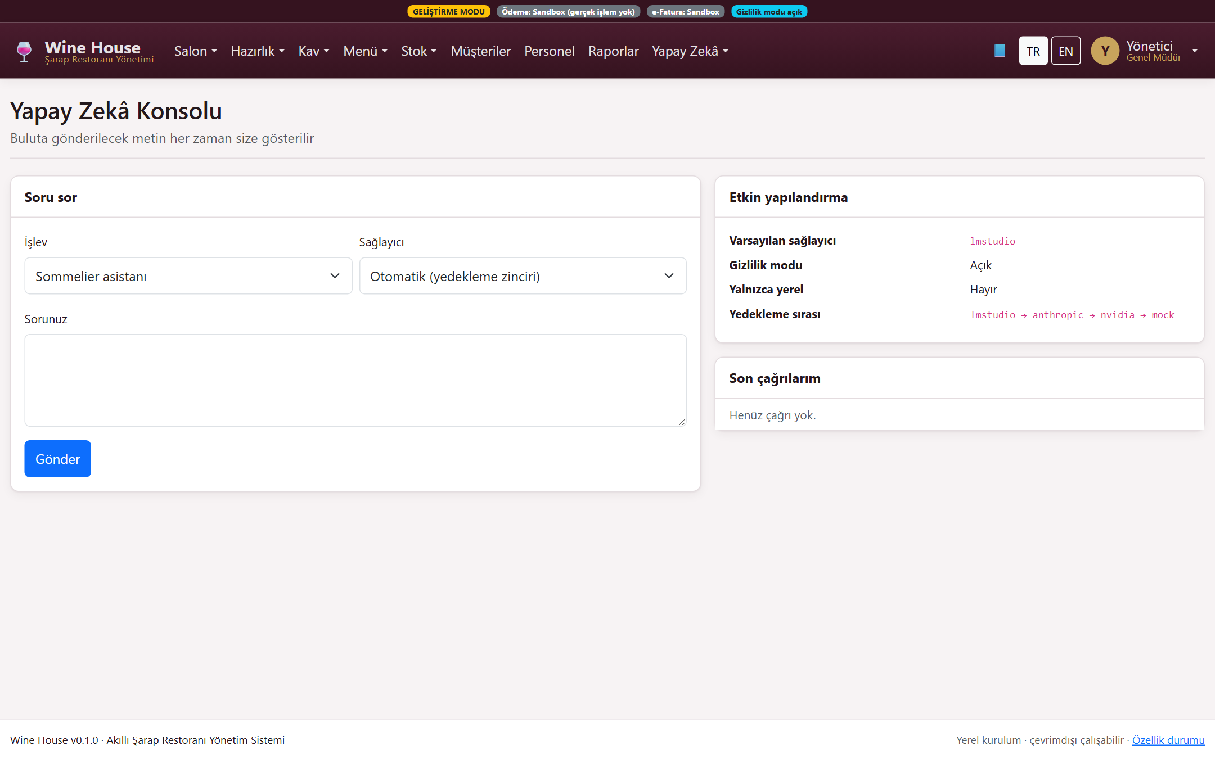
AI assistant
Local-first providers, masking and budget control; it advises, never decides
Wine House · Aziz Şekerdil · 2026
55

Slide 56

Training centre
Role-based staff training modules and lessons
Wine House · Aziz Şekerdil · 2026
56

Slide 57
Wine House
◆ Runs locally · resilient offline
◆ Freezes financial records and leaves an audit trail
◆ Deducts by-the-glass sales from stock correctly
◆ Makes AI an assistant, never an authority
◆ Encrypts and masks personal data
Smart Wine Restaurant Management System
Version 0.1.0 · 2026
Wine House · Aziz Şekerdil · 2026
57

