Slide 1
HACKOUT’26 · RENEWABLE ENERGY INTELLIGENCE · TEAM EX PROJECTIANS
SOLE PULSE
AI-Powered Predictive Maintenance for Solar & Wind Assets
Detect early. Act before failure. Protect energy and revenue.
Team Ex Projectians · GLS University
Jayesh Vatwani Mukesh Kumar · Aziz Juzar Shahiwala · Wadhwani Vivek Mahesh Kumar

Slide 2
THE WARNING WINDOW
THE PROBLEM
From signal to downtime
1
2
3
4
5
Normal
operation
Abnormal
signals
Degradation
Failure
Downtime
Renewable assets can fail before we notice
Critical event
Lost generation
Stable readings
Health declines
Small deviations
Detect early. Prioritize the asset that needs attention first.
Small abnormal sensor changes can appear long before a serious failure.
Manual inspection is slow and expensive across continuously operating solar panels and wind turbines.
Late detection means downtime, lower generation, and revenue loss.
The real challenge is knowing which asset needs attention first.

Slide 3
THE CASE
Small abnormal sensor changes can appear before serious failure.
Manual inspection is slow and expensive across continuously operating solar panels and wind turbines.
Late detection means downtime, lower generation, and revenue loss.
The real problem: detecting the warning signs early enough and knowing which asset needs attention first.
Renewable assets can fail before we notice
01
02
03
Normal operation
Abnormal signals
Degradation
04
05
Failure
Downtime
The real problem: detecting the warning signs early enough and knowing which asset needs attention first.

Slide 4
THE PROMISE
01
02
Sense
Detect
SOLE PULSE turns raw readings into a maintenance decision
Collect sensor and environmental data.
Learn healthy behavior and flag unusual patterns.
03
04
Prioritize
Act
Translate severity into risk and maintenance priority.
Recommend what the team should inspect next.
Continuous monitoring moves the operator from “something failed” to “this asset needs attention now.”

Slide 5
THE SYSTEM LOOP
Sensor / IoT telemetry+ external weather context | Data processing | Flask backend
PyTorch AI engine | Anomaly detection | Risk + maintenance engine
PostgreSQL | React + TypeScript dashboard | Operator
The system connects data, AI, and action in one loop
Sensor simulation supports development and testing.
Flask bridges frontend, database, and AI.
PostgreSQL stores historical readings, predictions, alerts, and maintenance history.

Slide 6






MULTI-SIGNAL HEALTH
Asset health emerges from six signals read together
The model learns how multiple sensor values behave together, not one threshold at a time.
Temperature
Voltage + current
Irradiance
Abnormal heating
Electrical behavior and generation performance
Available solar energy
Soiling
Power output
Asset record
Cleanliness and performance impact
Actual generation
P001 · 42.5 °C · 220.4 V · 8.7 A · 850 W/m² · 12% soiling · 1,850 W

Slide 7
DATA ADAPTER
1
2
Open-Meteo / external environmental data
Sensor or IoT telemetry
Environmental context and equipment health stay separate
Voltage · current · soiling · power output
Temperature · solar radiation / irradiance · cloud conditions · wind conditions
3
4
Standardized sensor record
SOLE PULSE
One consistent input for detection and action
Message to judges: the API provides environmental context; the asset sensors provide equipment health.
Open-Meteo / external environmental data provides context. The asset sensor layer provides equipment health.

Slide 8
MODEL LOGIC
The autoencoder learns what healthy operation looks like
Six sensor features
Encoder
Decoder
6 → 4 → 2
2 → 4 → 6
Original sensor data
Compressed representation
Reconstructed sensor data
Healthy operating pattern
Compare with the original
Train mainly on normal operating data.
Compare original readings with the model’s reconstruction.
A large reconstruction error signals unusual behavior.

Slide 9
01
02
03
INTERPRETATION LAYER
Reconstruction error
Anomaly detection
Risk score
0–100
04
05
06
An anomaly is a reason to inspect, not a claim of failure
Risk level
Maintenance priority
Recommended action
Normal
Anomaly
Severe anomaly
Low risk → routine monitoring.
Higher risk → schedule inspection.
Risk is an application-level score from 0–100.
Critical → urgent inspection.
Fault type and maintenance recommendation are interpretation and business logic around the anomaly result, not direct neural-network outputs.

Slide 10
OPERATOR VIEW
ASSET P999
PRIORITY SIGNALS
ANOMALY
Risk · CRITICAL
Maintenance · URGENT
Failure risk · application-level output
Possible issue
combined abnormal sensor pattern
Action
immediately inspect and schedule urgent maintenance.
The dashboard makes the signal actionable
Reconstruction error · anomaly status · risk score · risk level
ESTIMATED IMPACT
WHAT THE TEAM SEES
6.62 kWh
Asset ID · reconstruction error · anomaly status · risk score · risk level
Failure risk · possible fault type · maintenance priority · recommended action
Estimated energy loss · estimated revenue loss
estimated energy loss
₹52.99
Application-level estimates, not guaranteed predictions.
estimated revenue loss

Slide 11
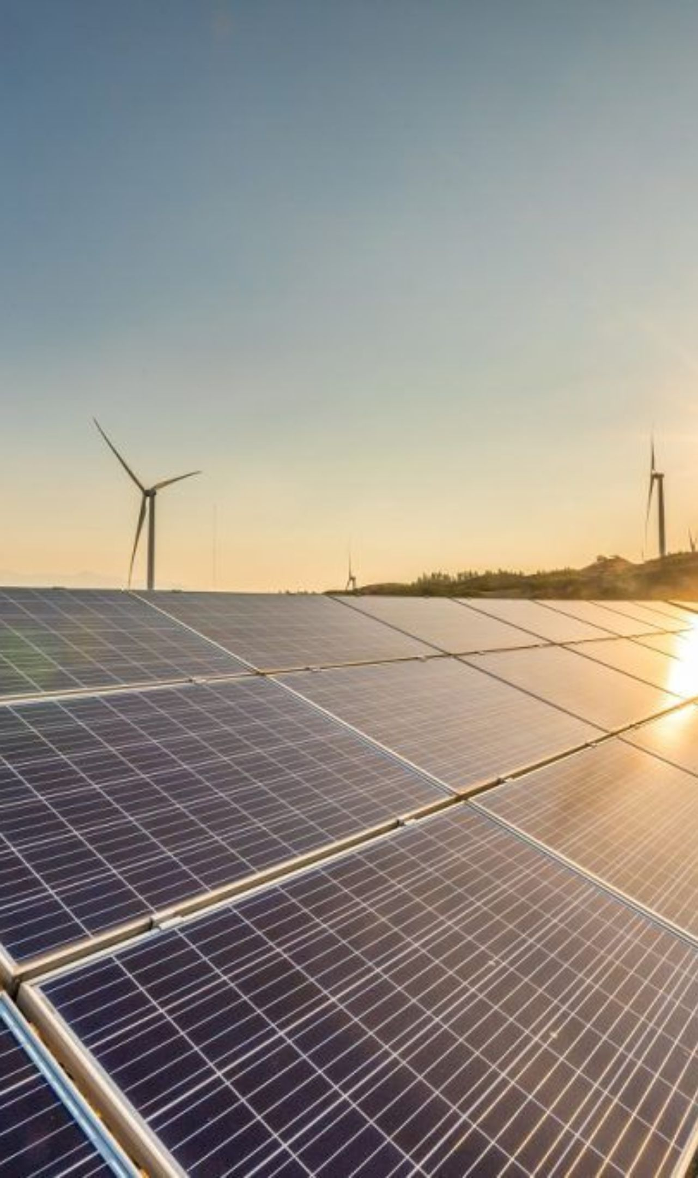
SOLE PULSE
THANK YOU
Predicting failures before they become downtime.
Team ExProjectians
GLS University

