Slide 1
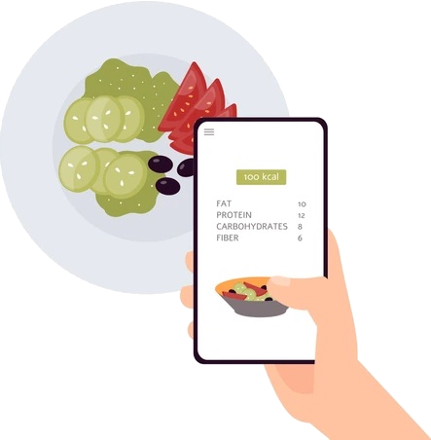
See-Sense: Neural Carbohydrate Estimation
Bridging the Gap Between Computer Vision and Type 1 Diabetes Safety

Slide 2

The Engineering Environment
Developed on the Edge: WSL2 + RTX 3050
Architecture: Hybrid development using Windows Subsystem for Linux (WSL2).
Compute: Powered by NVIDIA CUDA & cuDNN for 50x faster training than CPU.
Stability: Custom VRAM management to ensure OS stability during high-load training.

Slide 3
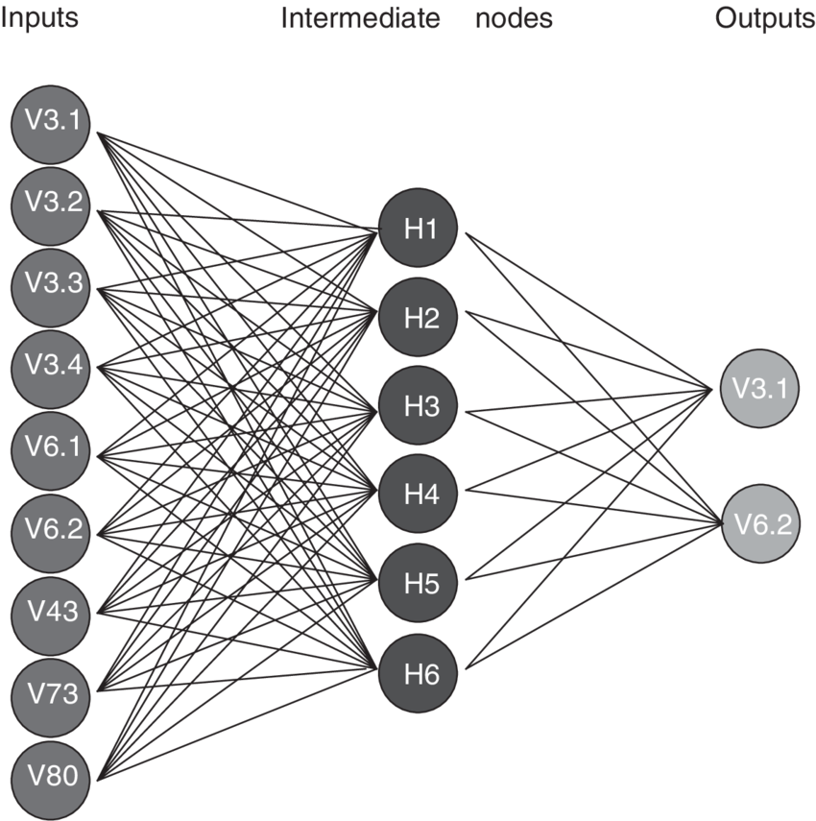
The Neural Engine
Transfer Learning with EfficientNetB0:
Model: Chosen for the best "Efficiency-to-Accuracy" ratio.
Anti-Cheat Lock: Frozen BatchNormalization layers to ensure clinical-grade stability.
Head: Custom Global Average Pooling + 40% Dropout to prevent overfitting.

Slide 4

Clinical Robustness & Data Integrity
From "Data" to "Gold Standard":
The Audit: AI-driven data cleaning (removing low-confidence "imposters").
Augmentation: Training for real-world scenarios (dim lighting, restaurant angles).
Precision: Mixed Precision Training (float16) for rapid, accurate calculations.

Slide 5

The Results
Performance Metrics
Classes: 251 distinct food categories.
Output: Predictive confidence + Carbs per 100g.
Reliability: Filtered validation set ensuring a representative cross-section of foods.

Slide 6
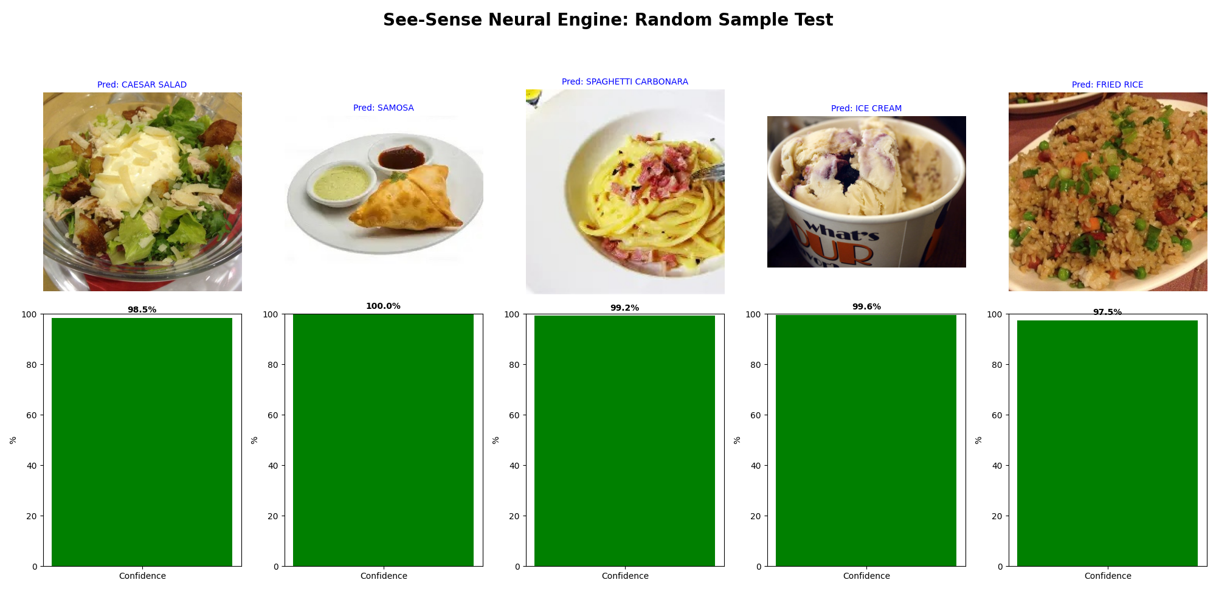

Slide 7

Conclusion & Next Steps
Ready for Delivery
Model exported as .keras for mobile deployment.
Class mapping finalized for instant nutritional lookup.
Next Phase: Real-time mobile integration for T1D patients.

