Slide 1

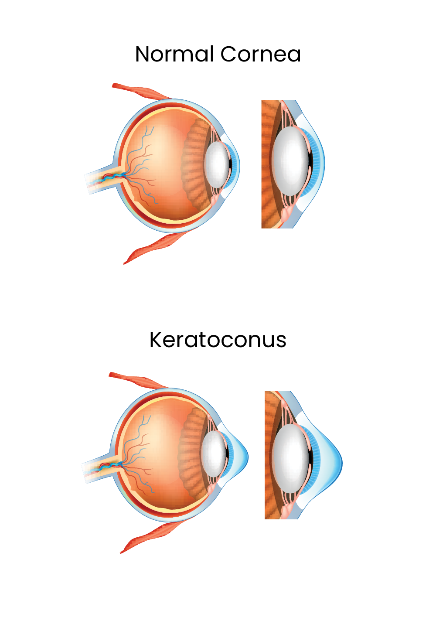

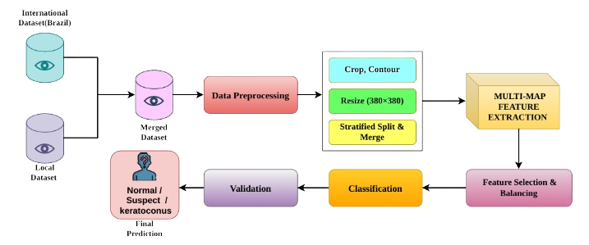
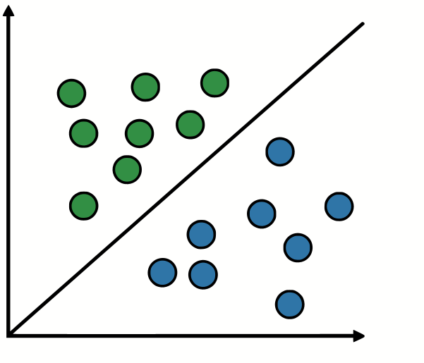
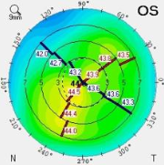
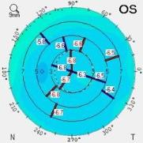
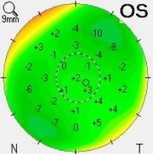
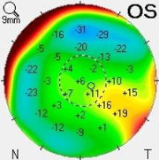
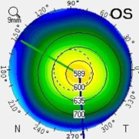
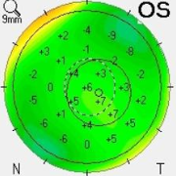
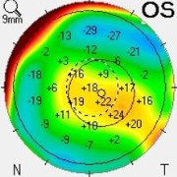
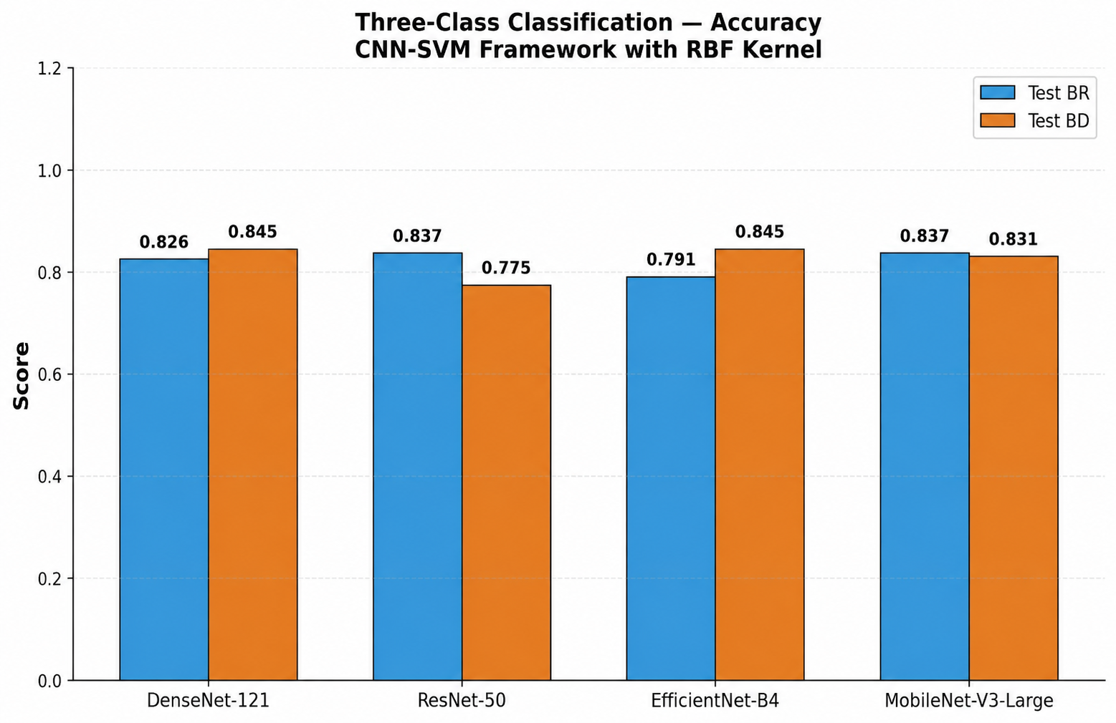
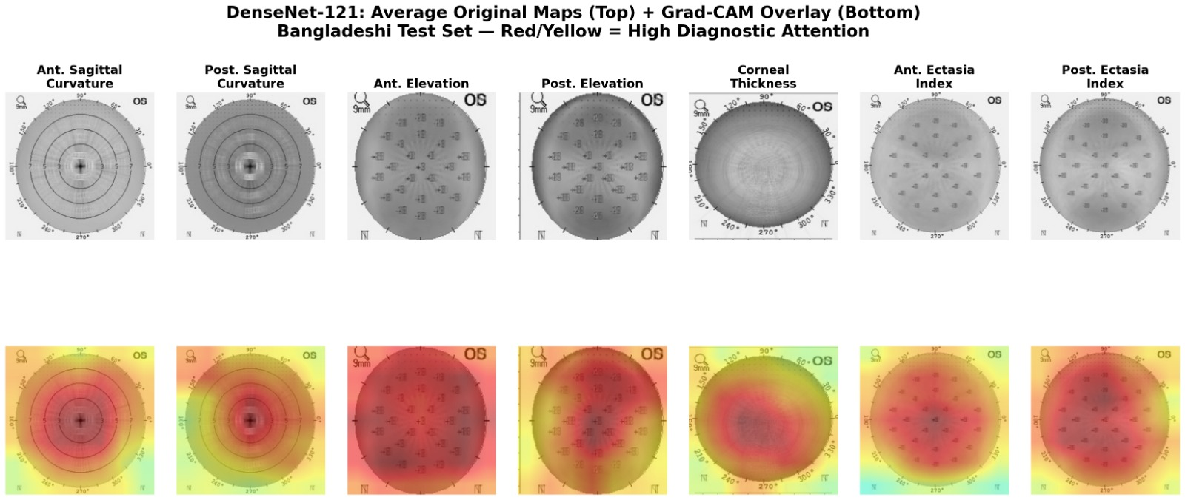
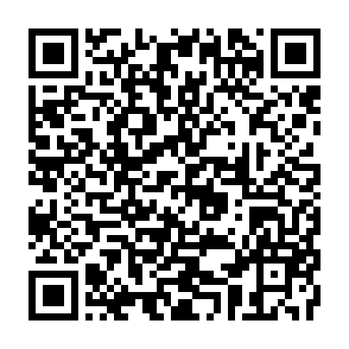
AI-Powered Multi-Map Framework for Keratoconus Classification in Bangladeshi Eye Images
Stream B — smart cities, vision, security, and applied AI systems
Poster # 06
Keratoconus (KC) is a progressive corneal disease that can lead to severe visual damage if not detected earlier. Most existing artificial intelligence (Al) systems rely on a single Pentacam corneal map and are rarely validated across different ethnic people; This research proposes a multi-map AI framework that utilizes all seven Pentacam tomographic maps and evaluates performance using both Brazilian and Bangladeshi datasets. Features were extracted using pre-trained CNN backbones and classified using an RBF-SVM classifier, The proposed approach demonstrates superior performance compared with individual map-based methods while maintaining robustness across different populations. The framework shows promise as an affordable and scalable screening tool for early keratoconus detection, particularly in resource-constrained regions.
ABSTRACT
INTRODUCTION
Why Keratoconus Detection Matters
Keratoconus causes progressive thinning and protrusion of the cornea.
Early diagnosis enables treatments such as corneal cross-linking to prevent vision loss.
Diagnosis currently requires expert interpretation of Pentacam corneal maps.
Rural and low-resource healthcare settings often lack specialists.
Research Gaps
Underutilization of the seven available Pentacam maps
Limited cross-ethnic validation
Heavy dependence on specific CNN architectures
Difficulty identifying suspect keratoconus cases
Objective
Develop a robust deep-learning-based keratoconus screening system that:
Utilizes all seven Pentacam maps
Generalizes across different populations
Improves detection of early-stage and suspect cases
1
2
3
METHODOLOGY
Dataset
Data Preprocessing
Proposed Framework
Brazilian Dataset
Total Dataset: 573 eyes
Normal: 150 + 50 = 200 eyes
Suspect: 123 + 50 = 173 eyes
Keratoconus: 150 + 50 = 200 eyes
Each eye has seven Pentacam maps
Bangladeshi Dataset
142 eyes collected from National Institute of Ophthalmology & Hospital, Dhaka
Labels are generated using BAD-D range and some clinical parameters
Cropping
Contour detection
Grayscale conversion
Image resizing
Stage 3: Feature Optimization
Data Augmentation
SVM (RBF Kernel)
Rotation
Horizontal Flip
Brightness / Contrast
Adjustment
Gaussian Blur
Hyper Parameters:
Kernel = RBF
Regularization Parameter = 5.0
Gamma = Scale
Class Balancing
Stage 1: Multi-Map Feature Extraction
SMOTE
Class-weighted SVM
Seven Pentacam maps per eye
Stage 2: Feature Optimization
Data Partition Summary
Split | Source | Normal | Suspect | Keratoconus | Total
Train_BR | Brazilian (70%) | 105 | 86 | 105 | 296
Train_BD | Bangladeshi (50%) | 25 | 26 | 18 | 69
Total Train |  | 130 | 112 | 123 | 365
Validation | Brazilian (15%) | 22 | 18 | 22 | 62
Test_BR | Brazilian (15%) | 23 | 19 | 23 | 65
Test_BD | Bangladeshi (50%) | 26 | 27 | 19 | 72
Total |  | 201 | 176 | 184 | 561
StandardScaler
(Normalization)
SAG_A SAG_P ELV_A ELV_P CT_A EC_A EC_P
SelectKBest
(Feature Selection)
Pre-trained CNN (Feature Extractors)
DenseNet-121
ResNet-50
EfficientNet-B4
MobileNetV3-Large
Reduced Feature Vector
(1000 Dimensions)
RESULT ANALYSIS
Three-Class Classification all performance data table
Model | Dataset | Accuracy | Precision | Recall | F1-Score
DenseNet-121 | Test BR | 0.8256 | 0.8868 | 0.8393 | 0.8624
DenseNet-121 | Test BD | 0.8451 | 0.8542 | 0.9111 | 0.8817
ResNet-50 | Test BR | 0.8372 | 0.9375 | 0.8036 | 0.8654
ResNet-50 | Test BD | 0.7746 | 0.7959 | 0.8667 | 0.8298
EfficientNet-B4 | Test BR | 0.7907 | 0.8800 | 0.7857 | 0.8302
EfficientNet-B4 | Test BD | 0.8451 | 0.8696 | 0.8889 | 0.8791
MobileNet-V3-Large | Test BR | 0.8372 | 0.9038 | 0.8393 | 0.8704
The proposed deep learning framework successfully detected and classified keratoconus from corneal topography maps with high accuracy with DenseNet-121. These findings highlight the potential of AI-assisted diagnostic systems to support early detection and clinical decision-making in ophthalmology. By selecting DenseNet-121—smaller and more efficient than alternatives—the entire training footprint remained at just 0.62 kg CO₂, supporting sustainable AI deployment.
CONCLUSION
SDG 3 (Good health & well-being)
SDG 9 (Industry, innovation & infrastructure)
SDG 10 (Reduce inequalities)
PyTorch
TensorFlow
Python
Grad-CAM
Multi-map AI Framework
SMOTE
NVIDIA Tesla P100
SelectKBest
ImageNet-pretrained models
StandardScaler
SDG
MODERN TOOLS
Patient Safety & Equity: Selected DenseNet-121 over larger models to ensure robust, equitable performance across Bangladeshi and Brazilian populations, minimizing misdiagnosis risks for underrepresented groups.
Data Integrity & Privacy: Used only real, de-identified Pentacam scans with anonymized study IDs; applied feature-space SMOTE to avoid generating fake medical images.
Transparency & Trust: Implemented Grad-CAM visualization for every prediction, ensuring clinicians understand why a decision was made rather than relying on black-box outputs.
ETHICS & PROFESSIONAL RESPONSIBILITIES
REFERENCES

