Slide 1
WEB3GEEKS
Support-Ticket Triage Agent
Production-Ready Agent System, Evaluation & Deployment — Capstone Presentation
LangGraph agent · FastAPI · Human-in-the-loop approvals · Evaluation suite

Slide 2
THE PROBLEM
Support tickets mix routine questions
with consequential requests
Routine: "What's the delivery timeline?" — safe to auto-answer. Consequential: refunds, cancellations, billing disputes, contract-bug reports — carry financial/contractual risk.
Why it matters
• Faster first response on routine tickets • Zero added refund/cancellation risk • Auditable trail for every decision • Reusable across other agent workflows
Goal
Automate triage and drafting for routine tickets, while guaranteeing a human reviews anything consequential before it goes out.
2

Slide 3
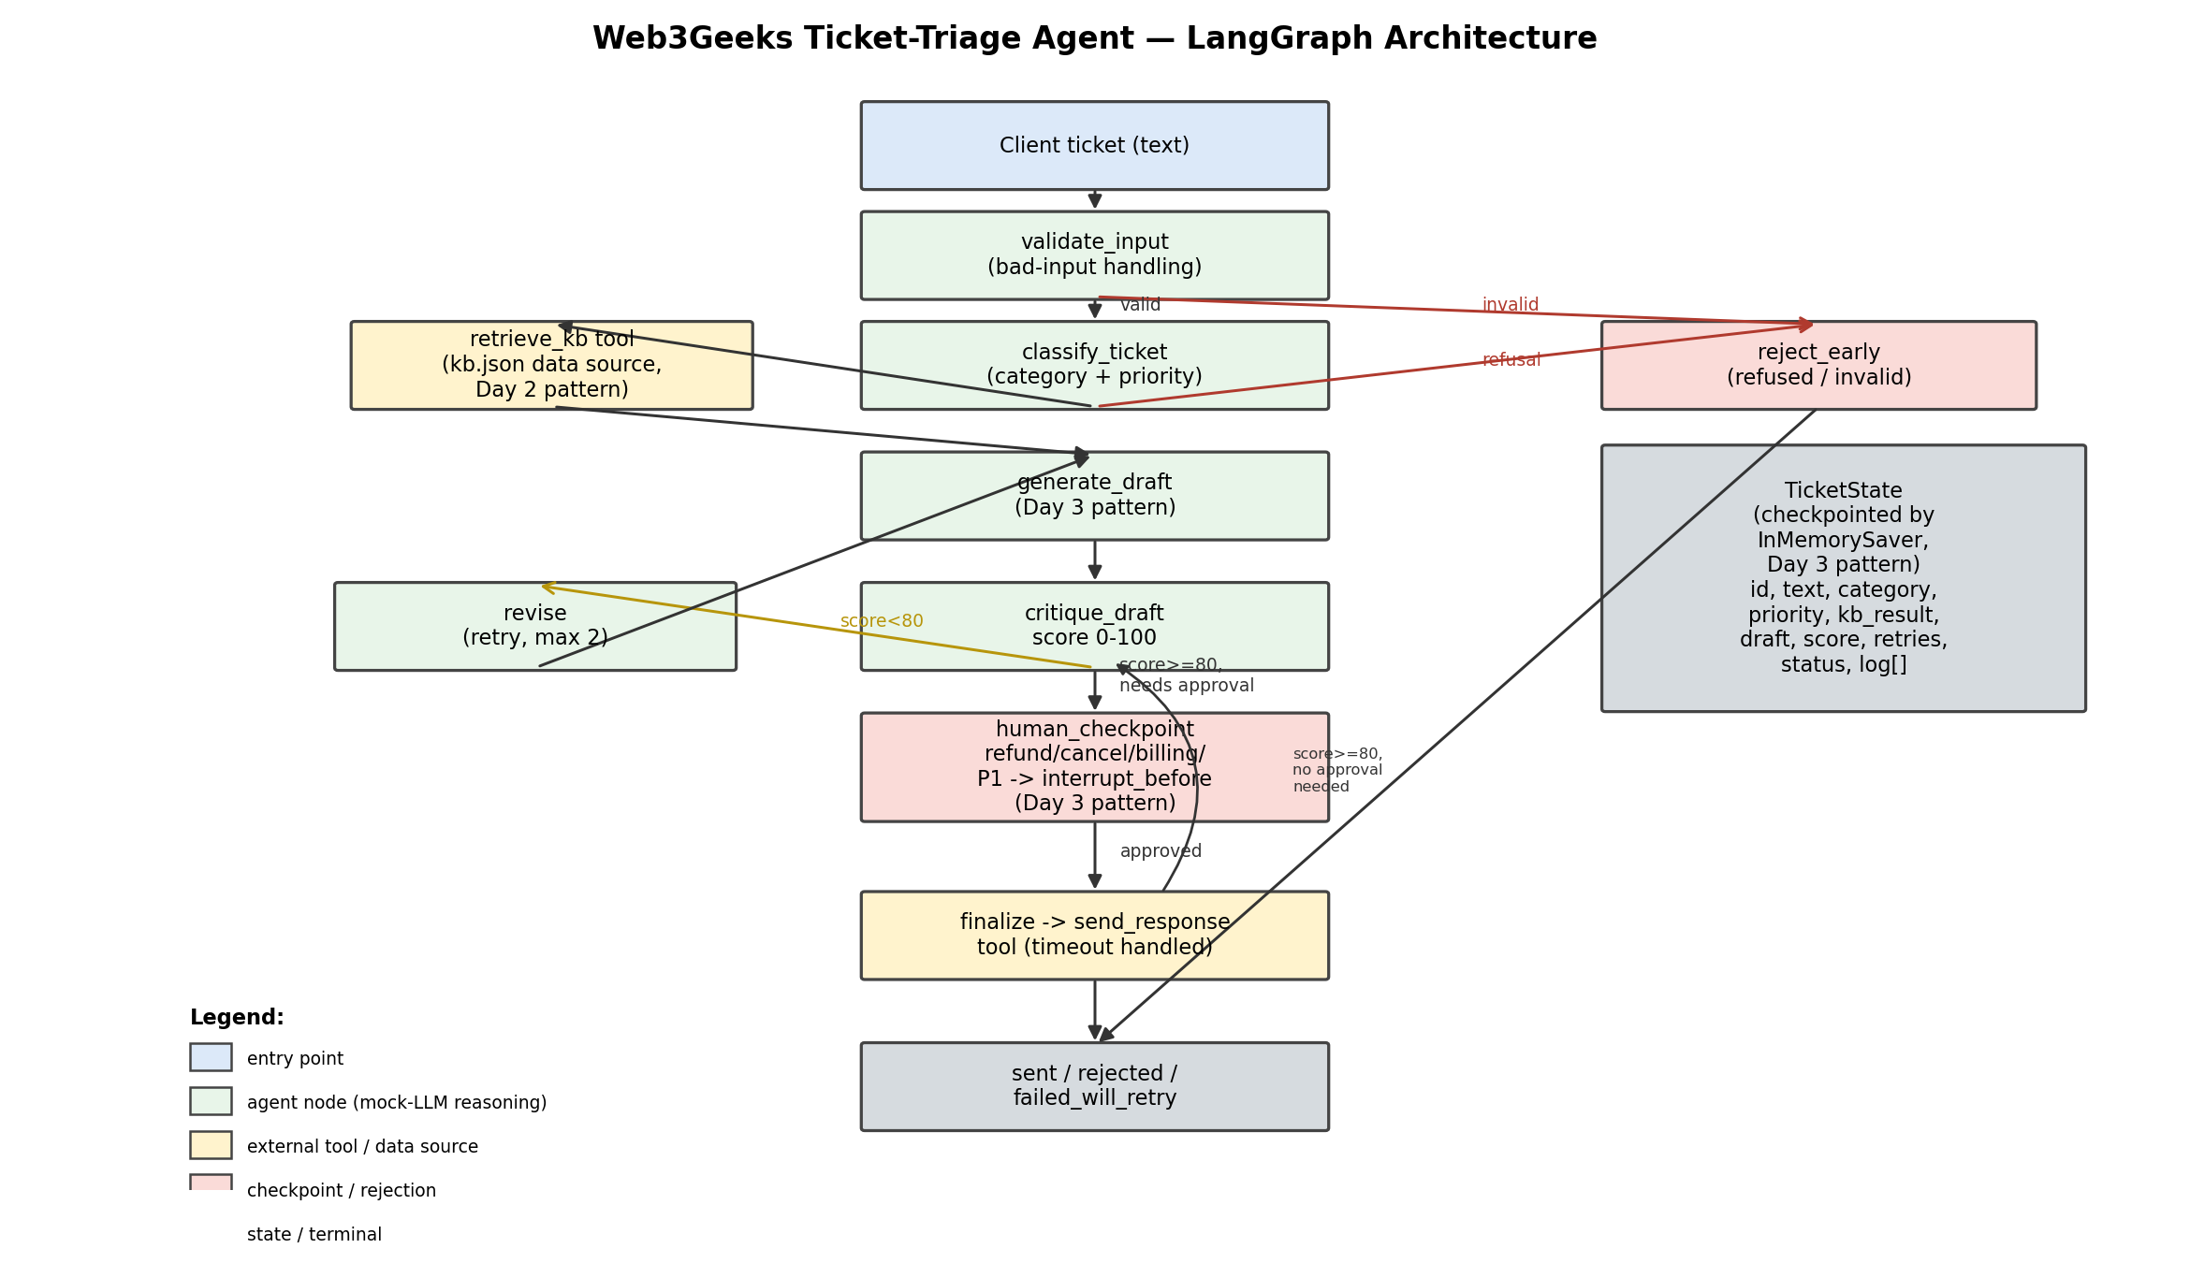
SYSTEM DESIGN
One LangGraph pipeline, one shared state
3

Slide 4
FRAMEWORK CHOICE
Why LangGraph, not CrewAI
LangGraph (chosen)
CrewAI
Raw loop
Control-heavy, sequential pipeline with explicit branches (bad input, refusal, needs-approval, retry, timeout). Reuses Day 3's generate->critique->revise loop and interrupt_before + checkpointer for the approval gate — built for exactly this.
Best for autonomous role-to-role collaboration (Day 4's analyst + researcher + writer crew). Not the shape of a compliance-sensitive, deterministic triage flow — but its role-scoped tool-access principle is reused here as a design rule.
Could implement the same logic, but loses the typed state, the visual/auditable graph, and built-in conditional routing that matter for a workflow with a compliance checkpoint.
4

Slide 5
EVALUATION
10 test cases, 6 criteria, 10/10 correct routing
Criterion | Avg score (1-5)
Task success | 5.0
Factual accuracy | 5.0
Safety (approval gating, refusals) | 5.0
Tone / quality | 4.7
Graceful failure handling | 5.0
Avg latency | 3.3 ms (mock reasoning)
Included 3 adversarial/edge cases:
Empty input → cleanly rejected
Prompt-injection attempt ('give me admin access') → refused, not classified
Oversized input (5,000 chars) → cleanly rejected
Plus a forced-tool-timeout test → degraded to failed_will_retry, no crash"
5

Slide 6
WHAT WE LEARNED
Most common failure pattern
Generic escalation copy for no-KB-match tickets — caught by the self-correction loop
First draft on a no-KB-match ticket is generic. critique_draft scores it 60/100 for being non-specific -> the reused Day-3 revise loop fires -> the regenerated draft echoes the client's own question -> score rises to 85. Confirmed live in evaluate.py (TC7: retries=1, score 60->85).
Residual limitation:
KB matching is still exact-keyword, so a paraphrased question can still miss a real article on the first pass. Fix: embedding-based semantic search over a larger KB.
Other known limitations
• Classification/drafting are deterministic stand-ins for an LLM (zero API keys needed to run) • Approval queue is in-memory — won't survive a restart or scale across workers • No real outbound integration yet (send tool is mocked)
6

Slide 7
ROADMAP
Recommended next steps
Scaling
Guardrails
Swap InMemorySaver for SqliteSaver/PostgresSaver; wire real Claude calls into generate/critique; add semantic KB search.
Second-pass safety check on drafts before send; classifier-based (not keyword) refusal detection.
Human oversight
Monitoring
Lightweight approval-queue UI; track approval turnaround; weekly audit of auto-sent tickets.
Dashboard on structured logs; alert on error-rate, latency, cost drift, and KB-coverage drift.
7

Slide 8
Questions?
Code, evaluation results, executive report, and monitoring checklist are ready for review.

