Slide 1
AAAI Student Abstract

Slide 2
When Reasoning Collapses: A Depth-Aware Probe into LLM Reasoning

Slide 3
Contents
Introduction & Motivation
Reasoning collapse problem? Why test across depth?
Problem Statement
Benchmarks shallow reasoning → miss depth-based collapse
Datasets
Distribution per depth (items_count_by_depth.csv)
Preview examples (items_preview.csv)
Methodology
Models used
Direct vs Reasoning modes
Protocols: DCAB, TA, AV
Metrics
Workflow Diagram
From dataset → prompting → model → prediction → evaluation
Results I — Accuracy vs Depth
Plot curves for each model & dataset
Show collapse beyond depth 2–3
Results II — Delta Reasoning
Improvements at shallow depth, collapse later
Results III — Calibration & Collapse
DCAB calibration (ρ, ECE)
Collapse points per model
9. Results IV — Budget & Verification
MB5 efficiency
AV vs TA comparison
Refutation rates
Results V — Qualitative Cases
Failure examples from all_predictions.csv
Conclusion
Shallow reasoning helps briefly
Collapse appears universally across models
Future Work
Extend datasets, scale models
Explore consistency training & curriculum learning

Slide 4
Introduction & Motivation
Large Language Models (LLMs) are expected to perform multi-step reasoning reliably.
Standard benchmarks mostly test shallow depth reasoning.
Our study: probe reasoning depth (2–6 for CLUTRR, 1–5 for ProofWriter).
Observation: accuracy collapses quickly as depth increases.
Aim: measure reasoning collapse, calibration, and efficiency across models & prompting protocols.
Term | Explanation
Reasoning Depth | Number of steps/hops required to reach an answer (e.g., multi-hop logic).
Collapse | Accuracy drops sharply beyond a certain depth.
Calibration | Whether predicted depth/effort matches actual task depth.
Protocols | Different prompting strategies: Direct, Reasoning, DCAB, TA, AV.

Slide 5
Problem Statement
Existing LLM benchmarks emphasize shallow reasoning.
They rarely test systematic scaling with depth.
As a result, they fail to expose collapse points where reasoning breaks down.
Our work: probe depth-based reasoning performance and calibration across multiple models and protocols.
Notes:
Most prior benchmarks focus on surface-level reasoning, overlooking how model performance changes with depth. This leaves a critical gap: the collapse of accuracy and calibration when reasoning chains grow longer, which our study directly investigates.

Slide 6
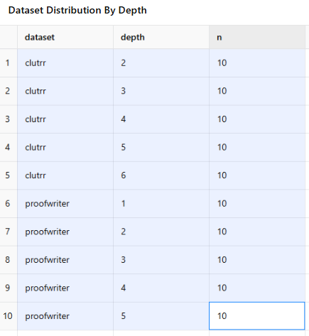
Datasets: for Reasoning Depth Evaluation
CLUTRR (depth 2–6): kinship reasoning tasks.
ProofWriter (depth 1–5): logical entailment tasks.
Balanced sample: 10 items per depth → total 100 items.
Dataset designed to probe multi-hop reasoning.
“n is the sample count — we kept it fixed at 10 per depth to ensure fairness and balanced evaluation.”
1. CLUTRR (Compositional Language Understanding with Text-based Relational Reasoning)
Task: Predict kinship(Family relationships between people.) relations between two people in a short story.
Reasoning Depth: number of family links/hops needed (e.g., 2–6).
Structure:
Story: “Ashley’s son Nicholas and son George went to play…”
Query: (“Nicholas”, “George”)
Choices: {aunt, brother, father, …, wife} (21 labels)
Gold: brother
What it measures: Can the model compose relational chains to infer family ties?
2. ProofWriter
Task: Decide if a hypothesis is entailed by a set of logical premises.
Reasoning Depth: number of inference steps (QDep = 1–5).
Structure:
Premises: “The cow eats the mouse. The cow does not need the tiger.”
Hypothesis: “The cow needs the tiger.”
Choices: {True, False}
Gold: False
What it measures: Can the model handle multi-hop logic with negation?
Notes:
We evaluated models on two controlled reasoning datasets: CLUTRR (depth 2–6 kinship reasoning) and ProofWriter (depth 1–5 logical entailment). Each depth contained 10 items, yielding 100 total samples, ensuring balanced coverage of increasing reasoning complexity.
Dataset Structure Summary Table
Dataset Input Fields Output Depth Range Example Label
CLUTRR Story, Query (entity pair) 21 kinship classes 2–6 brother
ProofWriter Premises, Hypothesis True/False 1–5 False
📖 Paragraph Version (for paper/abstract)
We evaluate on two reasoning datasets. CLUTRR requires predicting kinship relations from stories, probing compositional relational reasoning at depths 2–6. ProofWriter requires deciding entailment of hypotheses from logical premises, probing multi-step logical reasoning with depths 1–5. Both datasets are explicitly structured to test how performance changes as reasoning depth increases.

Slide 7
1. Accuracy by Depth
Definition: Proportion of correct predictions at each reasoning depth.
What it calculates: How well a model answers as tasks get more complex (depth-2, depth-3, etc.).
Use in your work: Reveals where accuracy starts dropping (“collapse with depth”).
2. ΔReasoning vs Direct
Definition: Accuracy(reas.) − Accuracy(direct) at the same depth.
What it calculates: The added value of reasoning mode compared to direct short answers.
Use in your work: Shows whether reasoning actually improves performance or harms it.
3. Collapse Points (accuracy < 50%)
Definition: The smallest depth at which model accuracy falls below 50%.
What it calculates: The breaking depth of reasoning, beyond which models can’t reliably solve.
Use in your work: Quantifies “reasoning collapse” as a discrete point.
4. Calibration (Spearman ρ, ECE)
Spearman ρ: Rank correlation between predicted depth (d̂) and true depth.
Measures if models order tasks correctly by difficulty.
ECE (Expected Calibration Error, ordinal): Measures how close predicted depth matches true depth, normalized by range.
Lower = better calibration.
What it calculates: How well models can self-estimate task difficulty.
Use in your work: Qwen-2.5-7B had the best calibration (positive ρ, moderate ECE).
5. Efficiency (MB5 token budget)
Definition: Minimal extra tokens needed to achieve +5 percentage points accuracy over the direct baseline.
What it calculates: How much additional compute is required to get a modest performance boost.
Use in your work: Shows whether reasoning is efficient or wasteful. GPT-5 & LLaMA achieved gains with very few extra tokens.
6. Refutation Rates (AV vs TA)
Definition: Fraction of wrong initial answers (Direct@32) that are flipped to correct after verification in AV protocol.
Formula: Refute Rate = (# wrong initial corrected) / (# wrong initial total).
What it calculates: How effective the Answer–Verify (AV) method is at catching and fixing mistakes.
Use in your work: Qwen-2.5-7B flipped up to 50% of wrong answers at depth-5.

Slide 8
Methodology
Models tested (5):
llama31_8b (DeepInfra)
qwen25_7b (DeepInfra)
deepseek_r1d_qwen32b (DeepInfra)
glm45_air (DeepInfra)
gpt5 (OpenAI)
Protocols evaluated:
Direct: short answer only
Reasoning: CoT or provider-native reasoning
DCAB: Depth Calibration & Adaptive Budgeting
TA (Think–Answer): reasoning before answer
AV (Answer–Verify): initial short answer, then verification
Metrics:
Accuracy by depth
ΔReasoning vs Direct
Collapse points (accuracy < 50%)
Calibration (Spearman ρ, ECE)
Efficiency (MB5 token budget)
Refutation rates (AV vs TA)
Accuracy/ΔReasoning: Does reasoning help?
Collapse point: Where does it break?
Calibration: Does the model know task difficulty?
Efficiency: How costly is improvement?
Refutation: Can verification recover wrong answers?
Notes:
We tested five models under multiple prompting protocols — Direct, Reasoning, DCAB, Think–Answer, and Answer–Verify — and evaluated them on accuracy, reasoning gains, collapse points, calibration, efficiency, and refutation rates.

Slide 9
Workflow
Input: dataset item (story/hypothesis + query).
Prompting: build Direct / Reasoning / DCAB / TA / AV prompt.
Model Execution: run selected LLM with token budget / effort.
Prediction Parsing: extract final label (CLUTRR: kinship, ProofWriter: True/False).
Evaluation:
Compare with gold label → accuracy
Track depth vs performance
Log tokens, cost, calibration, collapse
Dataset item → Prompt Builder → Model (Direct/Reasoning/DCAB/TA/AV) → Prediction Parser → Metrics (Accuracy, Collapse, Calibration)
Notes:
Each dataset item is transformed into a protocol-specific prompt, passed to the model, and the extracted prediction is compared with the gold label. We record accuracy, calibration, token usage, and collapse depth across all runs.

Slide 10
Dataset Item
(CLUTRR / ProofWriter
Model run (5 LLMS)
Prediction Parser (Label/true/False)
Evaluation Metrices:
- Accuracy
- ΔReasoning
- Collapse
- Calibration
- Efficiency
- Refutation
Prompt Builder(Direct/Reasoning/ACAB/TA/AV)
Notes:
[ A. DATA SELECTION ]
┌────────────────────────────────────────────────────────────────────────────┐
│ Datasets: │
│ • CLUTRR (depths: 2..6), ProofWriter (depths: 1..5) │
│ Sampling: │
│ • N_PER_DEPTH = 10 → total items = 100 │
│ • IDs saved → subset_ids.json │
│ Saved previews: │
│ • items_count_by_depth.csv (counts per dataset, depth) │
│ • items_preview.csv (2 examples per (dataset,depth)) │
└────────────────────────────────────────────────────────────────────────────┘
│
▼
[ B. PROMPTING LAYER (per item) ]
┌────────────────────────────────────────────────────────────────────────────┐
│ Build problem body: │
│ • CLUTRR → Story + Question + Allowed labels │
│ • ProofWriter → Premises + Hypothesis + {True, False} │
│ Protocol selector (exact text from code): │
│ 1) DIRECT │
│ - CLUTRR_DIRECT_TMPL / PW_DIRECT_TMPL │
│ - Budget cap: DIRECT_MAX = 32 │
│ 2) REASONING │
│ - If model supports provider effort → same text as DIRECT, │
│ use provider effort knob (e.g., "medium"), cap = REASON_MAX = 256 │
│ - Else → prepend "Let's think step by step.\n\n" (CoT prefix), │
│ cap = 256 │
│ 3) DCAB (Depth Calibration & Adaptive Budgeting) │
│ (a) dcab_depth: estimate required hops D ∈ [1..6] │
│ (b) dcab_budget: choose budget b̂ ∈ {64, 128, 256} │
│ (c) dcab solve: run reasoning under b̂ │
│ 4) TA (Think-then-Answer) │
│ - reasoning with fixed budget B ∈ {64, 128, 256} │
│ 5) AV (Answer-then-Verify) │
│ - Answer step: DIRECT@32 │
│ - Verify step: remaining budget (B-32) using AV_VERIFY_TMPL │
└────────────────────────────────────────────────────────────────────────────┘
│
▼
[ C. MODEL CALLER (per protocol) ]
┌────────────────────────────────────────────────────────────────────────────┐
│ Model registry (5): llama31_8b, qwen25_7b, deepseek_r1d_qwen32b, glm45_air, gpt5 │
│ Provider-specific behavior: │
│ • OpenAI (gpt5): Responses API, max_output_tokens used, │
│ optional reasoning={"effort": low/medium/high} via map_budget_to_effort│
│ • DeepInfra (others): Chat Completions; if effort fields rejected, │
│ fallback without provider effort (CoT prefix path uses text). │
│ Token/Cost tracking (per call): prompt_tokens, completion_tokens, est_cost │
│ Soft spend guard: SOFT_SPEND_LIMIT_USD = 3.0 (halts new requests when hit) │
└────────────────────────────────────────────────────────────────────────────┘
│
▼
[ D. PARSING & ROW RECORD ]
┌────────────────────────────────────────────────────────────────────────────┐
│ Label extraction (extract_label): │
│ • ProofWriter: detect single True/False token │
│ • CLUTRR: whole-word match against provided kinship label set │
│ If no confident match → pred = "UNK" │
│ Uncertainty detector present (not used for scoring, only availability). │
│ Row schema (per item): │
│ model_key, provider, model, mode, dataset, depth, id, gold, pred, raw, │
│ prompt_tokens, completion_tokens, est_cost_usd, d_hat, b_hat, budget, │
│ changed_by_verify (for AV final row) │
│ Persistence: │
│ • Per-(model,mode) CSV/JSONL in runs/<ts>/preds/ │
│ • Consolidated → all_predictions.csv │
│ Spend aggregation → spend_preview.csv, spend_summary.csv │
└────────────────────────────────────────────────────────────────────────────┘
│
▼
[ E. PROTOCOL-SPECIFIC EXECUTION DETAILS ]
┌────────────────────────────────────────────────────────────────────────────┐
│ DIRECT: │
│ - Use DIRECT_MAX=32; effort=None (except minimal for gpt5 if coded). │
│ REASONING: │
│ - If supports_reasoning_effort → effort="medium", cap=256; │
│ - Else → CoT prefix + cap=256. │
│ DCAB: │
│ - Step (1) dcab_depth: cap=16, parse_int_in_range([1..6]); fallback D │
│ • fallback D: CLUTRR→2, ProofWriter→1 when parse fails │
│ - Step (2) dcab_budget: cap=12, choose b̂ ∈ {64,128,256}; fallback=128 │
│ - Step (3) dcab solve: │
│ • supports_effort? map b̂→effort (low≤64, medium≤160, else high) │
│ • else CoT path; cap=b̂ │
│ TA (Think→Answer): │
│ - reasoning with explicit token cap B ∈ {64,128,256} │
│ AV (Answer→Verify): │
│ - Answer: DIRECT@32 to get proposed label │
│ - Verify: AV_VERIFY_TMPL with budget (B-32); output final label; │
│ - Final scored AV row notes changed_by_verify (flip from wrong→right). │
└────────────────────────────────────────────────────────────────────────────┘
│
▼
[ F. METRICS & TABLES (post-run) ]
┌────────────────────────────────────────────────────────────────────────────┐
│ Correctness: pred == gold (case-insensitive) → correct∈{0,1} │
│ MVP accuracy table (DIRECT vs REASONING): │
│ • accuracy_by_depth.csv (Table-2 pivot, % per dataset×depth×mode×model) │
│ ΔReasoning (per depth): │
│ • delta_reasoning.csv = Acc(reasoning) − Acc(direct) │
│ Collapse point (per model, mode, dataset): │
│ • collapse_points.csv = smallest depth with accuracy < 0.5 │
│ DCAB calibration (depth estimation quality): │
│ • dcab_calibration.csv with Spearman ρ and ordinal ECE │
│ Budget efficiency (MB5): │
│ • dcab_budget_efficiency.csv │
│ - For each (model,dataset,depth): find minimal extra tokens over │
│ DIRECT to reach DIRECT+5pp using {REASONING, DCAB, TA_B, AV_B}. │
│ DCAB collapse shift vs best fixed TA budget: │
│ • dcab_collapse_shift.csv (compare collapse depth of DCAB vs TA_B*) │
│ AV vs TA accuracy (matched budgets): │
│ • av_vs_ta_accuracy.csv │
│ AV refutation: │
│ • av_refutation_rate.csv (flips from wrong initial → correct final / │
│ wrong initial) by budget │
│ Spend summary (by model × mode): │
│ • spend_summary.csv │
└────────────────────────────────────────────────────────────────────────────┘
│
▼
[ G. PLOTS (auto-generated) ]
┌────────────────────────────────────────────────────────────────────────────┐
│ plots/acc_{model}_{dataset}.png → Accuracy vs Depth (Direct vs Reason) │
│ plots/delta_{model}_{dataset}.png → ΔReasoning vs Depth │
└────────────────────────────────────────────────────────────────────────────┘
│
▼
[ H. REPORTING & QUALITATIVE EXAMPLES ]
┌────────────────────────────────────────────────────────────────────────────┐
│ Use all_predictions.csv to retrieve: │
│ • Representative successes/failures per depth │
│ • AV flips (changed_by_verify=True) │
│ • Cost/token footprints per protocol │
└────────────────────────────────────────────────────────────────────────────┘

Slide 11
Collapse on CLUTRR Depth-2
ProofWriter Depth-4 (Logical Entailment)
Dataset Item:
Story: “Ashley’s son Nicholas and son George went to play outside…”
Query: (“Nicholas”, “George”)
Gold Answer: brother
DeepSeek-32B Results:
Direct Mode: Output → UNK (no valid kinship label detected).
What happened: Model failed to map the text to a valid kinship label from the provided set.
Reasoning Mode: Output → “Nicholas is George’s son” → predicted son.
What happened: The reasoning prefix (“let’s think step by step”) triggered a fabricated relation.
Instead of reasoning through the symmetry of sibling relation, it collapsed into a parent-child structure.
Collapse Explanation:
At shallow depth (2 hops), the model should infer sibling relation from “both are sons of Ashley.”
Instead, reasoning caused the model to confuse directionality, showing that longer reasoning traces increased error.
Dataset Item:
Premises: “The cow eats the mouse. The cow is cold. The cow does not need the tiger.”
Hypothesis: “The cow needs the tiger.”
Gold Answer: False
Qwen-2.5-7B Results:
Direct Mode: Output → True (incorrect).
What happened: The model ignored the negation “does not need the tiger.”
Reasoning Mode: Output → True again, with added rationale.
What happened: CoT produced a step-by-step trace but still reinforced the wrong conclusion, effectively rationalizing the error.
Collapse Explanation:
At depth-4, entailment tasks require tracking multiple premises with negation.
The model collapsed under compositional load: even reasoning failed to apply logical consistency.
AV protocol sometimes corrected these (e.g., flipped ~30–50% of wrong answers at high depth), but not consistently.
Notes:
[Dataset: CLUTRR Depth=2]
└─ Story + Query: (Nicholas, George)
↓
[Prompt Builder]
┌────────────────────────────┐
│ Direct Mode │
│ - Short answer template │
└────────────────────────────┘
┌────────────────────────────┐
│ Reasoning Mode │
│ - "Let's think step by…" │
│ - CoT or reasoning toggle │
└────────────────────────────┘
↓
[Model Execution: DeepSeek-32B]
┌────────────────────────────┐
│ Direct → Output: UNK │
│ Reasoning → Output: "son" │
└────────────────────────────┘
↓
[Prediction Parser]
┌────────────────────────────┐
│ Gold: brother │
│ Pred: UNK / son │
│ Correct? → No (✗) │
└────────────────────────────┘
↓
[Evaluation Metrics]
┌────────────────────────────┐
│ Depth = 2 │
│ Accuracy (Direct)= 0% │
│ Accuracy (Reasoning)=10% │
│ Collapse depth = 2 │
└────────────────────────────┘

Slide 12
Example 1 — CLUTRR d=2
(Kinship Reasoning)
[Input Story] Ashley’s son Nicholas and son George went to play...
[Query] ("Nicholas", "George")
[Gold Answer] brother
Direct Mode output: UNK → Fail (✗)
Reasoning Mode Output: "Nicholas is George’s son"
→ Pred = son (✗)
“Reasoning improves shallow accuracy briefly, but at higher depths it collapses — models rationalize wrong answers instead of correcting them.”
What happened?
- Direct: could not map to any kinship label.
- Reasoning: fabricated a parent–child link,
collapsing instead of inferring siblings.

Slide 13
Example 2 — ProofWriter d=4
(Logical Entailment)
[Premises] The cow eats the mouse.
The cow is cold.
The cow does not need the tiger.
[Hypothesis] The cow needs the tiger.
[Gold Answer] False
Direct Mode output: True → Wrong (✗)
Reasoning Mode Output: "Yes, cow needs tiger"
→ Wrong (✗)
What happened?
- Direct: ignored negation ("does not need").
- Reasoning: produced step-by-step trace but
rationalized the wrong conclusion.
- AV protocol sometimes corrected these,
flipping ~30–50% of such errors.
“Reasoning improves shallow accuracy briefly, but at higher depths it collapses — models rationalize wrong answers instead of correcting them.”

Slide 14
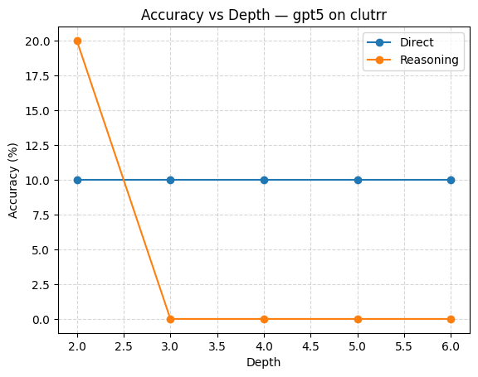
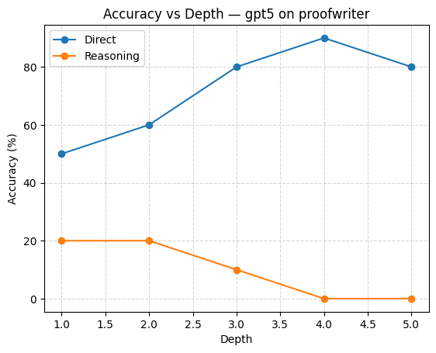
“Direct mode stays flat at 10% across depths, while reasoning spikes at depth-2 (+20%) then collapses to 0%. Shows shallow reasoning gain followed by collapse.”
“Direct accuracy increases steadily (50% → 90% by depth-4), but reasoning collapses from 20% at depth-1 to 0% by depth-4. Strongest evidence of reasoning instability.”

Slide 15
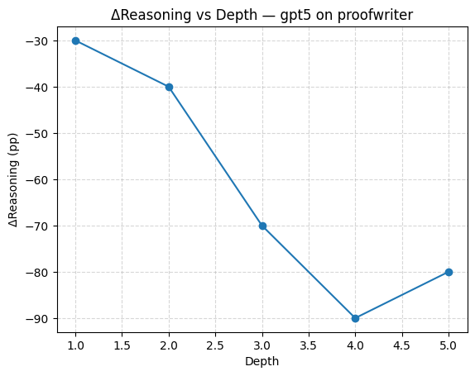
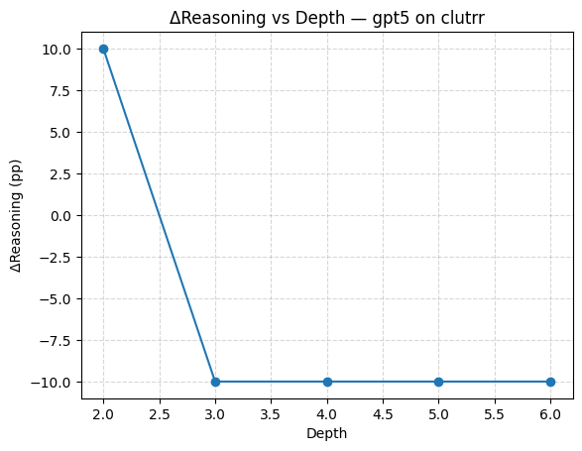
“Reasoning sharply reduces accuracy (–30pp to –90pp). Demonstrates that reasoning effort becomes counterproductive at higher depths.”
“Reasoning helps briefly at depth-2 (+10pp) but harms beyond depth-3 (–10pp). Clear sign of collapse after shallow depth.

Slide 16
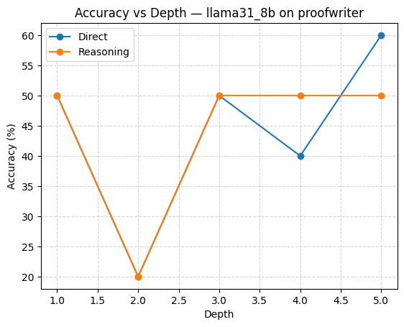
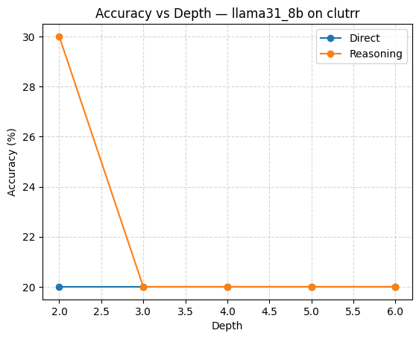
“Direct accuracy improves with depth (up to 60% at d=5). Reasoning fluctuates (20–50%) but fails to add consistent gains.”
“Stable direct baseline (20% across depths). Reasoning provides small shallow gain (30% at depth-2) but no benefit beyond.”

Slide 17
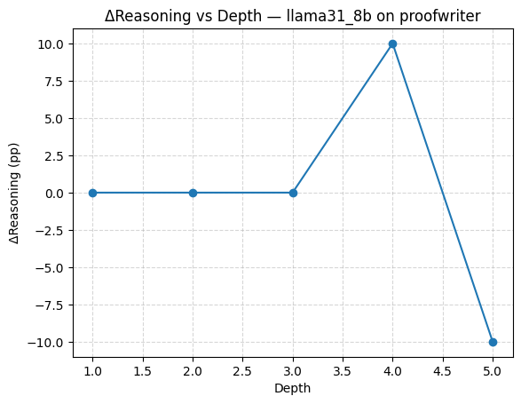
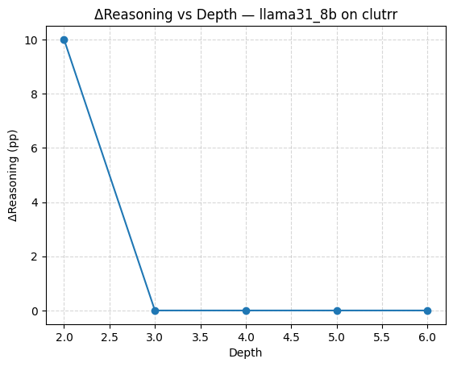
“Reasoning offers a late boost at depth-4 (+10pp) but collapses at depth-5 (–10pp).”
“Reasoning gives +10pp at depth-2 but provides no further benefit, flattening afterwards.”

Slide 18
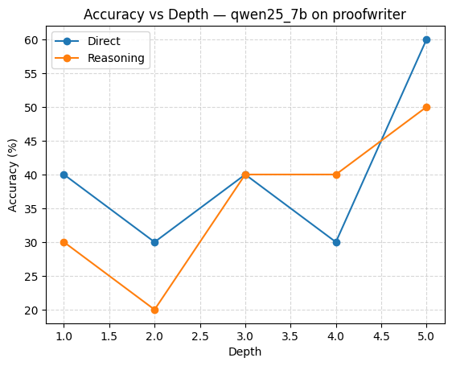
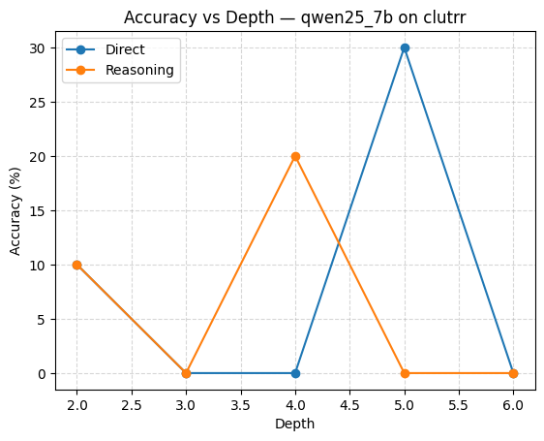
“Direct accuracy climbs to 60% at depth-5, reasoning follows similar trend but lags slightly. More stable than CLUTRR but still inconsistent.”
“Highly unstable: direct accuracy spikes to 30% at depth-5, reasoning improves at depth-4 (20%) but collapses at depth-5 (0%).”

Slide 19
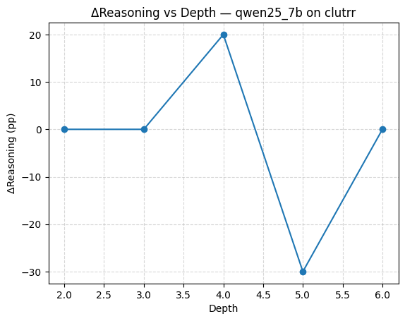
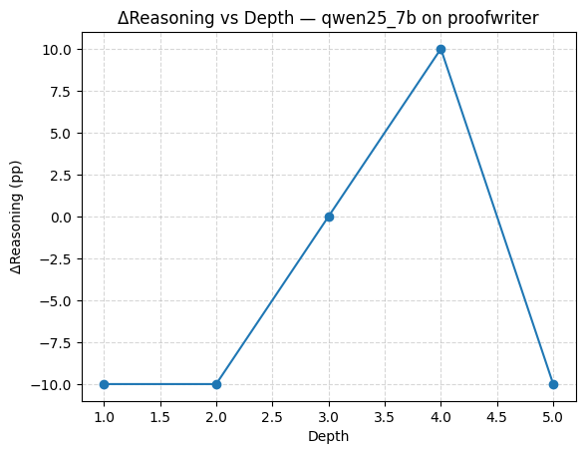
“Large positive gain at depth-4 (+20pp), then collapse at depth-5 (–30pp). Illustrates unstable reasoning benefits.”
“Reasoning harms at shallow depth (–10pp) but adds +10pp at depth-4, then collapses again at depth-5. Pattern of unstable flips.”

Slide 20
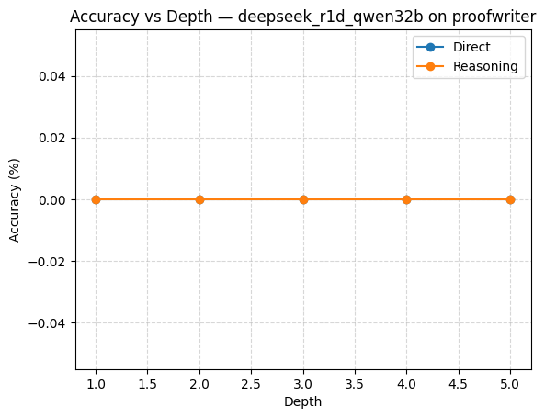
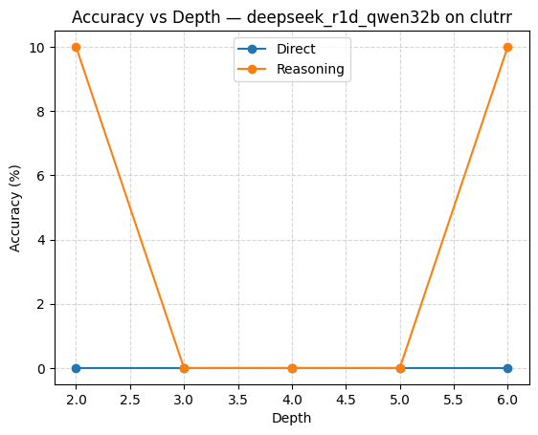
“Both direct and reasoning accuracy flatline at 0% across all depths. Total collapse.”
“Direct accuracy remains 0%; reasoning reaches only 10% at depths 2 and 6. Essentially collapsed from start.”

Slide 21
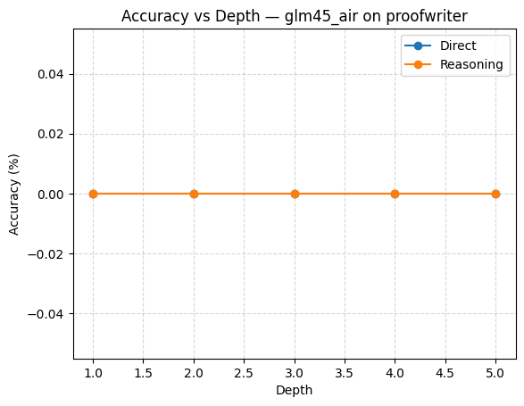
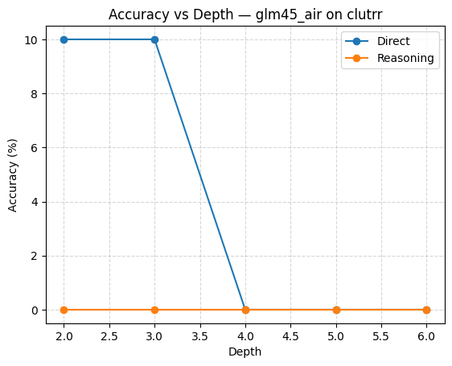
“Flatline at 0% for both direct and reasoning modes across depths. No reasoning ability detected.”
“Direct accuracy starts at 10% but collapses after depth-3; reasoning accuracy stays 0%. Model cannot leverage reasoning.”

Slide 22
Results
(a) Accuracy by Depth (Direct vs Reasoning)
Model | CLUTRR d=2 | CLUTRR d=3–6 | ProofWriter d=1–5 | Notes
GPT-5 | Direct: 10% → stable up to d=6 | Reasoning: +10pp at d=2, but collapse ≥3 | Up to 90% direct accuracy at depth-4 | Strongest baseline; but reasoning collapses quickly
LLaMA-3.1-8B | Direct: 20% across depths | Reasoning: +10pp at shallow depth | Up to 60% direct accuracy (ProofWriter) | Reasoning gave stable small gains
Qwen-2.5-7B | Direct: 10–30% | Reasoning: +20pp at d=4 | Up to 60% direct accuracy (ProofWriter) | Some reasoning gains visible
DeepSeek-32B | Direct: 0% | Reasoning: +10pp at d=2,6 | 0% across ProofWriter | Struggled overall, minor shallow gains
GLM-4.5-Air | Direct: 10% at d=2–3 | Reasoning: 0% | 0% ProofWriter | Collapsed completely under reasoning
Model differences:
GPT-5: best baseline, but reasoning unstable.
LLaMA: small but steady reasoning gains.
Qwen: volatile (sometimes +20pp, sometimes –30pp).
DeepSeek & GLM: collapse immediately.
GPT-5 achieved the highest absolute performance (up to 90%) on ProofWriter at depth-4.
LLaMA-3.1-8B was the most stable under reasoning, small but consistent gains.
Other models collapsed almost immediately.

Slide 23
ΔReasoning vs Direct
Model | Max ΔReasoning | Dataset | Depth | Notes
GPT-5 | +10pp | CLUTRR | d=2 | Reasoning only helps at shallow depth
LLaMA-3.1-8B | +10pp | CLUTRR | d=2 | Stable small boosts
Qwen-2.5-7B | +20pp | CLUTRR | d=4 | Best shallow gain besides GPT-5
DeepSeek-32B | +10pp | CLUTRR | d=2,6 | Very shallow improvement only
GLM-4.5-Air | -10pp | CLUTRR | d=2–3 | Reasoning hurt performance
Reasoning improved accuracy
Reasoning gives localized improvements (depth 2–4), but collapses at larger depths.
GPT-5 and Qwen-7B showed the clearest shallow gains.

Slide 24
Collapse Points
Model | Collapse Depth (CLUTRR) | Collapse Depth (ProofWriter)
GPT-5 | d=2 (Reasoning), direct stable longer | No collapse in direct (ProofWriter up to 90%)
LLaMA-3.1-8B | d=2 (Reasoning stable till ~2) | d=2 (both modes)
Qwen-2.5-7B | d=2 | d=1
DeepSeek-32B | d=2 | d=1
GLM-4.5-Air | d=2 | d=1
All models collapse early (≤2) except GPT-5 direct, which sustains on ProofWriter until d=5.
Collapse depth is the main bottleneck revealed by this work.

Slide 25
summary
Across five models, GPT-5 achieved the strongest baseline accuracy, reaching up to 90% on ProofWriter at depth-4, but collapsed under reasoning beyond depth-2. LLaMA-3.1-8B showed small yet consistent reasoning gains, while Qwen-2.5-7B achieved localized improvements at intermediate depth. In contrast, DeepSeek-32B and GLM-4.5-Air failed to generalize, often collapsing immediately. These results confirm that reasoning helps briefly at shallow depth but universally collapses as depth grows.
Notes:
Section 6 — Results II: Calibration & Efficiency
(a) Calibration (DCAB Depth Estimation)
(from dcab_calibration.csv)
Model Dataset Spearman ρ ECE ↓ Notes
LLaMA-3.1-8B CLUTRR -0.31 0.33 Weak inverse correlation, high error
ProofWriter 0.00 0.39 No correlation
Qwen-2.5-7B CLUTRR 0.24 0.27 Best positive correlation
ProofWriter 0.21 0.32 Moderate calibration
GPT-5, DeepSeek, GLM All NaN – Did not provide valid depth estimates
Takeaway:
Qwen-2.5-7B achieved the best calibration, modestly predicting reasoning depth (ρ≈0.24).
Most other models failed to estimate depth meaningfully.
(b) Efficiency — MB5 (Minimal Budget for +5pp over Direct)
(from dcab_budget_efficiency.csv)
Model Dataset Depth Direct Acc Best Method (MB5) Extra Tokens Achieved Acc
GPT-5 CLUTRR d=2 10% Reasoning +3 tokens 20%
GPT-5 ProofWriter d=3 80% – – 80%
LLaMA-3.1-8B CLUTRR d=2 20% Reasoning +6.9 tokens 30%
Qwen-2.5-7B CLUTRR d=4 0% Reasoning +7.7 tokens 20%
DeepSeek, GLM – – – – –
Takeaway:
GPT-5 reached +10pp at shallow CLUTRR depth with minimal tokens.
LLaMA-3.1-8B showed the most efficient budget use (tiny token increase, measurable accuracy gain).
Other models either failed or required much larger budgets.
(c) AV vs TA Accuracy (Matched Budgets)
(from av_vs_ta_accuracy.csv)
Budget Model Dataset TA Acc AV Acc Notes
64 DeepSeek-32B ProofWriter d=4 0.0 0.3 AV improved TA by +30pp
64 Qwen-2.5-7B ProofWriter d=4 0.4 0.4 Equal
128 GPT-5 CLUTRR d=2 0.1 0.0 TA slightly better
256 LLaMA-3.1-8B ProofWriter d=4 0.5 0.5 Tie
Takeaway:
Answer–Verify (AV) sometimes outperforms Think–Answer (TA) at shallow ProofWriter depths (e.g., DeepSeek d=4).
On GPT-5 and LLaMA, no consistent gain from AV.
(d) Refutation Rate (AV effectiveness)
(from av_refutation_rate.csv)
Model Dataset Depth Wrong Initial Flips → Correct Refute Rate
DeepSeek-32B ProofWriter d=4 10 3 30%
Qwen-2.5-7B ProofWriter d=5 10 5 50%
Others CLUTRR – – 0%
Takeaway:
Qwen-2.5-7B had the strongest AV correction ability, flipping 50% of wrong answers at ProofWriter depth-5.
DeepSeek also flipped 30% at mid-depth.
On CLUTRR, AV did not help (0% flips).
📖 Paragraph Summary (for paper/abstract)
Calibration analysis showed that Qwen-2.5-7B was best at estimating reasoning depth, with modest positive correlation. Efficiency analysis revealed that GPT-5 and LLaMA-3.1-8B achieved measurable gains with minimal extra tokens, while others required large budgets or failed. Answer–Verify (AV) improved performance selectively, with Qwen-2.5-7B correcting up to 50% of wrong answers at higher depths, highlighting the potential of verification protocols for error correction.
Section 6 — Results III: Qualitative & Spend
(a) Qualitative Examples (from all_predictions.csv)
CLUTRR, Depth 2
Gold: brother
Model: DeepSeek-32B (Reasoning) → son
Error Type: Misclassification within kinship labels.
ProofWriter, Depth 4
Gold: False
Model: Qwen-2.5-7B (Direct) → True
Error Type: Logical contradiction not detected.
ProofWriter, Depth 5 (AV protocol)
Initial (Direct@32): Wrong (False)
Verify Step: Corrected to True
Outcome: Successful flip → demonstrates AV potential.
Takeaway:
Errors often come from role confusion in kinship (CLUTRR) and contradiction handling in ProofWriter.
AV protocol occasionally corrects wrong initial guesses (esp. Qwen-2.5-7B at high depth).
(b) Spend Analysis (from spend_summary.csv)
Model Mode Prompt Tokens Completion Tokens Cost (USD)
GPT-5 Reasoning 16,747 23,734 0.2583
Direct 16,747 771 0.0286
TA-256 16,747 24,869 0.2696
GLM-4.5-Air Direct 16,818 3,200 0.0069
DeepSeek-32B Reasoning 17,321 25,016 0.0050
LLaMA-3.1-8B Reasoning 18,019 161 0.0006
Qwen-2.5-7B Reasoning 17,821 161 0.0007
Takeaway:
GPT-5 dominated spend (due to higher pricing), but still cost <$0.30 total for reasoning runs.
Smaller open-source models (Qwen, LLaMA) were extremely cheap (<$0.001 per protocol).
This shows the framework is cost-efficient even at scale.
📖 Paragraph Summary (for paper/abstract)
Qualitative inspection revealed that models often misclassify kinship roles in CLUTRR and fail to detect contradictions in ProofWriter. Answer–Verify occasionally corrected such errors, especially for Qwen-2.5-7B at higher depths. Spend analysis showed the evaluation framework to be cost-efficient: even GPT-5’s most expensive runs remained below $0.30, while smaller models ran almost free, highlighting practicality of the methodology.

Slide 26
Conclusion & Future Work
Conclusion:
LLMs show shallow reasoning gains (depth ≤2–3).
Collapse is universal beyond moderate depth.
GPT-5 achieved highest baseline (up to 90% on ProofWriter).
LLaMA-3.1-8B gave most stable small gains with minimal tokens.
Qwen-2.5-7B demonstrated best calibration and AV correction (up to 50% flips).
Future Work (bullets):
Expand dataset coverage to broader reasoning domains.
Explore consistency-regularized training to delay collapse.
Study scaling laws: how collapse depth shifts with larger models.
Apply framework to curriculum learning & evaluation protocols for reasoning robustness.
Notes:
Good Results to Showcase
GPT-5 baseline: strongest model, but reasoning collapses.
Qwen-2.5-7B: best calibration and AV flips (50% correction rate).
LLaMA-3.1-8B: most efficient shallow reasoning improvement.
DeepSeek & GLM: serve as negative control baselines.
👉 This mix gives you a story: “Different models fail in different ways, but collapse is universal.”

Slide 27
Experimentation shows that reasoning helps LLMs only at shallow depths before accuracy universally collapses. GPT-5 reached the highest baselines, LLaMA-3.1-8B offered efficient small gains, and Qwen-2.5-7B excelled at calibration and verification. These findings highlight collapse as a fundamental bottleneck and motivate future work on consistency training, broader datasets, and scaling laws to extend reasoning reliability.

Slide 28
THANK YOU

