Slide 1

SA-86:When Reasoning Collapses: A Depth-Aware Probe into LLM Reasoning(Student Abstract)
Azka Ikramullah¹, Abdul Majeed², Kyunghyun Lee², Seong Oun Hwang²*
Information security & machine learning Lab
¹ Department of IT Convergence Engineering, Gachon University, South Korea
² Department of Computer Engineering, Gachon University, South Korea

Slide 2
Table of contents
01
02
03
04
Research problem
Research questions
A depth-aware investigation into how LLM reasoning performance collapses as task inference depth increases.
Do reasoning prompts continue to help at deeper reasoning levels, and how does accuracy change across increasing inference depths?
Framework Overview
Experimental Setup
Our evaluation framework pairs direct and reasoning prompts across graded depths and introduces collapse-depth as a robustness metric.
Evaluation on CLUTRR and ProofWriter using five LLMs, 100 balanced samples per depth, and per-depth accuracy comparison.

Slide 3
Table of contents
05
06
07
08
Key Results
Visual Results (Graphs)
Depth-aware evaluation shows shallow reasoning gains but rapid collapse as inference depth increases across all models.
Plots illustrating accuracy vs. depth, highlighting where reasoning performance deteriorates relative to direct answers.
Conclusion
Future Work
Reasoning prompts offer limited benefits and become brittle at deeper levels; collapse depth reveals true robustness.
Extend evaluations to broader benchmarks and explore training or architectural methods to mitigate depth-driven collapse.

Slide 4
01
Research
problem
A depth-aware investigation into how LLM reasoning performance collapses as task inference depth increases.

Slide 5
The Problem
Large Language Models (LLMs) often appear to reason well on shallow tasks.
However, their reasoning performance becomes unstable or collapses as reasoning depth increases.
Why This Is a Problem
Real tasks require multi-step inference, not just surface-level reasoning.
Chain-of-thought prompting gives an illusion of reasoning and fails on complex tasks.
Current benchmarks do not evaluate depth, hiding these weaknesses.
The Gap
We lack a systematic way to measure how reasoning breaks as tasks become deeper and more complex.

Slide 6
02
Research questions
Do reasoning prompts continue to help at deeper reasoning levels, and how does accuracy change across increasing inference depths?

Slide 7
RQ1 — Do reasoning prompts actually help as reasoning depth increases?
Do chain-of-thought prompts improve accuracy only at shallow depths, or can they sustain performance in deeper multi-step inference tasks?
RQ2 — How does model accuracy change across controlled reasoning depths?
How do different LLMs behave when inference depth increases from simple to complex reasoning chains?
RQ3 — When and where does reasoning collapse occur?
At what reasoning depth do models fall below a minimally useful accuracy threshold (collapse depth)?
RQ4 — Do open-source and closed-source models show different depth-driven failure patterns?
How do models like GPT-5 compare with LLaMA, Qwen, DeepSeek, and GLM under deep reasoning?

Slide 8
Background
LLM Reasoning & Chain-of-Thought (CoT)
CoT prompting improves performance on shallow reasoning tasks by explaining intermediate steps.
Studies (Wei et al., 2022) suggest it enhances LLMs’ accuracy for simple tasks.
Recent evidence shows these improvements may stem from pattern exposure, not genuine multi-step reasoning.
Illusion of Reasoning
Shojaee et al. (2025) demonstrated that LLMs often produce an illusion of reasoning, failing on more complex tasks.
Despite longer explanations, LLMs still reinforce systematic logical errors.
CoT is fragile and collapses under deep inference due to inherent weaknesses in handling complexity.
Lack of Depth-Aware Evaluation
Existing benchmarks evaluate tasks with low reasoning depth, masking deeper brittleness.
Depth — defined as the number of inference steps required — is rarely controlled or measured.
No existing framework evaluates direct vs. reasoning prompts across increasing depths.
Why Depth Matters
Real-world reasoning (logical proofs, relational inference, planning) requires multi-step, compositional inferences.
Without depth-aware evaluation, LLMs may appear strong on “easy” datasets while failing abruptly on harder compositions.

Slide 9
03
Framework Overview
Our evaluation framework pairs direct and reasoning prompts across graded depths and introduces collapse-depth as a robustness metric.

Slide 10
Evaluation Framework
Direct vs. Reasoning Prompts: Our framework compares models using both direct prompts (final answer only) and reasoning prompts (with intermediate steps) at various inference depths.
Collapse Depth: We introduce collapse depth as a metric to assess where reasoning fails. This is the depth at which accuracy falls below 50%, marking the collapse of reasoning capacity.
Controlled Depth Sampling: We evaluate across graded depths, ensuring models are tested with an increasing number of inference steps to simulate complex tasks.

Slide 11
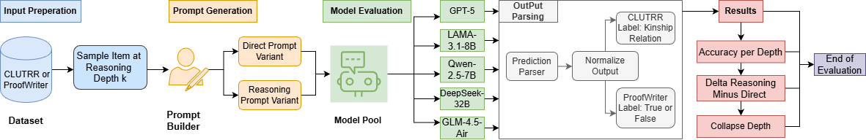
Figure 1: Evaluation framework that compares direct and reasoning prompts across controlled depths, tracking accuracy and introducing collapse depth as the robustness indicator.

Slide 12
04
Experimental Setup
Evaluation on CLUTRR and ProofWriter using five LLMs, 100 balanced samples per depth, and per-depth accuracy comparison.

Slide 13
Datasets
CLUTRR (Kinship Reasoning): Depths 2–6
ProofWriter (Logical Entailment): Depths 1–5
Models Evaluated
Closed-source: GPT-5
Open-source:
LLaMA-3.1-8B
Qwen-2.5-7B
DeepSeek-32B
GLM-4.5-Air
Evaluation Methodology
100 balanced items per depth for each dataset.
Comparison: Direct prompts (final answer) vs. Reasoning prompts (intermediate steps).
Metrics: Accuracy at each depth, collapse depth (where performance drops below 50%).

Slide 14
05
Key Results
Depth-aware evaluation shows shallow reasoning gains but rapid collapse as inference depth increases across all models.

Slide 15
Model | Best Dir/Rea (PW) | Best Gain (CL) | Coll. (CL/PW) | d2 | d3 | d4 | d5
GPT-5 | 90/0% @ d4 | +10% @ d2 | 2/1 | 60/20/+10 | 80/10/-10 | 90/0/-10 | 80/0/-10
LLaMA-3.1-8B | 60/50% @ d5 | +10% @ d2 | 2/2 | 20/20/+10 | 50/50/0 | 40/50/0 | 60/50/0
Qwen-2.5-7B | 60/50% @ d5 | +20% @ d4 | 2/1 | 30/20/0 | 40/40/20 | 30/40/20 | 60/50/-30
DeepSeek-32B | 0% | ≤10% | 2/1 | 0/0 | 0/0 | 0/0 | 0/0
GLM-4.5-Air | 0% | 0% | 2/1 | 0/0 | 0/0 | 0/0 | 0/0

Slide 16
Key Findings
Shallow gains: Small improvements in reasoning accuracy at low inference depths (e.g., depth 2).
Rapid collapse: Significant performance drop beyond depth 3, even for GPT-5.
Unstable behavior: Open-source models like LLaMA and Qwen show inconsistent improvements.
No improvements: DeepSeek-32B and GLM-4.5-Air show no reasoning gain at any depth.
Takeaways
Reasoning prompts are ineffective at deeper depths, where task complexity overwhelms model performance.
Current benchmarks miss the brittleness of reasoning in LLMs at increasing complexity.

Slide 17
06
Visual Results (Graphs)
Plots illustrating accuracy vs. depth, highlighting where reasoning performance deteriorates relative to direct answers.

Slide 18
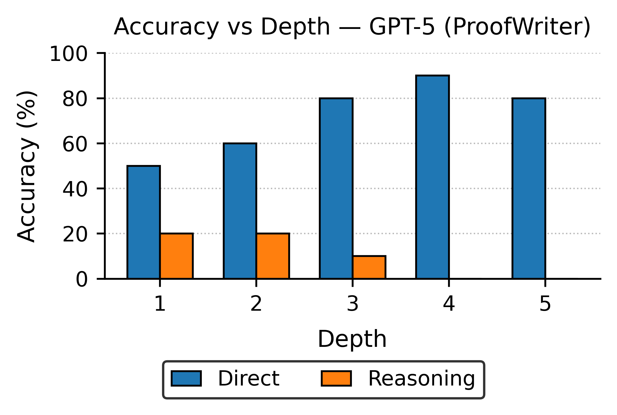
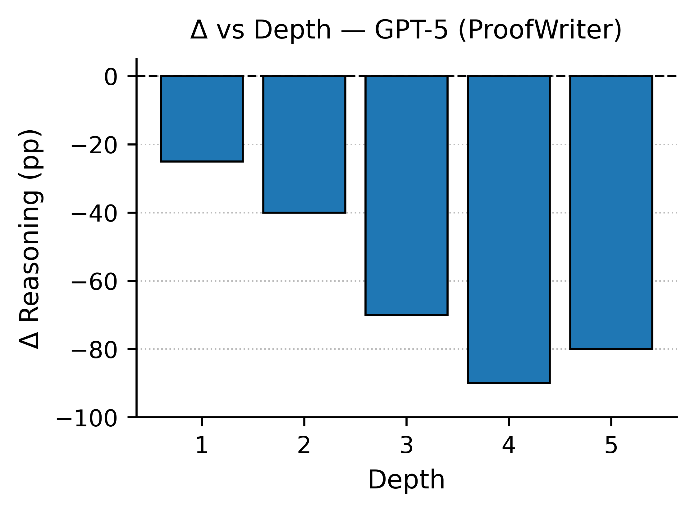
Figure 1: Accuracy vs Depth — GPT-5 (ProofWriter) Shows how reasoning performance deteriorates as depth increases.
Figure 2: Δ vs Depth — GPT-5 (ProofWriter) Difference between reasoning and direct answers, highlighting the collapse points.
Shallow Depths: Most models show stable performance with direct answers. Reasoning boosts performance marginally.

Slide 19
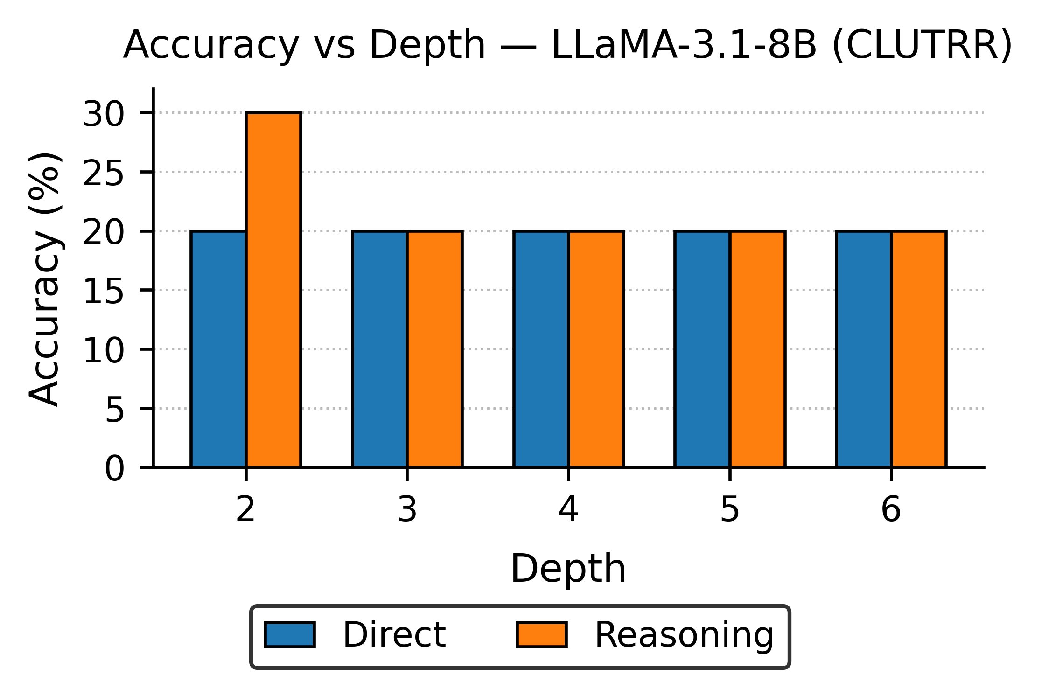
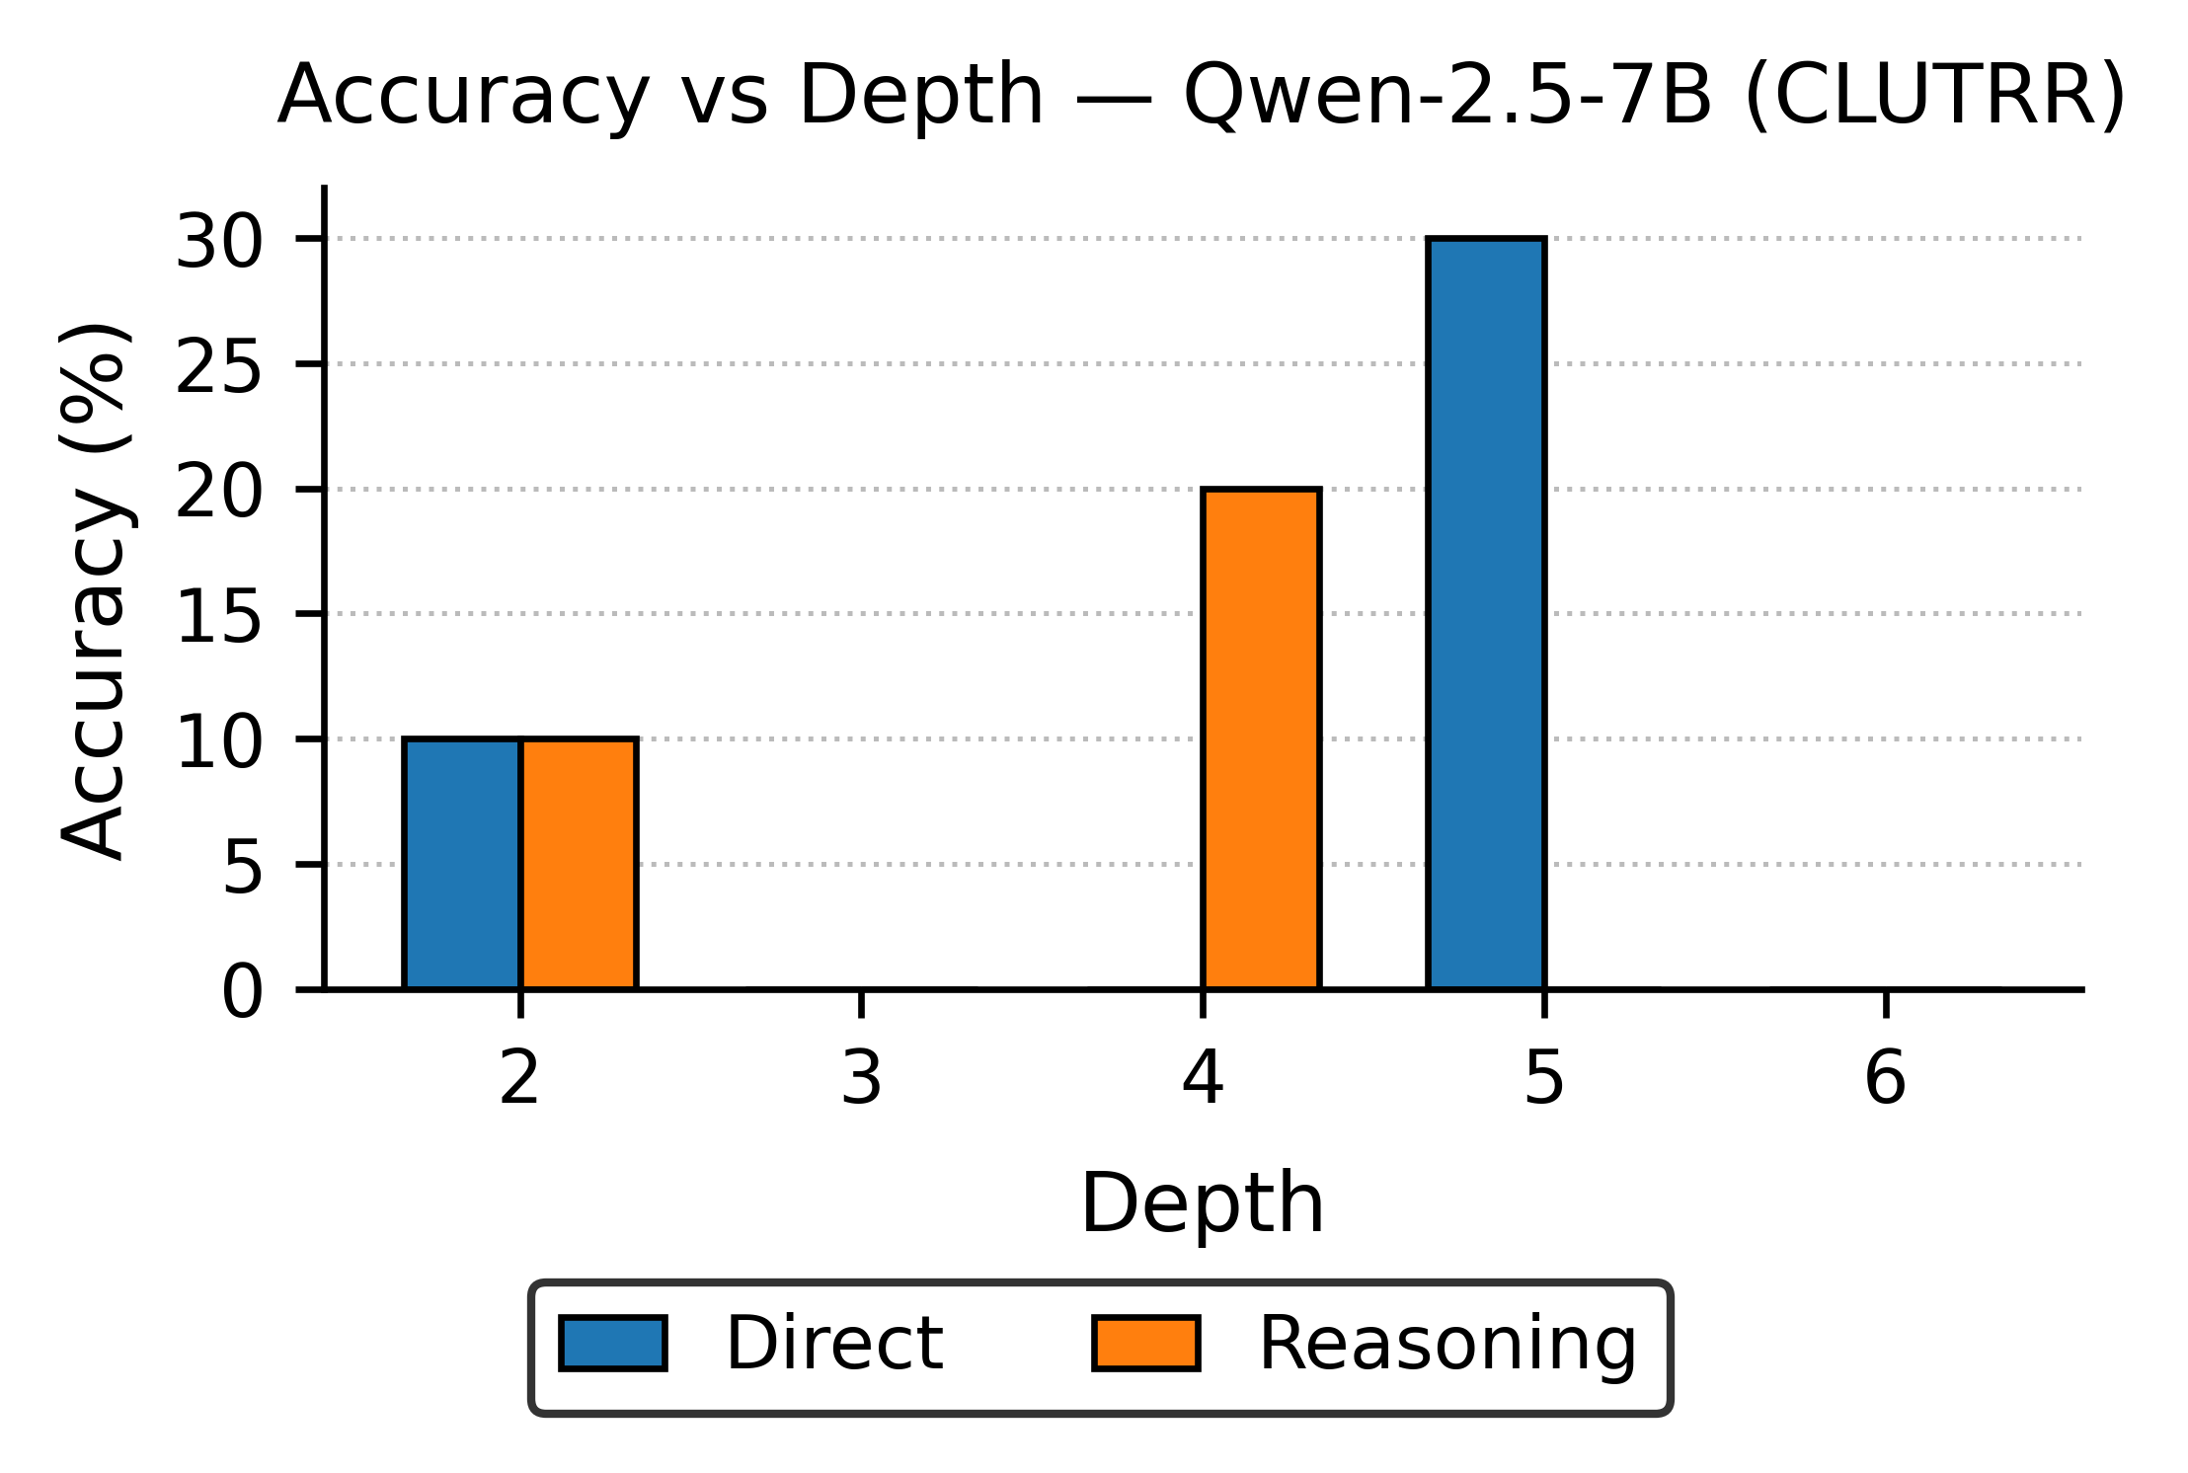
Figure 3: Accuracy vs Depth — LLaMA-3.1-8B (CLUTRR) Shows relatively stable performance for reasoning and direct prompts at deeper depths.
Figure 4: Accuracy vs Depth — Qwen-2.5-7B (CLUTRR) A sharp improvement at depth 4, followed by a collapse.
Deep Reasoning: Across all models, reasoning performance collapses beyond depth 3, illustrating the depth-driven brittleness of reasoning in LLMs.

Slide 20
Conclusion
Key Observation
Implications
Reasoning prompts offer limited benefits at shallow depths.
As the depth of reasoning increases, models' performance collapses, revealing depth-driven brittleness.
Collapse depth is a critical metric for assessing the robustness of reasoning in LLMs.
Current benchmarks that do not measure reasoning beyond shallow depths tend to underestimate LLMs’ limitations.
Depth-aware evaluations offer a better understanding of when reasoning breaks down and highlight model weaknesses that are not captured by conventional tasks.

Slide 21
Future Work
Next Steps:
Extend depth-graded evaluations to broader reasoning benchmarks beyond CLUTRR and ProofWriter.
Investigate training strategies or architectural methods that could improve reasoning stability and mitigate collapse.
Exploration Areas:
Assess depth-aware learning techniques to enhance performance on tasks requiring compositional and logical reasoning.
Develop frameworks that can handle complex multi-step reasoning tasks while maintaining consistent performance.

Slide 22
References
Wei et al., 2022 — Chain-of-Thought prompting improves shallow reasoning.
Shojaee et al., 2025 — LLMs show illusion of reasoning; collapse as complexity increases.
Sinha et al., 2019 — CLUTRR: depth-graded relational reasoning benchmark.
Tafjord & Clark, 2021 — ProofWriter: multi-step logical entailment dataset.

Slide 23


THANK YOU! QUESTIONS?
Azka Ikramullah
First Author & Presenter IT Convergence Engineering, Gachon University 📧 202540395@gachon.ac.kr
Scan for links: LinkedIn GitHub QR

