Slide 1




CSV FILES
By
AZKA KARIM

Slide 2

WHAT ARE CSV FILE

Slide 3
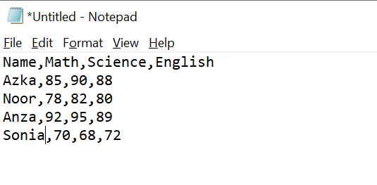
Introduction
CSV = Comma-Separated Values
Stores tabular data in plain text
Widely used for:
Data exchange (Excel, Databases, Python, ML)
Lightweight and easy to use
Notes:
When conducting research, it is easy to go to one source: Wikipedia. However, you need to include a variety of sources in your research. Consider the following sources:
Who can I interview to get more information on the topic?
Is the topic current and will it be relevant to my audience?
What articles, blogs, and magazines may have something related to my topic?
Is there a YouTube video on the topic? If so, what is it about?
What images can I find related to the topic?

Slide 4

Difference between csv and xls/xlsx
Feature | .xls (Excel) | .csv
File Type | Binary (Excel) | Plain text
Data | Supports formulas, charts, formatting | Only raw data
Size | Larger | Smaller
Compatibility | Only Excel & tools | Universal
Speed | Slower | Faster
Notes:
Once you find your sources, you will want to evaluate your sources using the following questions:
Author:
Who is the author?
Why should I believe what he or she has to say on the topic?
Is the author seen as an expert on the topic? How do you know?
Current:
How current is the information in the source?
When was the source published?
Is the information out-of-date?
Accuracy:
Is the content accurate?
Is the information presented objectively? Do they share the pros and cons?

Slide 5
Point to noted
Yes, a CSV file can be easily opened in Excel either by double-clicking it, selecting File → Open in Excel. However, unlike Excel files, CSV files only store raw data without any formatting, formulas, charts, or multiple sheets. When opened in Excel, the data is displayed in tabular form, but if you save it again as a CSV, any formatting or formulas you applied will be lost. This makes CSV ideal for lightweight data exchange, while Excel formats like .xlsx are better for advanced features and presentation.
Notes:
When conducting research, it is easy to go to one source: Wikipedia. However, you need to include a variety of sources in your research. Consider the following sources:
Who can I interview to get more information on the topic?
Is the topic current and will it be relevant to my audience?
What articles, blogs, and magazines may have something related to my topic?
Is there a YouTube video on the topic? If so, what is it about?
What images can I find related to the topic?

Slide 6
Create CSV Files
There are 2 methods
Create CSV Manually
Create CSV with Python
Notes:
Now, that you have narrowed your topic, you will want to organize your research in a structure that works. There are some common organizational patterns based on the kind of research you are doing.
Organizational Structures:
Cause and Effect- this kind of structure is great for explaining the causes and effects of a topic
Compare and Contrast- in this pattern you highlight the similarities and differences of the topic
Explain process- this structure is great for outlining a series of steps to follow;
Definition- if you want to make sure your audience understands what something is using illustrations, meanings, clarifying misconceptions, you may want to use this structure
Classification- a common organizational structure is grouping like topics or facts from the research together. For instance, in the internet safety about social media apps, you may organize the research where you look at each social media app one at a time

Slide 7
Method 1: Create CSV Manually
Open Notepad (or any text editor).
Copy this example data:
Notes:
When conducting research, it is easy to go to one source: Wikipedia. However, you need to include a variety of sources in your research. Consider the following sources:
Who can I interview to get more information on the topic?
Is the topic current and will it be relevant to my audience?
What articles, blogs, and magazines may have something related to my topic?
Is there a YouTube video on the topic? If so, what is it about?
What images can I find related to the topic?

Slide 8
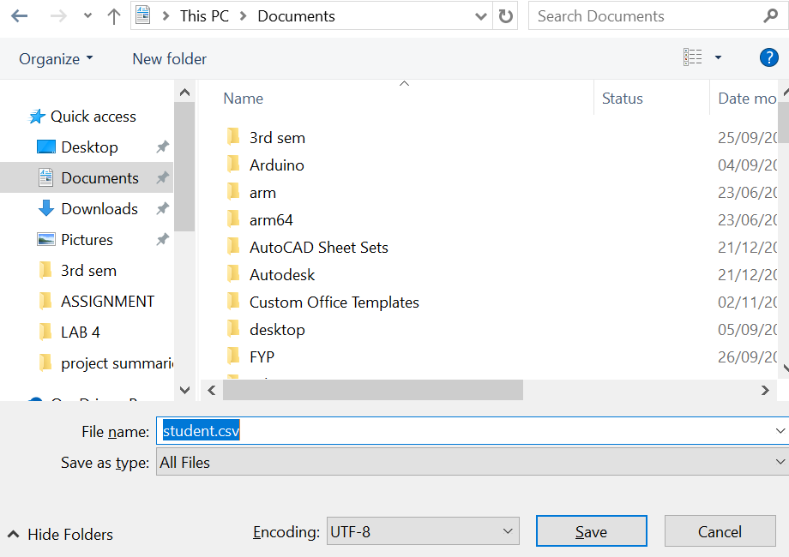
Method 1: Create CSV Manually
Save the file as students.csv
File → Save As
File name: Students.csv
Save as type: All Files
Encoding: UTF-8
✅ Done! You now have a CSV file
File saved
Notes:
When conducting research, it is easy to go to one source: Wikipedia. However, you need to include a variety of sources in your research. Consider the following sources:
Who can I interview to get more information on the topic?
Is the topic current and will it be relevant to my audience?
What articles, blogs, and magazines may have something related to my topic?
Is there a YouTube video on the topic? If so, what is it about?
What images can I find related to the topic?

Slide 9
🔹 Method 2: Create CSV with Python
import csv
# Data for the CSV
data = [
["Name", "Math", "Science", "English"],
[“Azka", 85, 90, 88],
[“Noor", 78, 82, 80],
[“Anza", 92, 95, 89],
[“Sonia", 70, 68, 72]
]
# Write data to students.csv
with open(“students_Record.csv", "w", newline="") as file:
writer = csv.writer(file)
writer.writerows(data)
print("students_Record.csv file created successfully!")
Code
After running this, a file called students_Record.csv will be created in the same folder as your Python program.
Notes:
When conducting research, it is easy to go to one source: Wikipedia. However, you need to include a variety of sources in your research. Consider the following sources:
Who can I interview to get more information on the topic?
Is the topic current and will it be relevant to my audience?
What articles, blogs, and magazines may have something related to my topic?
Is there a YouTube video on the topic? If so, what is it about?
What images can I find related to the topic?

Slide 10
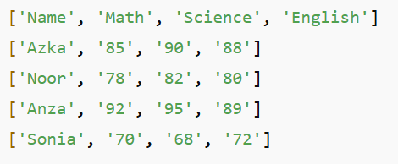
🔹 Example 1: Read & Display Data
import csv
with open("students_Record.csv", "r") as file:
reader = csv.reader(file)
for row in reader:
print(row)
Code
Output
Notes:
When conducting research, it is easy to go to one source: Wikipedia. However, you need to include a variety of sources in your research. Consider the following sources:
Who can I interview to get more information on the topic?
Is the topic current and will it be relevant to my audience?
What articles, blogs, and magazines may have something related to my topic?
Is there a YouTube video on the topic? If so, what is it about?
What images can I find related to the topic?

Slide 11
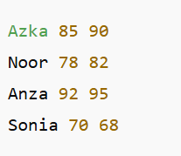
Example 2: Using DictReader (Access by Column Name)
import csv
with open("students_Record.csv", "r") as file:
reader = csv.DictReader(file)
for row in reader:
print(row["Name"], row["Math"], row["Science"])
Code
Output
Notes:
When conducting research, it is easy to go to one source: Wikipedia. However, you need to include a variety of sources in your research. Consider the following sources:
Who can I interview to get more information on the topic?
Is the topic current and will it be relevant to my audience?
What articles, blogs, and magazines may have something related to my topic?
Is there a YouTube video on the topic? If so, what is it about?
What images can I find related to the topic?

Slide 12
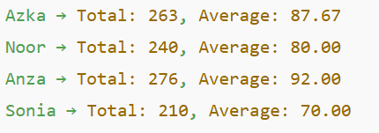
🔹 Example 3: Calculate Total & Average Marks
import csv
with open("students_Record.csv", "r") as file:
reader = csv.DictReader(file)
for row in reader:
total = int(row["Math"]) + int(row["Science"]) + int(row["English"])
average = total / 3
print(f"{row['Name']} → Total: {total}, Average: {average:.2f}")
Code
Output
Notes:
When conducting research, it is easy to go to one source: Wikipedia. However, you need to include a variety of sources in your research. Consider the following sources:
Who can I interview to get more information on the topic?
Is the topic current and will it be relevant to my audience?
What articles, blogs, and magazines may have something related to my topic?
Is there a YouTube video on the topic? If so, what is it about?
What images can I find related to the topic?

Slide 13
🔹 Example 4: Save Results into a New CSV
import csv
with open("students_Record.csv", "r") as file:
reader = csv.DictReader(file)
results = []
for row in reader:
total = int(row["Math"]) + int(row["Science"]) + int(row["English"])
average = total / 3
results.append([row["Name"], total, round(average, 2)])
with open("results.csv", "w", newline="") as file:
writer = csv.writer(file)
writer.writerow(["Name", "Total Marks", "Average"])
writer.writerows(results)
print("results.csv created with totals and averages!")
Code
Notes:
When conducting research, it is easy to go to one source: Wikipedia. However, you need to include a variety of sources in your research. Consider the following sources:
Who can I interview to get more information on the topic?
Is the topic current and will it be relevant to my audience?
What articles, blogs, and magazines may have something related to my topic?
Is there a YouTube video on the topic? If so, what is it about?
What images can I find related to the topic?

Slide 14
🔹 Example 5: Add Columns to the Same File
import csv
# Step 1: Read existing data
with open("students_Record.csv", "r") as file:
reader = csv.DictReader(file)
rows = []
for row in reader:
total = int(row["Math"]) + int(row["Science"]) + int(row["English"])
average = total / 3
# Add new values directly into the row dictionary
row["Total Marks"] = total
row["Average"] = round(average, 2)
rows.append(row)
# Step 2: Get fieldnames (old + new columns)
fieldnames = reader.fieldnames + ["Total Marks", "Average"]
# Step 3: Write back to the same CSV file
with open("students.csv", "w", newline="") as file:
writer = csv.DictWriter(file, fieldnames=fieldnames)
writer.writeheader()
writer.writerows(rows)
print("students.csv updated with totals and averages!")
Code
Notes:
When conducting research, it is easy to go to one source: Wikipedia. However, you need to include a variety of sources in your research. Consider the following sources:
Who can I interview to get more information on the topic?
Is the topic current and will it be relevant to my audience?
What articles, blogs, and magazines may have something related to my topic?
Is there a YouTube video on the topic? If so, what is it about?
What images can I find related to the topic?

Slide 15
🔹 Example 6: Add a Row with csv.writer
import csv
# New row data
new_student = ["Warda", 88, 91, 85] # Name, Math, Science, English
# Append the new row to the file
with open("students_Record.csv", "a", newline="") as file:
writer = csv.writer(file)
writer.writerow(new_student)
print("New row added successfully!")
Code
Notes:
When conducting research, it is easy to go to one source: Wikipedia. However, you need to include a variety of sources in your research. Consider the following sources:
Who can I interview to get more information on the topic?
Is the topic current and will it be relevant to my audience?
What articles, blogs, and magazines may have something related to my topic?
Is there a YouTube video on the topic? If so, what is it about?
What images can I find related to the topic?

Slide 16
THANK YOU
Notes:
You can use this slide as your opening or closing slide. Should you choose to use it as a closing, make sure you review the main points of your presentation. One creative way to do that is by adding animations to the various graphics on a slide. This slide has 4 different graphics, and, when you view the slideshow, you will see that you can click to reveal the next graphic. Similarly, as you review the main topics in your presentation, you may want each point to show up when you are addressing that topic.
Add animation to images and graphics:
Select your image or graphic.
Click on the Animations tab.
Choose from the options. The animation for this slide is “Split”. The drop-down menu in the Animation section gives even more animations you can use.
If you have multiple graphics or images, you will see a number appear next to it that notes the order of the animations.
Note: You will want to choose the animations carefully. You do not want to make your audience dizzy from your presentation.

