Slide 1
AUTONOMOUS cAR
Emb 535 Group - Maadi

Slide 2
Team Members :
Name | Email
Ahmed Gamal Azklany | asklany250@gmail.com
Abdulrahman Alaa Ahmed | abdoalaa4231@gmail.com
Mohamed Hany Mahmoud | mohamed.hany19@msa.edu.eg
Youssef Mohamed Ahmed | yf.godaa@gmail.com
Ahmed Metwally Abdalsttar | Ameto309@gmail.com

Slide 3
Introduction :
This Project aims to implement a Self-Driving Car that can avoid the obstacles with very fast response by AVR-ATmega32-Drivers .
Autonomous cars, also known as self-driving cars, are vehicles equipped with advanced technologies to navigate and operate without human input. These vehicles utilize sensors, cameras, radar, and artificial intelligence to interpret their surroundings and make decisions. The goal is to enhance safety, reduce accidents, and provide a more efficient and convenient mode of transportation.

Slide 4
Component :
AMIT AVR-KIT (AVR-ATmega32)
Ultrasonic HC- SR04.
Servo motor.
LCD
H-Bridge (L293D).
Motors.
Caster wheel.
Chassis

Slide 5


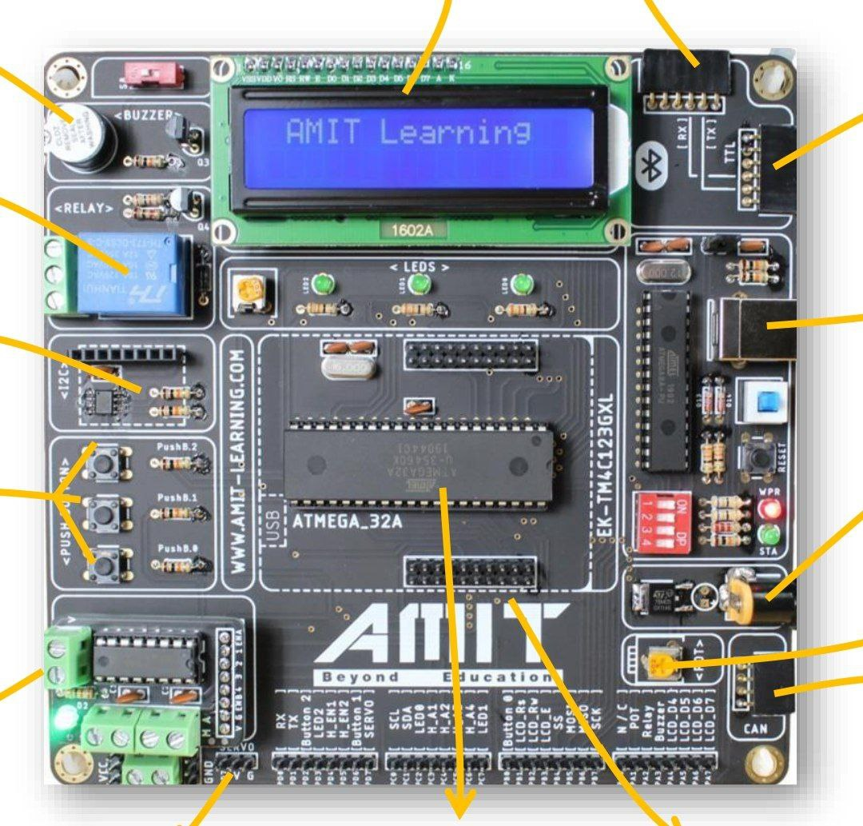
AMIT AVR-KIT (avr-atmega32)
The ATmega32 is a low-power CMOS 8-bit microcontroller based on the AVR enhanced RISC architecture. By executing powerful instructions in a single clock cycle, the ATmega32 achieves throughputs approaching 1 MIPS per MHz allowing the system designer to optimize power consumption versus processing speed.

Slide 6
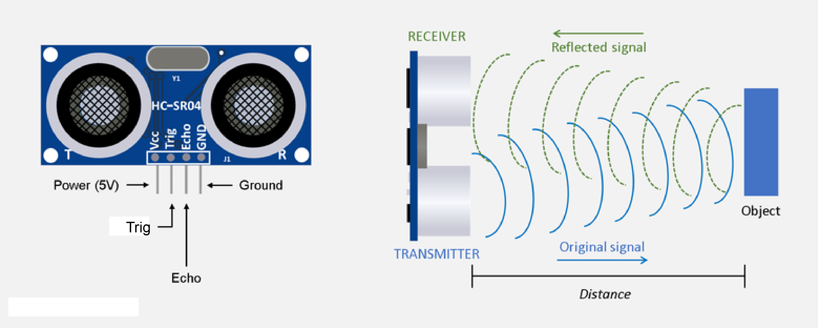
Ultrasonic Sensor
Ultrasonic is placed on servo motor axis, its function to detect the obstacles on the car way.
Ultrasonic is used to detect any obstacles towards to the car, and the car must fast react to avoid this obstacle like stopping and turning to any empty direction.
If the car found an obstacle, it must change its way according to the ultrasonic data

Slide 7
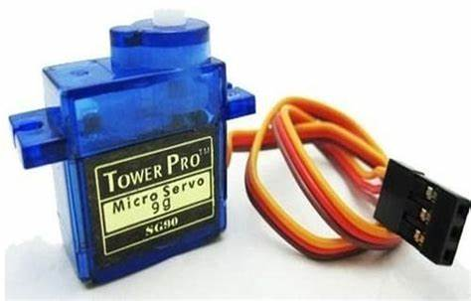
Servo Motor
Servo is used to make ultrasonic scanning around 180°.

Slide 8
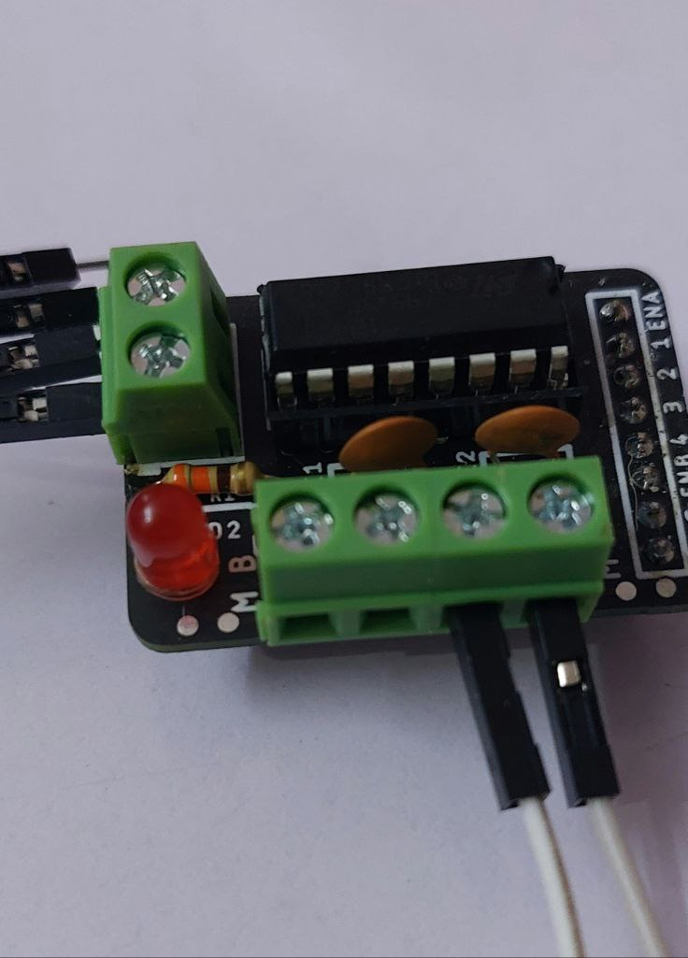
H-Bridge (L293D)
L293D is used to control the speed and the direction of motors.

Slide 9

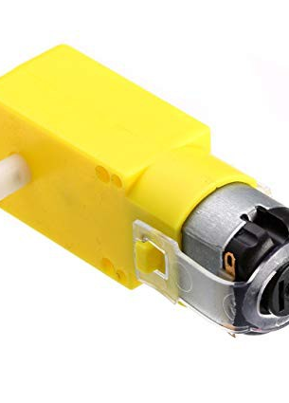
Motors
A DC motor is an electrical motor that uses direct current (DC) to produce mechanical force.

Slide 10
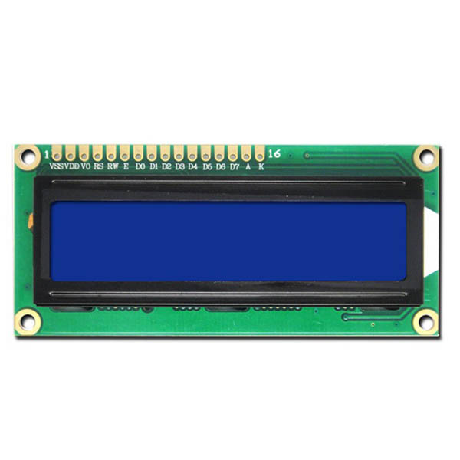
LCD
LCD displays the current direction that car
immediately move and the distance between
it and the wall.

Slide 11
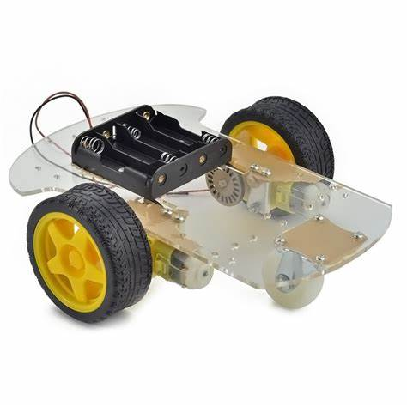
Chassis & Caster wheel.

Slide 12
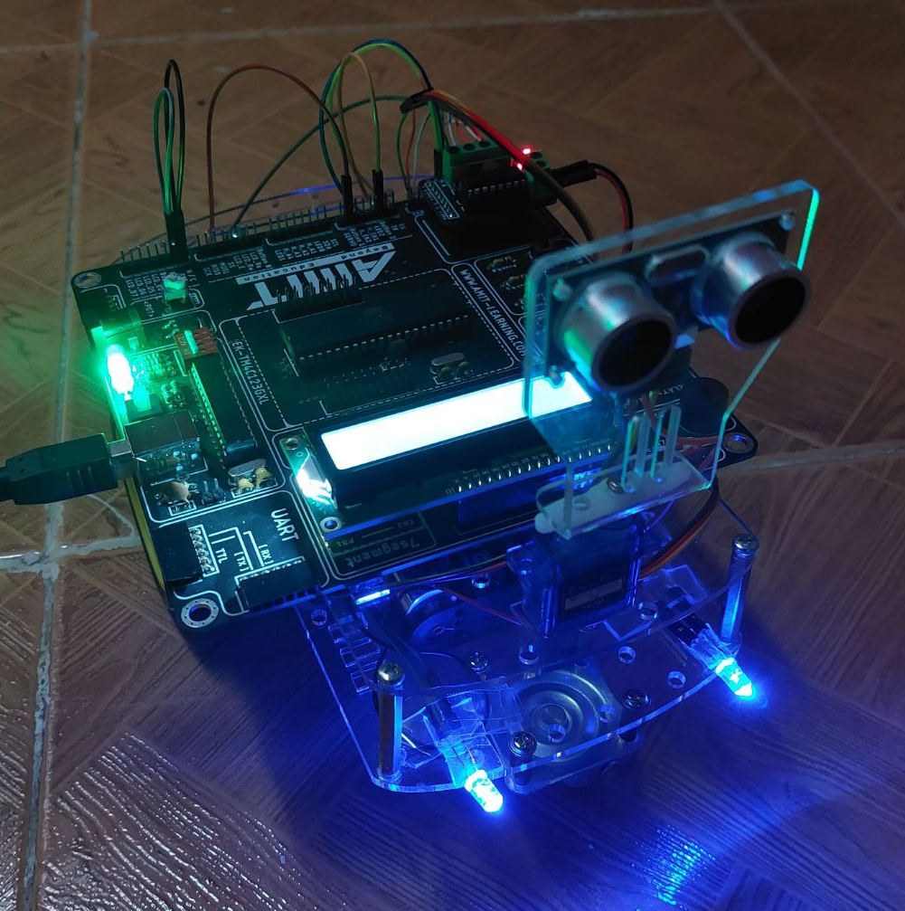
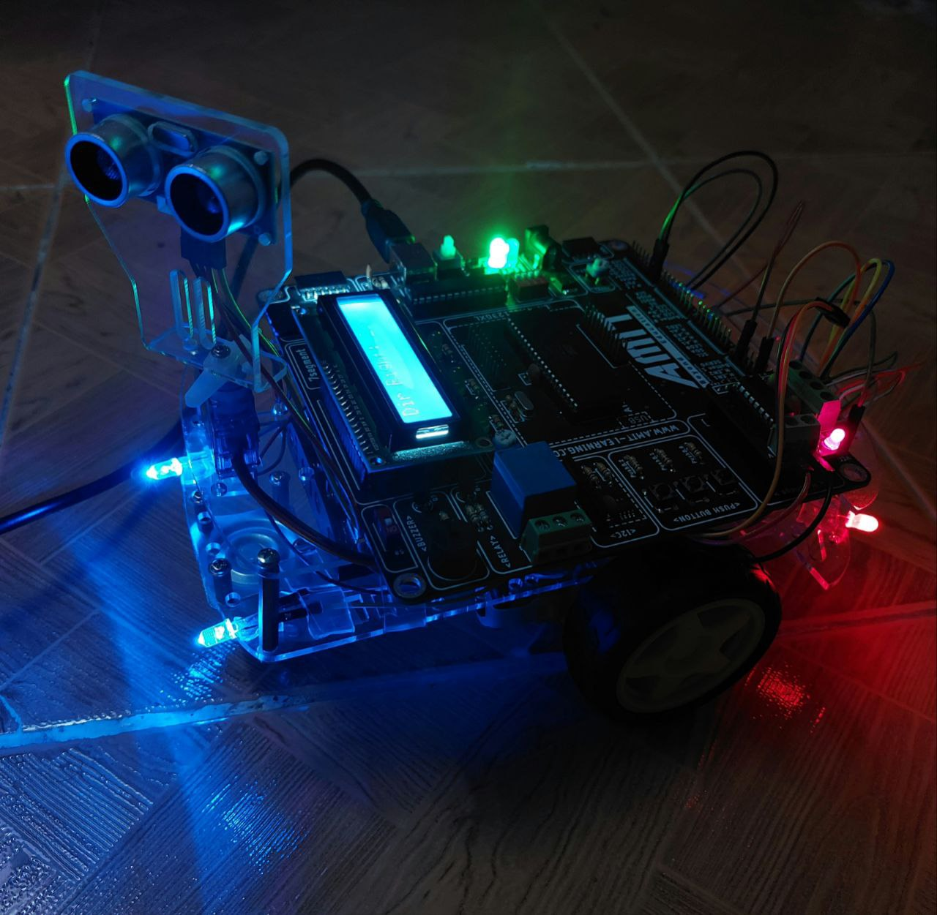
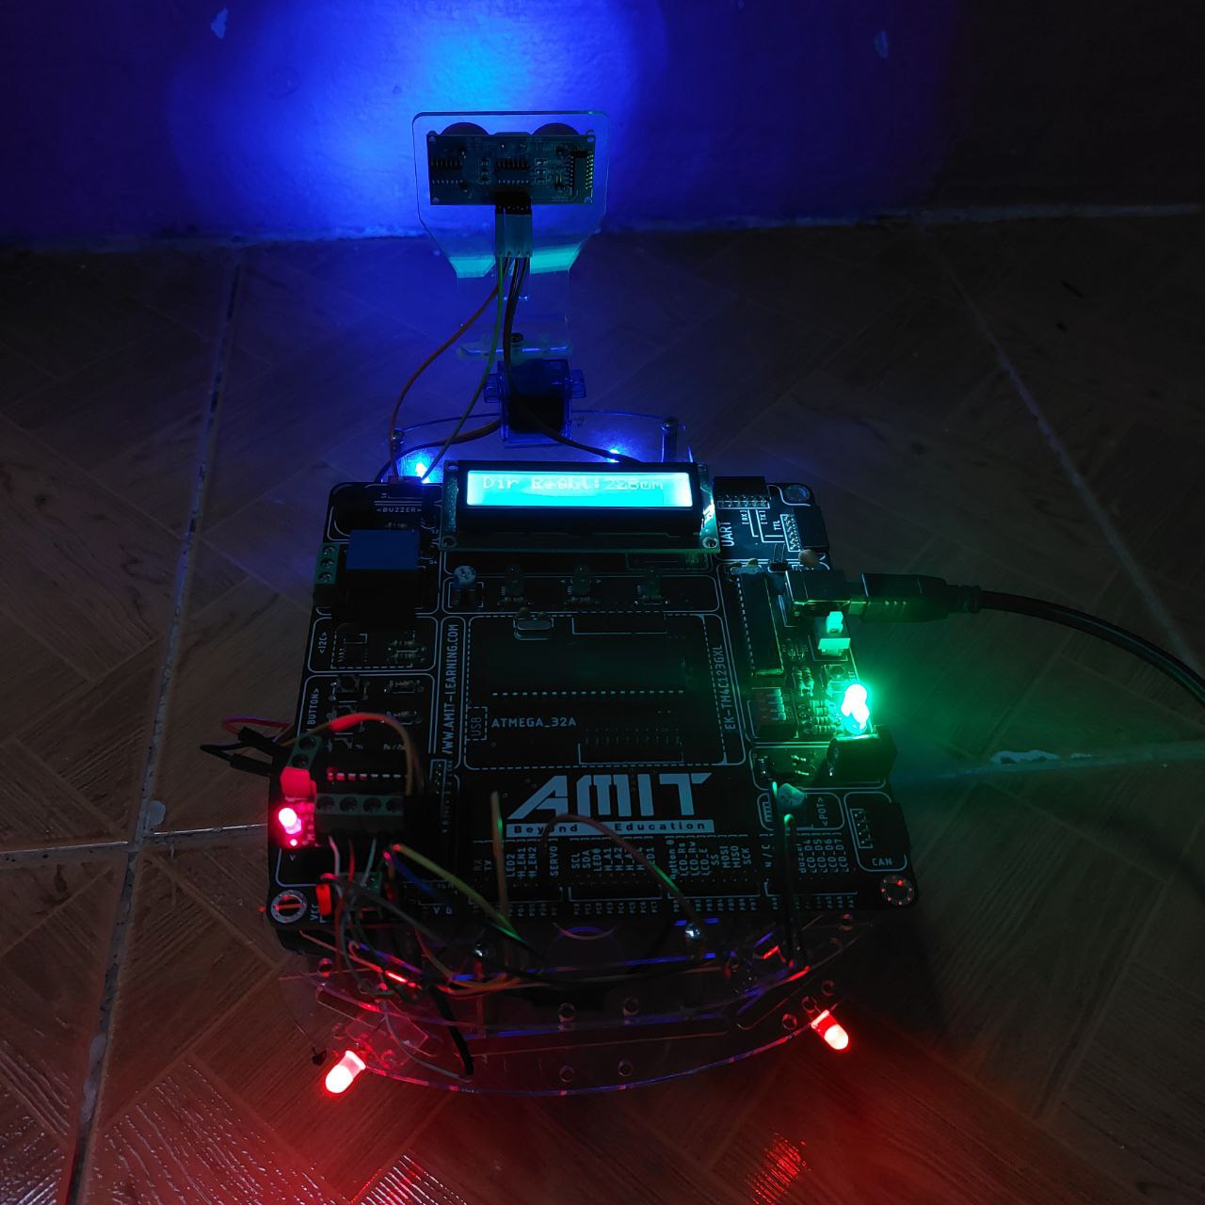

Slide 13
Drivers
Application
Autonomous Car
main
HAL
Common
MCAL
LED
LCD
Buzzer
H-Bridge
Servo Motor
DIO
Timer 0
Timer 1
Interrupt
MCU
Macro
STD-Type
Ultrasonic Sensor

Slide 14
Code Overview :
First of all We make initialization for the system by initialize the front lead and put the servo motor at angle 90° .second, the robot starts to move forward movement as the maximum speed and the ultrasonic sensor is to detect any block in the anonymous car way, and show the distance of any object in front the ultrasonic sensor at the LCD by cm, when the anonymous car see a block in front of the ultrasonic sensor when the distance between the car and the is less than 30cm, the servo start to move from 0° and 180° to see the right path and the left path if right has a distance between the car and the blocks more than the left. The car will turn right with one second(this is the time to make a car turn right or left and to be in line again). If the block is less than 10 cm the car will move backward with lead is blinking and buzzer is on, until the distance will be 30 cm then moved to right or left and this is dependent.

Slide 15
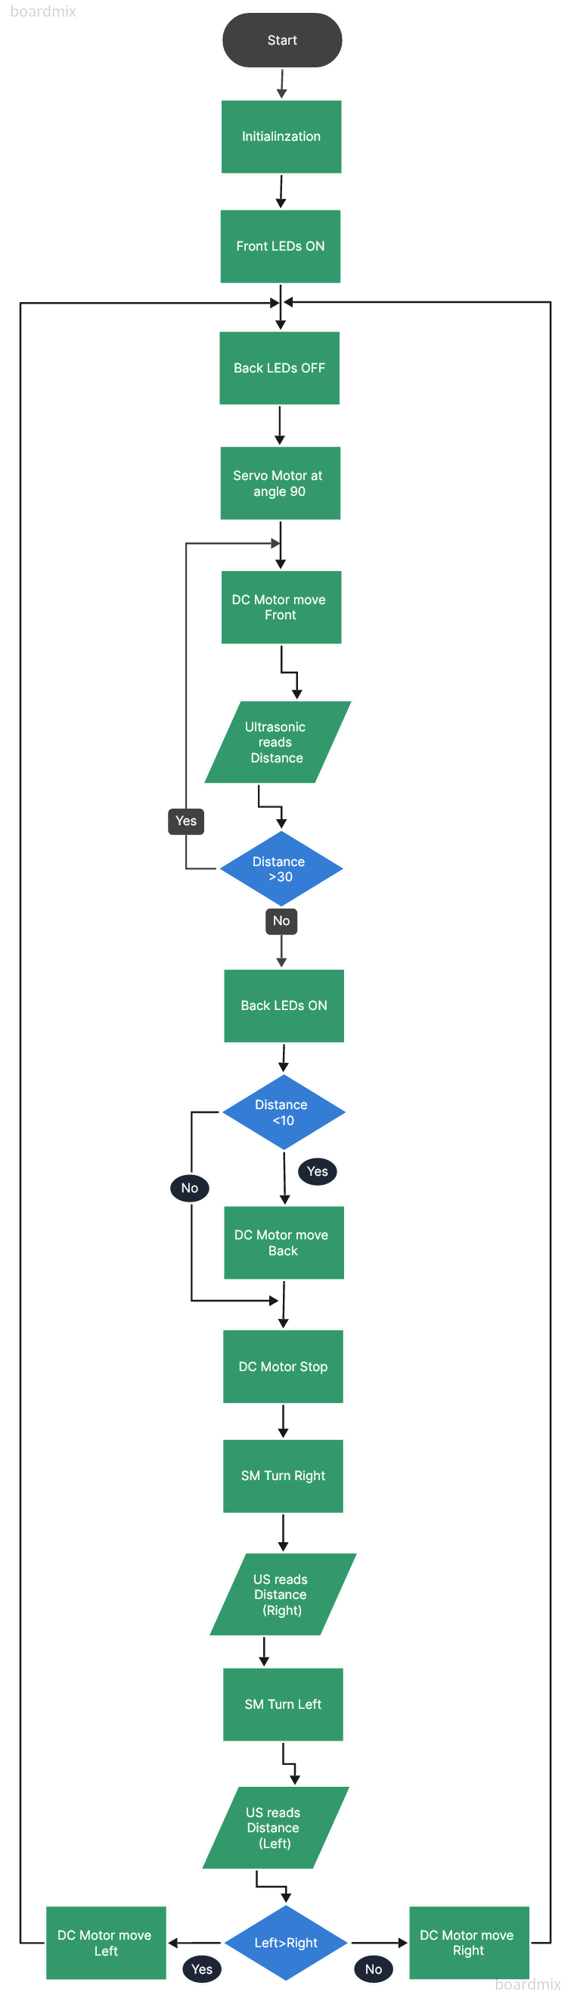
Flowchart
Here

Slide 16


Slide 17

Links :
Code in GitHub
Code in Drive
Video in Drive
Flowchart in Drive
ATmega32 Datasheet

Slide 18

Thanks ...

