Slide 1
ANC3 PAC MAN!!! 1st Iteration Hugo Barbachano & Tidiane Toure

Slide 2
Analysis

Slide 3
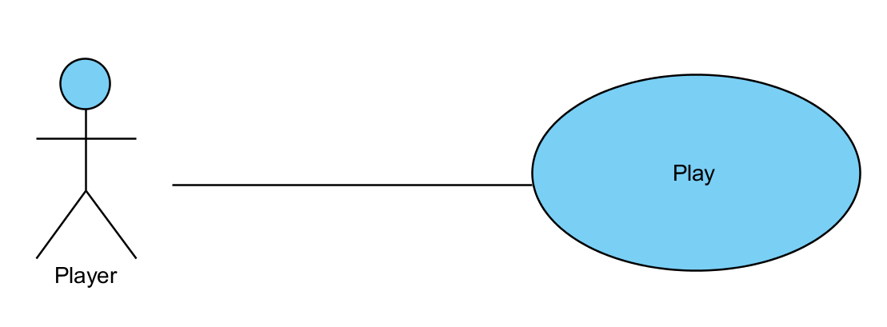
Use Case Diagram

Slide 4
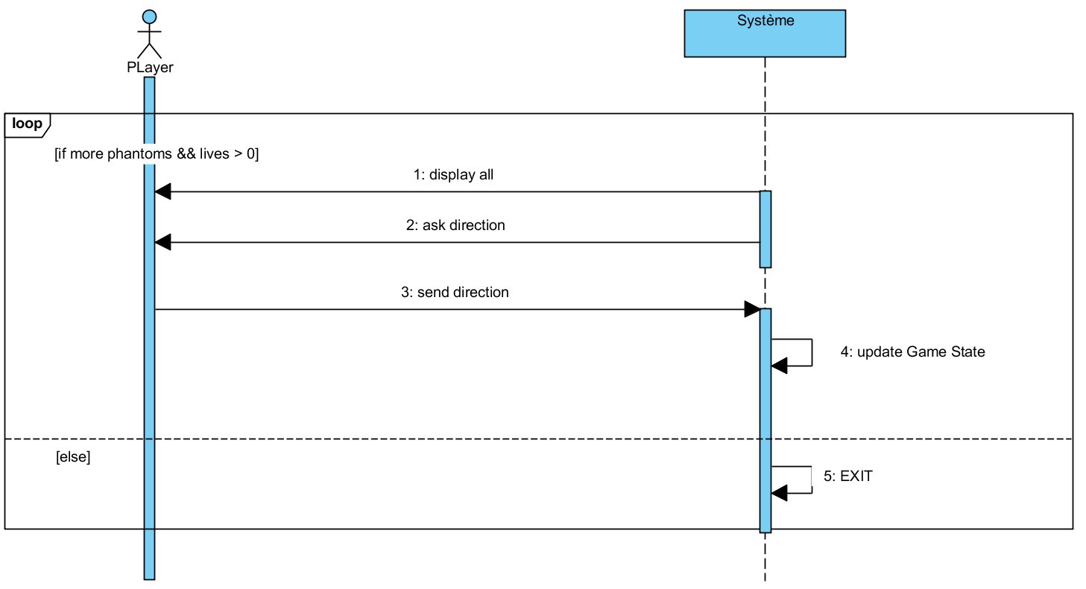
DSS Play

Slide 5
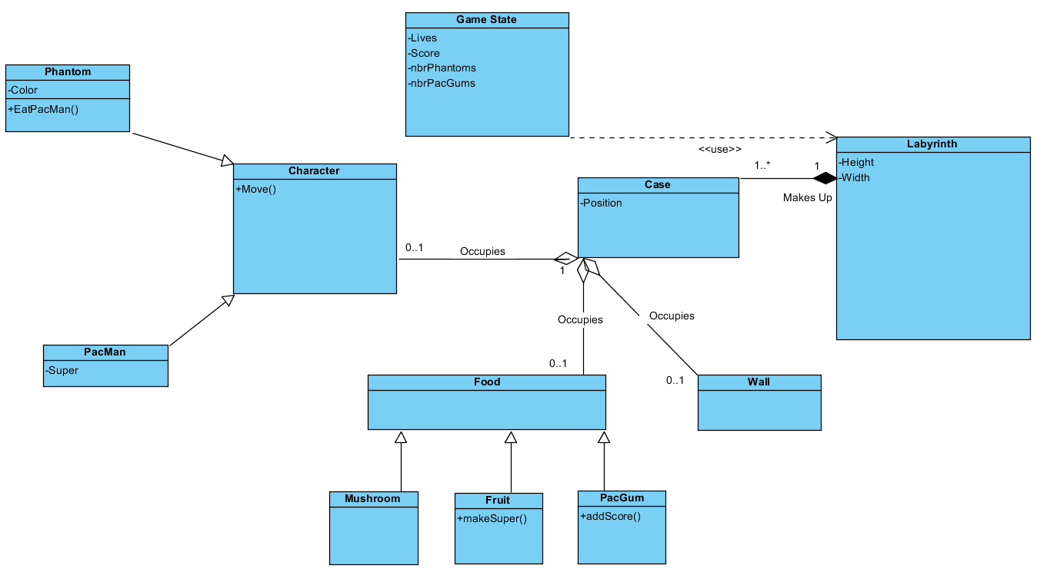
Domain Classes

Slide 6
Conception

Slide 7
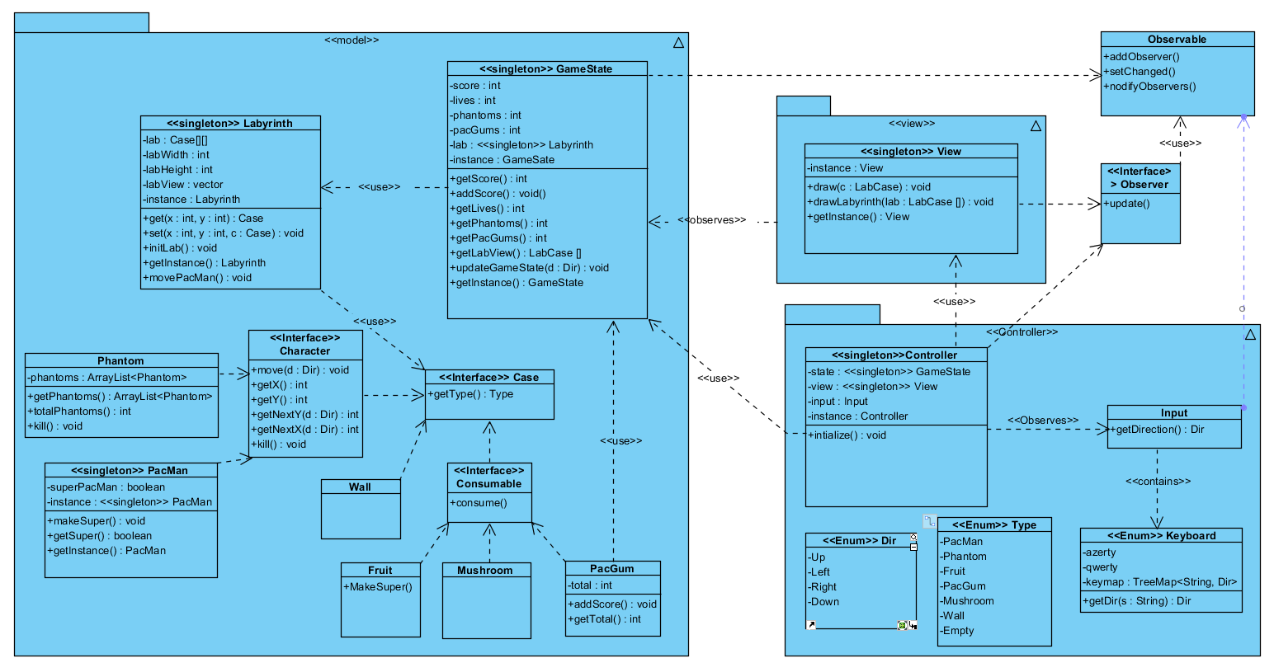
Software Classes

Slide 8
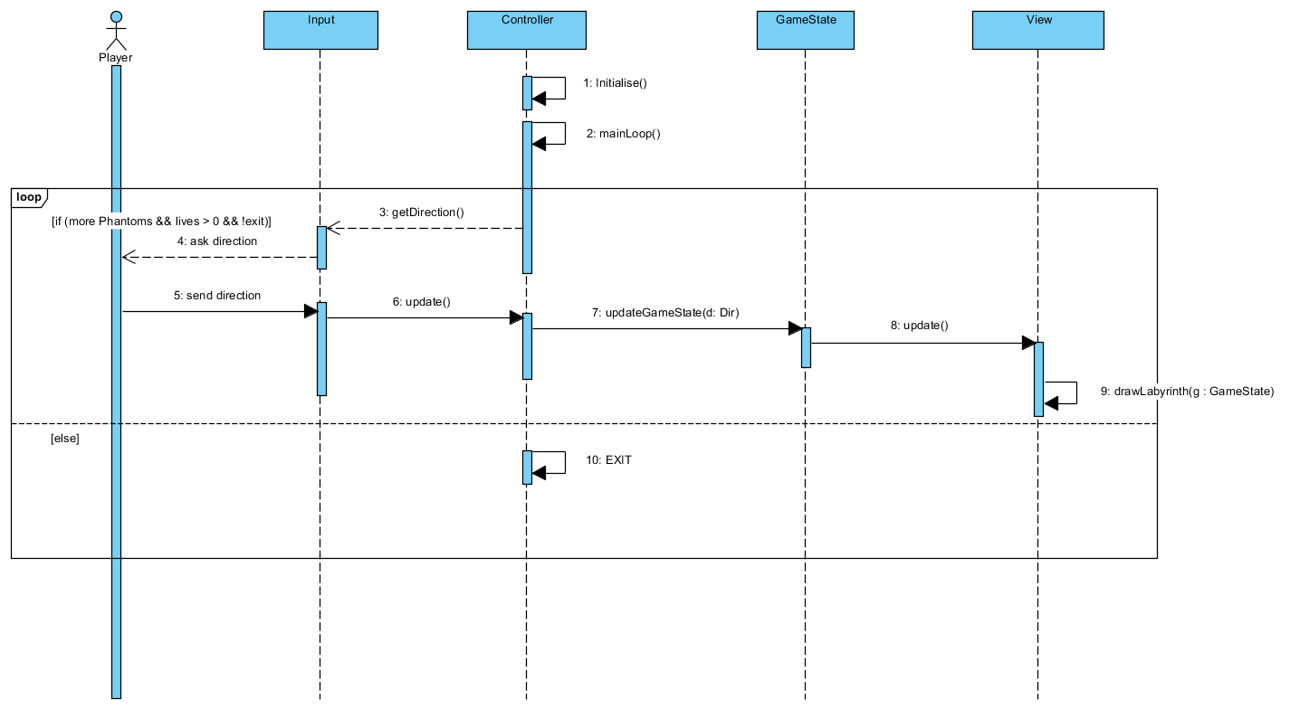
DS Play

Slide 9
Readme
Main Game Loop
In it´s main() the Controller creates all the objects, sets itself as an observer of Input and sets View as an observer of GameState.
Then the Controller calls Input.getInput() which runs an infinite loop:
{
1 – Input checks for input from the Player and notifies it´s observers (the Controller).
2 - In it´s update() the Controller calls GameState.updateGameState().
3 - In updateGameState() GameState handles the movement and notifies it´s observers (the View).
4 - In it´s update() the View gets a copy of the Labyrinth calling GameState.getLabView() and draws it based on that.
5 - The Controller calls System.Exit() if the conditions for Game Over or Win are met or if the player types “x”.
}

