Slide 1
IMA MARKET
PIP2001 Capstone Project
Review-1
Batch Number: IST-03
Under the Supervision of,
Prof. Srinivas Mishra
Assistant Professor
School of Computer Science and Engineering
Presidency University
Roll Number | Student Name
20211IST0025 | Gana N H
20211IST0004 | Aneesh K
20211IST0015 | Azmath Patel
20211IST0018 | Rajavardhan R
Name of the Program: B.Tech in Information Science And Technology
Name of the HoD: Dr.Pallavi R
Name of the Program Project Coordinator: Prof. Srinivas Mishra
Name of the School Project Coordinators: Dr. Sampath A K

Slide 2
Content
Introduction
Literature Review
Proposed Method
Objectives
Methodology
Timeline of Project
Expected Outcomes
Conclusion
References

Slide 3
Introduction
We propose two interconnected platforms to harness India’s IT talent for national projects: the National Importance Project Portal and an E-commerce Website. The portal will act as a centralized hub, listing critical projects with detailed information on financial and technical contributions, while facilitating project tracking, collaboration, and feedback. The e-commerce website will support these initiatives by providing a marketplace for products and services related to the projects, enabling resource sharing and engagement from the community. Together, these platforms aim to address national challenges efficiently, with an initial focus on projects like the Ima Market recovery in Manipur, leveraging IT skills and resources for impactful solutions.

Slide 4
Literature Review
The development of electronic commerce applications has become increasingly significant as businesses seek to enhance their online presence and customer engagement. This paper focuses on creating a general-purpose e-commerce platform specifically for the Ima Market, which allows users to conveniently purchase traditional products from the market via the Internet. The application is designed to facilitate seamless transactions, enabling customers to search for products by name or category, add them to a shopping cart, and complete purchases using credit card transactions. Key features include a user-friendly interface for browsing products, a shopping cart for managing selections, and a wish list for future purchases. Additionally, the paper discusses potential improvements, such as developing a mobile app and integrating with local vendors to create a more interactive shopping experience. Overall, the research highlights the importance of e-commerce applications in modern retail, emphasizing their role in expanding market reach and enhancing customer satisfaction within the Ima Market community.

Slide 5
Literature Review
Sl.no | Title of the Paper | Authors | Technology/Concept Used | Results/Findings | Limitations/ Challenges
1 | Dynamic Contributions to a Public Project: The Impact of Rising Marginal Benefit and Completion Benefits | Ronald Baker and Matthew Halloran | Laboratory experiments using z-Tree software | Completion benefits significantly increase contributions and project completion rates, especially when combined with rising marginal benefits. | Potential subject confusion and the arbitrary nature of some design choices, such as the 20-token threshold used in analysis.
2 | Bridging the Digital Divide: Assessing the Impact of a Community-Focused Service-Learning Project | Rouxan Colin Fouché and Liezel Nel | Online questionnaire using Google Forms, with analysis in SPSS and Nvivo | High participant satisfaction, improved computer literacy and employment prospects, but limited community input in project planning | Study specific to one service-learning project in South Africa, may not be generalizable to other contexts or communities.
3 | E-government Platform of Personalized Information Service Based on Gridding Management | CAI Yun-Juan, TANG Zhi-Wei, GAO Tian-Peng | Gridding management applied to e-government personalized information service platform | Proposed platform can subdivide and integrate government information resources, match user needs efficiently, and anticipate potential information needs | The paper presents a theoretical framework without empirical implementation or testing of the proposed system
4 | Engagement Program of Public Health Volunteers and Caregivers in Home Care Service for Stroke Patients | Uten Sutin, Srimuang Paluangrit, Supika Dangkrajang, Wandee Sutthinarakorn, Vanida Prasert | Quasi-experimental design with intervention and control groups, using questionnaires for data collection | The engagement program significantly improved stroke knowledge, care practices, and patients' Barthel ADL index scores | Study was limited to one geographic area and may not be generalizable to other contexts or populations Share New Continue G

Slide 6
Literature Review
Sl.no | Title of the Paper | Authors | Technology/Concept Used | Results/Findings | Limitations/ Challenges
5 | Application of management information systems and new technologies in crisis management | Seyyed Kamran Yeganegi | Management information systems, GIS, remote sensing, global positioning systems, and decision support systems | Advanced information systems and technologies can significantly improve crisis prevention, response, and management capabilities | Implementation challenges in developing countries and need for updated information systems and staff training Share New Continue GPT-
6 | Volunteer selection based on crowdsourcing approach | Nurulhasanah Mazlan, Sharifah Sakinah Syed Ahmad, Massila Kamalrudin | Crowdsourcing approach and fuzzy system for volunteer selection and task matching | Proposed framework integrates crowdsourcing into volunteering systems to automate and improve volunteer selection and matching | Framework is theoretical and needs to be implemented and evaluated in real-world environments
7 | Exploring The Benefits of Volunteer Engagement in Nonprofits: A Value Co-Creation Perspective | Ridvan Kocaman | Qualitative research approach with in-depth interviews and qualitative content analysis | Volunteer engagement increases volunteer loyalty, encourages recommendations, and generates new ideas for social service development | Study is exploratory in nature and focused on a specific context, which may limit generalizability
8 | Expert-Citizen Engineering: "Crowdsourcing" Skilled Citizens | Zhi Zhai, Peter Sempolinski, Douglas Thain, Greg Madey, Daniel Wei, Ahsan Kareem | Web-based platform with OpenFOAM CFD software and cloud computing resources | Expert citizens have higher expectations for system stability and computational capacity compared to average citizen engineers | Small sample size, lecture quiz design issues, and challenges in automating evaluation of complex submissions

Slide 7
Literature Review
Sl.no | Title of the Paper | Authors | Technology/Concept Used | Results/Findings | Limitations/ Challenges
9 | Development of E-government Platform Based on B/S Architecture and Performance Evaluation Program | HE Wei, TAN Junshan, WU Yiqiang | B/S (Browser/Server) architecture, database management systems, and information security systems | Proposed a novel e-government platform model integrating B/S architecture with performance evaluation | The paper is largely theoretical and does not provide detailed implementation or testing results
10 | Accessibility and Scalability in Collaborative eCommerce Environments | Michel Khoury, Shervin Shirmohammadi | Adobe Shockwave, .NET v3.0, peer-to-peer networking, and application-layer multicasting | The system supports up to 241 nodes in a 3-level ALM tree while maintaining <200ms delay for real-time collaboration | Limited to 16 connections per peer due to Director constraints, and potential issues with nodes leaving the system

Slide 8
Existing method Drawback
Drawbacks of the AGRA Portal Methodology
Limited Community Participation
Resource Constraints
Data Reliability
Resistance to Change
Maintenance and Updates
Drawbacks of the E-Commerce Website Methodology
Digital Divide
Vendor Readiness
Security Concerns
Market Saturation
Dependence on Technology

Slide 9
Proposed Method
1. AGRA Portal for Flood Victims
1.1. Needs Assessment
Stakeholder Engagement
Data Collection
Requirement Prioritization
Feedback Loop
1.2. Project Listing
Project Categorization
Integration of Feedback
Administrative Tools
1.3. Transparency and Tracking
Progress Dashboard
Transparency Reports
Project Updates
1.4. Community Engagement
Collaborative Forums
Community Representatives
Regular Meetings
1.5. Resource Allocation
Data-Driven Decisions
Funding Mechanism
Impact Monitoring

Slide 10
Proposed Method
2. E-Commerce Website for Ima Market Vendors
2.1. Vendor Empowerment
Vendor Onboarding
Training Workshops
Support Channels
2.2. User Experience
User-centeric Design
Seamless
Responsive Design
2.3. Secure Transactions
Payment Gateway Integration
SSL Encryption
Transaction Monitoring
2.4. Inventory Management
Product Listing Tools
Stock Alerts
Order Management Dashboard
2.5. Community Integration
Partnerships
Promotional Campaigns
Local Stories

Slide 11
Objectives
1. AGRA Portal for Flood Victims
Needs Assessment: Gather and analyze requirements from flood victims in Ima Market to ensure that listed projects directly address their most pressing needs.
Project Listing: Develop a user-friendly interface for project administrators to create, manage, and update a diverse range of projects based on community feedback and requirements.
Transparency and Tracking: Implement features that allow flood victims to track project progress, provide feedback, and stay informed about ongoing initiatives.
Community Engagement: Foster a collaborative environment by encouraging active participation from flood victims, ensuring their voices are heard in project planning and execution.
Resource Allocation: Facilitate efficient allocation of resources and support to prioritize projects that will have the greatest impact on the community.

Slide 12
Objectives
2. E-Commerce Website for Ima Market Vendors
Vendor Empowerment: Create a platform that enables local vendors to showcase and sell their products online, enhancing their visibility and market reach.
User Experience: Design an intuitive and user-friendly interface that allows customers to easily browse, search, and purchase products from various vendors.
Secure Transactions: Ensure that the platform supports secure payment options, including credit card transactions, to build trust and encourage online shopping.
Inventory Management: Implement features for vendors to manage their inventory, track sales, and update product listings efficiently.
Community Integration: Develop partnerships with local vendors to integrate their offerings, promoting the unique cultural and traditional products available in Ima Market, thereby supporting local entrepreneurship.

Slide 13
Methodology
AGRA Portal for Flood Victims:
Stakeholder Engagement: How will you gather feedback and involve victims in decision-making?
Progress Tracking: Use of dashboards or regular reports.
Data-Driven Resource Allocation: Using data to decide how to distribute resources.
E-Commerce Website for Ima Market Vendors:
Vendor Onboarding and Training: Outline the process for getting vendors onto the platform and training them.
Secure Transactions: What technologies (like SSL encryption) will be used to secure transactions?
Responsive Design: It will help the platform adapt to different devices.

Slide 14
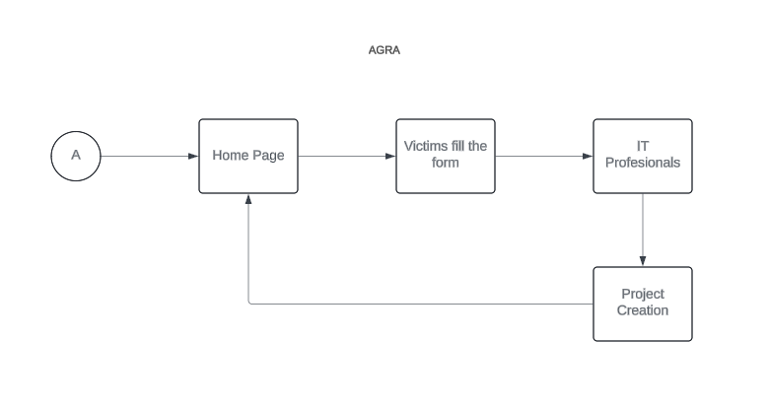
Architecture
AGRA Portal

Slide 15
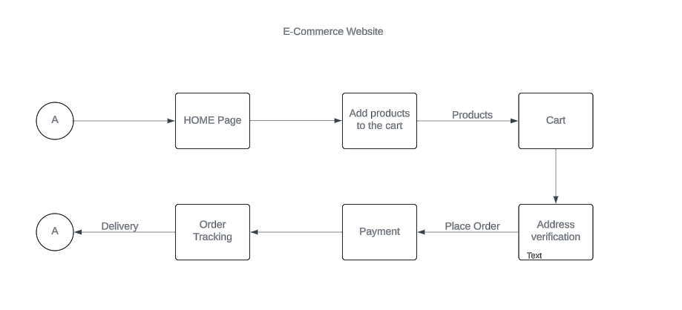
Architecture
E-Commerce Website

Slide 16
Software components
1. AGRA Portal for Flood Victims
Frontend Components
HTML/CSS/JavaScript Frameworks
b. Backend Components
Web Server
Database Management System
c. APIs and Integration
PayPal, FireBase
2. E-Commerce Website for Ima Market Vendors
a. Frontend Components
HTML/CSS/JavaScript Frameworks
b. Backend Components
Database Management System
c. E-Commerce Frameworks
E-Commerce Platforms
d. Payment Processing
Payment Gateways

Slide 17
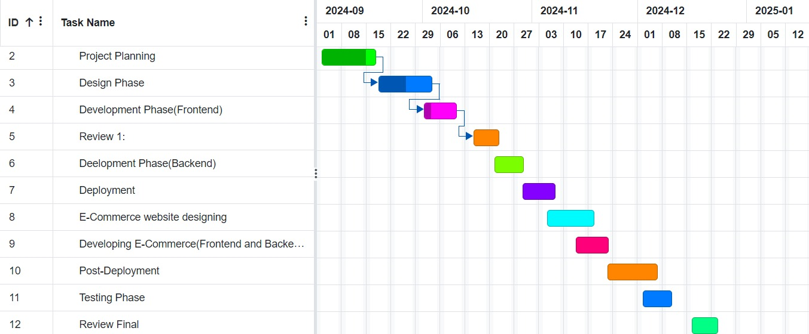
Timeline of Project

Slide 18
Expected Outcomes
The AGRA Portal enhances transparency, community engagement, and efficient resource distribution for flood relief projects. It provides real-time updates, public dashboards, and feedback mechanisms, allowing flood victims to actively participate in project planning and decision-making. Resources are allocated based on community needs, ensuring that high-impact projects are prioritized.
The E-Commerce Website empowers Ima Market vendors by expanding their reach and increasing sales through a global online platform. It offers tools for secure transactions, inventory management, and promotions, enabling vendors to manage their businesses more effectively. Additionally, it supports local entrepreneurship by providing training and digital business skills, while promoting traditional goods to a wider audience.

Slide 19
Conclusion
In conclusion, both the AGRA Portal and the E-Commerce Website offer transformative solutions tailored to address the specific needs of flood victims and local vendors in Ima Market. The AGRA Portal promotes transparency, community participation, and efficient resource distribution, empowering flood-affected communities to take an active role in their recovery. On the other hand, the E-Commerce Website enhances the market reach and sales potential of local vendors by providing them with a digital platform to showcase their products globally. It not only supports local entrepreneurship but also helps preserve and promote traditional crafts. Together, these platforms create sustainable pathways for community resilience and economic empowerment, utilizing technology to make a lasting positive impact.

Slide 20
Github Link
GitHub Link: https://github.com/Azmath-77/Ima-Market

Slide 21
References (IEEE Paper format)
Kumar, G. S., & Jose, J. T. (2017). Developing an electronic commerce platform. 2017 IEEE International Conference on Power, Control, Signals and Instrumentation Engineering (ICPCSI). https://doi.org/10.1109/icpcsi.2017.8391922
X. Tian and W. Dai, "Study on Information Management and Security of E-commerce System," 2010 International Symposium on Intelligence Information Processing and Trusted Computing, Huanggang, China, 2010, pp. 270-273, doi: 10.1109/IPTC.2010.183.
M. Khoury and S. Shirmohammadi, "Accessibility and scalability in collaborative eCommerce environments," 2007 2nd International Conference on Digital Information Management, Lyon, France, 2007, pp. 738-743, doi: 10.1109/ICDIM.2007.4444312.
M. Lingyu, C. Lauren and D. Zhijie, "Strategic Development of Fresh E-Commerce With Respect to New Retail," 2019 IEEE 16th International Conference on Networking, Sensing and Control (ICNSC), Banff, AB, Canada, 2019, pp. 373-378, doi: 10.1109/ICNSC.2019.8743243.
Coleman ER, & Moudgal R. (2017). Share Early Rehabilitation After Stroke: a Narrative Review. Curr Atheroscler Rep, 7(19), 12-59. doi: 10.1007/s11883-017-0686-6.

Slide 22
References (IEEE Paper format)
Ajzen, I. (1991). The theory of planned behavior. Organizational Behavior and Human Decision Processes, 50(2), 179-211.
Deci, E. L., & Ryan, R. M. (2000). The "what" and "why" of goal pursuit: Human needs and the self-determination of behavior. Psychological Inquiry, 11(4), 227-268.
Kocaman, R. (2024). Exploring the benefits of volunteer engagement in nonprofits: A value co-creation perspective.
Alexander H Nave. (2019). Physical Fitness Training in Patients with Subacute Stroke (PHYS-STROKE): multicentre, randomized controlled, Endpoint blinded trial. BMJ, 366, doi: https://doi.org/10.1136/bmj.l5101.
Belagaje SR. (2017). Stroke Rehabilitation. Continuum, 10.1212/CON.0000000000000423.

Slide 23
Thank You

