Slide 1

SWE-4739: Embedded Software Development
Credit: 3.00
Lec: System-On-a-Chip
Creating Global Citizens Rooted with Islamic Values

Slide 2

Microprocessor vs Microcontroller
Factor 1: Applications
Microprocessor: Perform multiple tasks-gaming, web browsing, photo editing.
Microcontroller: Perform single task
Creating Global Citizens Rooted with Islamic Values

Slide 3
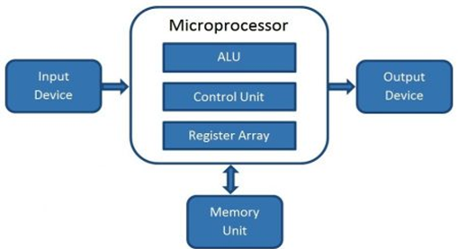
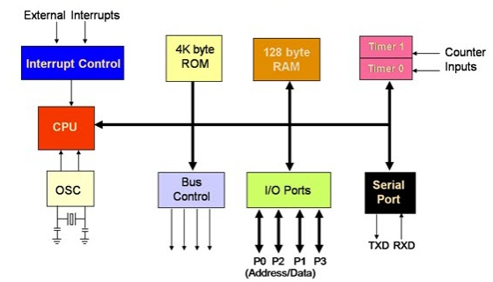
Microprocessor vs Microcontroller
Factor 2: Internal structure
Microprocessor
Microcontroller
Creating Global Citizens Rooted with Islamic Values

Slide 4
Microprocessor vs Microcontroller
Factor 3: Processing power and memory consumption
 | Microprocessor | Microcontroller
Clock speed | 1-4 GHz | 1-300 MHz
RAM | 512 MB-32 GB | 2- 256 KB
ROM | 128 GB - 2 TB | 32 KB - 2 MB
Peripheral interfaces | USB, high speed Ethernet | I2C
no. of bits | 32 or 64 bit | 8, 16 or 32 bit
Power consumption and cost | High | Low
Creating Global Citizens Rooted with Islamic Values

Slide 5
System-On-A-Chip
A system on a chip or system-on-chip (SoC) is an integrated circuit that integrates most or all components of a computer or other electronic system.
These components almost always include on-chip central processing unit (CPU), memory interfaces, input/output devices and interfaces, and secondary storage interfaces, often alongside other components such as radio modems and a graphics processing unit (GPU) – all on a single substrate or microchip.

Slide 6
System-On-A-Chip
In a narrow sense, it is the chip integration of the core of the information system, which is to integrate the key components of the system on one chip;
in a broad sense, SoC is a micro-miniature system.
If the central processing unit (CPU) is the brain, then the SoC is It is the system that includes the brain, heart, eyes, and hands.

Slide 7
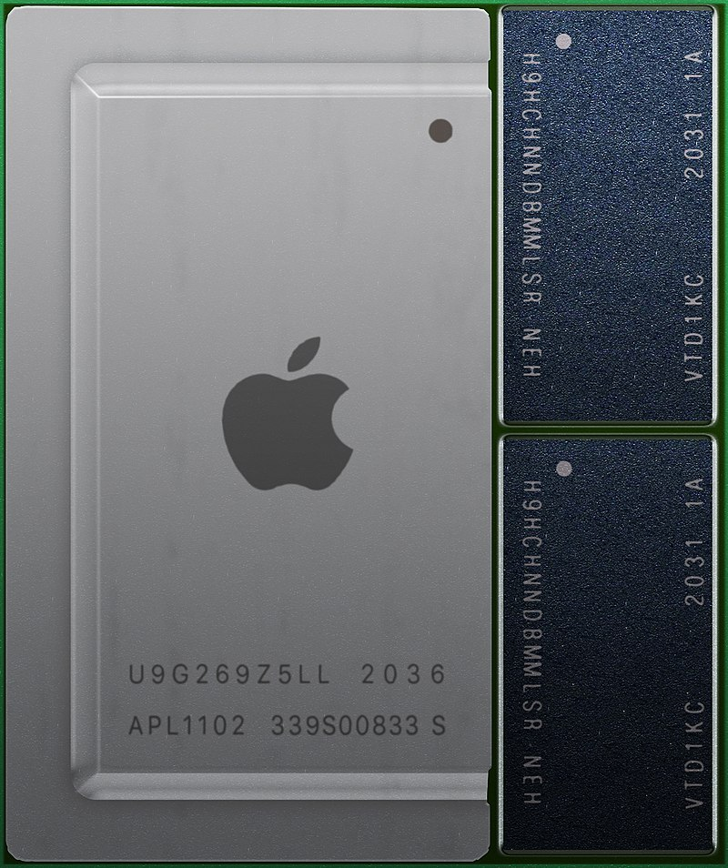
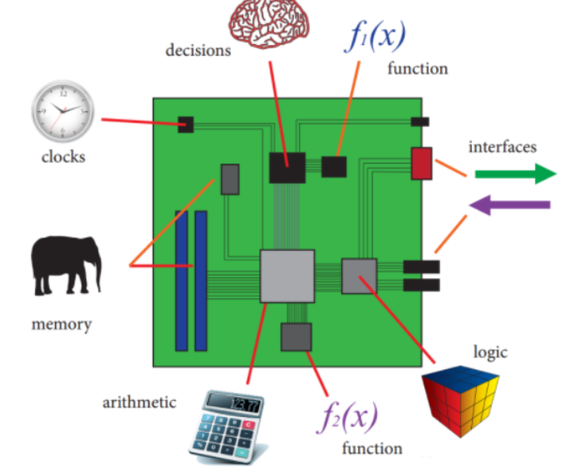
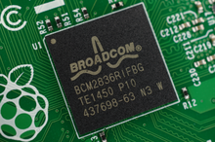
System-On-A-Chip

Slide 8
System-On-A-Chip
SoCs may contain separate/dedicated memory or secondary storages – for high performance
May also contain wired/wireless modules separately

Slide 9
SoC - Types
In general, there are three distinguishable types of SoCs:
SoCs built around a microcontroller,
SoCs built around a microprocessor, often found in mobile phones;
Specialized application-specific integrated circuit SoCs designed for specific applications that do not fit into the above two categories.

Slide 10
SoC- Applications
SoCs can be applied to any computing task.
However, they are typically used in mobile computing such as tablets, smartphones, smartwatches and netbooks as well as embedded systems.

Slide 11
SoC- Applications
Embedded Systems:
Where previously only microcontrollers could be used, SoCs are rising to prominence in the embedded systems market.
Tighter system integration offers better reliability and mean time between failure, and SoCs offer more advanced functionality and computing power than microcontrollers
With IoT, Edge Device AI, Embedded systems can do a lot
And SoC can help in ES not just with power, but also in terms of efficiency, optimized implementation, utilization and simplicity.

Slide 12
SoC- Applications
Mobile and Personal Computing :
Mobile computing based SoCs always bundle
processors, memories, on-chip caches, wireless networking capabilities
and often digital camera hardware and firmware.
With increasing memory sizes, high end SoCs will often have no memory and flash storage and instead, the memory and flash memory will be placed right next to, or above (package on package), the SoC

Slide 13
SoC - Structures
An SoC consists of hardware functional units, including microprocessors that run software code, as well as a communications subsystem to connect, control, direct and interface between these functional modules.

Slide 14
SoC - Structures
Functional Components:
Processor Cores:
Processor cores can be a microcontroller, microprocessor (μP), or application-specific instruction set processor (ASIP) core.
ASIPs have instruction sets that are customized for an application domain and designed to be more efficient than general-purpose instructions for a specific type of workload.
Memory:
Can include anything from cache, and ROM (erasable or not) to RAM (static/dynamic)
Interfaces:
Serial, USB, UART, USART, Ethernet, I2C, SPI, CSI, WiFi, Bluetooth, what not!

