Slide 1

SWE-4739: Embedded Software Development
Credit: 3.00
Lec: Architectures
Creating Global Citizens Rooted with Islamic Values

Slide 2

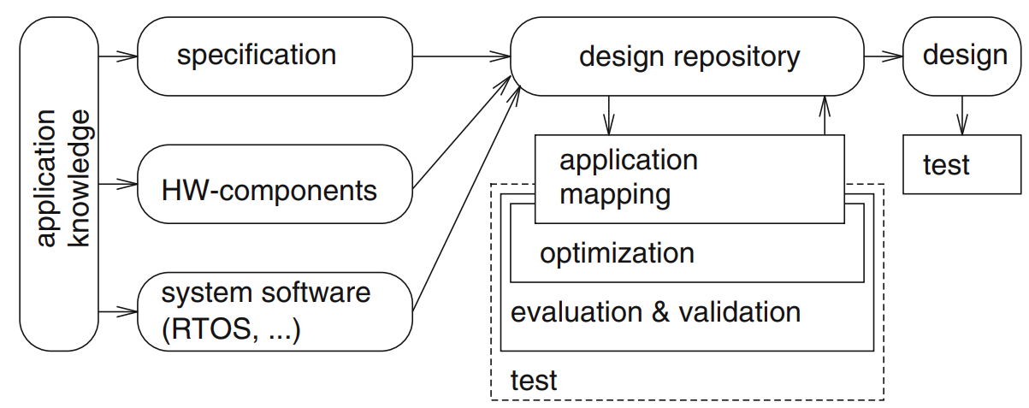
Hypothetical design flow
*
* could be integrated loop
Creating Global Citizens Rooted with Islamic Values
2

Slide 3
Three key embedded system technologies
Technology
A manner of accomplishing a task, especially using technical processes, methods, or knowledge
Three key technologies for embedded systems
Processor technology
Integrated Circuit (IC) technology
Design technology
Creating Global Citizens Rooted with Islamic Values
3

Slide 4
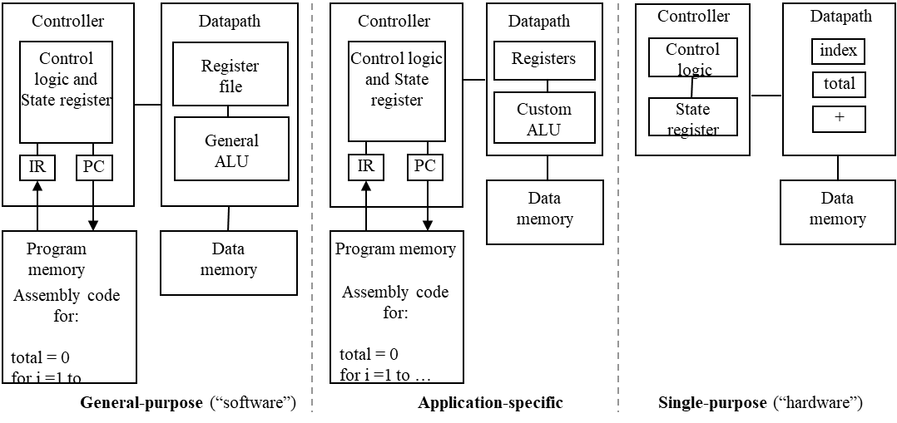
Processor technology
The architecture of the computation engine used to implement a system’s desired functionality
Processor does not have to be programmable
“Processor” not equal to general-purpose processor
Creating Global Citizens Rooted with Islamic Values
4

Slide 5
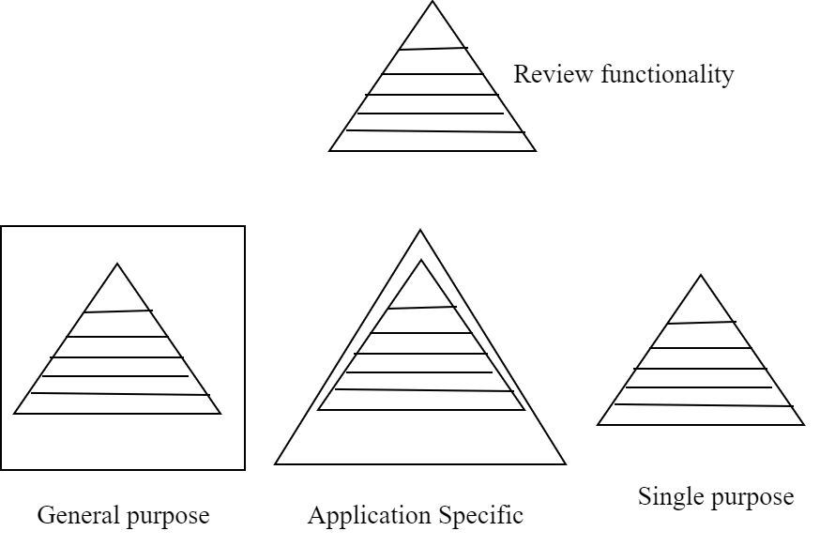
Processor technology
Creating Global Citizens Rooted with Islamic Values
5

Slide 6
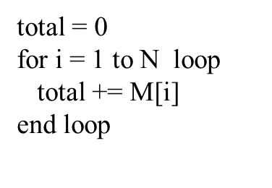
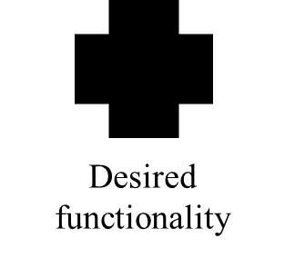
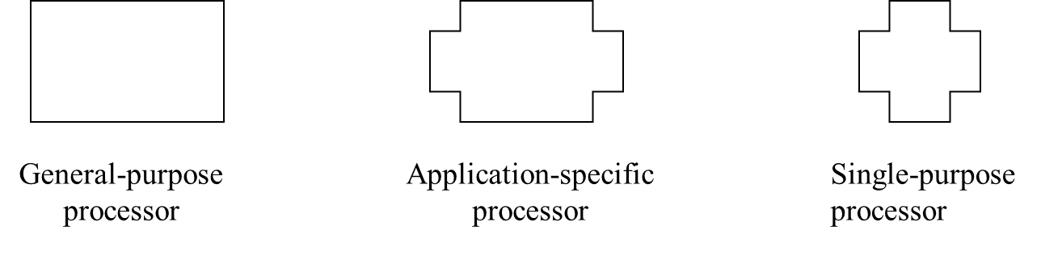
Processor technology
Processors vary in their customization for the problem at hand
Creating Global Citizens Rooted with Islamic Values
6

Slide 7
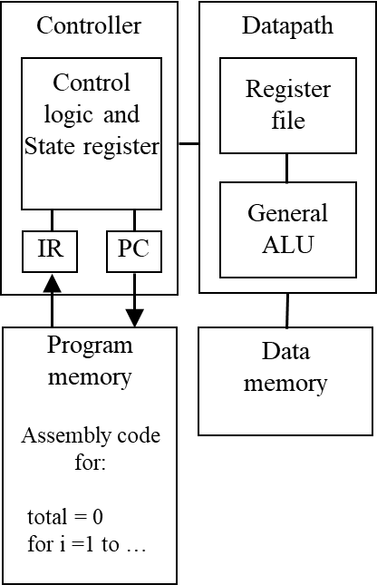
General-purpose processors
Programmable device used in variety of applications
Also known as “microprocessor”
Features
Program memory
General datapath with large register file and
general ALU
User benefits
Low time-to-market and NRE costs
High flexibility
“Pentium” the most well-known, but
there are hundreds of others
Creating Global Citizens Rooted with Islamic Values
7

Slide 8
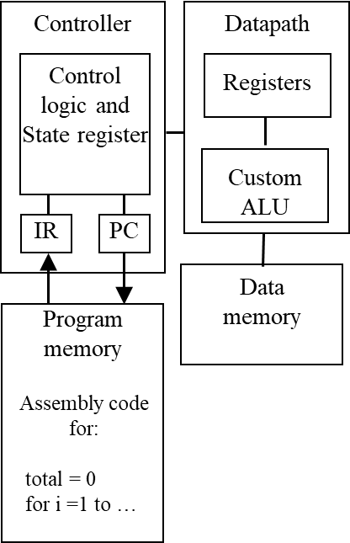
Application-specific processors
Programmable processor optimized for a particular
class of applications having common characteristics
Compromise between general-purpose and
single-purpose processors
Features
Program memory
Optimized data path
Special functional units
Benefits
Some flexibility, good performance, size and
power
Creating Global Citizens Rooted with Islamic Values
8

Slide 9
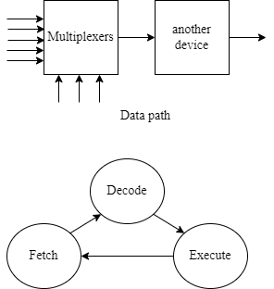
Control path and data path
Data path
Registers, wires, multiplexers, data elements
Control path
It is basically a finite state machine
can be hardware and microprogram control
Creating Global Citizens Rooted with Islamic Values
9

Slide 10
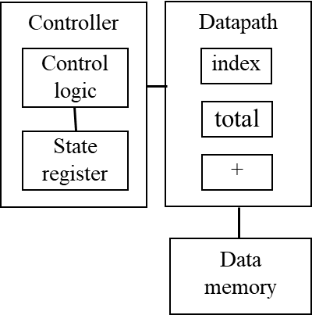
Single-purpose processors
Digital circuit designed to execute exactly one program
a.k.a. coprocessor, accelerator or peripheral
Features
Contains only the components needed to
execute a single program
No program memory
Benefits
Fast
Low power
Small size
Creating Global Citizens Rooted with Islamic Values
10

Slide 11
Harvard vs Von Neumann Architecture
Von Neumann Architecture : a digital computer architecture based on the concept of storing program data and instruction data in the same memory.
Harvard Architecture: a digital computer architecture based on the concept where there are separate storage and separate buses (signal path) for instruction and data. It was basically developed to overcome the bottleneck of Von Neumann Architecture.

Slide 12
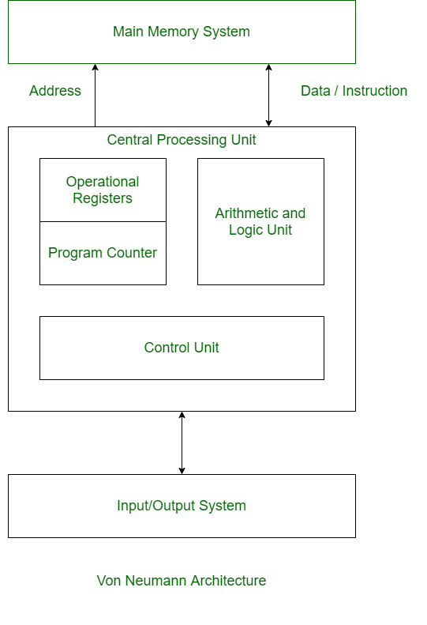
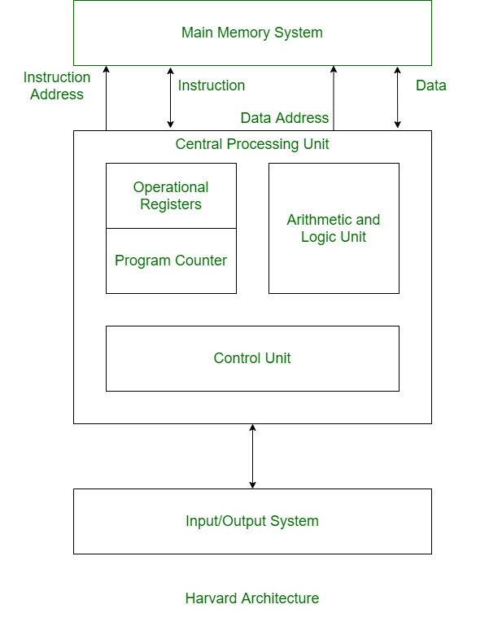
Harvard vs Von Neumann Arch.

Slide 13
Harvard vs Von Neumann Arch.
VON NEUMANN ARCHITECTURE | HARVARD ARCHITECTURE
It is ancient computer architecture based on stored program computer concept. | It is modern computer architecture based on Harvard Mark I relay based model.
Same physical memory address is used for instructions and data. | Separate physical memory address is used for instructions and data.
There is common bus for data and instruction transfer. | Separate buses are used for transferring data and instruction.
Two clock cycles are required to execute single instruction. | An instruction is executed in a single cycle.
It is cheaper in cost. | It is costly than Von Neumann Architecture.
CPU can not access instructions and read/write at the same time. | CPU can access instructions and read/write at the same time.
It is used in personal computers and small computers. | It is used in micro controllers and signal processing.

