Slide 1
Chapter 7
Reverse Engineering

Slide 2
Overview
Reverse Engineering
Purpose and Objectives of Reverse Engineering
To recover lost information, facilitate migration between platforms, improve documentation, provide alternative view, extract reusable components, cope with complexity, detect side effects, reduce maintenance effort
Levels of Abstraction and Reverse Engineering
Redocumentation, Specification Recovery and , Design Recovery
Factors that motivate the application of Reverse Engineering

Slide 3
Overview
Supporting Techniques
Forward Engineering
Restructuring (control flow driven, efficiency driven, adaptation driven)
Reengineering (reverse and forward engineering)
Benefits of Reverse Engineering
Maintenance
Software Reuse
Current Problems in Reverse Engineering
Automation Problem
Naming Problem

Slide 4
Reverse Engineering
Def: The process of analysing a subject system to identify the system's components and their interrelationships and create representations of the system in another form or at higher levels of abstraction.

Slide 5
Purpose and Objectives of Reverse Engineering
Objectives:
To recover lost information: With time, a system undergoes a series of changes. Documentation for the requirements specification and design may not be kept up to date and may not even exist. This makes the code the only source of information about the system. Reverse engineering tools allow this information to be recovered
To facilitate migration between platforms: In order to take advantage of a new software platform, (for example, a CASE environment or hardware platform (for example, a parallel architecture) a combination of reverse and forward engineering can be used.

Slide 6
Purpose and Objectives of Reverse Engineering
Objectives:
3. To improve or provide documentation: RE Tools can be used to augment inadequate documentation or to provide new
4. To provide alternative views: Redocumentation tools can be used to provide alternative documentation such as data flow diagrams, control flow diagrams and entity-relationship diagrams in addition to the existing documentation. This is a means whereby other views of the system can be obtained. For example, data flow diagrams portray the system from the point of view of data flow within the system and outside. Control flow diagrams, on the other hand, show the system from the perspective of the flow of control between the different components.

Slide 7
Purpose and Objectives of Reverse Engineering
Objectives:
5. To extract reusable components: The use of existing program components can lead to an increase in productivity and improvement in product quality. Success in reusing components depends in part on their availability.
6. To cope with complexity: One of the major problems with legacy systems is that as they evolve, their complexity increases. This complexity must be dealt with by abstracting system information relevant to the change and ignoring that which is irrelevant

Slide 8
Purpose and Objectives of Reverse Engineering
Objectives:
7. To detect side effects: In cases where the maintainer lacks a global view of the system, ripple effects are a common result of change. That is, undesired side effects are caused and anomalies go unnoticed.
8. To reduce maintenance effort: A large percentage of the total time required to make a change goes into understanding programs. Reverse engineering has the potential to alleviate these problems.

Slide 9
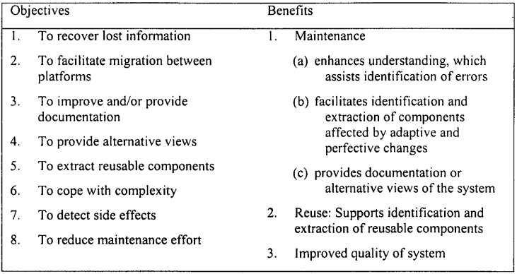
Purpose and Objectives of Reverse Engineering

Slide 10
Levels of Abstraction and Reverse Engineering
The product of a reverse engineering process does not necessarily have to be at a higher level of abstraction
If it is at the same level as the original system, the operation is commonly known as 'redocumentation'
If on the other hand, the resulting product is at a higher level of abstraction, the operation is known as 'design recovery'

Slide 11
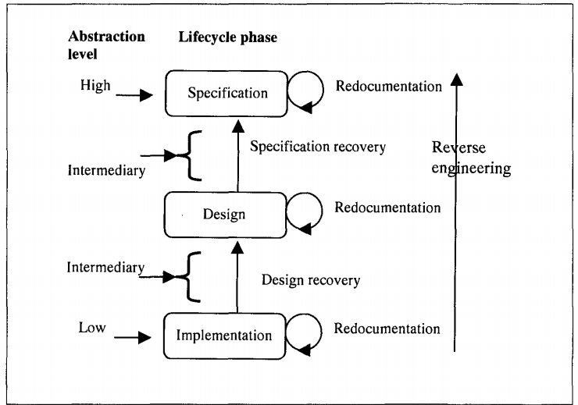

Slide 12
Levels of Abstraction and Reverse Engineering
Redocumentation: Redocumentation is the recreation of a semantically equivalent representation within the same relative abstraction level. The goals of this process are threefold
To create alternative views of the system so as to enhance understanding
To improve current documentation.
To generate documentation for a newly modified program. documentation.

Slide 13
Levels of Abstraction and Reverse Engineering
2. Design Recovery: Design recovery entails identifying and extracting meaningful higherlevel abstractions beyond those obtained directly from examination of the source code
Recovered design - which is not necessarily the original design - can then be used for redeveloping the system. important aspect of design recovery is being able to recognise, understand and represent design decisions present in a given source code.
It is assumed that an experienced programmer can reconstruct the design of a program by recognising the cliches used (cliches are standard problem solving techniques, such as searching and sorting, that can easily be identified by inspection).

Slide 14
Levels of Abstraction and Reverse Engineering
3. Specification Recovery: If there is a paradigm shift and the design of the new paradigm has little or nothing in common with the design of the original paradigm, for instance moving from structured programming to object-oriented programming. In this case, an appropriate approach is to obtain the original specification of the system through specification recovery. Specification Recovery involves identifying, abstracting and representing meaningful higher levels of abstractions beyond those obtained simply by inspecting the design or source code of the software system. Specification can be derived directly from the source code or from existing design representations through backward transformations.

Slide 15
Levels of Abstraction and Reverse Engineering
3. Specification Recovery: The specification recovered during reverse engineering can be put to a number of uses.
Firstly, a fairly representative specification of a system can be used to support software maintenance without necessarily requiring access to the source code.
Secondly, the specification assists the maintainer in acquiring the appropriate level of understanding required to effect a change to a software system.
Thirdly, if the specification is suitably represented it can be used in the development or maintenance of similar software systems.

Slide 16
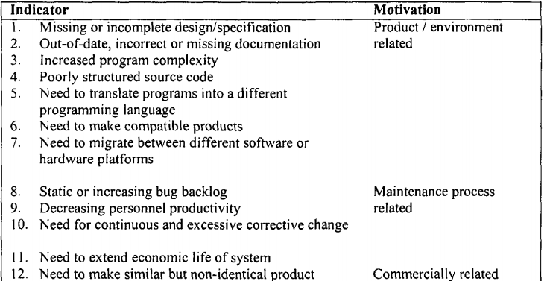
Factors that motivate the application of Reverse Engineering

Slide 17
Supporting Techniques
The understanding obtained through reverse engineering can support the implementation of change through techniques such as forward engineering, restructuring, and reengineering
Forward Engineering: The traditional software engineering approach starting with requirements analysis and progressing to implementation of a system.
Restructuring: This involves transforming a system from one representational form to another at the same relative level of abstraction without a change in its functionality or semantics

Slide 18
Restructuring
As the degeneration continues, the programs become more complex and difficult to understand. To control this increase in complexity, the source code needs to be restructured.
There are various types of restructuring which differ in the part of the system affected and the manner in which this is done.
Control-flow-driven restructuring: This involves the imposition of a clear control structure within the source code and can be either intermodular or intramodular in nature. An example of restructuring in the small is restructuring a 'spaghetti-like' module's code. An example of restructuring in the large is regrouping physically distant routines - located in different modules, to give a coherent structure.

Slide 19
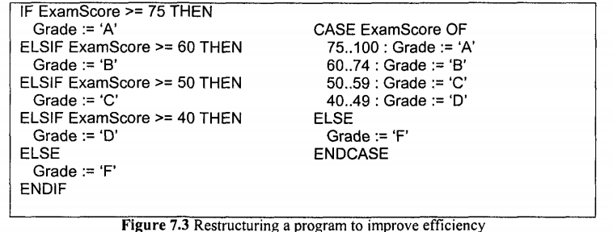
Restructuring
2. Efficiency-driven restructuring: This involves restructuring a function or algorithm to make it more efficient. A simple example of this form of restructuring is the replacement of an IFTHEN-ELSIF-ELSE construct with a CASE construct

Slide 20
Restructuring
3. Adaption-driven restructuring: This involves changing the coding style in order to adapt the program to a new programming language or new operating environment, for instance changing an imperative program in Pascal into a functional program in Lisp.
In addition to the source code, other representations of a software system can be restructured. These include requirements specifications, data models and design plans.

Slide 21
Reengineering
Def: This is the process of examining and altering a target system to implement a desired modification.
Reengineering consists of two steps.
Firstly, reverse engineering is applied to the target system so as to understand it and represent it in a new form
Secondly, forward engineering is applied, implementing and integrating any new requirements, thereby giving rise to a new and enhanced system
These two steps can be further broken down as, for example, in the 8-layer Source Code Reengineering Model (SCORE/RM) proposed by Colbrook et al.

Slide 22
Benefits of Reverse Engineering
The output of reverse engineering can also be beneficial to software reuse - reapplication of existing software code or design. Some benefits are mentioned below:
Maintenance: Generally, the ability to use reverse engineering tools to recapture design history and provide documentation facilitates understanding of a system. Considering the time devoted to program understanding, reverse engineering tools offer real scope for reducing maintenance costs, complexity and increasing maintainability.
Software Reuse: The software components that result from a reverse engineering process can be reused. Quite often these components need to be modified in one way or another before they can be reused.

Slide 23
Current Problems in Reverse Engineering
Problems in reverse engineering stem primarily from the difficulty of extracting high-level descriptions of a system from its source code alone.
The automation problem:Complete automation may never be feasible because the process of understanding a system - in which reverse engineering plays a part - requires the use of domain-specific information. This may always be reliant upon domain experts.
The naming problem: Even if it was possible to automate the extraction of high-level descriptions from source code, naming would still pose a problem. Take as an example the source code for a binary sort algorithm. Extracting the specification is one thing, but automatically naming is quite another.

