Slide 1
EEG-Based Sleep Stage Classification Using ML and DL Approaches
A Comparative Study of Random Forest and LSTM Models with Temporal Context
Azim Chyngozhoev 20212003

Slide 2
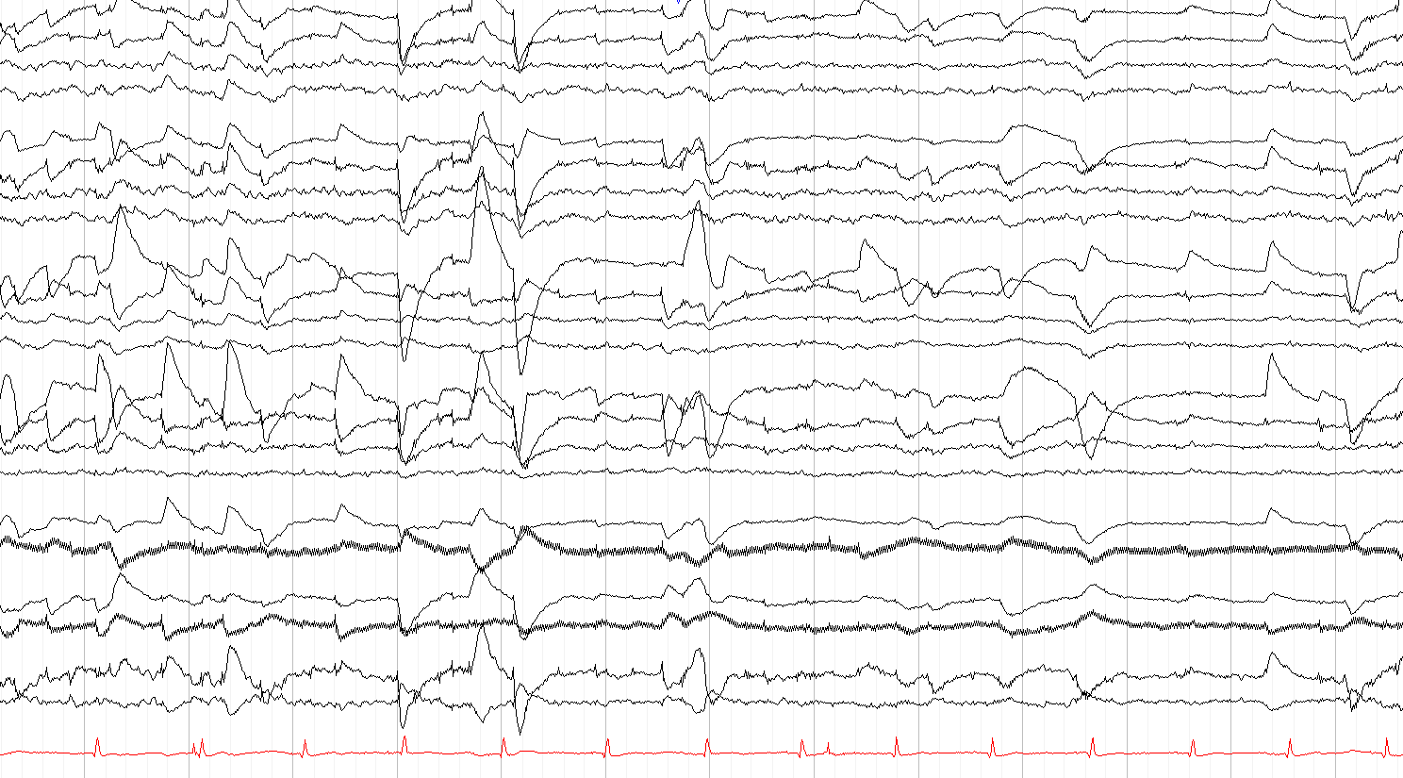
Introduction
Sleep stage classification is essential for analyzing sleep patterns and diagnosing sleep disorders like insomnia, sleep apnea, and narcolepsy.
Sleep EEG specifically records brain activity during sleep to analyze and classify different sleep stages. Sleep stages reflect distinct patterns of brain waves, which are categorized based on their frequency and amplitude…
Currently, sleep stages are manually scored by experts using polysomnography (PSG), which includes EEG signals. This process is:
Time-consuming: Reviewing 8 hours of sleep data takes hours of work.
Subjective: Scoring varies among experts.

Slide 3
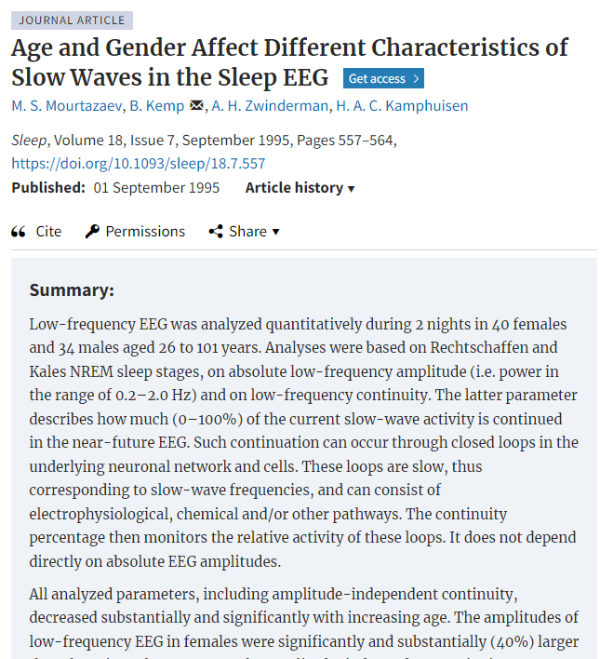
Data Description
EEG signals recorded over full nights of sleep.
Each recording is divided into 30-second segments (epochs).
Sleep stages are labeled as:
Wake (W), Stage 1 (N1), Stage 2 (N2), Stage 3/4 (N3), and REM.
74 healthy individuals (40 females and 34 males) aged between 26 and 101 years.
Recorded signals included EEG (Fpz-Cz and Pz-Oz), horizontal electrooculogram (EOG), submental electromyogram (EMG), event markers, and time synchronization signals. The EEG signals were sampled at 100 Hz.

Slide 4
Preprocessing
Artifact Rejection: An automatic artifact rejection algorithm was applied to exclude 1-second epochs with potential artifacts, such as mains interference, EMG artifacts, EOG activity, or body movements.
Slow-Wave Analysis: Two primary measures were analyzed: Slow-Wave Power (SWP): Computed in the 0.5-2.0 Hz frequency band using a bandpass filter. Slow-Wave Continuity Percentage (SW%): An amplitude-independent measure assessing the percentage of current slow-wave activity continued in the near-future EEG, reflecting the activity of slow-wave-generating neuronal networks.

Slide 5
Primary Objectives
Perform Traditional Classifier and Deep Neural Network and comparison with their variations.
Generalization:
Use Leave-One-Subject-Out (LOSO) validation to test how models generalize to unseen participants.
Temporal Context:
Incorporate neighboring epochs (before and after) to provide context about stage transitions. Hypothesis: Sleep stages are sequential and dependent on neighboring time windows.

Slide 6
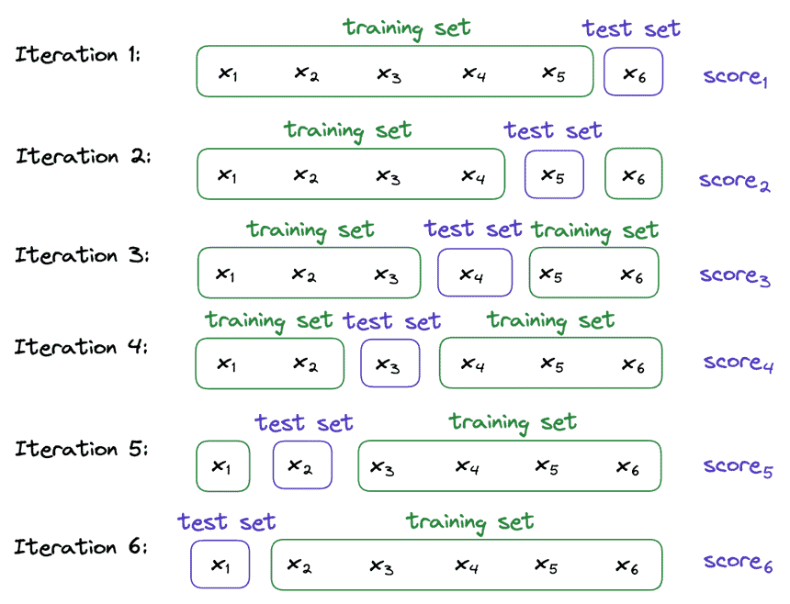
LOSO
Training and Testing Splits: For a dataset with 𝑁N subjects, LOSO involves splitting the data such that the model is trained on 𝑁−1N−1 subjects and tested on the one subject left out. This process is repeated 𝑁N times, with each subject being the test subject exactly once.
Generalization: By training on all subjects except one and testing on the unseen subject, LOSO evaluates how well the model generalizes to new, unseen individuals. This is especially important for physiological datasets like EEG, where individual differences (e.g., brain structure, signal amplitude) can be significant.

Slide 7
Temporal Context
Sleep EEG signals are divided into consecutive epochs, typically 30 seconds each
Temporal context involves analyzing how the features or patterns of an epoch relate to those of its neighboring epochs (e.g., the epochs immediately preceding and following the current epoch).
A sliding window is often used to capture temporal relationships between a sequence of epochs. For example, when analyzing one epoch, the model might consider the surrounding 5 epochs (2 before, 2 after) to understand trends in sleep architecture, slow-wave activity, or other characteristics
Stage Transitions: Temporal context helps in identifying transitions between sleep stages (e.g., from NREM to REM) by examining patterns in successive epochs.
Artifact Detection: Temporal information can improve the detection of anomalies or artifacts that persist across multiple epochs.
Deep Sleep Analysis: Slow-wave activity, a hallmark of deep sleep, exhibits patterns that benefit from temporal context to detect its continuity and characteristics.

Slide 8
Models
EEG signals were normalized to ensure consistent scale across participants: Data was segmented into 30-second epochs for model input.
Random Forest (RF):
1. RF_LOSO: Generalized across subjects.
2. RF_TC: Included temporal context with neighboring epochs.
Long Short-Term Memory (LSTM):
1. LSTM Pure: Single epoch as input.
2. LSTM_TC: Neighboring epochs included for temporal context.

Slide 9
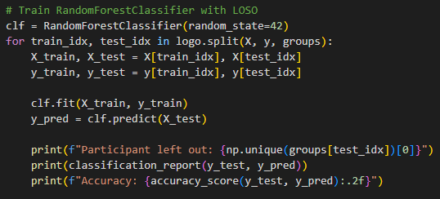
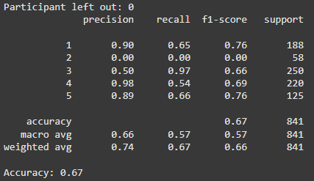
Random Forest (RF):
RF_LOSO: Generalized across subjects.

Slide 10
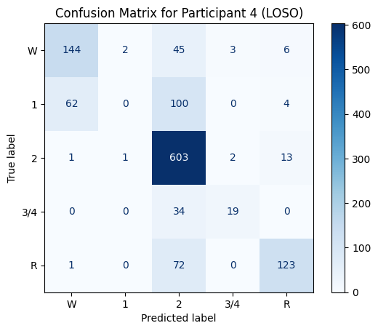
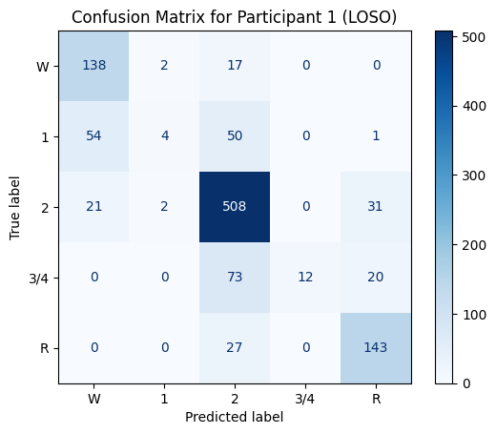
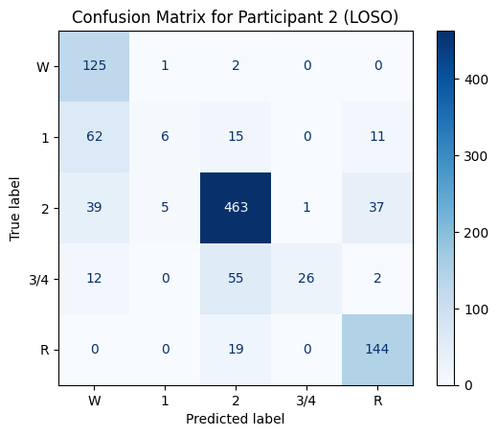
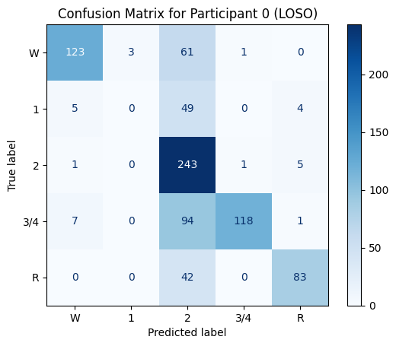
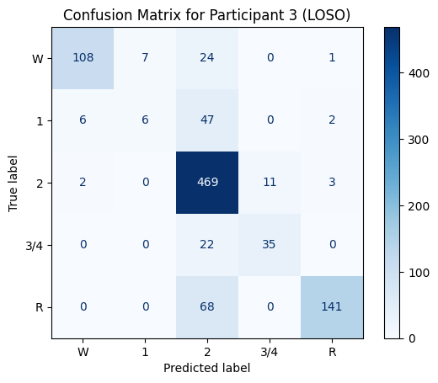
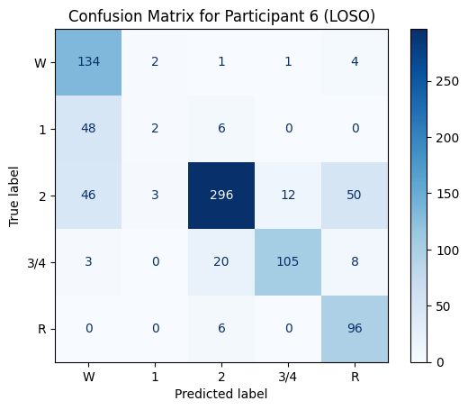
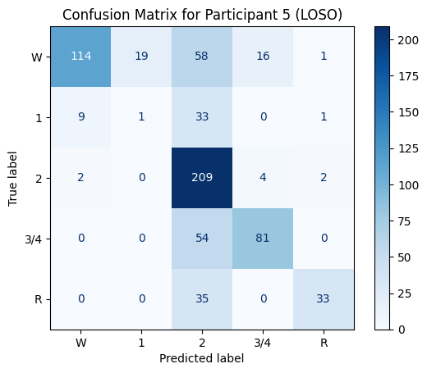
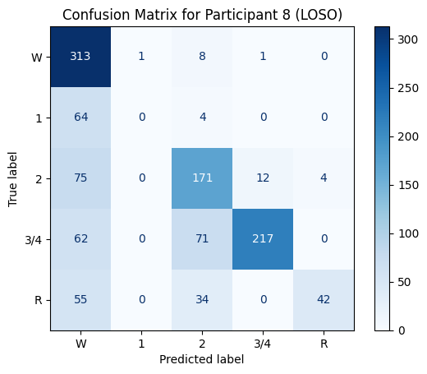
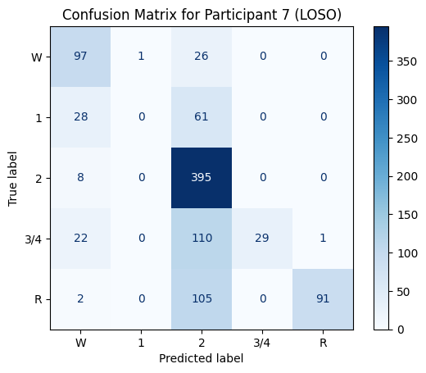
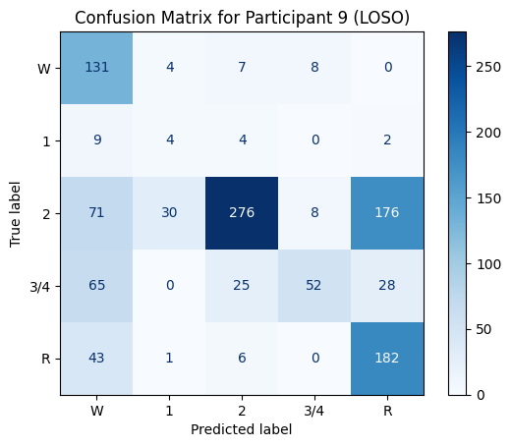
Random Forest (RF):
RF_LOSO: Generalized across subjects.
0.67
0.73
0.75
0.80
0.72
0.65
0.75
0.63
0.66
0.57

Slide 11
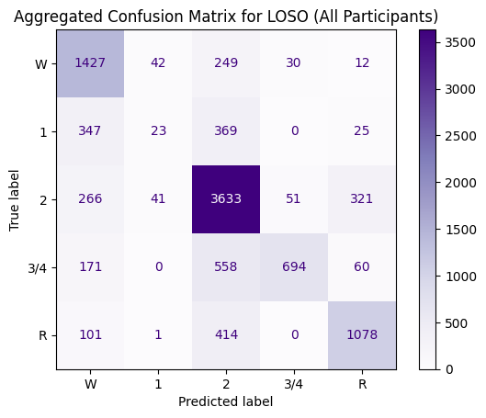
Random Forest (RF):
RF_LOSO: Generalized across subjects.
0.69
0.75
0.80
0.72
0.63
0.66
0.57

Slide 12

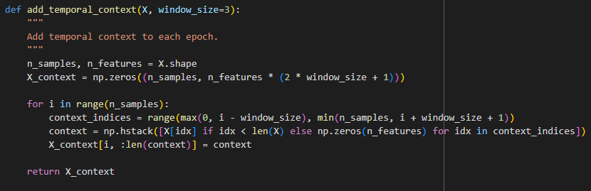
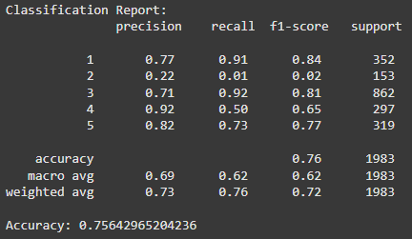
Random Forest (RF):
2. RF_TC: Included temporal context with neighboring epochs

Slide 13
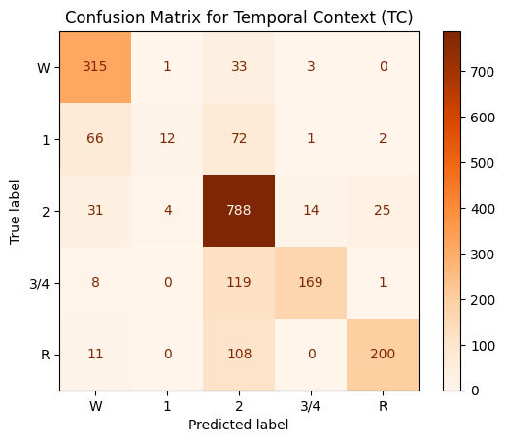
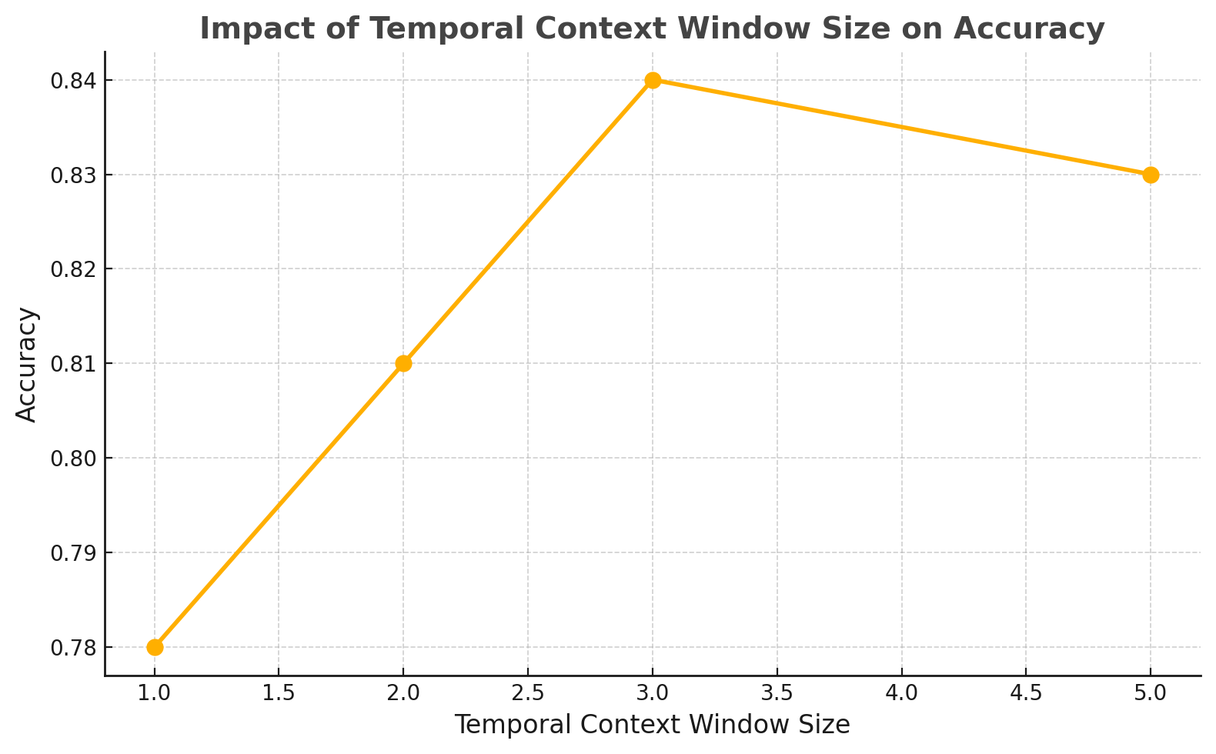
Random Forest (RF):
2. RF_TC: Included temporal context with neighboring epochs.
0.75

Slide 14
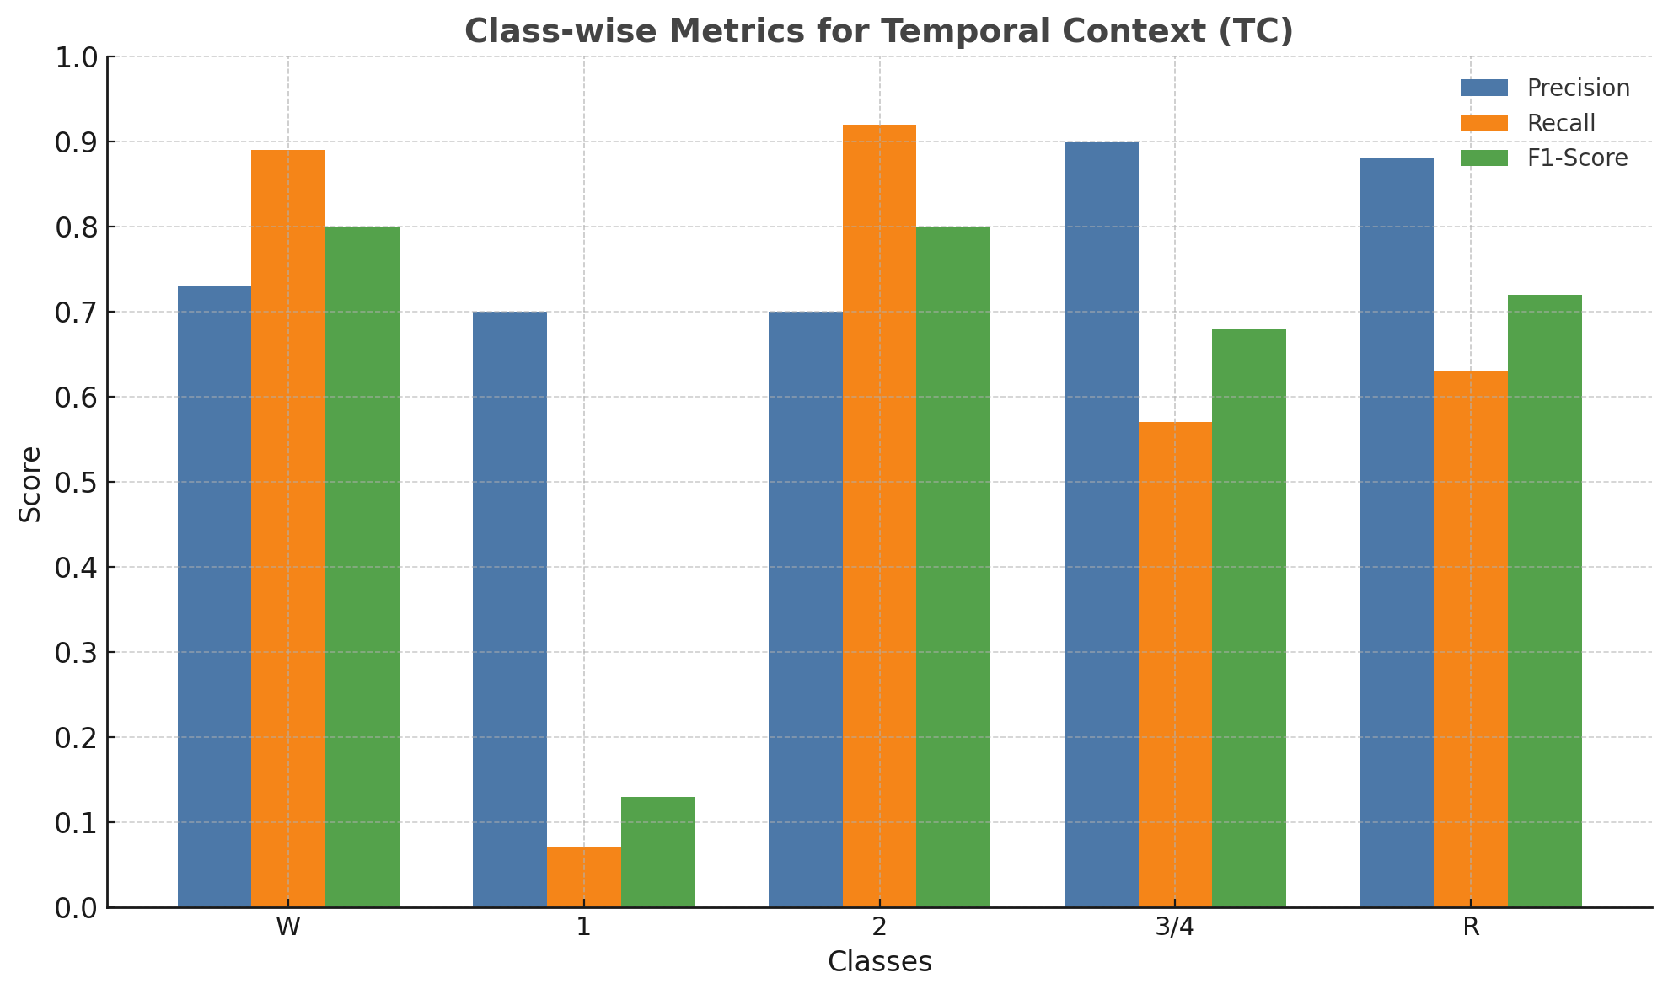
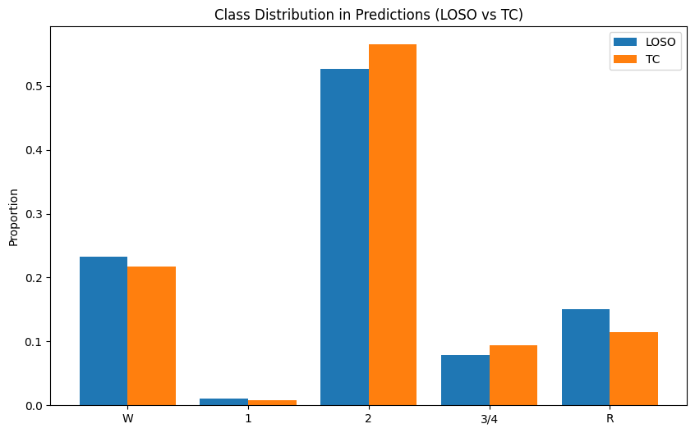
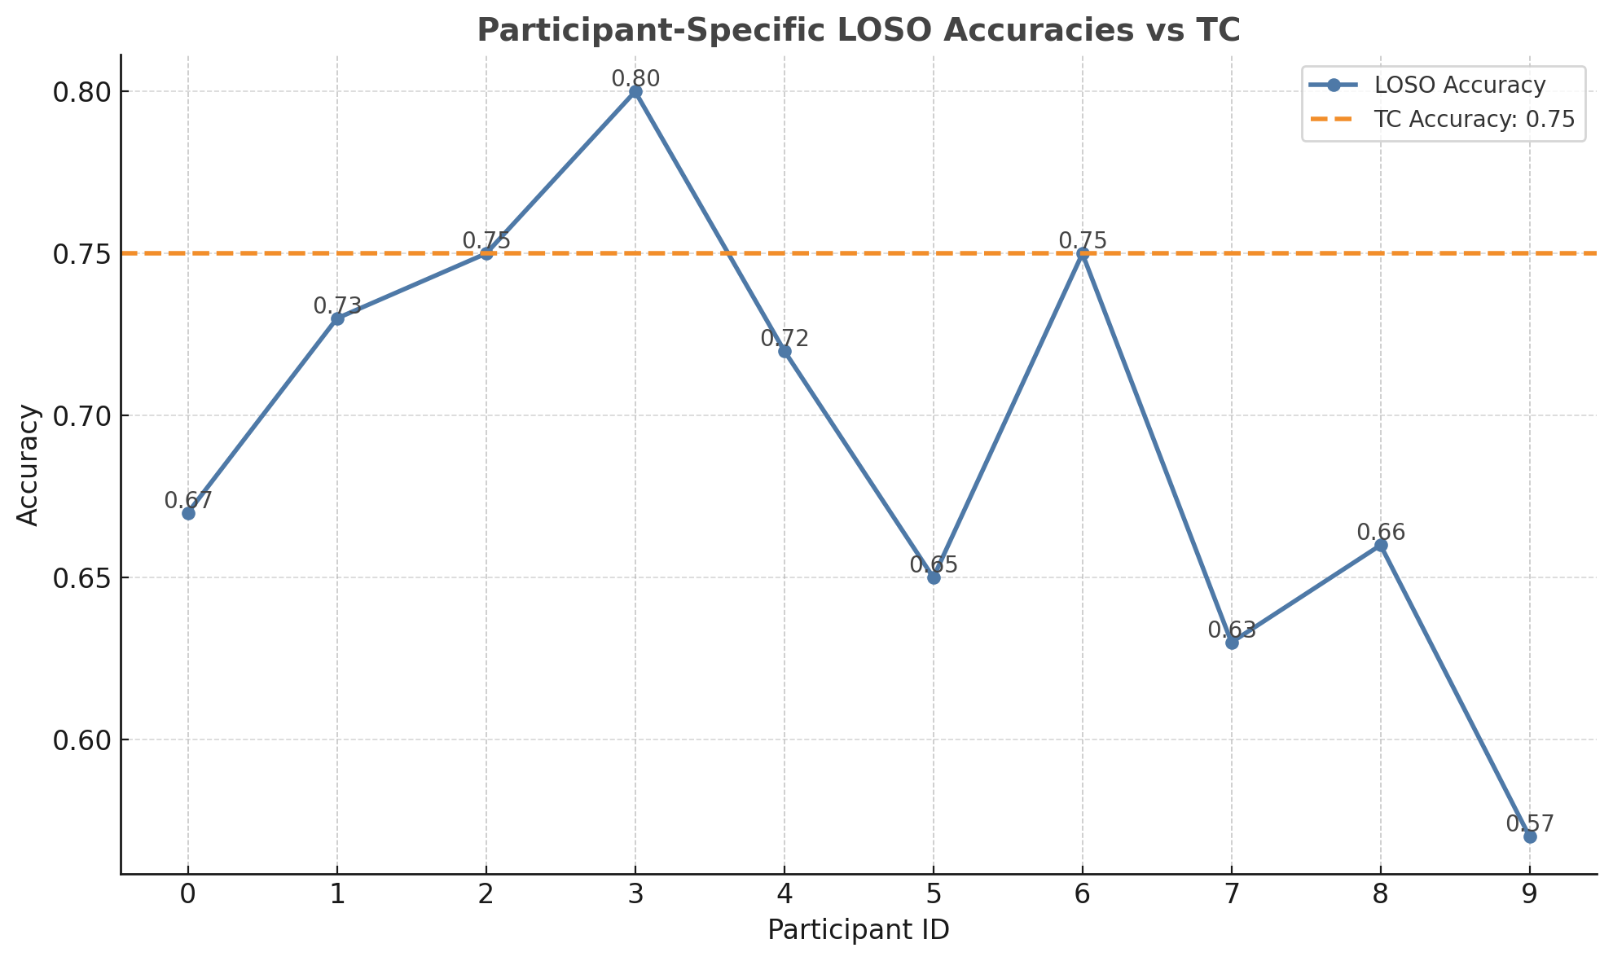
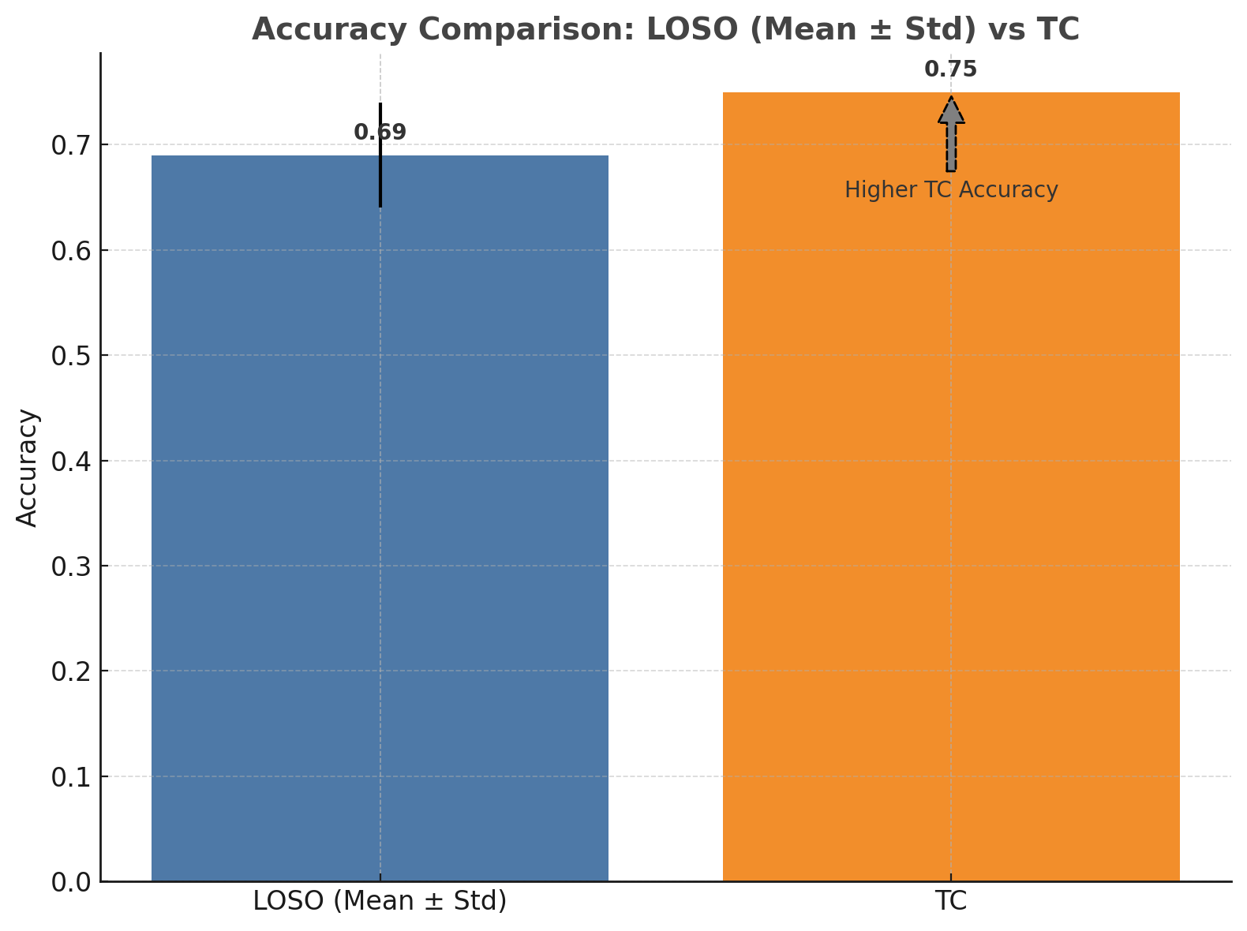
Random Forest (RF):

Slide 15
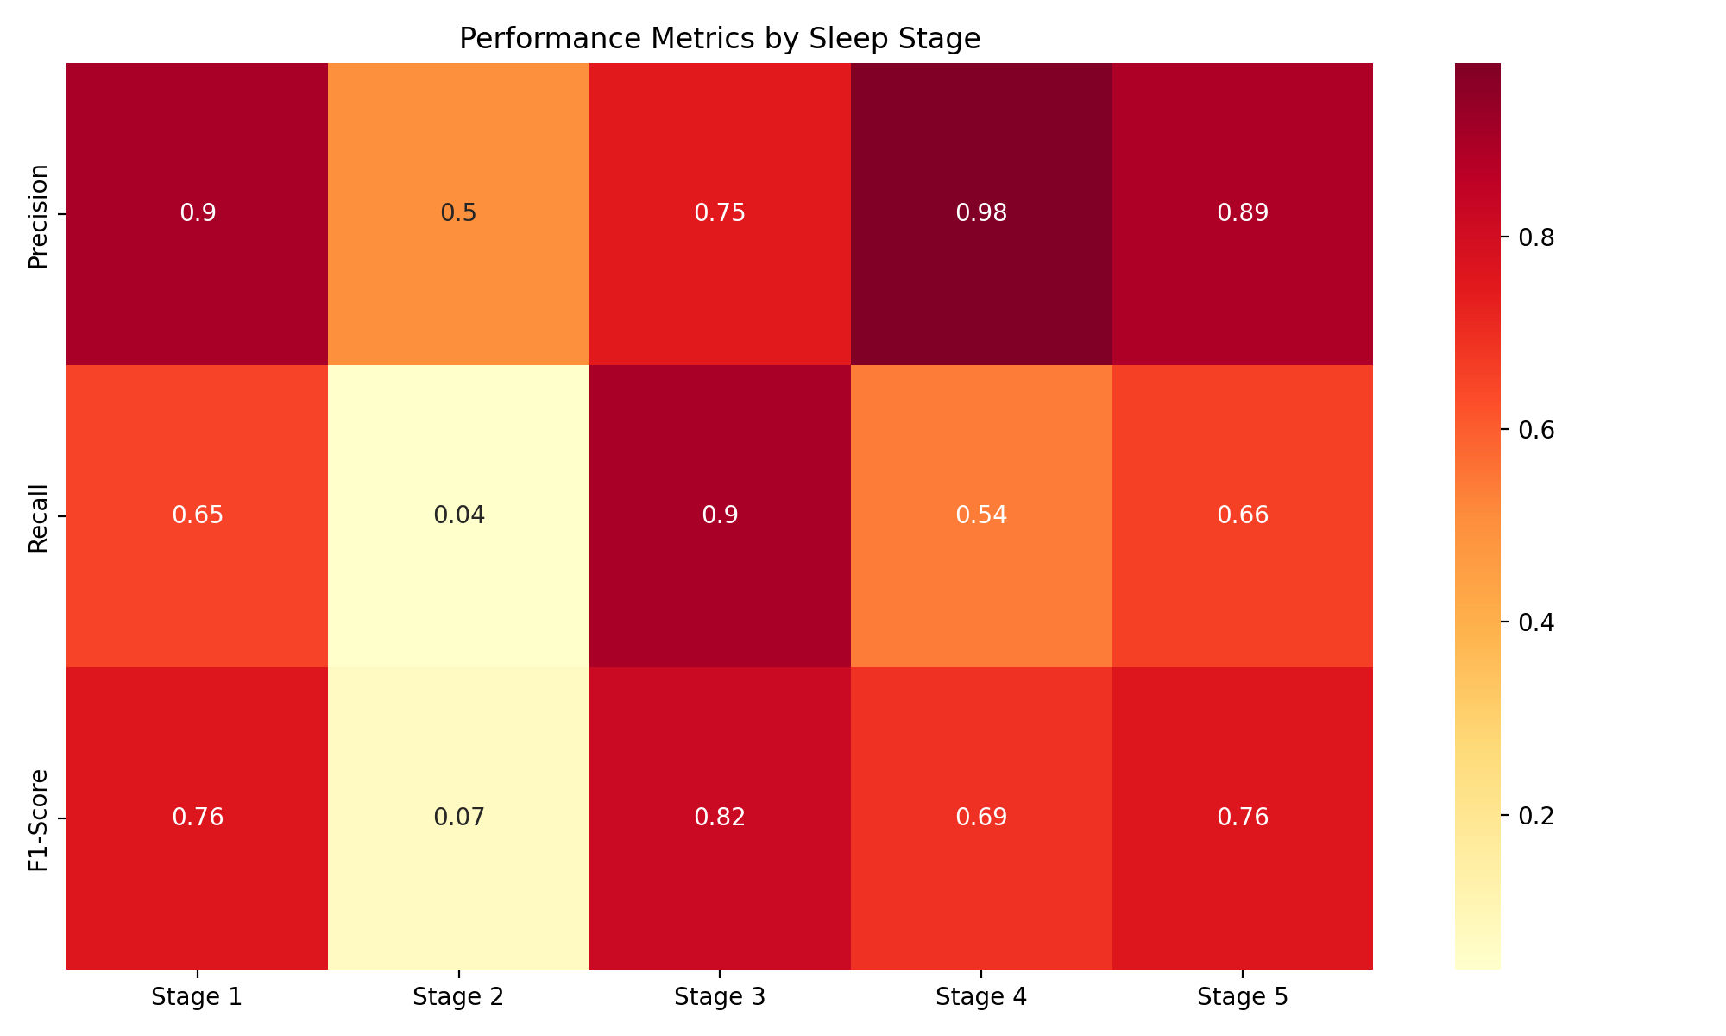
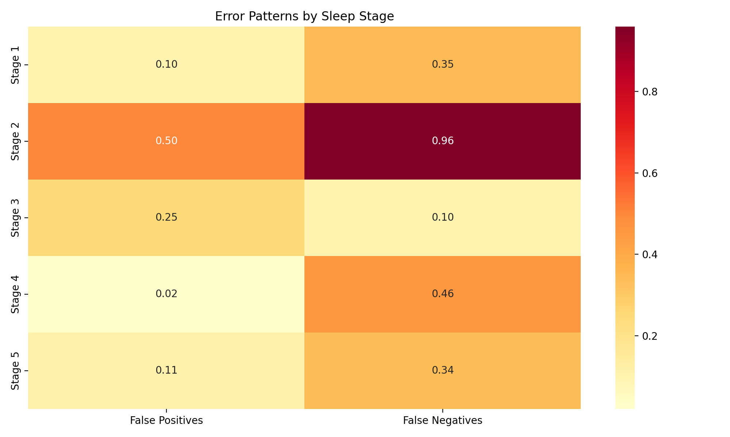
Models
2. LSTM TC

Slide 16
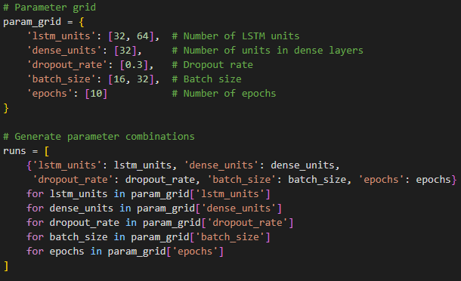
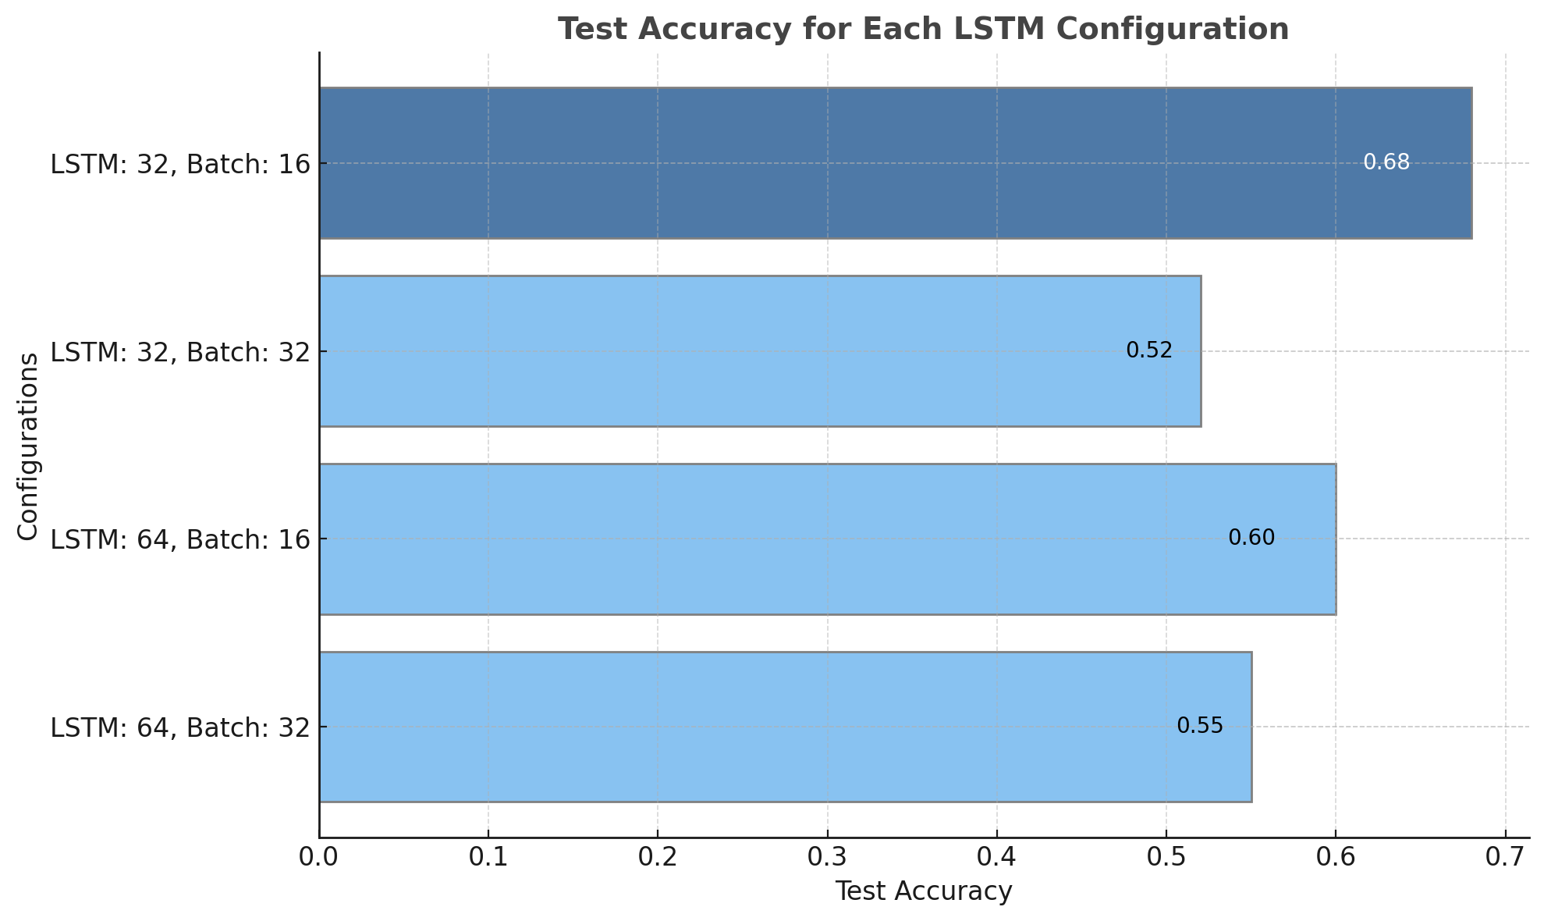
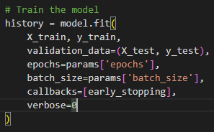
Models
1. LSTM Pure

Slide 17
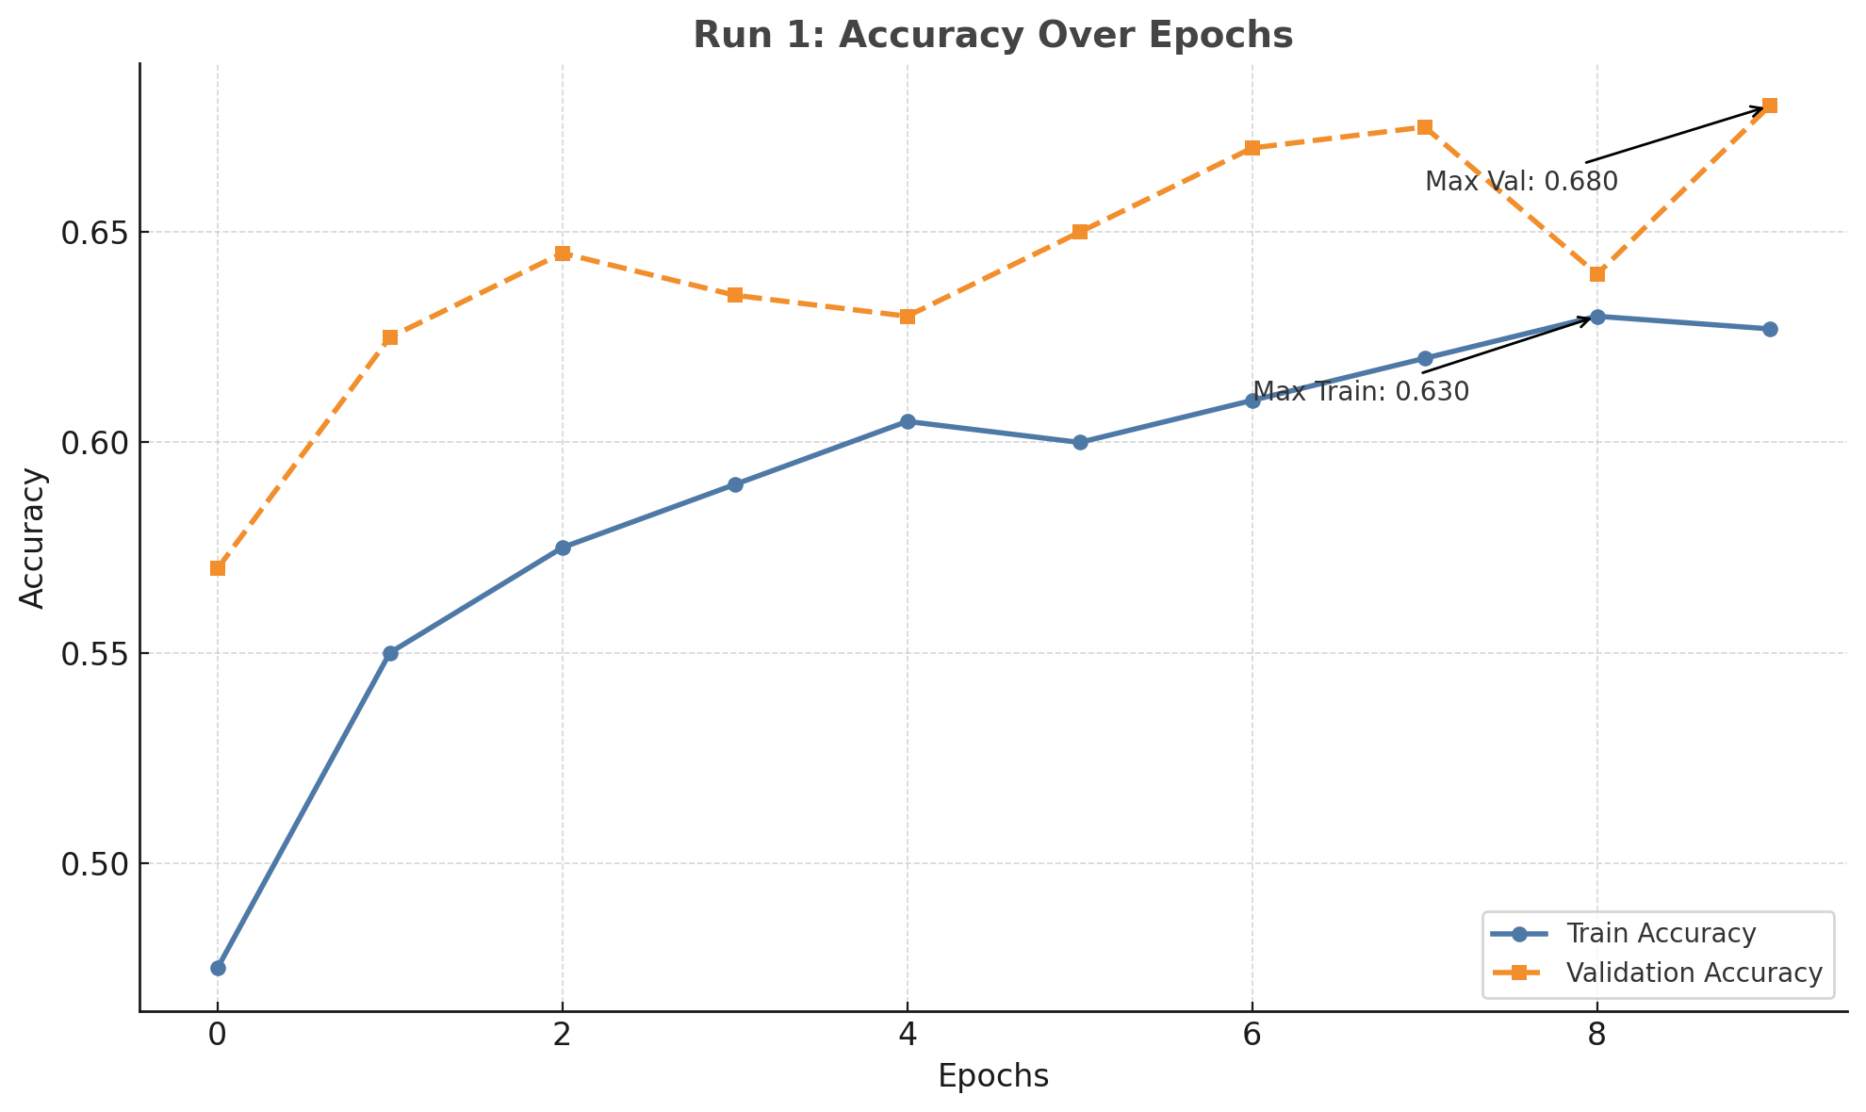
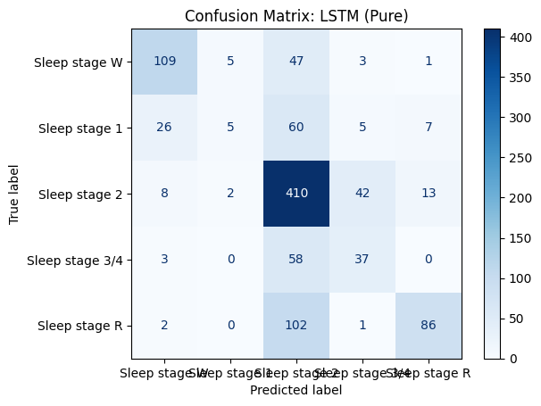
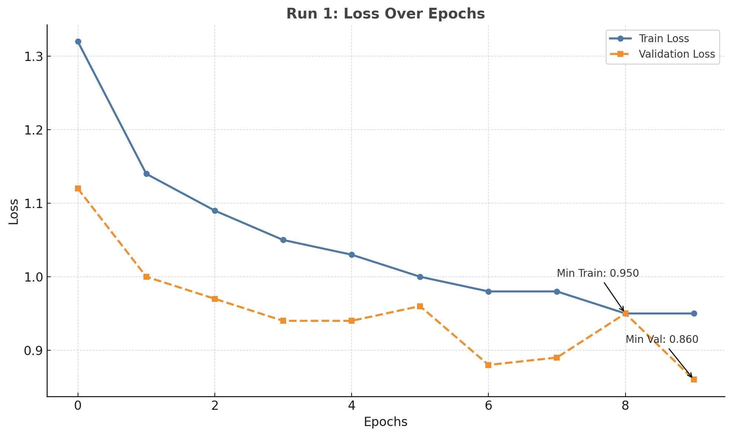
Models
LSTM Pure
Lstm units: 32, Dense: 32, Dropout: 0.3, batch_size: 16

Slide 18
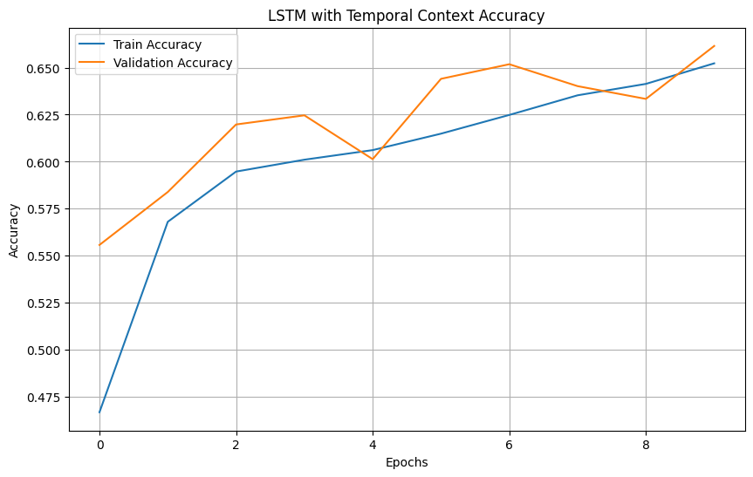
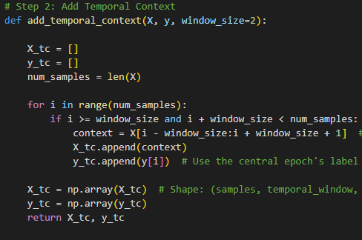
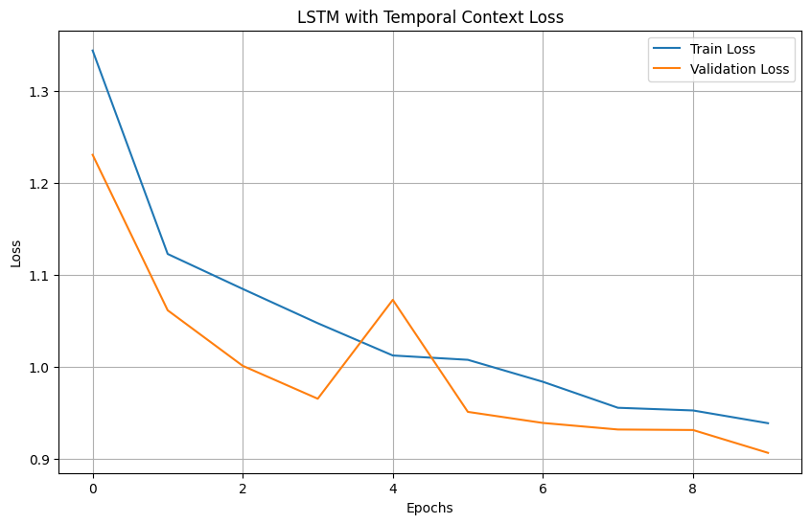
Models
2. LSTM TC

Slide 19
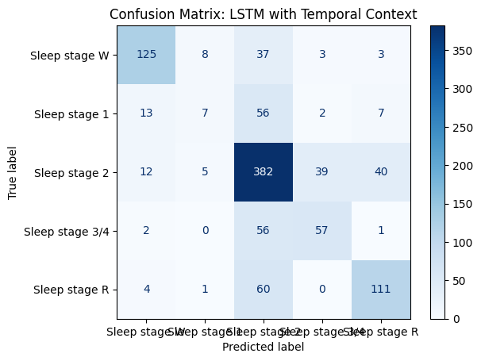
Models
2. LSTM TC

Slide 20
Key Findings
Accuracy Comparison
Model Accuracy
RF_LOSO 68%
RF_TC 76%
LSTM Pure 63%
LSTM_TC 66%
Random Forest with Temporal Context (RF_TC)
Improved accuracy for:
Wake (W): Better distinction from light sleep stages.
REM (R): Reduced misclassifications into Stage 2.
LSTM Models
LSTM Pure:
High confusion between Wake and Stage 2.
LSTM_TC:
Better performance for Wake and REM due to added temporal context.

Slide 21
Key Findings
Accuracy Comparison
Model Accuracy
RF_LOSO 68%
RF_TC 76%
LSTM Pure 63%
LSTM_TC 66%
Challenges:
Misclassification persists between similar stages (e.g., Stage 2 and Stage 3/4).
Data imbalance: Certain stages (e.g., Stage 1) occur less frequently, reducing performance.
Temporal Context is Essential:
Including neighboring epochs improves accuracy by capturing transitions between sleep stages.
Random Forest Performs Best:
RF_TC achieves 76% accuracy and is computationally efficient.
LSTM Needs More Data:
LSTM models showed promise but require larger datasets to generalize better.

Slide 22
Conclusion
Summary
1. Temporal context enhances accuracy and generalization.
2. RF_TC provides the best accuracy while maintaining interpretability.
3. LSTM_TC shows improved learning dynamics but needs further optimization.
Future Work
1. Use larger datasets to improve deep learning generalization.
2. Explore hybrid models combining Random Forest and LSTM.
3. Implement attention mechanisms to focus on critical EEG features.

Slide 23
Reference
Mourtazaev, M. S., Kemp, B., Zwinderman, A. H., & Kamphuisen, H. A. C. (1995)."Age and Gender Affect Different Characteristics of Slow Waves in the Sleep EEG."Available at: PhysioNet Sleep-EDF Rechtschaffen, A., & Kales, A. (1968). "A Manual of Standardized Terminology, Techniques, and Scoring System for Sleep Stages of Human Subjects."National Institute of Neurological Diseases and Blindness, Bethesda, Maryland.Iber, C., Ancoli-Israel, S., Chesson, A., & Quan, S. F. (2007). "The AASM Manual for the Scoring of Sleep and Associated Events.“
Breiman, L. (2001). "Random Forests." Machine Learning, 45(1), 5–32.DOI: 10.1023/A:1010933404324

