Slide 1

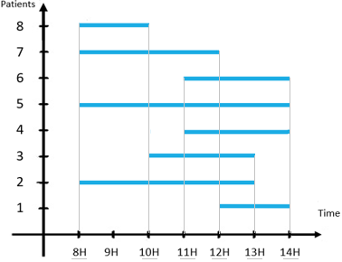
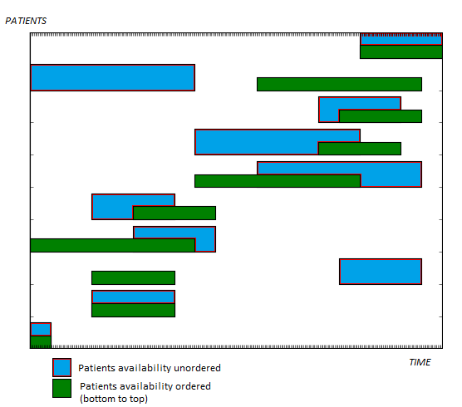
Traveling Salesman Problem with Time
Windows applied to liberal professions
FLATRES Karla, HERVÉ Marc-Antoine, LELIÈVRE Pierre, MATHIEU Robinson, ROCHA-PINTO Quentin, SANCHEZ Diego, Mentor: Jacques ROSSARD
Motivation
A simplified morning of a liberal nurse
In a morning, liberal nurses usually work 6 hours straight, see 25 to 30 patients and drives about 150km. Optimizing their route to reduce transportations between each patients may help them to reduce this number.
This problem is known as the Traveling Salesman Problem with Time Windows and we will propose here an implementation of an exact solution.
Patient availability :
Methodology
1 : Extracting time intervals
By using the example above, we merge every patient’s time interval to have a list of each portion of time.
Loop with the next
time interval
The time intervals created will be :
[8h , 10h]
[10h, 11h]
[11h, 12h]
[12h, 13h]
[13h, 14h]
Extract different
time intervals
from all patients’ availability schedule¹
Compute new possible sequences, based on:
Patients available on this time interval
Sequences done at the previous iteration
For each sequence :
Compute time needed
Remove similar² and impossible³ sequences
Return of the shortest path and the complete time of the journey
2 : Similar sequences
Consider the 2 following sequences :
1 : [A, B, C, D], time needed : 5 2 : [A, C, B, D], time needed : 7
The 2 sequences start by, finish by and visit the same patients. We can remove the 2), as it is longer.
3 : Impossible sequences
The impossible cases are the cases where the nurse arrives too early at the patients house, too late, or where a patient hasn’t been treated before the maximum interval of the patient (so it is too late to meet him).
Tests
Conclusion
Tests
Execution time depending on the number of patients and patients’ average disponibility
This algorithm :
Gives the best solution of the best schedule to follow, not an approached one;
Only asks for the needed distances;
Has a too long execution time for it to be usable on real nurses’ journey, but might work for other liberals’.
Patients’ Average Disponibility over the period of time
Number of patients
 | 16% | 33% | 50% | 66% | 83% | 100%
5 | 0.28 ms | 0.33 ms | 0.80 ms | 1.4 ms | 2.5 ms | 3.4 ms
6 | 0.30 ms | 0.46 ms | 0.87 ms | 1.6 ms | 2.7 ms | 4.6 ms
7 | 0.32 ms | 2.0 ms | 44 ms | 1.7 s | 9 s | 10.3 s
8 | 0.32 ms | 2.3 ms | 0.5 s | 3.27 s | 4 min | 7 min
9 | 0.33 ms | 2.6 ms | 0.9 s | 32 min | X | X
10 | 0.36 ms | 2.7 ms | 2.7 s | X | X | X
Perspectives
« X » means the time to compute is higher than 1 hour.
Results shown are the mean of 10 computations.
Removing similar sequences accounts for 95% of our program execution time.
Future improvements possible :
Optimize the implementation of the « removing similar sequences » function that currently accounts for roughly 95% of our computation time;
Deal with cases where patients have discontinuous availability, i.e. are available during 2 or more different periods of time
Example of a solution
Bibliographic References:
An Exact Algorithm for the Time Constrained TSP by Edward K. Baker (1983)
An Optimal Algorithm for the TSP by Yvan Dumas, Jacques Desrosiers, Eric Gelinas, Marius M. Solomon (1995)
Dynamic Programming Strategies for the TSP with Time Window and Precedence Constraints by Aristide
Mingozzi, Lucio Bianco, Salvatore Ricciardelli (1997)
4. A compressed-annealing heuristic for the TSP with time windows by Jeffrey W Ohlmann, Barrett W Thomas (2007)

