Slide 1
Employee Data Analysis using Excel
STUDENT NAME: S.AZRA FATHIMA
REGISTER NO: 312200903
DEPARTMENT: B.COM(COMPUTER APPLICATIONS)
COLLEGE : PACHAIYAPPAS COLLEGE FOR WOMEN
KANCHIPURAM

Slide 2
AGENDA
1.PROBLEM STATEMENT
2. PROJECT OVERVIEW
3. USERS
4. OUR SOLUTION AND DESCRIPTION
5. DATASET DESCRIPTION

Slide 3

PROJECT OVERVIEW
visualizing employee attendance trends with excel charts
Involves evaluating and measuring employess work efficiently and effectiveness this data is then analyzed using excel function pivot tables charts and areas improvement promotion bar chart business objectives(eg. Performance weights ,measures, period, frequency etc)

Slide 4
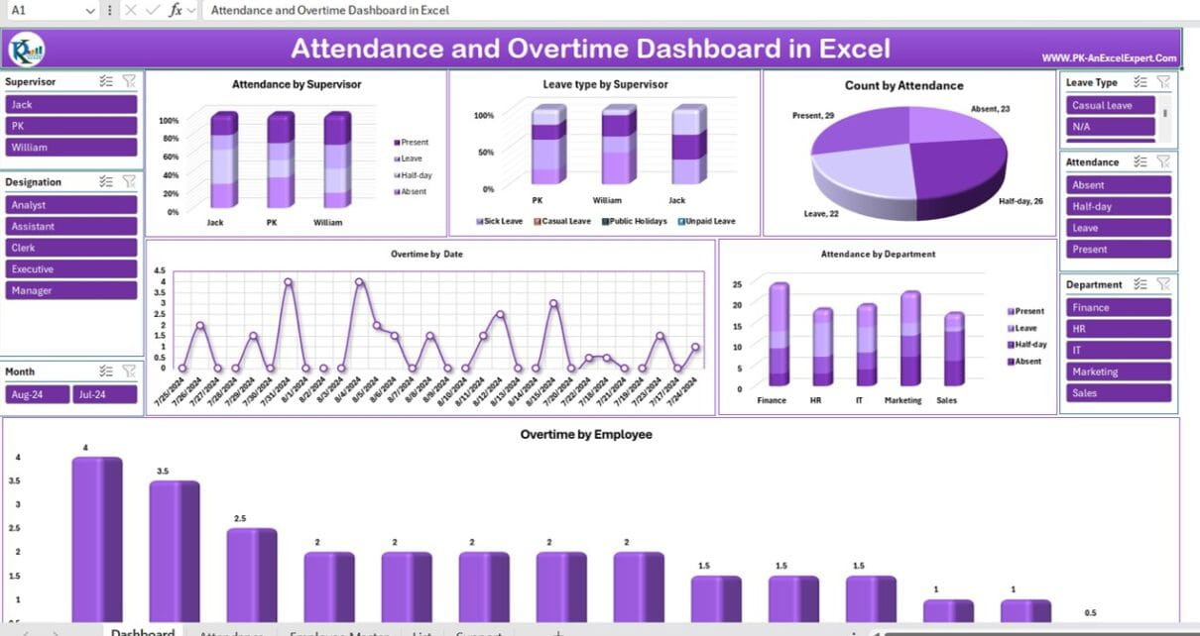

WHO ARE THE END USERS?

Slide 5

OUR SOLUTION AND ITS VALUE PROPOSITION
an attendance Excel tracker comes with many benefits for your business, with keeping track of employee absence and work hours being the most obvious one. You can identify patterns of tardiness and use the information to address attendance issues, ensuring your employees show up at work as scheduled. Also, employee attendance tracker Excel can facilitate the accurate calculation of payroll costs. With information on the number of days each employee has worked, you can easily calculate the wages owed.As you’ll see from the rest of this article, an attendance tracker can be a valuable tool for businesses of all sizes. Continue reading to see how you can take advantage of and maximize its potential for your organization.
ouuu

Slide 6
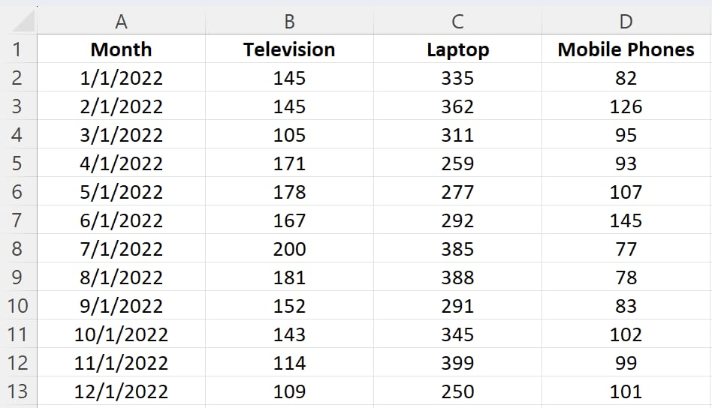
Dataset Description
Open Excel and create a new workbook.Copy the dataset above and paste it into cell A1Format the cells as needed (e.g., adjust column width, apply bold formatting to headers, etc.).Electronics dataset in Excel

Slide 7

MAINTAING EMPLOYEE ATTENDANCE RECORDS
work setting, attendance sheets help track entry time, analyze employee productivity and regularity, and record overtime. Managers may use the data to:Monitor punctuality and employee conduct before performance reviewsCorrelate employees’ attendance to productivityEnsure payroll calculations are accurateAnalyze past data (like time-off requests and overtime patterns) to plan schedules on a weekly or monthly basisComply with state and federal laws in terms of working hours and overtime pay
3/21/2024 Annual Review
7

Slide 8
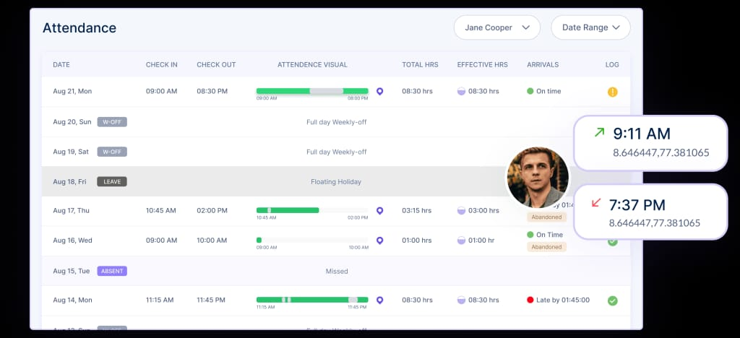
TRACKING TRENDS
Employees are easily accountable since all their actions are recorded. This ensures that workers are disciplined and productive at all times due to accountability. Real-time reduces time theft and unauthorized breaks by employees. Since workers know their attendance is recorded in real-time, time theft cannot be achieved. This results in accurate work hours.
8

Slide 9
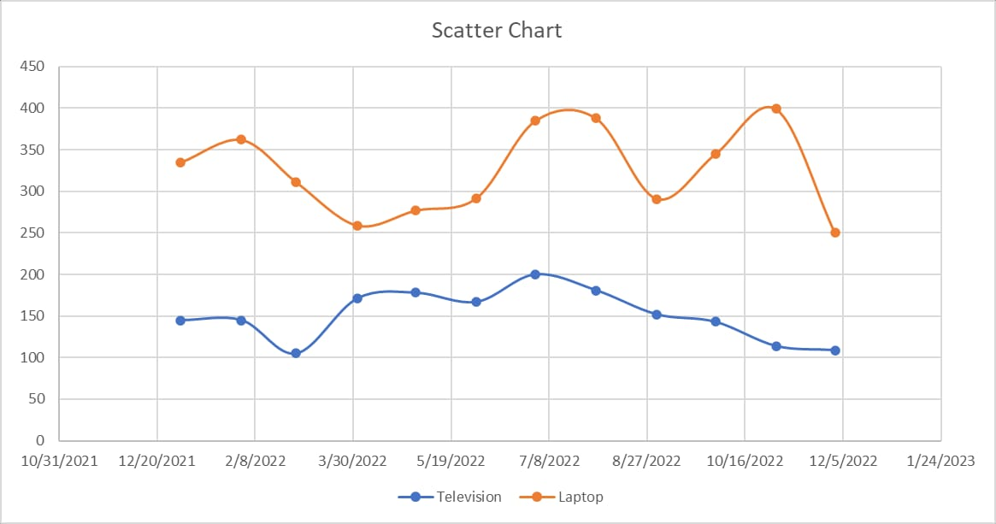
EXCEL VISUALIZATION TECHNIQUES
column chart, also known as a vertical bar chart, helps visualize data where categories are placed on the x-axis and the values on the y-axis. Similar to bar charts, they help visualize data across categories.To create a column chart in Excel:Select the data range A1:D13Click the "Insert" tab in the Excel ribbonClick on the columns icon dropdown, and under the “2-D Column” category, choose “Clustered Column”You can now see a column chart that displays the number of units sold for each product category by the month.
9

Slide 10
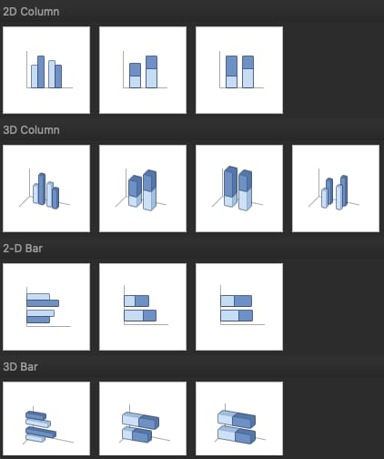
BASIC CHART IN EXCEL
Excel has multiple options for choosing a particular chart type. For example, if you want to create a column or bar chart, you are often presented with various visualization options. For example, there are 2D and 3D versions and normal, stacked, and 100% stacked options. Depending on your requirements, you can choose the visualization type that best suits your needs.

Slide 11
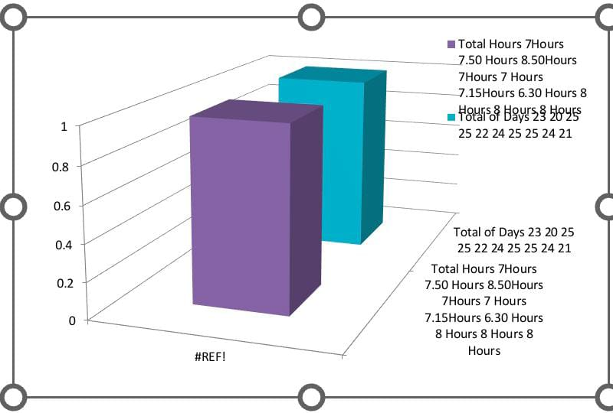
RESULTS

Slide 12

CONCLUSION
Excel attendance tracker or spreadsheet simplifies tracking attendance, absences, and other attendance-related data. Here is how you can create a detailed monthly attendance track
Consider creating a separate sheet in the workbook for monthly summaries. Here, you can use Excel functions likeSUM
COUNT
AVERAGE

