Slide 1
Threat Hunting Factory
Hypothesis driven threat hunting, from the question to the report
An end to end platform: choose the hypothesis, upload the evidence, and receive a report
carrying the observations, the original log extracts, the cyber risk, the impact and the remediation.
136
96
33
1,860
DETECTIONS
ATT&CK TECHNIQUES
HYPOTHESES
TESTS PASSING
Notes:
Opening slide. The platform turns a hunting hypothesis and a bag of logs into an evidence backed report. Every figure on this slide is produced by the repository itself.

Slide 2
CONTENTS
What we will cover
01
The platform
What it does, who it is for and how a hunt is framed
02
Architecture
The detection engine, the parsers, the mathematics and the security posture
03
The agents
The hypothesis collector and the behavioural analyst, both running locally
04
End to end
A complete hunt, from sign in to the exported report, with the real interface
Threat Hunting Factory
2
Notes:
Four parts: the platform, the architecture, the two agents, then a full walkthrough on real evidence.

Slide 3
01
PART ONE
The platform
What it does, and why a hunt starts from a hypothesis rather than from an alert queue.
Notes:
Section opener. The platform. What it does, and why a hunt starts from a hypothesis rather than from an alert queue.

Slide 4
THE APPROACH
Hunting starts with a question, not an alert
The problem
What the platform does about it
Alert queues only show what a tool already knows how to name.
Hunting is done by hand, so the quality depends on who is on shift.
Evidence arrives in a different format from every vendor.
The write up takes longer than the analysis and is rarely reproducible.
A hypothesis states the question and declares the telemetry it needs.
The engine reads every common log format and normalises it into one schema.
136 detections and 13 statistical models run in a single pass over the evidence.
Each observation carries its own log line, risk, impact and recommendation.
Threat Hunting Factory
4
Notes:
The contrast the product is built around: a hunt is a question you can state, test against evidence and reproduce.

Slide 5
THE WORKFLOW
Six steps from hypothesis to report
1
Choose a hypothesis
2
Collect the right evidence
3
Upload one archive
33 hypotheses across threat intelligence scenarios, techniques and mathematical models.
Each hypothesis declares the data sources it needs, the accepted formats and how to export them.
Zip, tar, tar.gz or a single log file, extracted with path and size protections.
4
The engine analyses everything
5
Read and export the report
6
Track the programme
Every file is sniffed, parsed, normalised and pushed through the detection library.
Observations with the original log line, the risk, the impact and the remediation. PDF or JSON.
The dashboard aggregates hunts, observations, ATT&CK coverage and risk over time.
Threat Hunting Factory
5
Notes:
The product is one loop. The analyst supplies the question and the evidence, the platform supplies the analysis and the write up.

Slide 6
AT A GLANCE
What ships in the box
136
96
33
27
DETECTIONS
ATT&CK TECHNIQUES
HYPOTHESES
LOG FORMATS
Pattern, threshold, sequence and statistical rules
Mapped across eleven tactics of the lifecycle
Threat intelligence, technique and mathematical families
Each proven against a fixture of the real emitted shape
1,860
140
27k
0
TESTS PASSING
END TO END CHECKS
RECORDS A SECOND
EXTERNAL DEPENDENCIES
Identical on Python 3.11, 3.12 and 3.13, nothing skipped
Fourteen journeys driven through a real browser
Extract and parse throughput on a single core
The engine is dependency free Python, the interface has no build step
Threat Hunting Factory
6
Notes:
Every number here is produced by the repository: the rule count, the technique count and the test count are all read from the code rather than quoted from a slide.

Slide 7
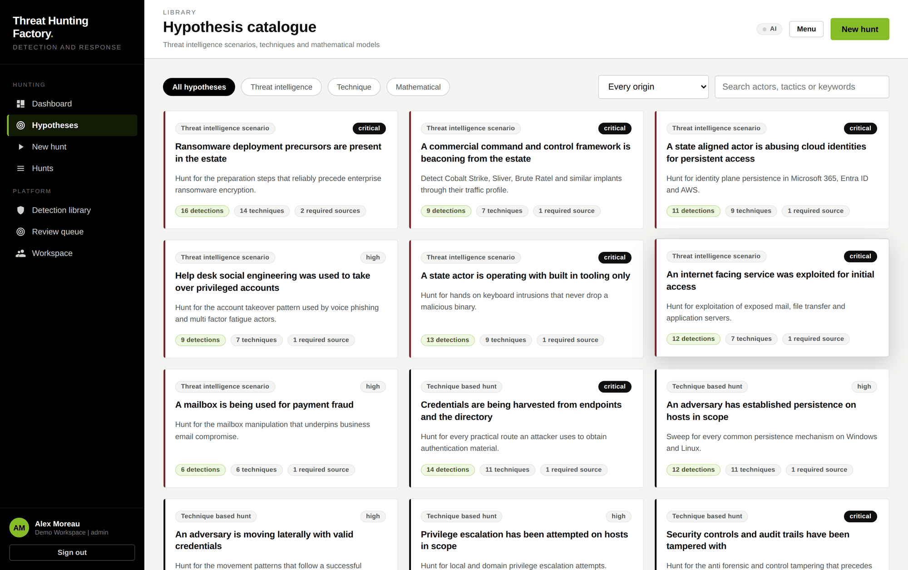
THE CATALOGUE
Three families of hypothesis
Threat intelligence
Scenarios tied to named actors and campaigns: ransomware precursors, commercial command and control, cloud identity intrusion, help desk social engineering, business email compromise, Active Directory escalation.
Technique
Standard technique based hunts: credential access, persistence, lateral movement, privilege escalation, defence evasion, discovery, exfiltration, Kubernetes, pipelines, databases, macOS.
Mathematical
Hunts built on mathematics rather than signatures: Fourier beaconing, Shannon entropy, long tail stacking, robust outlier detection, Benford's law and temporal profiling.
Every hypothesis declares its question, the telemetry it needs and the detections that will run.
Threat Hunting Factory
7
Notes:
The catalogue is not a fixed list any more. Collected hypotheses from public reporting join the built in ones once an analyst accepts them.

Slide 8
02
PART TWO
Architecture
A dependency free detection engine, a thin API in front of it and an interface with no build step.
Notes:
Section opener. Architecture. A dependency free detection engine, a thin API in front of it and an interface with no build step.

Slide 9
HOW IT IS BUILT
Four layers, one process
Interface
Vanilla JavaScript, no framework and no build step
Design constraints
web/
The engine imports nothing optional, so it runs anywhere Python 3.11 runs.
A test fails the build if the engine ever imports the AI package.
Any SQLAlchemy database, SQLite by default and PostgreSQL in production.
The AI layer is a feature flag: with no model server the platform behaves exactly as it does today.
API
FastAPI: authentication, catalogue, hunts, reports, statistics, administration
app/routers/
Services
Background hunt execution, persistence, multi tenant scoping, PDF rendering
app/hunt_service.py, app/reporting/
Engine
Ingest, parse, normalise, detect, profile and score. Dependency free Python
app/engine/
Threat Hunting Factory
9
Notes:
The important line is the last one. The deterministic engine never depends on the model layer, so an audit can be reproduced with the AI switched off.

Slide 10
THE ENGINE
One pass over the evidence
01
02
03
04
05
06
Ingest
Parse
Normalise
Detect
Profile
Score
Archive extracted with zip slip and size protections. A damaged member is skipped and reported, never fatal.
Every file is sniffed and scored against every parser, with a free text fallback that still recovers timestamps.
Records become one common schema through an alias table covering several hundred vendor field names.
An inverted keyword index selects candidate rules per record, so only those rules are evaluated.
Every entity is compared against its own peer group. No model, pure mathematics, milliseconds.
Observations are ranked, the risk is aggregated and the verdict is written.
Measured on a single container core against a generated archive of 500,000 records
Stage | Throughput | 500,000 records
Extract and parse | about 27,000 records a second | roughly 18 seconds
Detect, focused hypothesis (16 rules) | about 33,000 records a second | roughly 15 seconds
Detect, full library (136 rules) | about 16,000 records a second | roughly 32 seconds
Threat Hunting Factory
10
Notes:
One pass, not one pass per rule. That choice is what makes a large archive analysable at all.

Slide 11
UNIVERSAL PARSING
It reads the logs you actually have
Family | Formats
Structured | JSON, NDJSON, JSON Lines, pretty printed documents, CSV, TSV, semicolon and pipe delimited, logfmt
Windows | Binary .evtx, exported event XML, Sysmon operational, PowerShell script block, Windows Firewall
Unix | Syslog RFC 3164 and 5424, auth.log, secure, sudo, PAM, auditd including hex fields, journald JSON
Web | Apache and Nginx common and combined, error logs, W3C extended (IIS), Squid, HAProxy, Cloudflare
Network | Zeek TSV and JSON, Suricata EVE, AWS VPC flow, Cisco ASA, Fortinet, Palo Alto PAN-OS
Appliance | CEF (ArcSight), LEEF (QRadar), and any appliance that states its flow in the message text
Cloud | AWS CloudTrail, Microsoft 365 unified audit, Entra ID sign ins, Azure diagnostics, Google Cloud audit
Platform | Kubernetes audit and events, Docker and CRI, identity provider logs, source control audit, osquery
Mail and database | Postfix, Exchange message tracking, M365 message trace, SQL Server, PostgreSQL, MySQL
Fallback | Any free text, with timestamp recovery, key value extraction and indicator extraction
Measured, not asserted
The claim that the engine reads any log is only worth its evidence, so it is tested.
A fixture holds samples of 27 formats in the shape the platform actually emits. Every one must be identified, timestamped and have its key fields mapped to the common schema.
When that corpus was first run, 15 of the 27 had a gap. A format that silently regresses to the free text fallback now fails the suite instead of quietly producing a weaker hunt.
Threat Hunting Factory
11
Notes:
The 15 of 27 figure is the honest part of this slide. The corpus was written to find gaps and it found them.

Slide 12
DETECTION
Four detection styles, one index
Style | Count | What it does
pattern | 103 | Single event matching on normalised fields or raw text
threshold | 18 | Sliding window counting per group, with distinct value counting
sequence | 2 | Ordered stages for the same entity inside a window
statistical | 13 | Whole dataset mathematics
Cost per record, full rule library
240
under 10
microseconds
microseconds
One alternation regex over every keyword
The inverted keyword index doing the same work
How the prefilter works
Each record is tokenised once into its alphanumeric runs, and that set is intersected with an index built from the rule keywords. A keyword is indexed on its most selective run, so certutil.exe is indexed on certutil: any record containing the keyword necessarily contains the run, which keeps the index sound while the rule selector still performs the exact test.
That is the difference between a large archive being analysable and not. A test asserts the index never drops a rule the contract keeps, checked against real generated evidence rather than synthetic strings.
Threat Hunting Factory
12
Notes:
Twenty four times faster, and the soundness of the shortcut is itself under test.

Slide 13
THE MATHEMATICS
Hunts that need no signature
Model | Method
Beacon detection | Timestamps per source and destination pair are binned at a quarter of the median interval, mean centred and transformed with an iterative radix 2 fast Fourier transform. The dominant peak power is compared against the mean spectrum and combined with the coefficient of variation and the jitter ratio.
Domain generation | Shannon entropy, consonant ratio, longest consonant run, digit ratio and length combine into a randomness score, then group by registrable parent domain.
Encoded payloads | Shannon entropy of long command line tokens, with hashes and identifiers excluded.
Long tail stacking | Frequency counting of process images, process lineage and user agents, reporting the tail with its share of the population.
Outlier detection | Modified z scores on the median absolute deviation, with the mean absolute deviation as fallback, scored inside peer groups so accounts are never compared against addresses.
Transfer analysis | Chi square test of leading digit frequencies against Benford's law, plus a Gini coefficient of egress concentration.
Temporal profiling | Hour of day profiling per account and robust burst detection over the binned timeline.
No signature required, and no numerical dependency
These models describe what normal looks like in the evidence itself, so they find activity nobody wrote a rule for. The fast Fourier transform, the entropy, the z scores and the Benford test are all implemented in the engine in plain Python.
Threat Hunting Factory
13
Notes:
This is the part a signature based tool cannot do. Thirteen statistical detections, all implemented in app/engine/stats_math.py with no numerical dependency.

Slide 14
SECURITY POSTURE
The untrusted paths were tested, not assumed
The platform ingests archives from outside and renders their content in a browser and a PDF. What was found and fixed:
Finding | Effect | Fix
Catastrophic backtracking in the syslog helper | 31 seconds for a 50,000 character line, 34 minutes for 400,000, quadrupling with every doubling | Quantifiers bounded and helper input capped: under 10 milliseconds at every size
Quadratic patterns in four detection rules | A crafted record cost 2 seconds per rule | Bounded to the lengths the formats actually allow
Extraction trusted the archive's declared sizes | The size budget could be bypassed by a lying header | The budget counts bytes actually written
A damaged archive member aborted the hunt | One corrupt file destroyed the analysis of every other file | Members are skipped individually and reported
Login timing revealed valid accounts | 275 ms for a real account against 3 ms for an unknown one | The same verification work runs either way, measured at a 1.01x spread
No limit on password guessing | Unlimited attempts against the platform's own sign in | Sliding window limits per account and per source address
Verified as safe: cross tenant reads return 404 rather than disclosing existence, archive members cannot escape the extraction directory, and log content reaches both the browser and the PDF as literal text, checked by rendering live payloads in a real browser.
Threat Hunting Factory
14
Notes:
Known limits are stated rather than hidden: the login limiter keeps state in process, there is no built in transport security, and uploaded evidence is stored unencrypted on disk.

Slide 15
03
PART THREE
The agents
Two agents running on open source models served locally, so no evidence ever leaves the tenant.
Notes:
Section opener. The agents. Two agents running on open source models served locally, so no evidence ever leaves the tenant.

Slide 16
THE GOVERNING PRINCIPLE
The model proposes, the engine verifies
A threat hunting report is evidence a client acts on. A local 8B to 14B model will invent an ATT&CK identifier, misquote a log line and state a false conclusion with complete confidence. So the architecture puts the model where it is strong and never where it is authoritative.
The model is allowed to
The model is never allowed to
Read prose and extract structure from it
Rank, group and explain candidates the engine found
Draft text: the hypothesis wording, the description, the risk, the impact, the recommendation
Propose a field extraction specification for an unknown format
Decide on its own that something is a confirmed compromise
Produce a log excerpt, since excerpts are always copied from the parsed corpus
Create a hypothesis whose technique identifier or data sources it invented
Be the only reason an observation exists at high or critical severity
Every model output passes a validator before it reaches the database. The 136 deterministic rules are untouched, so an audit can be reproduced byte for byte with the AI layer switched off.
Threat Hunting Factory
16
Notes:
This is the slide to linger on. It is the answer to the question every security buyer asks about a model in a report pipeline.

Slide 17
AGENT ONE
The hypothesis collector
Runs once a week, unattended. Nobody has to paste anything.
1
Fetch feeds
Vendor and incident response reporting, CISA advisories, the known exploited vulnerabilities catalogue and the arXiv API, each with its own since cursor
Why the cheap filter matters
Technique vocabulary, ATT&CK mentions, command line and telemetry vocabulary, then embedding similarity. About 300 articles a week become 90 worth reading
3,000
2
Filter, no model
model calls a run without it, most of a day on a processor only host
3
Extract
Schema bound model calls, two to four chunks per article, producing the statement and the technique identifier
about 270
4
Ground
Every claim carries a quote that appears verbatim in the article. The technique is checked against the ATT&CK table and the tactic is read from it, never trusted from the model
with it, which is a few hours overnight and nobody is waiting
5
Dedupe and write
Above 0.88 cosine similarity the article attaches to the existing hypothesis as a further reference rather than creating a near duplicate
It honours robots.txt, rate limits per domain, and asks each feed conditionally so an unchanged one costs a single request.
Threat Hunting Factory
17
Notes:
The collector is the only component that touches the internet, and only to fetch public articles. It never sends anything.

Slide 18
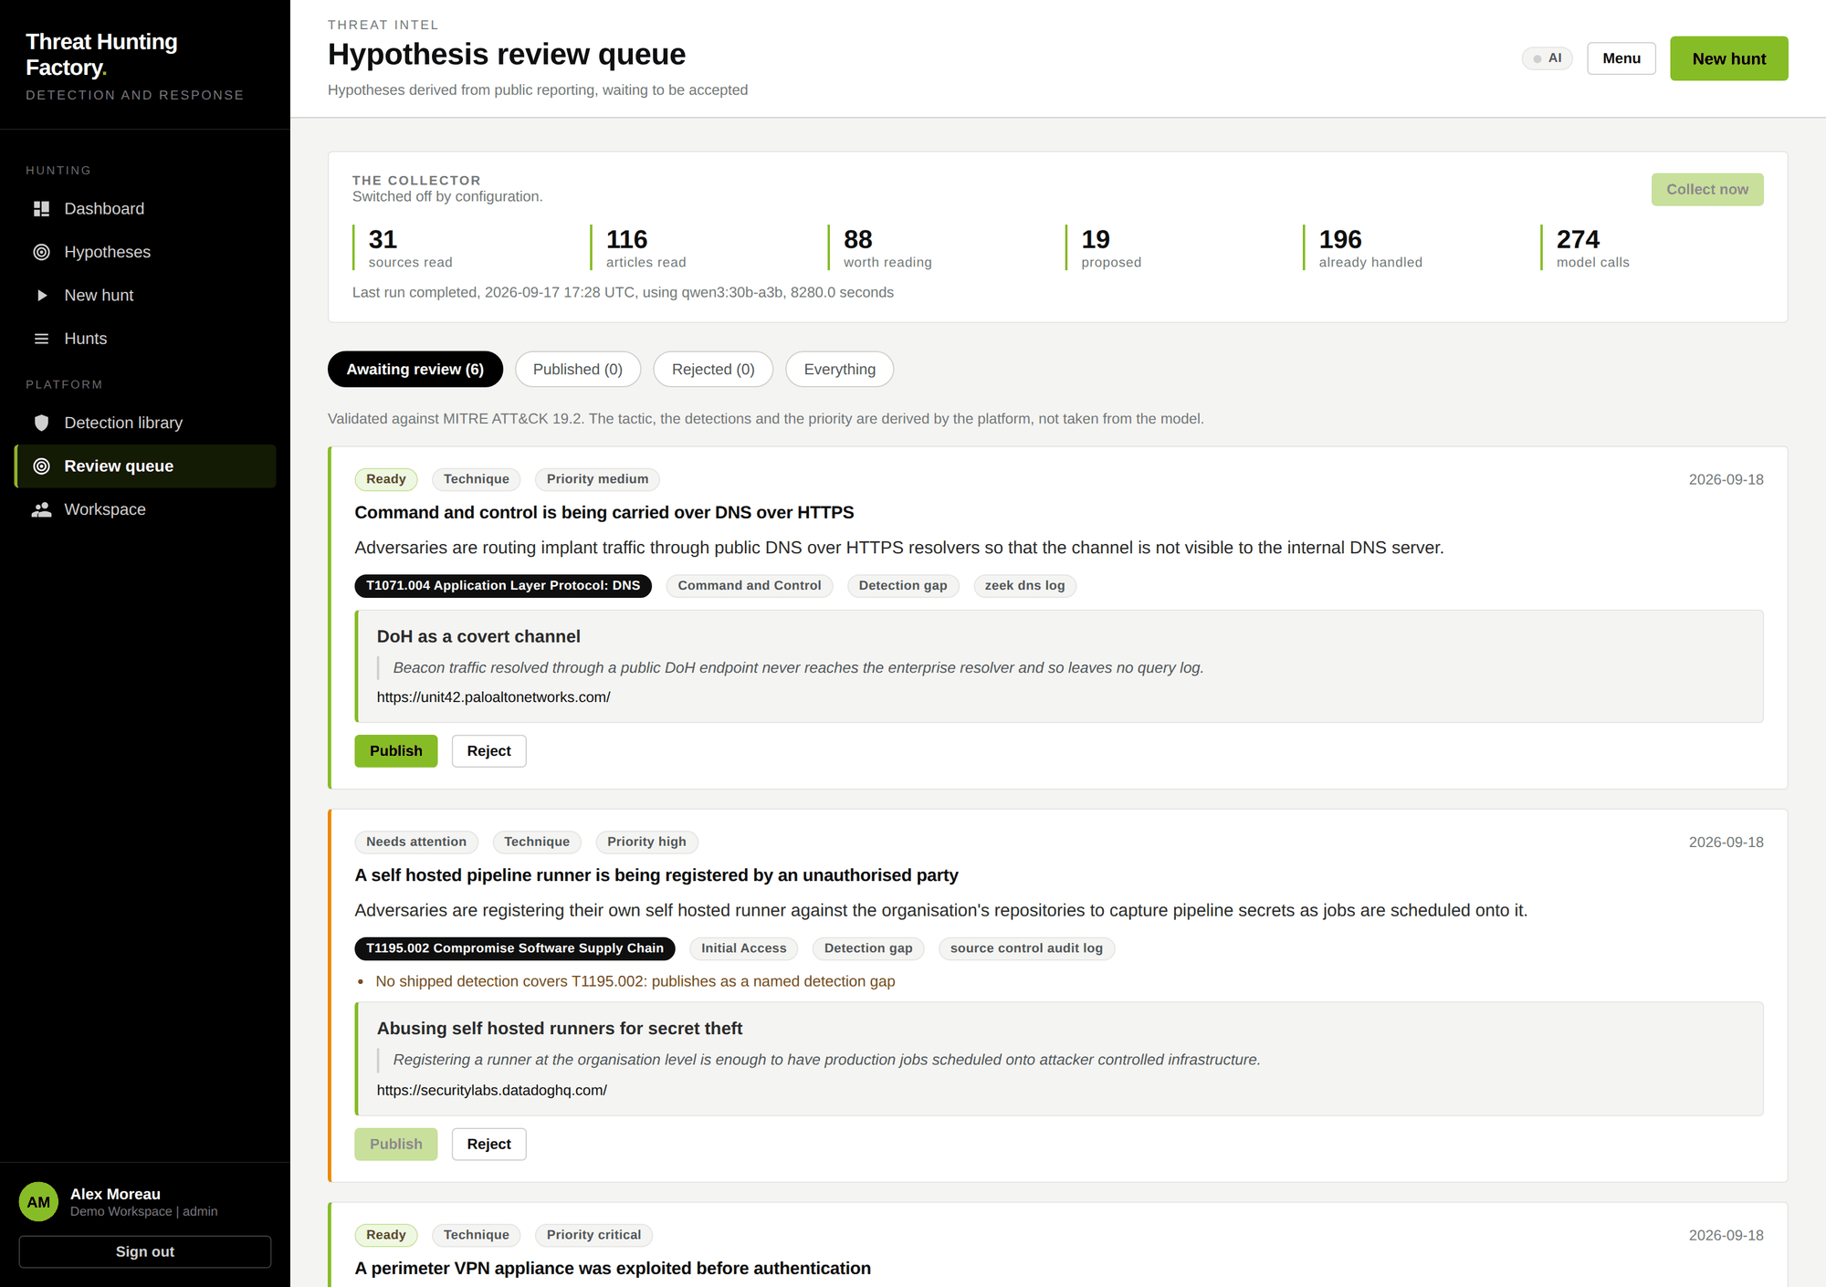
AGENT ONE IN THE INTERFACE
Nothing publishes itself
The weekly review
One run produces one queue, so there is one review a week: fifteen to twenty five candidates, a few minutes of work.
Each candidate shows its statement, technique, tactic, data sources, source link and the quoted passage behind it.
The validators are a quality label rather than a gate. Ready means every check passed. Needs attention shows which check failed and why.
A technique no rule covers still publishes, as a named detection gap that runs behavioural profiling alone. That is itself useful output.
A rejected article is remembered, so the same source is never proposed twice.
Threat Hunting Factory
18
Notes:
The header strip is the run record: 31 sources read, 116 articles read, 88 worth reading, 19 proposed, 274 model calls. The queue below is what an analyst actually reviews.

Slide 19
AGENT TWO
The behavioural analyst
Two stages, because 500,000 events do not fit in any model context.
Stage A
Stage B
Profiling, with no model at all
Adjudication by the local model
Every host, account, process, address, destination and client gets a feature vector across volume, diversity, rarity, timing, content, volumetrics and structure.
Peer group robust outliers: an entity is compared only to entities of the same kind, using modified z scores over the median absolute deviation. That is what stops a domain controller being flagged for behaving unlike a laptop.
Sequence surprise: a first order Markov model over each entity's own sequence of actions catches the right events in the wrong order, which no fixed rule expresses.
After the hunt completes, and only after, each candidate goes to the model: suspicious, benign or inconclusive, with the reasoning, the risk, the impact, the recommendation and the most likely innocent explanation.
Asking the model to argue the other side measurably reduces the rate at which routine administration is labelled an attack.
Benign verdicts are kept, in a collapsed section. Showing what was examined and cleared is what makes a hunt report credible.
Validators between the model and the database:
Evidence citation check
ATT&CK whitelist
Severity ceiling at medium
Text hygiene
Threat Hunting Factory
19
Notes:
Stage A lives in the engine package, not the AI package, and a test fails the build if the engine ever imports app.ai. Stage A is always available. Stage B is optional.

Slide 20
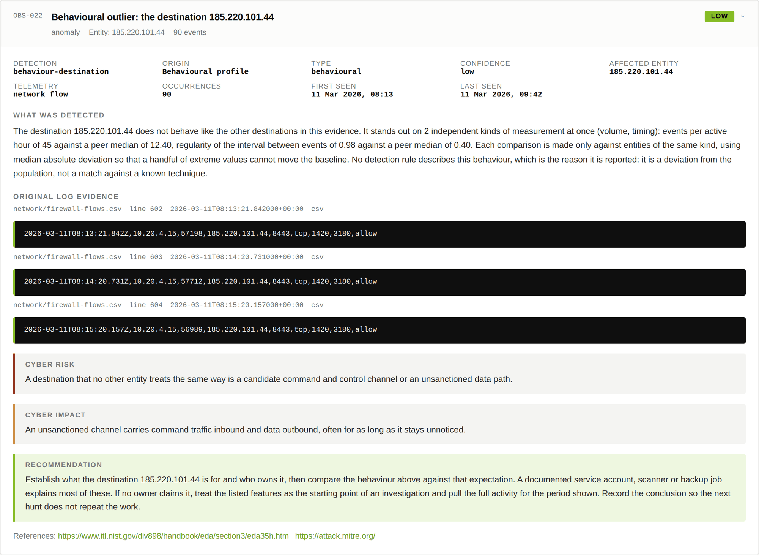
AGENT TWO IN THE REPORT
A finding no rule describes
What this observation says
No detection rule matched here. The destination was reported because it does not behave like any other destination in the evidence.
It stands apart on two independent kinds of measurement at once: 45 events per active hour against a peer median of 12.4, and an interval regularity of 0.98 against a peer median of 0.40.
Agreement across independent features is the quality signal, not the magnitude of any single one.
The observation carries the same description, original log extract, risk, impact and recommendation as every rule finding, and is marked behavioural so a reader can tell them apart.
Threat Hunting Factory
20
Notes:
A regular beacon to a hosting provider address on port 8443, found without a signature for it. This is the case that justifies the whole behavioural layer.

Slide 21
WHERE THE MODELS RUN
Locally, on the tenant's own hardware
The platform detects what the host can actually run, picks a model and reports it. It counts the weights plus the working context plus room for the host, and counts the processor as well: fitting in memory is not the same as being worth waiting for.
Model | Parameters | Active | Needs | Licence | Why it is on the ladder
gpt-oss:120b | 120B | 5.1B | 80 GB VRAM | Apache 2.0 | Best quality available locally
qwen3:32b | 32B | 32B | 24 GB VRAM | Apache 2.0 | Best dense model on a single workstation card
qwen3:30b-a3b | 30B | 3B | 22 GB | Apache 2.0 | Mixture of experts: 30B of knowledge at 3B speed
gpt-oss:20b | 20B | 3.6B | 16 GB | Apache 2.0 | Strong structured output, fits a 16 GB host
qwen3:14b | 14B | 14B | 12 GB VRAM | Apache 2.0 | Dense fallback for a 12 GB card
qwen3:8b | 8B | 8B | 7 GB | Apache 2.0 | Runs on any laptop
The ladder is ordered differently for processor and card
All inference is local
A mixture of experts model activates a fraction of its parameters per token, so it beats a dense model of the same size on a processor while losing to it on a card.
No evidence and no client log leaves the tenant. That is the reason for choosing a local model server over a hosted API, and it is stated in the report footer.
Threat Hunting Factory
21
Notes:
The AI layer never blocks the hunt. The deterministic report is complete and viewable first, then the model observations arrive and the report updates.

Slide 22
04
PART FOUR
End to end
One complete hunt on real evidence, captured from the running application.
Notes:
Section opener. End to end. One complete hunt on real evidence, captured from the running application.

Slide 23
THE WALKTHROUGH
What happens, in order
1
2
3
4
Sign in
Read the dashboard
Choose a hypothesis
Prepare the evidence
Workspace, email and password. Access is scoped per tenant and per user.
Hunts, observations, ATT&CK coverage and risk over time.
Ransomware deployment precursors, from the threat intelligence family.
The hypothesis lists the sources it needs and how to export each one.
5
6
7
8
Upload and start
Read the report
Open an observation
Export
One archive. The analysis runs in the background.
Risk score, severity split, techniques observed and data source coverage.
Description, original log line, cyber risk, cyber impact, recommendation.
PDF for the client, JSON for the pipeline. The hunt stays in the history.
Threat Hunting Factory
23
Notes:
Every screenshot that follows was captured from the application running against a generated evidence archive. Nothing is a mockup.

Slide 24
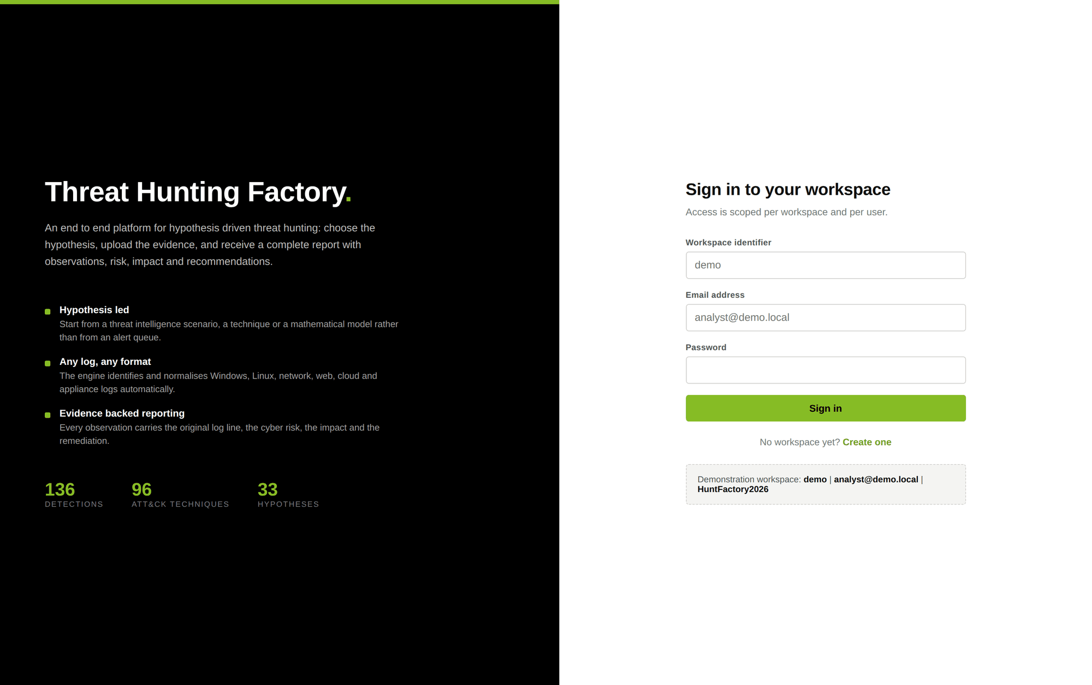
STEP ONE
Sign in to the workspace
What to look at
Access is scoped per tenant and per user. A workspace identifier, an email address and a password.
Three roles: an administrator can run hunts and manage members, an analyst can run hunts, a viewer can only read.
Cross tenant reads return 404 rather than 403, so the existence of another workspace is never disclosed.
Sign in attempts are rate limited per account and per source address, and the verification work is constant time.
Threat Hunting Factory
24
Notes:
The sign in page also states what the platform does and the three figures behind it.

Slide 25
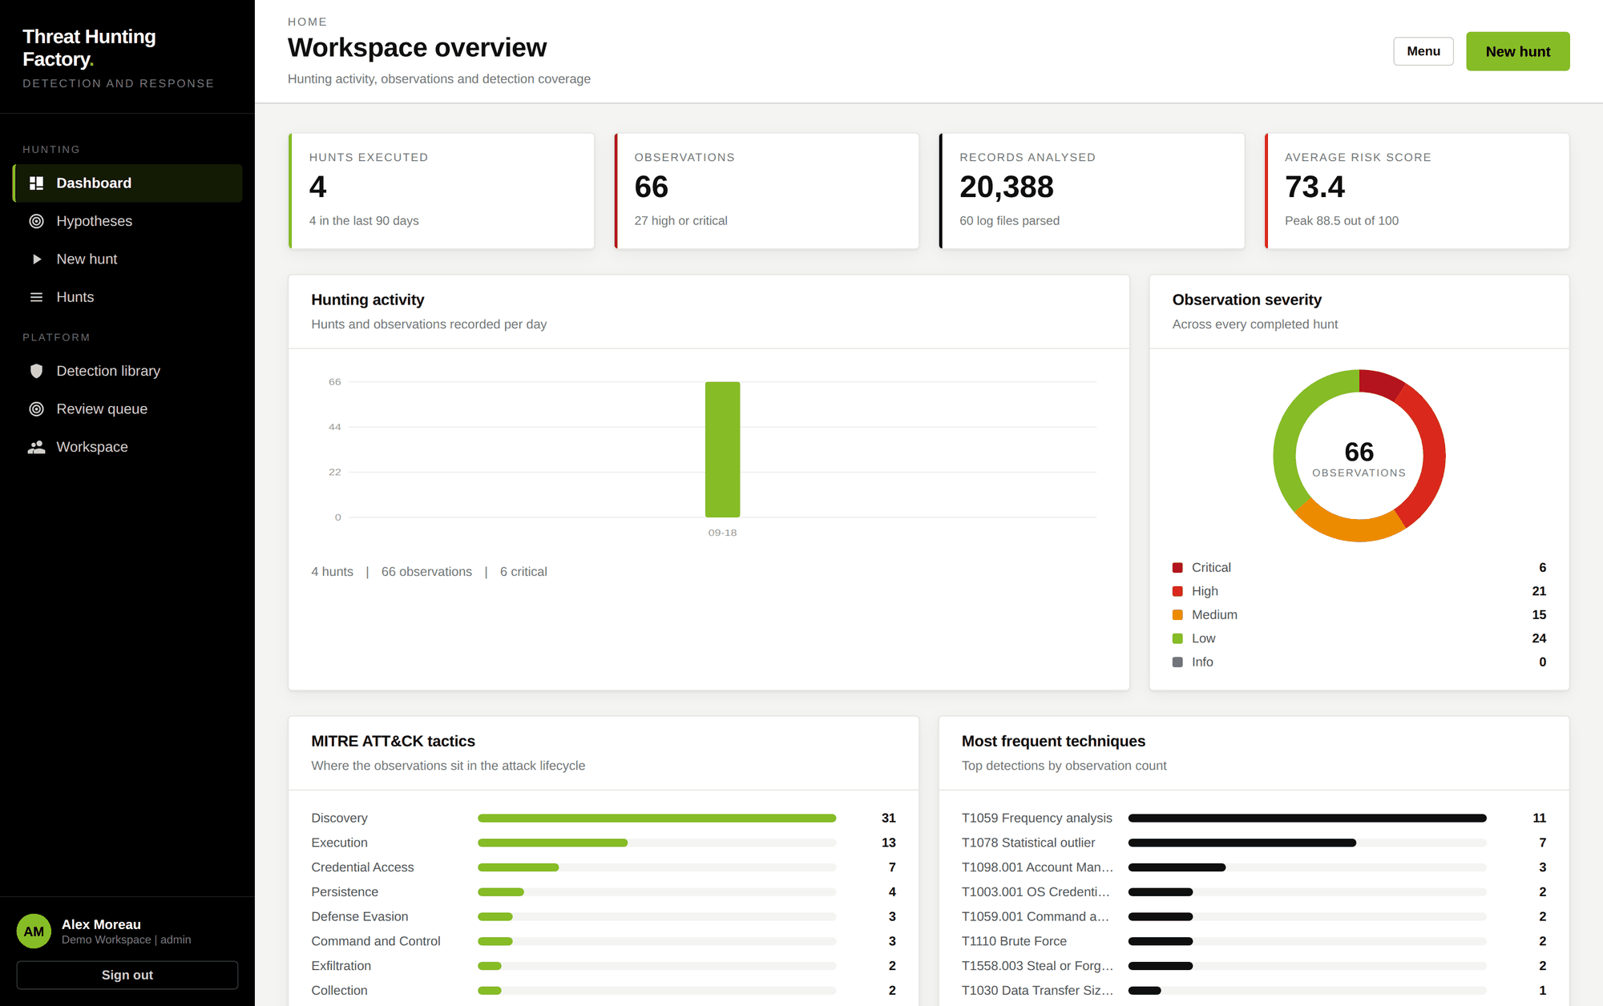
STEP TWO
The workspace overview
What to look at
Four headline figures: hunts executed, observations, records analysed and the average risk score.
Hunting activity per day, with the count of critical findings.
Observation severity as a whole, across every completed hunt in the workspace.
Where the observations sit in the ATT&CK lifecycle, and the techniques seen most often.
This is the programme view. It answers what has been hunted and what it found, not just what happened today.
Threat Hunting Factory
25
Notes:
Four hunts had been run against the same evidence archive at this point, producing 66 observations over 20,388 records.

Slide 26
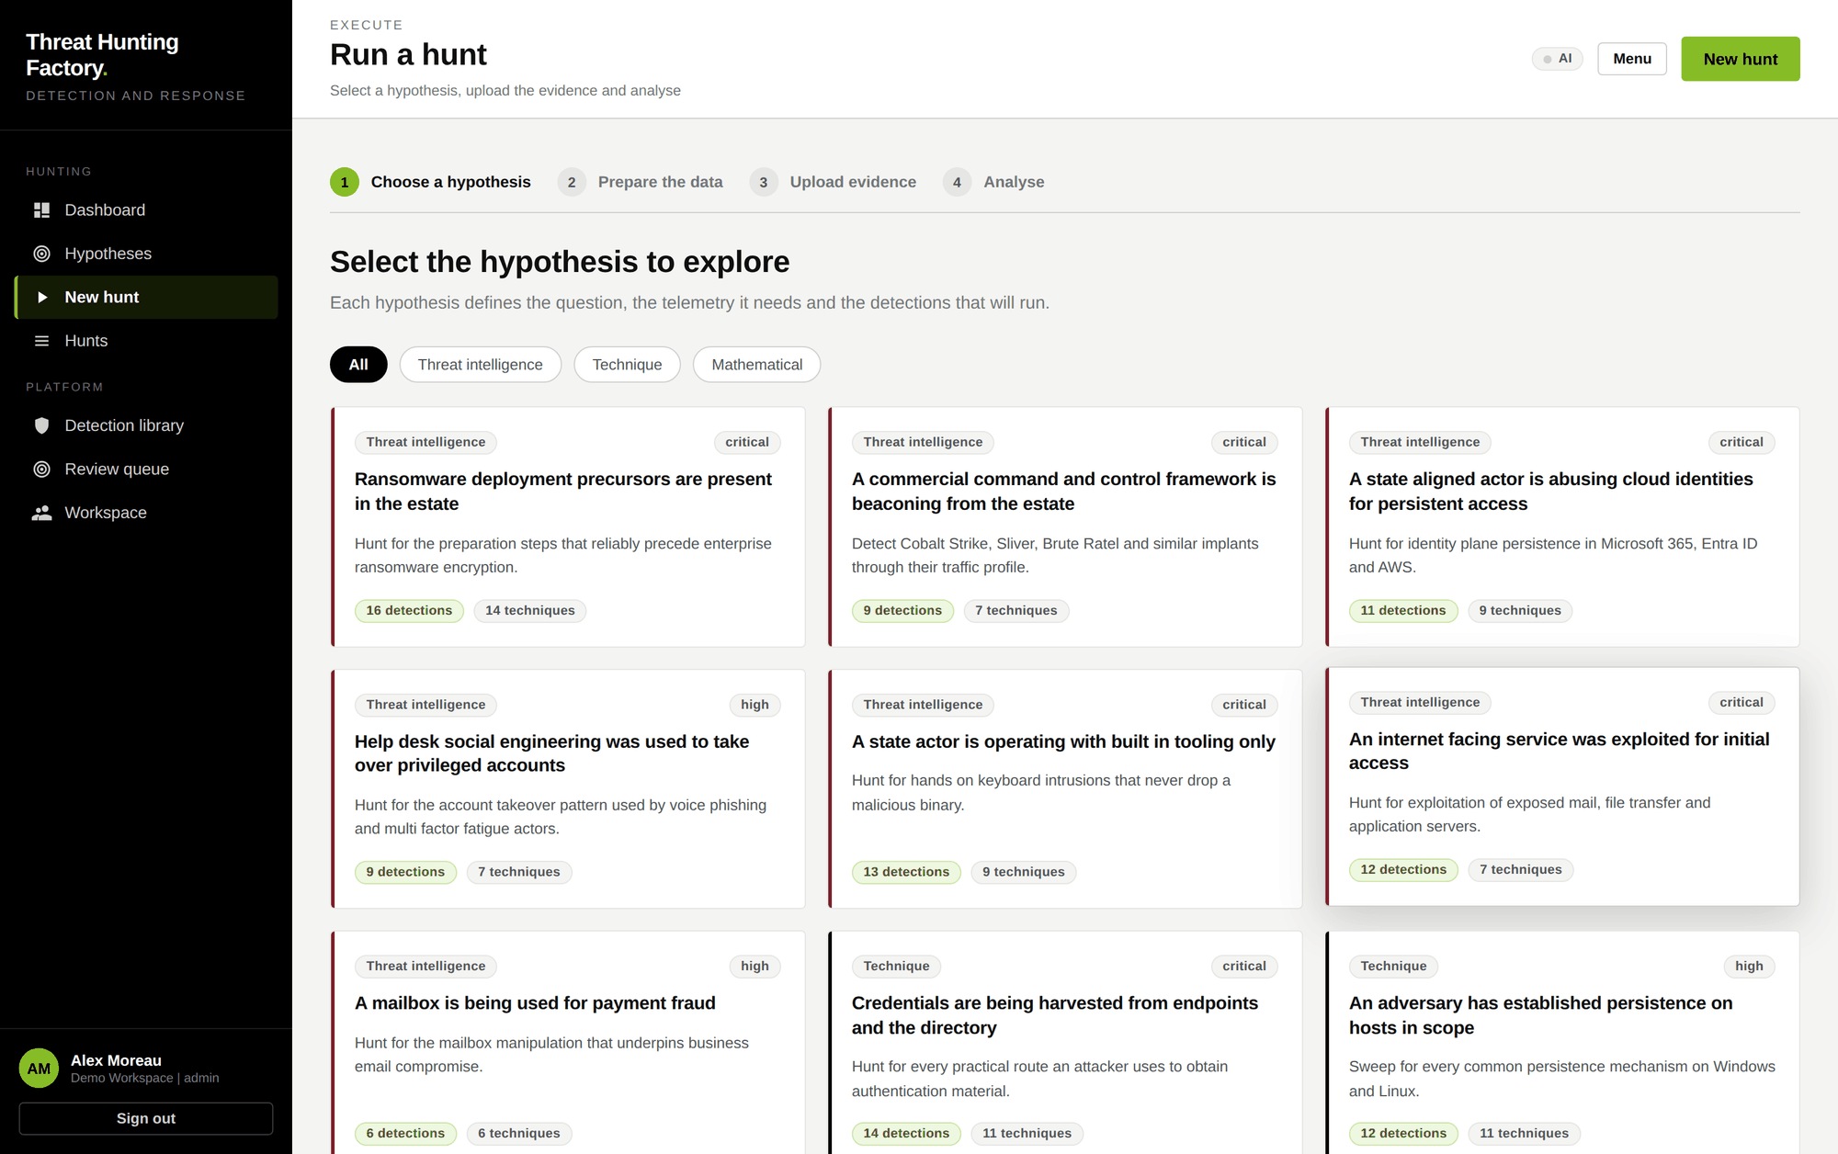
STEP THREE
Choose the hypothesis
What to look at
A four step wizard: choose a hypothesis, prepare the data, upload the evidence, analyse.
Filter by family: threat intelligence, technique or mathematical.
Each card states the question, its priority, the number of detections that will run and the techniques they cover.
For this walkthrough: ransomware deployment precursors are present in the estate, which runs 16 detections across 14 techniques.
Threat Hunting Factory
26
Notes:
The hypothesis is the unit of work. It defines the question, the telemetry and the detections in one place.

Slide 27
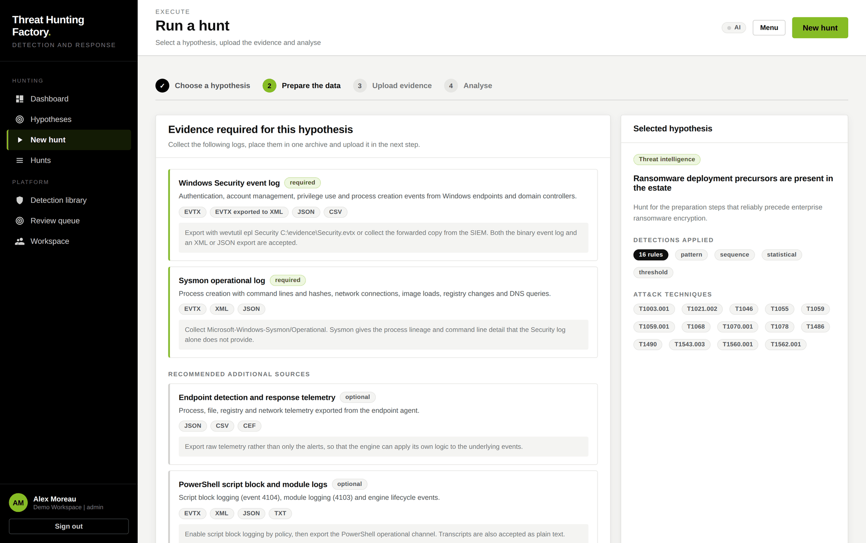
STEP FOUR
Prepare the evidence
What to look at
The hypothesis declares exactly what it needs before anything is uploaded.
Required sources are separated from recommended ones, so a partial collection is still a valid hunt.
Each source lists the accepted formats and the command or export path that produces them.
The panel on the right confirms the detections that will apply and the ATT&CK techniques they cover.
This is what stops the common failure of hunting against telemetry that cannot answer the question.
Threat Hunting Factory
27
Notes:
The collection guidance is the difference between a hunt that concludes and a hunt that reports nothing because the right log was never exported.

Slide 28
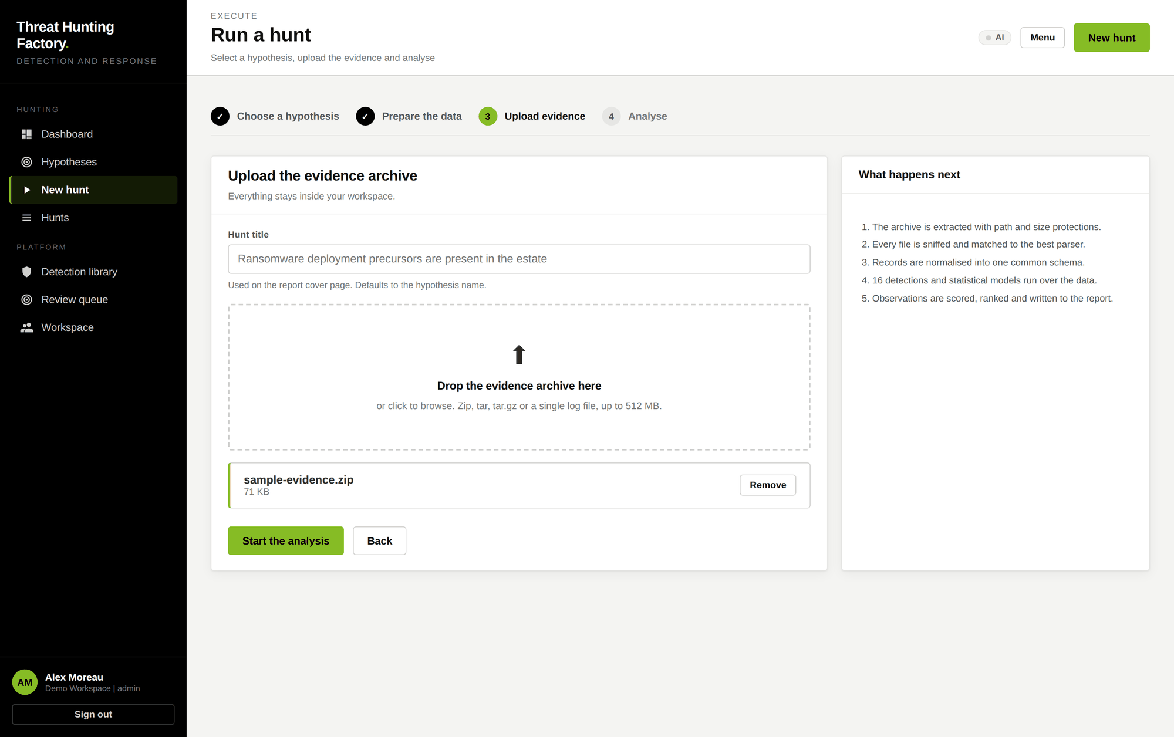
STEP FIVE
Upload and start the analysis
What to look at
One archive: zip, tar, tar.gz or a single log file, up to 512 MB.
The title defaults to the hypothesis name and appears on the report cover.
Extraction is bounded by path and by size, and the budget counts bytes actually written rather than the sizes the archive declares.
The panel on the right states what will happen next, in order, before the analyst commits to it.
Everything stays inside the workspace.
Threat Hunting Factory
28
Notes:
The sample archive holds Windows Security events, Sysmon XML, Active Directory events, Linux auth, macOS telemetry, web logs, Zeek DNS, firewall flows, CloudTrail, a Microsoft 365 audit export, a Kubernetes audit log and more.

Slide 29
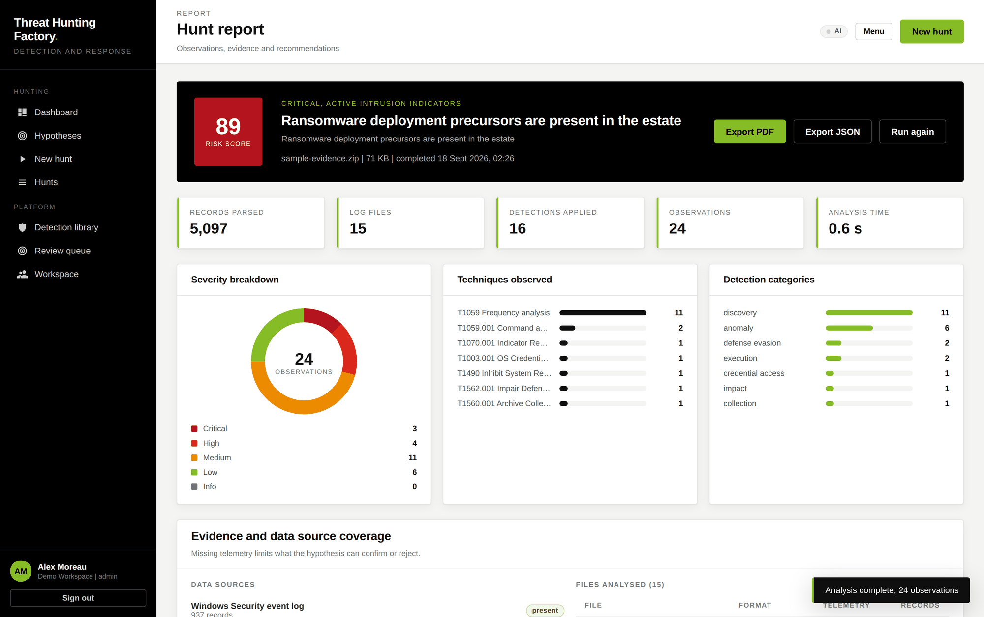
STEP SIX
The report
What the hunt found
The analysis finished in 0.6 seconds: 5,097 records from 15 log files, 16 detections applied, 24 observations.
Risk score 89 out of 100, classified as critical with active intrusion indicators.
The severity split, the techniques observed and the detection categories are all on the first screen.
Below this, evidence and data source coverage states what was present and what was missing, because a missing source limits what the hypothesis can confirm or reject.
Export to PDF or JSON, or run the same hypothesis again against fresh evidence.
Threat Hunting Factory
29
Notes:
The verdict line is deliberately a sentence rather than a number alone. A score on its own is not a finding.

Slide 30
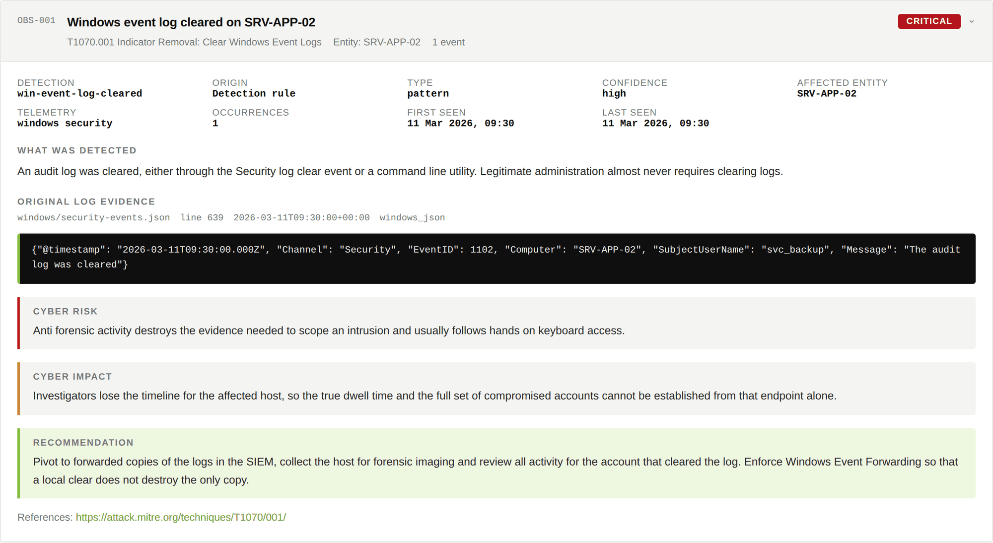
STEP SEVEN
Open an observation
Five things, every time
What was detected, in plain language, with the detection name, style, confidence, affected entity and timestamps.
The original log evidence: the file, the line number, the parser that read it and the untouched record.
The cyber risk: why this matters to an attacker's progress.
The cyber impact: what it costs the organisation if it is real.
The recommendation: the next action, named and specific.
The excerpt is copied from the parsed corpus, never written by a model, so a fabricated quote cannot reach the report.
Threat Hunting Factory
30
Notes:
OBS-001: a Security log clear event, 1102, on SRV-APP-02 by the account svc_backup. Critical, because anti forensic activity usually follows hands on keyboard access.

Slide 31
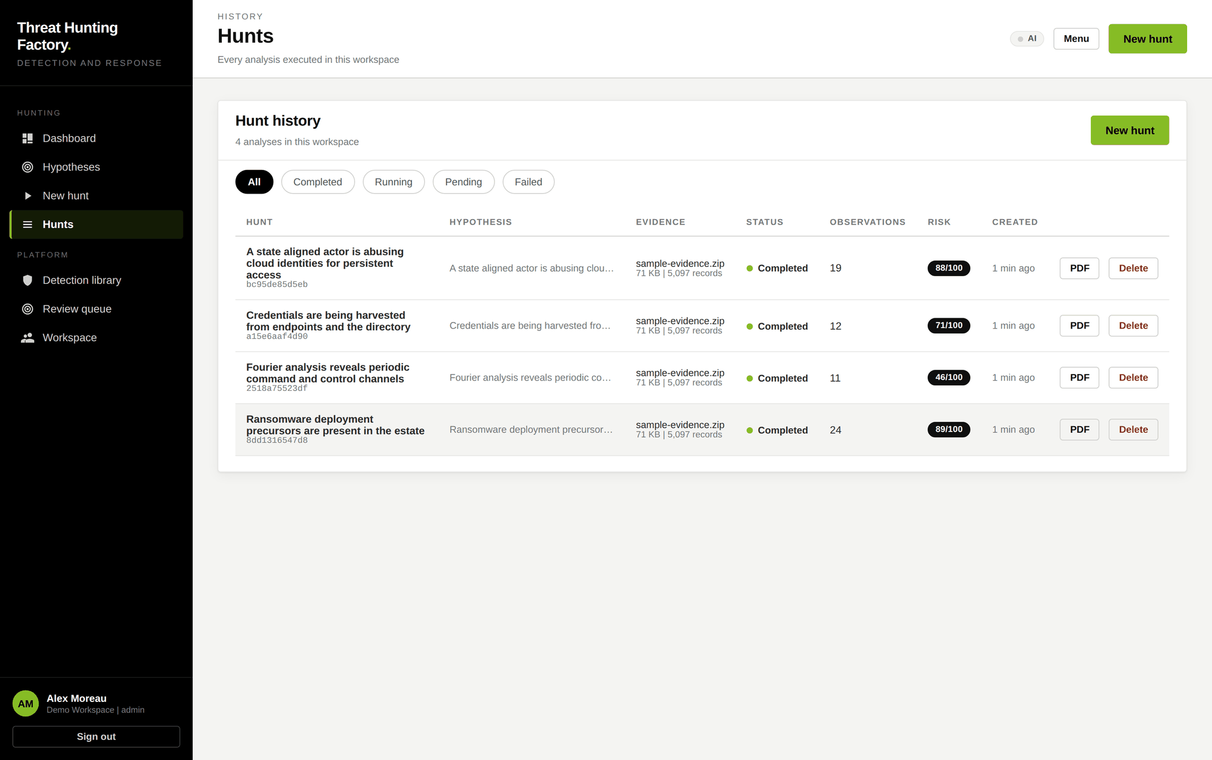
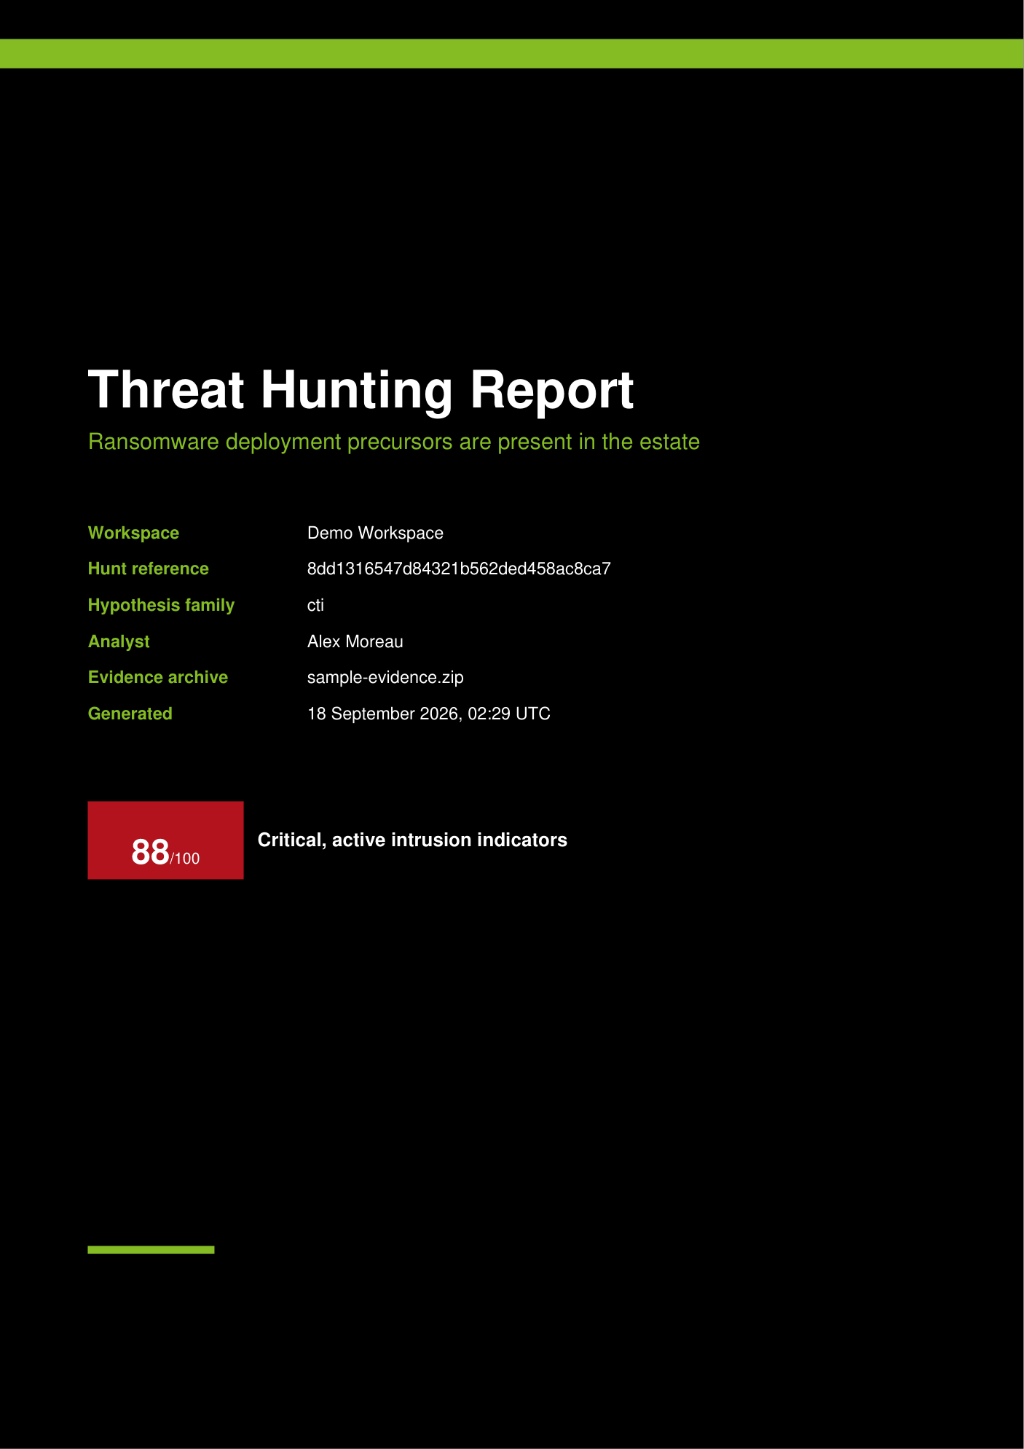
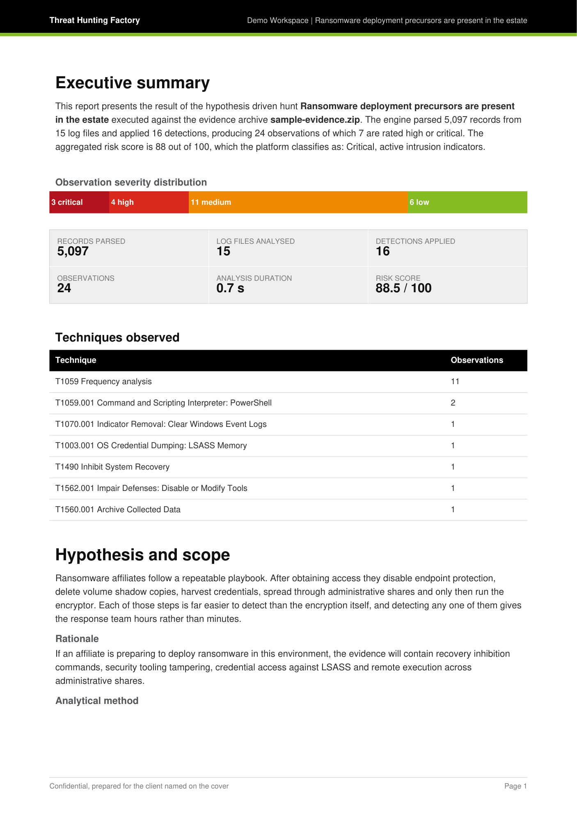
STEP EIGHT
History and export
Every analysis executed in the workspace
The report the client receives
Hypothesis, evidence, status, observation count, risk score and a one click PDF, all scoped to the workspace and recorded in the audit log.
31 pages: the cover and the verdict, an executive summary, the techniques observed, the hypothesis and its scope, then every observation with its evidence.
Threat Hunting Factory
31
Notes:
The PDF is rendered by the platform in the same visual language as the interface, and the same hostile payloads render as literal text there as well.

Slide 32
THE RESULT
What this walkthrough produced
5,097
16
24
0.6 s
RECORDS PARSED
DETECTIONS APPLIED
OBSERVATIONS
ANALYSIS TIME
From 15 log files across Windows, Linux, macOS, web, network and cloud
Selected by the hypothesis, not the whole library
3 critical, 4 high, 11 medium, 6 low
From upload to a complete report
Findings that mattered
The point of the last line
CRITICAL
Windows event log cleared on SRV-APP-02, T1070.001
Five of these came from detection rules and were found because somebody already knew to look for them. The sixth came from the behavioural profiler, which had no rule for it and reported it because the destination did not behave like any other destination in the evidence.
CRITICAL
Credential dumping attempt against LSASS on SRV-APP-02, T1003.001
CRITICAL
Volume shadow copies deleted on SRV-FILE-01, T1490
HIGH
Endpoint protection disabled on SRV-FILE-01, T1562.001
HIGH
Data staged into an archive on SRV-FILE-01, T1560.001
LOW
Behavioural outlier: the destination 185.220.101.44, no rule matched
Threat Hunting Factory
32
Notes:
A clean summary of the walkthrough, and the argument for the two layers working together: known technique coverage plus population deviation.

Slide 33
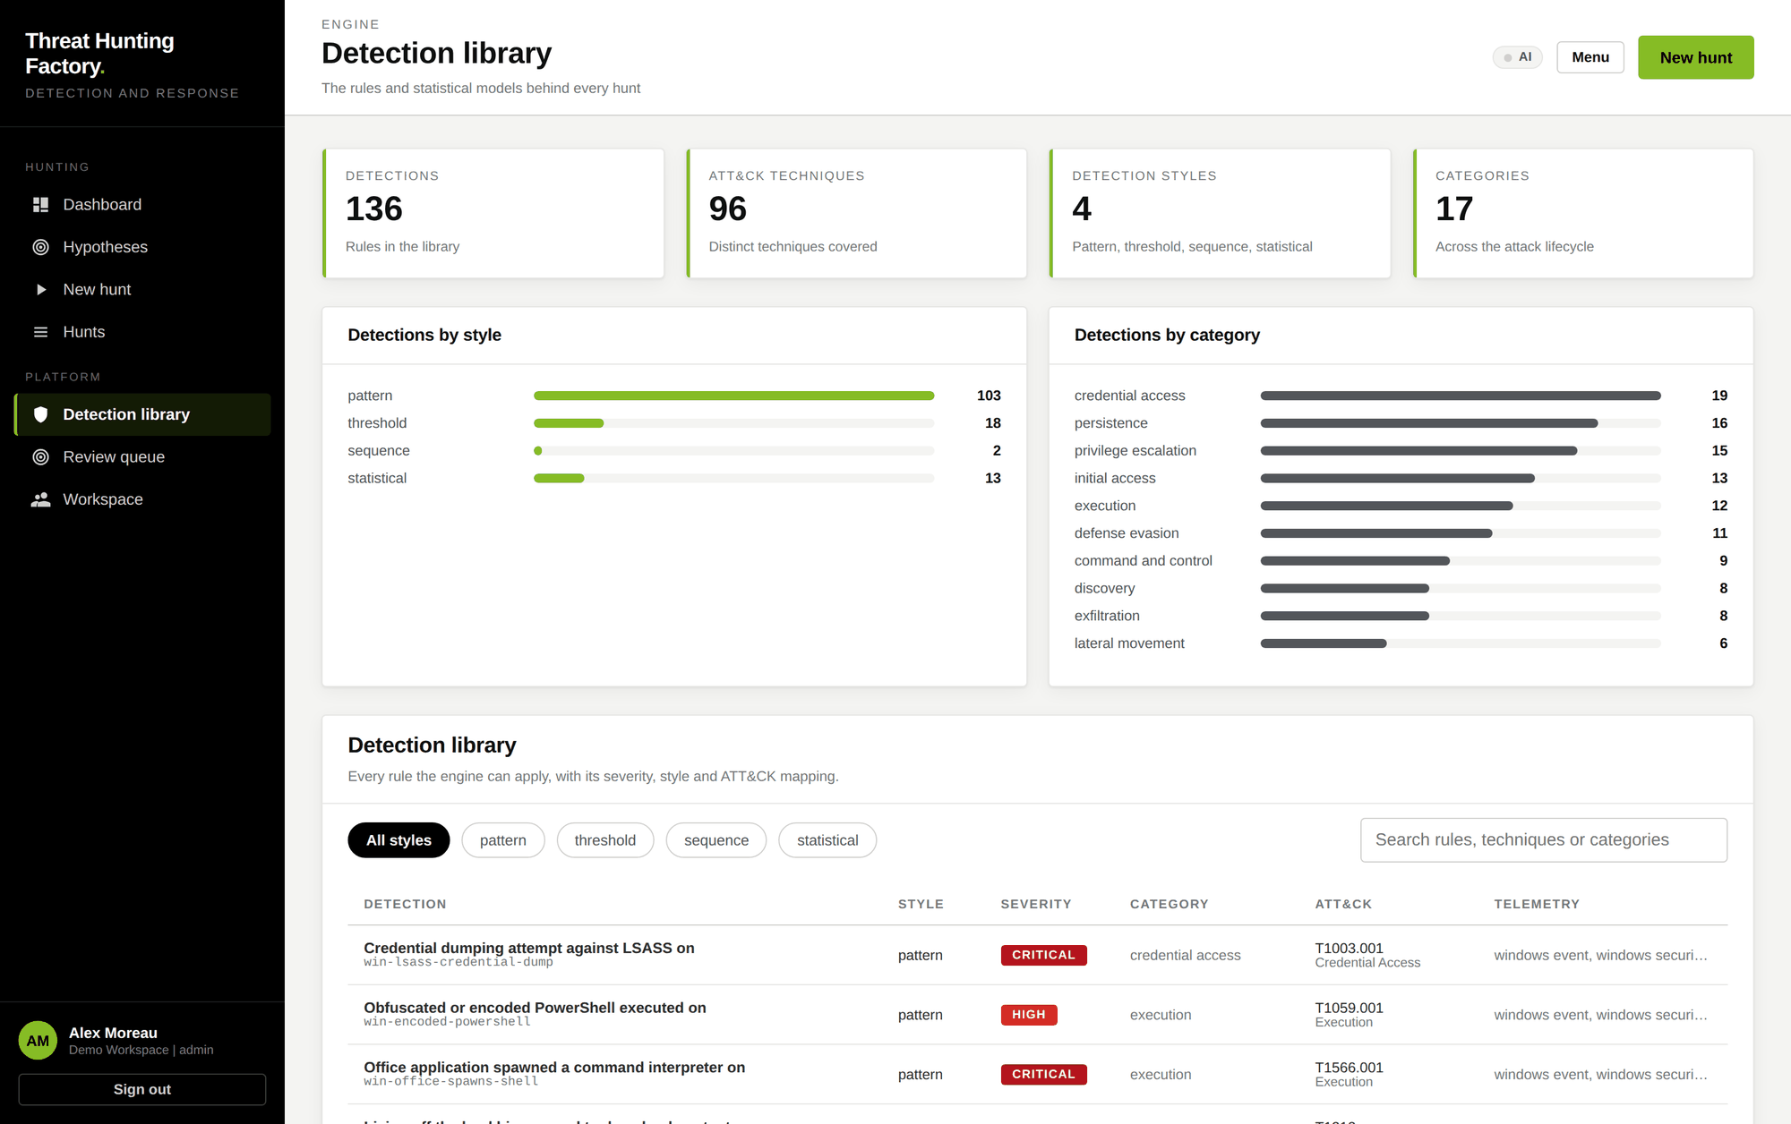
BEHIND EVERY HUNT
The detection library is visible, not hidden
Why this page exists
An analyst can see every rule the engine can apply, with its severity, style, category, ATT&CK mapping and the telemetry it needs.
136 detections, 96 techniques, 4 styles, 17 categories across the attack lifecycle.
Searchable by rule, technique or category, so a coverage question has an answer rather than an opinion.
Knowing what the library does not cover is as useful as knowing what it does, which is why an uncovered technique publishes as a named detection gap.
Threat Hunting Factory
33
Notes:
Coverage claims in security products are usually unverifiable. Here the library is a page in the product.

Slide 34
ROADMAP
In place, and what comes next
In place
Designed, not yet implemented
Model selection
The platform detects what the host can run, picks a model and reports it.
Learned parsers
For formats the engine has never seen: the model proposes a field extraction specification, which is then verified by execution against a held out sample rather than trusted.
Behavioural profiling
Peer group outliers and sequence surprise, with no model at all.
Generated hypotheses
The attack story
Validated against ATT&CK, held in a review queue until an analyst accepts them.
An ordered kill chain narrative in the executive summary, built only from observations that exist and checked by identifier.
The weekly collector
Reads vendor reporting, advisories and research feeds on its own.
Local adjudication
The whole model layer is optional at every step. With no model server installed, the platform behaves exactly as it does today.
A local model judges each behavioural candidate and cites evidence by identifier.
Threat Hunting Factory
34
Notes:
Stating what is designed but not built keeps the rest of the deck credible.

Slide 35
Findings are derived only from the evidence supplied
The absence of an observation is not proof that the activity did not occur. The relevant telemetry may not have been collected, may have rotated before collection, or may fall outside the period covered by the archive. Every observation should be validated against the source system before an operational decision is taken.
A hunt is a question
The evidence is the report
The model never decides
Nothing leaves the tenant
Stated, tested against evidence, and reproducible byte for byte.
Every observation carries the log line it came from, not a summary of it.
It proposes. The engine verifies. Validators sit between the two.
All inference is local. Only the collector touches the internet, and only to read.
Threat Hunting Factory
The interface and the reports follow a Deloitte inspired palette. The product is not affiliated with, endorsed by, or produced by Deloitte, and uses no Deloitte trademark or logo.
Notes:
Close on the limitation first, then the four things the product is actually built around.

