Slide 1

an introduction to artificial intelligence
Seth Juarez
seth.juarez@microsoft.com
@sethjuarez

Slide 2
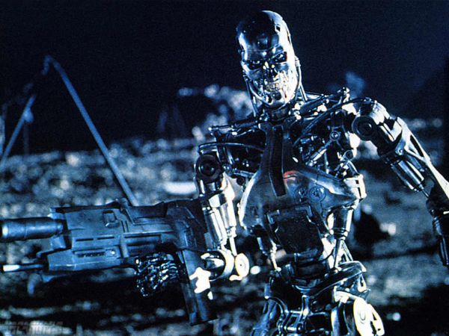
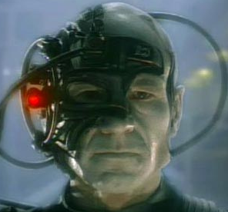


Slide 3
overview
introduction
hard vs soft AI
setting up the problem
puzzles, games
uninformed search
bfs, dfs, depth limited
heuristic search
heuristic function
best-first
A*
adversarial search
minimax
alpha-beta

Slide 4
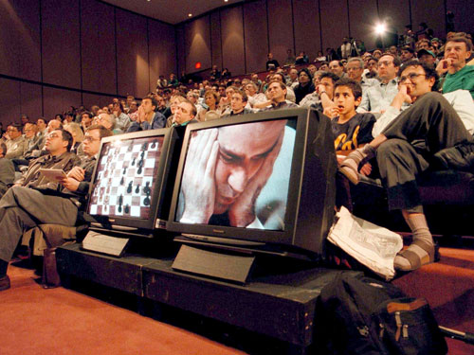
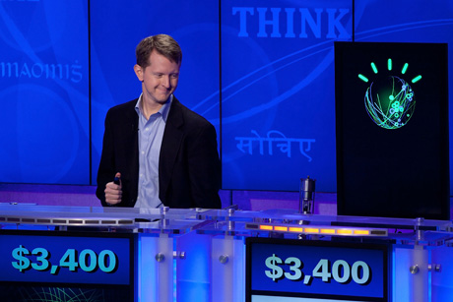
artificial intelligence
1997
2011

Slide 5
search
path finding

Slide 6
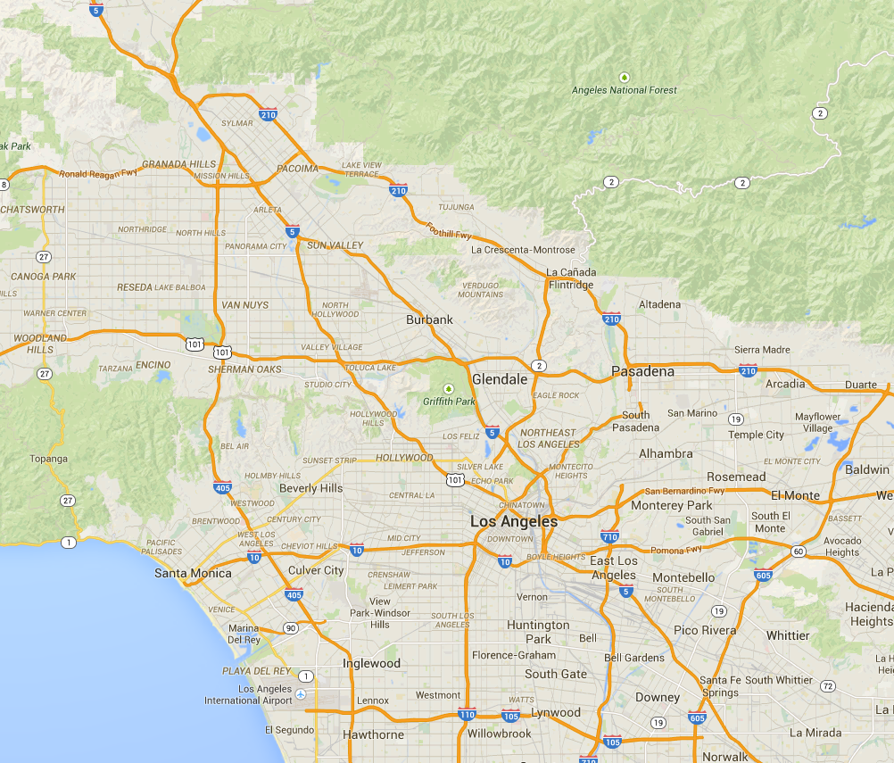
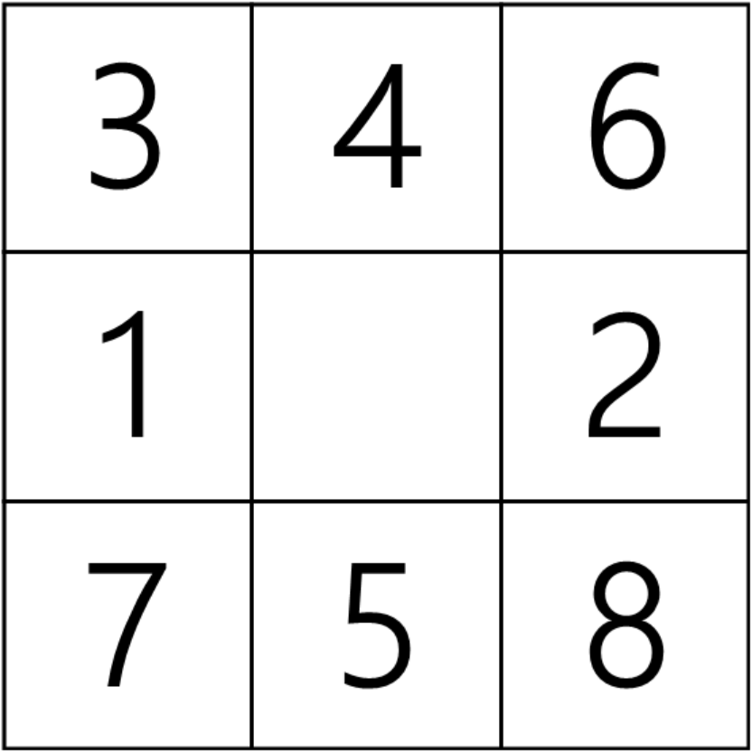
path finding

Slide 7
search problem
a well defined problem has 5 components:
states – what does our world look like?
initial state – where do we start?
successor function – where can we go / what can we do?
goal test – are we there yet?
path cost – how long is this taking?

Slide 8
puzzle problem
states
state description specifies location of 8 tiles and a blank space

Slide 9
puzzle problem
initial state
any state

Slide 10
puzzle problem
successor function
generates legal states from each of four actions:
left
right
up
down

Slide 11
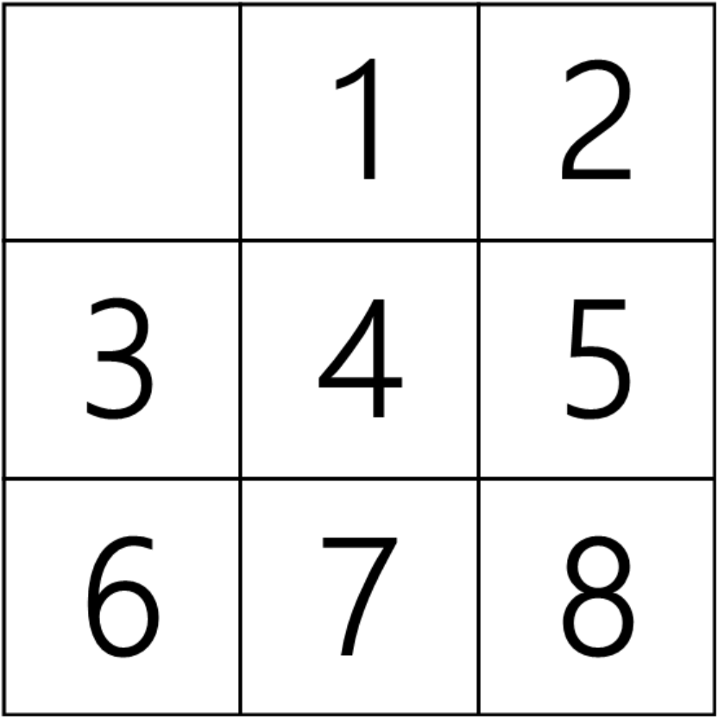
puzzle problem
goal test
this state

Slide 12
puzzle problem
path cost
in this case each move costs “1” – we want to solve it in as few moves as possible

Slide 13
uninformed search – exploring
which node do we explore next?
breadth first search – fifo queue
uniform cost search – priority queue
depth first search – lifo queue
depth limited search – lifo queue (bounded recursion)
measuring
completeness – will it find a solution if one exists?
optimality – will it find the lowest cost path?
time complexity – how long will it take?
space complexity – how much space does it take?
Notes:
bfs – complete, optimal if non-decreasing function in depth of the node (if the shallowest node is not the optimal one, all bets are off)
ucs – same as above
dfs – complete (maybe…), not optimal if it starts down a suboptimal path,
dls – complete if correct depth (or correct assessment of problem diameter), optimal - maybe

Slide 14
demo
uninformed search

Slide 15
informed search
expand the state space and find a path (but be smarter)
using a heuristic function
greedy best-first search – pick the one we think is closest
A* – pick the one we think will produce the best overall cost

Slide 16
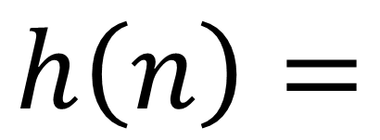
heuristic function
a function to help us out
what is our best guess?
$$h\left(n\right)=$$
estimated cost of the cheapest
path from node n to a goal node

Slide 17
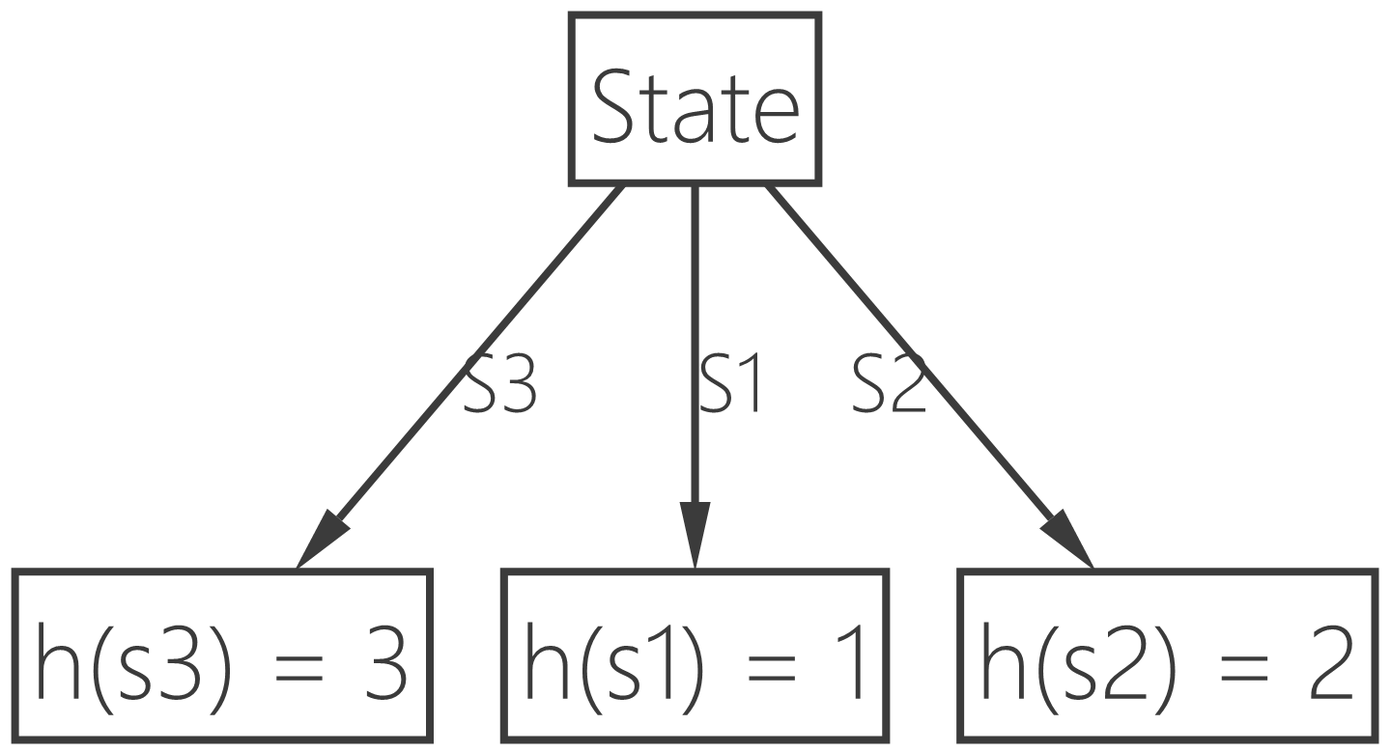
greedy best-first search
expand the node that is likely to lead to a solution quickly
Notes:
resembles depth first
not optimal
not complete

Slide 18
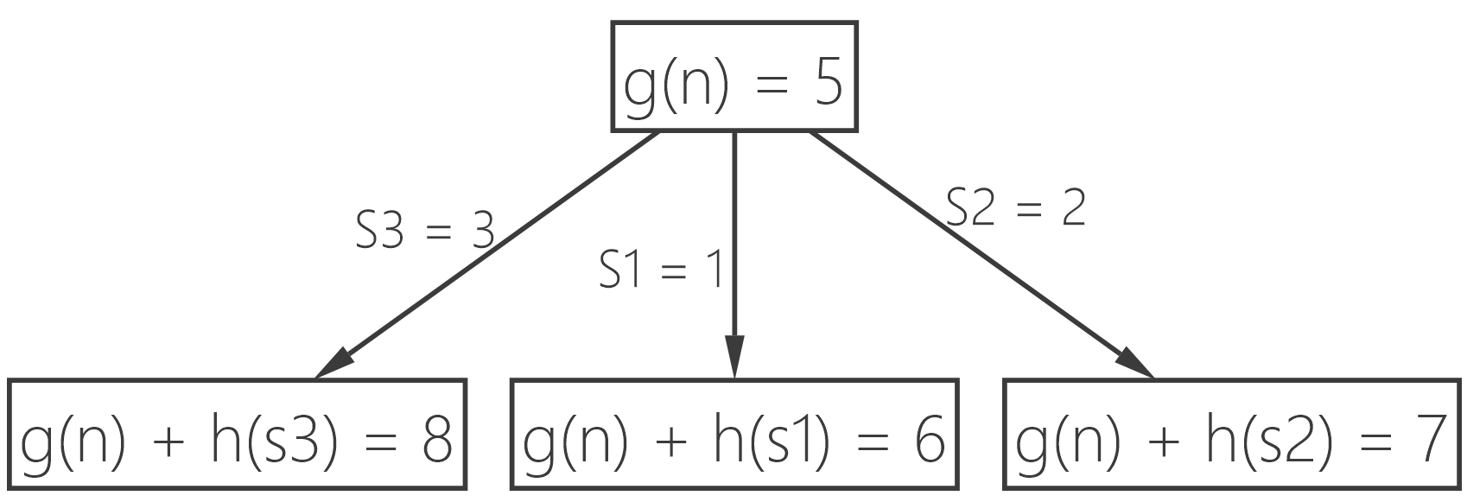

A*
expansion strategy
$f\left(n\right)=g\left(n\right)+h\left(n\right)$
combine the cost to reach the current node and the estimated cost to the goal
Notes:
complete and optimal if the heuristic function is admissible

Slide 19
heuristic function
A* is both complete and optimal…
if there is an admissible heuristic function
or, provided that h(n) never overestimates the cost to reach the goal
creating admissible heuristic functions
relax the problem

Slide 20
heuristic function

Slide 21
demo
informed search (A*)

Slide 22
adversarial search
games

Slide 23
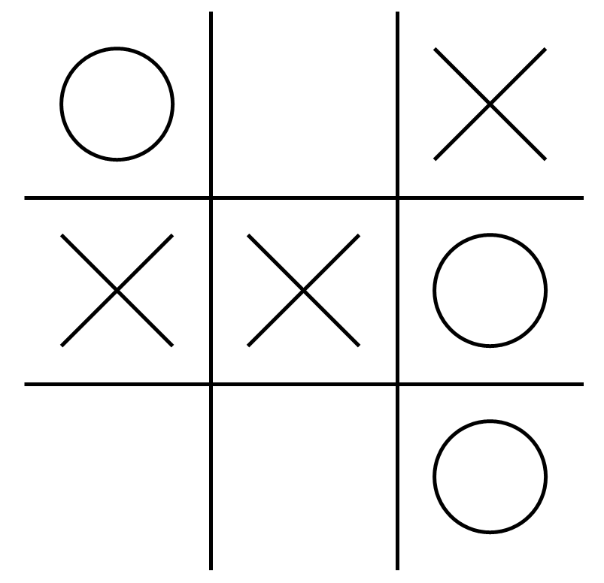
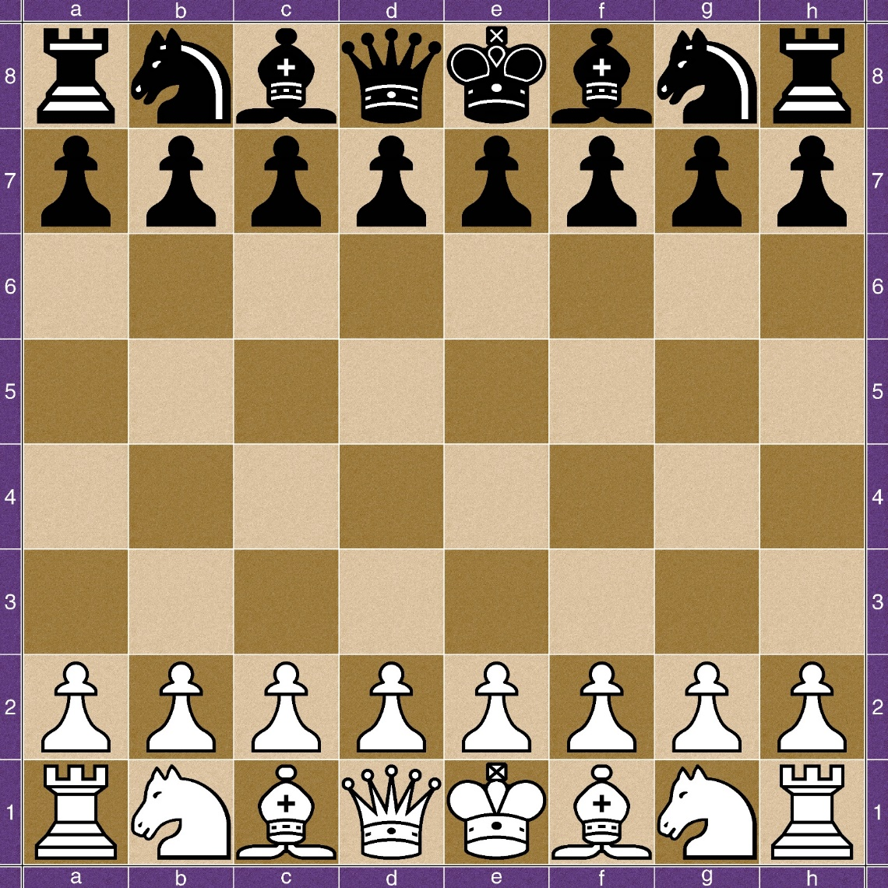
games

Slide 24
adversarial search
a game is a search problem with four components:
initial state – where do we start? / whose turn is it?
successor function – where can we go / what can we do?
terminal test – when is the game over?
utility function – who wins? / assign numeric value to terminal states

Slide 25
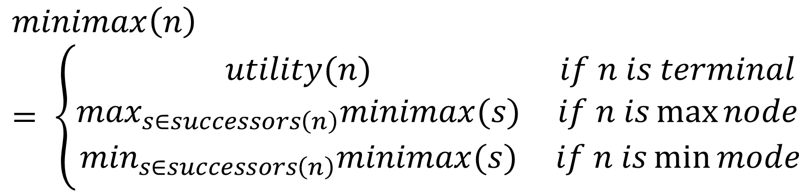
minimax
minimize the maximum of the other player (or the other way around)
$$minimax\left(n\right)= \left\{\begin{matrix}utility(n) & if n is terminal \\ \max_{s∈successors\left(n\right)}minimax(s) & if n is\max{node} \\ \min_{s∈successors\left(n\right)}minimax(s) & if n is\min{mode}\end{matrix}\right.$$

Slide 26
minimax demo
tic-tac-toe

Slide 27
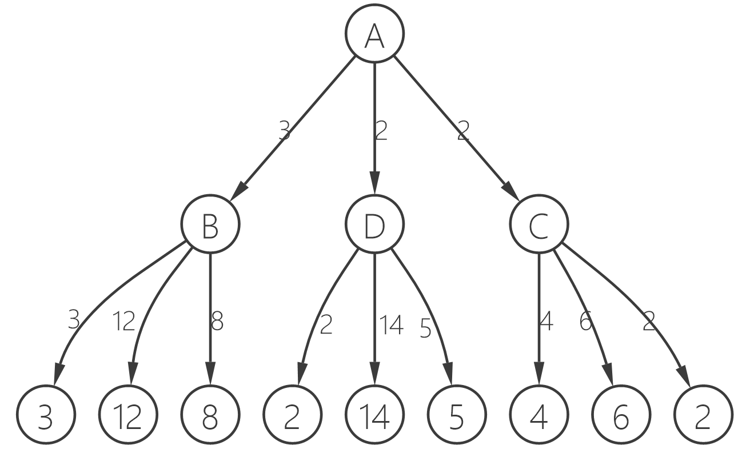



alpha-beta pruning
$$=max⁡(\min\left(3, 12, 8\right),\min\left(2, 14, 5\right),\min\left(4, 6, 2\right))$$
$$=max⁡(3,\min\left(2, x, y\right),2)$$
$$=max\left(3,z,2\right)where z≤2$$
$$={3}$$

Slide 28
alpha-beta pruning
intuition
if we have a choice, always take the best outcome the earliest possible
we can remove consideration of the other nodes

Slide 29
alpha-beta demo
tic-tac-toe

Slide 30
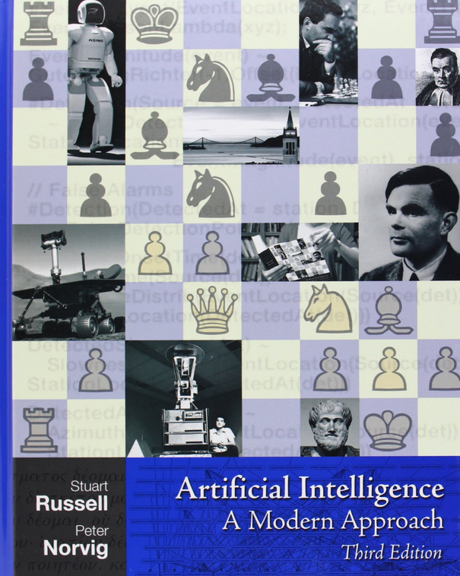
some reading

Slide 31
questions?
numl.net
Seth Juarez
seth.juarez@microsoft.com
@sethjuarez

Slide 32
AI Lab
Download and run
Puzzle Solver
Tic-Tac-Toe
try changing the depth on the minimax algorithm
Create a Maze Solver
IState
ISuccessor
Use A* to solve
API Docs: http://numl.net/api/numl.AI.html
http://netman.io/numl/square.zip
http://netman.io/numl/maze-initial.zip

