Slide 1
SUST
Overview
Shahjalal University of Science and Technology (SUST) was established in 1986. The only university of its kind at that time, it started it''s journey on the 13th of February 1991 with only three departments: Physics, Chemistry and Economics, 13 teachers and 205 students. It has now expanded to 7 schools, 27 departments , 2 institutes and and centers. The number of teachers has grown to 566 and the students to 8596. Besides, the University has 12 affiliated colleges under the School of Medical Sciences with 4000 students.

Slide 2
Culture
SUST campus isn't just an academic institution. It's an active and supportive community, with harmony of its own. A vast range of cultural, educational, athletic and social activities are available at SUST students, faculty and staff.

Slide 3
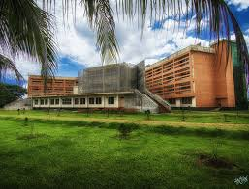
Achievements
Through research, academic, and various extra- curricular activities, Shahjalal University of Science & Technology faculty and students achieved many awards and recognition.

Slide 4
Publications
The teaching-learning activities of Shahjalal University of Science & Technology are notable at the national context. A diverse range of articles and journals are published by teachers and students all the year round
For more details
Home

