Slide 1
Programming for IoT Boards Project
IoT-Based Smart Door-Lock System
Shreyas Sundar 22BCT0052
Syed Furqaan Lateef 22BCT0116
Arjun Sreedhar 22BCT0303
Nihal J 22BCT0184
Deerendra Saravanan 22BCT0244

Slide 2
Abstract
The first implementation uses an ESP32 microcontroller and its built-in WiFi capabilities for IoT integration. This model includes a keypad for entering a PIN, a PIR sensor for motion-triggered activation, and supports a One-Time Password.
The second implementation targets ongoing, offline security using an Arduino Uno, an RFID-RC522 module for tag-based authentication, and onboard EEPROM for safely storing authorized user credentials, like RFID UIDs and PINs.

Slide 3
Introduction
Aim: Design & simulate two smart lock models
ESP32 WiFi model with PIR & OTP
Arduino model with RFID & EEPROM
Need for modern secure access systems

Slide 4
System Analysis
Existing: Mechanical locks (limitations)
Literature: BLE, Biometric, RFID, Keypad
Proposed: Multi-factor smart lock
Improved security & convenience

Slide 5
System Design & Implementation
Two architectures: ESP32 and Arduino
Common components: Keypad, LCD, Servo
ESP32: WiFi + PIR + OTP
Arduino: RFID + EEPROM persistent storage

Slide 6
Algorithms & Flow
ESP32: PIR → PIN/OTP → Unlock
Arduino: RFID/PIN verification → Unlock
EEPROM used for persistent credentials
State transitions and lock-reset logic

Slide 7
Results & Conclusion
Both systems validated in Wokwi
ESP32: IoT-enabled, dynamic OTP
Arduino: Stable offline mode with RFID
Future scope: Mobile app, biometrics, cloud logs

Slide 8
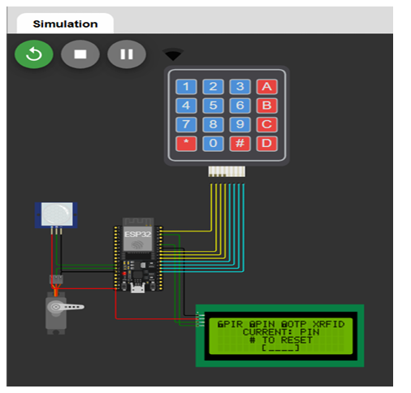
Implementation 1

Slide 9
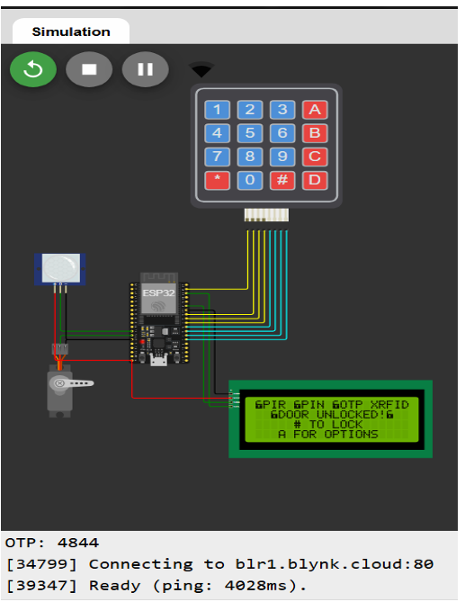
Implementation 2

Slide 10
Appendix – ESP32
PIN & OTP verification logic
Volatile memory for simulation
Blynk integration for notifications
PIR-triggered wake-up flow

Slide 11
Appendix – Arduino EEPROM
Uses internal EEPROM for PIN & RFID UIDs
RFID read/compare logic
Offline authentication flow
Long-term storage across reboots

