Slide 1
Executive Summary
Epictrips.com is an online booking platform that has observed a substantial surge in mobile bookings over the recent years.
In order to leverage this burgeoning trend, Epictrips.com must tactically allocate its marketing budget with the aim of increasing its revenue.

Slide 2
Methodology
I embarked on a comprehensive analysis of the two datasets, employing a combination of Microsoft Excel and Power BI

Slide 3
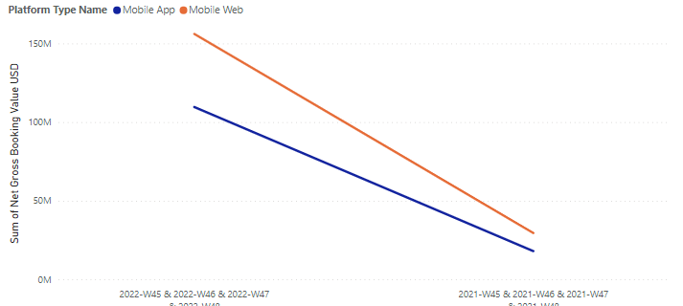
Data Analysis
In 2022, revenue generated from mobile devices surpassed 265 million, marking a remarkable increase of more than 400% compared to the previous year, 2021, when it stood at 47 million.
The chart also indicates that a higher percentage of the revenue was generated via mobile web.

Slide 4
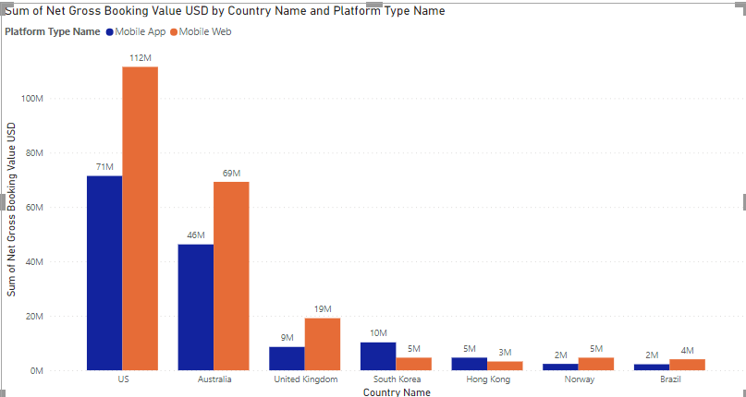
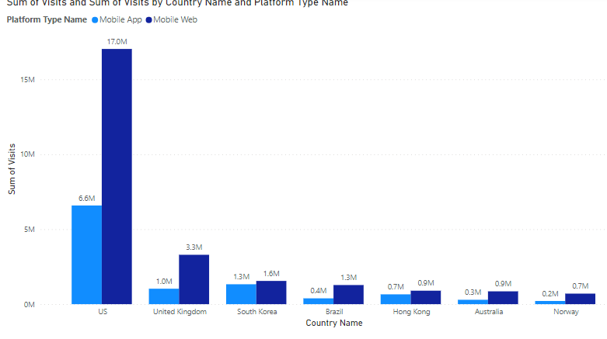
Data Analysis
The chart on the left displays the country that contributed the highest revenue, highlighting the USA as the top revenue generator, while Brazil emerged as the lowest revenue contributor. Conversely, in the chart on the right, we observe that Brazil secured the fourth position in terms of the most visits, despite ranking at the bottom in revenue generation.

Slide 5
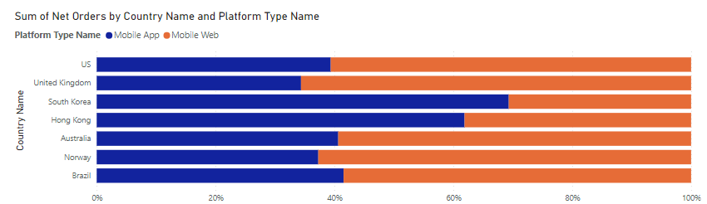
Data Analysis
The charts reveal that South Korea leads in the total orders placed on Mobile App.

Slide 6
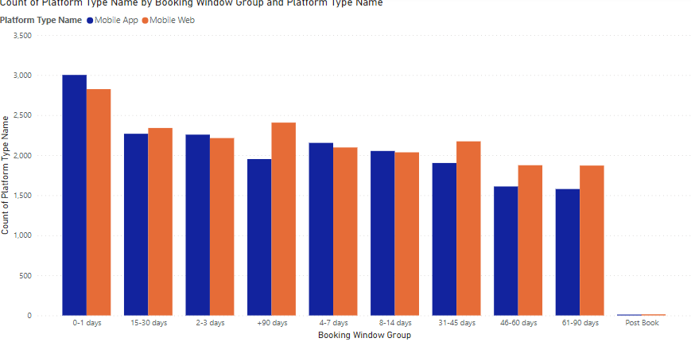
Data Analysis
The charts reveal more booking are made during the 0-1 day booking window.

Slide 7
Recommendations
Ramp up promotions in the United States, as it generates a significant portion of total revenue. Also consider new markets like Brazil, where mobile visits are very high but have the lowest revenue.
Enhance the Mobile web experience for users, as it’s projected that growth will keep on increasing.
The data reveals customers make their bookings closer to their dates. Increase last-minute offers.

