Slide 1
AZUBI AFRICA · LEVEL 2 · PROJECT 3
AlphaAsk
AI-Powered Student Academic Support Platform
100% Serverless on AWS · 4-Provider AI Engine · RAG Grounding
TEAM ALPHA
MH
Mustapha Haadi
DH
Daniel Hanson Reynolds
EY
Emmanuel Yelisomah
DY
David Yirenkyi
AZ
Adeeba Zakaria
EC
Evame Cobblah
Presented by Team Alpha · Managed via Trello Sprint Boards · August 2026
Notes:
Good morning evaluators and stakeholders. Team Alpha presents AlphaAsk—an enterprise-grade, cloud-native serverless AI platform engineered to solve academic support bottlenecks for educational institutions. Our team: Mustapha Haadi, David Yirenkyi, Daniel Hanson Reynolds, Adeeba Zakaria, Emmanuel Yelisomah, and Evame Cobblah — managed via Trello sprint boards to deliver a production-ready application.

Slide 2
THE CHALLENGE
Problem Statement & Project Objectives
THE ACADEMIC SUPPORT BOTTLENECK
CORE PROJECT OBJECTIVES
Inquiry Surges
1
Automate Query Resolution
Support staff swamped with thousands of repetitive questions during midterms and finals.
Instant AI-generated academic answers across Math, Science, Writing, Code, and History.
Delayed Student Help
2
Durable Persistence
TAs and tutors take 24-72 hours to respond via email queues or office hours.
Store all user sessions, messages, and questions in Amazon DynamoDB.
Strained Manual Resources
3
Automated CI/CD
Staff spend over 60% of their time answering basic, recurring questions.
100% automated build, test, and deployment via GitHub Actions and Terraform.
No Centralized Data
4
Zero Idle Overhead
Institutions lack automated tracking of common student learning gaps.
Fully serverless AWS execution with zero idle compute costs.
ALPHAASK
02
Notes:
Educational institutions face severe operational strain during exam periods. Students wait days for answers, hurting their learning velocity. AlphaAsk addresses this by providing instant 24/7 answers while maintaining zero infrastructure cost when idle.

Slide 3
THE SOLUTION
Intelligent, Serverless, Always-On Assistance
1
4-Provider AI Cascade
2
Discipline Model Routing
OpenRouter (400+ models) + Groq + Gemini + Bedrock — zero single point of failure.
6 academic subjects auto-routed to specialist models (DeepSeek-R1, Qwen-Coder, Claude).
3
RAG Strict Grounding Mode
4
Full Academic Study Toolkit
Chunked, keyword-scored document retrieval with anti-hallucination prompting.
Flashcard generator, Pomodoro timer, citation manager, and course workspaces.
KEY PRODUCT FEATURES
Real-Time Streaming — native SSE via /api/ask/stream
6 Academic Personas — Math, Science, Writing, Code, History, Study
Bookmarks, Course Workspaces & Question History — DynamoDB-backed
Fail-Safe Rate Limiting — Redis sliding window vs. abuse
ALPHAASK
03
Notes:
AlphaAsk now combines four AI providers — OpenRouter, Groq, Gemini, and Bedrock — with discipline-aware model routing and a Strict RAG Grounding mode for document-based, anti-hallucination answers. A full academic study toolkit rounds out the platform: flashcards, a Pomodoro timer, and a citation manager.

Slide 4
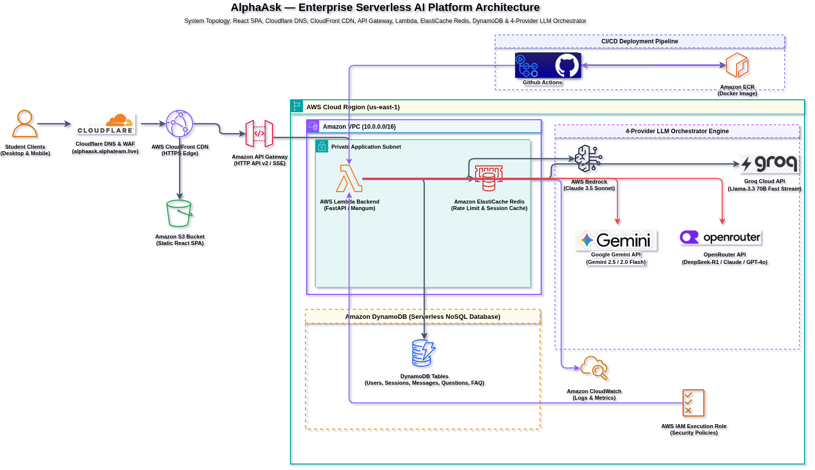
ARCHITECTURE
End-to-End Serverless AWS Architecture
ALPHAASK
04
Notes:
Here is our complete AWS architecture. Student clients reach us through Cloudflare DNS and WAF, then CloudFront, into API Gateway, which proxies to our containerized FastAPI Lambda function inside a VPC. Data is persisted in DynamoDB and cached in ElastiCache Redis, while AI inference cascades across our 4-provider orchestrator: Bedrock, Groq, Gemini, and OpenRouter, all wired up behind an automated GitHub Actions and Terraform CI/CD pipeline with IAM and CloudWatch for security and observability.

Slide 5
AI RELIABILITY
Multi-Provider AI Orchestration & Streaming
4-PROVIDER FAILOVER CASCADE
OpenRouter — 400+ models, discipline-routed
REAL-TIME SSE TOKEN STREAMING
PRIMARY
POST /api/ask/stream
Groq Cloud — Llama 3.3 70B, native SSE
data: {"content": "..."}\n\n
FALLBACK 1
Google Gemini — 2.5 / 2.0 Flash
FALLBACK 2
Native streaming on OpenRouter and Groq; graceful 3-word chunk emission fallback on Gemini/Bedrock.
AWS Bedrock — Claude 3.5 (resilience backstop)
USER BENEFIT
FALLBACK 3
Eliminates long wait times — students see answers begin rendering within milliseconds.
On any provider failure or rate limit, the engine falls through to the next tier — the student never sees an interruption.
DISCIPLINE MODEL ROUTING
Math → DeepSeek-R1 · Code → Qwen-2.5-Coder · Writing/History → Claude 3.5 · Science → Gemini Flash
Each of the 6 academic disciplines routes to a specialist model chain via OpenRouter.
ALPHAASK
05
Notes:
AI reliability is paramount. Our engine now tries OpenRouter first — giving us access to 400+ models with subject-aware discipline routing — then falls back to Groq's native streaming, then Gemini, then Bedrock as the final resilience backstop. The student experiences unbroken streaming regardless of provider status.

Slide 6
DATA LAYER
Data Architecture & O(1) DynamoDB Optimization
Table | Partition Key | GSI | Function
alphaask-Users | user_id (S) | EmailIndex | Student auth & profiles
alphaask-Sessions | session_id (S) | UserSessionsIndex | Conversation thread tracking
alphaask-Messages | message_id (S) | SessionMessagesIndex | Chronological chat history
alphaask-Questions | id (S) | UserQuestionsIndex | Fast question history lookups
alphaask-FAQ | faq_id (S) | N/A | Centralized institutional FAQs
Table
Partition Key
GSI
Function
PERFORMANCE ENGINEERING: O(1) GSI INDEXING
The Problem: Scanning session messages to build user question lists caused expensive O(N × M) table scans. The Optimization: Created UserQuestionsIndex GSI on alphaask-Questions. Question records write on answer creation, enabling O(1) GSI retrieval. RAG Document Retrieval: Documents over 12,000 characters are chunked into 1,500-char passages (200-char overlap) and top-5 keyword-scored before injection. Rate Limiting: ElastiCache Redis sliding-window token bucket (max 10 req/min per user) with graceful fail-open resilience.
ALPHAASK
06
Notes:
We optimized our database layer from expensive O(N x M) table scans to O(1) GSI queries by indexing alphaask-Questions on user_id. Redis protects our API from rate limit abuse with fail-open fallback.

Slide 7
DEVOPS
Infrastructure as Code & Automated CI/CD
100% AUTOMATED DECLARATIVE INFRASTRUCTURE (TERRAFORM)
Modules: ecr.tf · dynamodb.tf · elasticache.tf · iam.tf · lambda_apigw.tf · s3_cloudfront.tf — Zero drift: all AWS resources created, updated, and managed declaratively.
4-STAGE GITHUB ACTIONS PIPELINE · .github/workflows/deploy.yml
1
2
3
4
Test & Validate
Provision ECR
Build & Push
Deploy Infra
Pytest + Vitest
Repo Check
Docker Image
Terraform + S3
DYNAMIC API GATEWAY INJECTION
Stage 4 extracts API_URL from terraform output -raw api_gateway_url after terraform apply. Compiles the React SPA with VITE_API_BASE_URL and syncs dist/ to S3. Result: destroying and recreating infrastructure automatically reconnects the frontend to the new API Gateway URL — no manual code changes.
ALPHAASK
07
Notes:
Our CI/CD pipeline automates everything. When we push code, Stage 1 tests, Stage 2 verifies ECR, Stage 3 builds the Docker container, and Stage 4 runs terraform apply while dynamically injecting the new API Gateway URL into the frontend build.

Slide 8
TRUST & OPS
Security, IAM Compliance & Observability
ENTERPRISE SECURITY & IAM HARDENING
CLOUDWATCH MONITORING & OBSERVABILITY
Cloudflare Edge WAF
Log Streams
DNS + Web Application Firewall in front of API Gateway, filtering malicious traffic at the edge.
/aws/lambda/alphaask-backend logs container startup, execution, and FastAPI requests.
Least Privilege IAM
Gateway Metrics
Policies restricted strictly to alphaask-* DynamoDB and Bedrock model ARNs.
API Gateway access logs monitor latency, request counts, and HTTP status codes.
Alarms
Password & Token Security
CloudWatch Alarms notify on Lambda error spikes and 5xx response thresholds.
bcrypt (12 rounds) hashing; JWTs signed with HS256, 8-hour session window.
Startup Validator
Pydantic validator enforces ≥32-char JWT secrets with safe fallbacks.
ALPHAASK
08
Notes:
Security and observability are built-in. We enforce least privilege IAM, bcrypt hashing, edge CORS at API Gateway, and CloudWatch alarms for real-time monitoring and log extraction.

Slide 9
ENGINEERING DEPTH · 14 RESOLVED
Key Technical Challenges & Solutions
Terraform State Sync in CI/CD
ROOT CAUSE
Ephemeral GitHub Actions runners start with empty state, causing ResourceInUseException on live tables/roles
SOLUTION
Pre-apply AWS CLI existence check + terraform import -lock=false before every apply — fully idempotent deploys
OpenRouter + Groq Native SSE via API Gateway
ROOT CAUSE
API Gateway HTTP responses are traditionally buffered, breaking chunked SSE streams
SOLUTION
HTTP API v2 (payload format 2.0) + StreamingResponse within the 29s API Gateway timeout, native chunked transfer
Binary PDF Byte Stream Pollution
ROOT CAUSE
FileReader.readAsText() on PDFs dumped raw font-table binary syntax into prompts
SOLUTION
Multi-stage clean_pdf_text_context(): pypdf extraction, base64/Latin1 decode, regex literal extraction, tag stripping
Discipline Model Routing at Scale
ROOT CAUSE
A single generic model handles all academic domains sub-optimally (e.g. math vs. writing)
SOLUTION
DISCIPLINE_MODEL_ROUTING table mapping 6 subjects to ordered specialist OpenRouter model chains with fallback
ALPHAASK
09
Notes:
We documented and resolved 14 real engineering challenges across the project. The four most impactful: making Terraform deployments idempotent against live infrastructure, getting true native SSE streaming through API Gateway's buffering behavior, cleaning binary PDF pollution out of RAG context, and building discipline-aware model routing across six academic subjects.

Slide 10
CONCLUSION
Specification Compliance & Conclusion
Requirement | Specification | Implementation | Status
AWS Cloud | Host infrastructure on AWS | Provisioned via Terraform in us-east-1 | 100%
API Gateway | Public API endpoints / proxy | Amazon API Gateway (HTTP API v2) | 100%
AWS Lambda | Process backend requests | Docker container image on Lambda | 100%
DynamoDB | Store questions & responses | 5 On-Demand tables + GSI | 100%
AI Integration | Connect to external AI service | OpenRouter → Groq → Gemini → Bedrock, 4-provider failover | 100%
CI/CD Pipeline | GitHub Actions workflow | 4-Stage automated pipeline | 100%
Agile Management | Track issues via Trello/Jira | Sprint workflow tracking stories & bugs | 100%
Requirement
Specification
Implementation
Status
AlphaAsk delivers a high-performance, cost-optimized AI Academic Support platform with 4-provider AI resilience, RAG-grounded answers, and a full study toolkit — live now at alphaask.alphateam.live.
ALPHAASK
010
Notes:
In conclusion, AlphaAsk meets 100% of the Azubi Africa Level 2 Project 3 specifications. We now transition to our Live Product, CI/CD, and AWS Console Demonstration.

