Slide 1
Toward Generalizable Whole-Body Skill Learning
Research Seminar 2025/02/12
Kenjiro Minamikawa

Slide 2
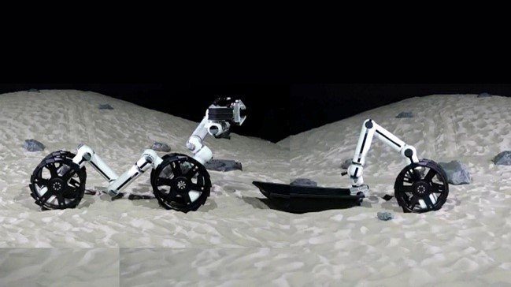
Background
Modular Robots Have Great Potential
Consists of multiple modules, transform into various morphology
Adaptable to various tasks
Deep RL expected to unlock its potential
1

Slide 3
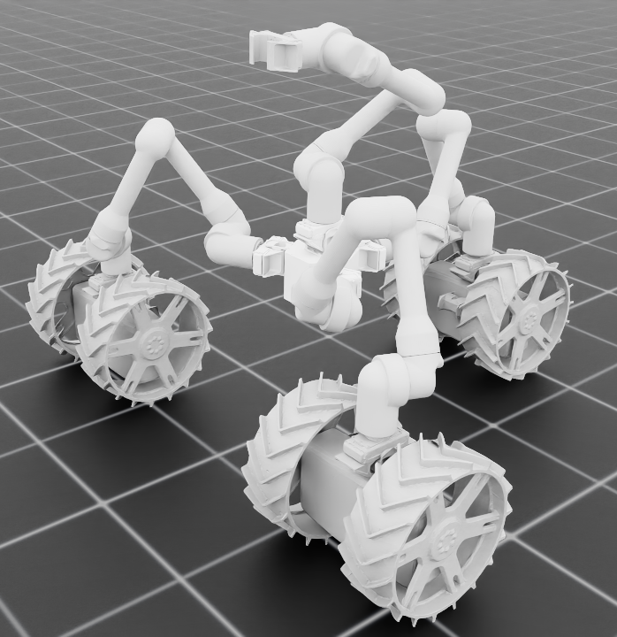
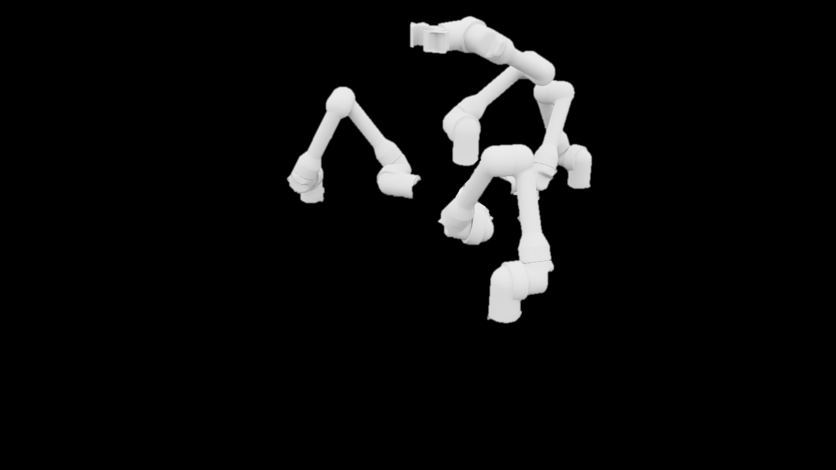
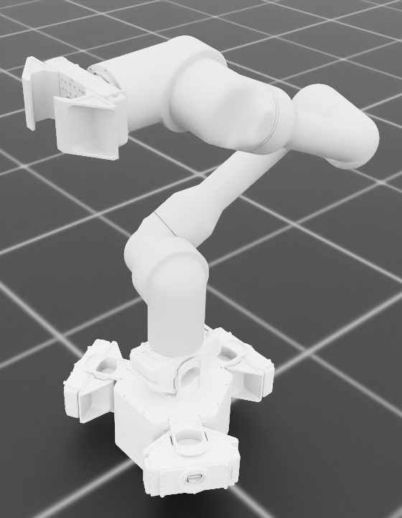
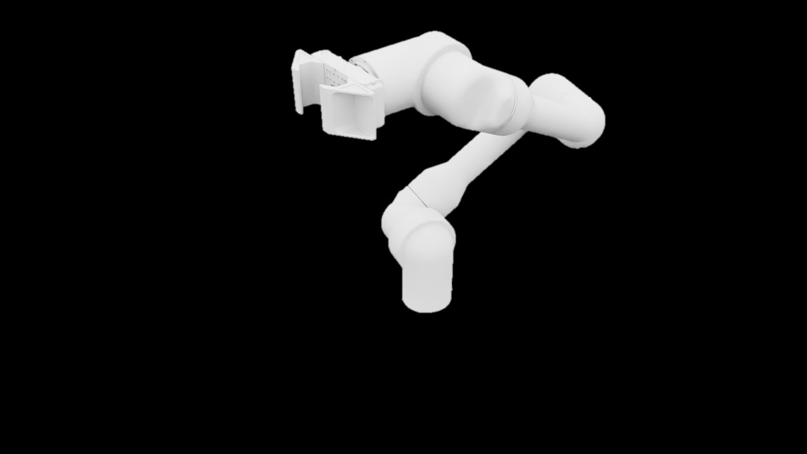
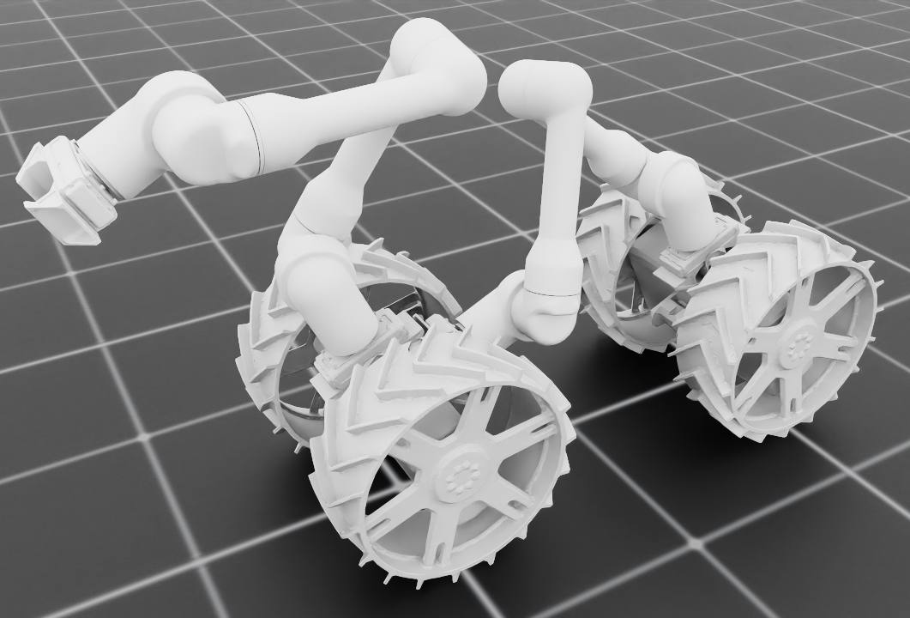
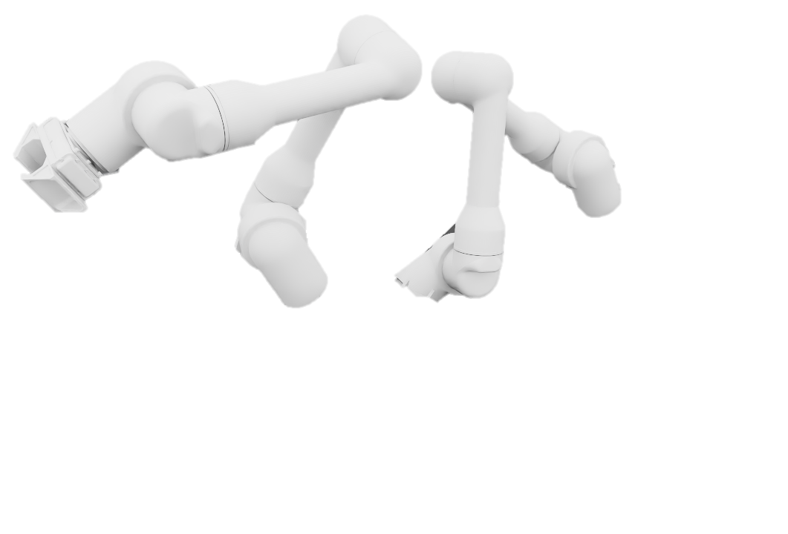
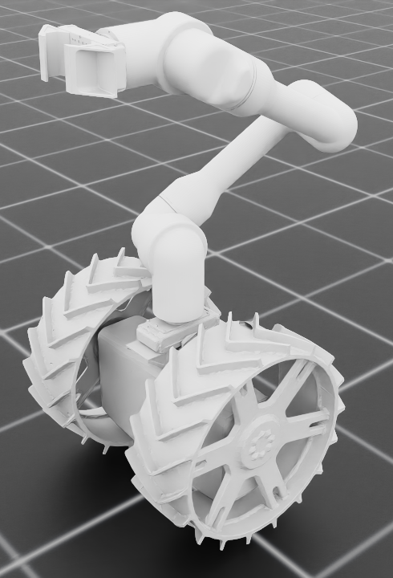
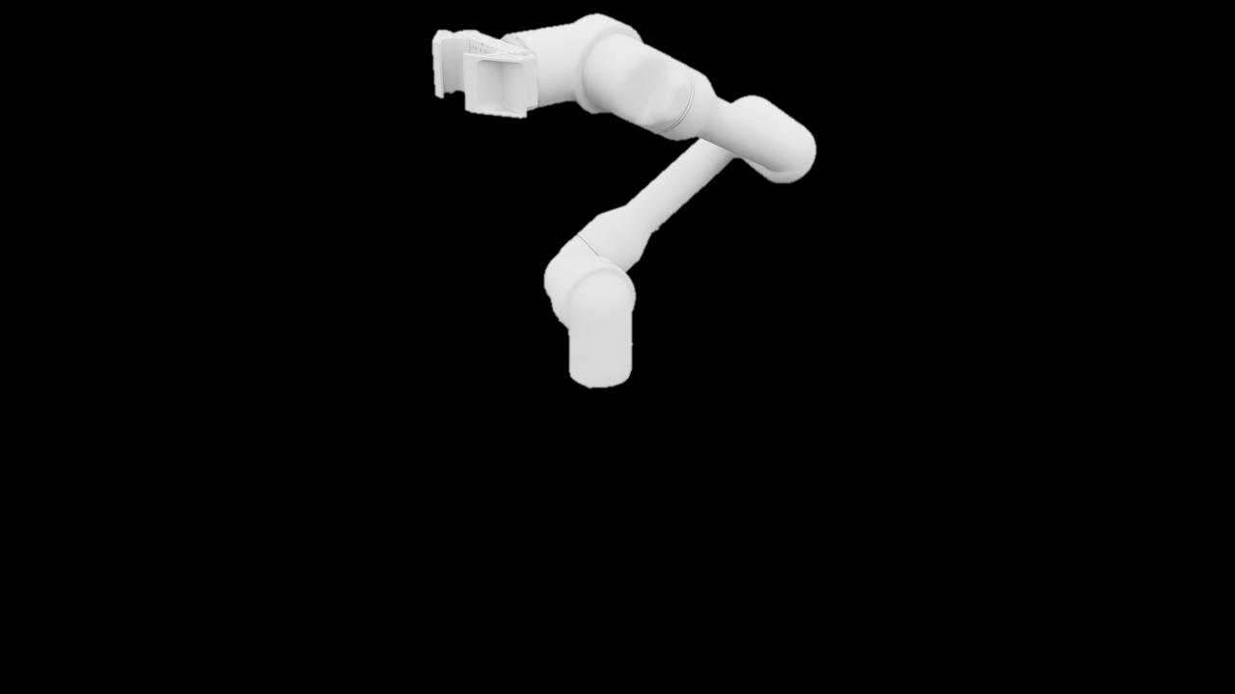




Background
Lots of Training Needed
Different morphology and task need different policy
Increasing the number of modules expands the state space
Constructing hierarchical policies at the module level
Module-level training
$π_{θ}$
$π_{θ}$
$π_{θ}$
$π_{θ}$
2

Slide 4



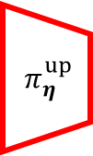

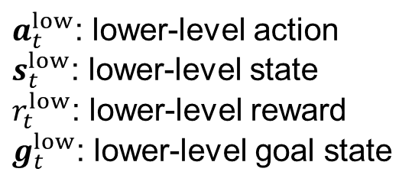












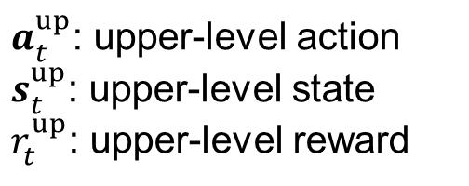
Background
Lots of Training Needed
Different morphology and task need different policy
Increasing the number of modules expands the state space
Constructing hierarchical policies at the module level
Upper-level
Dragon Morphology
$$g_{t}^{low}$$
$$a_{t}^{low}$$
$a_{t}^{up}$: upper-level action
$s_{t}^{up}$: upper-level state
$r_{t}^{up}$: upper-level reward
$$π_{η}^{up}$$
$$π_{θ}^{low}$$
$$s_{t}^{up}$$
$$r_{t}^{up}$$
$$s_{t}^{low}$$
Low-level
Arm Module
$a_{t}^{low}$: lower-level action
$s_{t}^{low}$: lower-level state
$r_{t}^{low}$: lower-level reward
$g_{t}^{low}$: lower-level goal state
$$g_{t}^{low}$$
$$π_{θ}^{low}$$
$$a_{t}^{low}$$
$$s_{t}^{low}$$
$$r_{t}^{low}$$
3

Slide 5
Papers
Toward Generalizable Whole-Body Skill Learning
ModSkill: Physical Character Skill Modularization
Huang, Yiming, et al. Proceedings of the IEEE/CVF International Conference on Computer Vision. 2025.
LeVERB: Humanoid Whole-Body Control with Latent Vision-Language Instruction
Xue, Haoru, et al. arXiv preprint arXiv:2506.13751. 2025.
Sumo: Dynamic and Generalizable Whole-Body Loco-Manipulation
Zhang, John Z., et al. "Sumo: Dynamic and Generalizable Whole-Body Loco-Manipulation." arXiv preprint arXiv:2604.08508. 2026.
4

Slide 6
Papers
Toward Generalizable Whole-Body Skill Learning
ModSkill: Physical Character Skill Modularization
Huang, Yiming, et al. Proceedings of the IEEE/CVF International Conference on Computer Vision. 2025.
LeVERB: Humanoid Whole-Body Control with Latent Vision-Language Instruction
Xue, Haoru, et al. arXiv preprint arXiv:2506.13751. 2025.
Sumo: Dynamic and Generalizable Whole-Body Loco-Manipulation
Zhang, John Z., et al. "Sumo: Dynamic and Generalizable Whole-Body Loco-Manipulation." arXiv preprint arXiv:2604.08508. 2026.
5

Slide 7

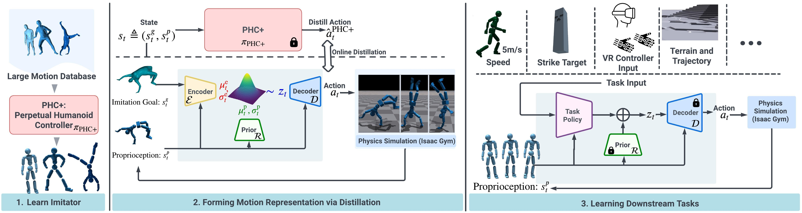
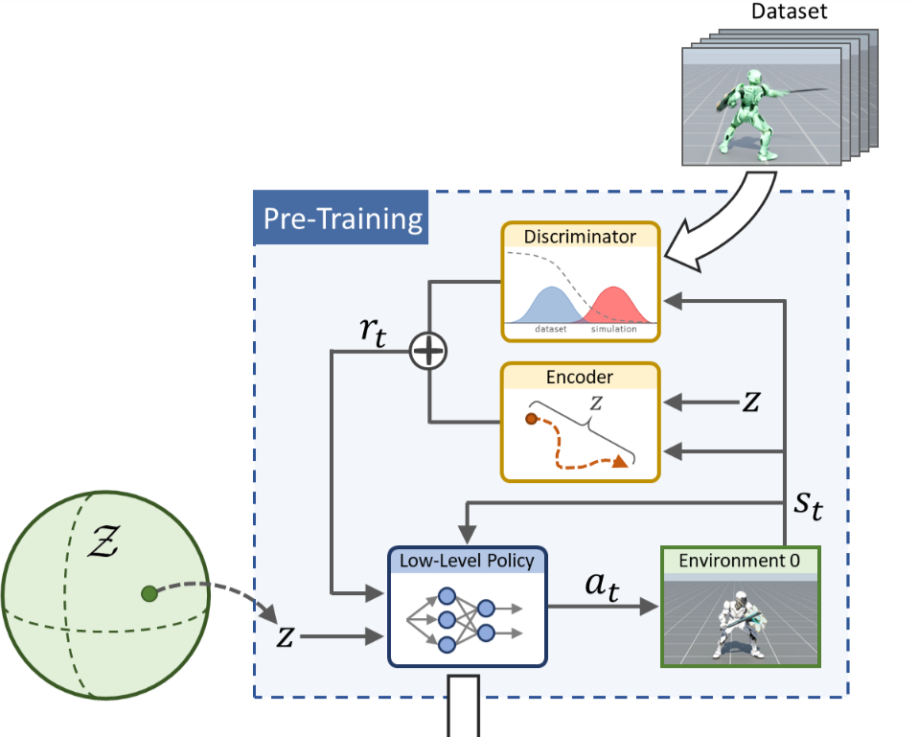







1. ModSkill: Physical Character Skill Modularization
Challenges of Learning from Large-Scale Data
Physical character skill learning has two main approaches
Both face scalability challenges (latent space, MoE)
Form a latent space/skill embedding,
reused in HRL
Low-level controller as a motion imitator high-level output kinematic motion
$$s_{t+1}$$
$${\hat{s}}_{t+1}$$
$$s_{t}$$
$$a_{t}$$
HRL
Motion
Generator
$$s_{t}$$
$$z$$
$$a_{t}$$
6
6
6

Slide 8
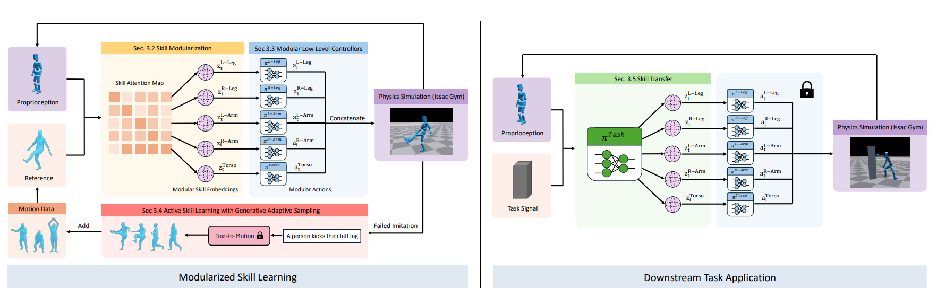
1. ModSkill: Physical Character Skill Modularization
ModSkill
ModSkill introduces modular skill learning
Decompose full-body motion into part-level skills
Two key components: 1) skill modularization attention layer
2) low-level skill-conditioned controllers
7
7
7

Slide 9
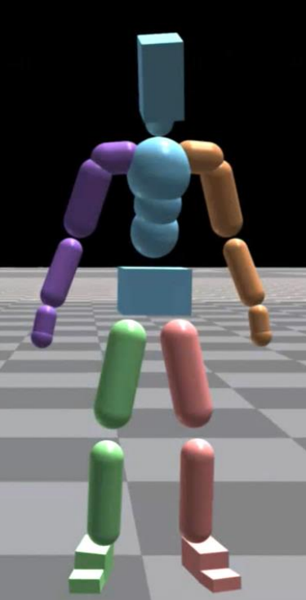

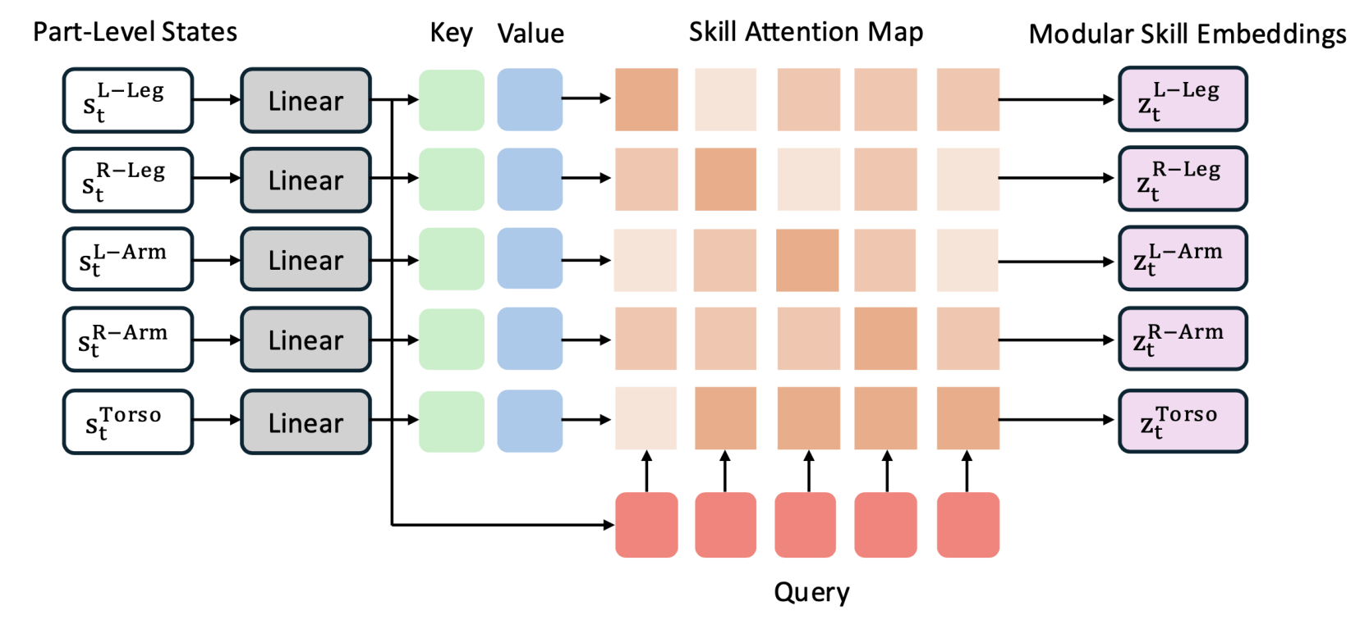
1. ModSkill: Physical Character Skill Modularization
Skill Modularization
Partition the body into five parts and states
Compute attention weights across body parts
Generate part-specific skill embeddings
8
8
8

Slide 10
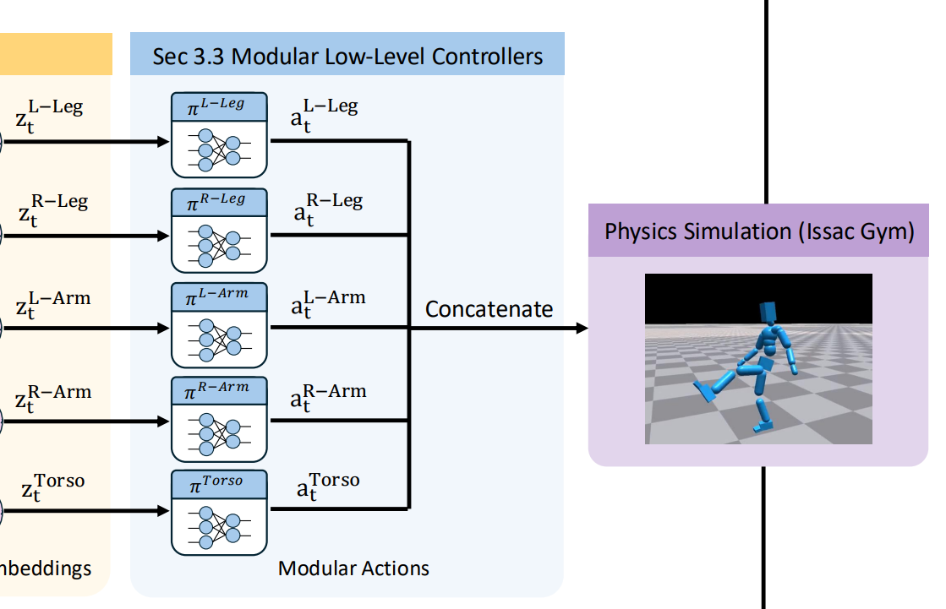
1. ModSkill: Physical Character Skill Modularization
Modular Low-Level Controllers
Control each body part with a dedicated low-level controller
Combine part-wise actions into full-body control
Encourage natural motion with a body-level discriminator
Trained with RL; amp-based PPO, attention layer and controllers
9
9
9

Slide 11
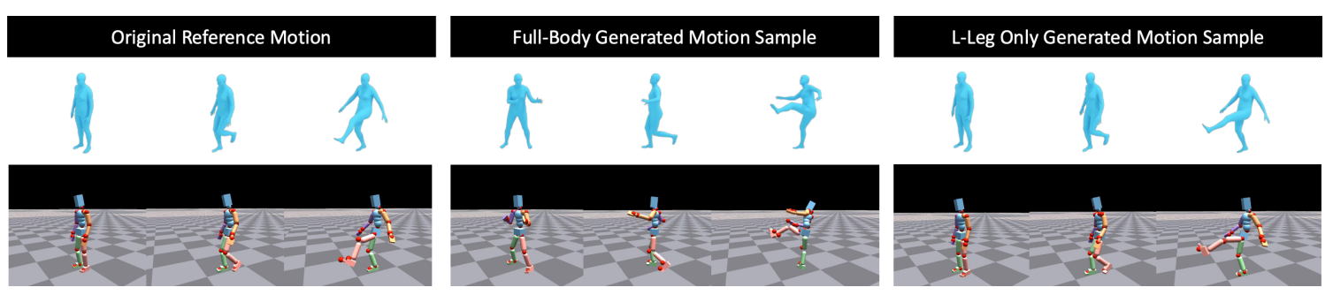
1. ModSkill: Physical Character Skill Modularization
Active Skill Learning with Generative Adaptive Sampling
Resample failed motions generatively
Synthesize full-body and part-specific variations
Augment training with diverse motion samples
Same text
“a person kicks their left leg”
Motion generation for specific part
10
10
10

Slide 12
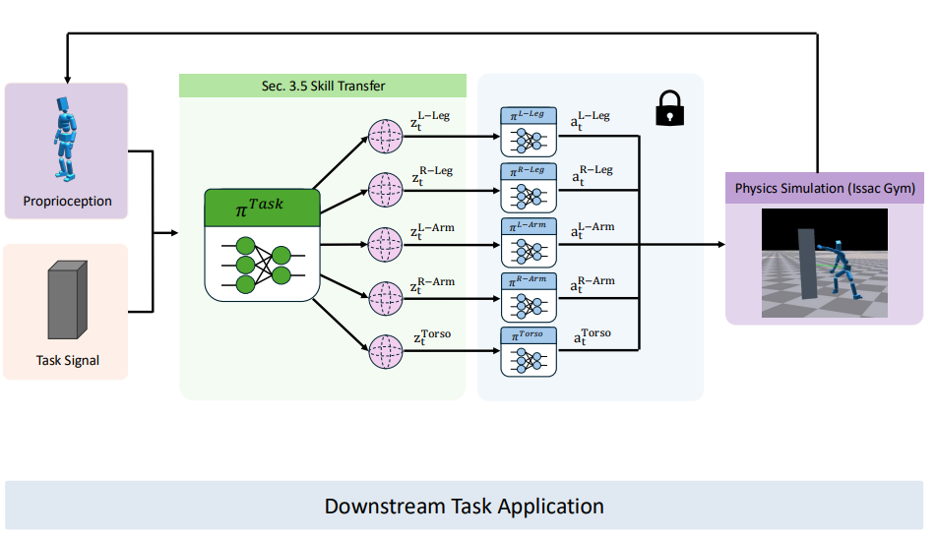
1. ModSkill: Physical Character Skill Modularization
Skill Transfer for Downstream Tasks
Freeze the learned low-level controllers
Train a high-level task policy
Reuse modular skills for downstream tasks
Search space: 64 dim x 5 parts
11
11
11

Slide 13
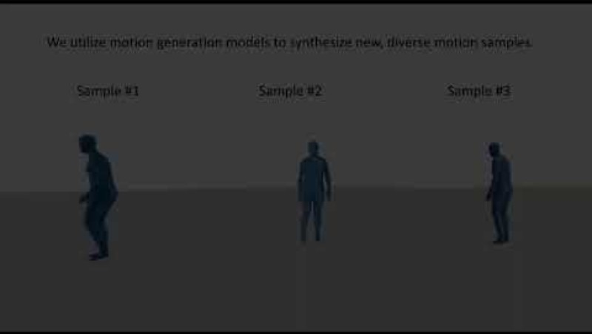
1. ModSkill: Physical Character Skill Modularization
Results
12
12
12

Slide 14
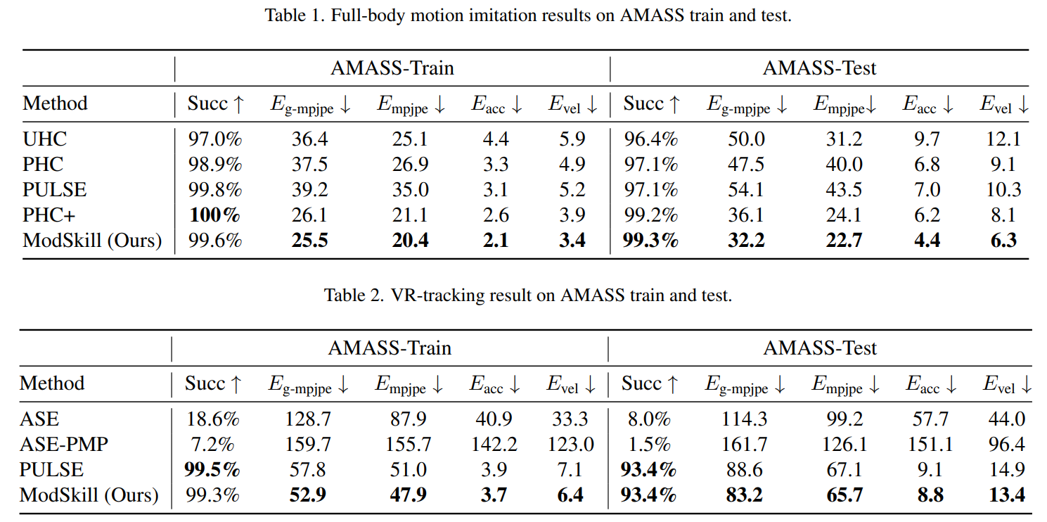
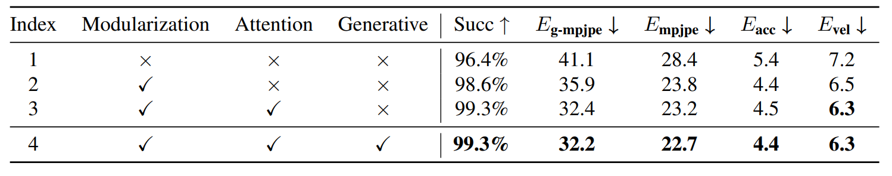
1. ModSkill: Physical Character Skill Modularization
Evaluation: Motion Imitation
Best performance on full-body motion imitation
Large improvements in position errors over PULSE
Modularization, attention, and generative sampling each
contribute to the gains
13
13
13

Slide 15
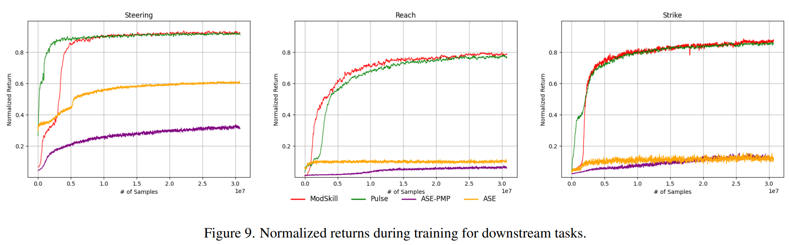
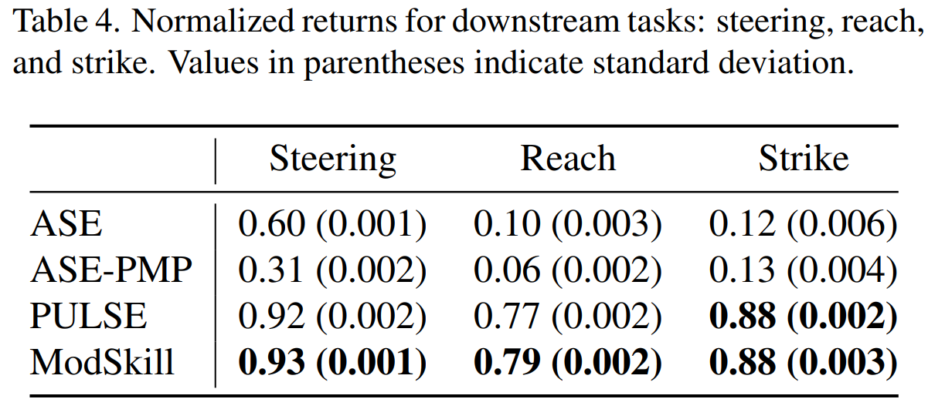
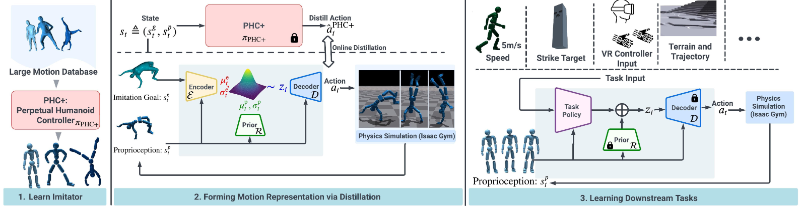
1. ModSkill: Physical Character Skill Modularization
Evaluation: Downstream Task
Competitive downstream-task performance
Comparable normalized returns to PULSE without extra distillation
Better flexibility on part-specific tasks such as reaching
14
14
14

Slide 16
Papers
Toward Generalizable Whole-Body Skill Learning
ModSkill: Physical Character Skill Modularization
Huang, Yiming, et al. Proceedings of the IEEE/CVF International Conference on Computer Vision. 2025.
LeVERB: Humanoid Whole-Body Control with Latent Vision-Language Instruction
Xue, Haoru, et al. arXiv preprint arXiv:2506.13751. 2025.
Sumo: Dynamic and Generalizable Whole-Body Loco-Manipulation
Zhang, John Z., et al. "Sumo: Dynamic and Generalizable Whole-Body Loco-Manipulation." arXiv preprint arXiv:2604.08508. 2026.
15

Slide 17
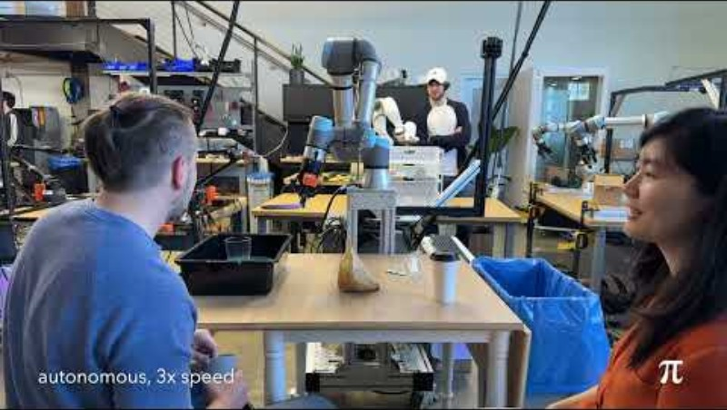
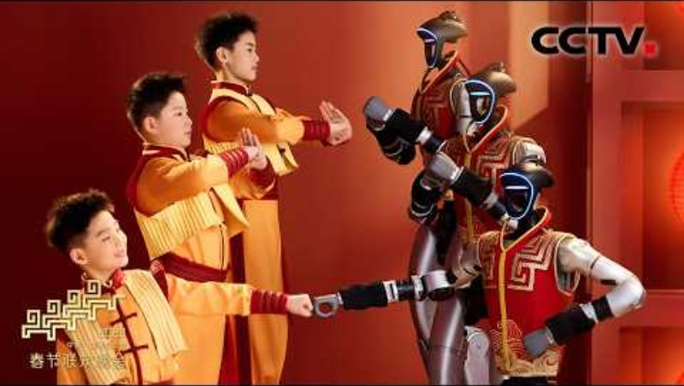
2. LeVERB: Humanoid Whole-Body Control with Latent Vision-Language Instruction
Why Humanoid VLA is Challenging ?
VLA success in manipulation and navigation
Humanoids require agile whole-body control
High-dimensional dynamics make control difficult
16
16
16

Slide 18
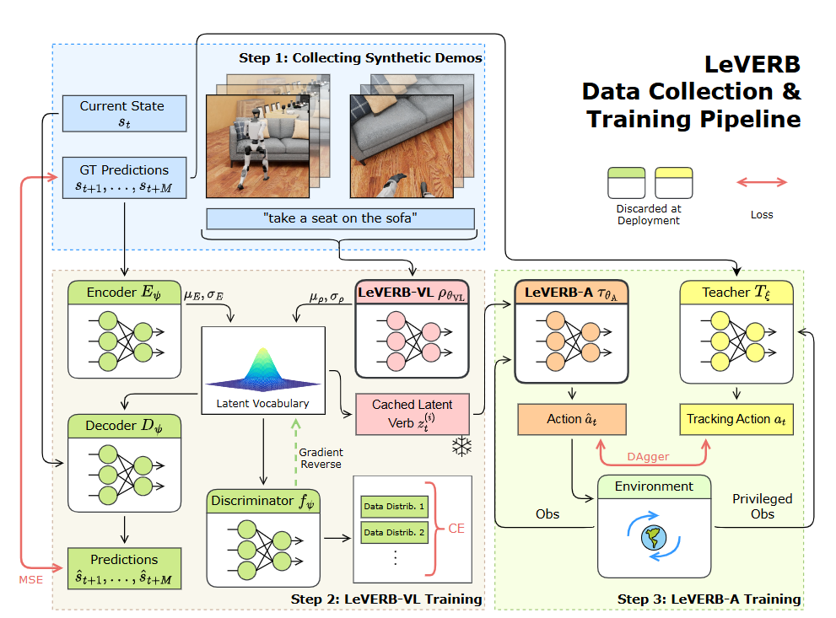
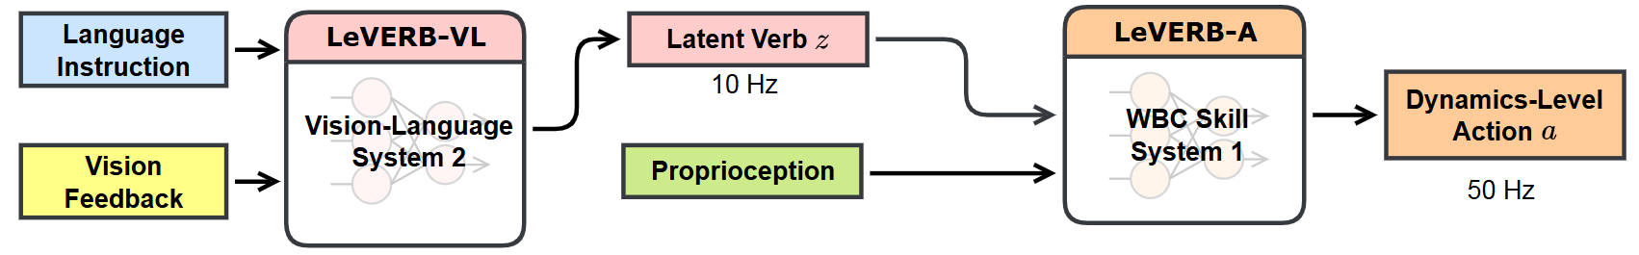
2. LeVERB: Humanoid Whole-Body Control with Latent Vision-Language Instruction
Why Humanoid VLA is Challenging ?
Inspired by human dual-process architecture
Prior work relies on explicit action verbs
Latent verbs capture finer whole-body motions
Bridge vision-language inputs and humanoid WBC
17
17
17

Slide 19
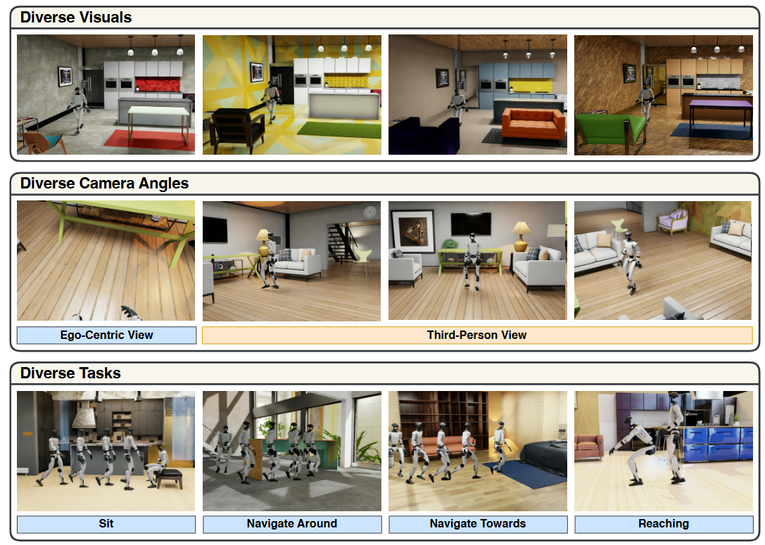
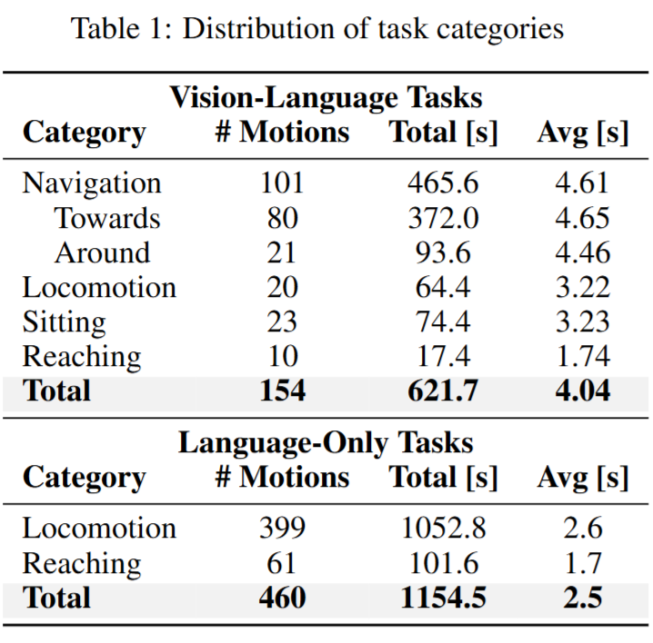
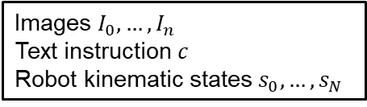
2. LeVERB: Humanoid Whole-Body Control with Latent Vision-Language Instruction
Benchmark for Humanoid VLA and WBC
Build a synthetic benchmark for humanoid vision-language WBC
Replay retargeted motions with photorealistic rendering
Scale data with randomization and language annotation
Images $I_{0}, …, I_{n}$
Text instruction $c$
Robot kinematic states $s_{0}, …, s_{N}$
18
18
18

Slide 20
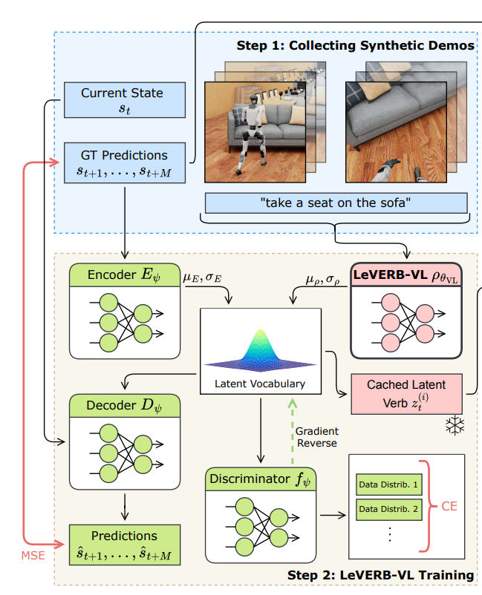
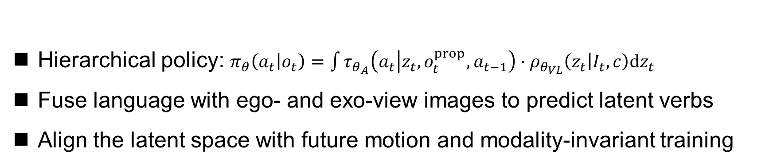
2. LeVERB: Humanoid Whole-Body Control with Latent Vision-Language Instruction
LeVERB-VL Training: VLA Semantic Alignment
Hierarchical policy: $π_{θ}\left(a_{t} | o_{t}\right)=\int{τ_{θ_{A}}\left(a_{t} | z_{t},o_{t}^{prop}, a_{t−1}\right)⋅ρ_{θ_{VL}}\left(z_{t} | I_{t}, c\right)dz_{t}}$
Fuse language with ego- and exo-view images to predict latent verbs
Align the latent space with future motion and modality-invariant training
19
19
19

Slide 21
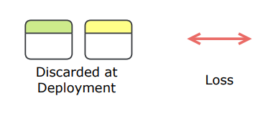

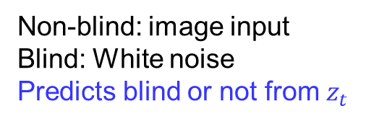




2. LeVERB: Humanoid Whole-Body Control with Latent Vision-Language Instruction
LeVERB-VL Training: VLA Semantic Alignment
Loss:
$$q\left(z_{t} | s_{t+1:t+M}, I_{t}, c, o_{t}\right)=𝒩(μ_{ρ}+μ_{E}, σ_{E}^{2})$$
KL loss
$$p\left(z_{t} | I_{t}, c\right)=𝒩(μ_{ρ}, σ_{ρ}^{2})$$
ego-image
exo-image
text
ViT
ViT
text-encoder
$$i_{t}^{ego}$$
$$i_{t}^{exo}$$
$$l_{t}$$
Transformer
Non-blind: image input
Blind: White noise
Predicts blind or not from $z_{t}$
MLP
$$μ_{ρ}, σ_{ρ}$$
20
20
20

Slide 22
2. LeVERB: Humanoid Whole-Body Control with Latent Vision-Language Instruction
LeVERB-A Training: Distilling Actions with Learned Latent Distribution
Train teacher policies to track reference whole-body motions
Distill their actions into LeVERB-A conditioned on latent commands
Sample latents during training and use the mean at deployment
Transformer
PPO, multi-policy
21
21
21

Slide 23
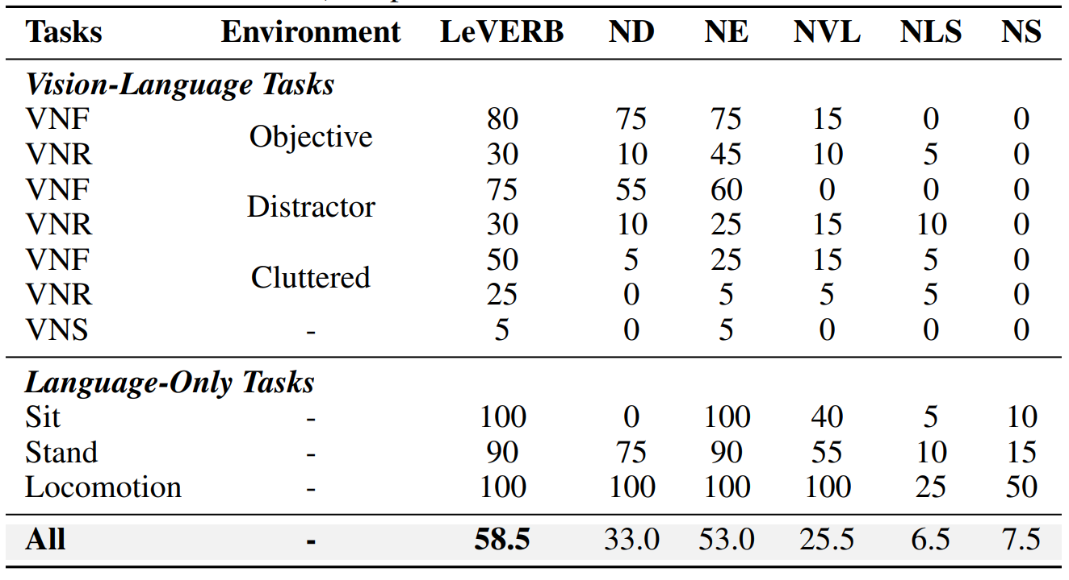
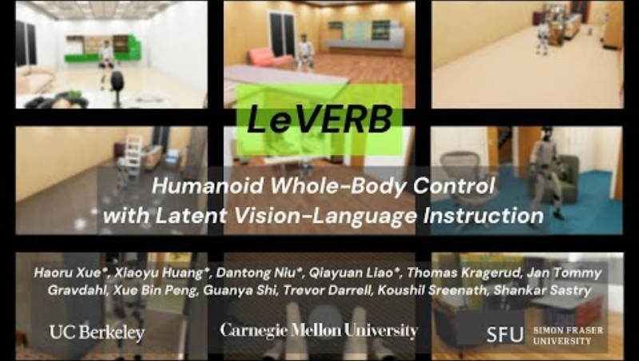
2. LeVERB: Humanoid Whole-Body Control with Latent Vision-Language Instruction
Result and Evaluation
Structured latent verbs improved closed-loop success
The latent interface transferred zero-shot to real humanoids
22
22
22

Slide 24
Papers
Toward Generalizable Whole-Body Skill Learning
ModSkill: Physical Character Skill Modularization
Huang, Yiming, et al. Proceedings of the IEEE/CVF International Conference on Computer Vision. 2025.
LeVERB: Humanoid Whole-Body Control with Latent Vision-Language Instruction
Xue, Haoru, et al. arXiv preprint arXiv:2506.13751. 2025.
Sumo: Dynamic and Generalizable Whole-Body Loco-Manipulation
Zhang, John Z., et al. "Sumo: Dynamic and Generalizable Whole-Body Loco-Manipulation." arXiv preprint arXiv:2604.08508. 2026.
23

Slide 25

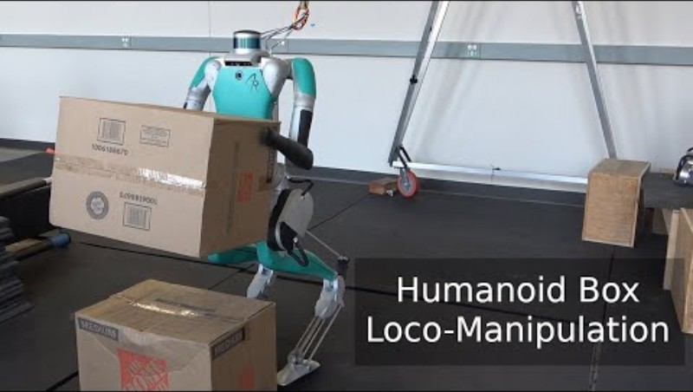
3. Sumo: Dynamic and Generalizable Whole-Body Loco-Manipulation
Challenges in Dynamic Loco-Manipulation
Imitation is limited to quasi-static settings
RL suffers from reward design and generalization issues
Sample-based MPC scales poorly to high-DoF robots
24
24
24

Slide 26
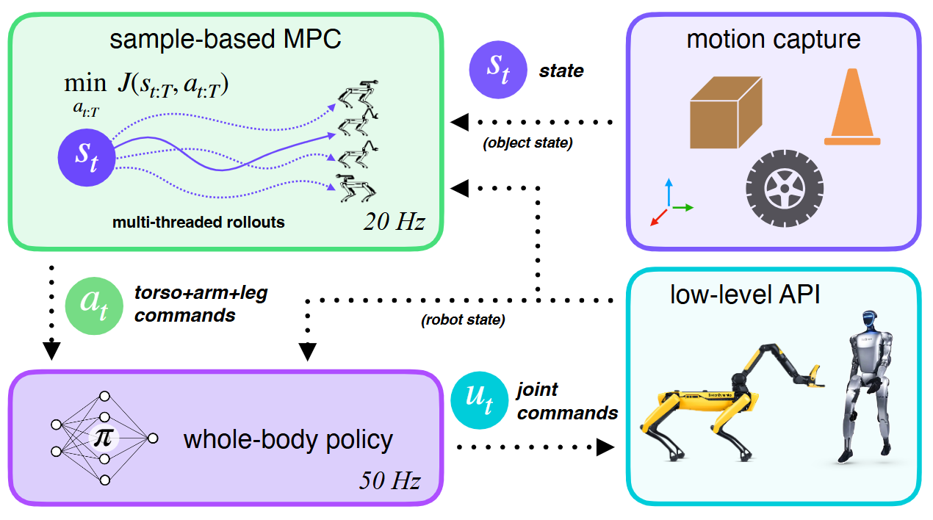
3. Sumo: Dynamic and Generalizable Whole-Body Loco-Manipulation
Challenges in Dynamic Loco-Manipulation
Pre-trained whole-body RL policy for robust low-level control
Sample-based MPC at test time for high-level planning and adaptation
Generalization to unseen objects and tasks without retraining
25
25
25

Slide 27
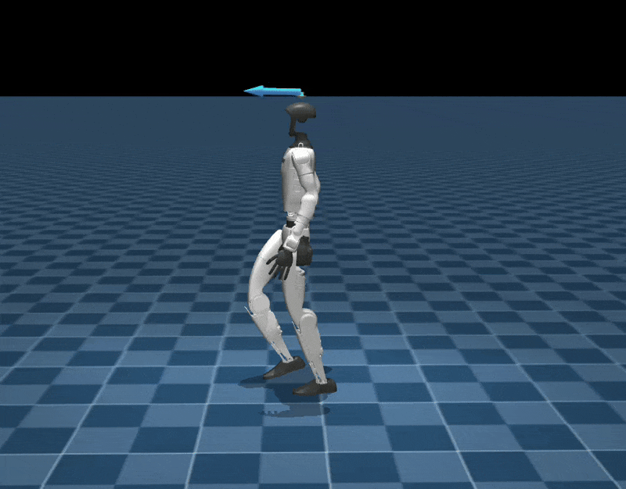
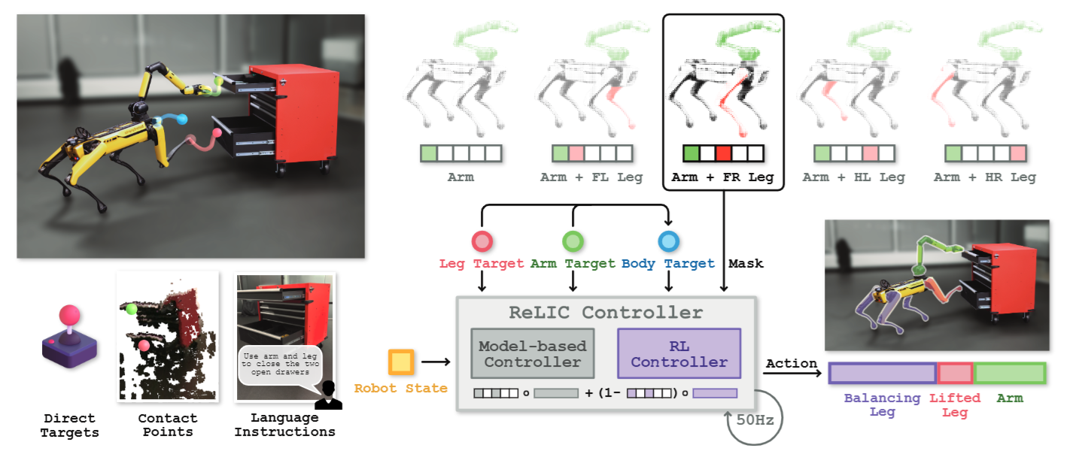
3. Sumo: Dynamic and Generalizable Whole-Body Loco-Manipulation
Pre-Trained Whole-Body Control Policy
Use a pre-trained whole-body policy for low-level control
Spot: ReLIC [Xinghao Zhu, arXiv, 2025]
G1: MJLab standard velocity-tracking policy
26
26
26

Slide 28
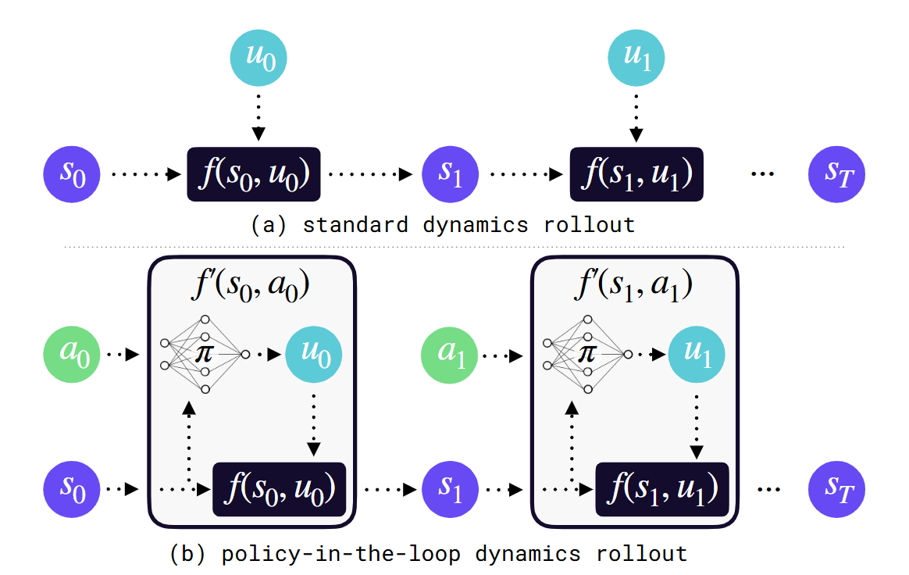
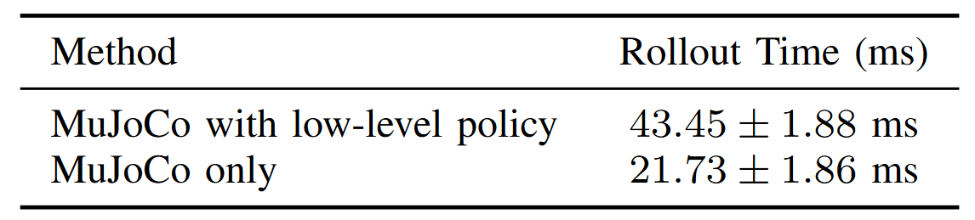
3. Sumo: Dynamic and Generalizable Whole-Body Loco-Manipulation
Policy-in-the-Loop Parallel Rollouts
Roll out MuJoCo with the low-level policy in the loop
Sample in policy input space instead of joint space
Reduce search dimension, improve stability, and simplify the cost
Rollout MuJoCo from the current state
27
27
27

Slide 29
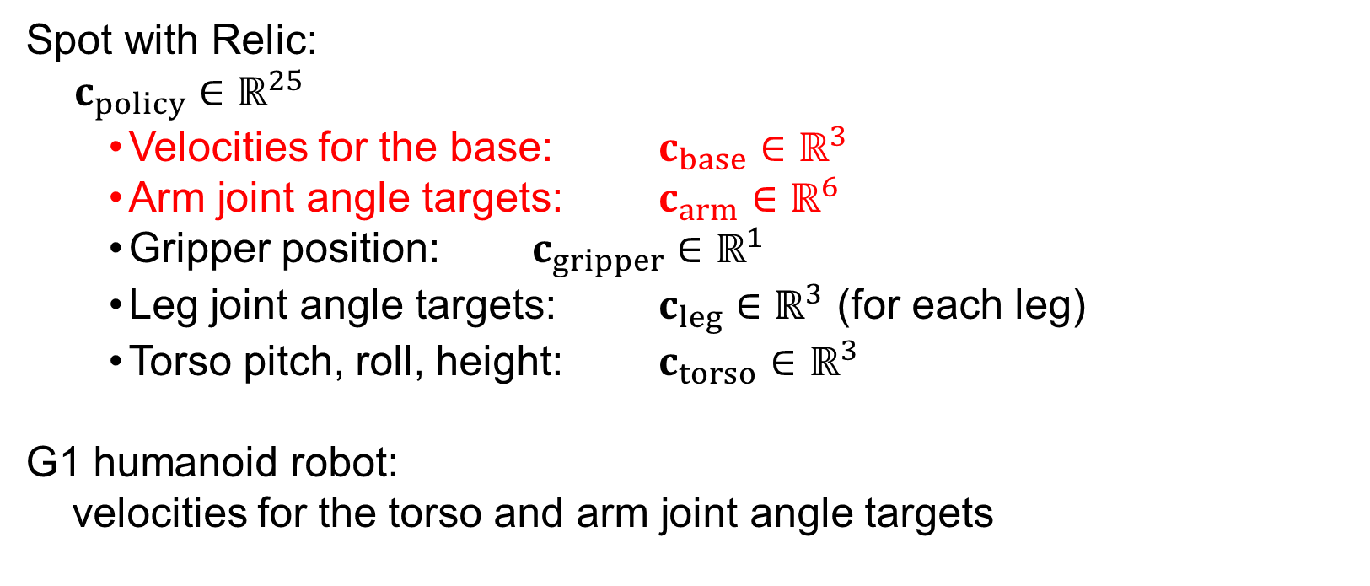
3. Sumo: Dynamic and Generalizable Whole-Body Loco-Manipulation
High-Level Sample-Based MPC
Plan in the input space of the low-level policy
By default, sample base velocities and arm joint targets
Optionally extend to torso, leg, and gripper commands
Spot with Relic:
$c_{policy}∈ℝ^{25}$
  Velocities for the base: $c_{base}∈ℝ^{3}$
  Arm joint angle targets: $c_{arm}∈ℝ^{6}$
  Gripper position: $c_{gripper}∈ℝ^{1}$
  Leg joint angle targets: $c_{leg}∈ℝ^{3}$ (for each leg)
  Torso pitch, roll, height: $c_{torso}∈ℝ^{3}$
G1 humanoid robot:
velocities for the torso and arm joint angle targets
28
28
28

Slide 30
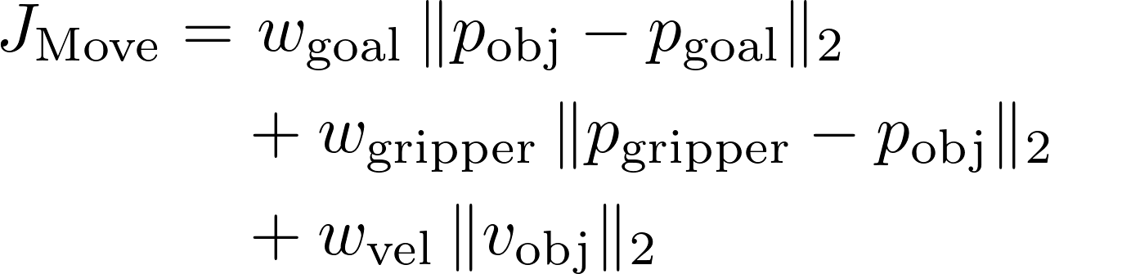
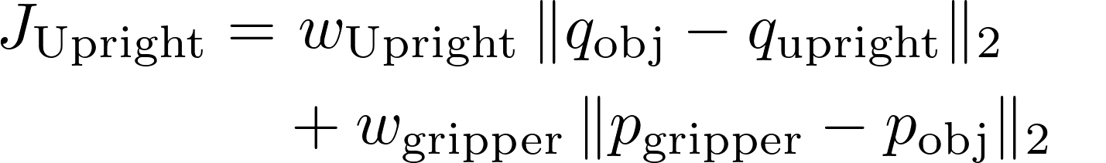
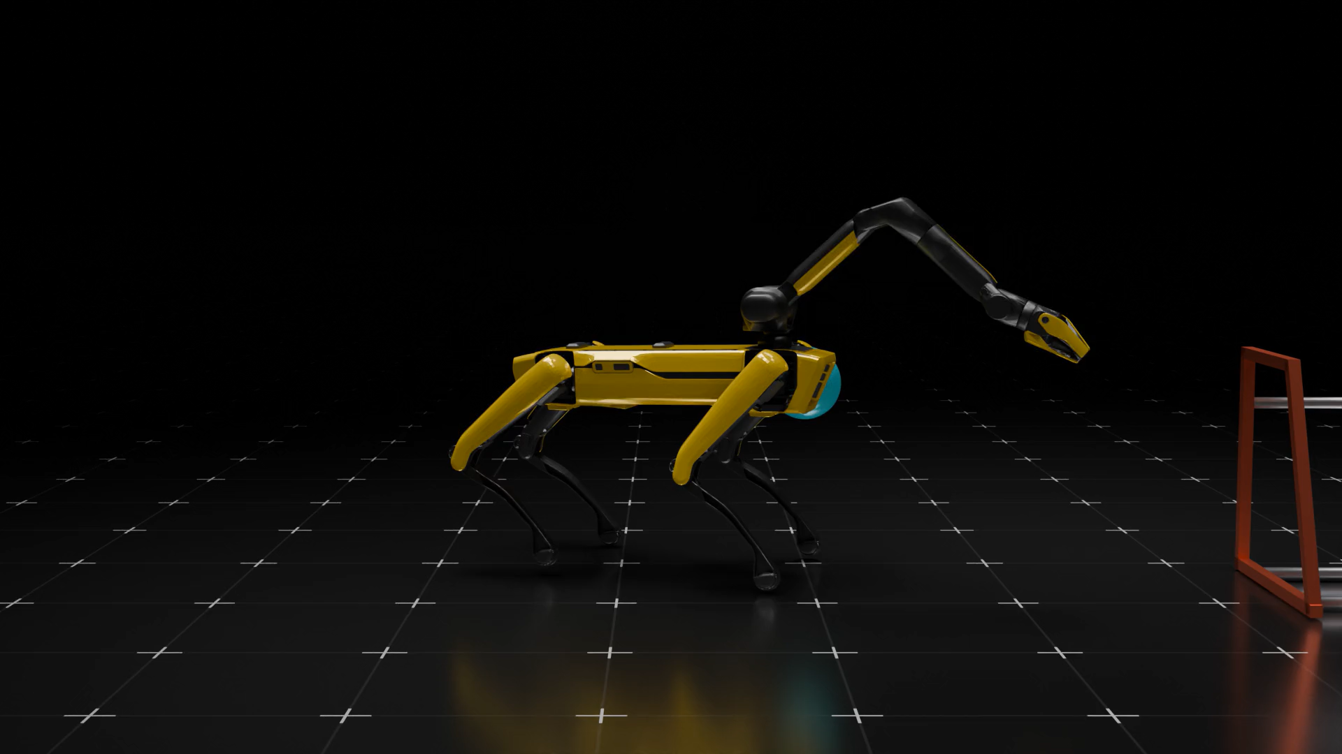
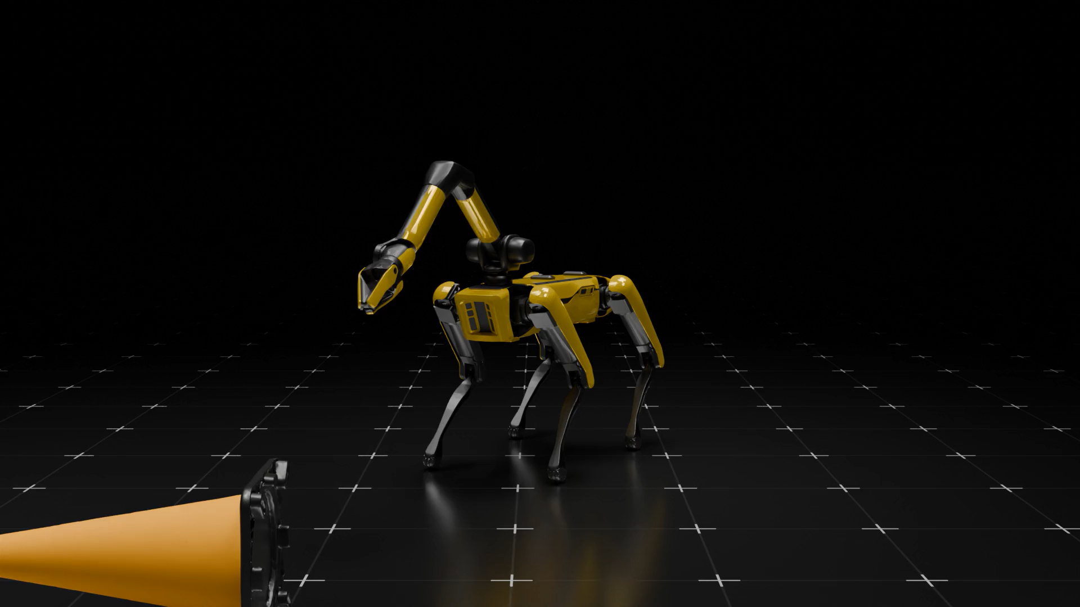
3. Sumo: Dynamic and Generalizable Whole-Body Loco-Manipulation
Task Definition and Experiment Setup
Tasks: Move to goal / Upright reorientation
Objects: Box, chair, tire, tire rack, cone; success by error threshold within 30 s
29
29
Move: tire rack
29
Upright: cone

Slide 31


3. Sumo: Dynamic and Generalizable Whole-Body Loco-Manipulation
Hierarchical Structure Simplifies Loco-Manipulation
Sumo outperforms E2E MPC on all Move tasks
vs. MPC: reduced search space and improved stability
vs. RL: simpler rewards and no task-specific retraining
30
30
30

Slide 32


3. Sumo: Dynamic and Generalizable Whole-Body Loco-Manipulation
Test-Time Search Enables Generalization
Online planning enables adaptation without retraining
Change the object model to handle new objects
Change the cost function to handle new tasks
31
31
31

Slide 33


3. Sumo: Dynamic and Generalizable Whole-Body Loco-Manipulation
Autonomous Demonstration in the Real World
Evaluate diverse real-world loco-manipulation tasks on Spot
Estimate robot and object states from encoders and MoCap
Run rollouts and CEM updates on an external desktop PC
32
32
32

Slide 34



Insights
How to Use Modularity and Hierarchy ?
Can we share attention map across different morphology ?
RL or Optimization for Hierarchical structure ?
Steering controller
HRL
33
33
33

