Slide 1
Three Ways to Use VLMs in Robot Learning
Real2Sim ・ Failure Detection ・ Inference-Time Steering
Research Seminar 2026/11/05
Kaneyoshi Hiratsuka
Notes:
[E] Good afternoon, everyone. Today I will present three papers from the perspective of "how can we bring the capabilities of today's VLMs into robot learning?" With foundation models such as GPT-6 Astra, manipulation benchmarks are starting to be solved. At the same time, using a VLM directly as the policy is still weak at precise and contact-rich manipulation. So I picked one paper from each of three areas where a VLM is combined with a pretrained policy: Real2Sim, failure detection, and inference-time steering.

Slide 2
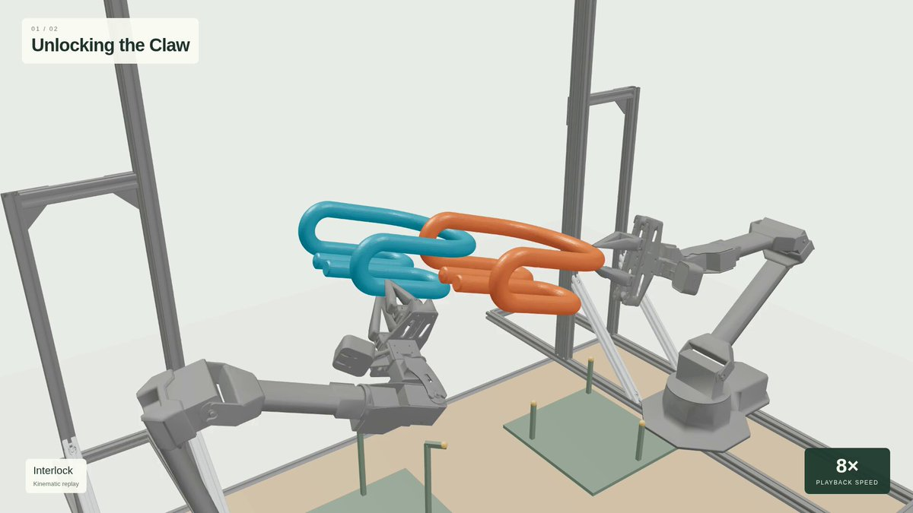
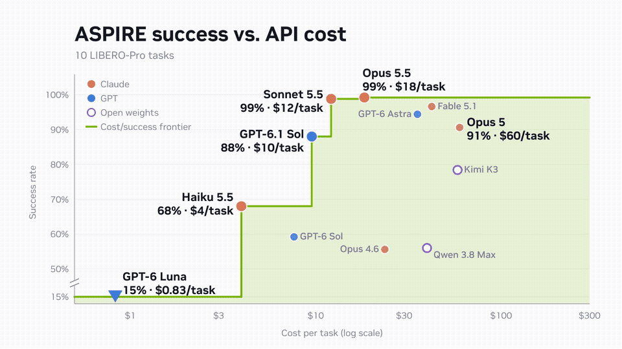
Background
VLMs are starting to solve benchmarks
GPT-6 Astra (OpenAI, Sep. 2026): a step change in spatial reasoning, drives robots via code
ASPIRE (NVIDIA GEAR): an agent discovers skills as code; v1.0 hits 99% on 80 LIBERO-Pro tasks
Stronger base models give higher success (GPT-6 Luna 15%, Claude Opus 5.5 99%)
GPT-6 Astra plans Dual-ALOHA spatial-constraint puzzles (Awesome-Astra-Embodied-AI, case 34, Q. Wang)
ASPIRE success vs. API cost on 10 LIBERO-Pro tasks (NVlabs/ASPIRE README, Oct. 2026)
Notes:
[E] First, some background. GPT-6 Astra, released by OpenAI in September 2026, has been described as a step change in spatial reasoning. Using it to write code that drives a robot directly has become common, and the left figure shows a case where it planned and solved a bimanual spatial-constraint puzzle. On the right is ASPIRE from NVIDIA GEAR. A coding agent writes robot skills as code, inspects failures, revises the code, and grows a library of reusable skills. Version 1.0, released in October, reaches 99% success on the 80 LIBERO-Pro tasks. The right figure shows success on 10 tasks: the stronger the base model, the higher the success, from 15% with GPT-6 Luna to 99% with Claude Opus 5.5. Simulation benchmarks are starting to be solved by VLM-centric methods.

Slide 3
Background
how to use VLMs in robot learning
As a policy, VLMs are still weak at precise and bimanual manipulation (RoboDojo 22.5%)
Instead: keep a pretrained policy and use the VLM around it
Today: one paper each from Real2Sim, failure detection, and steering
VLM (spatial understanding, reasoning, code generation)
① Real2Sim
SimFoundry
Build a sim from a video; use it for evaluation and training data
② Failure detection
Code-as-Monitor
Detect and prevent failures during execution with monitor code
③ Inference-time steering
VLS
Steer the policy's action generation with reward functions
Pretrained policy (π0.5 / Diffusion Policy / GR00T …)
Notes:
[E] So how should we use these capabilities in robot learning? There are evaluations that use the VLM directly as a policy, but they report 22.5% on RoboDojo and 11.1% on LIBERO-GeoMotion with geometric constraints, and precise, contact-rich and bimanual manipulation remains weak. There is a gap between semantic reasoning and physical execution. This motivates combining the VLM with a pretrained policy such as a VLA or a diffusion policy, and using the VLM's spatial understanding, reasoning and code generation around the policy. Today I split this into three areas. The first is Real2Sim, which uses the VLM's spatial understanding to copy a real scene into simulation for evaluation and training data. The second is failure detection, where VLM-written monitor code detects and prevents failures during execution. The third is inference-time steering, where VLM-written reward functions steer the action generation of a pretrained policy. I will present one paper for each, in this order.

Slide 4
Papers
Three Ways to Use VLMs in Robot Learning
SimFoundry: Modular and Automated Scene Generation for Policy Learning and Evaluation
N. Ranawaka, J. Wong et al., “SimFoundry: Modular and automated scene generation for policy learning and evaluation,” 2026. [Online]. Available: https://arxiv.org/abs/2606.28276
Code-as-Monitor: Constraint-aware Visual Programming for Reactive and Proactive Robotic Failure Detection
E. Zhou, Q. Su, C. Chi et al., “Code-as-Monitor: Constraint-aware visual programming for reactive and proactive robotic failure detection,” 2024. [Online]. Available: https://arxiv.org/abs/2412.04455
VLS: Steering Pretrained Robot Policies via Vision–Language Models
S. Liu et al., “VLS: Steering pretrained robot policies via vision–language models,” 2026. [Online]. Available: https://arxiv.org/abs/2602.03973
Notes:
[E] These are the three papers. The first is SimFoundry from NVIDIA, Stanford and Georgia Tech, which turns a single real-world video into a simulation environment for policy evaluation and training. The second is Code-as-Monitor from Beihang University, Peking University, BAAI and Galbot, published at CVPR 2025, which detects and prevents robot failures in real time with VLM-generated code. The third is VLS from the University of Washington and AI2, which steers a frozen generative policy at inference time with VLM-written rewards. I will go through them in the order Real2Sim, failure detection, steering.

Slide 5
Papers
Three Ways to Use VLMs in Robot Learning
SimFoundry: Modular and Automated Scene Generation for Policy Learning and Evaluation
N. Ranawaka, J. Wong et al., “SimFoundry: Modular and automated scene generation for policy learning and evaluation,” 2026. [Online]. Available: https://arxiv.org/abs/2606.28276
Code-as-Monitor: Constraint-aware Visual Programming for Reactive and Proactive Robotic Failure Detection
E. Zhou, Q. Su, C. Chi et al., “Code-as-Monitor: Constraint-aware visual programming for reactive and proactive robotic failure detection,” 2024. [Online]. Available: https://arxiv.org/abs/2412.04455
VLS: Steering Pretrained Robot Policies via Vision–Language Models
S. Liu et al., “VLS: Steering pretrained robot policies via vision–language models,” 2026. [Online]. Available: https://arxiv.org/abs/2602.03973
Notes:
[E] Let's start with SimFoundry. In one sentence, it is a modular system that automatically builds a simulation environment usable for both evaluation and training from a single real-world video. Three things to remember: it reconstructs a real scene in simulation, it generates many affordance-preserving variants of that reconstruction, and the result serves both sim evaluation of real-world policies and sim-to-real transfer of policies trained in simulation.

Slide 6
1. SimFoundry
Where it sits in this talk: Real2Sim
Input: one real-world video, plus the policy you want to evaluate or train
The VLM's job: detect objects, estimate mass and friction, propose new layouts and tasks
The policy is what gets evaluated or trained inside the sim; the VLM builds the sim
VLM (spatial understanding, reasoning, code generation)
Input
One real-world video + the policy to evaluate or train
① Real2Sim
SimFoundry
② Failure detection
Code-as-Monitor
③ Steering
VLS
VLM writes
Object labels, mass and friction, proposals for new layouts and tasks
Used by
The simulator (scene construction and automatic demo generation)
Pretrained policy
Policy
Evaluated inside the sim / trained on sim data
Notes:
[E] Let me place SimFoundry in the framework from the introduction. Of the three areas, this is Real2Sim. The input is a single real-world video plus the policy you want to evaluate or train. The job of the VLM and the vision foundation models is to find the objects in the video, turn them into 3D, estimate mass and friction, and propose alternative layouts and tasks. In other words, the VLM does not drive the policy; it builds the arena in which the policy is tested. The policy is what gets evaluated in the sim, or trained on sim data. Unlike the next two papers, the VLM is not involved at execution time, so there is no latency issue.

Slide 7
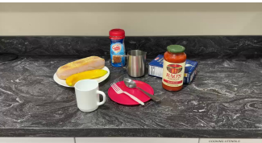
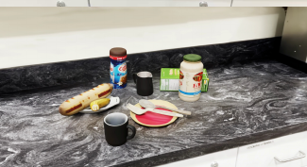

1. SimFoundry
What is new: automatic variants, not just a copy
Most real-to-sim work stops at one copy of the scene (digital twin)
SimFoundry adds object, layout and task variants (digital cousins) automatically
One scene gives a faithful sim for evaluation and diverse sims for training
Real scene (video)
Copy (digital twin)
Variants (digital cousins)
Input. A kitchen example
Faithful → usable for evaluation; training data for one scene only
Unlimited variants of objects, layouts, tasks → training data
Prior real-to-sim stops here
What SimFoundry adds
Images from Fig. 3 in Ranawaka et al., 2026
Notes:
[E] Here is what is new, on one slide. Building simulations from the real world is not new, but most prior work stops at one faithful copy of the scene, the digital twin. A twin is faithful, so it suits evaluation, but it gives training data for one scene only. SimFoundry starts from the twin and asks a VLM to propose versions with different object shapes, different layouts and different tasks, and builds them automatically. These are the digital cousins. As a result, one real scene yields both a faithful sim for evaluation and diverse sims for training. In the paper's Table 1, SimFoundry is the only system that covers evaluation, training and diversification together.

Slide 8
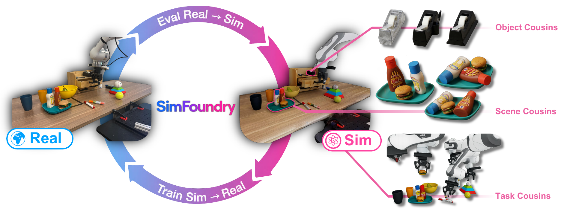
1. SimFoundry
Overview: from a reconstructed scene to variants
Input: one video. Output: a scene in a physics sim (digital twin)
From the twin, generate unlimited variants (digital cousins)
Uses: sim evaluation of real policies, and sim-to-real training
Fig. 1 in Ranawaka et al., 2026
Notes:
[E] Here is the overview. The input is a single video of a real scene and the output is an interactive scene in a physics simulator, which the paper calls a digital twin. From the twin, SimFoundry generates an unlimited number of variants that preserve the task-relevant affordances, called digital cousins, along three axes: objects, layouts and tasks. The resulting environments serve both purposes shown by the arrows: evaluating real-world policies in simulation, and training policies in simulation that transfer to the real robot.

Slide 9


1. SimFoundry
Reconstruction examples (video)
Left: a dining room. Right: a toy table. Both from a single video
Each object mesh is generated from one image crop, fully automatically
About 5 minutes per object, no manual annotation
Dining room: real → reconstructed
Toy table: real → reconstructed
▶ First half real, second half sim. Bottle shape and spatula pose match
▶ Small items (cookie, carrot) become individual meshes
Videos from github.com/NVlabs/SimFoundry (docs/gallery)
Notes:
[E] Let's look at reconstruction examples. On the left is a dining room and on the right a table with toys, both reconstructed from a single real video. The first half shows the real scene and the second half the reconstruction in simulation. Each object's 3D mesh is generated automatically from a single image crop, and you can see that the shapes and the layout match the real scene. No manual annotation is needed and it takes about five minutes per object. These reconstructed scenes are what we later use for evaluation and for generating training data.

Slide 10
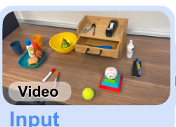
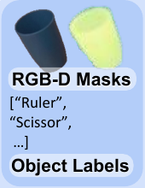
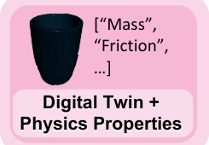
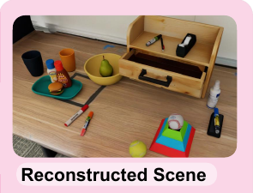
1. SimFoundry
Method 1: four steps from video to scene
① Pick one frame from the video, estimate depth, build a point cloud
② A VLM names the objects; SAM cuts them out one by one
③ Generate a 3D mesh from each crop; ask the VLM for mass and friction
④ Place everything in a physics sim and resolve penetrations
① Frame → point cloud
② Cut out objects one by one
③ 3D mesh + properties
④ Place in the physics sim
Depth gives the table and object positions
VLM names them, SAM 3 cuts them out
Mesh from one crop; mass and friction from the VLM
Resolve penetrations, stabilize, export
Images from Fig. 2 in Ranawaka et al., 2026
Notes:
[E] Let me break the reconstruction into four steps. First, pick a representative frame from the video and estimate depth to get a point cloud; this gives the table plane and where things are. Second, ask a VLM what is in the image, and cut the objects out one at a time with SAM 3; each cut-out object is inpainted away so the remaining ones can be found in turn. Third, from each single crop, a 2D-to-3D generative model produces a mesh, which is aligned to the point cloud; drawers and doors get joints from a separate module, and the VLM answers mass and friction from common sense. Fourth, everything is placed in a physics simulator, penetrations are resolved, and the scene is exported to IsaacLab and others. Each step just calls an off-the-shelf foundation model, so better models can be swapped in.

Slide 11
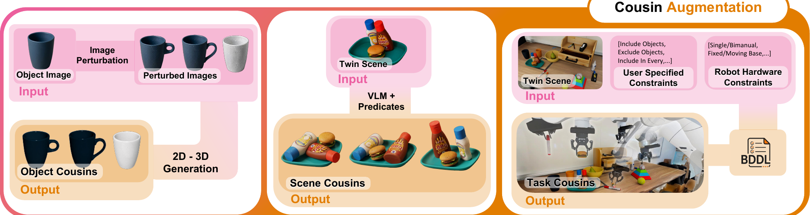
1. SimFoundry
Method 2: three kinds of variants
Object variants: perturb the crop, regenerate the mesh (a different mug)
Layout variants: the VLM rewrites relations such as "on top of"
Task variants: the VLM proposes other tasks; demos are generated
Fig. 2 (bottom) in Ranawaka et al., 2026
Notes:
[E] Now the variants. Object cousins perturb the cropped image with an image model and regenerate the 3D mesh, giving a mug with a different shape, handle or texture but the same function. Scene cousins have the VLM rewrite relations between objects such as on-top-of or right-of, producing meaningful new layouts rather than position noise; distractors can be added too. Task cousins have the VLM propose other tasks that are feasible on this table, convert them to goal specifications, and generate demonstrations with existing data-generation methods. Together these turn one real scene into a large training set that is diverse in objects, layouts and tasks.

Slide 12
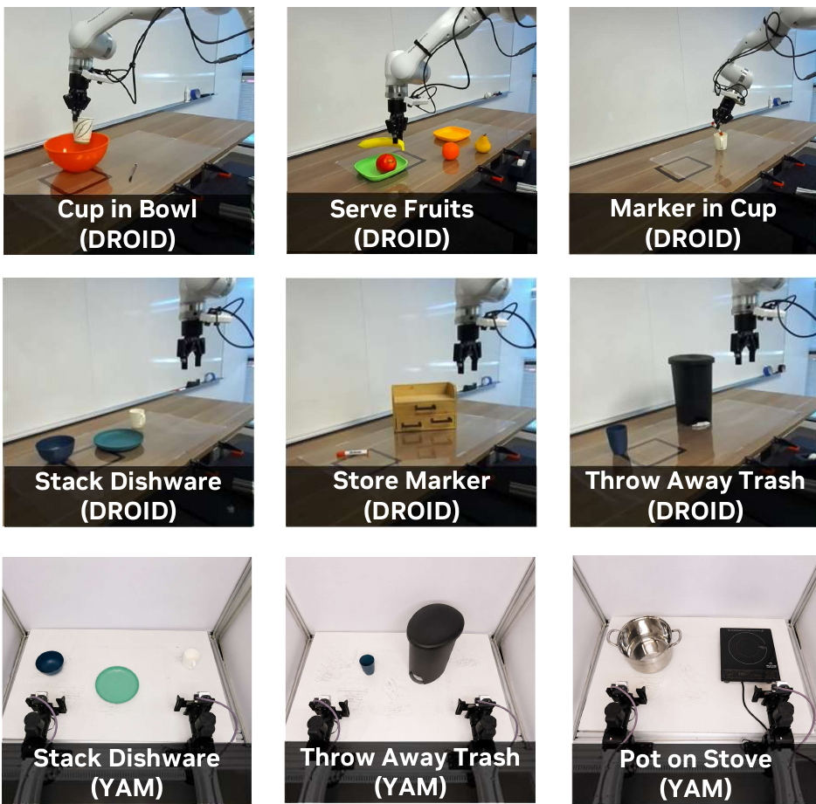
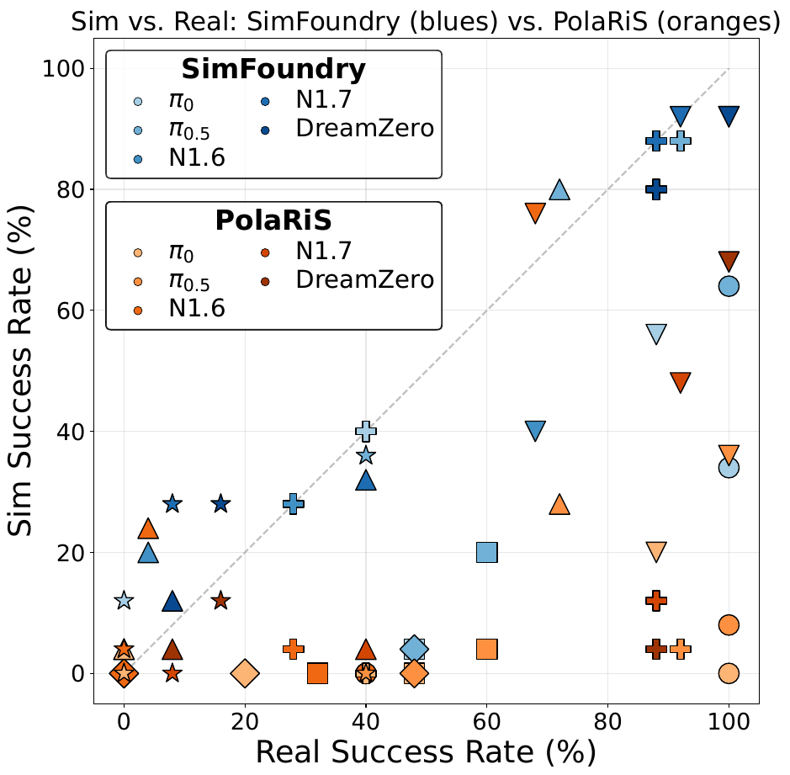
1. SimFoundry
Result 1: sim evaluation predicts real performance
7 tasks × 5 policies, evaluated in sim and on the real robots
Mean Pearson r = 0.911, MMRV = 0.018 (almost no rank flips)
r is 0.59 above PolaRiS, with no fine-tuning of the policies
Sub-task evaluation
r 0.90 → 0.95
Shows the weak stage of long tasks
Reveals model strengths
GR00T N1.7: precise grasping
π0.5: language following
Fig. 4 in Ranawaka et al., 2026
Notes:
[E] The first result is real-to-sim evaluation. Seven tasks on two real setups, a single-arm Franka in the DROID setup and a bimanual YAM, with five policies: π0, π0.5, GR00T N1.6, N1.7 and DreamZero, evaluated both in simulation and on the real robots. In the scatter plot, SimFoundry's blue markers lie close to the diagonal, with a mean Pearson correlation of 0.911 and a mean maximum rank violation of 0.018. The orange markers of the baseline PolaRiS are scattered, and the correlation gap is more than 0.59. Moreover, PolaRiS lightly fine-tunes the policies on its simulation data, while SimFoundry evaluates the policies zero-shot. Evaluating at the sub-task level raises the correlation from 0.90 to 0.95 and tells you which stage of a task is weak.

Slide 13
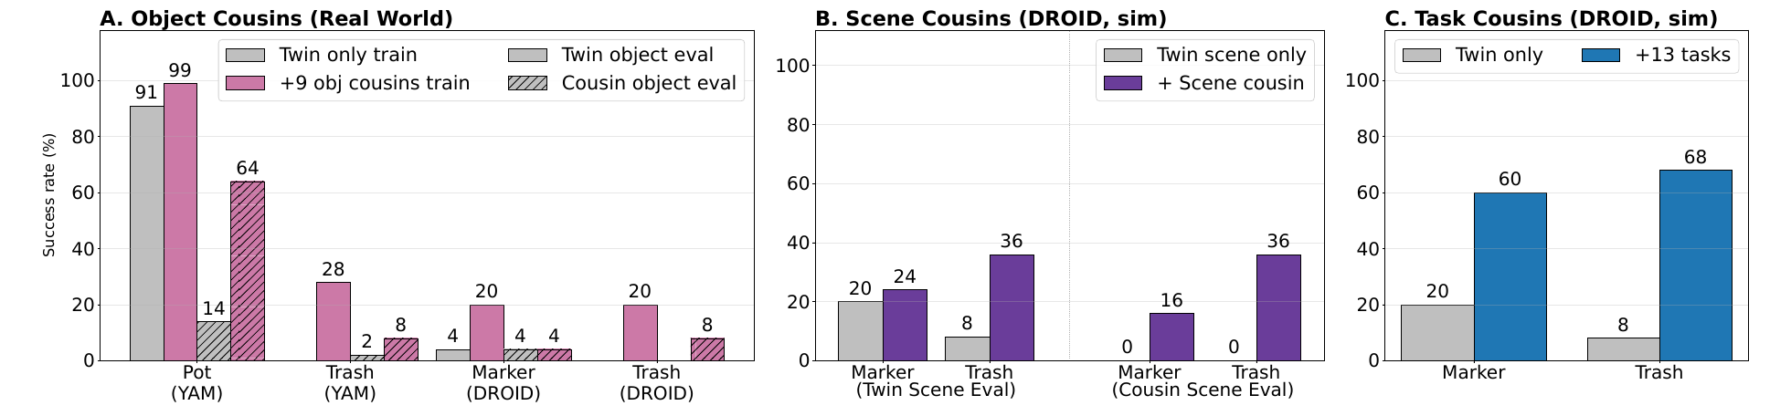
1. SimFoundry
Result 2: sim-to-real transfer and variants
Sim-only training reaches 99-100% zero-shot on the real robots
Object / scene / task cousins raise real success by +17 / +21 / +40%
Reconstruction fidelity: F1 0.81-0.92, about 5 min per object; tabletop scenes only
Fig. 5 in Ranawaka et al., 2026 A: object cousins help on unseen objects B: scene cousins help on new layouts C: related-task demos lift the target task
Notes:
[E] The second result is sim-to-real training. Policies trained only on SimFoundry data transfer zero-shot to the real robots, reaching 99% on Pot on Stove with YAM and 100% on Stack Dishware with DROID. On YAM this is a flow-matching policy trained from scratch; on DROID the π0.5 DROID checkpoint is fine-tuned on sim demonstrations. The figure shows the effect of the variants. In panel A, object cousins improve robustness to unseen objects, a 50-point gain on unseen Pot on Stove objects. In panel B, scene cousins improve layout generalization: 16% on cousin layouts where the twin-only policy gets 0%, and up to 28 points even on the twin layout. In panel C, with the total number of demos fixed, replacing some target-task demos with related-task demos actually raises success on the target task, by 60 points on Throw Away Trash. Fine-tuning π0.5 on multi-task data from 13 tasks gives 29% on held-out tasks and up to 18% improvement in the real world. A word on reconstruction quality: on a geometric evaluation over 12 scenes the fully automatic pipeline reaches F1 of 0.81 to 0.92, above SAM3D's 0.66 to 0.71, at about five minutes per object, and three minutes of manual tuning raises F1 to 0.93 to 0.99. The limitations are the tabletop assumption and inheriting the failures of each foundation model.

Slide 14
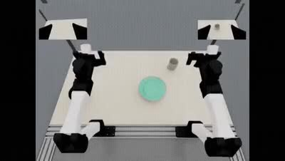
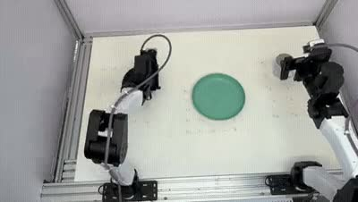
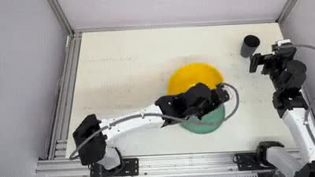
1. SimFoundry
Real-robot demo (video): sim-trained policies
Left: bimanual policy trained in sim (YAM). Middle: same policy, real robot
Right: objects never seen in training, thanks to object cousins
Pot on Stove reaches 99% on the real robot
Trained in sim (YAM, bimanual)
Same policy on the real robot
Unseen objects
▶ Carrying the pot to the stove inside the twin
▶ The same motion on the real robot, no fine-tuning
▶ Grasps a yellow bowl never seen in training
Videos from github.com/NVlabs/SimFoundry (docs/gallery): YAM simulated / real / unseen-object evaluation
Notes:
[E] Here are policies trained in simulation running on the real robot. On the left is the bimanual YAM policy trained inside simulation, and in the middle the same policy executed on the real robot without any fine-tuning. On the right it runs on objects that were not in the training set, which is where object cousins in the training data pay off. On the Pot on Stove task the real-world success rate was 99%.

Slide 15
Papers
Three Ways to Use VLMs in Robot Learning
SimFoundry: Modular and Automated Scene Generation for Policy Learning and Evaluation
N. Ranawaka, J. Wong et al., “SimFoundry: Modular and automated scene generation for policy learning and evaluation,” 2026. [Online]. Available: https://arxiv.org/abs/2606.28276
Code-as-Monitor: Constraint-aware Visual Programming for Reactive and Proactive Robotic Failure Detection
E. Zhou, Q. Su, C. Chi et al., “Code-as-Monitor: Constraint-aware visual programming for reactive and proactive robotic failure detection,” 2024. [Online]. Available: https://arxiv.org/abs/2412.04455
VLS: Steering Pretrained Robot Policies via Vision–Language Models
S. Liu et al., “VLS: Steering pretrained robot policies via vision–language models,” 2026. [Online]. Available: https://arxiv.org/abs/2602.03973
Notes:
[E] The second paper is Code-as-Monitor, from CVPR 2025. In one sentence, it unifies reactive failure detection and proactive failure prevention as checking whether constraints are satisfied, and monitors them in real time with VLM-generated code. Three things to remember: unifying reactive and proactive detection, constraint elements that abstract objects into points, lines and surfaces, and calling the VLM only once per subgoal.

Slide 16
2. Code-as-Monitor
Where it sits in this talk: failure detection
Input: task instruction, camera images, and the running (open-loop) policy
The VLM's job: write the conditions to keep, then code that checks them
The policy runs as is; the code watches and stops it to re-plan on a violation
VLM (spatial understanding, reasoning, code generation)
Input
Task instruction + multi-view images + the running policy (open-loop is fine)
① Real2Sim
SimFoundry
② Failure detection
Code-as-Monitor
③ Steering
VLS
VLM writes
The conditions to keep, and code that checks them
Used by
A monitor running alongside (tracks points, runs the code every frame)
Pretrained policy
Policy
Runs unchanged; stopped and re-planned on a violation
Notes:
[E] Here is where Code-as-Monitor sits: failure detection. The input is the task instruction, camera images and the running policy, which may be open-loop. The VLM's job is to write the conditions that must hold, and then to write code that checks them. The policy itself runs unchanged while the code watches alongside it; when a condition is violated the policy is stopped immediately and the reason is returned for re-planning. So the VLM never touches the policy; it places a monitor outside it.

Slide 17
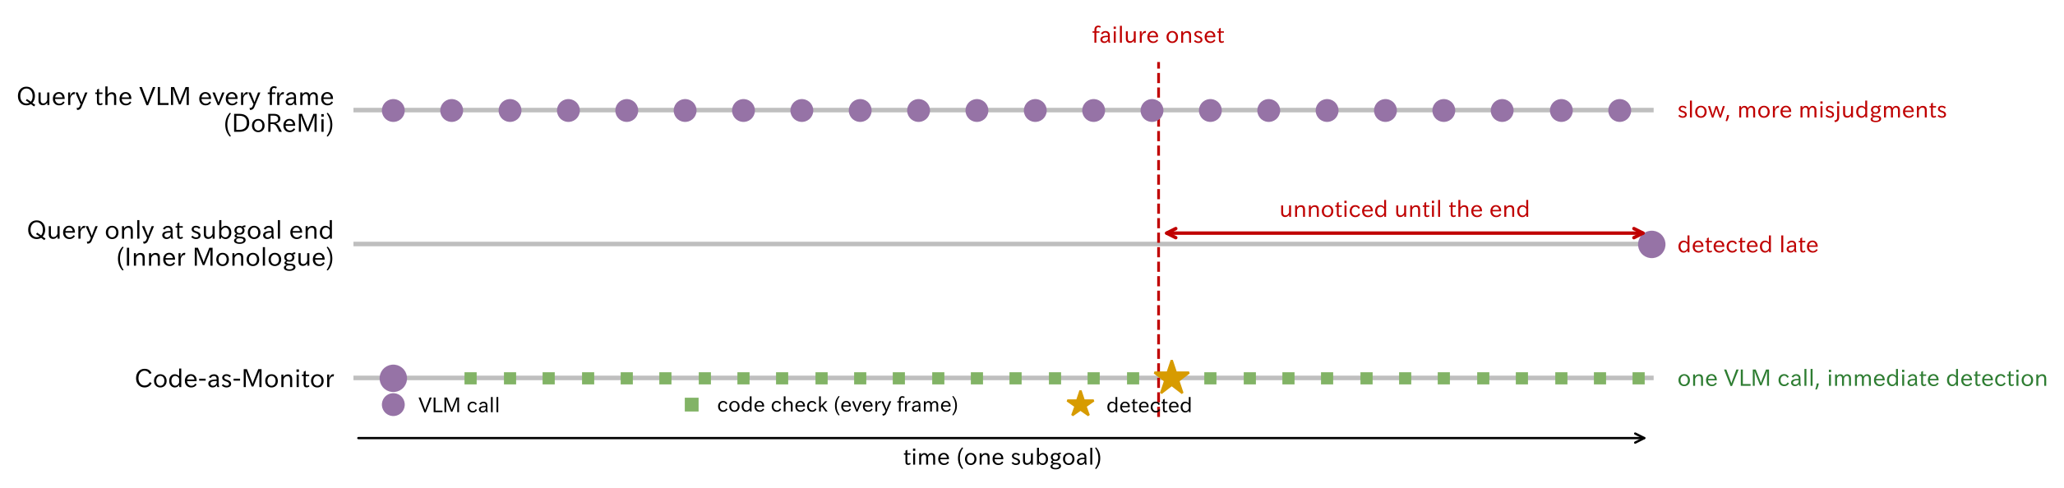
2. Code-as-Monitor
What is new: let code do the watching
Prior work asks the VLM "did it fail?" with images: slow, weak in 3D
Here the VLM writes checking code once; the code then checks every frame
Early signs (a tilting pan) show up as numbers, so failures are stopped early
Schematic by the presenter. Inner Monologue and DoReMi are the baselines in the paper
Notes:
[E] Here is what is new. Prior failure detection asks a VLM, with images, whether the task has failed. Asking every frame, as in the top row, is slow, and 3D relations are hard to read from a single image, so misjudgments increase. Asking only when a subgoal completes, as in the middle row, misses the early signs until the end. This method, in the bottom row, has the VLM write checking code once at the start of a subgoal, after which the code checks the coordinates of tracked points every frame. Because the code judges with numbers, it also catches early signs such as the pan starting to tilt, and stops the policy before the failure happens. With a single VLM call it is fast and less exposed to hallucination.

Slide 18
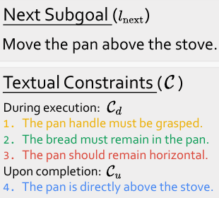
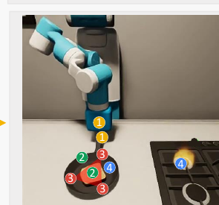
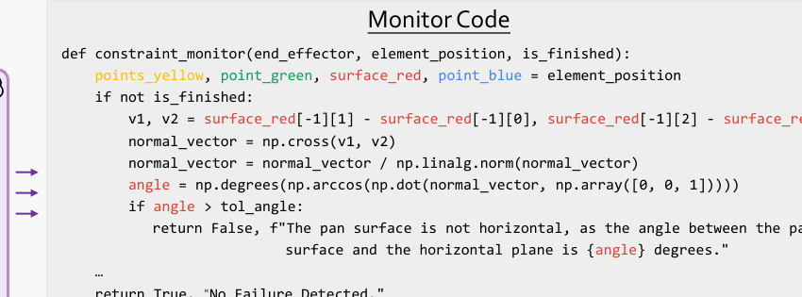
2. Code-as-Monitor
Method 1: three steps on "carry the pan"
① The VLM writes the conditions: "the pan stays level", "the bread stays in the pan"
② Relevant parts become points, lines, surfaces on the image: the pan surface is 3 red points
③ The VLM writes code over those points: tilt over 15° returns "failure"
① Write the conditions
② Draw as points, lines, surfaces
③ Write checking code over the points
During: pan level, bread in pan. Done: pan above the stove
Pan surface = 3 red points, bread = green, stove = blue; numbered on the image
Normal from the 3 points; if the angle to vertical exceeds 15°, return "not level"
Images from Fig. 2 in Zhou et al., 2025
Notes:
[E] Let me break the method into three steps using the example of carrying a pan with bread to the stove. First, from the instruction and the images, the VLM writes the next subgoal and the conditions to keep, in words. During execution: keep grasping the handle, the bread stays in the pan, the pan stays level. Upon completion: the pan is directly above the stove. Second, the parts relevant to each condition are abstracted into points, lines and surfaces and drawn on the image: three red points on the rim for the pan surface, a green point for the bread, a blue point for the stove. Third, shown these annotated images, the VLM writes checking code over the point coordinates. In the example it computes the surface normal from the three points and, if the angle to vertical exceeds 15 degrees, returns a failure with the reason "the pan is not level". After that the code simply runs every frame on the tracked points.

Slide 19
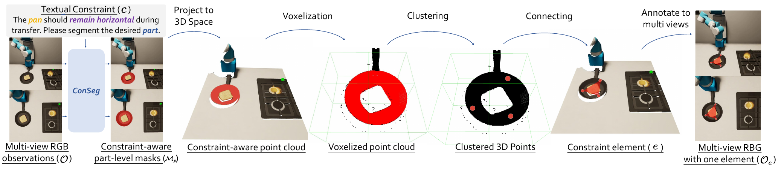
2. Code-as-Monitor
Method 2: why points, lines and surfaces
Objects and parts become points, lines, surfaces: easy to track
ConSeg (LISA + LoRA) segments the relevant part from the constraint text
Training data: BridgeData V2 auto-annotated by GPT-4o (10,181 traj.)
ConSeg:
Fig. 3, Eq. (2) in Zhou et al., 2025
Notes:
[E] The other core idea is the constraint element. Objects or parts relevant to a constraint are abstracted into compact geometric elements such as points, lines and surfaces. For "the pan should remain horizontal", the pan surface becomes three points and the code just computes the angle between its normal and the z axis. Irrelevant details such as texture are discarded, which makes tracking easy and generalizes to unseen objects and scenes. The pipeline segments instance and part masks from the constraint text, projects them to a 3D point cloud using depth, voxelizes and clusters them according to the element type, and connects the points into elements, which are then annotated onto the multi-view images with numbers. The segmentation model is called ConSeg. It is built on LISA, keeping the LLaVA and SAM encoder and decoder frozen and training LoRA parameters, and outputs the mask and element type directly from the constraint text. The training data comes from BridgeData V2: GPT-4o generates subgoals, constraints and object-part associations, Grounded SAM and Semantic SAM produce the masks, and the result is manually checked, giving 10,181 trajectories and 219,356 images.

Slide 20
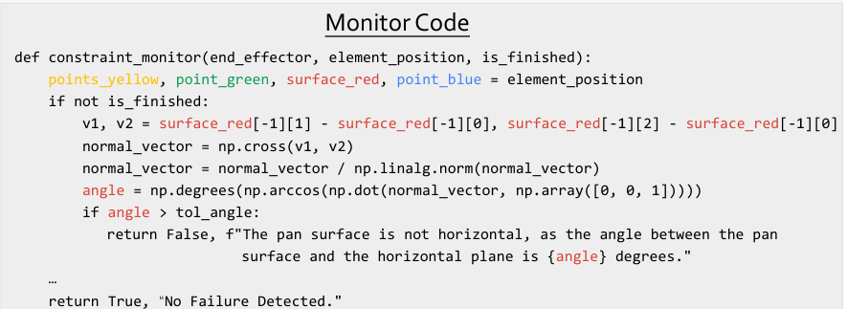
2. Code-as-Monitor
Method 3: inside the monitor code
Input: 3D element positions and history. Output: (bool, reason)
Thresholds from a knowledge base or the VLM; every branch is tested
On a violation: stop the policy, return the reason, re-plan
Call the VLM once at the start of a subgoal
Track the elements (CoTracker)
Evaluate the code every frame
On False: stop, return the reason, re-plan
Monitor code example from Fig. 2 in Zhou et al., 2025
Notes:
[E] Here is the monitor code in practice. GPT-4o receives the annotated multi-view images, the next subgoal and the constraints, and writes a function that takes the 3D positions of the elements. The code computes angles and distances with NumPy and returns a boolean indicating failure plus a string explaining why. In the example, if the angle between the pan surface normal and the z axis exceeds 15 degrees, it returns "the pan surface is not horizontal". Because the history of positions is also an input, precise conditions such as "move 2 cm" or "rotate 180 degrees" can be monitored, which VQA-style methods cannot do. Thresholds come from a knowledge base for common tasks and from the VLM's knowledge for unseen ones. Right after generation, the code is run on the current state so that every if-else branch is exercised, and it is regenerated on any error. During execution the elements are tracked and the code evaluated; when it returns False the policy stops immediately and the reason goes back to the VLM for re-planning.

Slide 21
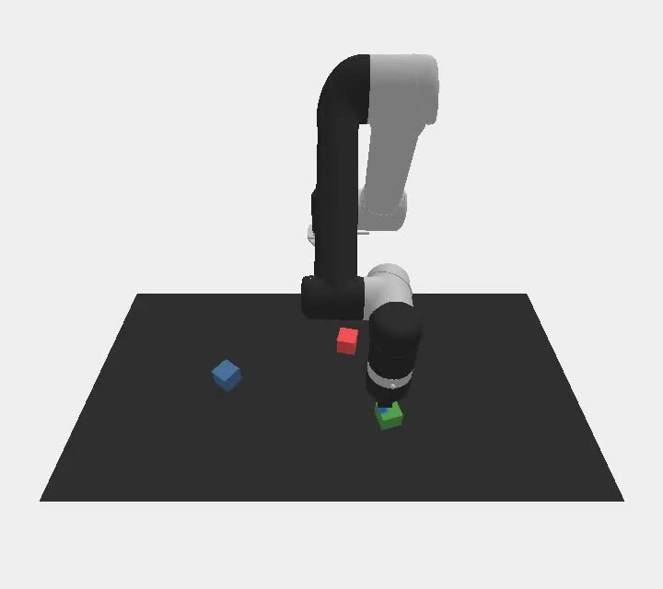
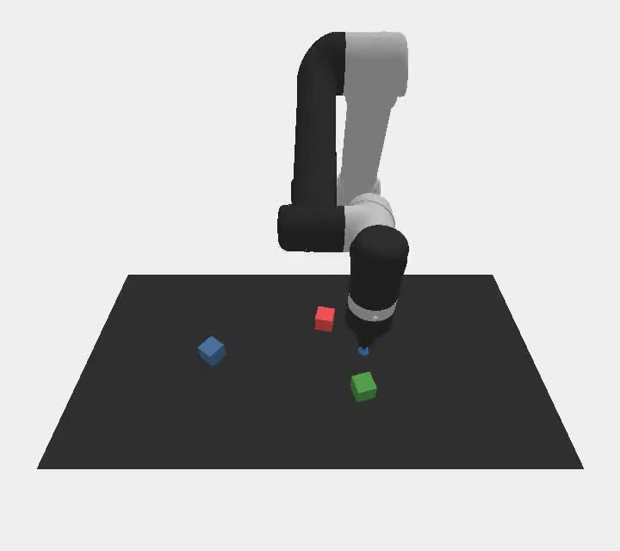
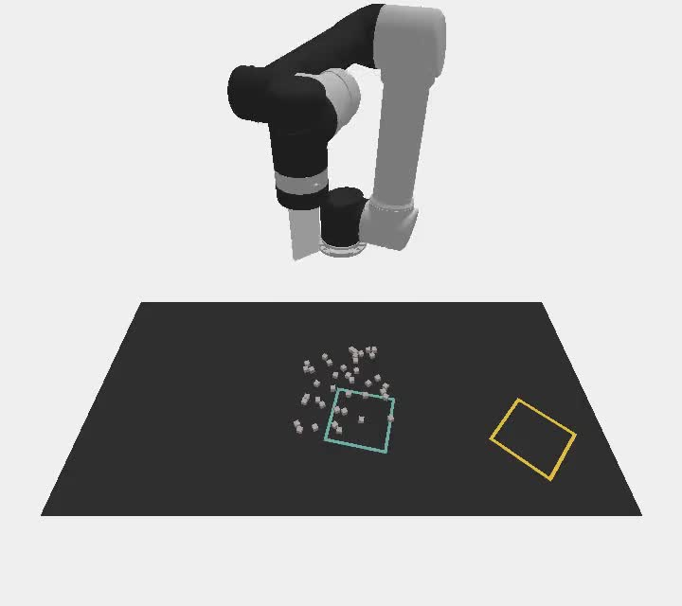
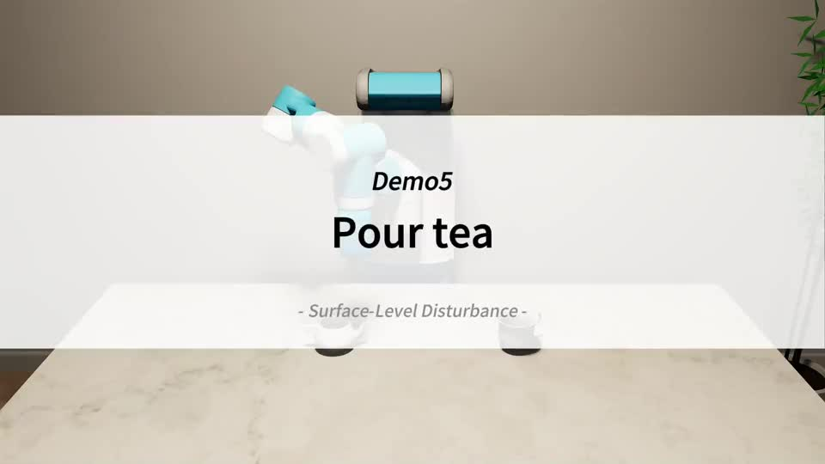
2. Code-as-Monitor
Sim demo (video): monitoring under disturbances
Left: stacking under placement noise. CaM restacks before collapse
Middle: DoReMi queries the VLM repeatedly and misjudges more often
Right: sweep half the blocks (count points), pour tea (surface tilt)
Stack in order: CaM
Stack in order: DoReMi
Sweep half the blocks
Pour tea (surface tilt)
▶ Block positions tracked as points; restacks after a shift
▶ Asks the VLM each time; misjudges a good stack and redoes it
▶ Counts points inside the region; stops at half
▶ Watches the teapot surface; stops over-tilting
Videos from zhoues.github.io/Code-as-Monitor (CLIPort / OmniGibson demos)
Notes:
[E] Let's watch the monitoring in simulation. On the left is block stacking in CLIPort with placement noise. Because the block positions are tracked as points, the method detects when the stack is about to collapse and restacks before moving on. In the middle is the baseline DoReMi, which keeps querying the VLM with images; 3D understanding from a single image is coarse, so misjudgments increase. On the right is the task of sweeping exactly half of the blocks, where counting the points inside the region lets the policy stop at the right moment. In OmniGibson's pour-tea task, the tilt of the teapot surface is monitored to catch a spill before it happens.

Slide 22
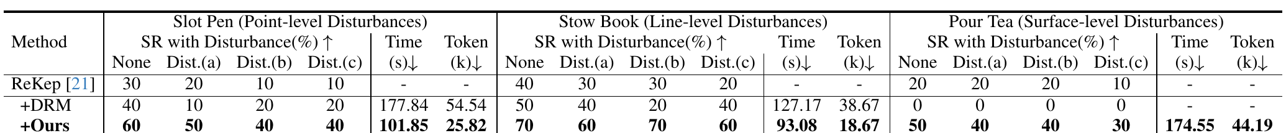
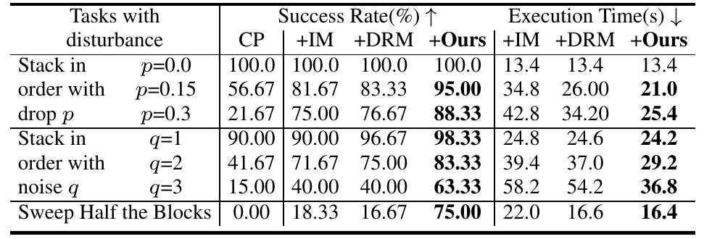
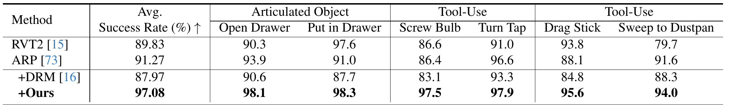
2. Code-as-Monitor
Result 1: simulation
CLIPort: 76.7% → 88.3% under disturbances; Sweep Half 16.7 → 75.0%
OmniGibson: only CaM catches surface tilt; time −35%, tokens −52%
RLBench: 91.3% → 97.1% on unseen articulated and tool-use tasks
Table 1, 2, 9 in Zhou et al., 2025 (DRM: DoReMi, IM: Inner Monologue)
Notes:
[E] Simulation results. Three simulators with different robots, end-effectors and policies, with disturbances injected to induce failures. In CLIPort block stacking under strong disturbances, a 0.3 drop probability and 3 cm placement noise, the baseline DoReMi reaches 76.7% while this method reaches 88.3%. DoReMi, which repeatedly asks the VLM, has coarse 3D understanding from single images and misjudges more. On sweeping half the blocks, counting element points raises success from 16.7% to 75%. In OmniGibson, with point-, line- and surface-level disturbances, only this method could detect the surface-level disturbance in pouring tea. Since code is generated once per subgoal, execution time drops by 34.8% and token usage by 52.2%. On RLBench, even on articulated-object and tool-use tasks absent from the training data, success rises from ARP's 91.3% to 97.1%, showing generalization.

Slide 23
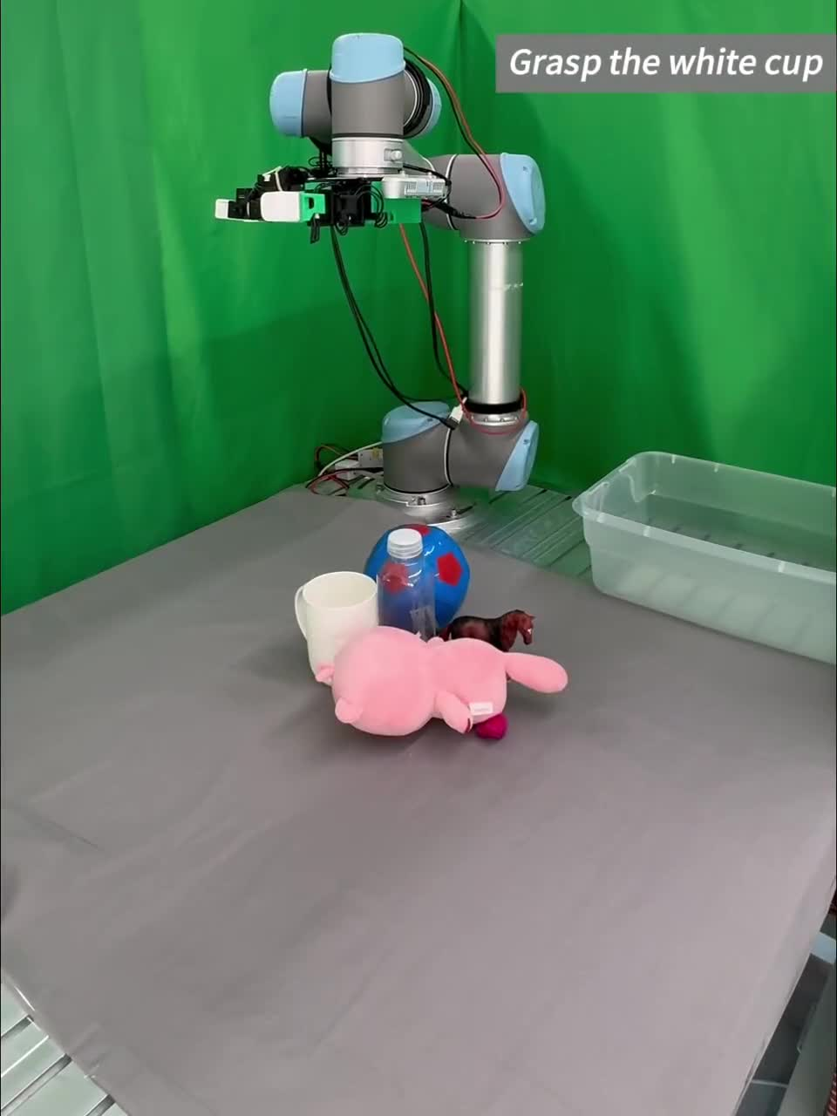
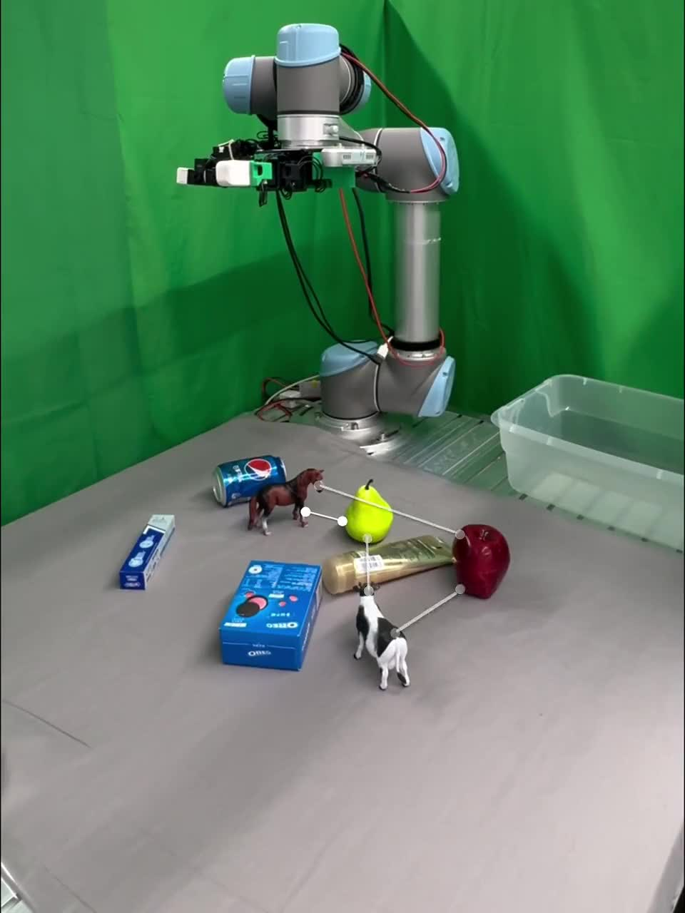
2. Code-as-Monitor
Real-robot demo (video): closing the loop
Left: "clear everything except the animals". Moved objects are retargeted
Right: "grasp animals nearest to the fruits first". Moving them reorders
The grasp model stays open-loop; the monitor code triggers re-planning
Clear all objects except animals (2x)
Grasp animals nearest to fruits first
▶ 0:01 a person moves the toy and cup → target updated from tracked points
0:18 the toy is pulled from the hand → detected, re-grasped
▶ 0:03 a person moves the horse → the cow is now nearest, target switches
0:14 the pear is moved → distances recomputed, back to the horse
Videos from zhoues.github.io/Code-as-Monitor (real-world demos, UR5 + Leap Hand), trimmed
Notes:
[E] Real-robot demos. The robot is a UR5 with a Leap Hand, and the grasp generation model DexGraspNet 2.0 is used as an open-loop policy. On the left, the task is to clear everything except the animals; when a person moves an object or takes it out of the hand, the tracked points update the target and execution continues. On the right, the task is to grasp the animals in order of distance to the fruits; when a person moves the horse or the pear, the distances are recomputed and the grasp order changes. In both cases the monitor code detects the failure or the change and triggers re-planning, so the open-loop policy behaves as a closed-loop system.

Slide 24
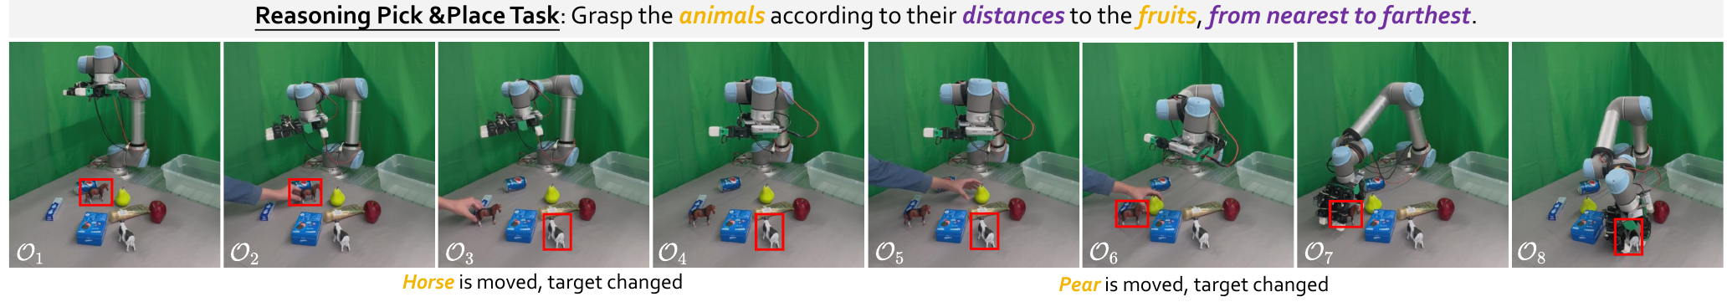
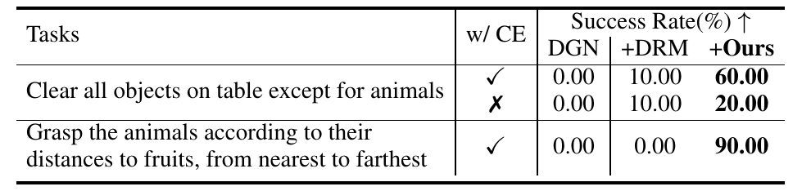
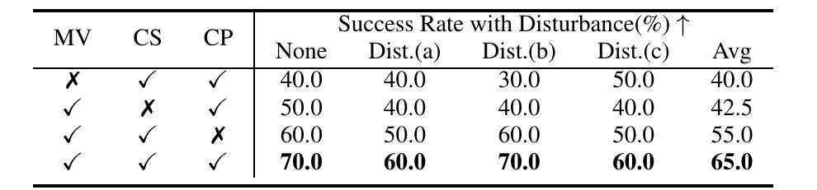
2. Code-as-Monitor
Result 2: real robot and ablation
CaM on an open-loop grasp policy: over 90% under disturbances
Long-horizon reasoning task: DoReMi 0% vs. CaM 90%
Ablation: multi-view, segmentation, point connection (65% → 40-55%)
Limits
VLM hallucination
force-related failures are hard to catch
Fig. 5, Table 4, Table 6 in Zhou et al., 2025
Notes:
[E] The real robot is a UR5 with a Leap Hand, and the policy is the open-loop grasp model DexGraspNet 2.0; the segmentation model is the base model without any simulator fine-tuning. Under disturbances, moving the object during grasping or removing it during transport, and across four object types including deformable and transparent ones, the method exceeds 90%, about 20 points above DoReMi, with shorter execution time. On the cluttered long-horizon task "grasp the animals from nearest to the fruits", moving the horse or the pear changes the order; the method monitors the distances and switches targets, reaching 90% where DoReMi gets 0%. The open-loop policy effectively becomes closed-loop. In the ablation, removing multi-view drops success from 65% to 40%, replacing constraint-aware segmentation with DINOv2 semantic points gives 42.5%, and removing point connection gives 55%, so each component matters; on the real robot, not forming elements drops success from 60% to 20%. Stated limitations are VLM hallucination, difficulty with force-related failures that involve no displacement, and no handling of other modalities such as sound or liquids.

Slide 25
Papers
Three Ways to Use VLMs in Robot Learning
SimFoundry: Modular and Automated Scene Generation for Policy Learning and Evaluation
N. Ranawaka, J. Wong et al., “SimFoundry: Modular and automated scene generation for policy learning and evaluation,” 2026. [Online]. Available: https://arxiv.org/abs/2606.28276
Code-as-Monitor: Constraint-aware Visual Programming for Reactive and Proactive Robotic Failure Detection
E. Zhou, Q. Su, C. Chi et al., “Code-as-Monitor: Constraint-aware visual programming for reactive and proactive robotic failure detection,” 2024. [Online]. Available: https://arxiv.org/abs/2412.04455
VLS: Steering Pretrained Robot Policies via Vision–Language Models
S. Liu et al., “VLS: Steering pretrained robot policies via vision–language models,” 2026. [Online]. Available: https://arxiv.org/abs/2602.03973
Notes:
[E] The third paper is VLS. In one sentence, it is a training-free framework that steers the sampling process of a frozen diffusion or flow-matching policy at inference time with differentiable rewards written by a VLM. Three things to remember: adding reward gradients to the generation process, having the VLM write the reward function as a program, and combining gradient-based refinement with reward-based candidate selection.

Slide 26
3. VLS
Where it sits in this talk: inference-time steering
Input: camera images and the instruction, plus a frozen diffusion / flow policy
The VLM's job: write, as code, a reward function that scores "good" actions
While the policy generates an action, reward gradients bend it; nothing is trained
VLM (spatial understanding, reasoning, code generation)
Input
RGB-D images + instruction + a frozen diffusion / flow policy
① Real2Sim
SimFoundry
② Failure detection
Code-as-Monitor
③ Steering
VLS
VLM writes
A reward function per stage (differentiable PyTorch code)
Used by
The policy's denoising loop (adds the reward gradient every step)
Pretrained policy
Policy
Weights unchanged; actions are bent gradually during generation
Notes:
[E] Here is where VLS sits: inference-time steering. The input is the camera images and the instruction, plus a frozen diffusion or flow-matching policy. The VLM's job is to write, as code, a reward function that scores how good an action is in the current situation. The policy builds its action gradually from noise, and during that process the reward gradient is added so the action bends toward higher reward. The policy weights are never changed and nothing is trained. Where Code-as-Monitor watches from outside the execution, VLS reaches inside the generation.

Slide 27
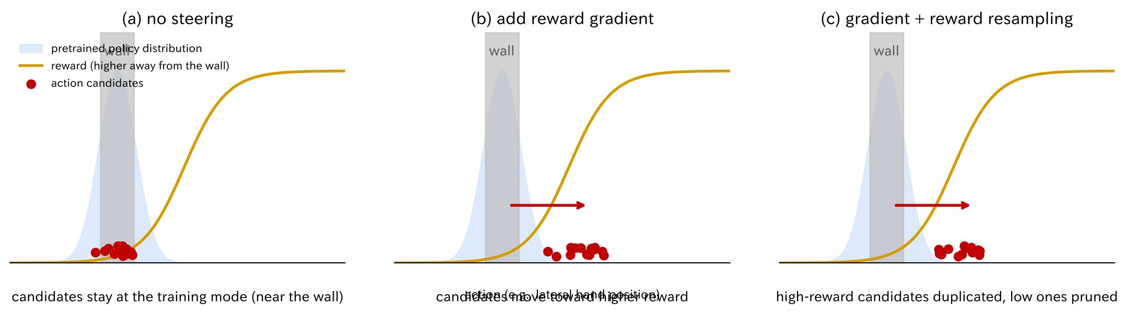
3. VLS
What is new: bend the generation, do not just pick
Prior work picks among candidates; if no candidate is good, nothing can be picked
Here the reward gradient moves the candidates themselves toward higher reward
Two stages: move by gradient, then select by reward; weights untouched
Schematic by the presenter, simplified to a one-dimensional action
Notes:
[E] Here is what is new, as a diagram. The horizontal axis is the action, say the lateral hand position; the blue hill is the pretrained policy's distribution, the orange curve is the VLM-written reward, and grey is the wall. In (a), without steering, candidates gather at the policy's hill, the actions that were common in training, and hit the wall. Most prior methods pick the best of these candidates with a VLM, a human or a value function, but if no candidate is good there is nothing to pick. In (b), this method adds the reward gradient to the candidates, so the candidates themselves move toward higher reward. In (c) it also duplicates high-reward candidates and prunes low ones. Move by gradient, then select by reward, with the policy weights untouched.

Slide 28
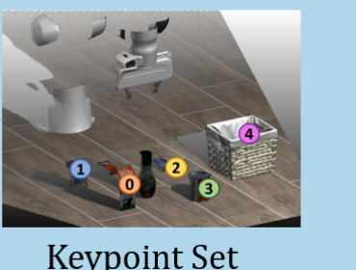
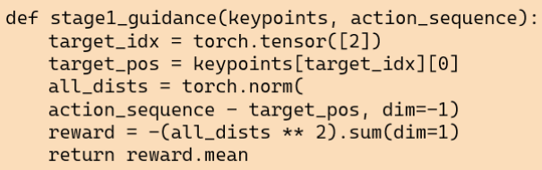
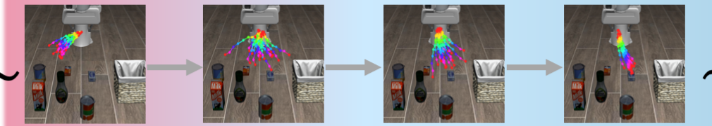
3. VLS
Method 1: three steps on "cheese in the basket"
① Extract numbered 3D points of the relevant objects: cheese, basket, others
② The VLM writes a reward: closer to the basket (point 2) scores higher
③ At every denoising step, add the reward gradient; the trajectory shifts to the basket
① Extract 3D keypoints
② VLM writes the reward as code
③ Add the gradient every step
VLM names objects; SAM + depth give numbered points (2 = basket)
Negative squared distance to point 2: closer is better, differentiable
While the action forms from noise, the trajectory shifts toward the basket
Images from Fig. 2 in Liu et al., 2026
Notes:
[E] Let me break the method into three steps on the example of putting the cheese in the basket. First, the VLM names the relevant objects, SAM cuts them out, and DINOv2 features plus depth turn them into numbered 3D points: the cheese, the basket and the surrounding objects each get a number. Second, the VLM writes a reward function in PyTorch using those numbers. In the figure it is the negative squared distance between the action trajectory and point 2, the basket, so closer is better. It is restricted to differentiable operations, so we can take the gradient with respect to the actions. Third, at every step where the policy builds its action from noise, this reward gradient is added. The trajectory shifts a little toward the basket each step and ends up reaching it. The VLM only writes the code; it plays no part in computing the gradient.

Slide 29
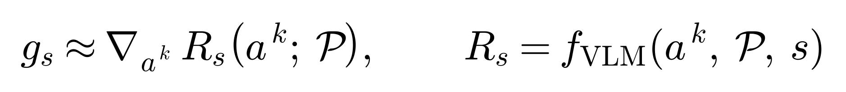
3. VLS
Method 2: how the gradient enters generation
Inject a gradient g into the frozen policy's denoising (classifier guidance)
Hard part: the new condition has spatial and semantic structure
Have the VLM write a differentiable surrogate score R as a program
Eq. (5), (6), (7) in Liu et al., 2026
Existing steering methods | Guidance signal | Issue
V-GPS / VGD | learned value / Q function | policy is pulled toward the critic's preferences
DynaGuide / Latent Policy Barrier | learned dynamics model | model error and rollout cost
ITPS / FOREWARN / Do-What-You-Say | selection of candidates by humans / VLMs | discrete, sparse signal; sample-inefficient
VLS (this paper) | differentiable reward written by a VLM | training-free, dense gradients; inference cost is the issue
Notes:
[E] The problem setting. The denoising process of the frozen base policy is steered by adding the gradient g of the log-likelihood of the new condition, in the form of classifier guidance known from image generation. For diffusion, the gradient scaled by a guidance strength lambda is added to the noise prediction; for flow matching, to the velocity field. The hard part is modeling g. A real-world condition is not a class label; it has spatial and semantic constraint structure, and the guidance must give dense, informative gradients with respect to the action trajectory. Existing steering methods use a learned value function, a learned dynamics model, or let humans or VLMs select among candidates, with respective issues: bias toward the critic's preferences, model error and cost, and discrete sparse signals. VLS instead has the VLM write the differentiable surrogate score R as a program, obtaining dense gradients without training.

Slide 30
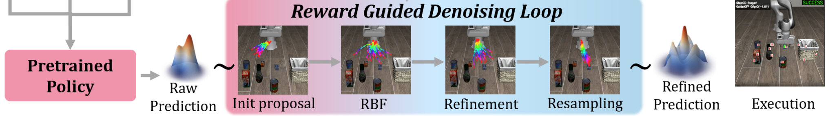
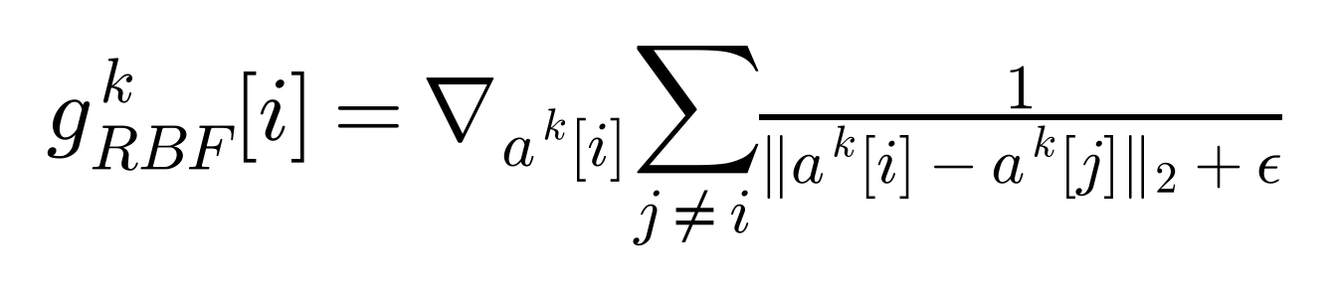
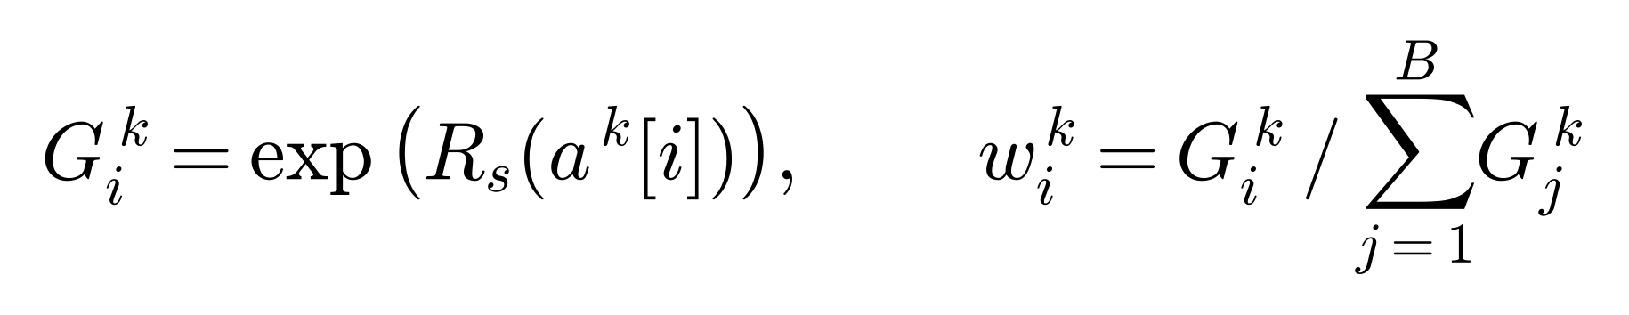
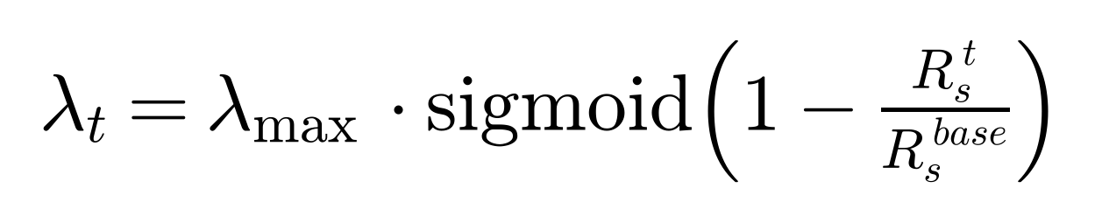
3. VLS
Method 3: loop details and closed-loop control
Repulsion keeps candidates diverse; reward gradients are applied repeatedly
Candidates are resampled by reward weights; high-reward ones are duplicated
Guidance strength λ adapts to the reward; stages switch with hysteresis
Repulsion between candidates (RBF)
Reward-weighted resampling (FK)
Adaptive guidance strength
Fig. 2 (bottom), Eq. (8)–(10) in Liu et al., 2026
Notes:
[E] Inside the denoising loop. A batch of B action candidates is initialized, and in the early steps a repulsive force between candidates is added as a gradient to prevent premature collapse to a narrow mode of the base policy. Then the reward gradient of stage s is injected to refine the candidates; for diffusion policies there are four inner updates per step, in the spirit of MCMC. In addition, a gradient-free selection step follows Feynman-Kac steering: the exponential of the reward becomes a particle weight, the candidates are resampled according to the weights, high-reward candidates are duplicated and constraint-violating ones are pruned. In the closed-loop control, the guidance strength lambda is adapted from the reward relative to the first chunk of the stage: strong when the deviation is large, weak near completion so the base policy dominates. Stage switching uses a Schmitt-trigger-style hysteresis with two thresholds that decide to advance, maintain or reinforce, avoiding oscillation and premature transitions. On a switch, the VLM interprets the outcome and selects the next reward function.

Slide 31
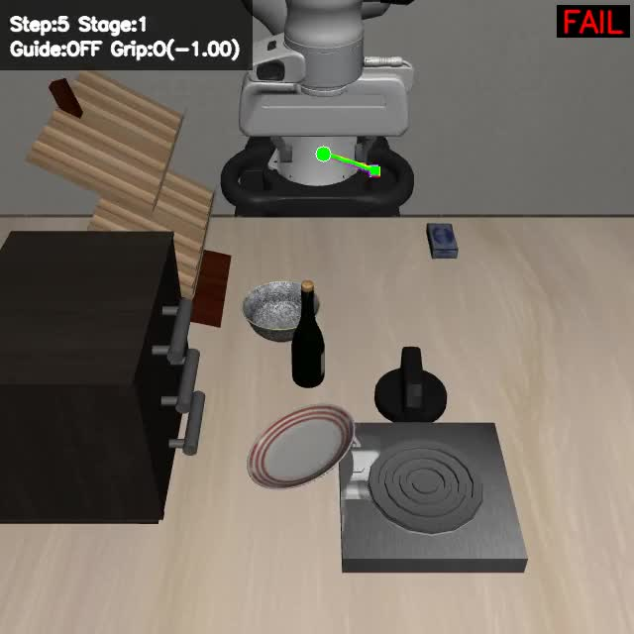
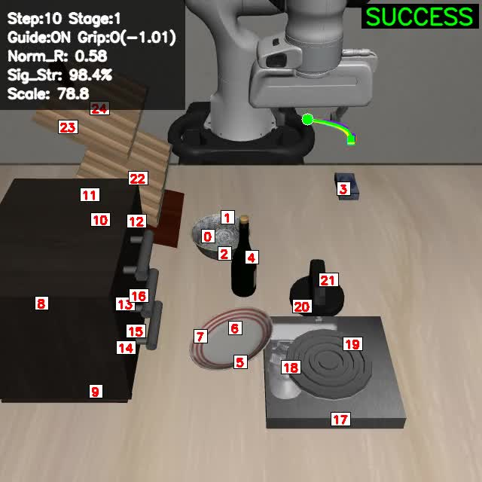
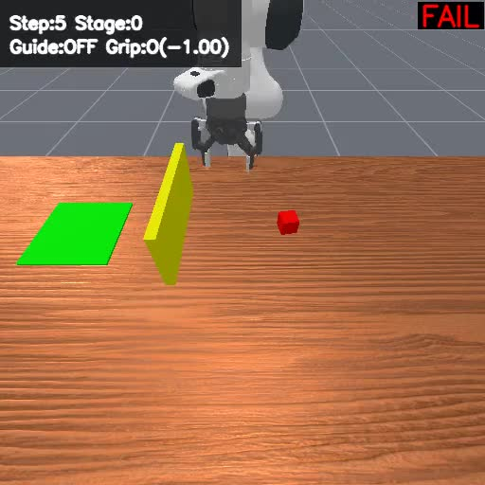
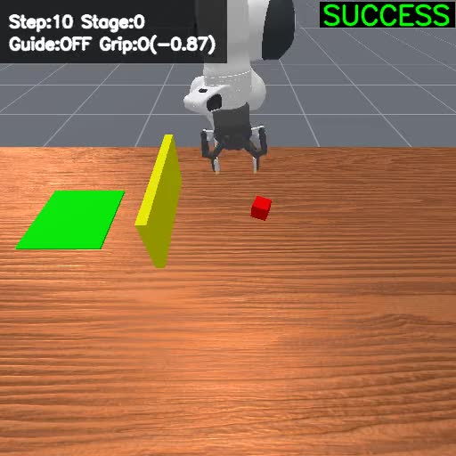
3. VLS
Sim demo (video): with and without steering
Left: LIBERO-PRO with moved objects. Frozen π0.5 fails; with VLS it succeeds
Right: "avoid the wall". An unseen instruction, satisfied via reward gradients
Numbered points: VLM-selected keypoints; rewards are distances to them
LIBERO-PRO: π0.5 (fail)
LIBERO-PRO: +VLS (success)
Avoid the wall: base (fail)
Avoid the wall: +VLS (success)
▶ Reaches for the training-time spot and misses
▶ Numbered points are the targets; corrected by reward
▶ Does not know "avoid the wall"; hits it
▶ Reward grows away from the wall → detours
Videos from vision-language-steering.github.io (LIBERO-PRO position perturbation, collision avoidance), trimmed
Notes:
[E] Here are videos of the same policy with and without steering. On the left is LIBERO-PRO with the object positions changed; the frozen π0.5 fails as is, but succeeds once VLS is added. The numbered points on screen are the keypoints chosen by the VLM, and the reward function is written in terms of distances to them. On the right the instruction is "put the red cube on the green patch while avoiding the wall", which does not appear in training. The base policy hits the wall, while the reward gradient corrects the trajectory so that it goes around the wall.

Slide 32
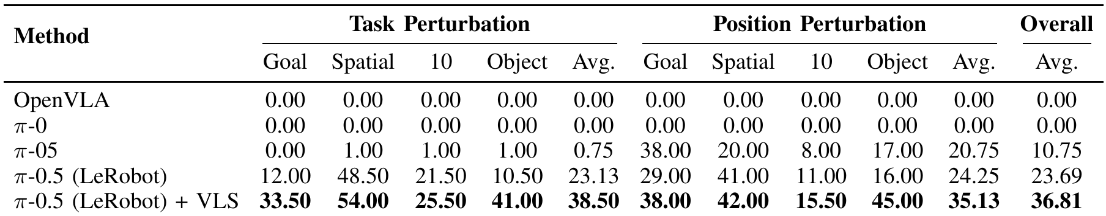
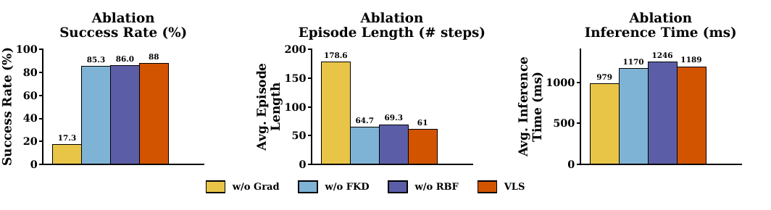
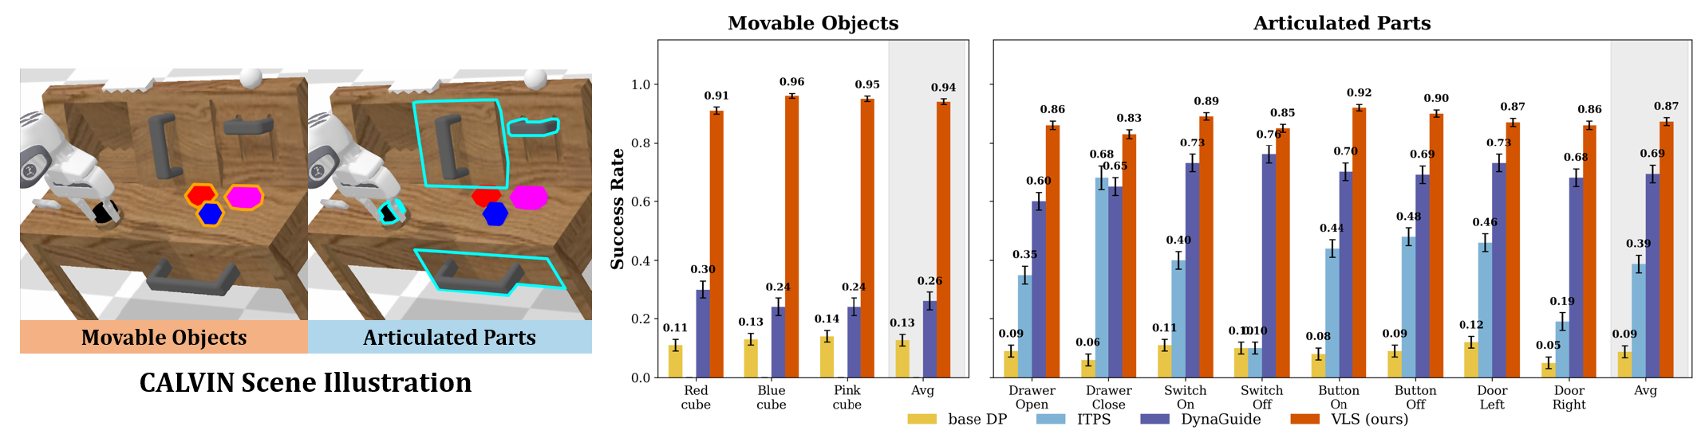

3. VLS
Result 1: simulation (LIBERO-PRO / CALVIN)
LIBERO-PRO: frozen π0.5 + VLS, 23.7% → 36.8% (+13 pt)
CALVIN: 94% on movable objects (7.4×), 87% on articulated parts (9.6×)
Ablation: no gradient guidance → 17%; selection and repulsion add efficiency
Fig. 4 in Liu et al., 2026 (left: ablation, right: scaling with the number of samples)
Table I, Fig. 3 in Liu et al., 2026
Notes:
[E] Simulation results. LIBERO-PRO adds object-position and task-specification perturbations to LIBERO; OpenVLA and π0 are near 0%, and even the LeRobot π0.5 gets 23.7%. Adding VLS to that frozen π0.5 raises it to 36.8%, a 13-point gain. The authors' interpretation is that post-training on robot data entangles the VLM backbone's spatial reasoning with the training context. On CALVIN with a Diffusion Policy base, VLS reaches 94% on movable objects, 7.4 times the base, and 87% on articulated parts, 9.6 times, outperforming DynaGuide and ITPS by 15 to 25 points. In the ablation, removing gradient guidance collapses success to 17%, so dense, trajectory-differentiable guidance is the main driver; reward-based resampling and repulsion matter less for success but improve episode length and stability. The bottom right shows scaling with the number of samples: more samples help, but inference time exceeds 1.2 seconds, a compute-performance trade-off.

Slide 33



3. VLS
Real-robot demo (video): steering on a Franka
Left: in-distribution, "put the banana on the green plate"
Middle: an unseen object, a mug instead of the banana (0% → 40%)
Right: plates swapped, same instruction; the policy follows
In-distribution: banana on green plate
Unseen object: mug on plate
Plates swapped
▶ Top-left: Guide on/off, Sig_Str = strength; it weakens near the end
▶ A mug never seen in training; distance-to-point rewards still work
▶ Same instruction; re-extracted plate points are enough to follow
Videos from vision-language-steering.github.io (real-world Franka rollouts)
Notes:
[E] Real-robot demos on a Franka with a frozen π0.5 base. On the left is an in-distribution task: put the banana on the green plate. In the middle the banana is replaced by a mug the policy has never seen; the frozen policy gets 0%, and with VLS it succeeds in 40% of trials. On the right the plates are swapped while the instruction stays the same, and the policy follows the new positions. The overlay in the top left shows the guidance strength and the reward, and you can see the guidance weaken as the stage nears completion.

Slide 34

3. VLS
Result 2: real robot and limitations
In-distribution: pick-and-place tasks go from 50% to 69% (+19 pt)
Under shifts: unseen mug 0% → 40%, average 42% → 69%
Limitation: latency, about 1 second per action chunk
Fig. 5 in Liu et al., 2026
Notes:
[E] The real robot is a Franka Emika with a frozen π0.5. The in-distribution tasks are placing an orange on the instructed plate, and, with a banana added, selecting both the object and the plate; average success rises from 50% to 69%, a 19-point gain. The out-of-distribution variants replace the plate with an unseen yellow one, swap the plate positions, and replace the banana with an unseen mug. The baseline degrades sharply, to 0% on the mug, while VLS gets 40% there and 69% on average versus 42%. The main limitation is inference overhead from batch sampling, repeated refinement and resampling, about one second per chunk in Figure 4; progress-aware reward generation and efficiency are listed as future work.

Slide 35
Insights
Side by side: what the VLM writes, who runs it
In all three, the VLM only writes code or structure; it never drives the robot directly
The difference is where the output is used: sim building, monitoring, steering
VLM call frequency sets real-robot latency; SimFoundry never calls it at run time
 | SimFoundry | Code-as-Monitor | VLS
Area | Real2Sim (before deployment) | Failure detection (during execution) | Steering (during generation)
VLM writes | Object labels, properties, layout / task proposals | Constraint sentences + checking code | Reward-function code
Used by | The simulator | A monitor running alongside | The policy's denoising loop
VLM call rate | Before deployment only | Once per subgoal | At each stage switch
Real-robot latency | None | Small (tracking + code) | About 1 s per chunk
Notes:
[E] Let me put the three papers in one table. The inputs are all camera images and an instruction, but what the VLM writes differs: SimFoundry gets object labels, physical properties and proposals for layouts and tasks; Code-as-Monitor gets constraint sentences and checking code; VLS gets reward-function code. Who uses it also differs: the simulator for SimFoundry, the monitoring process during execution for Code-as-Monitor, and the policy's denoising loop for VLS. The VLM is called only before deployment in SimFoundry, once per subgoal in Code-as-Monitor, and at each stage switch in VLS, which maps directly onto the real-robot latency. What they share is that the VLM only writes code or structure and never drives the robot directly.

Slide 36
Insights
Summary: three ways to use VLM capabilities
All three use the VLM around the policy: build sims, monitor execution, steer generation
SimFoundry: VLM spatial understanding copies real scenes into sim for eval and data
Code-as-Monitor and VLS share a pattern: VLM-written geometry + code, as monitor or reward
My view: all improve with base models; issues are latency and VLM errors; reuse sim-verified code
① Real2Sim SimFoundry
Build sims with VLM spatial understanding
② Failure detection Code-as-Monitor
Monitor with VLM-written code
③ Steering VLS
Steer with VLM-written rewards
Use VLM-written geometry and code for building sims, monitoring execution, and steering generation
Notes:
[E] To summarize. What the three papers share is that they use the VLM around the policy rather than as the policy. SimFoundry uses the VLM's spatial understanding to copy a real scene into simulation and produce evaluation and training data. Code-as-Monitor and VLS both have the VLM write geometric elements and the code that uses them; Code-as-Monitor uses that code as a monitor condition to check execution, VLS uses it as a reward to steer generation. I think the same code could serve both as a monitor at execution time and as a guide at generation time. As ASPIRE showed at the start, methods that have the model write code improve as the base model improves, and I expect these three to improve the same way. The shared issues are latency and VLM errors: VLS takes about a second per chunk, and Code-as-Monitor calls the VLM once per subgoal. From my own research perspective, if reward and monitor code verified in simulation were accumulated as an asset and only reused on the real robot, we could reduce both the dependence on the VLM at inference time and the latency.

Slide 37


Insights
My own work: steering + monitoring
Recently I have been testing VLS-style steering combined with CaM-style monitoring
VLM-written code both steers generation and monitors execution
Videos: LIBERO examples; the right panel shows the VLM judgment and monitor log
LIBERO-Goal: steering + monitoring
LIBERO-Object: steering + monitoring
Own preliminary experiments (LIBERO), 2026
Notes:
[E] Finally, a brief look at my own work. I have recently been testing a method that combines VLS-style reward steering with Code-as-Monitor-style monitor code, which is exactly the idea from the summary: VLM-written code used both to steer generation and to monitor execution. The videos show examples on LIBERO-Goal and LIBERO-Object, with the VLM's judgment and the monitor log on the right. It is still work in progress, but the early results are interesting, so please talk to me afterwards if you are curious. Thank you for your attention. I am happy to take questions.

