Slide 1




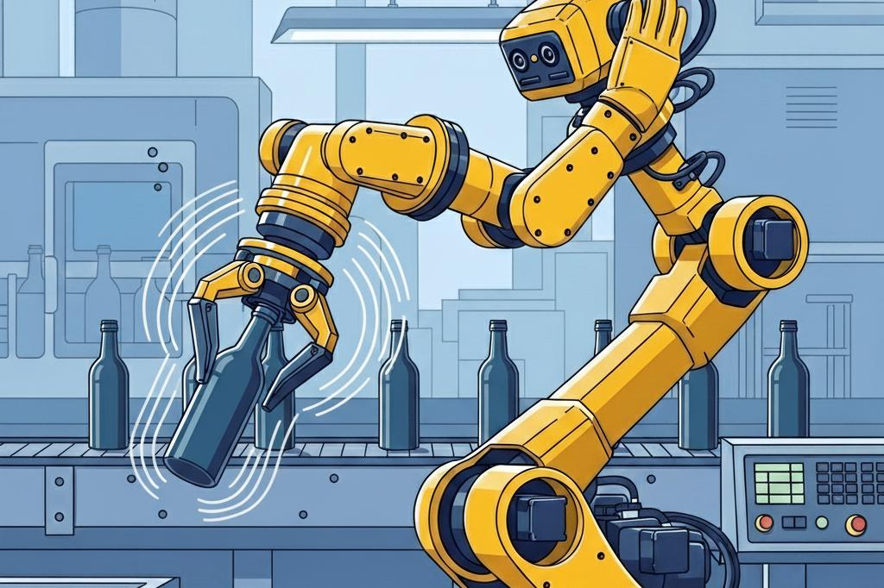
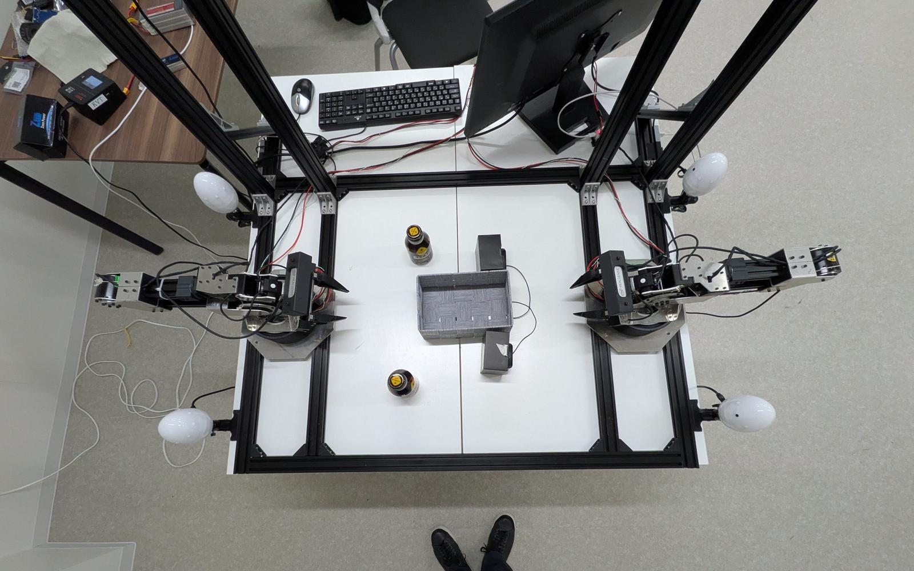

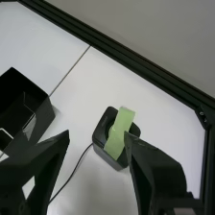
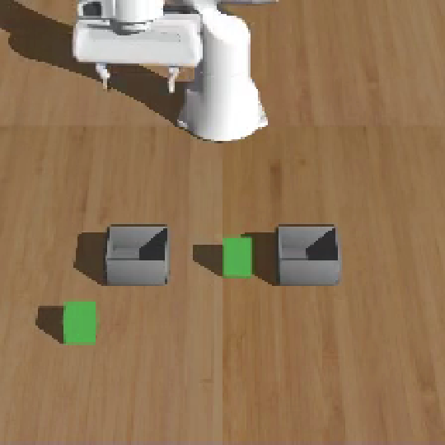
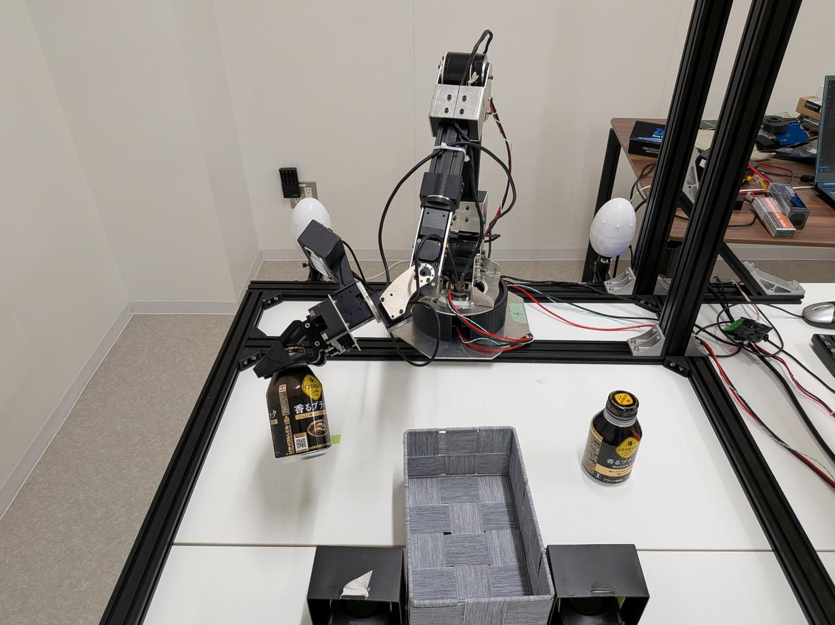
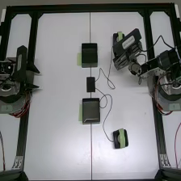
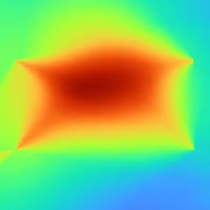
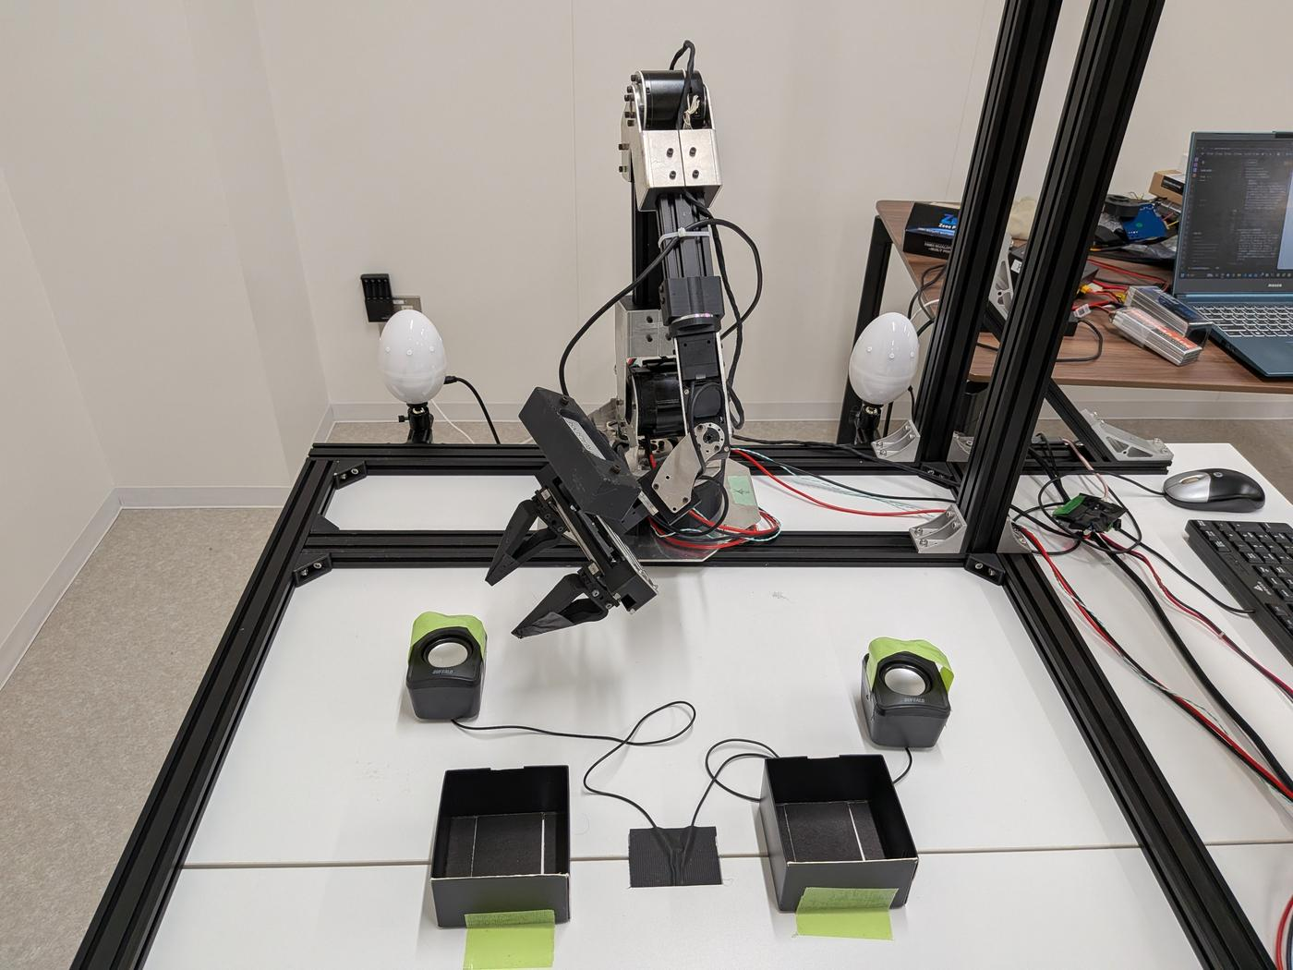
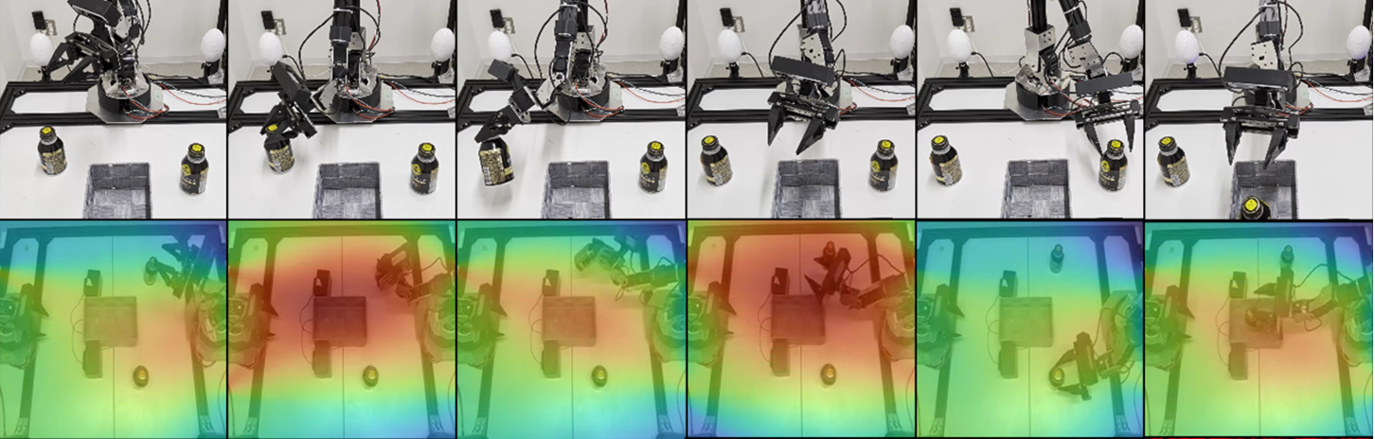

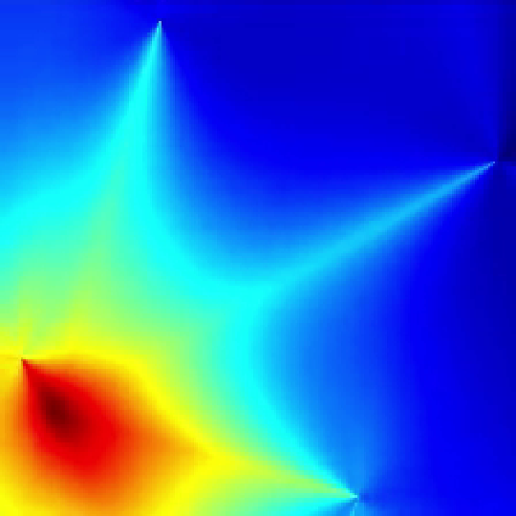
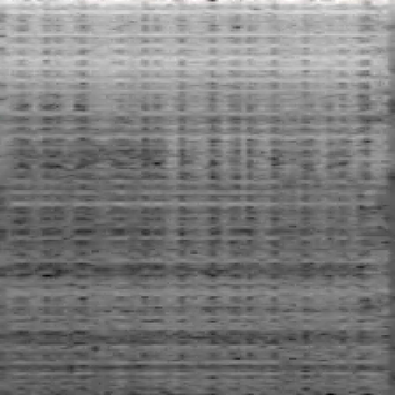
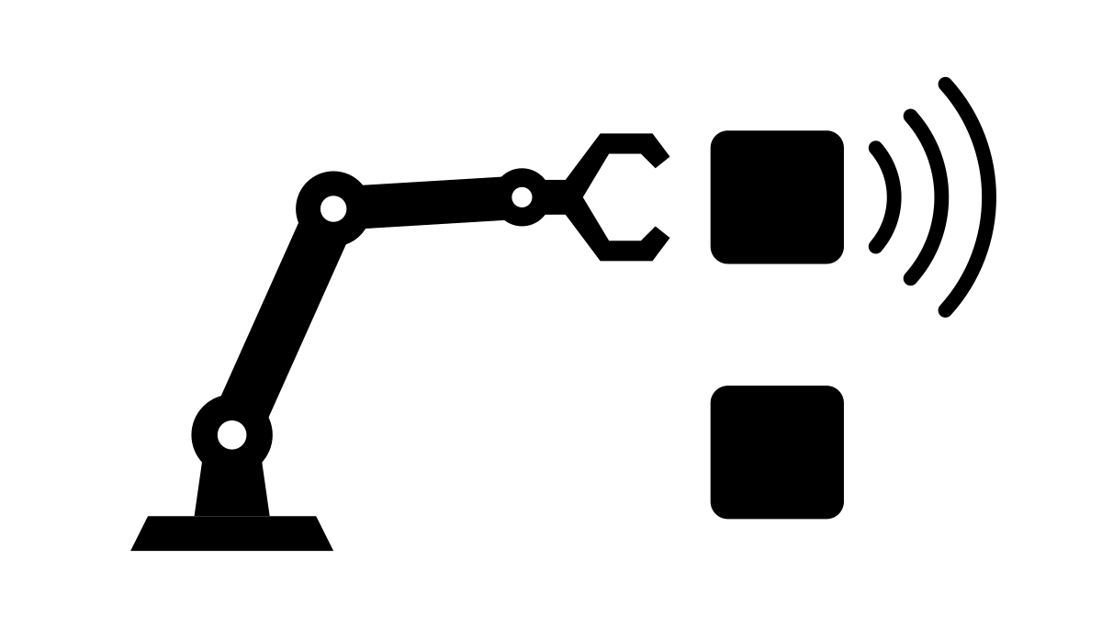
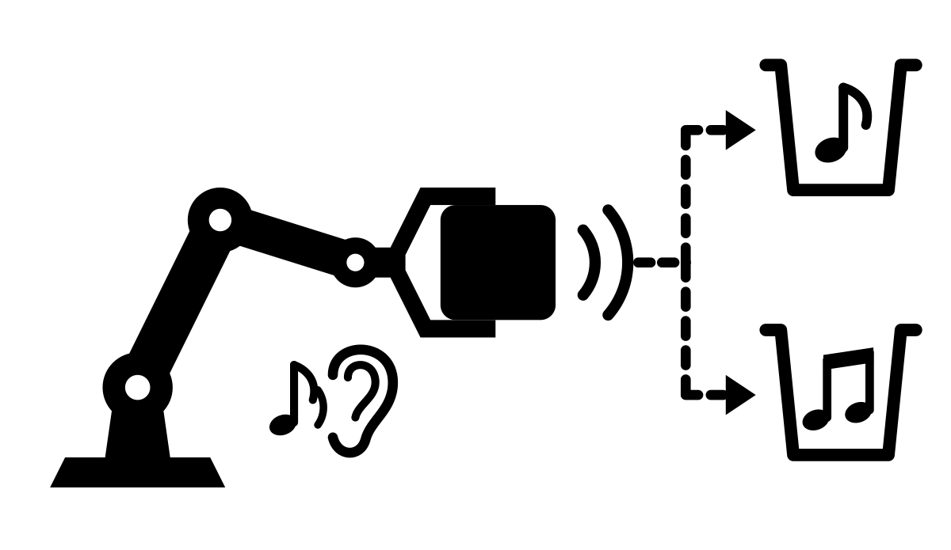
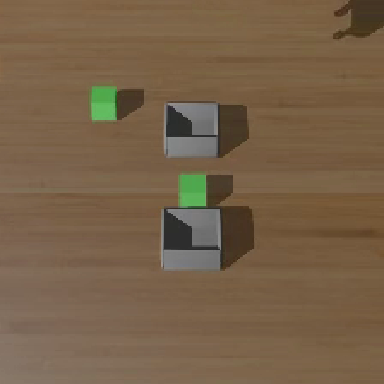
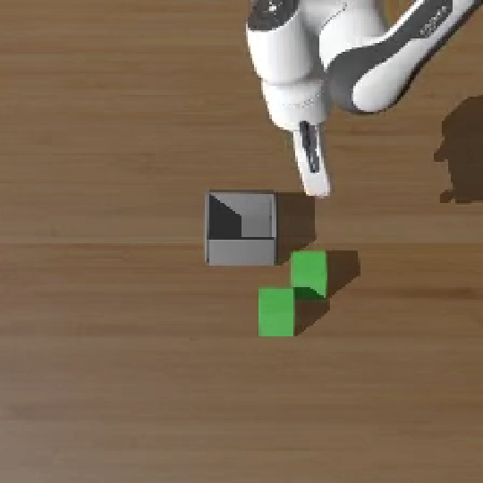
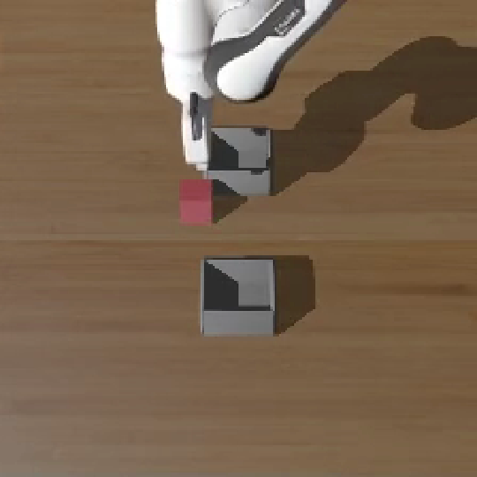
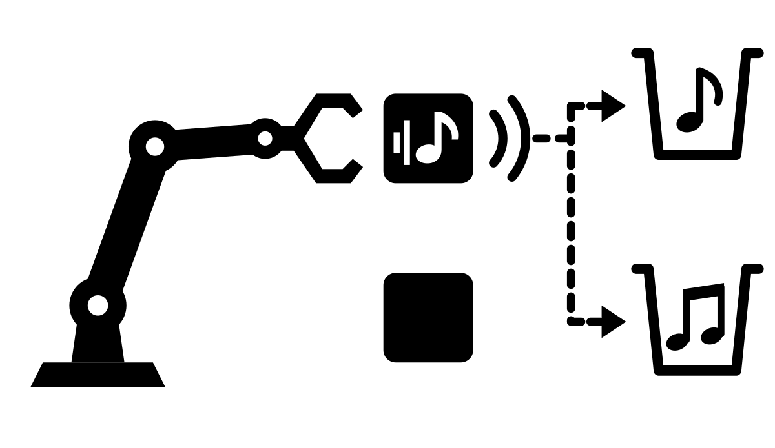
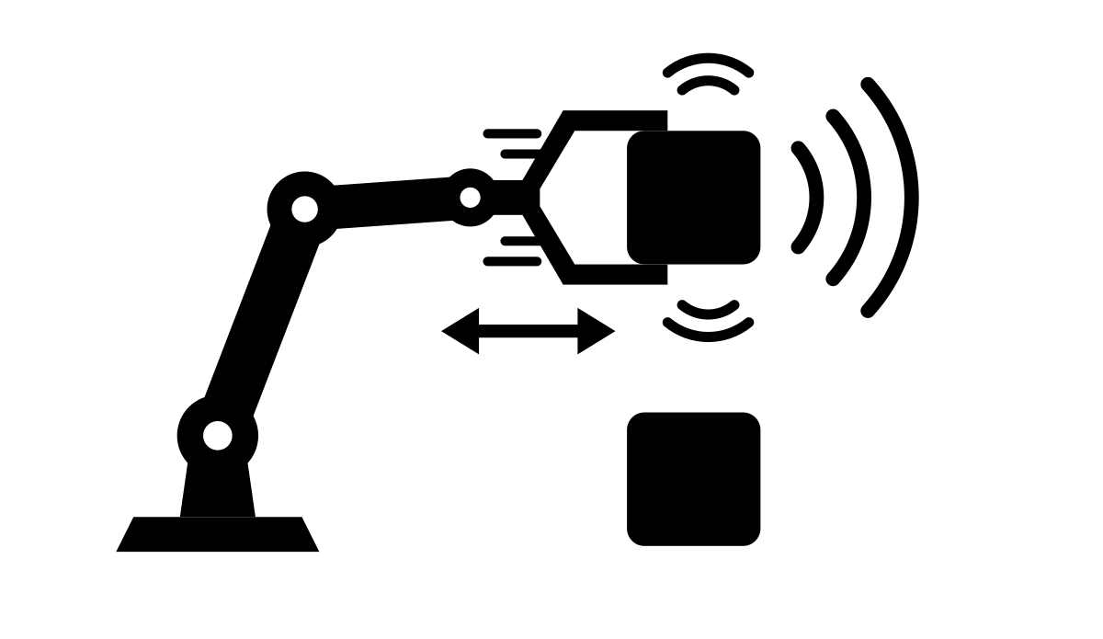
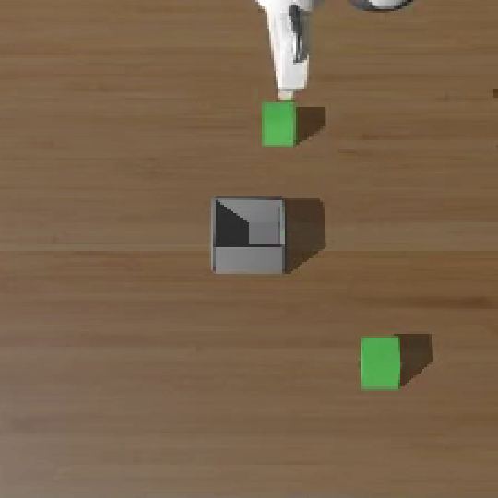
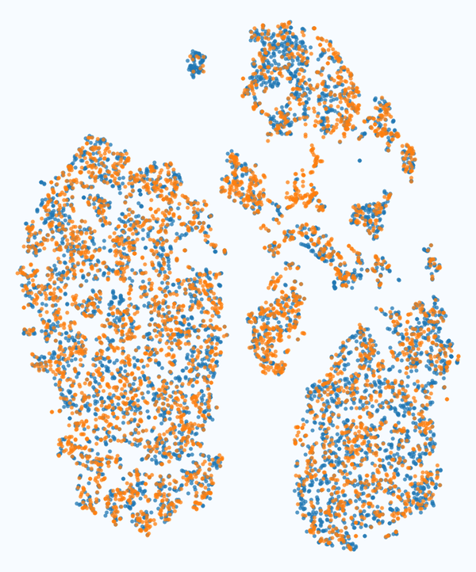
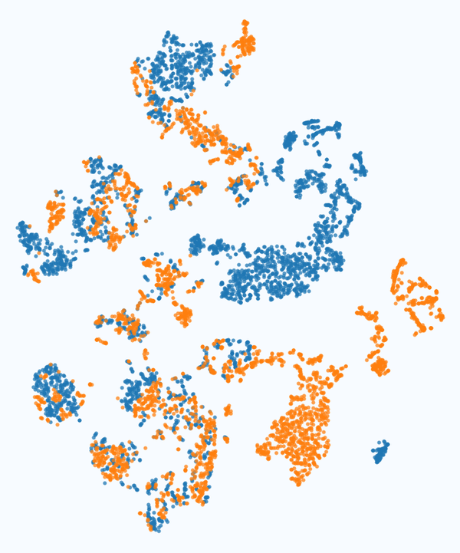
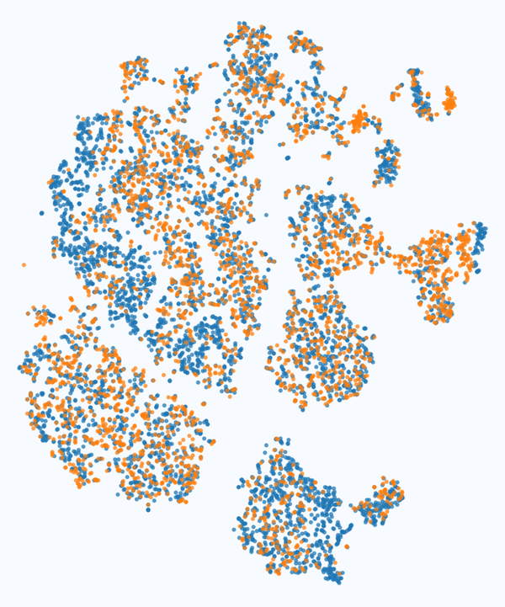
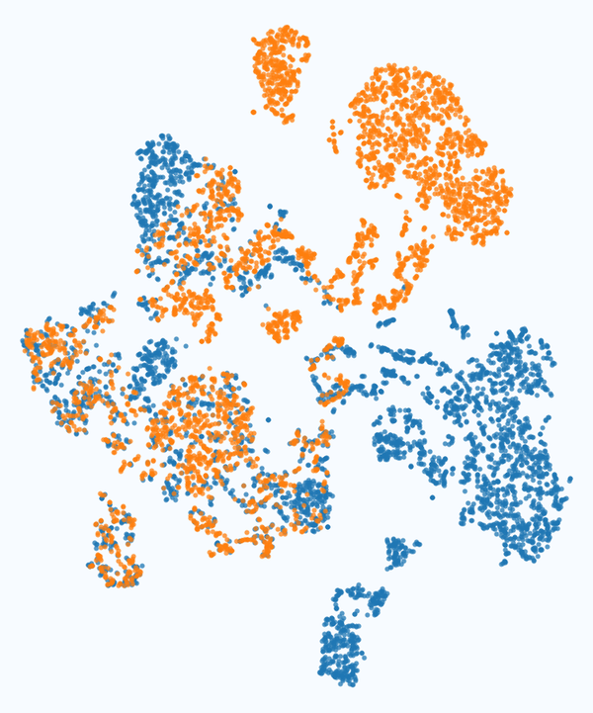
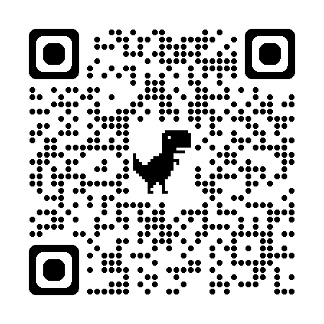
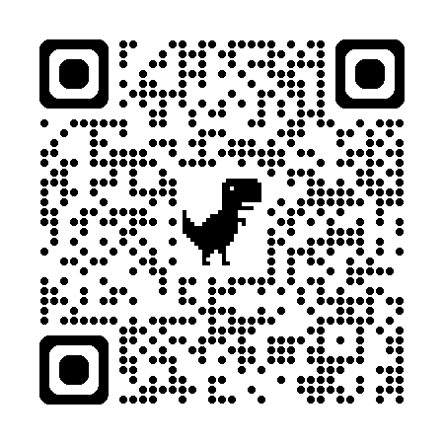
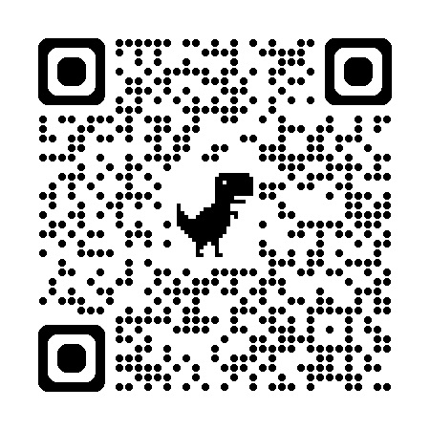
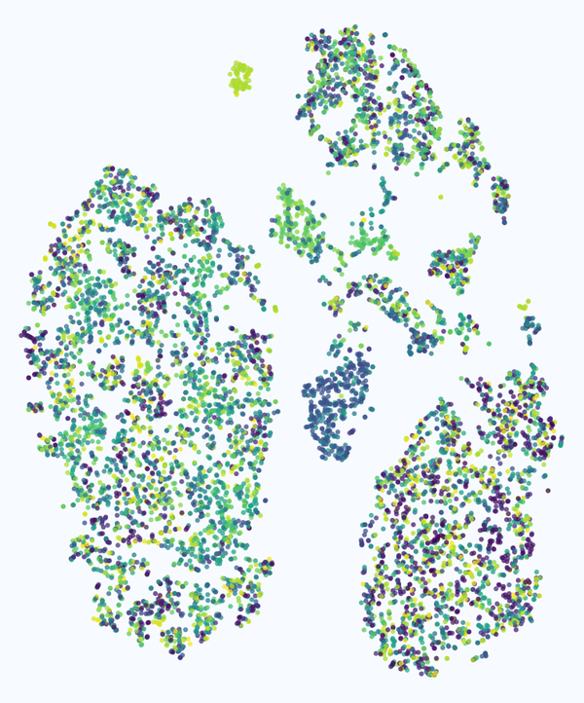
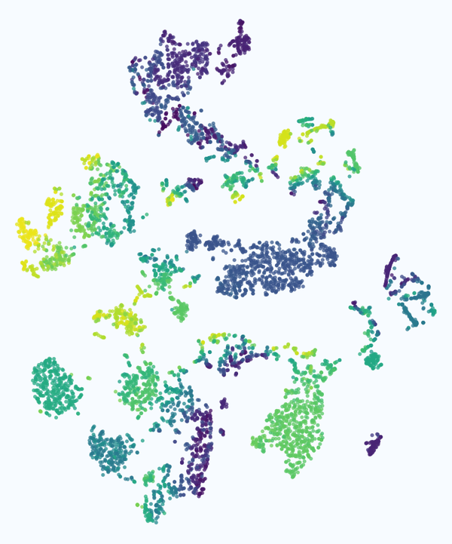
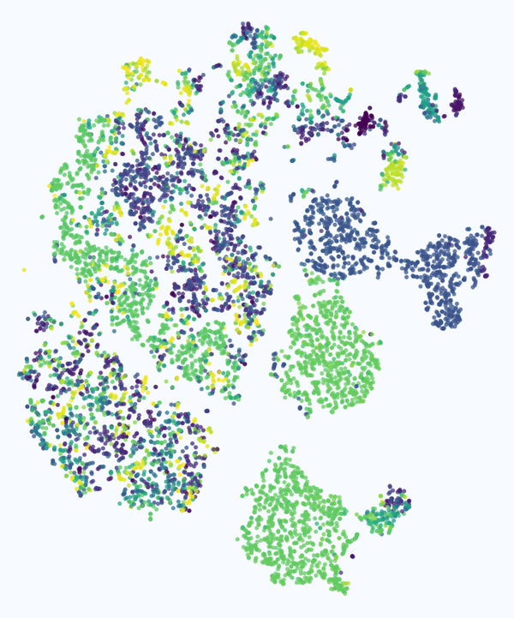
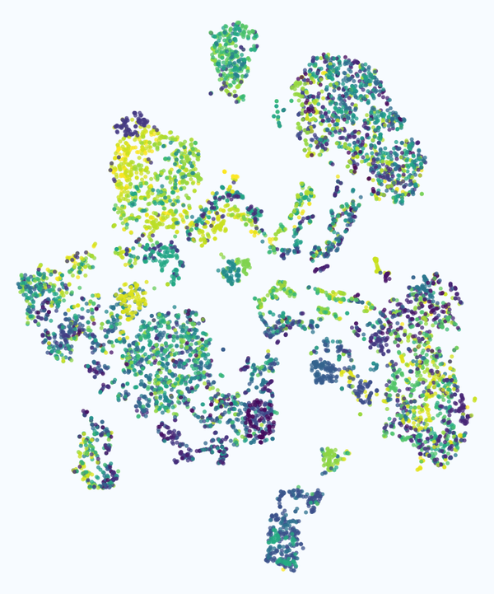
S2A2: Audio-Visual Imitation Learning for Manipulation Tasks
Using Acoustic Spatial Information
Kaneyoshi Hiratsuka^{1,2} Benjamin Yen^{2,3} Ryosuke Kojima^{1,2}
¹Kyoto University ²RIKEN ³Institute of Science Tokyo
Austin, TX · 2026
Background
S2A2 Framework: Spatial-Spectral Audio Action
Real Robot Results
Vision-only policies fail when objects look identical or their state is hidden [1, 2].
Sound carries two complementary cues: WHERE the source is and WHAT it is [3].
Prior audio imitation learning feeds only spectrograms or raw waveforms, so the source position stays implicit [1, 2, 4].
Key idea: feed the sound-source position from microphone arrays into the policy as an explicit acoustic spatial map, together with a Spotforming spectrogram and vision.
ILOHA arm (ALOHA-type [7]): 6 joints + gripper
4 TAMAGO-03 arrays (8 ch, 16 kHz); top-down + wrist RGB
ACT; 100 teleop demos per task; 100 trials
S2A2 wins both tasks: 72 % on L&I vs 5 % vision-only; spatial + spectral > either
Environment
Processing Pipelines
Multimodal Policy
Tasks
RGB cameras
RGB image
Policy
Network
ACT [7]
Diffusion
Policy [8]
VQ-BeT [9]
π0 [10]
→ action
chunk
wrist / front
camera images
Vision
Encoder
Sort by acoustic cues
Acoustic spatial map MUSIC [5] → 224×224×N map
Localization &
Identification
Top-down view, 4 microphone arrays
likelihood of the
source position
Feature Concat (+ proprioception)
S2A2 + ACT on the exploratory task
Spatial
Encoder
Acoustic-aware Manipulation Tasks
4 microphone arrays
×14 vs
vision only
Four diagnostic tasks that isolate localization, identification and exploration. Goal: grasp the right object, drop it into the right box.
Spectrogram Spotforming [6]: beamforming + NMF
sound separated
at the peak ★
Spectral
Encoder
Exploratory
Ambiguous visuals
Localization
Identification
Simulation Results
Top: robot. Bottom: acoustic spatial map on the top-down view. Time →
WHERE
WHAT
Conclusion & Limitations
2 look-alikes, 1 box
One emits a fixed sound
Carry the sounding one
overhead view
1 object, 2 boxes
It emits sound A or B
Box chosen by timbre
overhead view
Setup: Genesis [11] + Pyroomacoustics [12]; Franka Panda; 4 mic arrays @ 10 FPS; 2 cameras @ 30 FPS; 100–200 demos per task
Metric: success rate (%) over 100 trials × 3 seeds. DP = Diffusion Policy
✔ Explicit spatial map + spectrogram is best when a task needs both WHERE and WHAT (sim: all 4 policies; real: 72 % / 50 %).
✔ Unneeded acoustic pipelines can hurt with few demos; the gain depends on the policy architecture.
⚠ Single source, known array placement, exploration imitated from demos. Next: multi-source, sim-to-real [14].
front cam.
side cam.
Baseline (RGB only)
S2A2 (ours)
w/o Spec. (no spectrogram)
w/o Spat. (no spatial map)
L&I
Exploratory
WHERE
WHAT
WHERE
WHAT
EXPLORE
Contact & References
2 look-alikes, 2 boxes
One emits sound A or B
Find it, box by timbre
overhead view
2 look-alikes, 1 box
One sounds only when moved
Lift & shake to find it
overhead view
★ S2A2 best for all 4 policies
error bars: ± STD over 3 seeds
Kaneyoshi Hiratsuka
Kyoto University / RIKEN
hiratsuka.kaneyoshi.i62@kyoto-u.jp
https://azuma413.github.io/
[1] Du et al. Play it by ear. RSS 2022.
[2] Li et al. See, hear, and feel. CoRL 2022.
[3] Nakadai & Okuno. Robot audition. Adv. Intell. Syst. 2020.
[4] Liu et al. ManiWAV. CoRL 2024.
[5] Schmidt. MUSIC. IEEE Trans. Antennas Propag. 1986.
[6] Kagimoto et al. Spotforming by NMF. IROS 2022.
[7] Zhao et al. ACT. RSS 2023.
[8] Chi et al. Diffusion Policy. IJRR 2024.
[9] Lee et al. VQ-BeT. ICML 2024.
[10] Black et al. π0. arXiv 2024.
[11] Genesis Authors. Genesis physics engine. 2024.
[12] Scheibler et al. Pyroomacoustics. ICASSP 2018.
[13] van der Maaten & Hinton. t-SNE. JMLR 2008.
[14] Wang et al. The sound of simulation. CoRL 2025.
Acknowledgments: JST CREST (JPMJCR22D3), JST Moonshot R&D (JPMJMS2024), JSPS KAKENHI (JP26H02532, JP26H02525), RIKEN TRIP initiative (AGIS).
S2A2 is best on L&I for all 4 policies. The spatial map helps whenever WHERE matters and beats raw multi-channel audio there (ACT, Localization: 73 vs 43 %).
Latent space of Diffusion Policy on the L&I task (t-SNE [13])
Task | Spatial (WHERE) | Spectral (WHAT) | Explore
Localization | ✓ | – | –
Identification | – | ✓ | –
L&I | ✓ | ✓ | –
Exploratory | ✓ | ✓ | ✓
Baseline
S2A2
w/o
Spec.
w/o
Spat.
Color = sound type (top) or Y-coordinate of the sounding object (bottom).
S2A2 separates both cues; w/o Spat. loses position, w/o Spec. loses timbre → the two acoustic cues play independent roles in the latent space.
Sound
type
sound A
sound B
Source
Y-coord.
+0.3
Paper
Code
Webpage
0
−0.3 m

