Slide 1
EDA 2022 Final Project
By Yikai Jing & Azura Liu

Slide 2
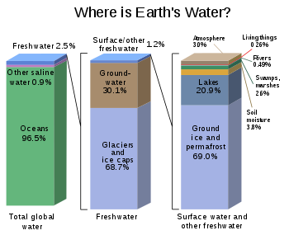
Introduction
Impact of precipitation and water withdrawal on the groundwater resources capacity
Water shortage is an imminent concern globally
Increasingly stressed aquifers
Groundwater as a major water source
@USGS

Slide 3
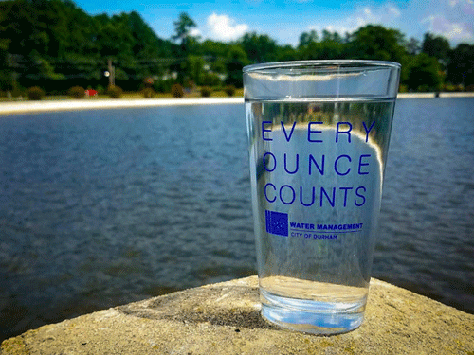
Research Question
Within the Durham region during recent years, we are interested in:
How does precipitation affect groundwater level?
How is groundwater table level related to river discharge?
How is groundwater table level related to local withdraws?
@durhamnc.gov

Slide 4


Data Sources
U.S. Geological Survey (USGS)
Precipitation
Discharge: Cape Fear River, Flat River, Little River
Groundwater Table
North Carolina Department of Environmental Quality (NCDEQ) Division of Water Resources
Durham City water withdraws
@USGS
@NCDEQ
Notes:
Durham withdraw
River discharge
Ground water table
Precipitation

Slide 5
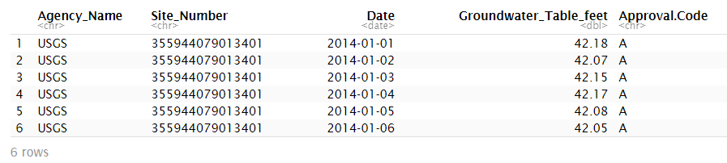
Exploratory Analysis
Data Scraping from USGS & NCDEQ
Data Wrangling
Explore: summary statistics, column metadata
Monthly average: precipitation, discharge, groundwater table
Combine three river discharges for simplicity

Slide 6
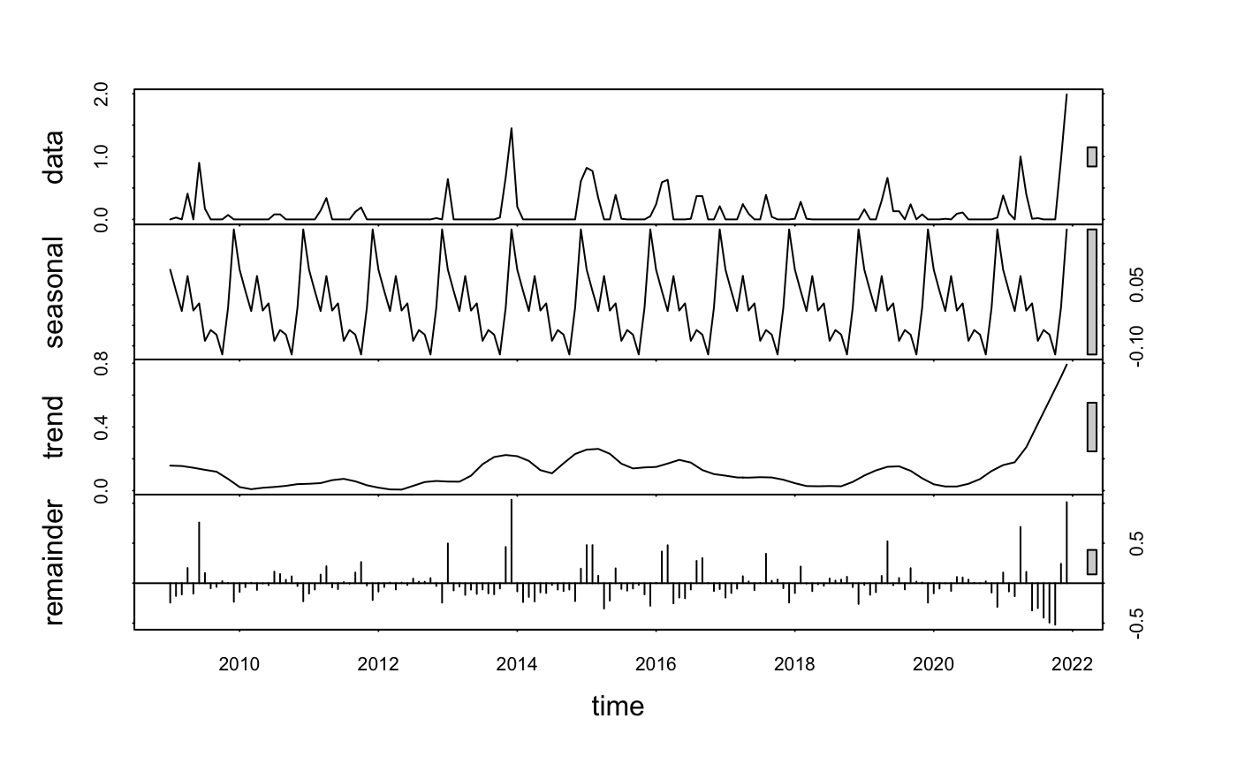
Time Series Analysis: Precipitation

Slide 7
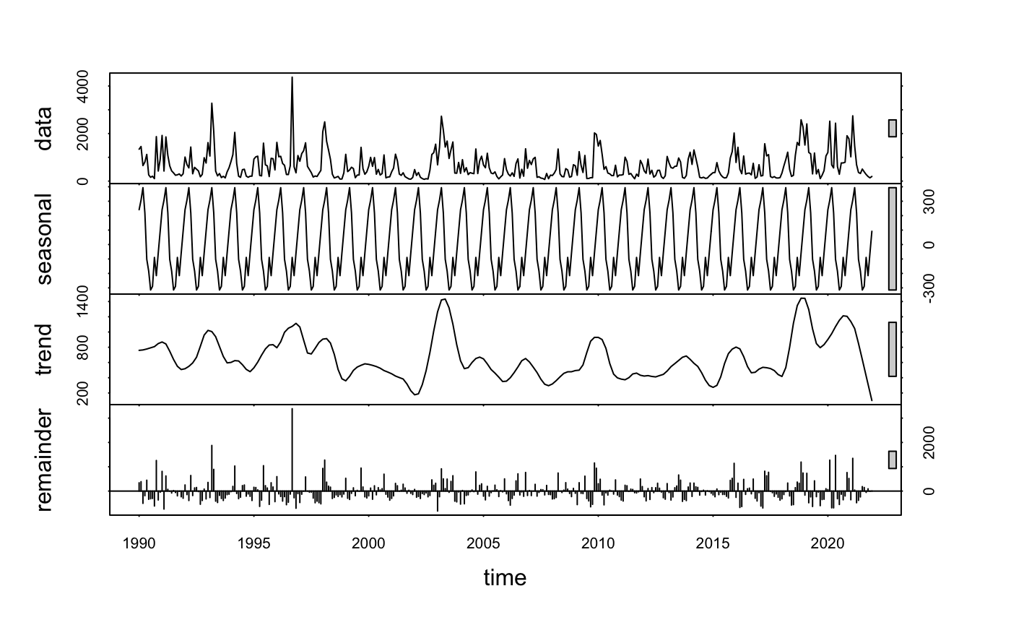
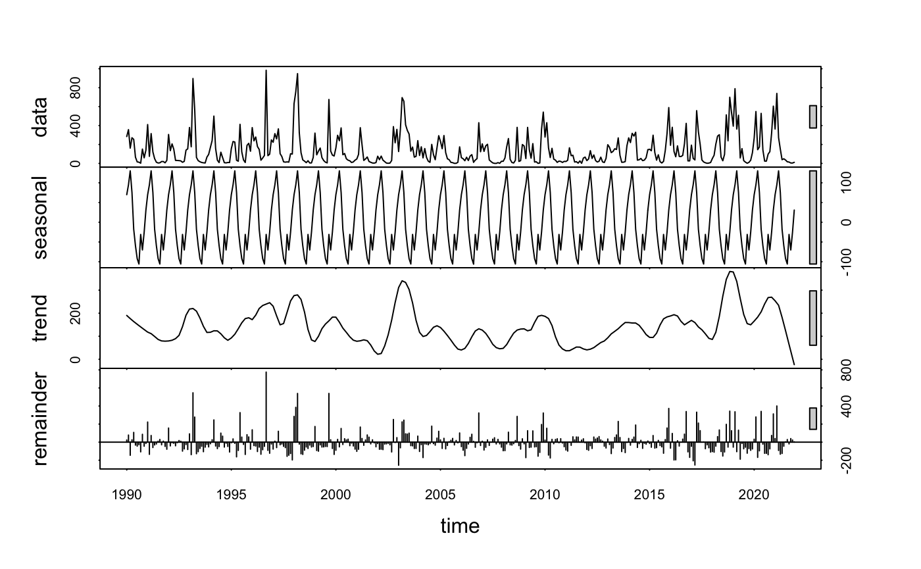
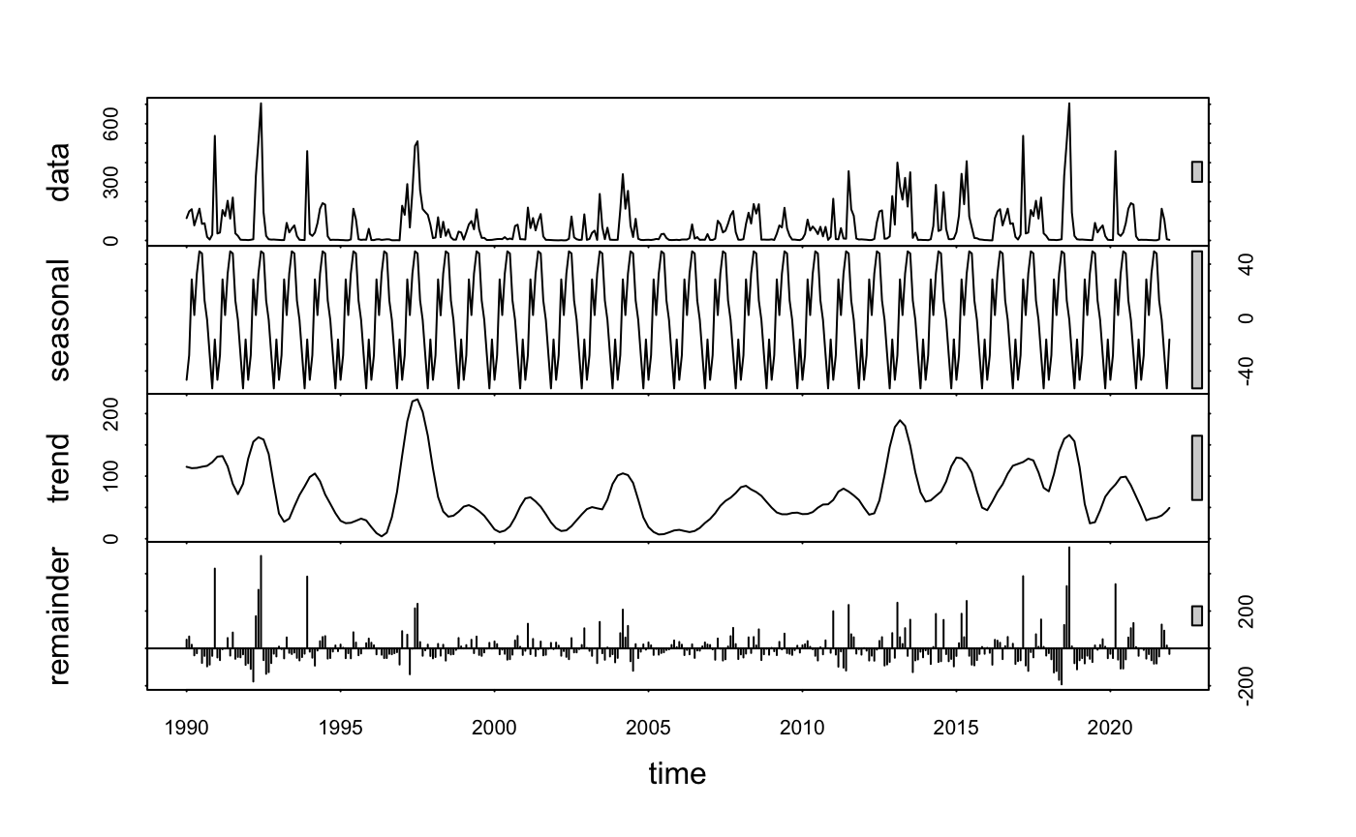
Time Series Analysis: River Discharge
a. Cape Fear River
b. Flat River
c. Little River

Slide 8
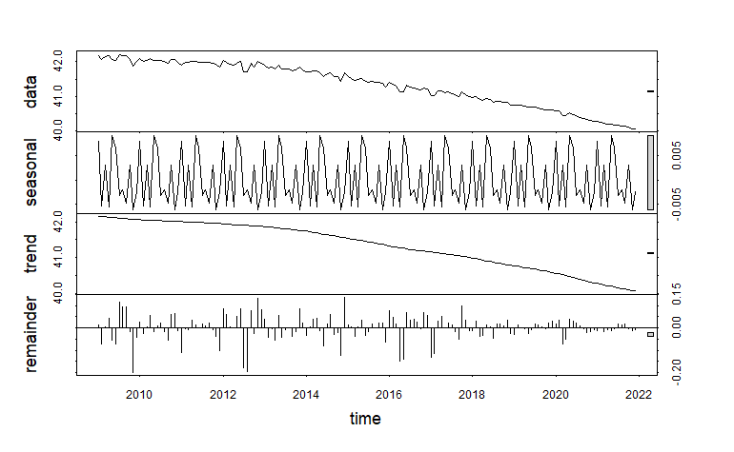
Time Series Analysis: Groundwater Table

Slide 9
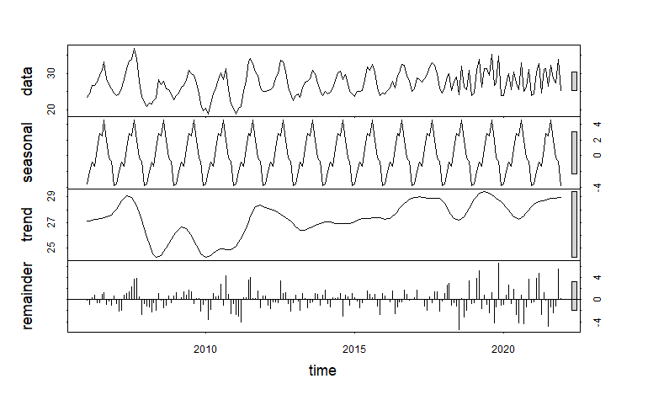
Time Series Analysis: Durham Withdraw

Slide 10
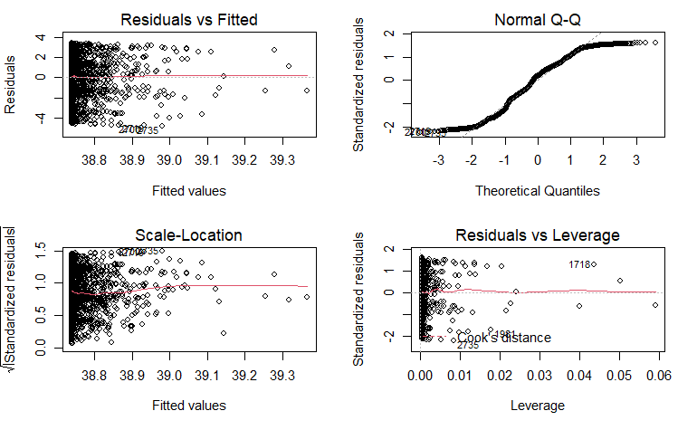
Linear Regression Analysis
LM1: Groundwater Table ~ Precipitation
P = 0.245
DF = 2872
Residual standard error = 2.164
Multiple R-squared = 0.0004699
Adjusted R-squared = 0.0001219

Slide 11
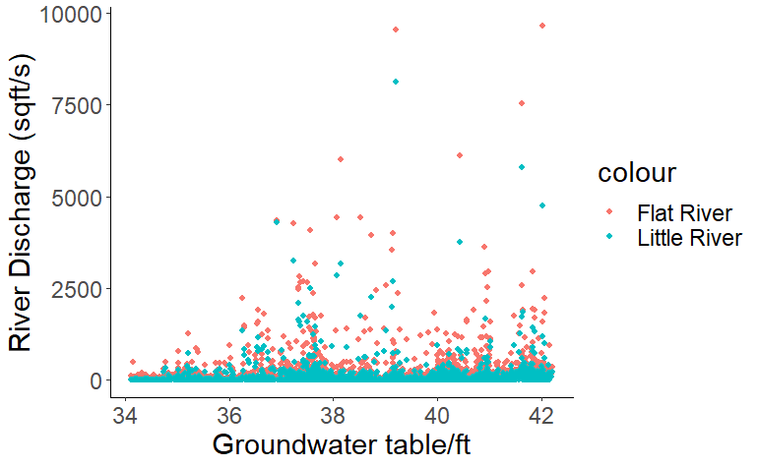
Linear Regression Analysis
LM2: Groundwater Table~ Cape Fear Discharge + Flat Discharge + Little Discharge
Groundwater Table~ Flat Discharge + Little Discharge
P<0.05
DF = 2901
Residual standard error = 2.155
Multiple R-squared = 0.007459
Adjusted R-squared = 0.08895

Slide 12
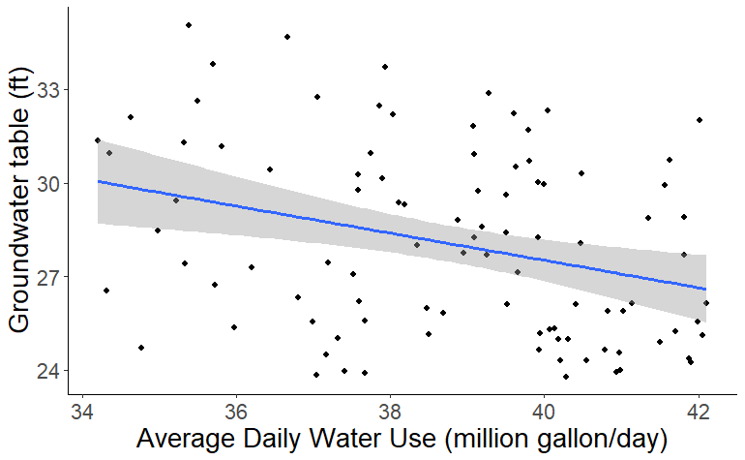
Linear Regression Analysis
LM3: Groundwater Table~ Average Daily Water Use
P<0.05
DF = 94
Residual standard error = 2.067
Multiple R-squared = 0.09854
Adjusted R-squared = 0.0001219

Slide 13
References
A. E. Ercin, A. Y. Hoekstra, Water footprint scenarios for 2050: A global analysis. Environ. Int. 64, 71-82 (2014).
Boretti A., Rosa L., Reassessing the projections of the World Water Development Report. Clean Water, 15 (2019).
C. J. Vörösmarty, P. Green, J. Salisbury, R. B. Lammers, Global water resources: Vulnerability from climate change and population growth. Science. 289, 284-288 (2000).
Brown T. C., Foti R., Ramirez J. A., Projected freshwater withdrawals in the United States under a changing climate. Water Resources Research. 49, 1259–1276 (2013).
Fan Y.B., Yang W. b., Li G., Wu L. L., Wei Y. S., Reuse rate of treated wastewater in water reuse system. Journal of Environmental Sciences. 17, 842-845, (2005).
Gleick P. H., Water in crisis: paths to sustainable water use. Ecological Applications. 8(3), 572-579 (1998).
M. M. Mekonnen, A. Y. Hoekstra, Four billion people facing severe water scarcity. Sci Adv. 2 (2) (2016).
Oki, T., and S. Kanae (2006), Global hydrologic cycles and world water resources, Science, 313, 1068–1072.
R. G. Taylor, B. Scanlon, P. Döll, M. Rodell, R. van Beek, Y. Wada, L. Longuevergne, M. Leblanc, J. S. Famiglietti, M. Edmunds, L. Konikow, T. R. Green, J. Chen, M. Taniguchi, M. F. P. Bierkens, A. MacDonald, Y. Fan, R. M. Maxwell, Y. Yechieli, J. J. Gurdak, D. M. Allen, M. Shamsudduha, K. Hiscock, P. J.-F. Yeh, I. Holman, H. Treidel, Ground water and climate change. Nat. Clim. Chang. 3, 322–329 (2013).
S. Siebert, J. Burke, J. M. Faures, K. Frenken, J. Hoogeveen, P. Döll, F. T. Portmann, Groundwater use for irrigation – a global inventory. Hydrol. Earth Syst. Sci. 14, 1863–1880 (2010).
Turner, S. W. D., Hejazi, M., Yonkofski, C., Kim, S. H., & Page, K., Influence of groundwater extraction costs and resource depletion limits on simulated global nonrenewable water withdrawals over the Twenty‐First century. Earth's Future, 7(2), 123-135 (2019).
World Water Assessment Programme (Nations Unies), The United Nations World Water Development Report 2018 (United Nations Educational, Scientific and Cultural Organization, New York, United States) www.unwater.org/publications/world-water-development-report-2018/. (2018).
Y. Wada, L. P. H. van Beek, D. Viviroli, H. H. Dürr, R. Weingartner, M. F. P. Bierkens, Global monthly water stress: 2. Water demand and severity of water stress. Water Resour. Res. 47, W07518 (2011).

Slide 14
THANK YOU!

