Slide 1










Knowledgeable Network of Local Partners
Notes:
DocuWare markets its solutions exclusively through qualified sales partners: around the world, there are over 400 Authorized DocuWare Partners employing more than 1,000 certified DocuWare experts to provide first-class service to customers locally. DocuWare also fosters numerous technology partnerships with leading providers, including Microsoft, SAP and Oracle. DocuWare and the solutions it provides are certified on many levels, including ISO 9001. This wealth of knowledge gives our joint customers access to solutions with highest productivity, practicability and efficiency.

Slide 2
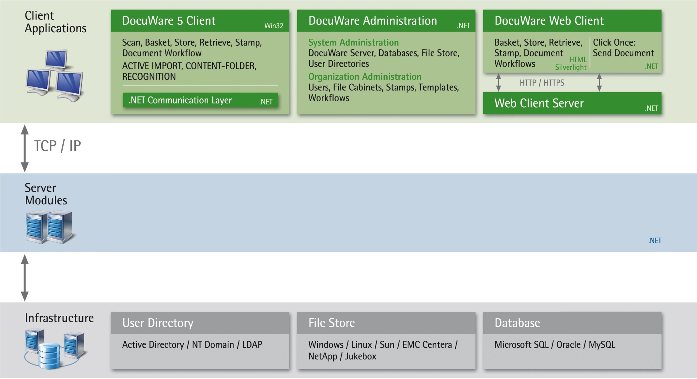







System Architecture
Notes:
New Servers:
Fulltext Server
Thumbnail Server
Notification Server

Slide 3
Software (e.g. ERP)
Hardware (Scanner)
Save
Print
Scan
Import
Folder
DocuWare Printer
DocuWare Web Scan
Upload
DocuWare Desktop Drop Folder
DocuWare Desktop
Service
Identify
Split
Sign
Client
Recognize
Add overlay
Print
DocuWare Job Server
Server
Job Processor
DocuWare Core Servers
Architecture
DocuWare Import
DocuWare Web Scan
DocuWare Printer
Important topics
Notes:
For every purpose there is now a way to store via DW Desktop.
External Software DW Import, DW Printer
Hardware (Scanner) DW Web Scan
Documents are all processed by DW Desktop Service
Mostly all operations are done on the client
JobServer is acting like a cache for Job Processor
Job Processor is the only one who interacts with DocuWare Authentication and Content Server
DocuWare Desktop is not using any client license, as you are not able to search, display or edit the documents in the file cabinet!

Slide 4
Demostration on...
No | Features | Function
1 | Basket Administration | Drag & Drop Stapled and unstapled Compound documents
2 | Remote Capturing | Scanning and importing Personalize configuration Barcode/OCR – page separation, zonal OCR and Dynamic Form Processing 'Upload' for direct indexing fulltext into the DW cabinets
3 | Indexing | Mouse over indexing Manual auto indexing
4 | Retrieval & Viewing | Boolean search Drop list search Fulltext search – highlight over the text Built-in AutoCAD Viewer
5 | Versioning Control | CheckOut for editing CheckIn with auto version update
6 | BYOD | iPad Android smartphone
Notes:
Former store configurations need to be transformed to Import Configurations in den Web-Client Settings first
Scanned images are preserved, if application is restarted

