Slide 1
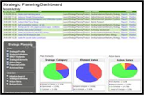
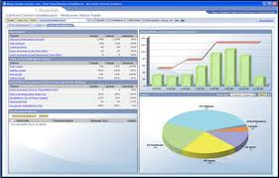
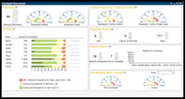
JPAK
Holistic View of Asset Mgmt Application Systems
STRATEGIC – NATIONAL (DASHBORD/REPORTS)
JKR DASHBOARD
& WAR ROOM
ASSET OWNER
DASHBORD & REPORTING
TACTICAL / STRATEGIC (DASHBORD/REPORTS)
STAKEHOLDERS
ASSET OWNER / MANAGER
MANAGERIAL & TACTICAL
SPP2
mySPATA
TPATA
1
2
3
4
5
6
7
8
9
0
ASSET MANAGER (JKR)
SPB
1
2
3
4
5
6
61
7
8
9
0
PM
J10
FM
ASSET OPERATOR / JKR
OPERATIONAL DASHBOARD
OPERATIONAL TOOLS
BCMMS
ROAMS
BMS
ISIS

