Slide 1
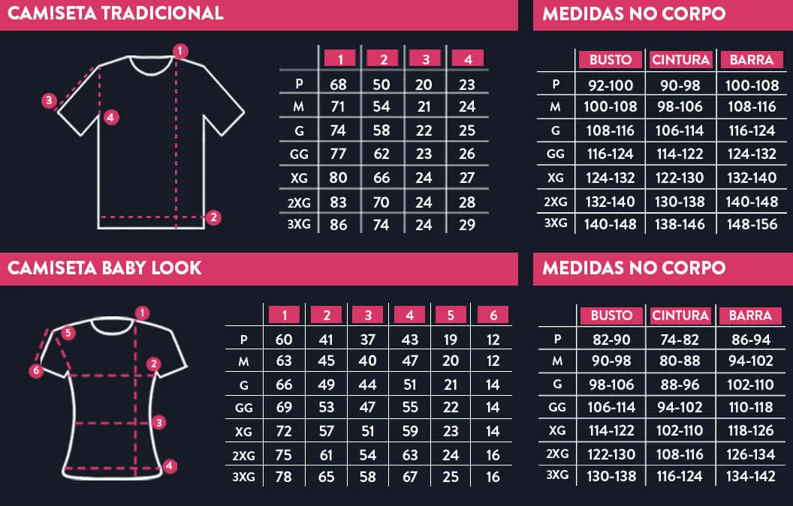
Men’s Shirt
Size
EXPAND YOUR HORIZONS AND TAKE HOME A PIECE OF THE GALAXY.
Bust
Waist
Hem
Women’s Shirt
Size
Bust
Waist
Hem
CLICK TO LEARN MORE

Slide 2
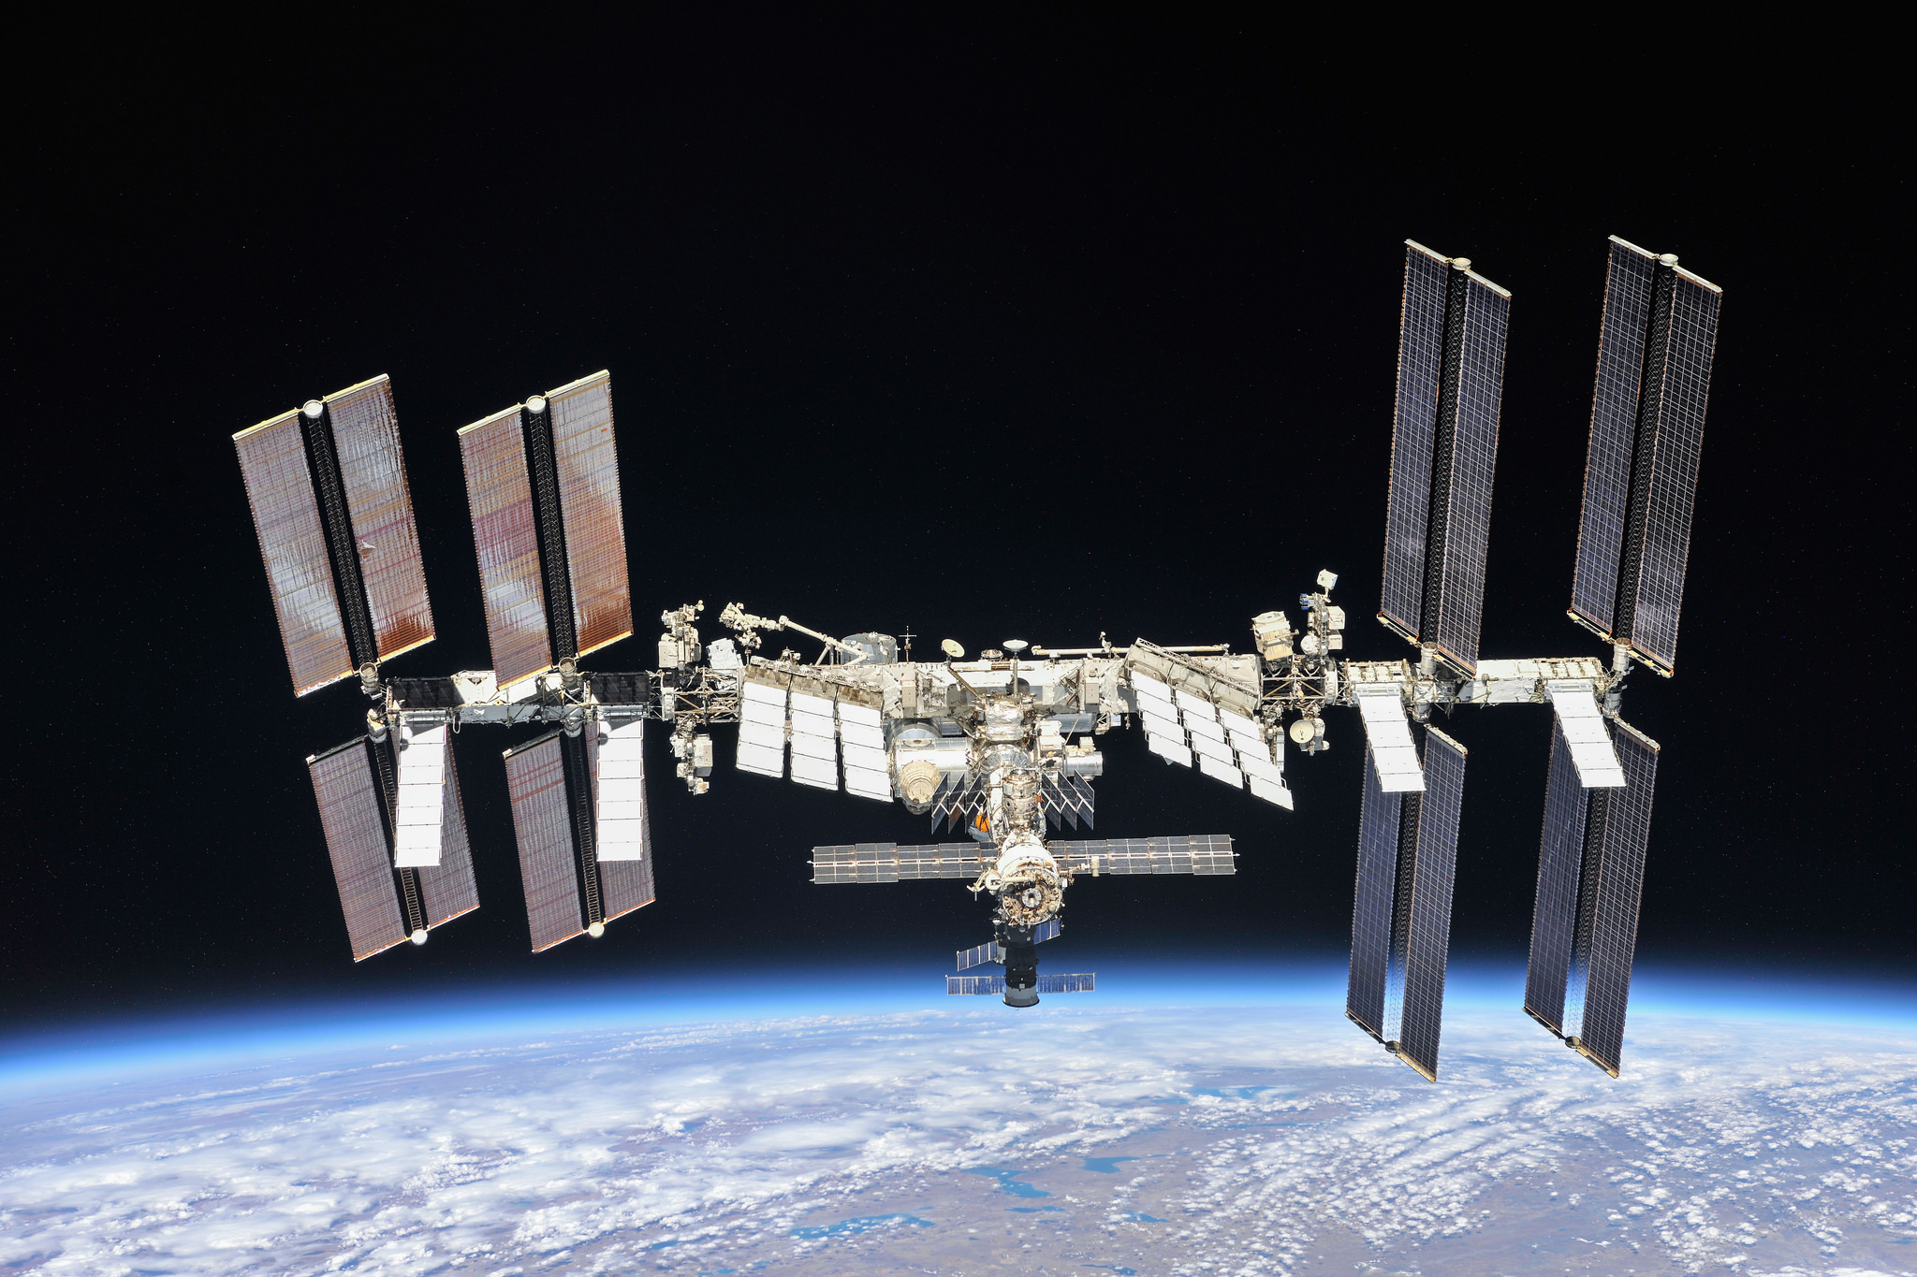
LIVE ONBOARD THE INTERNATIONAL SPACE STATION

Slide 3
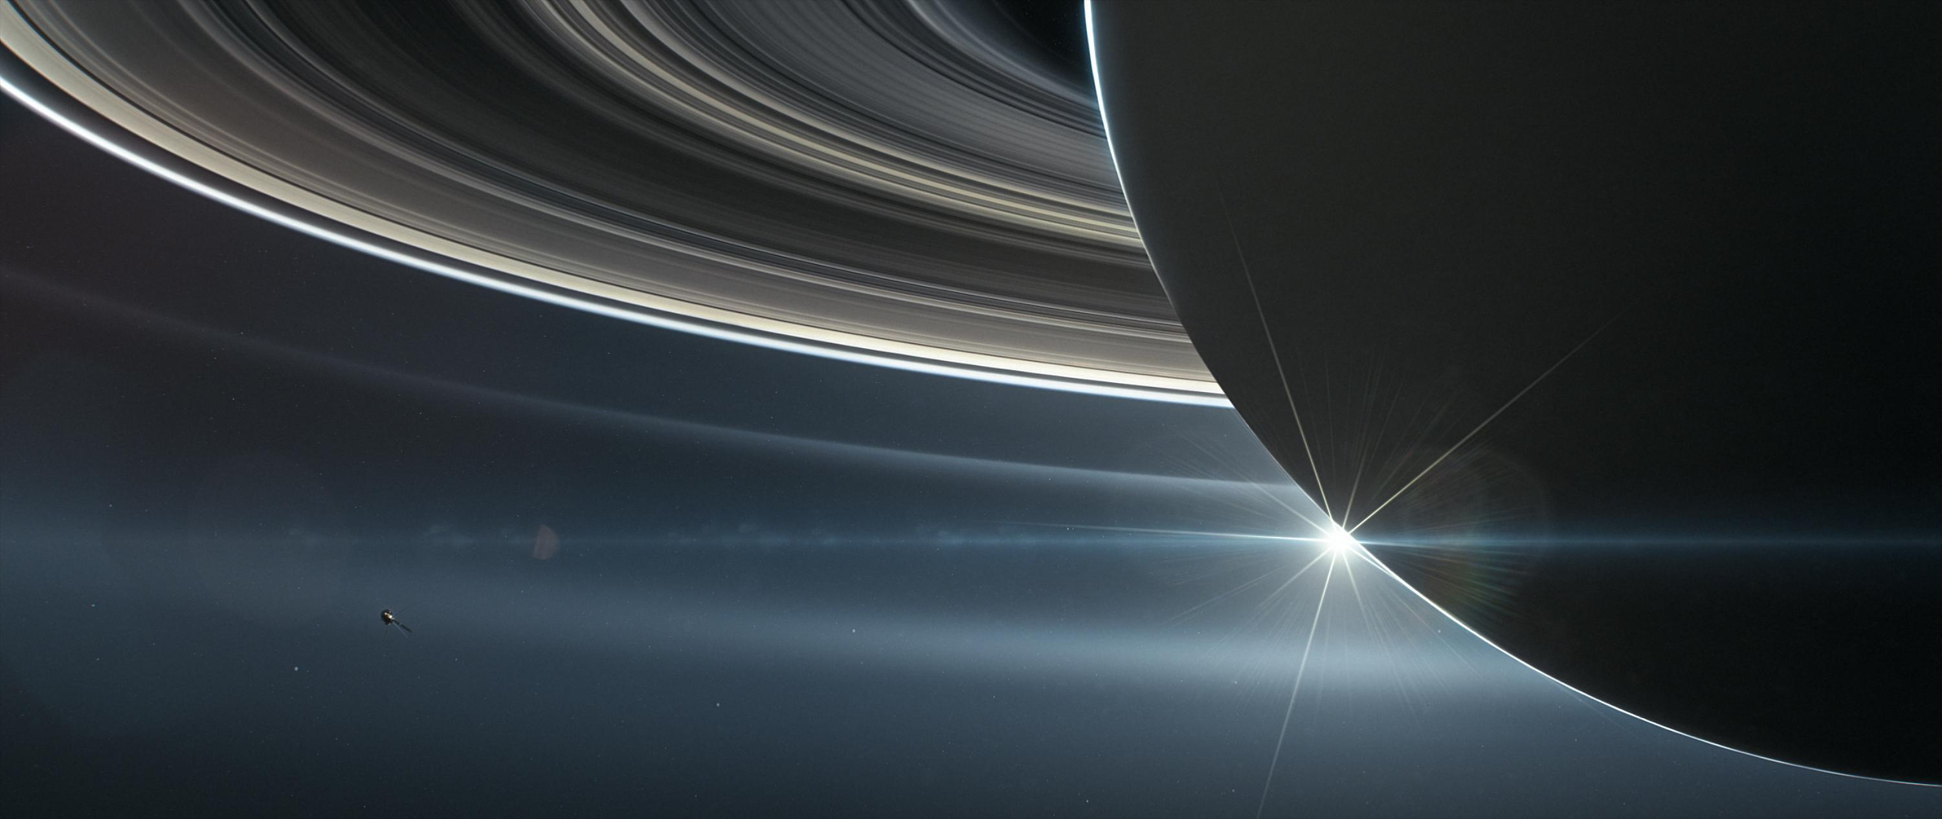
EXPAND YOUR HORIZONS AND TAKE HOME A PIECE OF THE GALAXY.
WE SHIP ANYWHERE IN THE GALAXY.
Unique, never seen products. Unveil the wonders of the universe here

Slide 4
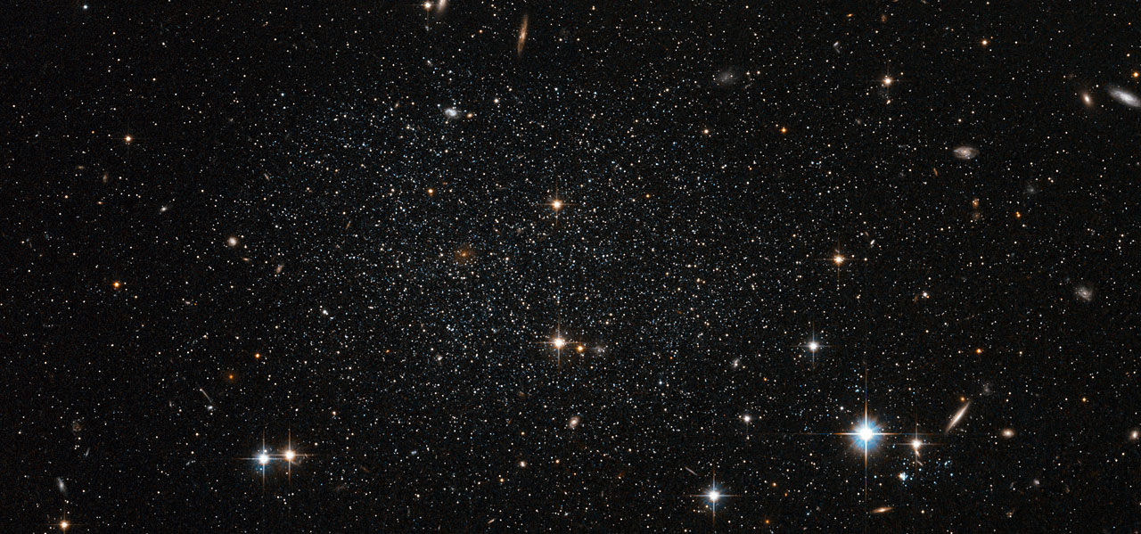


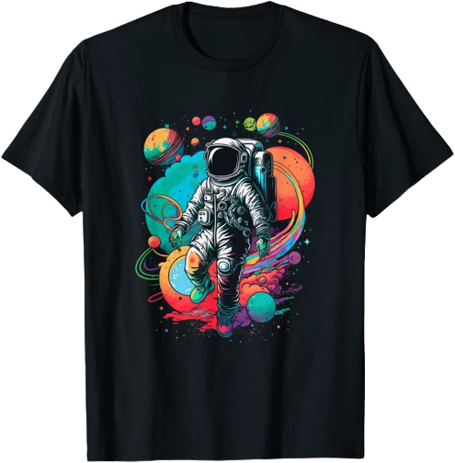
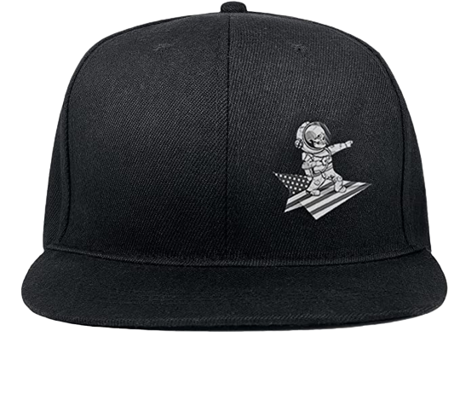
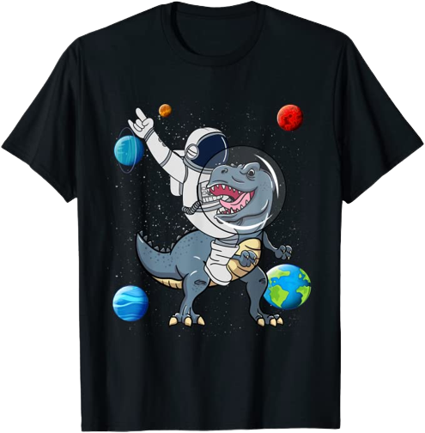
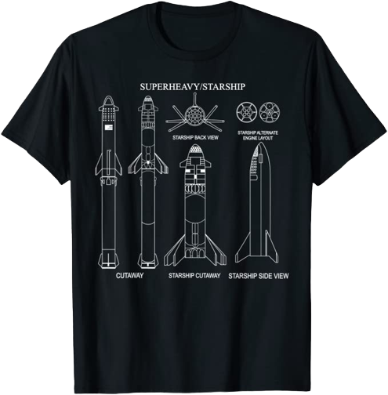
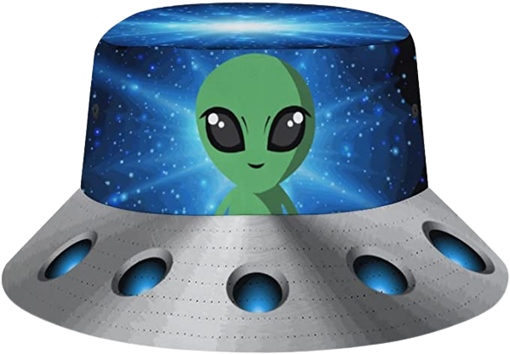
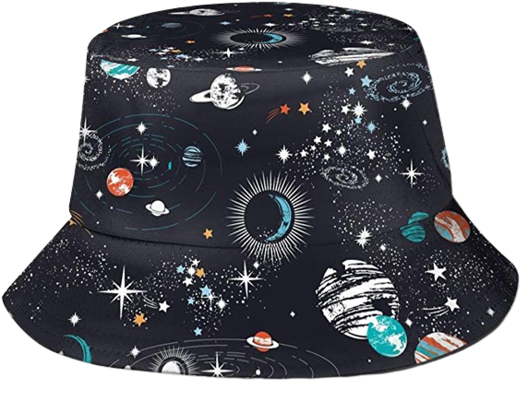




T-SHIRTS
HATS
HATS
Books

Slide 5




