Slide 1
EXPAND YOUR HORIZONS AND TAKE HOME A PIECE OF THE GALAXY.
CLICK TO LEARN MORE

Slide 2
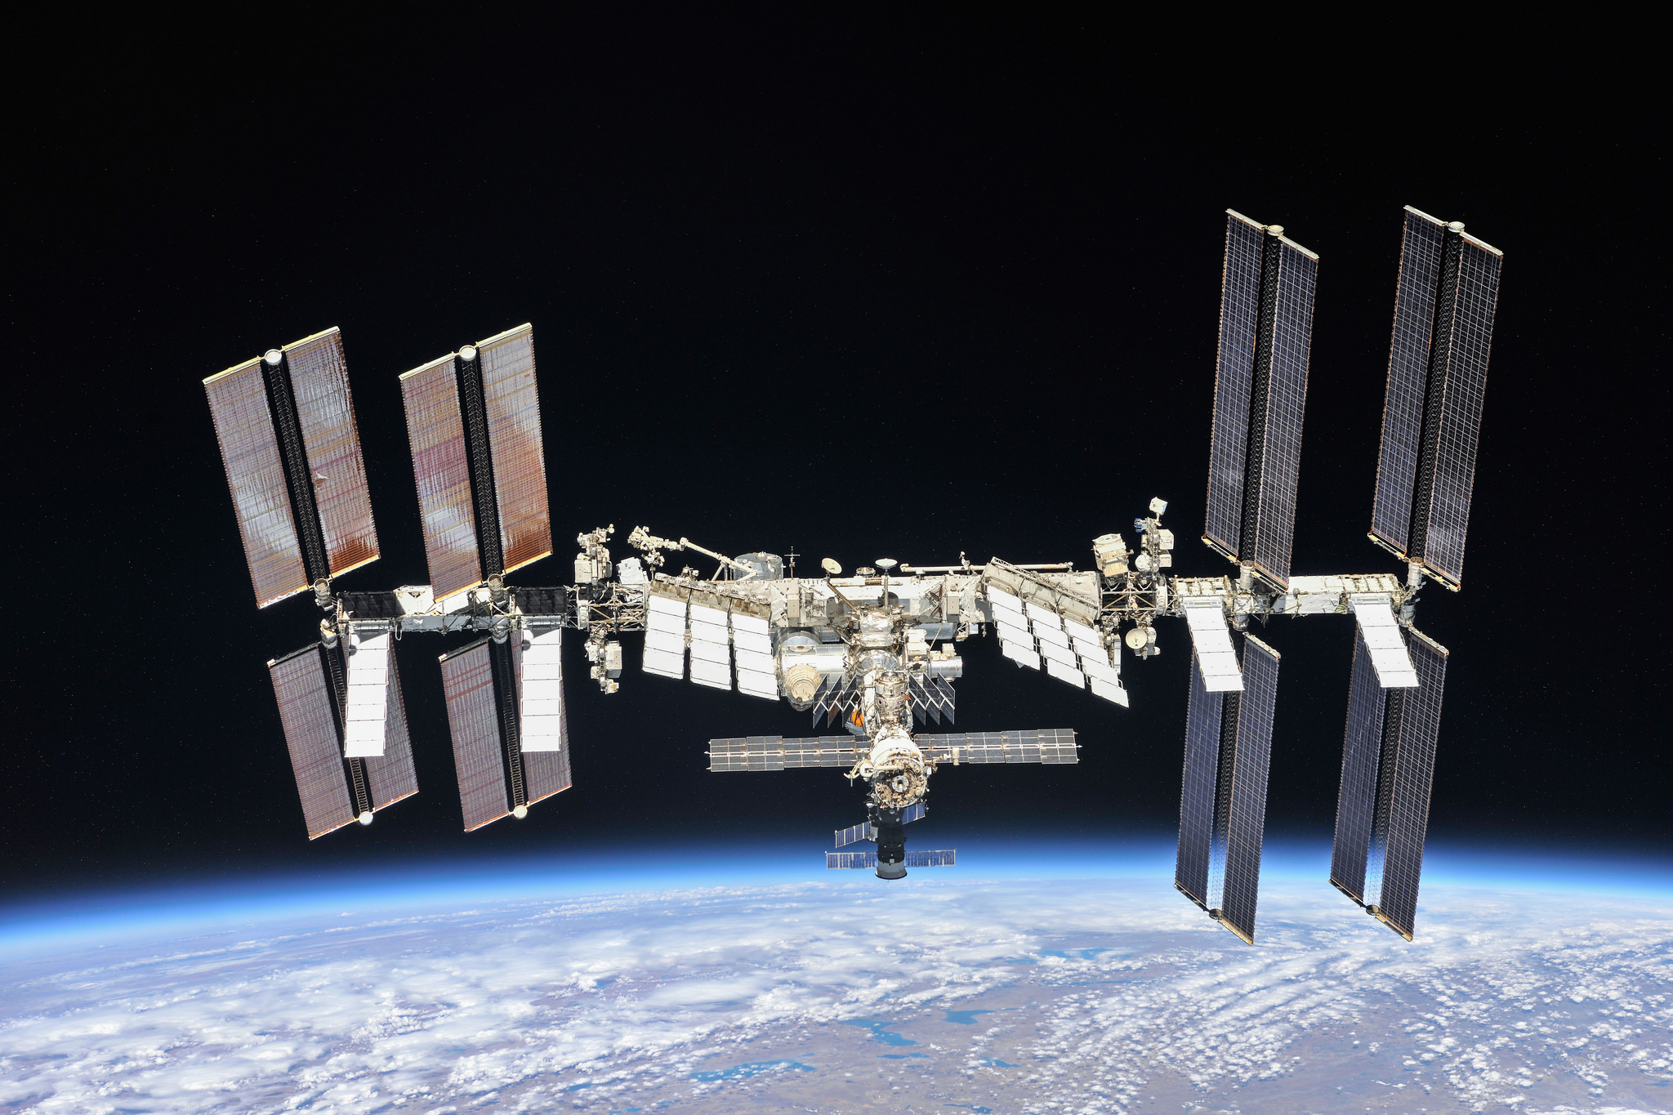
LIVE ONBOARD THE INTERNATIONAL SPACE STATION
CLICK TO LEARN MORE

Slide 3
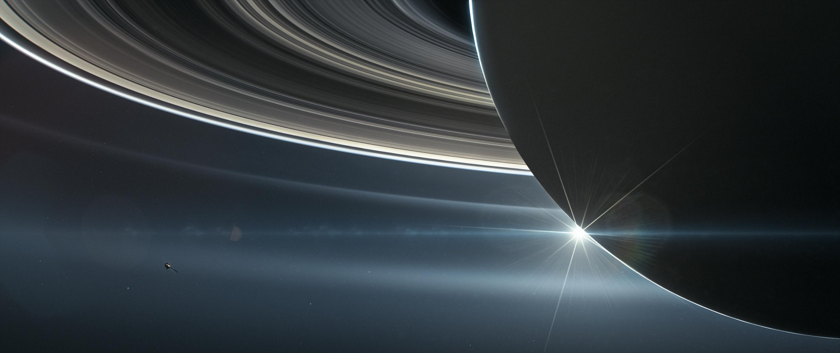
EXPAND YOUR HORIZONS AND TAKE HOME A PIECE OF THE GALAXY.
WE SHIP ANYWHERE IN THE GALAXY.
Unique, never seen products. Unveil the wonders of the universe here

Slide 4
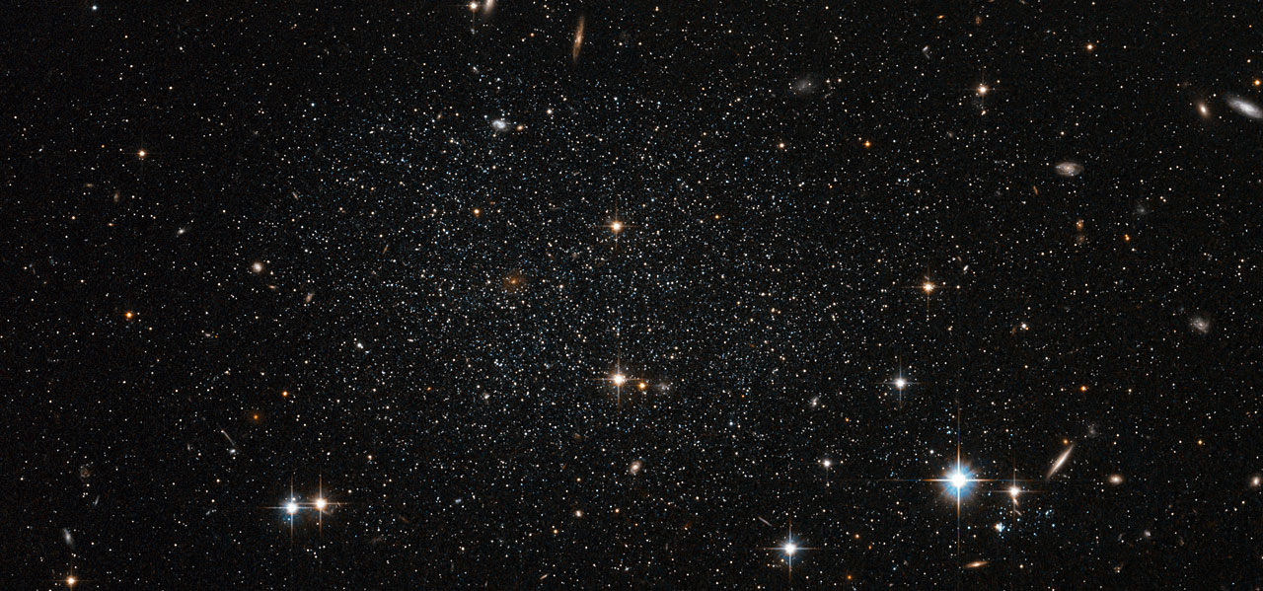


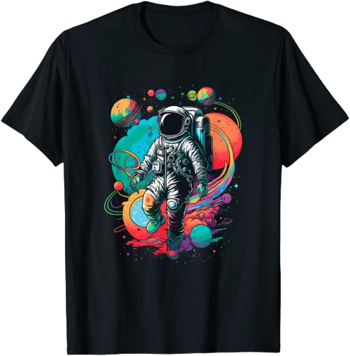

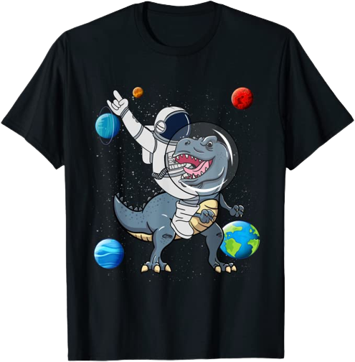

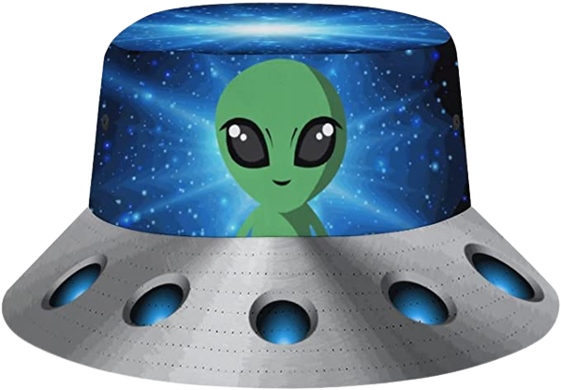
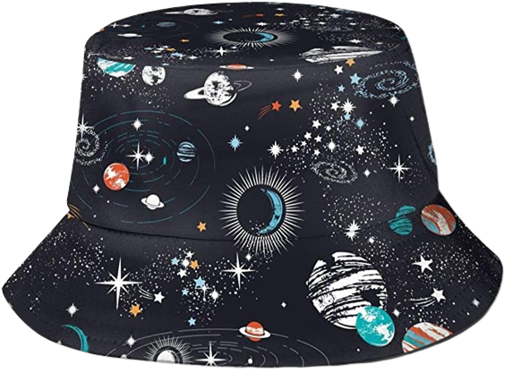




T-SHIRTS
HATS
HATS
Books

