Slide 1
Security and Identity
Name
Title
Microsoft Corporation
Notes:
Objectives:
This is a presentation that introduces key concepts of claim-based architecture.

Slide 2
Agenda
Claim-based architecture
Windows Azure ACS
Windows Azure Active Directory

Slide 3
Claim-based architecture

Slide 4
Security challenge
Dear programmer:
Thank you for securing your application!
Sincerely
Hacker
Customer
support
Data protection
Management
UI
Forget password?
User store
User mapping
More
User mapping
LDAP
Authentication
Authorization
Your App
Facebook
Auth API
Integration
with AD
Synchronization
Integration
With
Facebook
More
Synchronization
Notes:
Objectives:
Security is a common request of applications. However implementing **proper** security is hard. Also, additional security-related code increases complexity and attacking surface to your applications. We need authentication and authorization abstracted away so we can focus on business logics.
Transition:
N/A
Speaking Points:
Implementing proper security is hard
Security should not be added later on, but should be designed into the system at beginning.
Notes:
N/A

Slide 5

Solution: Claim-based architecture
?
ACS
+
WIF
ACS
+
WIF
“User is Joe”
“Role is Administrator”
Trust
Your App
Notes:
Objectives:
Wouldn’t it be nice if “someone” can hide all complexities and just provides simple assertions to us? Good news is, there are many security specialists that have put collectively hundreds of years of experiences and best practices into standards, specs, tools, and services.
On Windows Azure, this “someone” is ACS + WIF.
Transition:
Previous slide presents a problem, this slide provides a solution.
Speaking Points:
Claim-based architecture allows us to refocus on business logics.
The trustee has to be trust-worthy (has to be rock-solid to be included in the circle of trust)
Notes:
The circle of trust can be further extended to include other identity providers and service providers to enable scenarios such as federation and SSO.

Slide 6
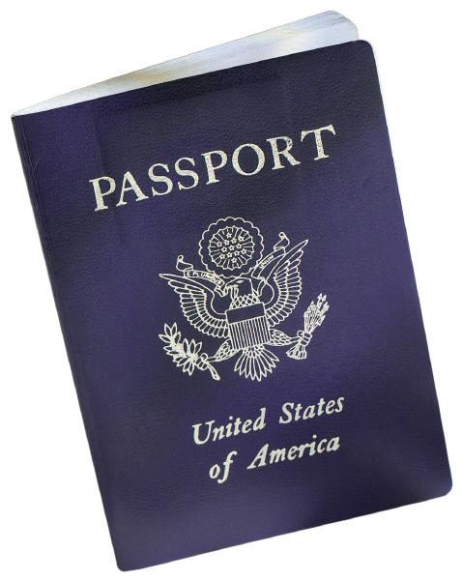
Digital identity in a nutshell
Claim:
Seat is 28A
RP
Token
Transform
IdP
Token
Home Realm Discovery
WIF
ACS
IdP
User
Notes:
Slide Objectives:
Provide a quick introduction to commonly used digital identity concepts using a real-life scenario.
Prepare the audience for a deeper discussion on ACS itself.
Transition:
This slide prepares the audience for future slides by equipping them basic set of jargon so that they don’t get confused navigating interleaved relations among different participants.
Speaking Points:
This is just an introduction slide. You don’t need to go into exact definitions and functions of different parties.
Notes:
The scenario is: you are going to an airport trying to get on a plane. You are stopped by security who demands a boarding pass. You go to the ticket counter to get a boarding pass. You are informed you need either a passport or a driver’s license in order to get a boarding pass. You present the passport in this case, and you get a boarding pass in return (after the passport checked out). You present the boarding pass to security and get permission to board. While you are on board, you use the information on the boarding pass to find your seat (Of course this is not the exact process while you are at the airport – probably you’ll directly go to ticket counter to get a boarding first – this is similar to an IP-initialized authentication process. Here we are just discussing RP-initialized authentication process).
Now let’s map the above story to digital concepts – you, USER, tries to access a SERVICE (the plan). The service relies on some other party for authentication, so it’s called a RELYING PARTY, RP for short, in this case. WIF (security counter) is configured to protect the service in this case. It will redirect all unauthorized calls to a trusted IDENTITY PROVIDER, IP or IdP for short, in this case ACS. ACS serves as dual-role here. It acts as an IP to the RP, but itself acts as an RP as it trusts other IPs (government departments) for actual authentication. In this case ACS is configured to trust two IPs – the DMV and Department of State. USER needs to acquire a SECURITY TOKEN, which contains CLAIMS on the user, from either IP. The process of selecting which IP to use is called HOME REALM DISCOVERY. Once a TOKEN is presented to ACS, ACS can apply TOKEN TRANSFORAMTION s based on pre-defined rules such as changing token format, and enriching token with more information, etc. Once TOKEN is transformed to desire format, it’s sent to WIF. WIF crack the TOKEN and provide CLAIMS to the RP. The RP can simply use the CLAIMS (such as seat number in this case) in business processes.

Slide 7

Access Control Service

Slide 8
Access Control Service
Makes it easy to authenticate and authorize users
Integration Single Sign On and centralized authorization into your web applications
Standards-based identity providers
Enterprise directories (e.g. Active Directory Federation Server v2.0)
Web identities (e.g. Windows Live ID, Google, Yahoo!, and Facebook)

Slide 9
ASP.NET & ACS
demo

Slide 10
Access Control
Browser
Identity Provider
Access Control
Application
1. Request Resource
2. Redirect to ACS
3. Auth/N
4. Home-realm
Discovery
5. Redirect to IdP
6. Login
7. Authenticate &
Issue Token
8. Redirect to AC service
9. Send Token to ACS
10. Validate Token, Run Rules Engine, Issue Token
11. Redirect to RP with ACS Token
13. Send ACS Token to Relying Party
14. Return resource representation
12. Validate
Token

Slide 11
Access Control Features
Integrates with Windows Identity Foundation and tooling
Claims-based access control
Support for OAuth WRAP, WS-Trust, and WS-Federation protocols

Slide 12
Access Control Features
Support for the SAML 1.1, SAML 2.0, and Simple Web Token token formats
Integrated and customizable Home Realm Discovery
OData-based Management Service to ACS configuration

Slide 13
Windows Azure
Active Directory

Slide 14

WARNING
This section is based on Windows Azure Active Directory Developer Preview (July 2012).

Slide 15
Windows Azure Active Directory
cloud
app
Extension of Active Directory into the cloud
Designed primarily to meet the needs of cloud applications
Identity as a service: an essential part of Platform as a Service
cloud
app
cloud
app
Notes:
Notes:
http://haishibai.blogspot.com/2012/07/guided-tour-of-windows-azure-active.html

Slide 16
Identity Management as a Service
cloud
app
Consolidate identity management across cloud apps
Connect to directory from any platform, any device
Connect with people from web identity providers and other organizations
cloud
app
cloud
app
Notes:
Notes:
http://haishibai.blogspot.com/2012/07/guided-tour-of-windows-azure-active.html

Slide 17
Relationship to Windows Server AD
cloud
app
On-premises and cloud Active Directory managed as one
Directory information synchronized to cloud, made available to cloud apps via role-based access control
Federated authentication enables SSO to cloud applications
cloud
app
cloud
app
Sync and Federation

Slide 18
Directory Graph API
RESTful programmatic access to directory
Objects such as users, groups, roles, licenses
Relationships such as member, memberOf, manager, directReport
Requests use standard HTTP methods
POST, GET, PATCH, DELETE to create, read, update, and delete
Response in XML or JSON; standard HTTP status codes
Compatible with OData 3.0
OAuth 2.0 for authentication
Role-based assignment for application and user authorization
Notes:
Notes:
http://haishibai.blogspot.com/2012/07/guided-tour-of-windows-azure-active.html

Slide 19
ASP.NET & AAD
demo

Slide 20
What We Covered
Claim-based architecture
Use ACS+WIF for your authentication needs
Windows Azure ACS
Easy integration with standard-based identity providers
Windows Azure Active Directory
Identity as a service
RESTful API

Slide 21
Thank You

