Slide 1
Windows Azure Virtual Networks
Speaker
Title
Organization

Slide 2
Agenda
Endpoints and Connectivity
New Features Supported by the Load Balancer
DNS and Name Resolution

Slide 3
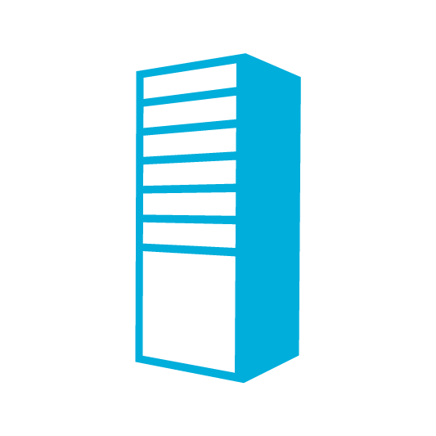
Overview: Connectivity in Azure
Input Endpoint
LB
Internal Endpoint

Slide 4

Overview: Existing Connectivity in Azure
Input Endpoint
Loadbalanced endpoint. Stable VIP per service.
Single port per endpoint
Supported protocols: HTTP, HTTPS, TCP
VIP:Input Endpoint
LB
Internal Endpoint
Instance-to-instance communication
Supported Protocols: TCP
Port ranges supported
Communication boundary = Deployment boundary
Name Resolution
Internal Endpoint
Windows Azure-provided DNS service for service-level name resolution
Runtime APIs for instance identification
foo.cloudapp.net → VIP
Notes:
Slide Objective:
This slide talks about connectivity options supported in SDK1.6. This slide does not include any of the new features.
Notes:
Cloud Service gets a VIP assigned for a deployment slot
No ports opened up by default
Need to define endpoints to open up ports
Input endpoint is a port
It is loadbalanced
Mapped across all role instances
Port maping is supported
Internal endpoint enables inter-role-instance communication
Ports for inter-vm communication are closed by default
Need to define an internal endpoint for communication
Internal endpoints can be port ranges
DNS resolution is only
Only service-level name resolution is supported
Need to use runtime APIs for instance name resolution.

Slide 5
Use Any IP Protocol in a Deployment
Internal endpoints are open by default with VMs
(Firewalls are not)
IP Traffic
Notes:
Slide Objective:
Internal endpoints are open by default
Notes:
Internal endpoints are an overhead for VMs.
Need all ports open for all IP based protocols
This has been done by default for VMs
Same can be done for PaaS by defining an internal endpoint with protocol = any
Allows al IP-ased traffic to flow
Notable exceptions: UDP MCAST, Broadcast; GRE and IP-inIP encap traffic

Slide 6
Use Any IP Protocol in a Deployment
Port forwarding
LB
UDP Traffic
Notes:
Slide Objective:
We support UDP for VM-to-VM as well as Internet to service communication.
Enables new scenarios such as gaming and media streaming in Windows Azure.

Slide 7
Port Forwarding
Windows Azure Role Instances
…
IN_1
IN_1
IN_1
Internet
Direct Connectivity to Individual Role Instances
Load Balanced
Traffic
Web Clients
Controller Service
Web Clients
Notes:
Slide Objective:
Explain how port forwarding works
Notes:
Connectivity to every role-instance behind an input endpoint is not possible. Several scenarios need a way to connect to VMs behind a loadbalancer.
Typical scenarios = monitoring, profiling and debugging
New endpoint type introduced to support this: Instance input endpoint
Port range is specified. Each port in the range corresponds to an instance.

Slide 8
Load Balancer: Default Health Probe
LB
VM
VM
Azure
Agent
Azure
Agent
Role Status
Role Status
Customer
Application
Customer
Application
Notes:
Slide Objective:
Explain default health probe
Notes: PaaS role instances run in a VM. We have a guest agent that does many things including responding to probes from the loadbalancer.
If probes are not responded to, instance will be taken out of LB rotation
This is not desirable in some cases as it does not take app’s health into account
Custom probes offers the ability to probe the app. Directly for health. Supported for TCP and HTTP.
Also required for loadbalancing VMs based on health

Slide 9
Load Balancer: Custom Health Probe
LB
VM
VM
Azure
Agent
Azure
Agent
Role Status
Role Status
Customer
Application
Customer
Application
Notes:
Slide Objective:
Explain that you can specify a custom health probe
Notes:
You can currently only set this through PowerShell

Slide 10
Windows Azure provided DNS
TestVM1
TestVM2
Who is TestVM2?
10.1.1.1
Who is TestVM2?
Who is TestVM2?
Notes:
Slide Objective:
Overview of Windows Azure Provided DNS
Notes:
PaaS uses runtime APIs
IaaS / VMs require a solution that does not require any code changes.
We provide name resolution as a service.
No need to deploy a DNS server. Name resoluton within the deployment boundary just works.
Malicious tenant cannot detect VMs in a deployment by name or IP address.
Name resolution boundary = deployment boundary.
No support for discovery today.

Slide 11
DNS Scenarios
Windows Azure DNS Scenarios
Use your own DNS Scenarios
A. Client-server applications using persistent VMs
B. Hybrid connectivity with on-premise (DNS on-premise)
On-Premises Machine
On-Premises Machine
Persistent VM Role
Persistent VM Role
Persistent VM Role
Active Directory
Web Tier
SQL Reporting Service
SQL Analysis Service
SQL Service
UI Process Components
Active Directory
On-Premises Machine
Business Components & Entities
SQL Service
Active Directory
Domain joined to On-Premises Network
C. SharePoint with custom DNS (persistent VM)
Persistent VM Role
Local DNS
DC
DNS
Open User Access (Website)
Persistent VM Role
SharePoint FrontEnd
Persistent VM Role
Persistent VM Role
SQL
LB
SQL Mirroring
Persistent VM Role
SharePoint FrontEnd
Persistent VM Role
Persistent VM Role
SQL
Search and Indes
SQL Service
Internet
Notes:
Slide Objective:
DNS Scenarios

Slide 12


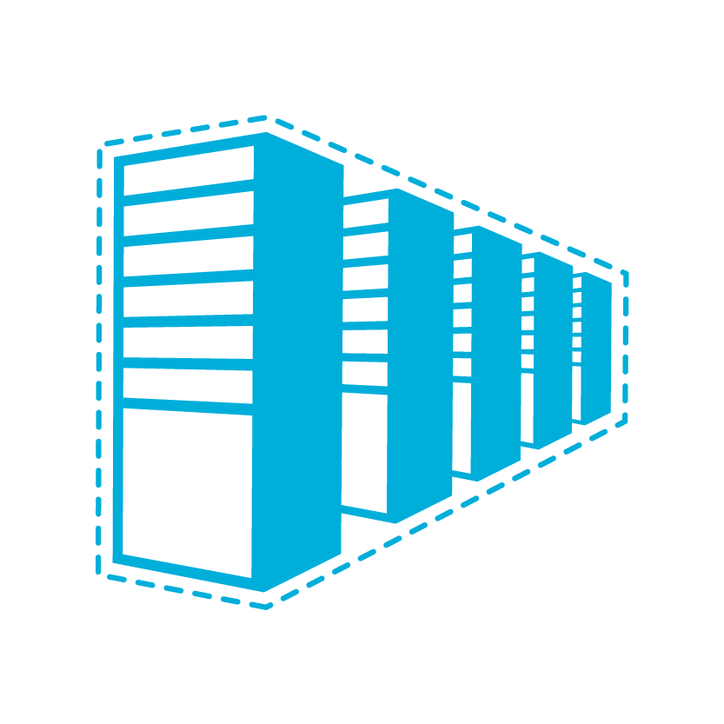

Windows Azure Connectivity Options
CLOUD
ENTERPRISE
Data Synchronization
SQL Data Sync
Application-Layer
Connectivity & Messaging
Service Bus
Secure Machine-to-Machine Network Connectivity Windows Azure Connect
Secure Site-to-Site
Network Connectivity
Windows Azure Virtual Network
Secure Site-to-Site
Network Connectivity
Windows Azure Virtual Network
Notes:
Slide Objective:
Microsoft stack to provide connectivity between on-premise and cloud.
Notes:
Servicebus vs connect – SB requires app code change, Connect/Virtual Networks do not.
Virtual Networks are the net new here. They provide site to site connectivity where Connect provided server to server connectivity.
Virtual Networks are the more flexible and powerful option.

Slide 13
Windows Azure Virtual Networks
Your “virtual” branch office / datacenter in the cloud
Enables customers to extend their Enterprise Networks into Windows Azure
Networking on-ramp for migrating existing apps and services to Windows Azure
Enables customers to run “hybrid” apps that span cloud and their premises
A protected private virtual network in the cloud
Enables customers to setup secure private IPv4 networks fully contained within Windows Azure
IP address persistence
Inter-service DIP-to-DIP communication
Notes:
Slide Objective:
VNET Overview
Notes:
Windows Azure Virtual Networks is our solution to providing hybrid solutions and solutions that require advanced connectivity in the cloud.
Hybrid on-premises to cloud is enabled by using the VPN solution that allows site<->site connectivity allowing machines on premise and machines in the cloud to appear on the same network.
Advanced connectivity solutions are enabled because Windows Azure applications that are deployed in to a virtual network will have persistent IP addresses. This is a requirement for solutions like Active Directory.
Other solutions enabled by virtual networks in the cloud are mixing VMs and web/worker role solutions in the same Windows Azure network. This allows for scenarios like web/worker roles to communicate back to VMs running applications like SQL server.

Slide 14
The “virtual” branch office
The Branch Office
The Corp. HQ
SQL Servers
IIS Servers
S2S VPN tunnel
S2S VPN Device
The Virtual Network
in Windows Azure
AD / DNS
S2S VPN Device
S2S VPN tunnel
Exchange
BRK Gateway
Notes:
Slide Objective:
Vnet is just like your branch office

Slide 15
Virtual Network Features
Customer-managed private virtual networks within Windows Azure
“Bring your own IPv4 addresses”
Control over placement of Windows Azure Roles within the network
Stable IPv4 addresses for VMs
Hosted VPN Gateway that enables site-to-site connectivity
Automated provisioning & management
Support existing on-premises VPN devices
Use on-premise DNS servers for name resolution
Enables customers to use their on-premise DNS servers for name resolution
Enables VMs running in Windows Azure to be joined to corporate domains running on-premise (use your on-premise Active Directory)
Notes:
Slide Objective:
VNET Feature Overview
Notes:
BYO IPv4 space. Only provite Ips in a VNet
Carve out IP subnets with a vnet
No overlapping subnets
IP address stays with the VM for it’s lifetime
We manage SW gateway. Run in active / passive mode for high availability.
DNS + IP address persistence is key to enable many new scenarios (AD, DNs, …)

Slide 16
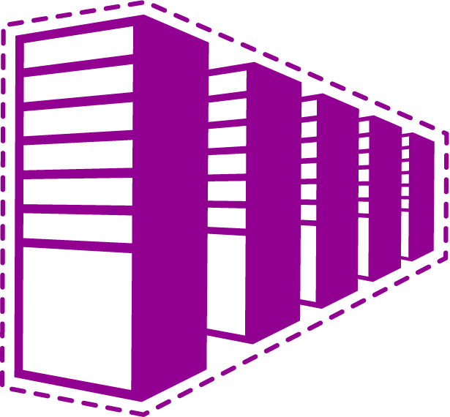
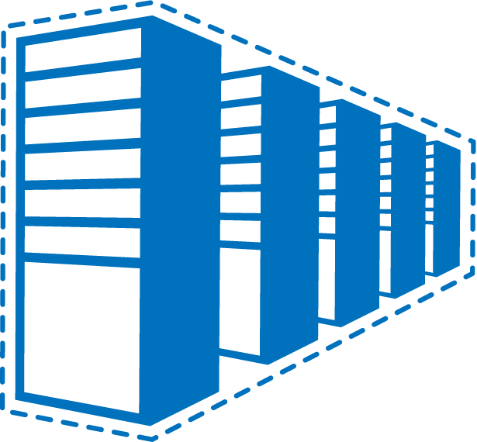
Example: Contoso’s Deployment
Contoso Production VNet in Windows Azure (10.1.0.0/16)
The Corp. HQ (10.0.0.0/16)
10.2.2.0/24
10.2.3.0/24
SQL Farm
IIS Servers
131.57.23.120
65.52.249.22
10.1.0.4
10.1.1.4
10.0.0.10
10.0.0.11
S2S VPN tunnels
Contoso Test in Windows Azure (10.2.0.0/16)
AD / DNS
S2S VPN Device
Exchange
BRK Gateway
10.2.2.0/24
10.2.3.0/24
Notes:
Slide Objective:
Example
Notes:
Customer can have more than 1 Vnet per subscription (capped at 5 but can be increased if they make a support call).
Vnets talking to the same site must not have overlapping IP ranges.

Slide 17
The Scenarios

Slide 18
Virtual Network Scenarios
Hybrid Public/Private Cloud
Enterprise app in Windows Azure requiring connectivity to on-premise resources
Enterprise Identity and Access Control
Manage identity and access control with on-premise resources (on-premises Active Directory)
Monitoring and Management
Remote monitoring and trouble-shooting of resources running in Windows Azure
Advanced Connectivity Requirements
Cloud deployments requiring persistent IP addresses and direct connectivity across services
Notes:
Slide Objective:
Use cases

Slide 19
Application Migration
The Corp. HQ
WA Web Role
SQL Farm
IIS Servers
VPN Tunnel
App Servers
AD / DNS
Notes:
Slide Objective:
Explain how to enable customers to extend their Enterprise Networks into Windows Azure
Networking on-ramp for migrating existing apps onto Windows Azure
Support “hybrid” apps that span cloud and on-premises
Notes:
Customer-managed private virtual networks within Windows Azure
“Bring your own IPv4 addresses”
Control over placement of Windows Azure Roles within the network
Stable IPv4 addresses for VMs
Hosted VPN Gateway that enables site-to-site connectivity
Automated provisioning & management
Support existing on-premises VPN devices
BYO on-premise DNS servers
Enables customers to use their on-premise DNS servers for name resolution
Enables VMs running in Windows Azure to be joined to corporate domains running on-premise (use your on-premise Active Directory)

Slide 20
Monitoring
The Corp. HQ
WA Web Role
SQL Farm
IIS Servers
VPN Tunnel
Monitoring Service
AD / DNS
Notes:
Slide Objective:
Enable customers to extend their Enterprise Networks into Windows Azure
Networking on-ramp for migrating existing apps onto Windows Azure
Support “hybrid” apps that span cloud and on-premises
Notes:
Customer-managed private virtual networks within Windows Azure
“Bring your own IPv4 addresses”
Control over placement of Windows Azure Roles within the network
Stable IPv4 addresses for VMs
Hosted VPN Gateway that enables site-to-site connectivity
Automated provisioning & management
Support existing on-premises VPN devices
BYO on-premise DNS servers
Enables customers to use their on-premise DNS servers for name resolution
Enables VMs running in Windows Azure to be joined to corporate domains running on-premise (use your on-premise Active Directory)

Slide 21
SharePoint in Windows Azure
On Premises
Windows Azure Virtual Network
Persistent VM Role
DC
DNS
Local DNS
10.8.8.x
Use Accounts
Persistent VM Role
SharePoint FrontEnd
DC
DNS
Server Account
Persistent VM Role
SQL
LB
SQL Mirroring
Persistent VM Role
SharePoint FrontEnd
Persistent VM Role
Persistent VM Role
SQL
Search and Indes
Persistent Desk
Internet
Domain Joined to On-Premises Network
Notes:
Slide Objective:
Show how SharePoint could be deployed in a hybrid approach

Slide 22
Mixed Mode with VNet
Persistent VM Role
Persistent VM Role
Business Components & Entities
SQL
Web Role
Persistent Disk
LB
SQL Mirroring
Persistent VM Role
Business Components & Entities
Web Role
Persistent VM Role
Persistent Disk
SQL
Notes:
Slide Objective:
Show how using a VNET multiple deployment types (IaaS and PaaS) could co-exist on the same network

Slide 23
How Do I Setup Virtual Networks?

Slide 24
Configuring Virtual Networks
Windows Azure Portal (API)
Network Admin
Network configuration
CorpOffice
Deployment package
IT Admin
ContosoCorpOffice (10.0.0.0/16)
ContosoVNet (10.1.0.0/16) → MyAffinityGroup
FrontEndSubnet
(10.1.1.0/24)
ADSubnet
(10.1.2.0/24)
SQLSubnet
(10.1.3.0/24)
Cisco ASA GW 131.57.23.45
SQLSubnet
(10.1.3.0/24)
BESubnet
(10.1.4.0/24)
GW IP
65.57.23.45
DNS2 10.0.0.21
DNS1 10.0.0.20
Notes:
Slide Objective:
Overview Steps of Deploying a VNET
Notes:
Network admin sets up network (logically)
IP ranges of premises and vnet(s)
Subnet specification
DNS server specification
IP of VPN GW
MSFT provides sample VPN config scripts for popular device families.
Services can eb deployed in VNet easily.

Slide 25
Portal Experience, APIs and Service Models
Portal
Wizard to create, and update virtual networks
Manage GW Lifecycle
APIs and Scripting
REST APIs
PowerShell Cmdlets
Service Model
Network Configuration
Operations on Net Config
Set Network Configuration
Get Network Configuration
Operations on GW Manager
Create Gateway
Delete Gateway
Get Gateway
Get Gateway SharedKey
Reset Gateway SharedKey
List Connections
Connect To Local Network Site
Disconnect From Local Network Site
Test Local Network Site
Get Operation Status
List Operation Status
Notes:
Slide Objective:
Explain entry points

Slide 26
Deploying a Virtual Network
demo
Notes:
Slide Objective:
Demo
Notes:
Show DEMO_DeployingHybrid (DemoMate)
Shows deploying VNET for site-to-site connectivity

Slide 27
Virtual Networks V1 Feature Set

Slide 28
Supported VPN Device List
Cisco
Juniper
Platform | OS Family | Examples
ASA 5500 Series (Adaptive Security Appliances) | ASA Software 8.4+ | 5505, 5550
ASR 1000 Series Aggregation Services Routers | IOS XE 2.1+ | 1002
ISR Series Integrated Services Routers | IOS 12.2+ | 2801, 2901, 2911
Platform | OS Family | Examples
SRX Series Routers | JunOS 10.2+ | 210, 650
J Series Routers | JunOS 9.4+ | 4350
ISG Series Routers | ScreenOS 6.2+ | SX2
SSG Series Routers | ScreenOS 6.2+ | 550
Generic VPN devices must support
IKE v1
AES 128, 256
SHA1, SHA2
Notes:
Slide Objective:
Show currently supported VPN devices
List above is just what we go to preview with. List will grow with time. Partners tested device against our solution.
Any industry standard VPN will work.

Slide 29
Note on GW redundancy and availability
Only single IPsec tunnel supported per Virtual Network
Gateway tenant on Azure side has 2 instances (active-passive mode)
Only one public IP address for tunnel establishment
A pair of VPN devices can be a redundant pair using industry standard protocols
HSRP
VRRP
Notes:
Slide Objective:
Explain availability

Slide 30
Limits (for V1 release)
Subscription Limits
One Network Configuration per subscription
Up to 5 VNets and 5 sites per subscription
One VNet per Affinity Group
Up to 9 DNS Servers per subscription
Virtual Network Site
Can use addresses defined in RFC1918
Can connect to only one site
No limit on subnets
Local Network Site
Public and Private IP addresses allowed
Only one gateway IP per site
Gateway
One GW tenant per Vnet (managed by the Windows Azure)
Only one active tunnel between site and VNet
No address space overlaps
Notes:
Slide Objective:
Preview limits

Slide 31
Limitations of V1 offering
Virtual Network
Cross-prem connectivity
Only IPv4 addresses allowed
No support for MCAST / BRCAST
No support for BYO MAC address
No support for assigning static IP addresses for VMs
No active routing support (BGP)
No support for forced tunneling
No dynamic updates to virtual network address space
No support for IKE v2
No support for cert. based auth.
No support for 2-factor auth.
No support for software-based VPN solutions
Notes:
Slide Objective:
Preview limits

Slide 32
The Differences
Networks in customers’ premises
Virtual Networks in Windows Azure
Customers have full control L2 and up
MAC address specification and VLANS supported
Static and DHCP address assignments supported
MCAST, BRCAST supported
Routing has to be configured explicitly
Trust boundary = VLAN boundary
Several modes of VPN connectivity supported (SSL, Ipsec, …)
WAN optimizers can be used to optimize cross-premise connectivity over the network
Customers can specify only some L3 properties
No support for MAC and VLANs
Only Azure-managed DHCP address assignments
No support for MCAST and BRCAST
Routing is implicit
Trust bundary = VNet boundary
Only Ipsec with IKEv1 supported
No support for WAN Optimizers
Notes:
Slide Objective:
Compare and contrast existing networking with VNETs in Windows Azure

Slide 33
Summary Of Networking Features
Input Endpoint
Internal Endpoint
Supported protocols: HTTP, HTTPS, TCP, UDP
Loadbalancing for virtual machines
Custom loadbalancer probes
Instance-to-instance communication
Supported Protocols: TCP, UDP, ANY IP based protocol
LB
Name Resolution
Windows Azure DNS service for service-level name resolution
Runtime APIs for instance identification
Windows Azure-provided DNS service for service-level name resolution
Windows Azure-provided DNS for vm-level name resolution
Using your DNS servers for name resolution
Windows Azure Traffic Manager
Windows Azure Virtual Network for Hybrid scenarios
Notes:
Slide Objective:
Summarize Presentation

