Slide 1
A.O. Smith Options With Microchip and Microsoft Azure IoT
Randy Wu, Principal ESE
Wireless Specialist (PACNW)

Slide 2
Current Solution
A.O. Smith Application
(No RTOS)
Ayla Production Agent
Networking: TCP/IP, TLS
Application MCU – (NXP Kinetis)
uRata
STM32
BCM43
BLE
(unused)
Security?

Slide 3
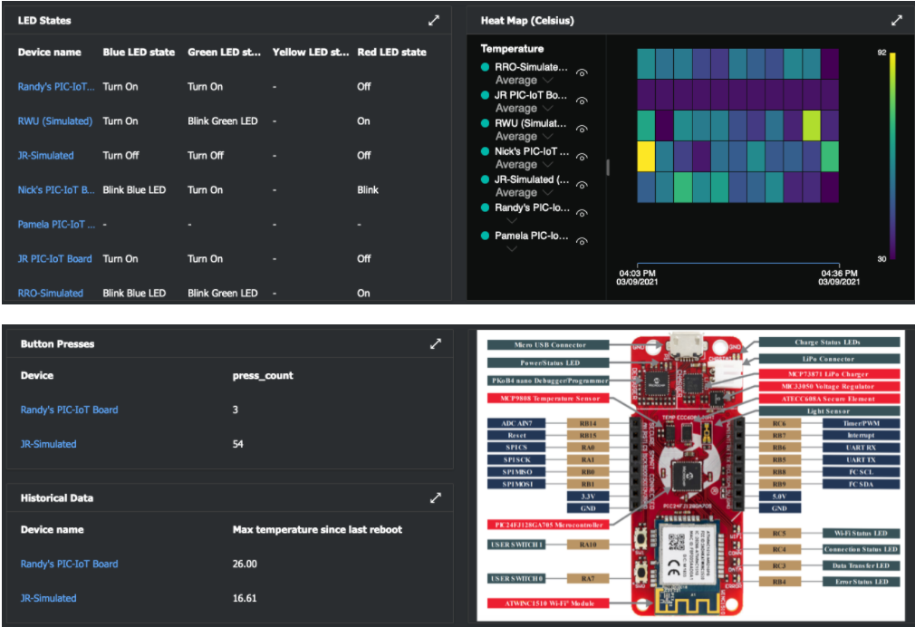
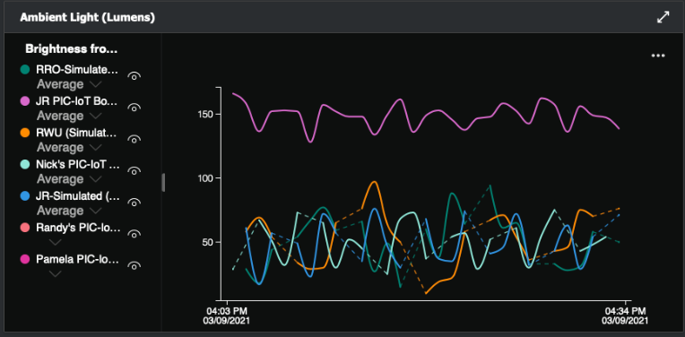
Azure IoT Central With SAM-IoT
https://github.com/Azure-Samples/Microchip-SAM-IoT-Wx/blob/main/SAM_IoT_Central.md

Slide 4
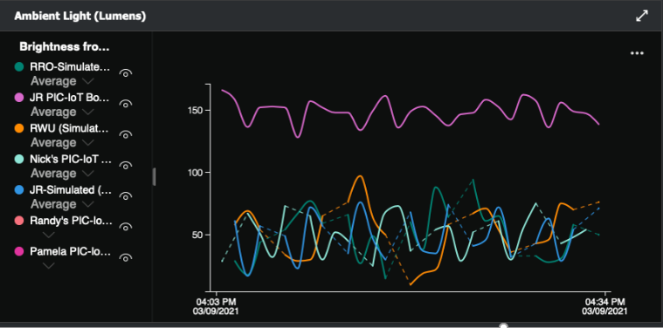
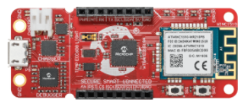
Option 1: Partitioned Embedded Cloud Agent
A.O. Smith Application
(No RTOS)
Azure-IoT “Agent” replace
Ayla Portable Agent
Networking: TCP/IP, TLS 1.2, WiFi, BLE
Benefits
Partitioned, straightforward firmware similar to existing architecture
Secure element
Separate MCU- easier switchover to Azure-IoT
Eliminates discrete BLE
Cloud Agent MCU
SAMD21
Application MCU SAMD54
WiFi/BLE WINC3400*
Concerns
Double MCU implementation
“Agent” development
ECC608
Hardware Secure Element
Simple Prototype
(WINC1510 +
SAMD21 +
ECC608B)
*Or WINC1510 (WiFi Only)

Slide 5
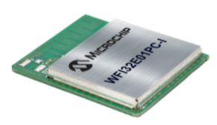
Option 2: App MCU + WFI32 for all Networking
Benefits
Little change to application FW
Simplify design- 2 chip solution
Built-in secure element
Azure-IoT “Agent” together with
Networking: TCP/IP, TLS 1.2, WiFi, WPA3
(Azure RTOS)
Secure Element
RN-Azure
Concerns
No BLE
A.O. Smith Application
(No RTOS)
Application MCU SAMD54
MCU+WiFi
WFI32
ECC608

Slide 6
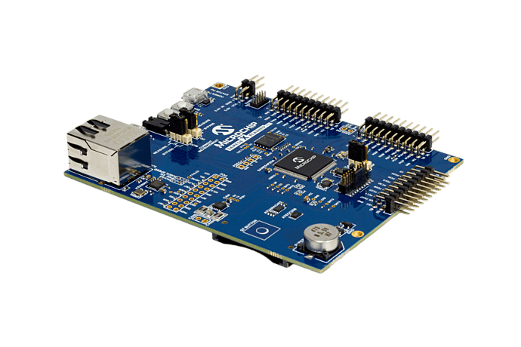
Option 3: Merged Cloud Agent with Application
A.O. Smith Application + Azure-IoT “Agent” running together under Azure RTOS
Networking: TCP/IP, TLS 1.2, WiFi, BLE
Benefits
Condensed firmware
Single MCU
Existing application running under an RTOS
Eliminates discrete BLE
Concerns
1 MB Flash
Heavier software effort to merge existing control with connectivity functions
Application MCU SAMD54 w/Azure RTOS
WiFi/BLE WINC3400*
ECC608
Hardware Secure Element
*Or WINC1510 (WiFi Only)

Slide 7
Option 4: Merge Everything into a Single Device
A.O. Smith Application,
Azure-IoT Agent together with
Networking: TCP/IP, TLS 1.2, WiFi, WPA3
(Azure RTOS)
Secure Element
Benefits
Condensed firmware
Single device- board space, layout
Built in secure element
Concerns
1 MB Flash
Heaviest software effort to merge all functions
No BLE
All in 1 MCU+WiFi
WFI32
ECC608

Slide 8

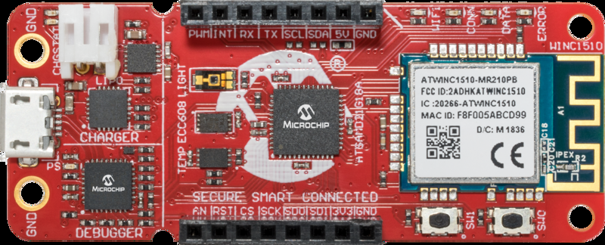

Recommended for Eval: SAM-IoT Dev Board
Easy Azure Connectivity for 32-bit ARM based Embedded Applications
Embedded sensors, actuators or mechatronic applications
Easy to add cloud connection to huge install base of SAM MCU applications
Smart: SAMD21 MCU
Low power down current
Great combination of large memory, ultra low power and rich feature set
Connected: WINC1510 Wi-Fi
Running TCP/IP and TLS connection to Azure
Secure: ATECC608A
Key storage, Authentication, Crypto
Secure device authentication to Azure
Secure provisioning support
Light Sensor
(TEMT6000)
Battery Charger
MCP73871
Voltage Regulator
(MIC33050)
mikroBUS
Indicator LEDs
Micro USB
Connector
1 in / 2.5 cm
Temp Sensor
(MCP9808)
nEDBG
Drag’n Drop
Serial/USB
Prog/Debug
Secure
ATECC608A
Smart
SAMD21
Connected
ATWINC1510
2 in / 5 cm
https://www.microchip.com/en-us/development-tool/EV75S95A
Notes:
1 min

Slide 9
Proof of Concept Demo using SAM-IoT Board
Azure IoT Hub
string
Application MCU
2KB
Bucket #1
string
2KB
Bucket #2
string
2KB
Bucket #3
string
2KB
Bucket #4
GOALS
Create 4 data buckets (strings of bytes) in Azure IoT Hub
Confirm IoT Hub receives correct data in each bucket using Azure IoT Explorer
All 8KB of data must be received within 5 seconds

Slide 10
Azure IoT PnP Interface for SAM-IoT (version 2)
Integers (4)
Strings (4)
Boolean (1)
Doubles (2)
Floats (2)
Long (1)
SAM-IoT Board
Sensors
- Light
- Temperature
4 LEDs
2 Buttons
Telemetry
Brightness
Temperature
Button events
Properties
Blue LED state
Green LED state
Yellow LED state
Red LED state
Telemetry interval
Commands
Reboot
NEW
Azure Cloud
MQTT
Integers – read only by cloud (2)
Integers – writable by cloud (2)
IP Address (read only string)
WINC1510 FW Version (read only string)
NEW
Azure Device Model
(“SAM_IoT_WM;1”)
Send ASCII Message
2
NEW

Slide 11
Application Parameters – Direction of Data Flow
SAM-IoT Board
Sensors
- Light
- Temperature
4 LEDs
2 Buttons
Telemetry
Brightness
Temperature
Button events
Properties
Blue LED state
Green LED state
Yellow LED state
Red LED state
Telemetry interval
Commands
Reboot
Integers (4)
Strings (4)
Boolean (1)
Doubles (2)
Floats (2)
Long (1)
Integers – read only by cloud (2)
Azure Cloud
Integers – writable by cloud (2)
Strings (IP Addr & FW ver) – read only
Send ASCII Message
Azure Device Model
(“SAM_IoT_WM;2”)
MQTT

Slide 12
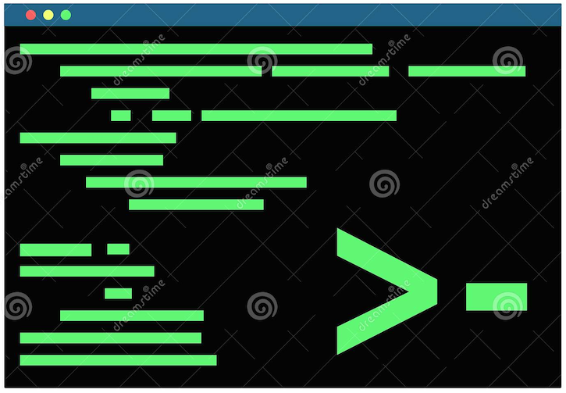
Command Line Interface (CLI) for SAM-IoT
Application MCU
Azure Cloud
CDC Interface (1200 to 500K baud)
UART (9600 baud)
MQTT
Update Telemetry & Properties using ASCII commands via Command Line Interface (CLI)
Telemetry Reported to Cloud
Properties Sync’d with Cloud

Slide 13
Standard ASCII Commands for SAM-IoT CLI
Command Format | Action
idscope [ID Scope] | Get and set Azure DPS ID Scope
reconnect | MQTT reconnect
wifi –set <ssid>[,<pass>,[authType]] | Set Wi-Fi credentials (authType: 1 = Open, 2 = WPA, 3 = WEP)
wifi –[scan|status] | Get list of Wi-Fi SSID’s or connection status
cloud -status | Get cloud connection status
key | Get ECC public key
device | Get ECC serial number
cli_version | Get CLI version
version | Get MCU application firmware version
debug [level] | Get and set debug level
reset | Reset host
q | Quit command processor
help | Help menu
NEW
Help
Notes:
Connection status – error in communication?

Slide 14
CLI Responses for [wifi & cloud] commands
>wifi -scan
Action | CLI Response
Get list of all SSID’s currently in range | <SSID_1>,<SSID_2>,..,<SSID_N>
>wifi -status
Wi-Fi Connection Status | CLI Response
Disconnected | 0.0.0.0
Connected | <IP_Addr>,<SSID>
>cloud -status
Cloud Connection Status | CLI Response
Disconnected | false
Connected | true

Slide 15
Application Command using CLI [telemetry]
NEW
Command: “telemetry”
Application MCU transmits its own telemetry updates using one of the storage slots in the table by choosing the desired index
index | description | name | schema | CLI Example | Action / Result
0 | Reset DTI command buffer |  |  | >telemetry 0,0 | Recommended before sending out a DTI data frame
1 | App Telemetry signed integer #1 | telemetry_Int_1 | integer | >telemetry 1,FE | telemetry_Int_1 = 254
2 | App Telemetry signed integer #2 | telemetry_Int_2 | integer | >telemetry 2,BA6E | telemetry_Int_2 = 47,726
3 | App Telemetry signed integer #3 | telemetry_Int_3 | integer | >telemetry 3,609D64 | telemetry_Int_3 = 6,331,748
4 | App Telemetry signed integer #4 | telemetry_Int_4 | integer | >telemetry 4,C36941E5 | telemetry_Int_4 = -1,016,512,027
5 | App Telemetry double #1 | telemetry_Dbl_1 | double | >telemetry 5,F537A021CF015B44 | telemetry_Dbl_1 = -4.43422395117885722194330763894E256
6 | App Telemetry double #2 | telemetry_Dbl_2 | double | >telemetry 6,9D1F2C043A774B55 | telemetry_Dbl_2 = 1.0367692620813990098267580227E-305
7 | App Telemetry float #1 | telemetry_Flt_1 | float | >telemetry 7,418345E1 | telemetry_Flt_1 = 16.40912
8 | App Telemetry float #2 | telemetry_Flt_2 | float | >telemetry 8,C20508DE | telemetry_Flt_2 = -33.25866
9 | App Telemetry Long | telemetry_Lng | long | >telemetry 9,CAFE1234BEEF5678 | telemetry_Lng = 14,627,148,657,496,905,336
10 | App Telemetry Boolean | telemetry_Bool | boolean | >telemetry 10,true | telemetry_Bool = true
11 | App Telemetry String #1 | telemetry_Str_1 | string | >telemetry 11,hello | telemetry_Str_1 = hello\0
12 | App Telemetry String #2 | telemetry_Str_2 | string | >telemetry 12,goodbye | telemetry_Str_2 = goodbye\0
13 | App Telemetry String #3 | telemetry_Str_3 | string | >telemetry 13,Hi!!! | telemetry_Str_3 = Hi!!!\0
14 | App Telemetry String #4 | telemetry_Str_4 | string | >telemetry 14,Bye!!! | telemetry_Str_4 = Bye!!!\0
> telemetry <index>,<data>

Slide 16

Enhancement: Dedicated Telemetry Interface (SPI)
Application MCU
(SPI Master)
Azure Cloud
MOSI (PA04)
SAM-IoT
(SPI Slave)
MQTT
SCK (PA05)
CS (PA06)
Data Frame
Header
Payload
Command Byte | Index Byte | Length (MSB) | Length (LSB) | Data Byte 1 | . . . . . . . | Data Byte N
Command = ASCII char ‘T’ or ‘t’ (hex value 0x54 or 0x74)
Index is defined by parameter table of the CLI telemetry command
Length (16-bit word) = total # of bytes in the payload
Max frame length = (4B header + 1024B max payload) bytes = 1028 bytes
Notes:
1. (5000 milliseconds / 2048 Words) = 2.44 msec per update
2. (5000 milliseconds / 1024 Integers) = 4.88 msec per update

Slide 17
Test Platform for Dedicated Telemetry Interface (SPI)
SPI Master
(PIC-IoT)
SPI Slave
(SAM-IoT)
3. Yellow LED Toggles
2. Red LED Toggles
RB14
RB15
RA0
RA1
RB0
RB1
1. Press the SW0 Button
PA02
PA03
PA06
PA05
PA07
PA04
PIC24
FJ128
GA705
AN
RST
CS
SCK
MISO
MOSI
+3.3V
GND
SAMD21
G18A
AN
RST
CS
SCK
MISO
MOSI
+3.3V
GND
Mikro
BUS
Mikro
BUS
Notes:
1. (5000 milliseconds / 2048 Words) = 2.44 msec per update
2. (5000 milliseconds / 1024 Integers) = 4.88 msec per update

Slide 18
Application Command using CLI [property]
NEW
Command: “property”
Application MCU communicates information about itself (e.g. state or configuration) using any of the properties (which can be read by the cloud on demand whenever needed). If the property is defined as writable by the cloud, this means the cloud is also allowed to change the value. In this case, the property command is also used as a confirmation response message (i.e. serving as an ACK to the SAM-IoT which will then send an ACK to the cloud).
index | description | name | schema | writable (by Cloud)
1 | App Property #1 | property_1 | integer | false
2 | App Property #2 | property_2 | integer | false
3 | App Property #3 | property_3 | integer | true
4 | App Property #4 | property_4 | integer | true
> property <index>,<data(hex)>
CLI Examples
Update Property #1 with a bitmask of 01110100b
> property 1,76
Update Property #3 with a value of 20,000
> property 3,4E20
Confirm that new value of Property #4 has been changed to 51,996 (after receiving the change request from the SAM-IoT)
> property 4,CAFE

Slide 19
Property Write from the Cloud (writable = true)
Writable properties can be changed from the Cloud
SAM will notify APP of the updated property by sending an ASCII message on the CLI PROP<x>=<new_value(hex)> (e.g. “PROP3=BEEF”)
Application must confirm the change using the property command as the ACK response
UART
MQTT
1. Send New Property Value
Azure Cloud
2. Send New Property Value
PROP<x>=<new_val(hex)>
Application MCU
3. Send Confirmation (ACK)
property <x>,<new_val(hex)>
4. Send ACK to complete sync

Slide 20
Read-only Properties (writable = false)
Cloud cannot change read-only properties
Typically used for Application to sync its state information with the cloud
UART
MQTT
1. Update Property #<x>
property <x>,<new_val>
Azure Cloud
Application MCU
2. New property value is synchronized with the cloud

Slide 21
Command: Send ASCII Message (from the Cloud)
Quick way to send an arbitrary ASCII string from the Cloud to the Application MCU
NEW
UART
MQTT
Send ASCII message
(1024 chars max)
Azure Cloud
Application MCU
2. ASCII message echoed on the console

Slide 22







Azure Code Examples Provided by Microsoft
Developers get full MPLAB X projects from Microsoft-owned GitHub repositories
PIC-IoT https://github.com/Azure-Samples/Microchip-PIC-IoT-Wx
SAM-IoT https://github.com/Azure-Samples/Microchip-SAM-IoT-Wx
SAME54-XPRO https://github.com/azure-rtos/samples
PIC32 WFI32E Curiosity TBD (UNDER CONSTRUCTION)
ATSAMA5D27 Wireless SOM TBD (UNDER CONSTRUCTION)
START HERE
Notes:
4 blocks of 1KB every 5 seconds

Slide 23
Application MCU Connections to SAM-IoT
Application
MCU
UART (9600 baud)
CLI
Azure Cloud
MQTT
SPI (30 kHz)
DTI
FUNC | DIR | PIN | HEADER
TXD | ← | PB02 | N/A
RXD | → | PB03 | N/A
MOSI | → | PA04 | J20-6
SCK | → | PA05 | J20-4
CS | → | PA06 | J20-3
UART
SPI

Slide 24
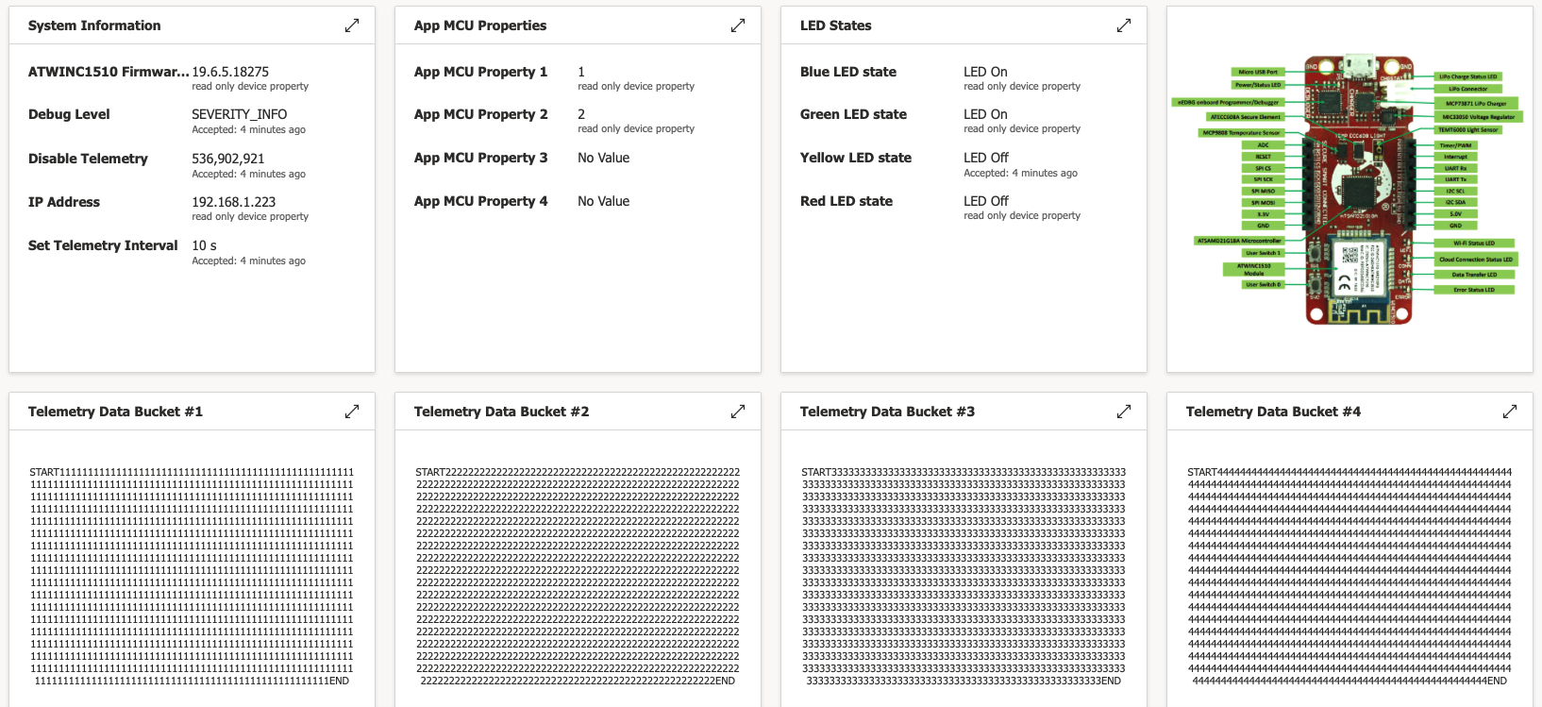
Azure IoT Central Application – Dashboard View

