Slide 1
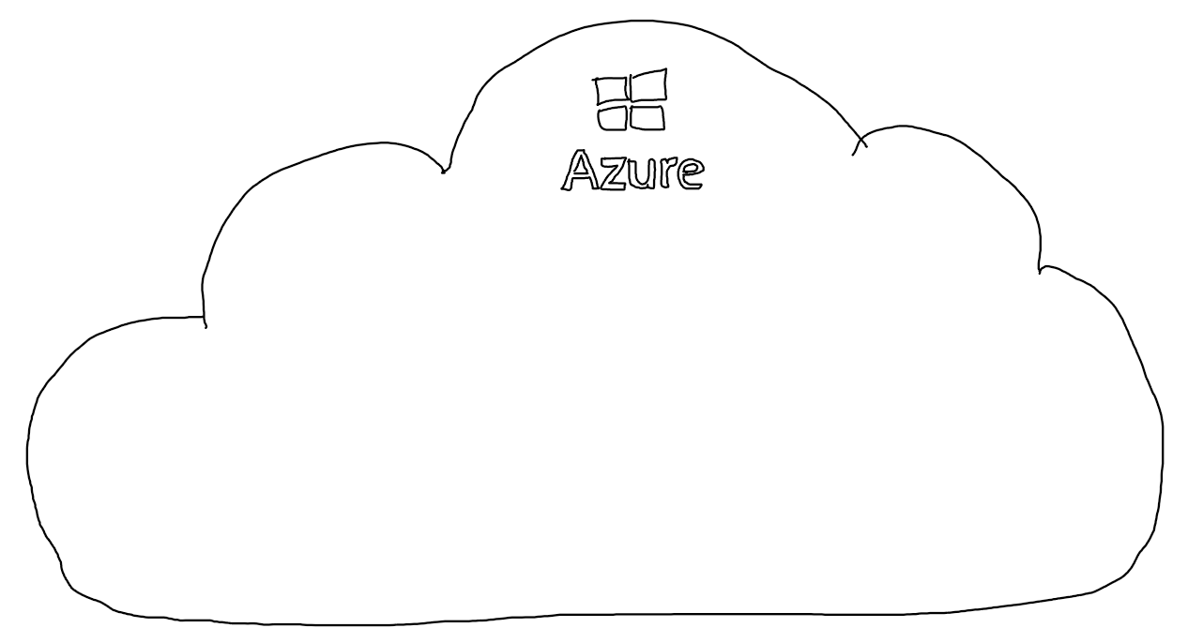
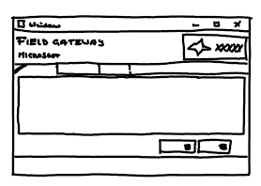









REST
Azure Cognitive Services
Instance
Model
REST
REST
…

Slide 2
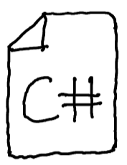
SDK
Azure Cognitive Services
Application
Instance
Model
REST
SDK
REST
…

Slide 3




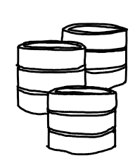
Semantic Kernel
Semantic Kernel
Completion
Plugins
Embedding
OpenAI
Planner
Connectors
Memories
Storage System
…
Storage

Slide 4

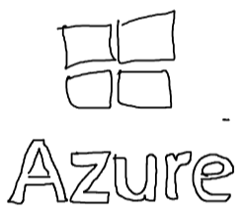
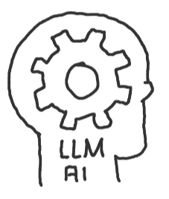
Plugins
Application
Plugins
Native Functions
OpenAI
Semantic Kernel
…
Execution
Connectors
Completion
Embedding
Semantic Functions
…
File
Inline

Slide 5

Memories
Application
OpenAI
Embedding
Semantic Kernel
Memory
Storage
…
…

Slide 6

Planner
Application
Plugins
Native Functions
Semantic Kernel
OpenAI
Planning
…
Completion
Connectors
Semantic Functions
Plan
Embedding
…
Execution

