Slide 1

APIM AI Gateway Level Up
Ramya Gangula - CSA
Andrew Redman - CSA
Cenk Caglar – CSA

Slide 3
Agenda Session 1
APIM Fundamentals
Policy Scopes
Networking & Security
AI Gateway
Demo
1
2
3
4
5

Slide 4

Azure API Management
Developer portal
API
Discover
Learn
Try
Onboard
Get help
Abstract
Secure
Evolve
Observe
Monetize
App
developers
Management plane
API
providers
User plane
Gateway
Employees
Partners
Customers
Data plane
Apps
on devices
(micro)services

Slide 5
Fully-managed serverless, classic, and v2 tiers
v1: Developer | Basic | Standard | Premium | v2: Basic | Standard | Premium
No infrastructure to provision or manage | No infrastructure to provision or manage
Manual scaling or external auto-scaling | Autoscaling supported; faster scaling (up to 10–30 units)
Billing based on reserved capacity | Billing based on reserved capacity
Constant, predictable monthly cost | Constant, predictable monthly cost
Reserved capacity | Reserved capacity
Dedicated management, user, and data planes | Dedicated management, user, and data planes
Always on | Always on; deploys in minutes vs. hours
Full set of features. Not governed. | VNet integration, workspaces, availability zones, SLA included

Slide 6
Full API lifecycle
Start fast with proxy mode
Design and mock
Import from a definition
Import from an Azure resource
Capture schema from test calls
Design
Develop
Secure
Scale
Monitor
Publish
Analyze
Built-in reports
Custom reports with Log Analytics
Reports in Power BI
Custom telemetry pipelines
50+ policies
SOAP-to-REST
Visual Studio Code integration
Live policy debugging
API scaffolding
Azure Monitor
Application Insights
Logs | Metrics | Traces | Alerts
Configurable verbosity
E2E request tracing
Local telemetry for self-hosted gateway
Data | Management | User planes
Keys, OAuth, certificates, custom
1st and 3rd party identity providers
Request/response validation
IP-based access control
Private networking
Compliance
Revisions and versions
API products, user groups, subscriptions
Customizable developer portal
Integrated API playground
Export to the Power Platform
Self-service onboarding
DevOps
Worldwide availability
Multi-region deployments
Availability zones
Caching
Auto-scaling
Hybrid and multi-cloud
Azure Arc enabled

Slide 7
Code- and design-first approaches to building APIs
API Management supports both approaches to building APIs:
Code-first approach
Implement the API and generate the API specification as an afterthought (i.e. with Swashbuckle)
Benefits:
More convenient for API developers
The only option for existing APIs
Design-first approach
Create an API specification, review it with stakeholders, and implement the API
Kickstart development by scaffolding the code from the API specification
Benefits:
Better API consumer experience thanks to the deliberate API design
Reduced risk thanks to the API review processes

Slide 8
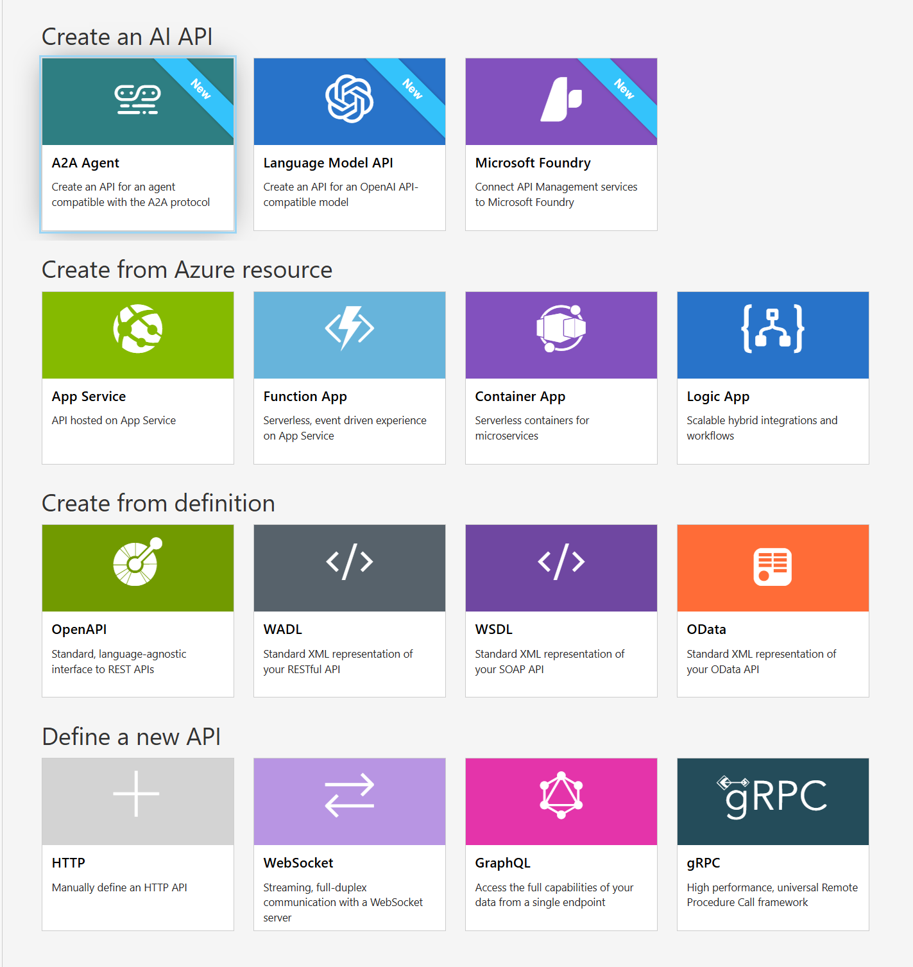
Create an API
Support for SOAP, REST, WebSocket and GraphQL APIs
Import an API from OpenAPI (1, 2, or 3), WADL, or WSDL files
Import an API from App Service, Logic App, Function App, or Container App
Create a blank API

Slide 9
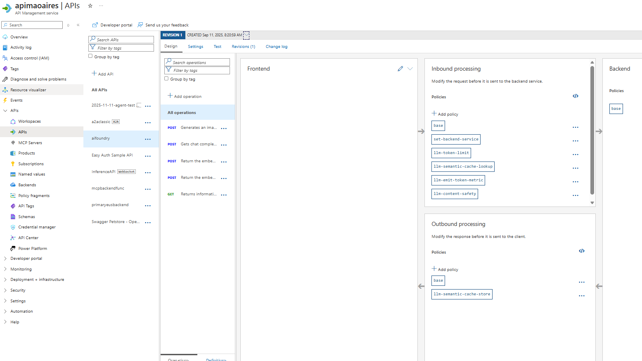
API vs Operations

Slide 10
There’s a policy for that
Encapsulate common API management functions
Access control, Protection, Transformation, Caching, …
Mutate request context or change API behavior
E.g. add a header or throttle
Set in the inbound and outbound directions
Apply at a variety of scopes or on error
Scope determines which APIs are affected
Can define custom scopes in addition to four available b default
Compose into a pipeline from effective scopes
Degree of control over inheritance of scopes, i.e. <base/> element
Don’t delete <base/> inadvertently
http://aka.ms/apimpolicyexamples

Slide 11
Policy scopes
GET /foo/bar HTTP/1.1
Host: api.constoso.com
Key: 0123456789
global
CORS
LOG
0123456789
product
from caller
RATE
QUOTA
to backend
inbound
/foo
api
JWT
/bar
operation
CACHE
URL
BODY
to caller
from backend
outbound

Slide 12
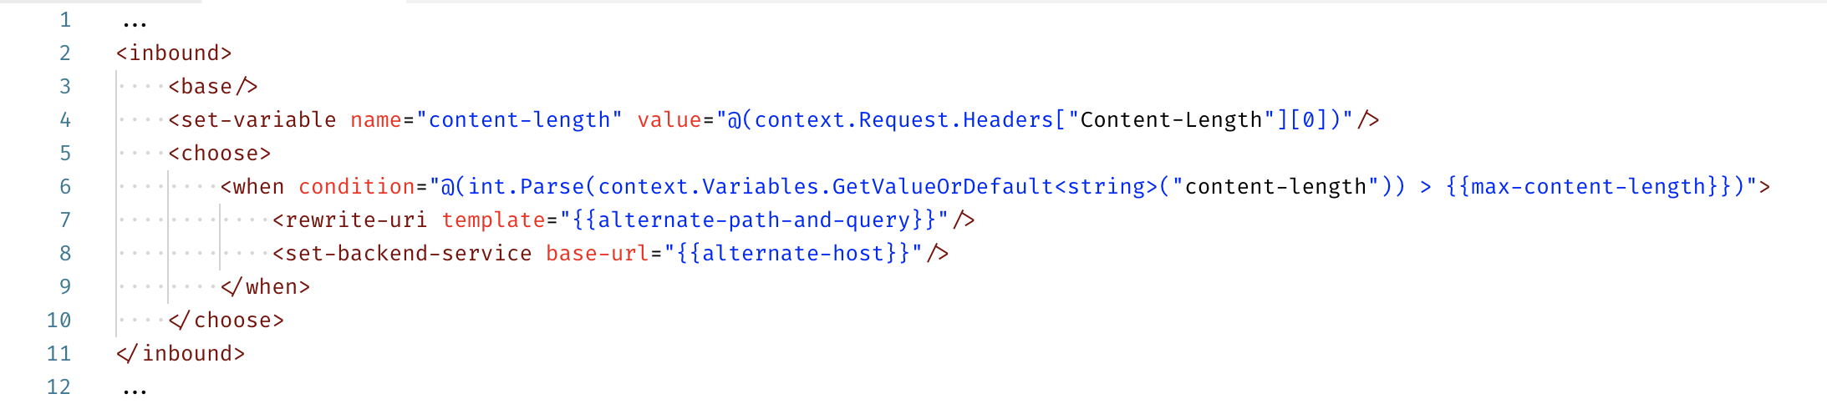
Policy expressions
Named values
C# “snippets” used with policies
Have read-only access to the request context
Use only whitelisted .NET types
Used to configure and conditionally execute policies
Scoped to an APIM service instance
Keep secrets and “magic” strings out of policies
Provide environment-specific values
Add semantics, if named well
Enable a single point of change
Integrate with Azure Key Vault for an additional layer of protection and access management

Slide 13
75 policies out of the box
Access restriction | Transformation | Advanced | Dapr integration
Check HTTP header Limit call rate by subscription Limit call rate by key Restrict caller IPs Set usage quota by subscription Set usage quota by key Validate client certificate Validate JWT | Convert JSON to XML Convert XML to JSON Find and replace string in body Mask URLs in content Set backend service Set body Set HTTP header Set query string parameter Rewrite URL Transform XML using XSLT | Send one way request Send request Set HTTP proxy Set variable Set request method Set status code Control flow Emit metric Log to Event Hub Trace Mock response Forward request Limit concurrency Return response Retry Wait | Send request to a service Send message to a pub/sub topic Trigger output binding
Authentication | Caching | Cross Domain | Validation policies
Authenticate with basic Authenticate with client certificate Authenticate with managed identity Authenticate with external identity | Get from cache Store to cache Get value from cache Store value from cache Remove value from cache | Allow cross-domain calls CORS JSONP | Validate content Validate parameters Validate headers Validate status code Validate GraphQL request

Slide 14
Private networking and upstream security

Slide 15
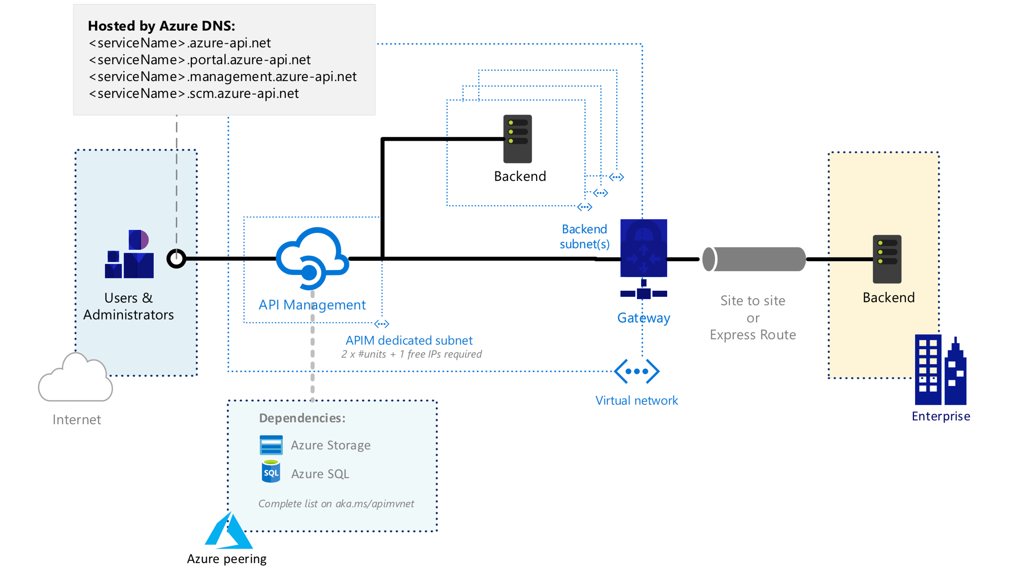
External configuration
Secure external access to private cloud and on-premises endpoints

Slide 16
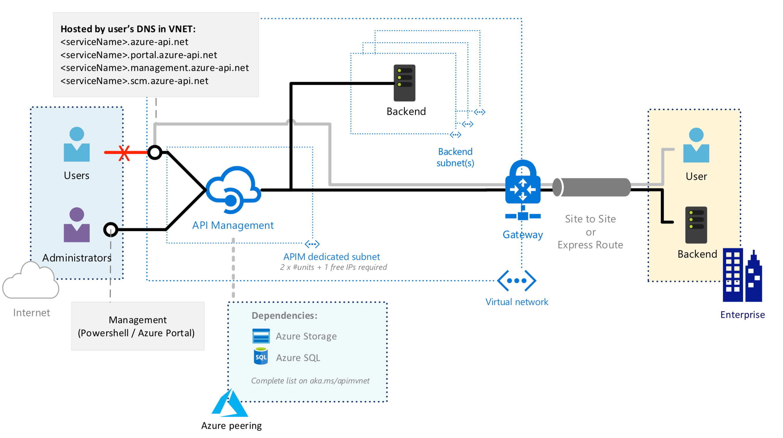
Internal configuration
Secure internal access to private cloud and on-premises endpoints

Slide 17
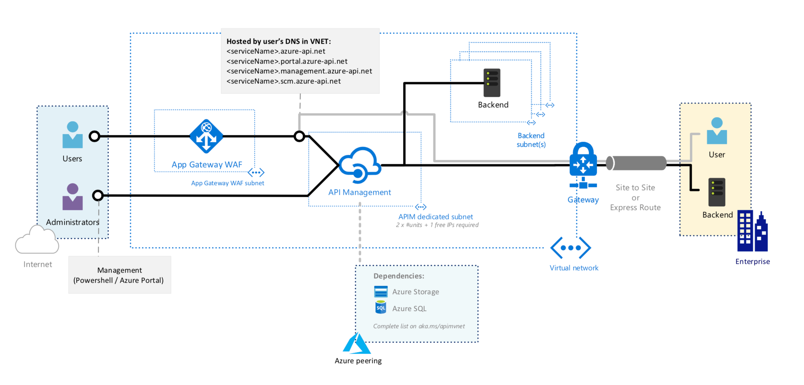
More secure external access to private and on-premises endpoints
Secure internal access to private cloud and on-premises endpoints
Internal configuration with WAF

Slide 18
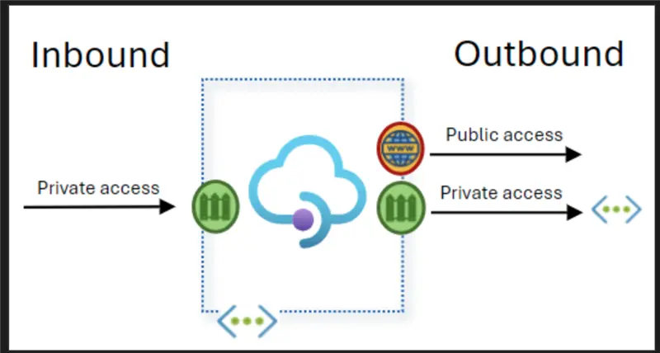
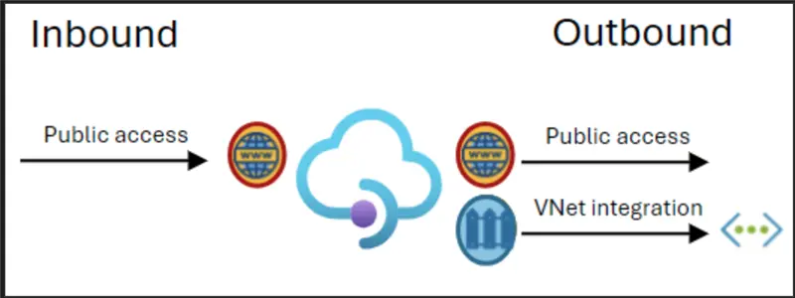
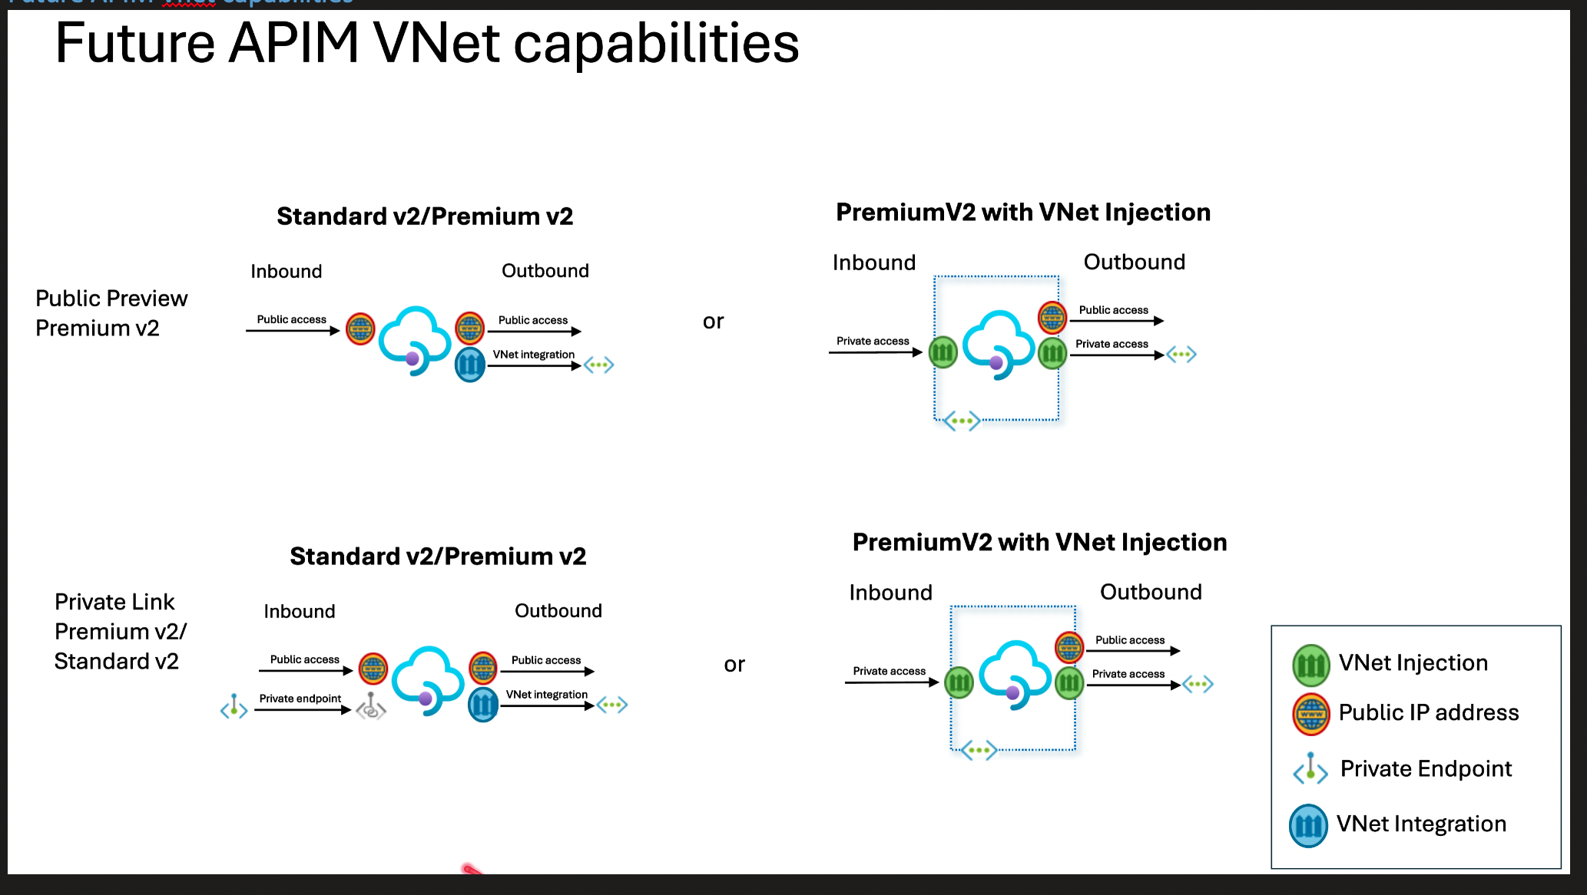
V2 SKUs VNET integration
VNET Injection
VNET Integration

Slide 19
Why an AI Gateway?

Slide 20
APIs are the bedrock of AI’s future
We’re heading toward a future where all code will essentially be API calls to large language models, with those LLMs in turn calling other LLMs.
APIs remain central to tech strategy and are more vital than ever due to their use by LLMs, including OpenAI plugins.
– Jensen Huang,
CEO,
NVIDIA
– Mark O’Neil,
VP Analyst for Software Engineering, Gartner

Slide 21

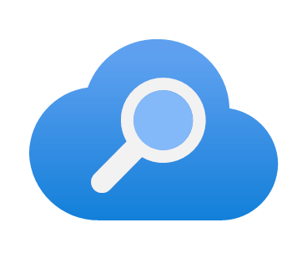





GenAI development runs on APIs
Intelligent Apps
AI Services
But these APIs must be
Managed
Conversational Agents
Chat on your Data
Microsoft Foundry
Azure AI Search
Secured
Personalized Content
Voice Assistants
OpenAI
Hugging Face
Governed
Mistral
Cohere
Content Generation
Your own Copilot
LLaMa
and more!

Slide 22
AI APIs operate on tokens, and managing these tokens is crucial
Intelligent Apps
AI Services
Performance Optimization
Cost Control
Conversational Agents
Chat on your Data
Data Security
Microsoft Foundry
Azure AI Search
PTU
Personalized Content
Voice Assistants
OpenAI
Hugging Face
PAYG
Mistral
Cohere
Content Generation
Your own Copilot
LLaMa
and more!

Slide 23
Unmanaged AI APIs increase risk and hinder potential
Unpredictable & Unattributable Costs
Reliability Concerns
Security Risks
Developer Friction
Governance Challenges

Slide 24
Azure API Management
Unleash AI’s full potential, knowing the AI APIs are managed, secured, and governed with a scalable API management solution

Slide 25




Azure API Management enables AI APIs
Intelligent Apps
AI Services
Cost efficiency
High reliability
Robust security
Developer enablement
Conversational Agents
Chat on your Data
Microsoft Foundry
Azure AI Search
Enhanced governance
Personalized Content
Voice Assistants
OpenAI
Hugging Face
Native Azure integration
Mistral
Cohere
Content Generation
Your own Copilot
Defender for APIs
Policy
Monitor
… and more
LLaMa
and more!

Slide 26
Maximize potential and take control of AI APIs with Azure API Management
Cost Efficiency
High Reliability
Robust Security
Developer Enablement
Enhanced Governance
Control and attribute costs with token monitoring, limits, and quotas
Return cached responses for semantically similar prompts
Enable geo-redundancy and automatic failovers with load balancing and circuit breakers
Isolate and manage user credentials
Secure APIs with built-in controls and Microsoft Defender for Cloud
Replace custom backend code with built-in policies
Publish AI APIs for consumption
Gain insights with comprehensive logs
Enforce runtime policies
Centralize monitoring and audit logs

Slide 27
Combine traditional and AI gateway capabilities to manage your entire API estate
Governance
Security & safety
Observability
Scalability
Velocity
Policies, like throttling, IP filtering, and more
Federated API management with workspaces
Enterprise-wide catalog and compliance scorecard
OWASP API Top 10 protections
Client authN/authZ
Keyless managed identities
Credential manager
Advanced security with Defender for Cloud
Logs
Metrics
Tracing
Dashboards and reports
Scale up/out
Autoscale
Multi-regional deployments
Self-hosted gateway for on-prem or multi-cloud
Backend pools with circuit breaker
API import wizards
Developer portal for self-serve API onboarding
VS Code extension
Copilot for policies
Linting
Test console
API Gateway
Publish approved models, MCP servers, skills, plugins, and A2A agents
Apply granular token rate limits and quotas
Enforce policies for MCP and A2A endpoints
Moderate prompt and completions
Prevent PII leakage
Track token consumption
Log prompt and completions
Log MCP tool interactions
Tracing agentic interactions
Save tokens and improve latency with semantic caching
Prioritize routing to provisioned capacity models
Implement model fallback strategies
SSE and streaming HTTP
Import AI Foundry models, models from other providers, existing MCP servers, A2A agents
Convert REST APIs to MCP servers
Discover and consume AI assets from agents via MCP server or API
AI Gateway

Slide 28
Demo

