Slide 1
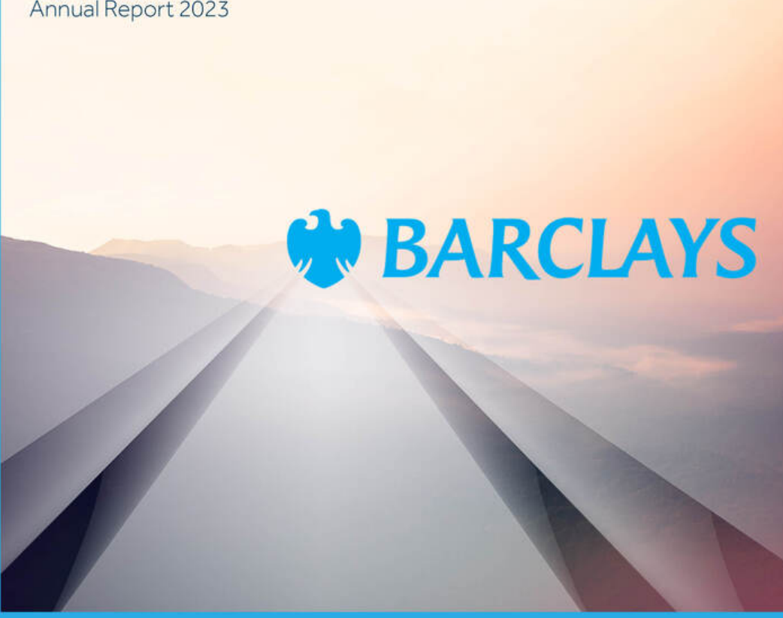
Transforming Enterprise Content with Multi-Modal GPT-4o
Subset of content from:
Barclays-PLC-Annual-Report-2023.pdf
Liam Cavanagh
June 2024

Slide 2
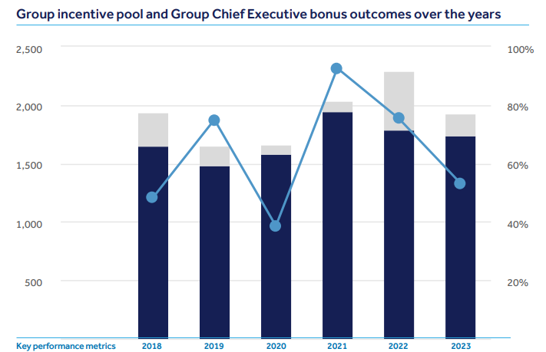

Group Incentive Pool

Slide 3
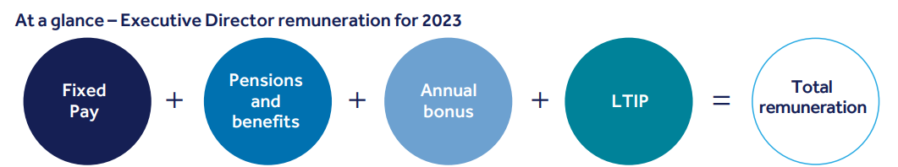
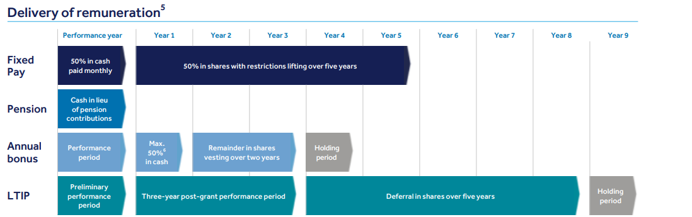
Executive Director Renumeration Report

Slide 4
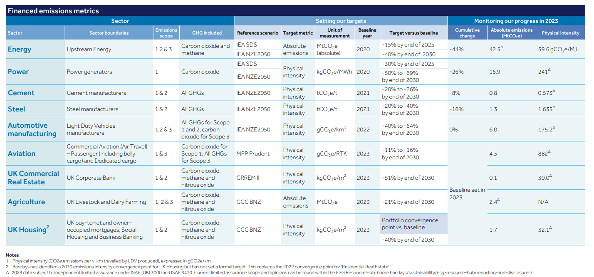

Slide 5
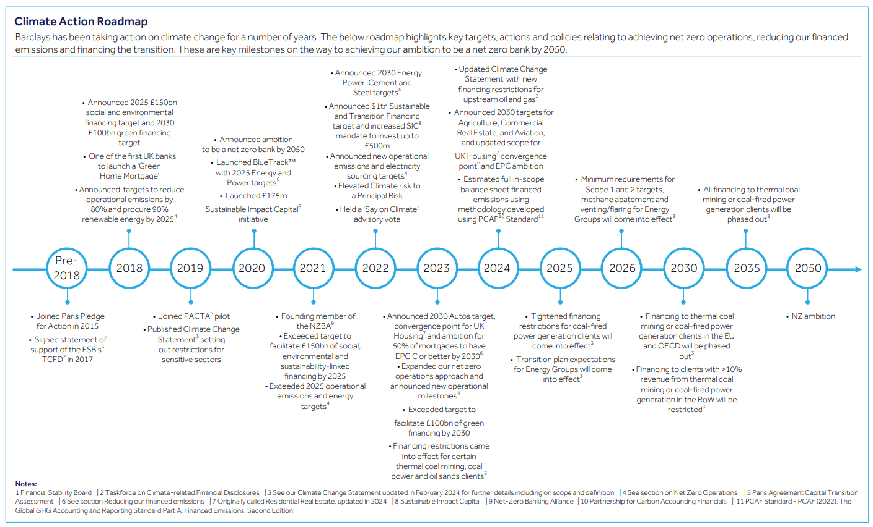

Slide 6
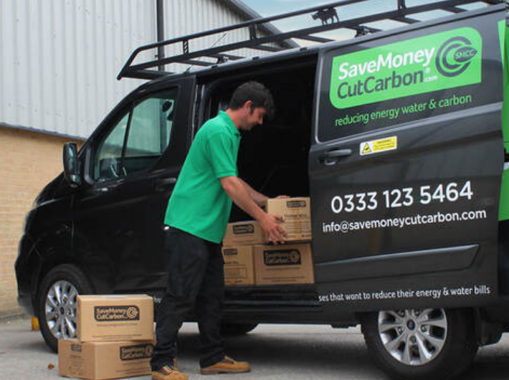
Partnering with SaveMoneyCutCarbon
SaveMoneyCutCarbon (SMCC) is an organisation focused on simplifying energy, water and carbon reduction. It seeks to save businesses time and money and help them achieve their sustainability goals by providing a range of services. Alongside the installation of products, these services include providing advice and education as well as performing building audits to help uncover savings opportunities and developing project plans to help businesses realise these savings.
Barclays is helping companies like SMCC to scale through its Unreasonable Impact partnership – and by investing equity capital in SMCC through the Barclays Sustainable Impact Capital mandate. In addition, Barclays Corporate Banking clients can utilise SMCC’s services to help them pivot their own operations to more sustainable practices.

Slide 7
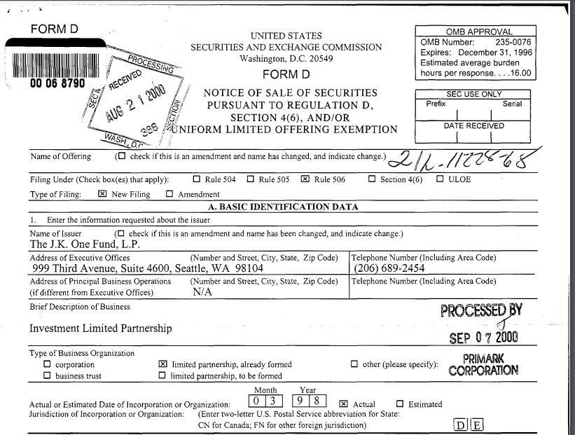
Forms

Slide 8

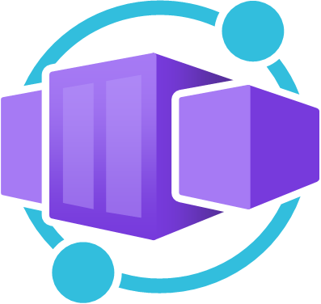









Processing Pipeline
AI Studio (Chat)
Container App
Azure OpenAI
AI Search
OneLake
Transformation
Job
Power BI

Slide 9
Pipeline Flow
Convert to PDF (LibreOffice or MSOffice Lib)
Extract Images from PDF(PyMuPDF)
Extract Text and Table from Images (GPT4o)
Vectorize Text & Table and Store to JSON
Index to Azure AI Search
https://github.com/liamca/GPT4oContentExtraction

