Slide 1
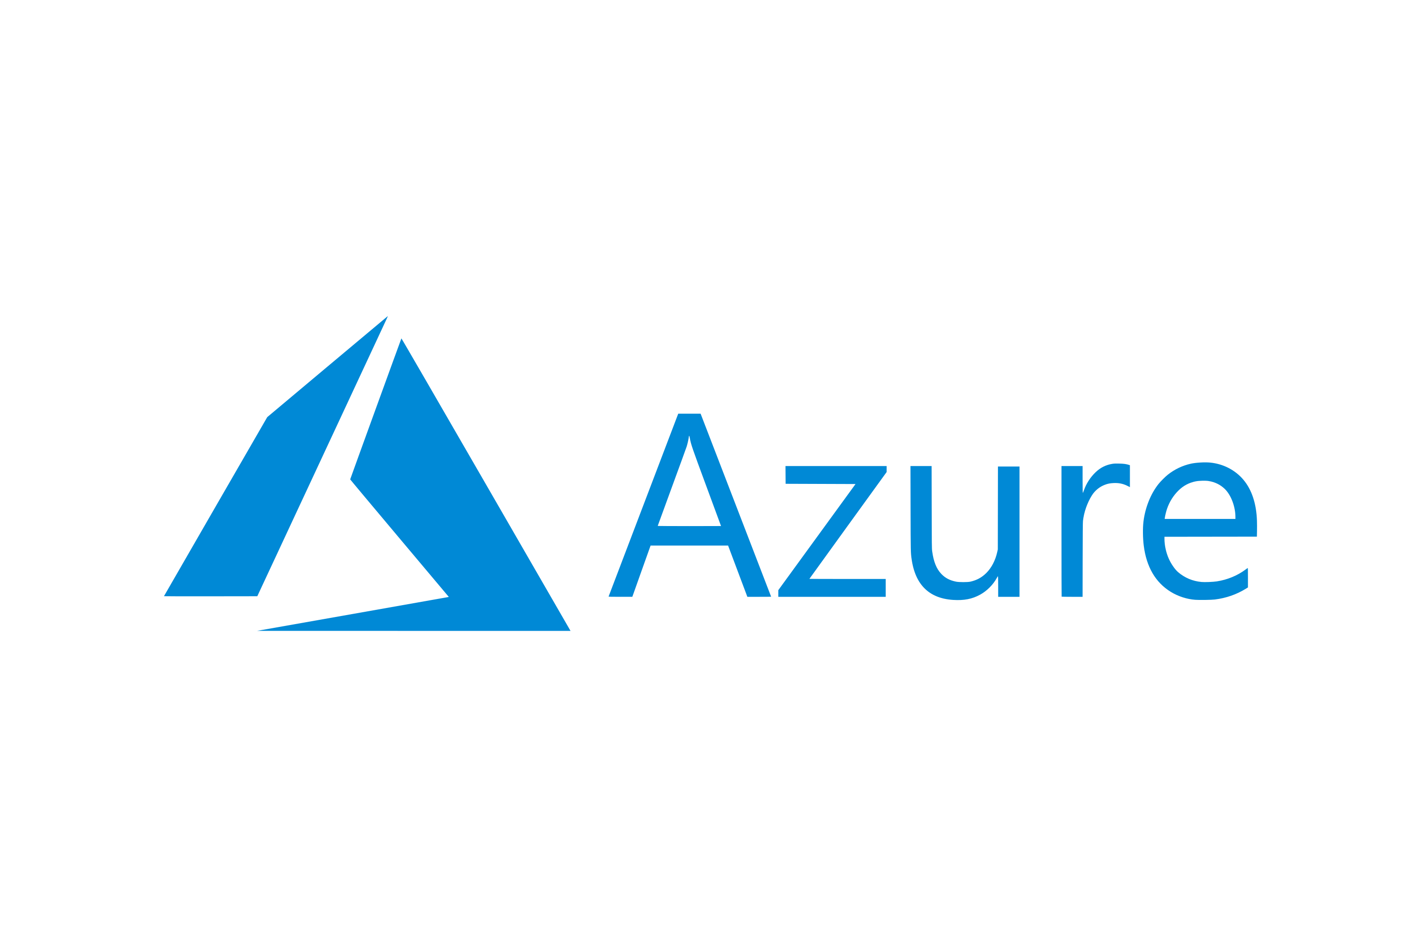






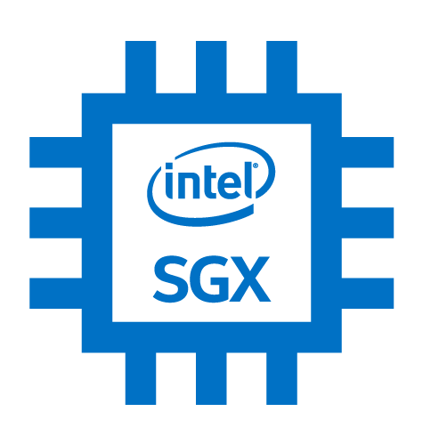












Data Ingestion
Data Storage
Data Analytics
Key Vault
Node: SGX enabled
Read
Spark Driver
RAM
Column Master Key
root
mHSM
Executors
Data Loader
Data Loader
Data Loader
Azure SQL
VPN
VPN
Kubernetes Cluster
Malicious Admin
VPN
root access
Ciphertext
JDBC
Ciphertext
Node: Generic HW
Plaintext
MSSQL
SGX Enclave
Azure Attestation
Executors
Token
Notes:
Raki

Slide 2



1. Spark job running on non-SGX hardware
Data
memory-dump.sh
Azure SQL
Code
Github
git clone
JDBC String
Pull data
Exfiltrate
Spark
entrypoint.sh
Azure-sql.py
spark-submit
Non-SGX
Clone Git Repo
Start Spark, log.io
sleep(10)
Localize JDBC String Plaintext code
Submit Spark job
Data in memory
2. Spark with Scone running on SGX (DC4s_v2)
Data
memory-dump.sh
vi azure-sql.py
memory-dump.sh
Azure SQL
Code
Github
git clone
JDBC String
Pull data
Pull data
Spark
entrypoint.sh
Azure-sql.py
spark-submit
fspf.sh
Azure-sql.py
Non-SGX
Clone Git Repo
Start Spark, log.io
sleep(10)
Encrypted code
OSS Spark 3.1.1
Localize JDBC String Plaintext code
Submit Spark job
Data in memory
Scone File Protection
Data in memory

Slide 3






Big Data Storage
Big Data Analytics
Database Engine
Key Vault
Node: SGX enabled
Read
Column Master Key
mHSM
Storage Account
Spark Driver
Azure SQL
spark.read.parquet(…)
spark.read.format(“jdbc”)
Parquet
50 GB | 1.5 B rows
1
Executors
2
Plaintext
MSSQL
NYC Taxi dataset
SGX Enclave
Kubernetes Cluster
Contoso HR dataset
Azure Attestation
Token
Notes:
Raki

