Slide 1
Contoso Real Estate Enterprise-grade Reference Architecture for JavaScript

Slide 2


Contoso Real Estate
Explore our Real-World e2e Sample
Enterprise-grade Reference Architecture for JavaScript with 8 core scenarios
Best-in-class developer tools from code to cloud
Notes:
Enterprise-grade Reference Architecture for JavaScript with 8 core scenarios
Contoso Real Estate is an Open-Source Enterprise-grade Reference Architecture for JavaScript based on a composable architecture with 8 core scenarios, showing best practices like monorepo usage (for multi-team and multi-project coordination), devcontainers (for Codespaces), built-in documentation (for self-guided exploration), micro-frontends, and more.
Best-in-class developer tools, from code to the cloud
From authoring in VS Code to testing with Playwright, deploying with Azure Dev CLI, automating with GitHub Actions, and featuring a fully fledged, no additional configuration needed, developer environment on Github Codespaces. Plus, early insights into using AI assistance with GitHub Copilot

Slide 3
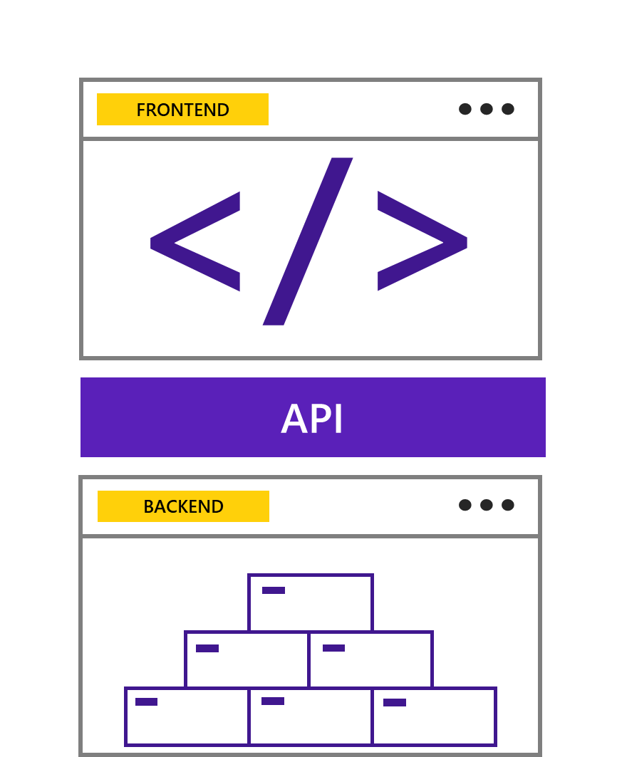
Composable Architecture?
Software architecture that divides the application into smaller parts, where each part is responsible for a specific functionality
Notes:
Composable architecture is a design pattern that allows developers to create reusable components to build applications more quickly and easily. This pattern has been gaining popularity in recent years as businesses strive to reduce the time needed to develop and deploy new applications.
Advantages of using composable architecture:
Reusability: components can be reused in different parts of the application.
Scalability: the application can be scaled horizontally; that is, it can be divided into smaller parts, and each part can be developed by a different team.
Maintainability: the application can be maintained more easily as each component is responsible for a specific functionality.

Slide 4
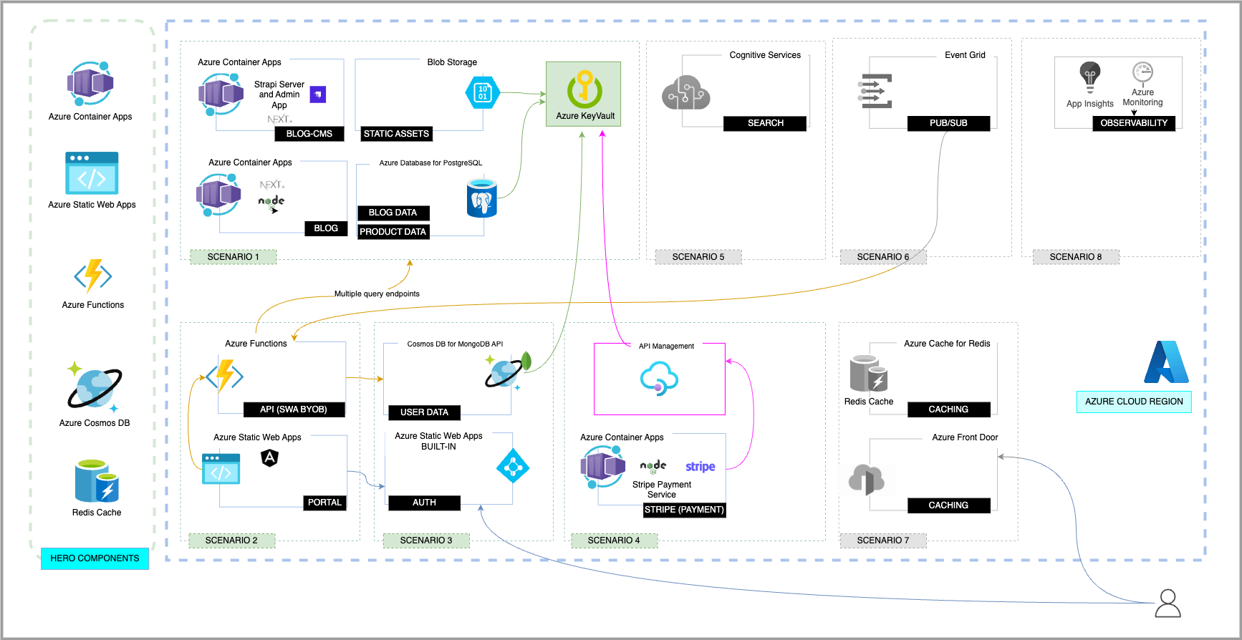
Notes:
Contoso Real Estate has 8 scenarios, including a static web app with a serverless backend, integrated monitoring and insights, micro-frontends, built-in authentication, containerized payments, intelligent search, and performance optimization.

Slide 5

Let’s hack together!
Starting with GitHub Codespaces
Building an API with Azure Functions and Azure Cosmos DB
Deploy the portal
with Azure Static
Web App CLI
Notes:
In our workshop, we will cover the use of GitHub Codespaces as our main development environment and the creation of an API in version 4 of the Node.js programming model using Azure Functions and Azure Cosmos DB. Finally, let's learn how to run and deploy the project with the Azure Static Web Apps CLI.

Slide 6






Everything you need to start your project
Get GitHub Copilot free for Students: https://aka.ms/Copilot4Students
Notes:
All you need to get started is a GitHub account to use Codespaces and Copilot and an Azure account to create the cloud services we'll learn about throughout the workshop.
If you're a student, you can sign up for the GitHub Student Developer Pack benefit program to get access to GitHub Copilot for free, 90 hours of GitHub Codespaces, and activate the Azure for Students offer, which gives you $100 in credits on Azure+ 25 free services for 1 year (can be renewed).

Slide 7
Quick and easy to create Set up fully configured cloud-hosted development environments in minutes
Easier remote work with cloud environments Work on multiple projects simultaneously without being slowed down by compute-intensive tasks
Develop wherever you are Edit, run, and debug apps from any device with an editor that supports Git repos, extensions, and CLI
Notes:
GitHub Codespaces is a cloud-hosted development environment. When you work in a Codespace, the environment you're working in is created using a development container, or dev container, hosted on a virtual machine. Development containers, or dev containers, are Docker containers that are specifically configured to provide a complete development environment. You can configure the dev container for a repository so that Codespaces created for that repository provide a custom development environment, complete with all the tools and runtimes you need to work on a specific project.

Slide 8
Convert comments to code GitHub Copilot uses the OpenAI Codex to suggest code and entire functions in real-time, right from your editor.
Autofill for repetitive code Quickly produces boilerplate and fills in repetitive code patterns
Show alternatives Show a list of solutions to use as provided, or edit to meet your needs
Notes:
GitHub Copilot is an AI pair programmer that offers autocomplete-style suggestions as you code. You can receive suggestions from GitHub Copilot either by starting to write the code you want to use, or by writing a natural language comment describing what you want the code to do. It is available where you want it. On your desktop using popular IDEs (Visual Studio Code, Visual Studio, JetBrains, Neovim) or in your browser using GitHub Codespaces.
GitHub Copilot is powered by Codex, a generative pretrained AI model created by OpenAI. It has been trained on natural language text and source code from publicly available sources, including code in public repositories on GitHub.

Slide 9
GitHub Student Developer Pack (including Azure for Students)
aka.ms/Copilot4Students
Azure Free Trial
aka.ms/azure/free-trial
GitHub Codespaces
github.com/features/codespaces
GitHub Copilot (60-day trial)
github.com/features/copilot
Notes:
Note: you can show how to enable codespaces https://docs.github.com/en/codespaces/getting-started/quickstart
Copilot offers 60-day trial

Slide 10
At this moment, you can run a demonstration of Contoso Real Estate on Codespace or start the workshop exercise!

