Slide 1
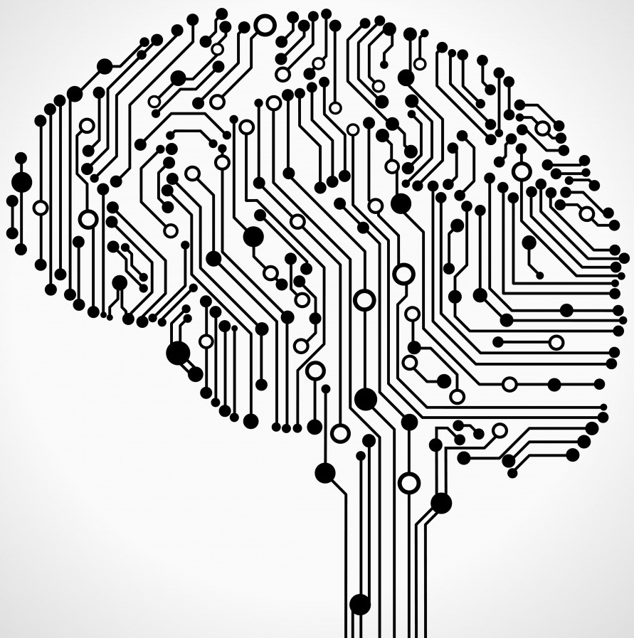
Neural Networks and Computational Graphs
Ali Zaidi
Microsoft AI and Research
@alikzaidi

Slide 2
Computation Graphs

Slide 3








Composite Functions – Forward Pass

Slide 4



Chain Rule – Backward Pass
-1
-3
6

