Slide 1

Deep Learning with the Data Science Virtual Machine
Ali Zaidi
Microsoft AI and Research
@alikzaidi

Slide 2
Pre-Configured VMs

Slide 3
Data Science Virtual Machine
Modern deep learning development requires a GPU
Setting up a GPU-based system with the necessary drivers, peripherals, and then installing your system is expensive (~$2,000)
The Ubuntu DSVM is a perfect choice
Pre-configured with >= 7 deep learning libraries
Up to 4 GPU cards on a single VM
No software cost
Pricing: $0.90 / hour for NC6

Slide 4
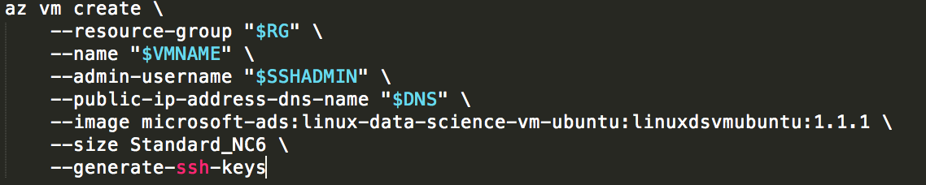
Provisioning a DSVM with Azure-CLI
Azure-CLI 2.o is a Python based CLI for managing Azure resources
Cross-platform: Linux, Windows, macOS
Designed for scripting and automation
Integrates with Microsoft ML Operationalization tools

Slide 5
Lab 1 – Provision DSVM Using Azure-CLI

Slide 6
Anaconda Virtual Environments

Slide 7
Anaconda Scientific Distribution of Python
Every DSVM ships with the Anaconda distribution of Python
Both 2.7 (root) and 3.5 (py35)
Anaconda should be your preferred distribution of Python for Scientific computing
Anaconda is both a package manager (conda) and a distribution
Cheat sheet for Conda
Virtual environments allow you to separate your dependencies across projects
Each virtual environment has it’s own Python environment, packages, directories, and even environmental variables

Slide 8
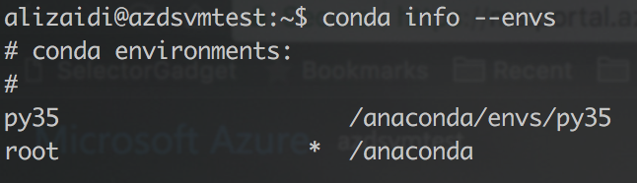
Using Conda Environments
List your conda environments
conda info --envs
Activate a specific environment

Slide 9
Lab 2 – Upgrade CNTK and CUDNN

Slide 10
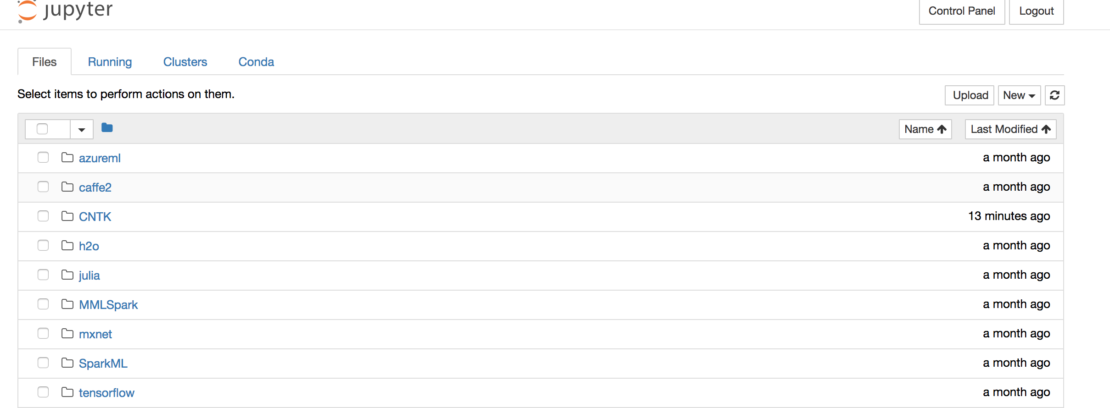
Working with Jupyter Notebooks
Your DSVM is already pre-configured with JupyterHub
Navigate to your DSVM’s JupyterHub port: https://<your_dns_name>.<region>.cloudapp.azure.com:8000
Ignore the privacy error
Login using the password you created in the first lab

