Slide 1


SoftMax

Slide 2

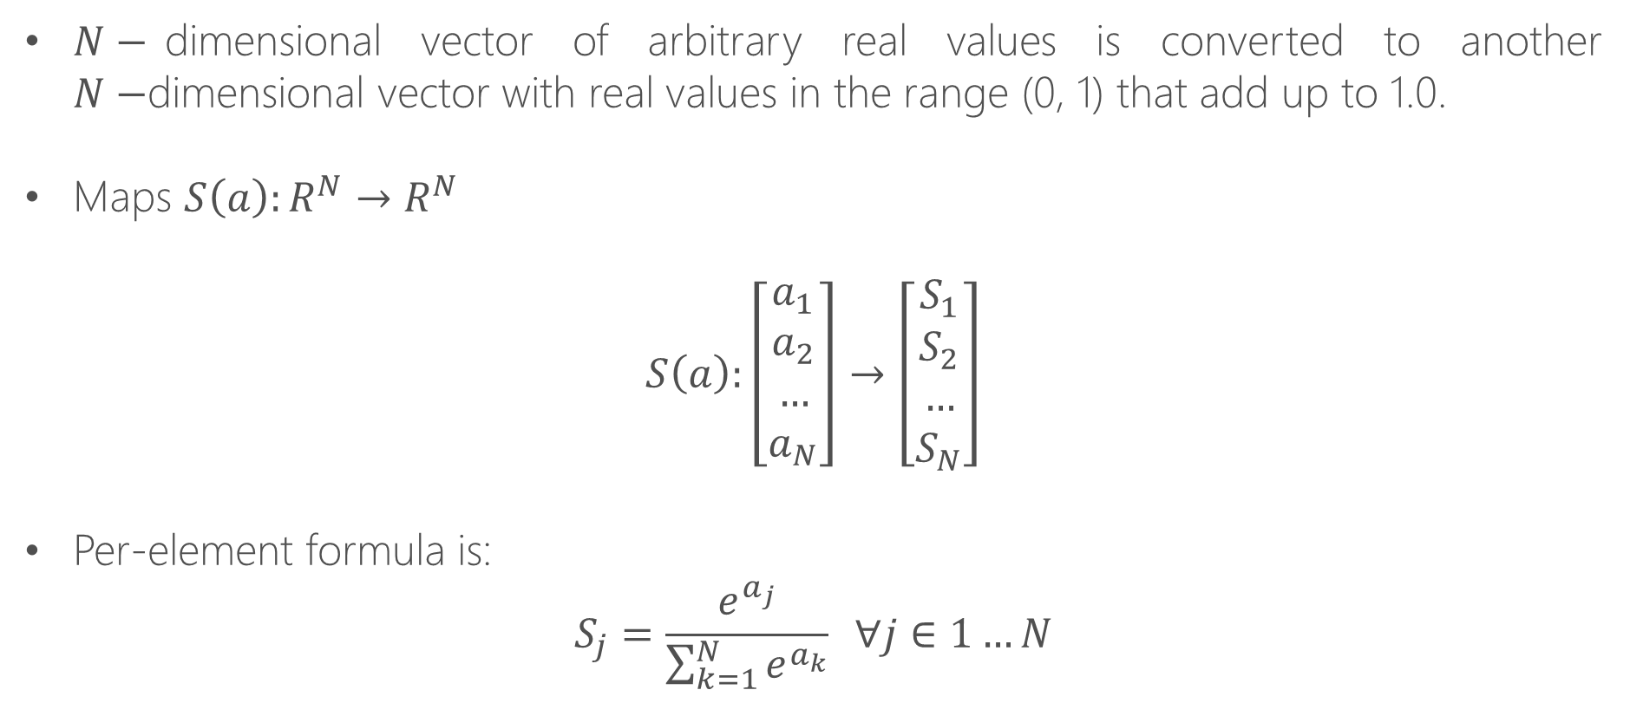
Softmax
$N−$dimensional vector of arbitrary real values is converted to another $N−$dimensional vector with real values in the range (0, 1) that add up to 1.0.
Maps $S\left(a\right):R^{N}→R^{N}$
$$S\left(a\right):\left[\begin{aligned}a_{1} \\ a_{2} \\ … \\ a_{N}\end{aligned}\right]→\left[\begin{aligned}S_{1} \\ S_{2} \\ … \\ S_{N}\end{aligned}\right]$$
Per-element formula is:
$$S_{j}=\frac{e^{a_{j}}}{\sum_{k=1}^{N}{e^{a_{k}}}} ∀j∈1…N$$

Slide 3
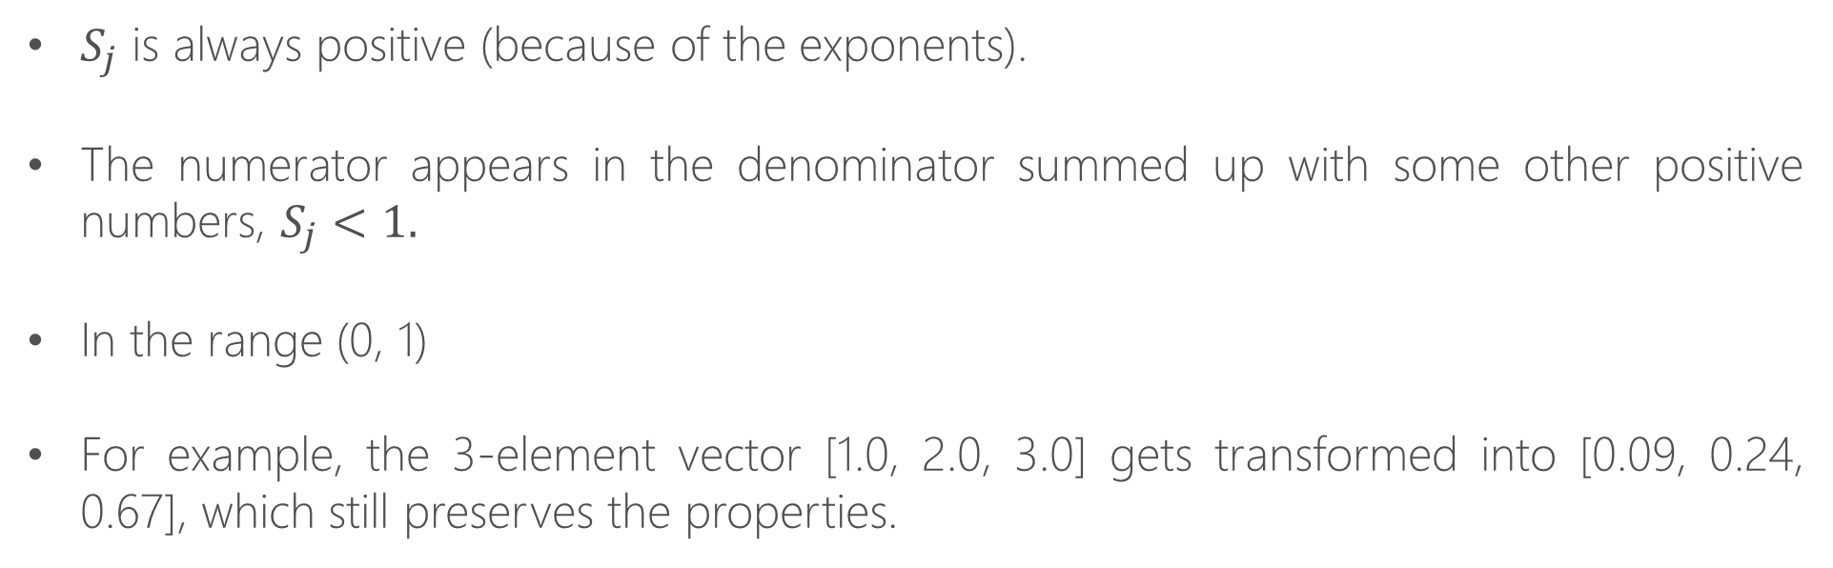
Properties Softmax
$S_{j}$ is always positive (because of the exponents).
The numerator appears in the denominator summed up with some other positive numbers, $S_{j}<1.$
In the range (0, 1)
For example, the 3-element vector [1.0, 2.0, 3.0] gets transformed into [0.09, 0.24, 0.67], which still preserves the properties.

Slide 4
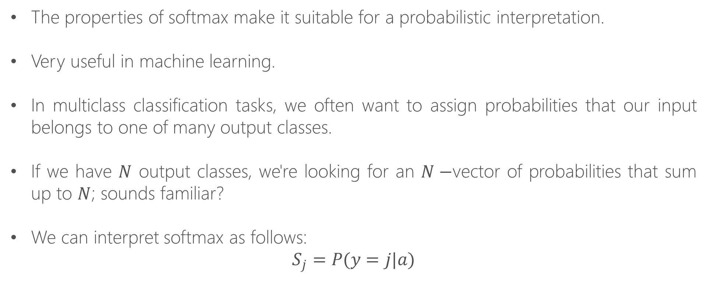
Probabilistic Interpretation
The properties of softmax make it suitable for a probabilistic interpretation.
Very useful in machine learning.
In multiclass classification tasks, we often want to assign probabilities that our input belongs to one of many output classes.
If we have $N$ output classes, we're looking for an $N−$vector of probabilities that sum up to $N$; sounds familiar?
We can interpret softmax as follows:
$$S_{j}=P(y=j|a)$$

Slide 5
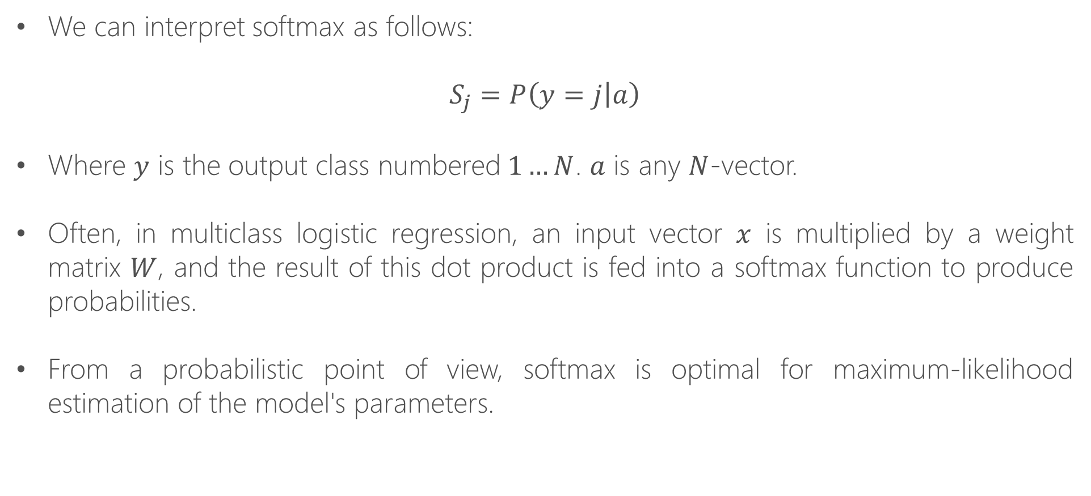
Probabilistic Interpretation
We can interpret softmax as follows:
$$S_{j}=P\left(y=j | a\right)$$
Where $y$ is the output class numbered$1…N$. $a$ is any $N$-vector.
Often, in multiclass logistic regression, an input vector $x$ is multiplied by a weight matrix $W$, and the result of this dot product is fed into a softmax function to produce probabilities.
From a probabilistic point of view, softmax is optimal for maximum-likelihood estimation of the model's parameters.

Slide 6
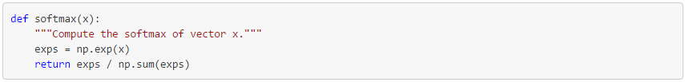
Computing Softmax and Numerical Stability
A simple way of computing the softmax function on a given vector in Python is:
Let's try it with the sample 3-element vector we've used as an example earlier:
However, if we run this function with larger numbers (or large negative numbers), we have a problem:

Slide 7
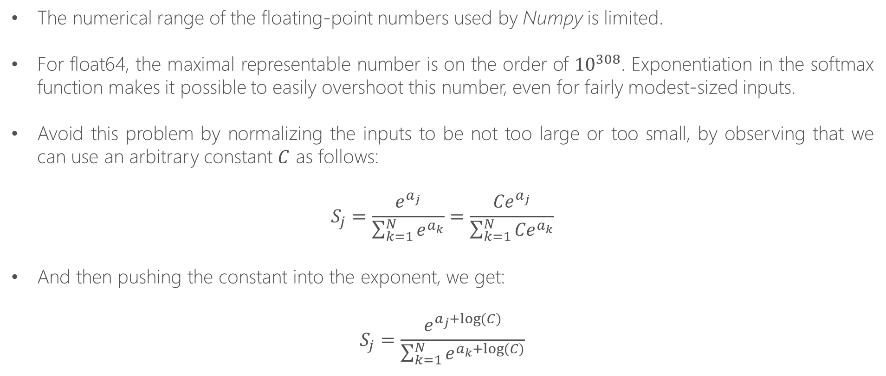
Numerical Range Limitations
The numerical range of the floating-point numbers used by Numpy is limited.
For float64, the maximal representable number is on the order of ${10}^{308}$. Exponentiation in the softmax function makes it possible to easily overshoot this number, even for fairly modest-sized inputs.
Avoid this problem by normalizing the inputs to be not too large or too small, by observing that we can use an arbitrary constant $C$ as follows:
$$S_{j}=\frac{e^{a_{j}}}{\sum_{k=1}^{N}{e^{a_{k}}}}=\frac{{Ce}^{a_{j}}}{\sum_{k=1}^{N}{{Ce}^{a_{k}}}}$$
And then pushing the constant into the exponent, we get:
$$S_{j}=\frac{e^{a_{j}+\log{(C)}}}{\sum_{k=1}^{N}{e^{a_{k}+\log{(C)}}}}$$

Slide 8
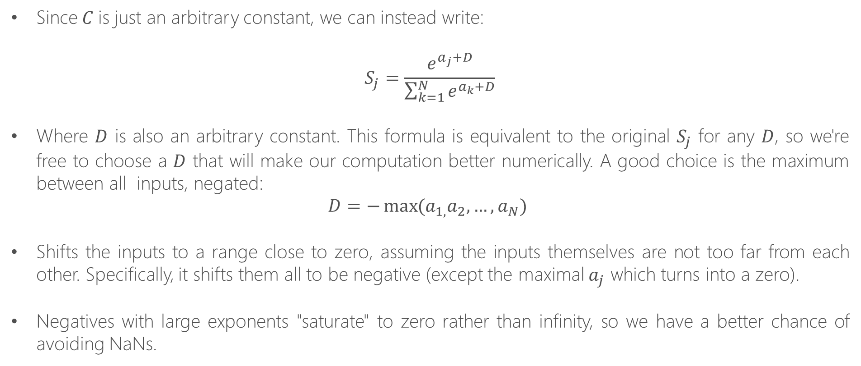
Numerical Range Limitations
Since$C$is just an arbitrary constant, we can instead write:
$$S_{j}=\frac{e^{a_{j}+D}}{\sum_{k=1}^{N}{e^{a_{k}+D}}}$$
Where $D$ is also an arbitrary constant. This formula is equivalent to the original $S_{j}$ for any $D$, so we're free to choose a $D$ that will make our computation better numerically. A good choice is the maximum between all inputs, negated:
$$D=−\max{(a_{1,}a_{2},…,a_{N}) }$$
Shifts the inputs to a range close to zero, assuming the inputs themselves are not too far from each other. Specifically, it shifts them all to be negative (except the maximal $a_{j}$ which turns into a zero).
Negatives with large exponents "saturate" to zero rather than infinity, so we have a better chance of avoiding NaNs.

Slide 9
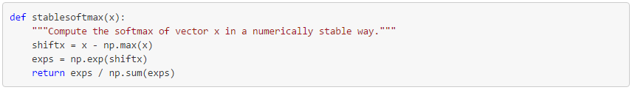
Numerical Range Limitations
And now:
Note:
That this is still imperfect.
Since mathematically softmax would never really produce a zero, but this is much better than NaNs, and since the distance between the inputs is very large it's expected to get a result extremely close to zero anyway.

